Slide 1

OLIST END-TO-END DATA ANALYTICS
What Actually Drives
Customer Satisfaction?
A data-driven investigation into seller acquisition, marketplace performance and customer satisfaction on Olist’s Brazilian e-commerce marketplace — built with Python, SQL and Tableau.
Estefania Barrosa • Final Project, Data Analytics Bootcamp • 2026
Notes:
Good afternoon. I'm Estefania, and for my final project I analyzed Olist's Brazilian e-commerce marketplace.
I started this expecting seller acquisition — or maybe price — to explain customer satisfaction. The data pointed somewhere else. The strongest relationship I found was delivery reliability.
Let me show you how I got there.
TRANSITION -> "First, some context."

Slide 2




WHERE THIS PROJECT STARTS
Context
Olist runs a marketplace connecting roughly 3,000 Brazilian sellers with customers across the country. Its growth depends on three things working well together and this project tests, with real data, whether they do.
Two real, anonymized datasets: the E-Commerce dataset (2016–2018) and the Marketing Funnel dataset (seller acquisition), published by Olist on Kaggle.
Seller acquisition
Delivery reliability
Customer satisfaction
Bringing in sellers through the right channels
Getting orders to customers on time
Turning orders into good reviews
02
Notes:
Olist is a Brazilian marketplace that lets small businesses sell online without building their own e-commerce infrastructure. It connects around 3,000 sellers with customers across the country, and its growth depends on three things working together: attracting sellers, delivering orders on time, and keeping customers satisfied.
To analyze it I worked with two real datasets published by Olist: the e-commerce dataset, with almost 100,000 orders between 2016 and 2018, and the marketing funnel dataset, which tracks how each seller was acquired. Together they let me connect what happens BEFORE a seller joins the marketplace with what happens AFTER they start selling.
TRANSITION -> "And that connection gives me the business problem."

Slide 3

WHY THIS ANALYSIS EXISTS
The Business Problem
“How can Olist use data to improve seller acquisition, marketplace performance and customer satisfaction — through data-driven decisions?”
With limited time and budget, which of these moves the needle? and where should Olist focus first?
Q1
Q2
Q3
Acquisition & performance
Delivery reliability
Customer satisfaction
Do stronger acquisition channels produce sellers with better commercial performance?
How reliable is delivery, and does it vary meaningfully by region?
What drives review scores: delivery, category, or price?
03
Notes:
With limited time and budget, which of those three levers actually moves the needle? Instead of assuming, I tested it.
I split it into three questions. First, does the acquisition channel predict how well a seller performs? Second, how reliable is delivery, and does it vary by region? Third, what is most strongly associated with customer satisfaction — delivery, product category, or price?
Those three questions are the structure of the rest of this presentation.
TRANSITION -> "So how did I answer them?"
Do NOT read the scope note out loud — it's on screen only.

Slide 4

HOW I GOT TO THE ANSWER
Data & Approach
~100K
842
3
Orders in the E-Commerce dataset (2016–2018), across 9 relational tables
Leads acquired through the Marketing Funnel, tracked to seller conversion
Hypothesis-tested research questions
1
2
3
4
Clean & validate
Explore & test
Validate in SQL
Visualize
→
→
→
Python (pandas/numpy) relational integrity checks across 9 tables, outlier handling, documented data-quality findings.
EDA + formal hypothesis tests (ANOVA & t-test), not just descriptive charts.
Core metrics reproduced in MySQL, cross-checked against the Python results.
A 7-sheet interactive Tableau dashboard with cross-filtering, built from the validated SQL extracts.
04
Notes:
I followed an end-to-end process, in four steps.
First, I cleaned and validated the data in Python, and checked that the tables actually connect the way they're supposed to.
Second, exploratory analysis with formal statistical testing — so I wasn't just reading patterns off a chart.
Third, I reproduced the core business metrics in SQL and cross-checked them against the Python results.
And fourth, I brought everything into an interactive Tableau dashboard.
The goal wasn't to produce visualizations. It was to make sure the business conclusions actually hold.
TRANSITION -> "And before I got to any business finding, the cleaning itself told me something."
Don't read the four test names off the slide. If asked in Q&A: Shapiro-Wilk for normality, ANOVA and Kruskal-Wallis for GMV across channels, Welch's t-test for review scores on-time vs late.

Slide 5

WHAT CLEANING ACTUALLY FOUND
The Data Quality Story
Why this matters
45.13%
Treated as a finding, not a bug — Rather than dropping or imputing the gap, it was validated through relational checks and documented explicitly — it changes what Q1 can and can’t claim.
of acquired sellers appear in the marketplace data
Scopes the acquisition analysis honestly — Any finding linking acquisition channel to marketplace performance applies only to the observable 380-seller subset, not all 842 — stated up front, not buried in a footnote.
Opens a real follow-up question — Are the missing 462 sellers dormant, stuck in onboarding, or a tracking/matching issue? Worth its own investigation — see Recommendations.
05
Notes:
The marketing funnel has 842 acquired sellers, but only 380 of them — about 45% — actually appear selling in the e-commerce data.
I didn't treat the other 462 as an error and drop them. I kept it as an explicit limitation: anything I conclude about acquisition applies only to those 380 observable sellers.
But it also opens a real business question. What happened to the other 462? Were they inactive, lost during onboarding, or simply not matched between the datasets?
TRANSITION -> "With that in mind, let's look at the marketplace itself."
SLOW DOWN HERE. This is your credibility slide — it shows you chose documentation over a convenient deletion.

Slide 6

SETTING THE STAGE
EDA Highlights: Marketplace Growth
8.7x
Growth in monthly GMV from Jan 2017 to the Nov 2017 peak
R$988K
Peak month (Nov 2017) — growth then stabilizes around R$830–980K/month through Aug 2018
Strong, sustained growth confirms the marketplace works at scale — but growth alone doesn’t explain review scores. That’s the next three slides.
06
Notes:
Monthly GMV grew from around 112 thousand reais in January 2017 to almost one million at its peak, and stayed at a much higher level through 2018. So the marketplace clearly works at scale.
But growth tells me how much Olist is selling. It doesn't tell me where the customer experience is breaking down.
TRANSITION -> "That's what the next three slides are about."

Slide 7

KEY INSIGHT 1 OF 3
Delivery Timing Is the Dominant Driver
37.8%
3.0%
of 1-star reviews involve a late delivery
of 5-star reviews involve a late delivery
That’s a 12x difference — the single sharpest split found anywhere in the analysis.
Confirmed with formal hypothesis testing, not just a descriptive gap (Welch's t-test, t = 89.4, p < 0.001) — delivery timing shows the strongest, most actionable relationship with satisfaction of any factor tested, ahead of category and price.
07
Notes:
This is the most important finding of the project.
Orders delivered on time have an average review score of 4.29 stars. Late ones drop to 2.57.
But the sharper pattern is at the extremes. 37.8% of one-star reviews involve a late delivery — against only 3% of five-star reviews. That's more than a twelve-times difference, and I confirmed it with formal statistical testing.
Of everything I tested, delivery timing had the strongest and most actionable relationship with customer satisfaction.
TRANSITION -> "So the next question is — where is that happening?"
SLOW DOWN. This is the centre of the whole talk. Don't read the test out loud — "not just a visual read" is the business version of a p-value.

Slide 8

KEY INSIGHT 2 OF 3
Delivery Performance Varies Sharply by Region
4.3x
Wider late-delivery gap between the worst state (Alagoas, 23.93%) and the best (Minas Gerais, 5.61%)
A single national SLA hides this. But the worst rate isn't where to start — Alagoas is small. The priority is where a high late rate meets real volume: Rio de Janeiro, at 13.5% late on the second highest order volume, alone accounts for 21% of every late delivery in the marketplace.
08
Notes:
Not equally across Brazil. Alagoas has a late-delivery rate of almost 24%. Minas Gerais is around 5.6% — more than four times lower.
This matters because a national average hides where the operational problem actually is. But the worst rate isn't automatically where you start — Alagoas is a small state. What matters is where a high late rate meets real volume.
By that measure the answer is Rio de Janeiro: a 13.5% late rate, more than double the national 8.1%, on the second largest order volume in the country. Rio alone accounts for 21% of every late delivery in the marketplace. That's where I'd start.
TRANSITION -> "And that brings me back to the question I opened the project with."
If asked why not Ceara or Maranhao: their rates are high (15.3% and 19.7%) but their volume is small — together they're about 4% of all late deliveries. Rio is 21%.
If someone notices Rio isn't on the chart: "Rio isn't in either extreme on rate — that's exactly the point. Ranking by rate alone hides it. Ranking by share of the problem puts it first."

Slide 9

KEY INSIGHT 3 OF 3
Acquisition Channel Is Not a Quality Signal
Descriptively different. Statistically, no.
No significant link to seller GMV across the four main channels (ANOVA p = 0.59; Kruskal-Wallis p = 0.38), despite organic search looking descriptively stronger.
Why this is the turning point of the story
The variable everyone assumes matters — acquisition channel — doesn’t predict seller performance. The variable that looks like an operational afterthought — delivery timing — is the confirmed, dominant driver of satisfaction. Using channel as a seller-quality proxy isn’t supported by the data.
09
Notes:
Descriptively, some channels look stronger — organic search shows higher average seller GMV than paid search. But when I tested that difference formally, it didn't hold up. The gap is within what you'd expect from normal variation.
So with the data I have, acquisition channel on its own is not a reliable signal of future seller performance.
TRANSITION -> "All of this is explorable in the dashboard."
"Within what you'd expect from normal variation" is the spoken version of "not significant". Same meaning, no jargon. Sample: 276 sellers across four channels.

Slide 10

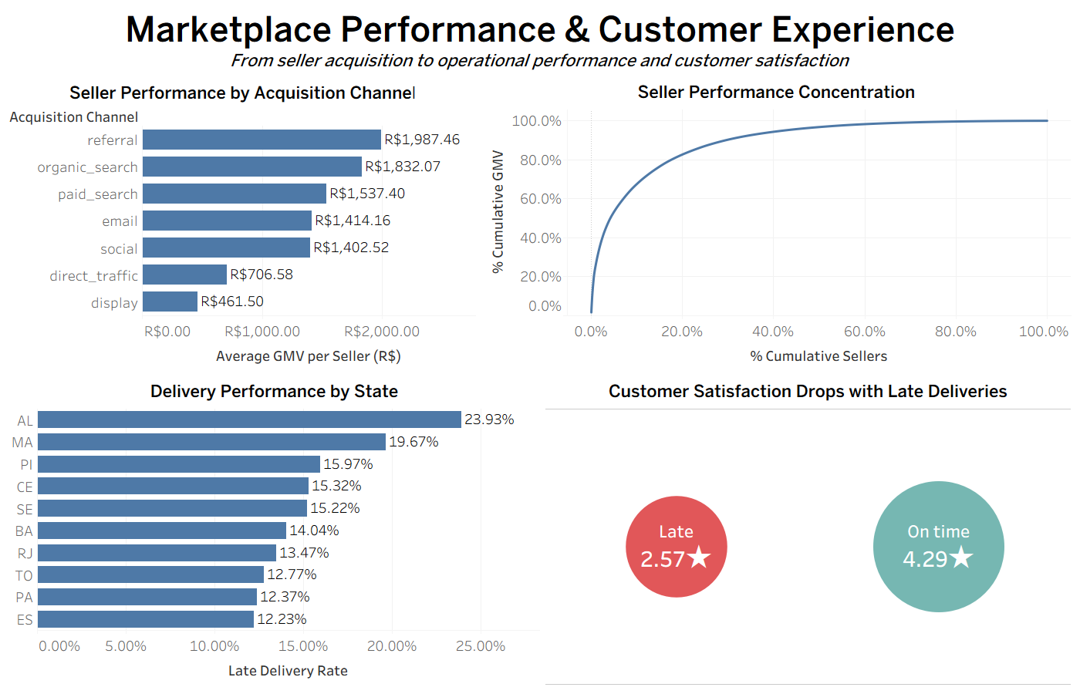
BRINGING IT TOGETHER IN TABLEAU
Interactive Dashboard
A 7-sheet Tableau workbook covering KPI overview, monthly GMV trend, acquisition channel performance, regional delivery, delivery’s link to satisfaction, seller concentration and at-risk categories — with cross-filtering between views.
KPI overview
Monthly GMV
Acquisition perf.
Regional delivery
Delivery → satisfaction
Seller concentration
At-risk categories
10
Notes:
I brought the findings into Tableau so the analysis can be explored from a business perspective. Seven sheets with cross-filtering — a KPI overview, monthly GMV, acquisition channel performance, regional delivery, delivery's link to satisfaction, seller concentration and the categories most at risk of dissatisfaction.
IF SHOWING LIVE: "Let me show you quickly how these connect."
TRANSITION -> "So what should Olist actually do with this?"
If the live demo fails, do not troubleshoot. Say "I'll show it after the presentation" and move on. Losing 30 seconds costs nothing; losing two minutes costs you the ending.

Slide 11

WHAT OLIST SHOULD DO NEXT
Recommendations
PRIORITY 1
PRIORITY 2
QUICK WIN
Fix delivery reliability in the worst states first
Treat delivery as a regional problem, not a national average
Stop using acquisition channel as a seller-quality signal
Finding: Late deliveries: 2.57★ vs. 4.29★ on time.
Finding: Delivery performance differs significantly by state.
Finding: Channel shows no significant link to seller GMV.
Action: Set state-level late-delivery alerts; renegotiate carrier terms starting with the worst-performing states.
Action: Segment carrier strategy by region; start where high volume meets high late-delivery rate.
Action: Remove channel as a standalone quality proxy; pair with real post-onboarding performance data.
Owner: Operations / Logistics
Owner: Regional Operations
Owner: Marketing / Acquisition
Two more recommendations — auditing high-dissatisfaction categories and investigating the 462 unmatched acquired sellers — are detailed in docs/recommendations.md.
11
Notes:
I'd prioritize three actions.
First, and highest impact: improve delivery reliability, starting with Rio de Janeiro — one state, a fifth of all late deliveries. And monitor it at state level, so problems show up earlier instead of hiding inside a national average.
Second, treat logistics as a regional problem, not a national average. Different states clearly need different operational attention.
Third, a quick win on the acquisition side: stop using channel alone as a proxy for seller quality. Post-onboarding performance is a much better signal.
Two more recommendations, on product categories and the missing sellers, are documented in the repository.
TRANSITION -> "Before I close, the limitations."

Slide 12

LOOKING FORWARD
Limitations & What’s Next
LIMITATIONS
NEXT STEPS
Coverage: acquisition findings apply only to the 380 observable sellers (45.1%), not all 842 acquired.
Multivariate regression isolating delivery, category and price effects on review score together.
Recency: data spans 2016–2018 — logistics and market conditions have likely changed since.
Root-cause investigation into the 462 unmatched acquired sellers — the biggest open question.
Granularity: order-level data can’t isolate whether a delay was the seller’s, carrier’s, or Olist’s.
Seller-level cohort analysis using SQL window functions — do late sellers improve over time?
No significance correction was applied across the three research questions tested.
Publish the dashboard live and connect it directly to the database instead of static exports.
“Olist doesn’t have an acquisition problem. It has a delivery problem wearing an acquisition costume — and that’s exactly the kind of finding that changes where a company spends its next dollar.”
Thank you — Estefania Barrosa | github.com/estefaniabarrosa/olist-end-to-end-data-analytics
Notes:
The acquisition analysis only covers the 380 sellers I could observe across both datasets. The data is historical. And a strong relationship isn't causality — the data doesn't tell me whether a delay was the seller's fault, the carrier's, or Olist's.
With more time, my next steps would be a multivariate model, to separate delivery, category and price, and a deeper look at those 462 missing sellers.
But coming back to where I started: I came into this assuming acquisition explained marketplace performance. The data says it doesn't. Olist doesn't have an acquisition problem — it has a delivery problem wearing an acquisition costume. And that's exactly the kind of finding that changes where a company spends its next dollar.
Thank you.
DELIVERY: pause before "Olist doesn't have an acquisition problem". Say the last two sentences slower than everything else. Then stop — add nothing after "thank you".

