Slide 1
Analyzing Music
Emmett Stein and Matthew Hudes

Slide 2

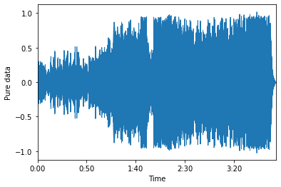
Part One - Splitting a Song Into Parts
Rate = 22,050 samples/sec
In total 5,358,738 samples

Slide 3
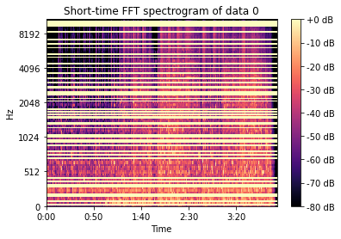
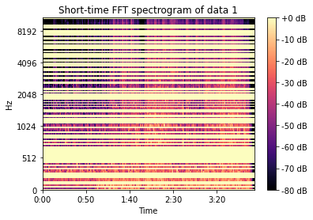
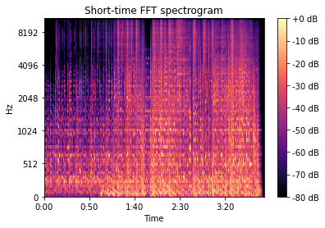
Spectrogram
128 rows and 10,467 columns
1,339,776 points in total

Slide 4
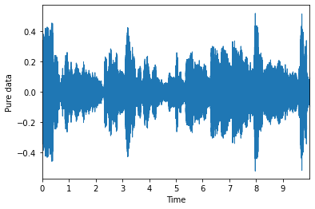
Let's take 10 seconds
Notes:
We need frequency data
Using all of the data isn’t feasible

Slide 5
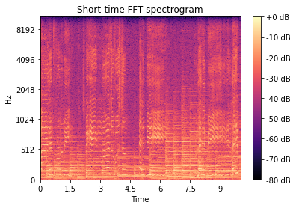
Spectrogram
441,775 samples total
Still to much data...

Slide 6
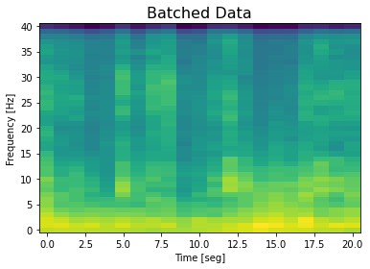
Batch the data
Rows per box = 25
Columns per box = 20

Slide 7
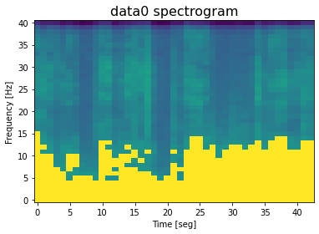
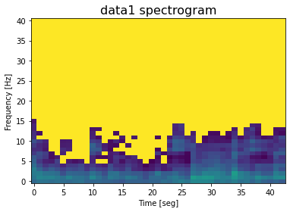
Cluster the batched data

Slide 8
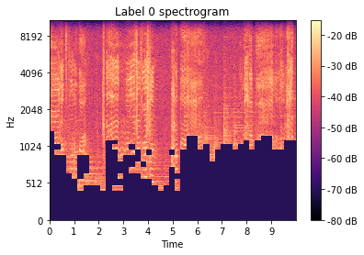
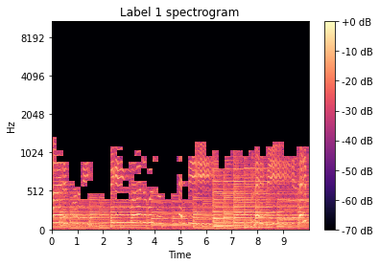
Corresponding Actual Clusters

Slide 9

Part Two - Identifying Instruments
Using certain technique to predict Instrument
Choosing data…
Ultimately found perfect online database!
Pros:
11 different unique instruments
Hundreds of recordings for each
Each recording 3 second clip
Cons:
Different amounts of recordings for each instrument
Each recording in its own file

Slide 10
Instrument - # | Hundreds of arrays of recording data:
Cello - 0 | Recording 1, Recording 2, Recording 3, … , Recording 512
Clarinet - 1 | Recording 1, Recording 2, Recording 3, … , Recording 753
Flute - 2 | ...
Guitar (ac) - 3 | ...
Guitar (el) - 4 | ...
Organ - 5 | ...
Piano - 6 | ...
Saxophone - 7 | ...
Trumpet - 8 | ...
Violin - 9 | ...
Voice - 10 | ...
Dimensions:
(6705, 66,150)

Slide 11
Example recordings:
Trumpet - 8:
Guitar (ac) - 3
Piano - 6

Slide 12

Too much data.
Too much data to process.
Any algorithm was taking hours + huge amounts of storage
Solution:
Helper function to keep certain amount of data from each instrument

Slide 13
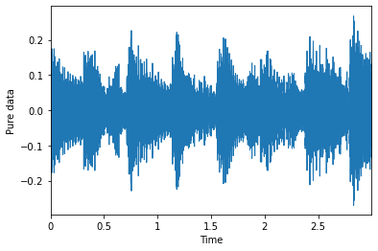
Data stored as .wav (raw)

Slide 14
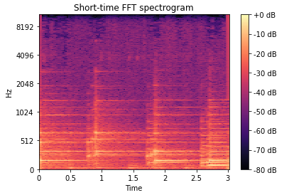
Converting each recording to frequency (Hz)

Slide 15
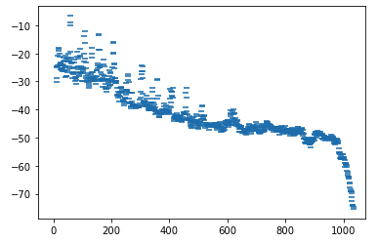
Each 1d recording became a 2d matrix

Slide 16

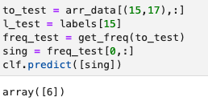
Applying SVM
Training data using chosen recordings
Testing data that wasn’t chosen
Input: audio as .wav
Output: Label 6 - Piano

Slide 17
Correct?
What does the 15‘th data point sounds like?
Success!

