Slide 1
Let’s Encrypt
Open Source Free Certificate Authority

Slide 2
What is Let’s Encrypt?
How does it work? It’s a two step process
Agent on the Web Server Proves to the CA that The Web Server Controls a Domain
Agent can then Request, Renew and Revoke certificates for that domain
2 Challenge Types To Choose From:
HTTP-01 ACME challenge
http://${domain}/.well-known/acme-challenge/${token}
DNS-01 ACME challenge
_acme-challenge.${domain} = ${DIGEST}
Certificates are valid for 90 Days
It’s an open, free certificate authority for domain validation certificates.
The stated Objective of Let’s Encrypt is to facilitate the provisioning of an HTTPS web server and have it obtain a valid, browser trusted TLS certificate without Human intervention.

Slide 3
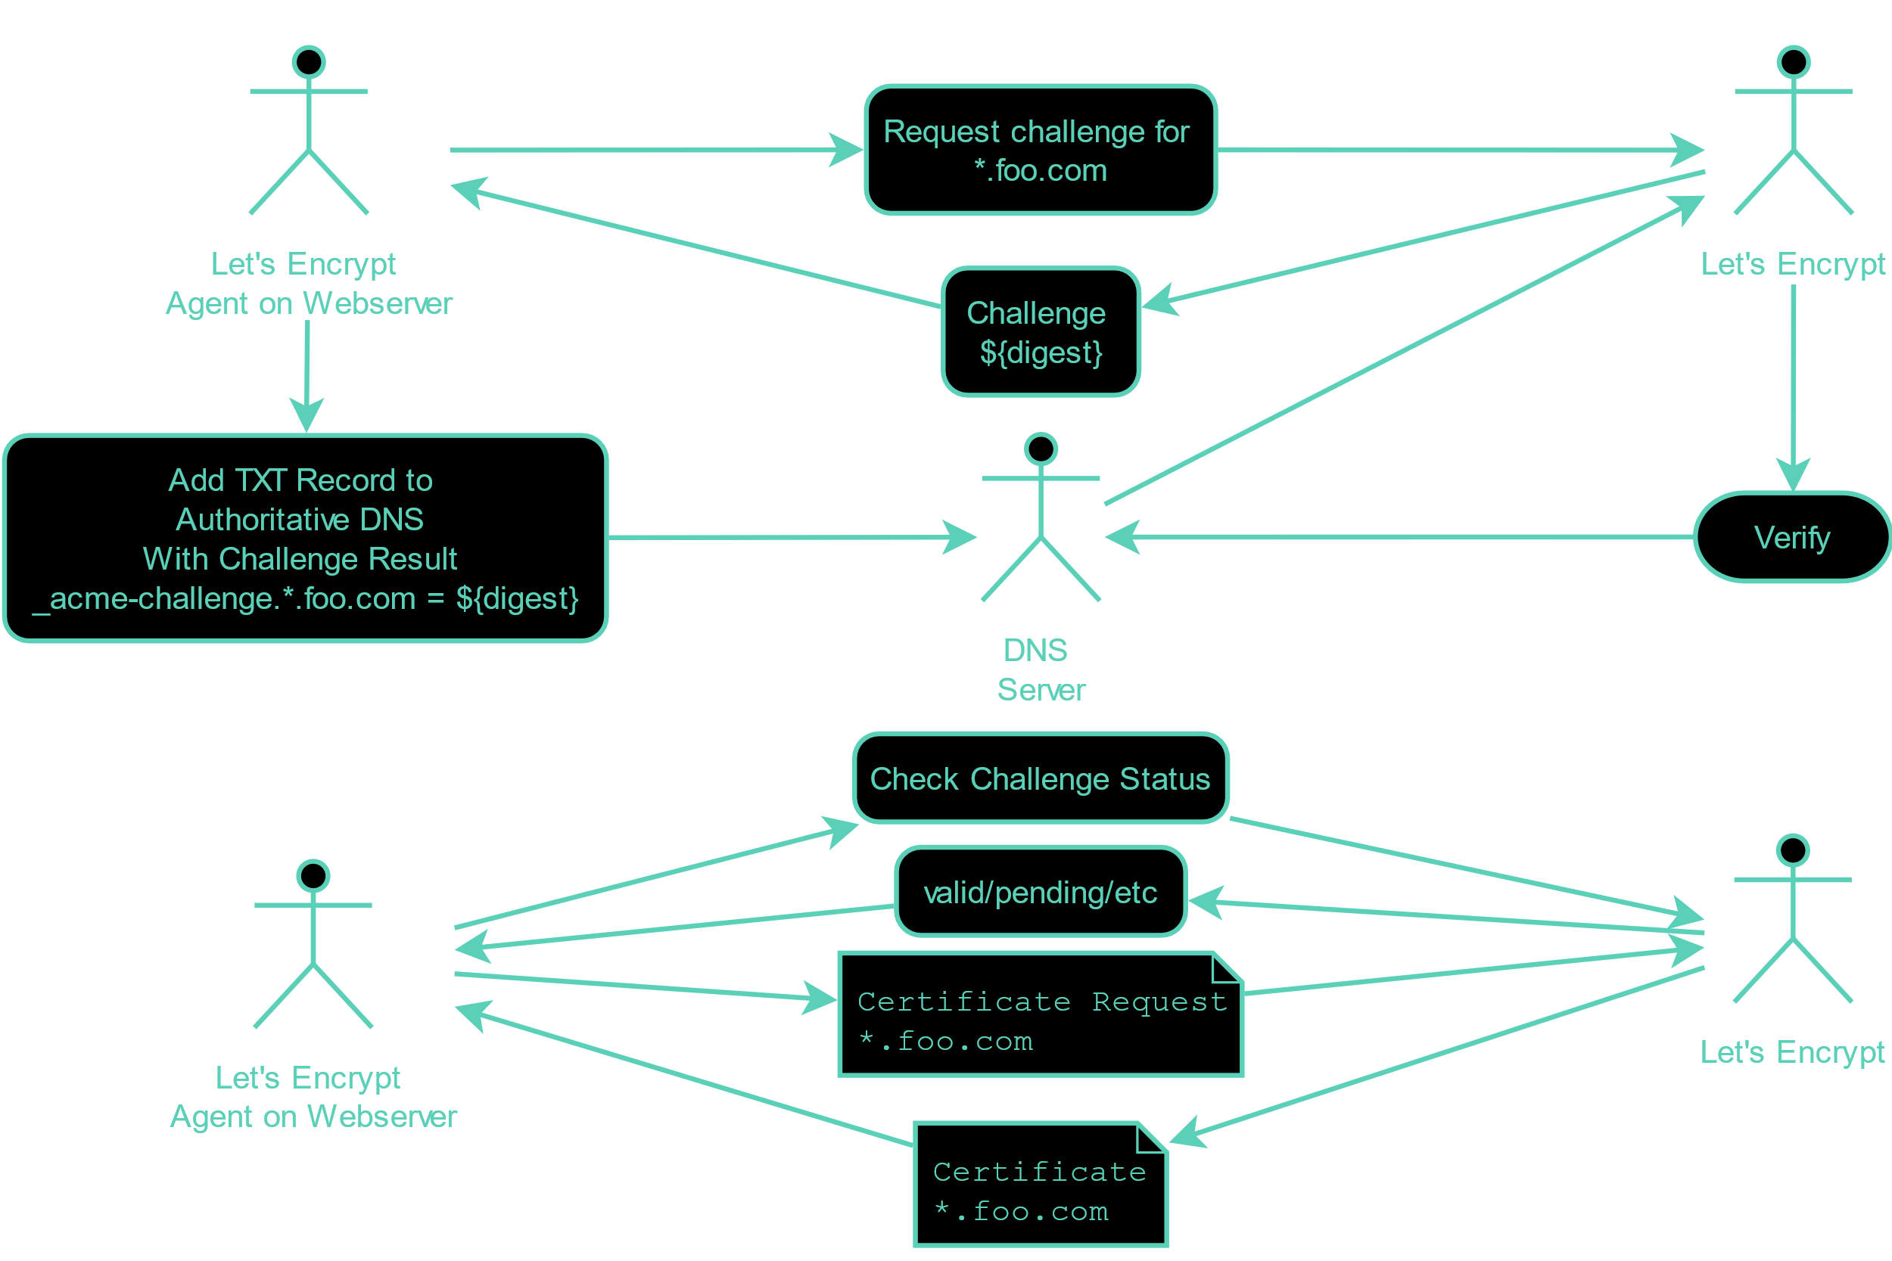
DNS-01 ACME challenge
Required for wildcard certificates

Slide 4
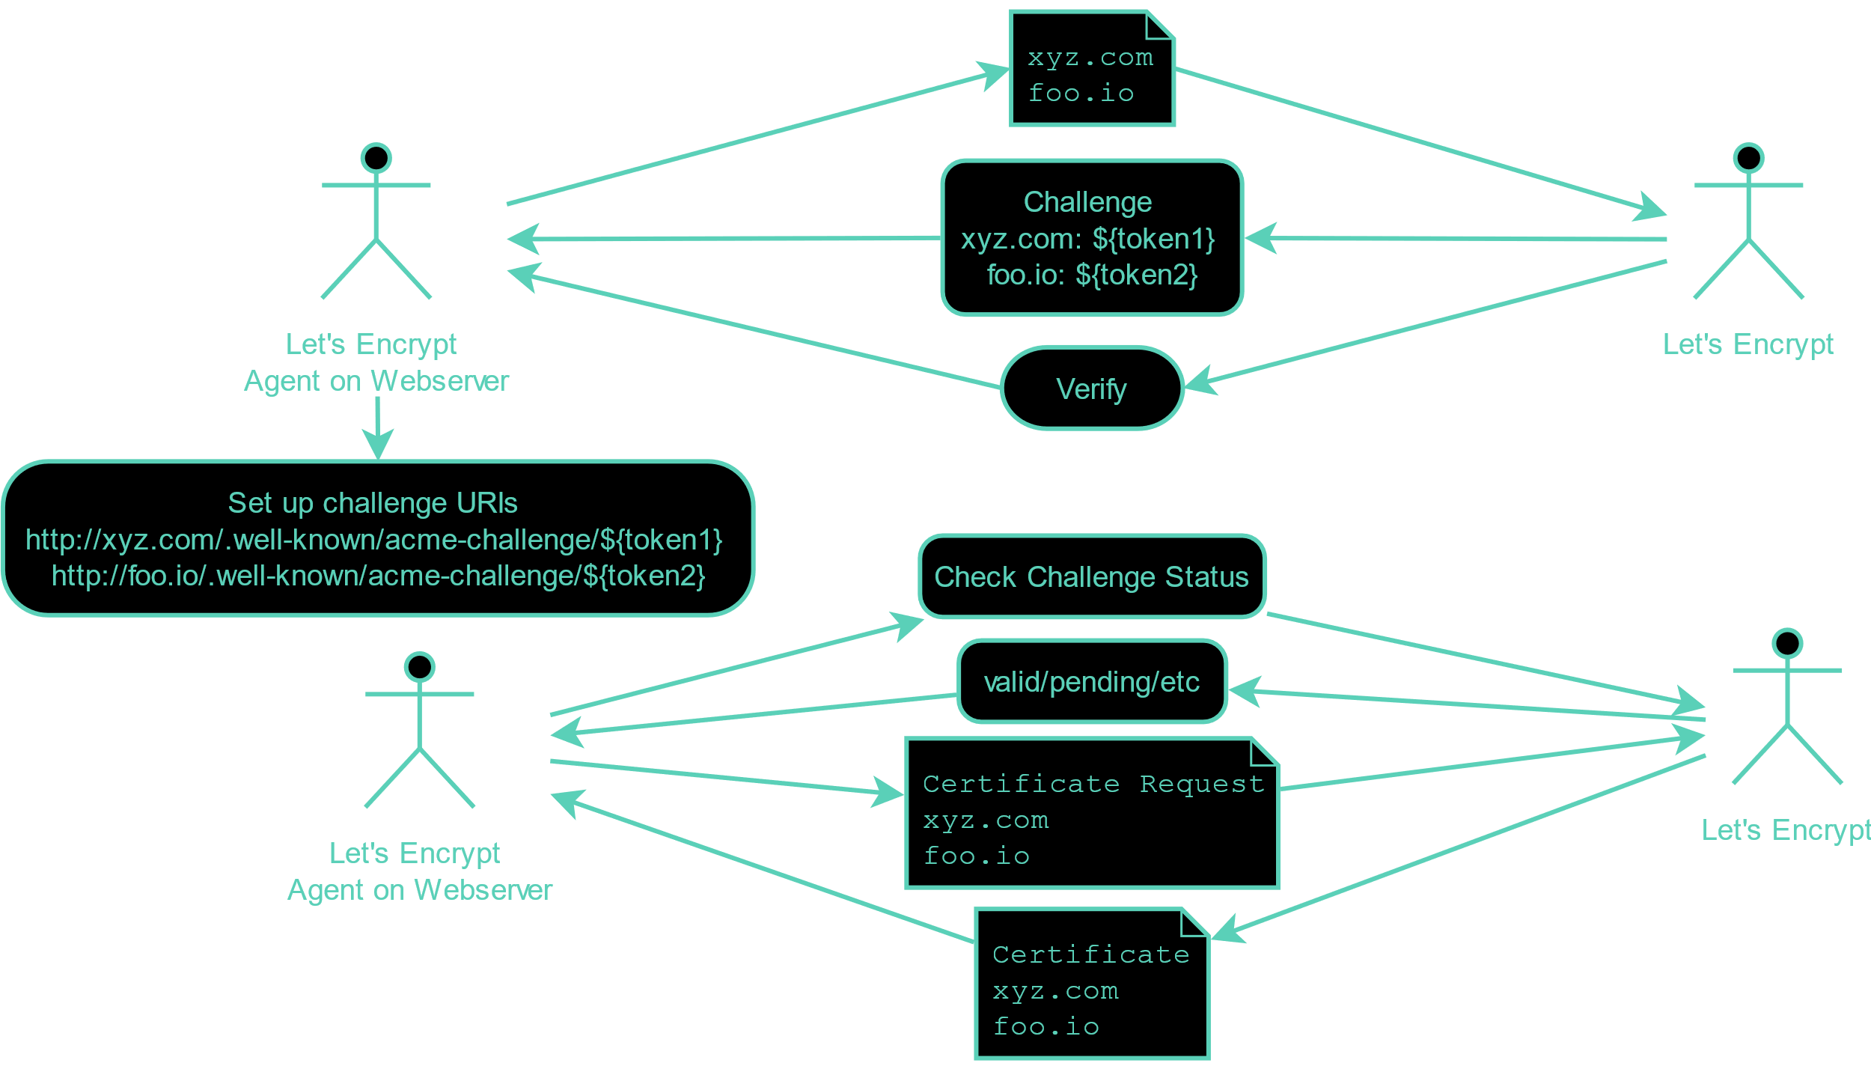
HTTP-01 ACME challenge

Slide 5
References
acme4j. (2018a). Dns-01 challenge. Retrieved from https://shredzone.org/maven/acme4j-acmev1/challenge/dns-01.html
acme4j. (2018b). Http-01 challenge. Retrieved from https://shredzone.org/maven/acme4j-acmev1/challenge/http-01.html
Bryan, B. (2016). Intranet SSL certificates using let’s encrypt | DNS-01. Retrieved from https://b3n.org/intranet-ssl-certificates-using-lets-encrypt-dns-01/
LetsEncrypt. How it works. Retrieved from https://letsencrypt.org/how-it-works/
Oda, K. (2018). Enabling free wildcard domain certificates with let's encrypt Retrieved from https://www.netlify.com/blog/2018/08/20/enabling-free-wildcard-domain-certificates-with-lets-encrypt/

