Slide 1
RF Location Triangulation
SEIS 740
Esten Rye
May 14, 2018

Slide 2
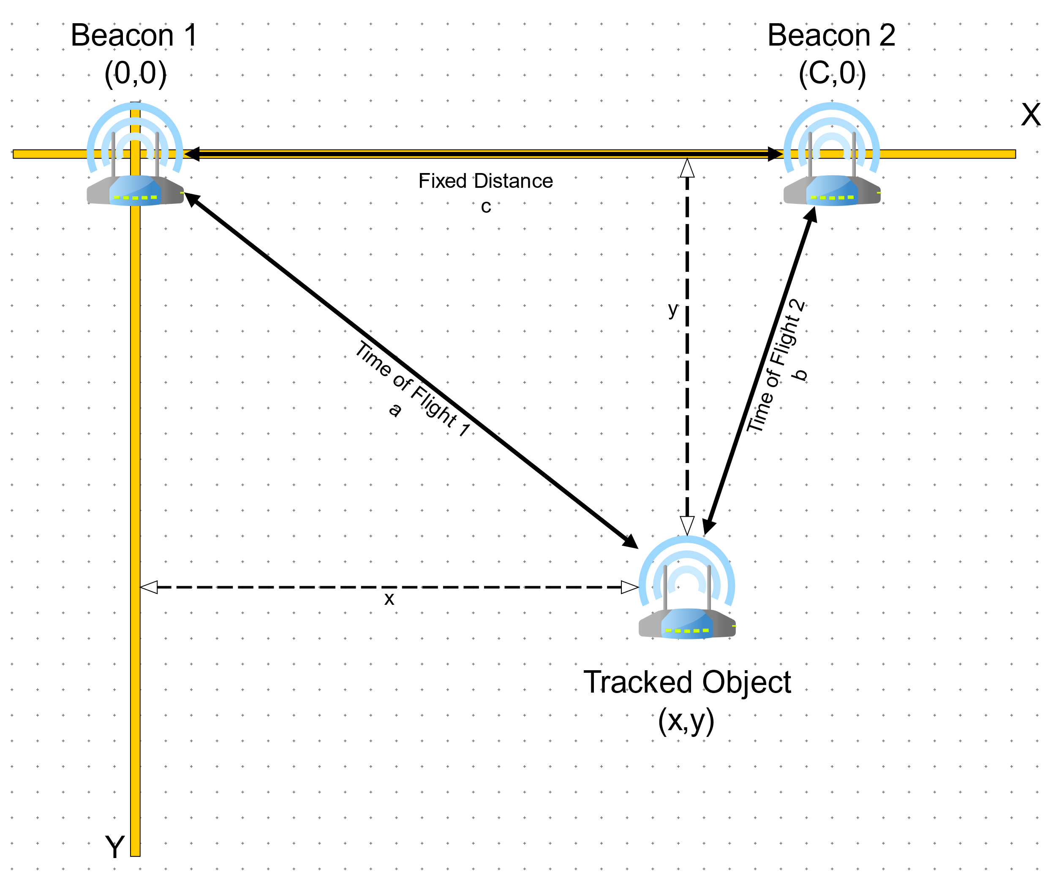
Project Overview
Use RF to Calculate Position on a Two-Dimensional Plane from Time of Flight Data (TOF)
Use 802.15.4 to transmit data from Beacons to Tracked Object

Slide 3
Key Tasks
Tracked Object
Beacon
Initialize Network and Register Beacons
Receive TOF Data From Beacons
Triangulate Location From Received Data
Update LCD Display
Join Network
Execute TOF Burst Measurement
Calculate Average TOF and RSSI Distances
Transmit TOF and RSSI Distance to Tracked Object

Slide 4
Challenges Encountered
Selected microcontroller used a proprietary RTOS.
Limited utility of Google.
A lot of beat my head against it until it works.
Received Time of Flight SDK one week before project due date.
SDK was incompatible with initially selected networking SDK.
Had to rewrite the entire project over the weekend.

Slide 5
Retrospective
What did I Learn?
What would I do differently?
My C Skills are a bit rusty.
Visual Studio Code is a much better editor than Eclipse.
802.15.4 is complicated, even with a good API
Proprietary RTOSs
Aren’t bad, but leave you dependent on the vendor for support.
Come with unique challenges.
Spend more time learning how to use a debugger with a RTOS.
Lots of vPrintf to the UART in my code.
Use GPS instead of RF
Reliability of the TOF data was an issue.
Modify the project to build beacons that output a differential GPS correction. Tracked Object now has a GPS Chip and receives correction data from the beacons.

Slide 6
Thank you
Questions?

