Slide 1
Proyecto Final Minería de Datos
Estephanie Gomez

Slide 2
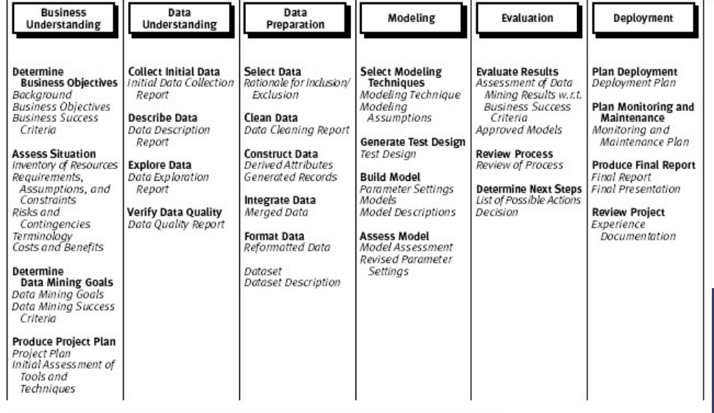
CRISP-DM, o Cross-Industry Standard Process for Data Mining
Notes:
Define los objetivos y las necesidades del proyecto.
Explora y comprende los datos disponibles
Limpia y transforma los datos para análisis
Aplica técnicas de minería de datos para resolver el problema
Verifica que los resultados sean útiles para el negocio
Presenta los resultados y los lleva a la práctica.

Slide 3
Cycle
1-Business Understanding
2- Data Understanding
4- Modeling
5- Evaluation
3- Data Preparation
6-Deployment
(1 & 2) Objectives and Success Criteria
(3) Extraction, Transformation, and Loading (ETL)
(4) Data Visualization
(5) Data Analysis

Slide 4
Objective Sucess Criteria
Objective
Analyze the sales trends of the stores Baldwin Bikes, Rowlett Bikes, and Santa Cruz Bikes over time.
Success Criteria
Clearly observe the fluctuations in sales and identify which store performs the best.
Objective
Analyze the variability in inventory days between the order date and the shipping date for each store, to identify whether there are delivery delays or longer inventory times in certain years.
Success Criteria
Observe the evolution of the average inventory days over the years for each store.
Objective
Display the average total sales per customer, highlighting the top customers those who have made the most significant purchases.
Success Criteria
Objective
Analyze the distribution of sales by product to highlight popular items as well as those that may require additional promotion or inventory restocking.
Success Criteria
El gráfico debe mostrar de manera visual qué productos tienen ventas más altas y tomando en cuenta las tiendas.
The chart should visually show which products have the highest sales, taking the different stores into account.

Slide 5
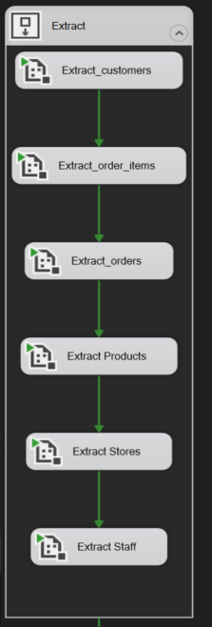
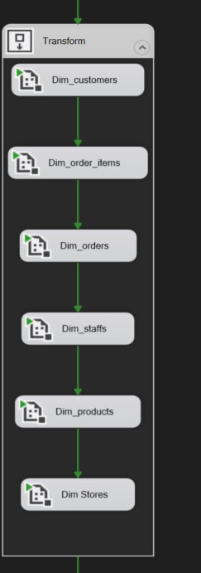
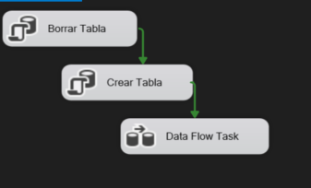
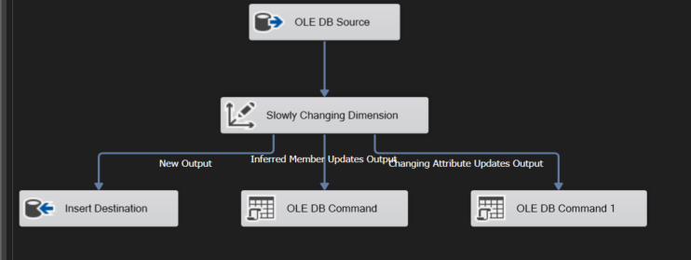
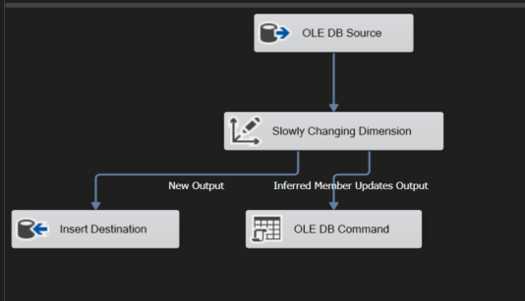
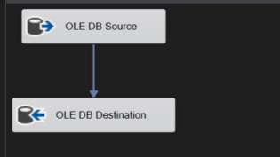
Extraction
Transformation
Type 0 y Type 1

Slide 6
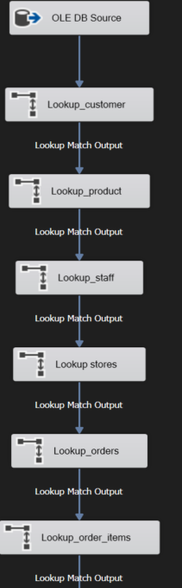
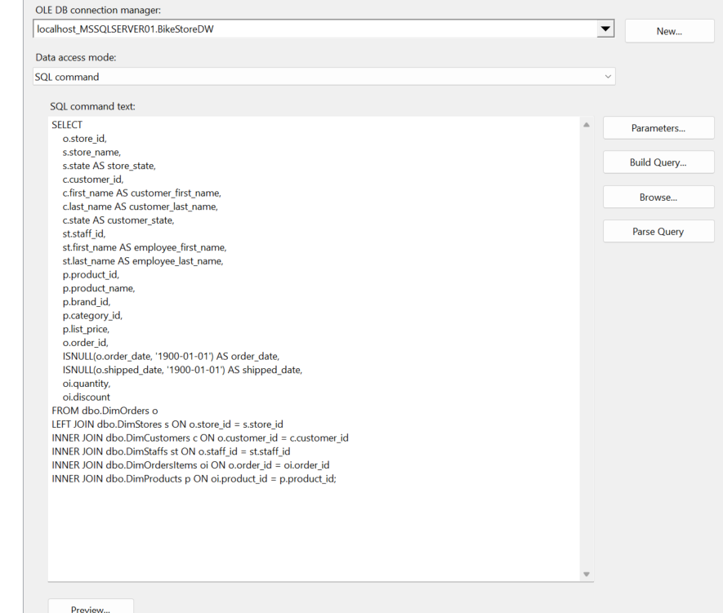
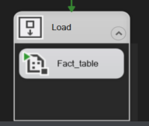
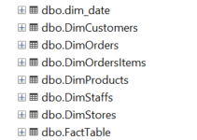
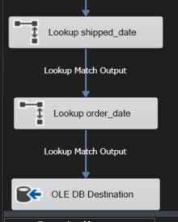
Load

Slide 7
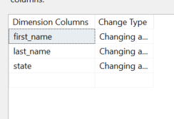
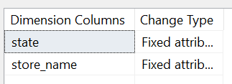
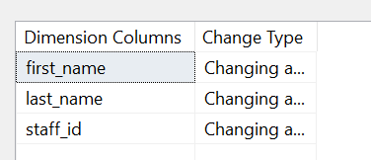
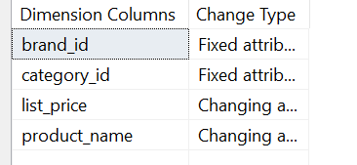
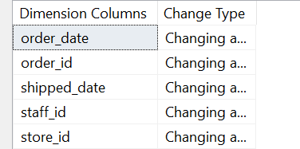
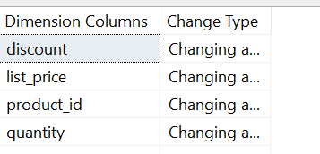
SCD
Table | Field y Type
Dim Customers | Type 1
Dim Stores | Type 0
Dim Staff | Type 1
Dim Products | Type 0 y Type 1
Dim orders | Type 1 -> Type 2
Dim Order Items | Type 1

Slide 8
Scheme
FACT TABLE
[customer_id]
[first_name]
[last_name]
[state]
[staff_id]
[first_name]
[last_name]
[store_id]
[product_id]
[product_name]
[brand_id] [category_id]
[list_price]
[order_id]
[customer_id]
[order_date]
[shipped_date]
[store_id]
[store_name]
[state]
Orders
[order_id]
[customer_id] [order_date] [shipped_date] [staff_id] [store_id]
Customers
[customer_id]
[first_name]
[last_name]
[state]
Staffs
[staff_id] [first_name] [last_name] [store_id]
OrdersItems
[order_id]
[product_id]
[quantity]
[list_price]
[discount]
Products
[product_id]
[product_name]
[brand_id] [category_id]
[list_price]
Stores
[store_id]
[store_name]
[state]
Dim date

Slide 9
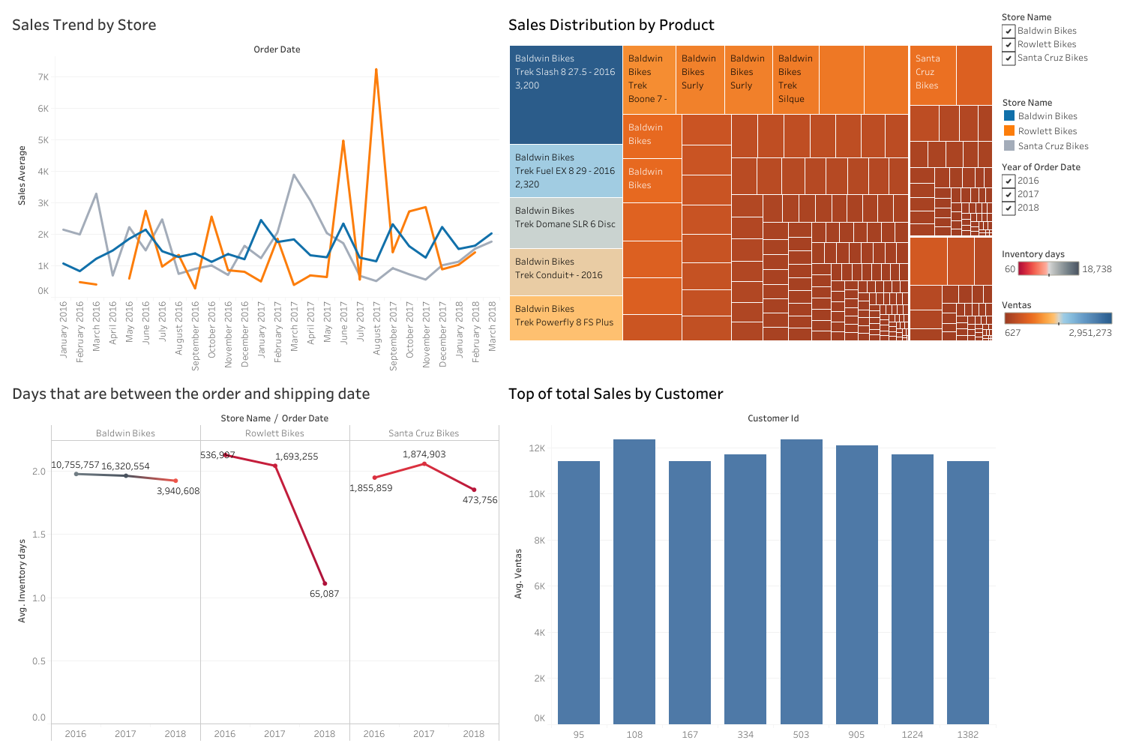
Tableau
Sales Trend by Store
Sales distribution by Product
Days between order and shipping date
Top of total sales by customer
proyecto_final_2 | Tableau Public

Slide 10
Objective 1 The chart shows the average sales trends over time for each store. Baldwin Bikes exhibits significant sales peaks in certain months (for example, in August 2017), which may indicate special sales events or seasonal patterns. Rowlett Bikes and Santa Cruz Bikes display smaller fluctuations in comparison, with more stable trends overall. Sales at Santa Cruz Bikes appear to decline in the most recent months, which may suggest a drop in demand or potential inventory issues. | Objective 2 The best-selling products come primarily from Baldwin Bikes, with items such as the Trek Slash 8 27.5 (2016) and Trek Fuel EX 8 29 (2016) standing out with the highest sales. The Trek Boone 7 (2017) also shows significant sales, suggesting that these products are popular and should continue to be prioritized in inventory. The lower-selling products appear grouped toward the end of the chart, indicating reduced demand for those models.
Objetivo 3 Baldwin Bikes shows greater variability in inventory days, with some years displaying longer times between the order and the shipment, which may indicate logistical issues or inventory shortages. Rowlett Bikes improved significantly in 2018, with reduced delivery times, suggesting an enhancement in operational efficiency. Santa Cruz Bikes also shows longer times in 2018, which may be a sign of delays or supply chain problems. | Objetivo 4 The customers with the highest sales are identified in this chart, with customers 95, 108, and 167 contributing significantly to total revenue. These customers should be considered high-value, and implementing retention strategies or personalized marketing is recommended. The relatively even distribution among the remaining customers shows that a diverse group contributes to total sales, which suggests a solid customer base but also highlights opportunities to improve customer loyalty.

Slide 11
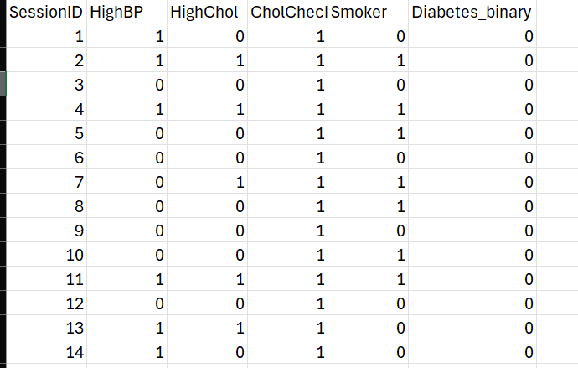
A priori algorithm in R
Kaggle Diabetes data set: https://www.kaggle.com/datasets/hosammhmdali/diabetes-dataset
There are 22 factors described in the dataset, and an arbitrary preselection was performed.
Events (HighBP, HighChol, CholCheck, Smoker)->Event(Diabetes)

Slide 12
A priori algorithm in R
Objetivo: Obtener la posibilidad de tener diabetes dato las condiciones de alta presion arterial (HighBP), colesterol alto (HighChol), chequeo de colesterol (CholCheck) y persona fumadora (Smoker). Eventos (A,B,C,D) -> Evento (diabetes)
Métricas:
  Soporte: mide la frecuencia con la que ocurre una combinación de elementos (reglas) en el conjunto de datos.
  Confianza: mide la probabilidad de que el lado derecho (rhs) de la regla ocurra dado que el lado izquierdo (lhs) de la regla es cierto-
  Lift: fuerza de la asociación entre los elementos del lhs y rhs en la regla.
  Coverage:

Slide 13
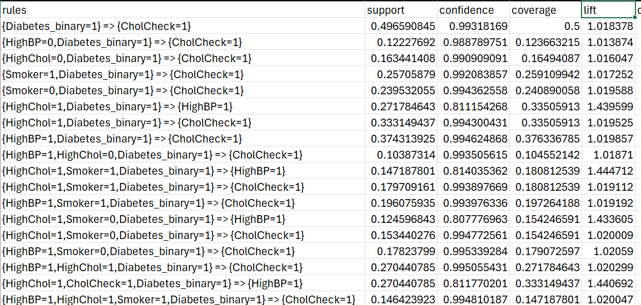
Results
Rule: {Smoker = 1, Diabetes_binary = 1} ⇒ {CholCheck = 1}
This rule indicates that smokers with diabetes have a 99.21% probability of undergoing a cholesterol check.
The support is 25.71%, meaning this rule is relatively common among smokers with diabetes who receive cholesterol screenings.
The confidence of 99.21% confirms that when these two conditions are present, a cholesterol check is almost guaranteed.
The lift of 1.071 shows a positive relationship between the events.

Slide 14
Lessons Learned
Use of SCD for historical tables, such as Orders.
In the FACT table, analyze whether any null values were present.
Check for repeated fields across tables that may create redundancy.
In Tableau, consider including employee performance metrics.
In R, improve the visualization of metrics and explore selecting additional columns from the dataset for the Apriori algorithm.

Slide 15
Conclusions
Understanding the data types of each column is essential; having inconsistent data types can result in empty columns in the fact table.
Proper key creation for the DW tables is necessary, and decimal fields must be correctly defined.
Pay attention to repeated columns across DW tables, as they can create inefficiencies.
Verify that the fact table contains the expected data.
Use Tableau to evaluate potential data inconsistencies at the visualization level, as these issues may lead to rework in the ETL process.

