Slide 1
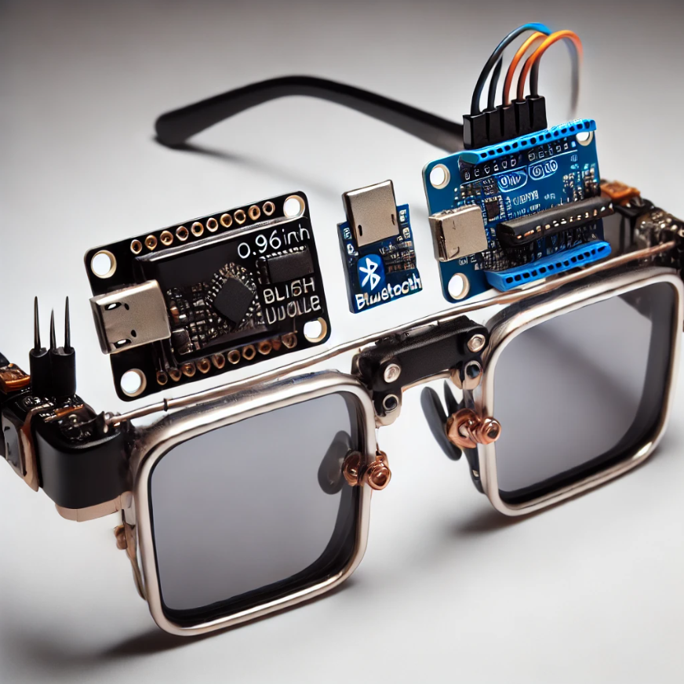
Smart Glasses
Project ID: Group 8
Ritwik Goel (rg3546)
Zhiyi Zhang (zz3274)
Ester Tsai (eyt2112)
EECS E4764 Fall ‘24
IoT - Intelligent and Connected Systems
Columbia university
Prof. Xiaofan (Fred) Jiang
‹#›

Slide 2
_{What and Why}
What
Smart glasses controlled by voice commands with features like time display, live translation, and navigation—seamlessly blending digital information with your surroundings.
A clip-on device that the user can attach to any pair of glasses.
Why
Smart glasses are wearable computers that integrate digital data with the physical world, allowing users to access information hands-free.
A type of Augmented Reality device that overlays information onto your real-world view.
Ideal for tech enthusiasts, professionals, and active lifestyle users.
‹#›

Slide 3
_{Feature List}
Feature | Description
Voice command | Navigate functions hands-free using voice commands.
Display time | Easily check the current time right in your line of sight without needing to look at your phone or watch.
Live translation / transcription | Instantly translate spoken language or transcribe conversations in real-time.
Phone notification | Receive notifications from your phone directly on the glasses, including messages, calls, and app alerts.
Show weather | Get live weather information, including temperature and humidity.
Show direction | Access turn-by-turn navigation from Google Maps, projected onto your glasses for easy navigation while walking or driving.
‹#›

Slide 4
Technical Components
The smart glasses project integrates several advanced components to provide real-time features like language translation, weather, time, location, and phone notifications. The system is powered by a Raspberry Pi and connected via Bluetooth (for phone sync) and Wi-Fi (for internet services).
Raspberry Pi: Core processor handling translation, weather, time, and notifications.
Bluetooth & Wi-Fi Modules: Enable phone sync and internet access.
Sensors: Possibly include cameras and microphones for input and interaction.
Language Translation APIs: For real-time translation.
Weather and Time Services: For live data display.
Cloud Notifications: Syncs phone alerts.
‹#›

Slide 5
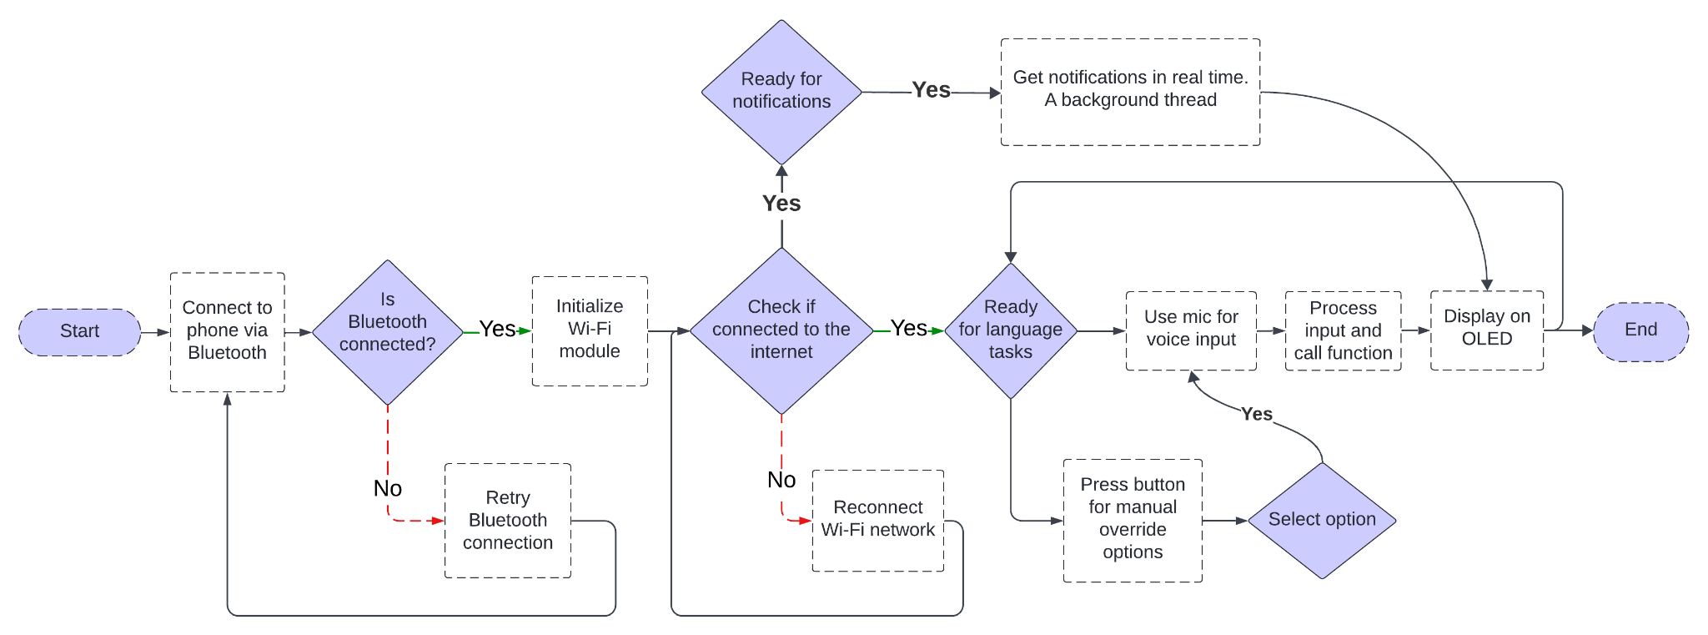
_{Block Diagram}
‹#›

Slide 6
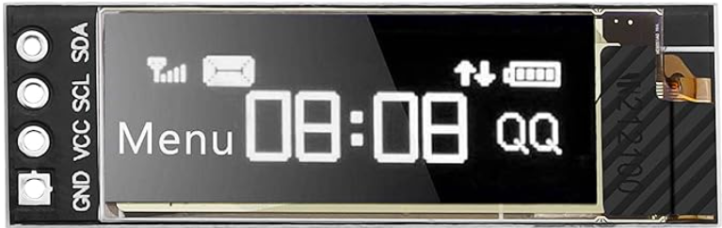
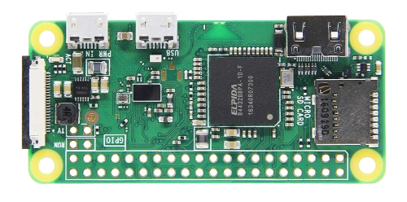
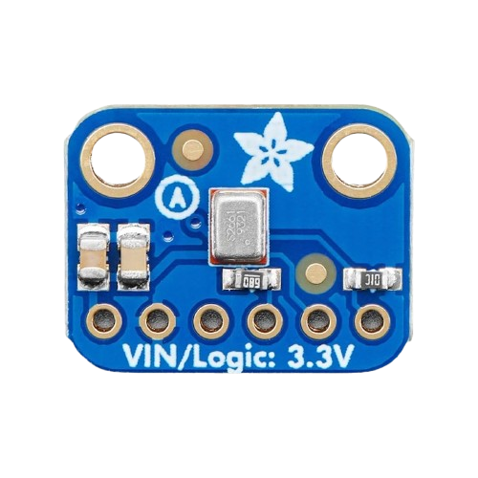
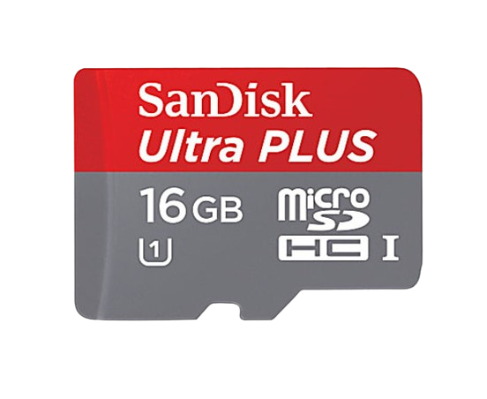
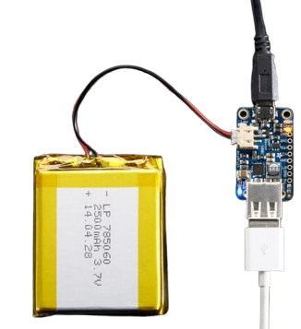
Components/Resources and Budget
Create a list of required components/resources and the associated cost.
* Remember to add components to the Google Order Sheet (budget $100)
Component | Units | Cost
0.91 Inch I2C OLED Display | 1 | $7
Raspberry Pi Zero W | 1 | $16
16GB Micro SDHC card | 1 | $8
PowerBoost 500 Charger | 1 | $15
Li-Po Battery | 1 | $10
Adafruit I2S MEMS Microphone Breakout | 1 | $7
Slide switch | 1 | $1
Wire | … | Already have wires
Total | 5 | Total Cost: $64
‹#›

Slide 7
_{Midpoint Milestone}
Midpoint milestone will be evaluated by the TA.
Milestones | Description
Midpoint | Connect to the phone using Bluetooth. Connect to the Internet. Implement voice command for these functions and display information on the screen: live transcription / translation Display time & weather
‹#›

