Slide 1
M&A deals analysis
Sample parameterized report in PowerPoint

Slide 2
Introduction
This is a sample analysis of deals per sectors over time. It is an automated report using R & tidyverse. Rendering is done with Quarto and Knitr. Inspired by a question on the quarto-cli repository.
Can also can be achieved with a parameterized quarto report. See esteveaq.github.io/hello/blog/report for more information.

Slide 3
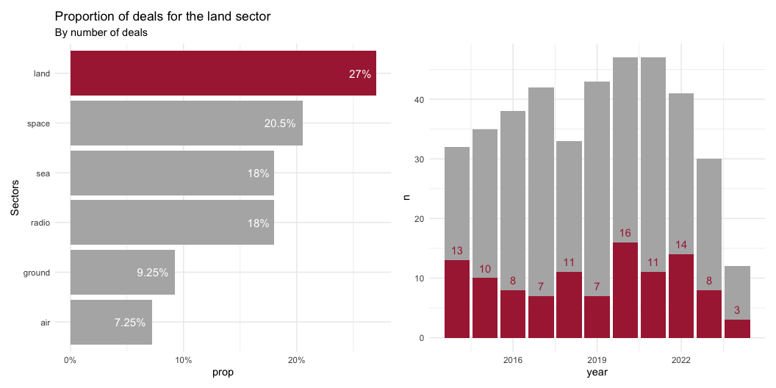
Sector land

Slide 4
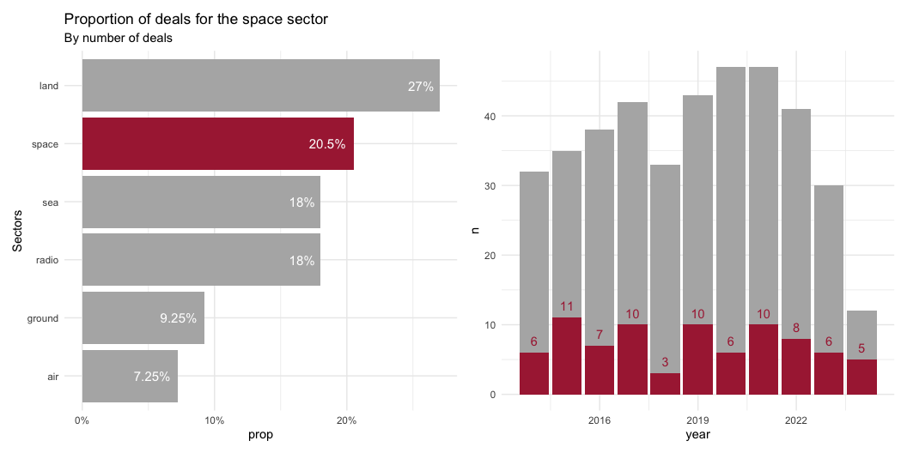
Sector space

Slide 5
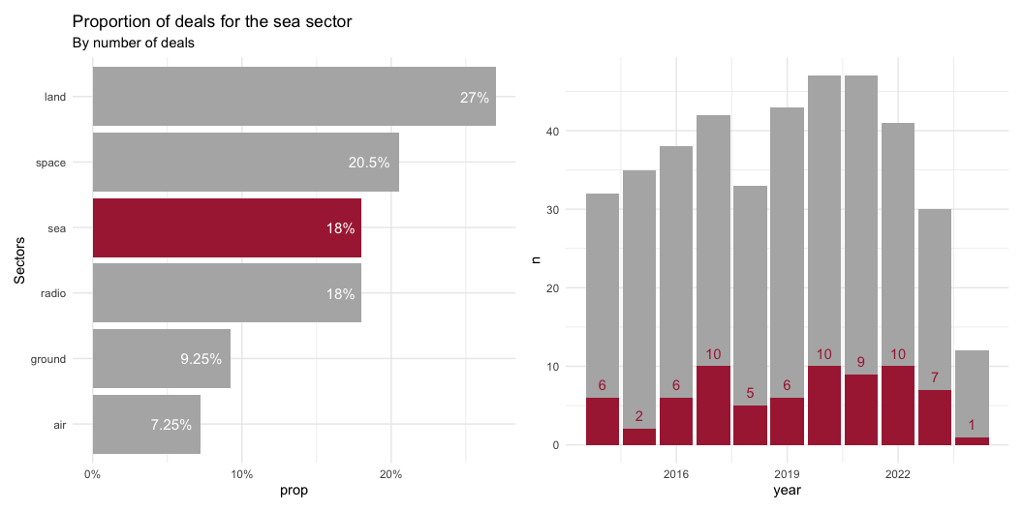
Sector sea

Slide 6
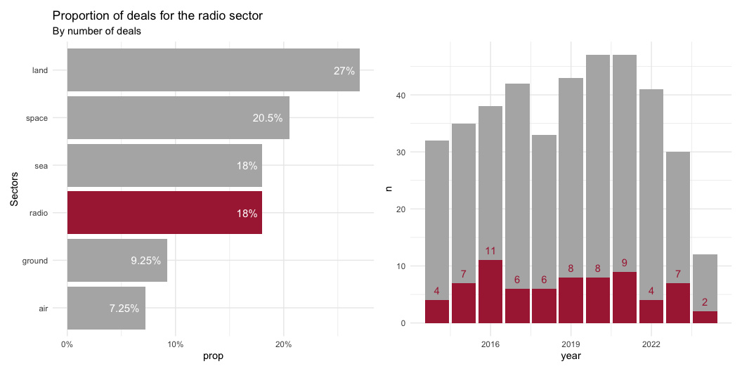
Sector radio

Slide 7
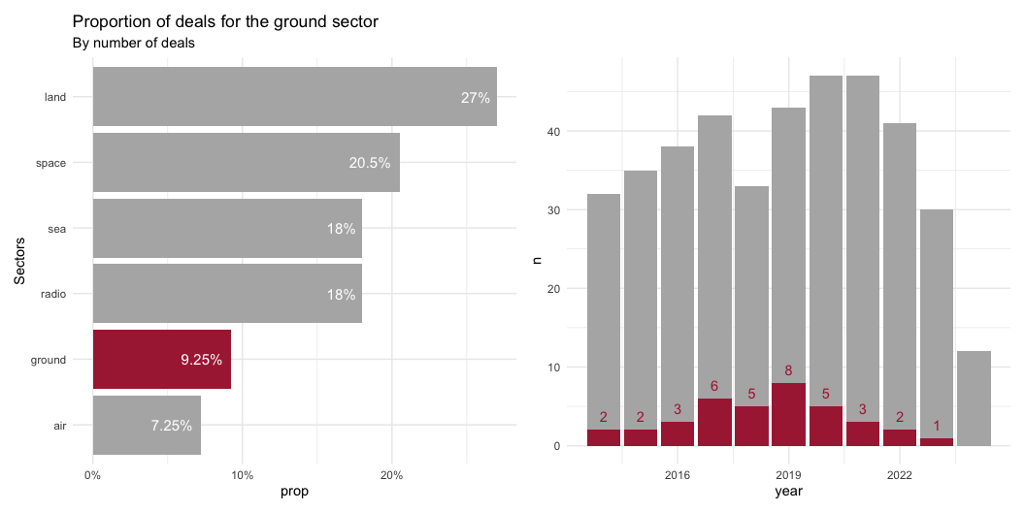
Sector ground

Slide 8
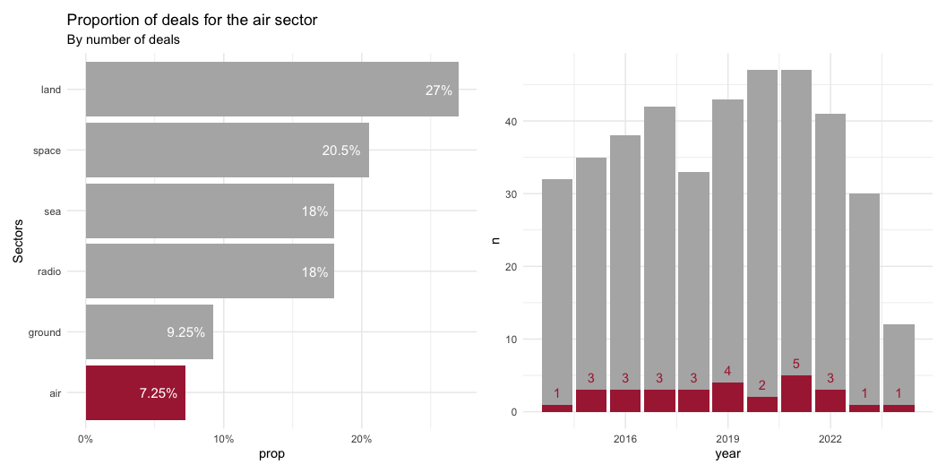
Sector air

