Slide 1
Qualis AI
Ahmed Fawad (ahmed.fawad@rabobank.nl)
Arnab Shil (arnab.shil@rabobank.nl)
Johannes Hettling (johannes.hettling@rabobank.nl)
Sheau Pei Chong (schong@bol.com)

Slide 2
Purpose
Qualis AI is revoluntionalize the way organisations manage data quality automation through agentic AI.
Our data quality automation solution is designed to provide intelligent automation that improves customer experience, optimises operations, ensures regulatory compliance, and supports sustainability objectives through accurate data insights.
We enable diverse industries—including financial services, consumer goods, healthcare, and sustainability—to confidently leverage data-driven decision-making and AI automation with simplicity.

Slide 3
Problem Statement
Poor data quality and the significant manual effort required are adversely affecting our businesses and sustainability, resulting in:
Extended manual processes and prolonged time to obtain insights, often taking months and considerable human resources.
Inadequate data quality that hinders effective business decision-making, customer personalisation, compliance reporting, and sustainability management.
An inability to expand Agentic AI initiatives due to a weak data quality foundation.
Industry benchmarks estimate that by 2030, the business impact from productivity losses, compliance chall35–45 billion annuallyenges, and limitations in scaling due to data quality issues could approach €, highlighting the critical need for enhanced data quality automation.

Slide 4
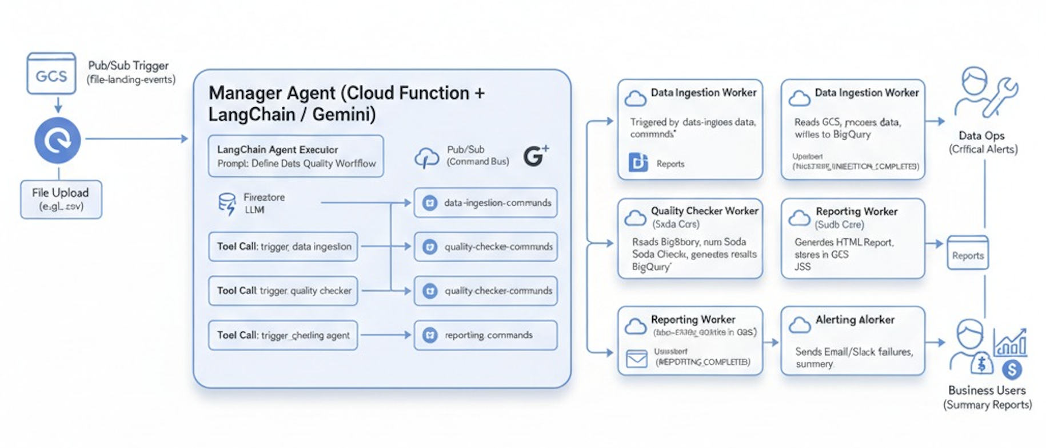
Architecture and Novelty of Our Solution
Our agentic solution is designed with a manager agent orchestrator that intelligently coordinates three modular agents—ingestion, quality check, and reporting agents—to ensure data quality objectives are met.
We proactively identify quality issues early in the process by implementing a shift-left approach. This includes leveraging both front-end and back-end technologies such as Google Cloud Run, Langchain, React/TypeScript, serverless functions, Python, and JSON integration.
Our solution undergoes deployment, integration, testing, and evaluation for this solution

Slide 5
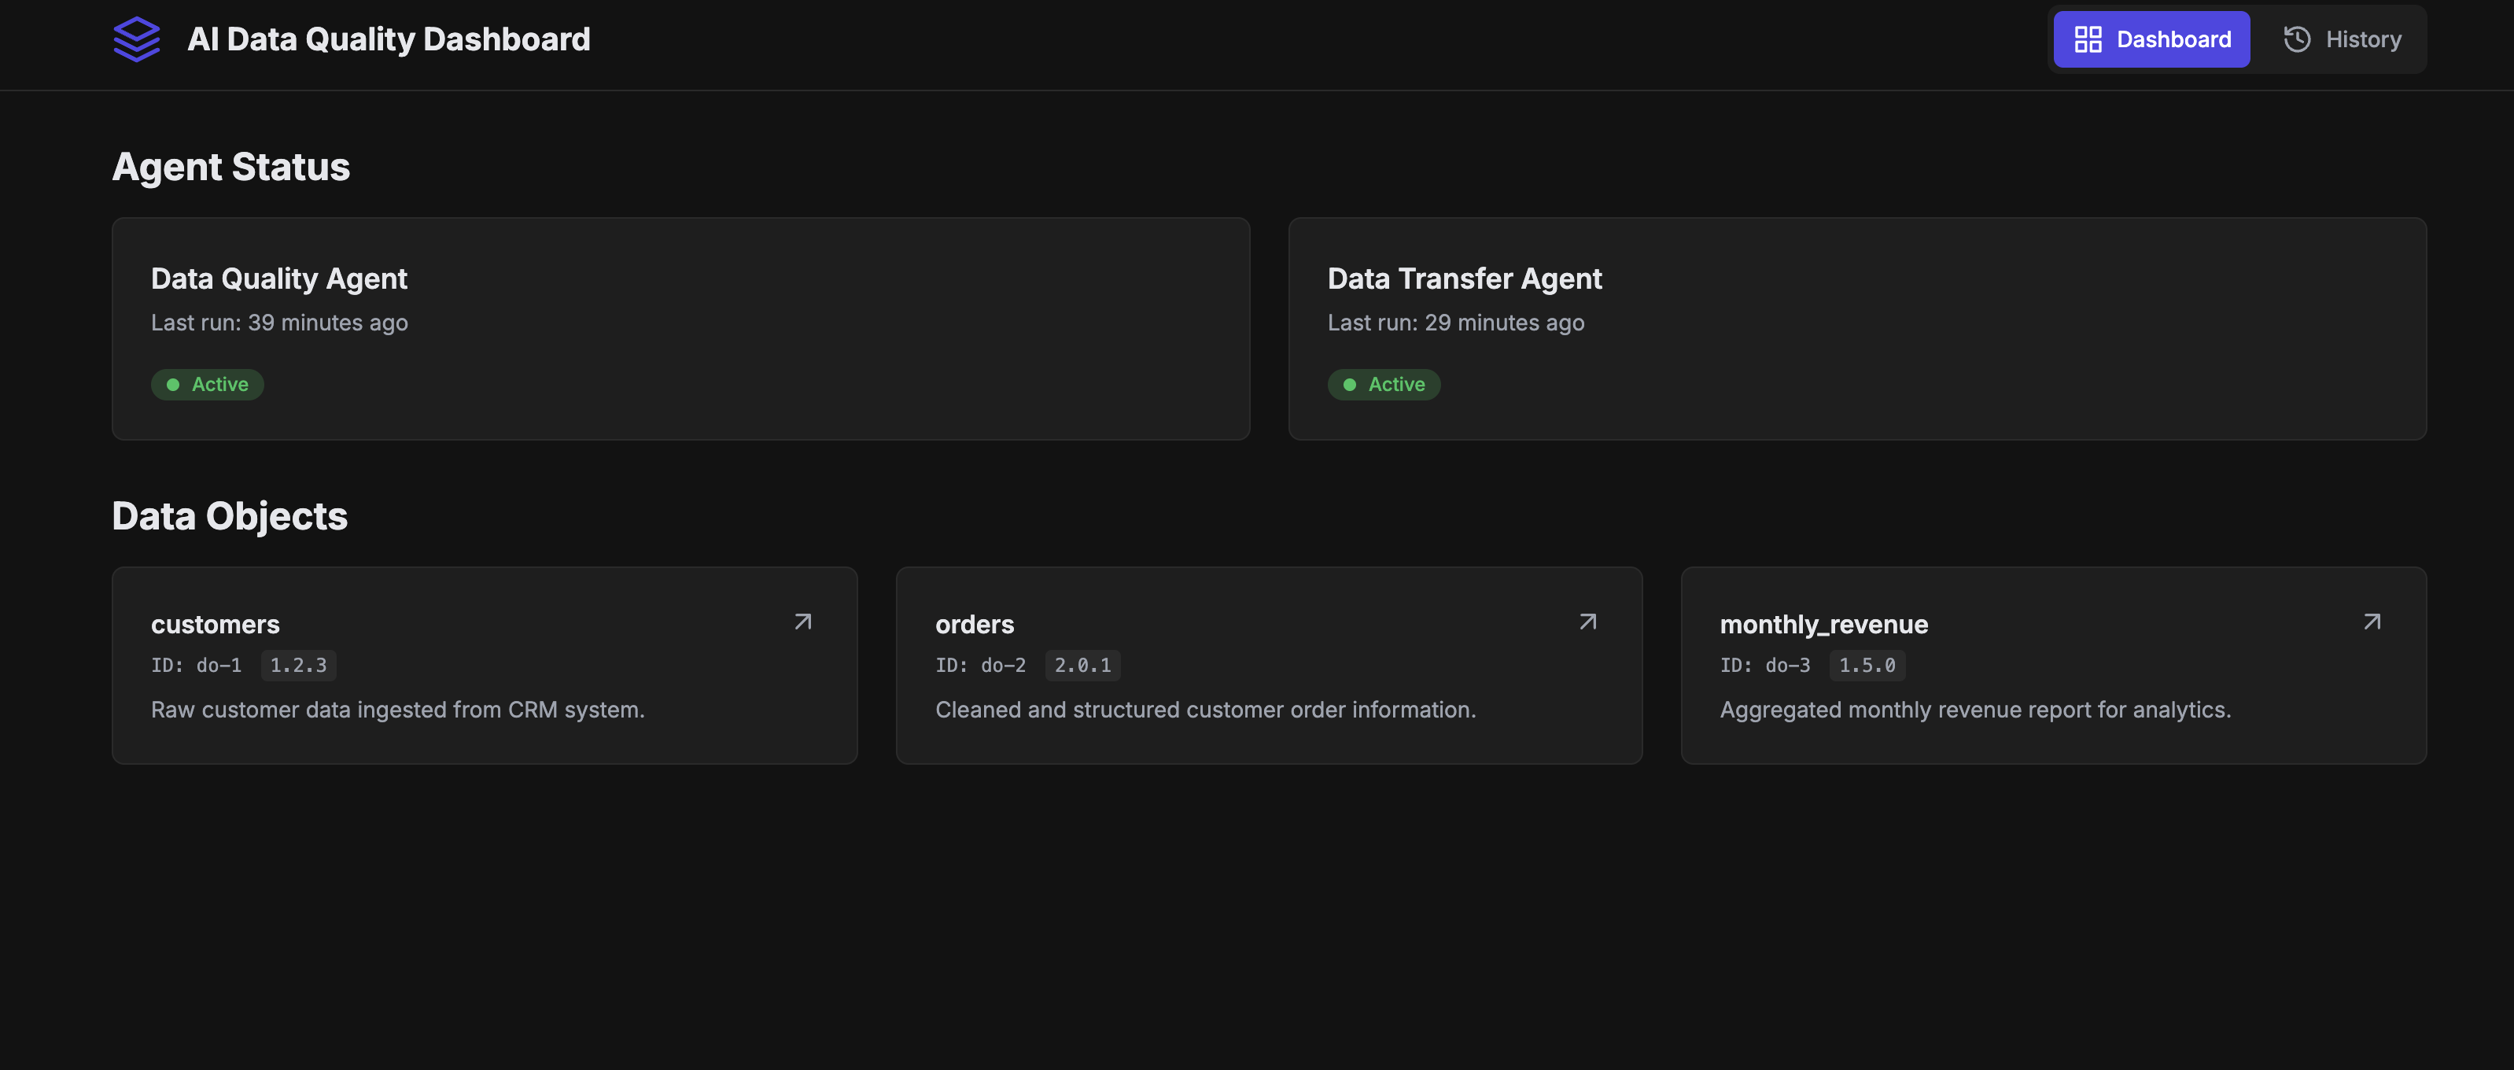
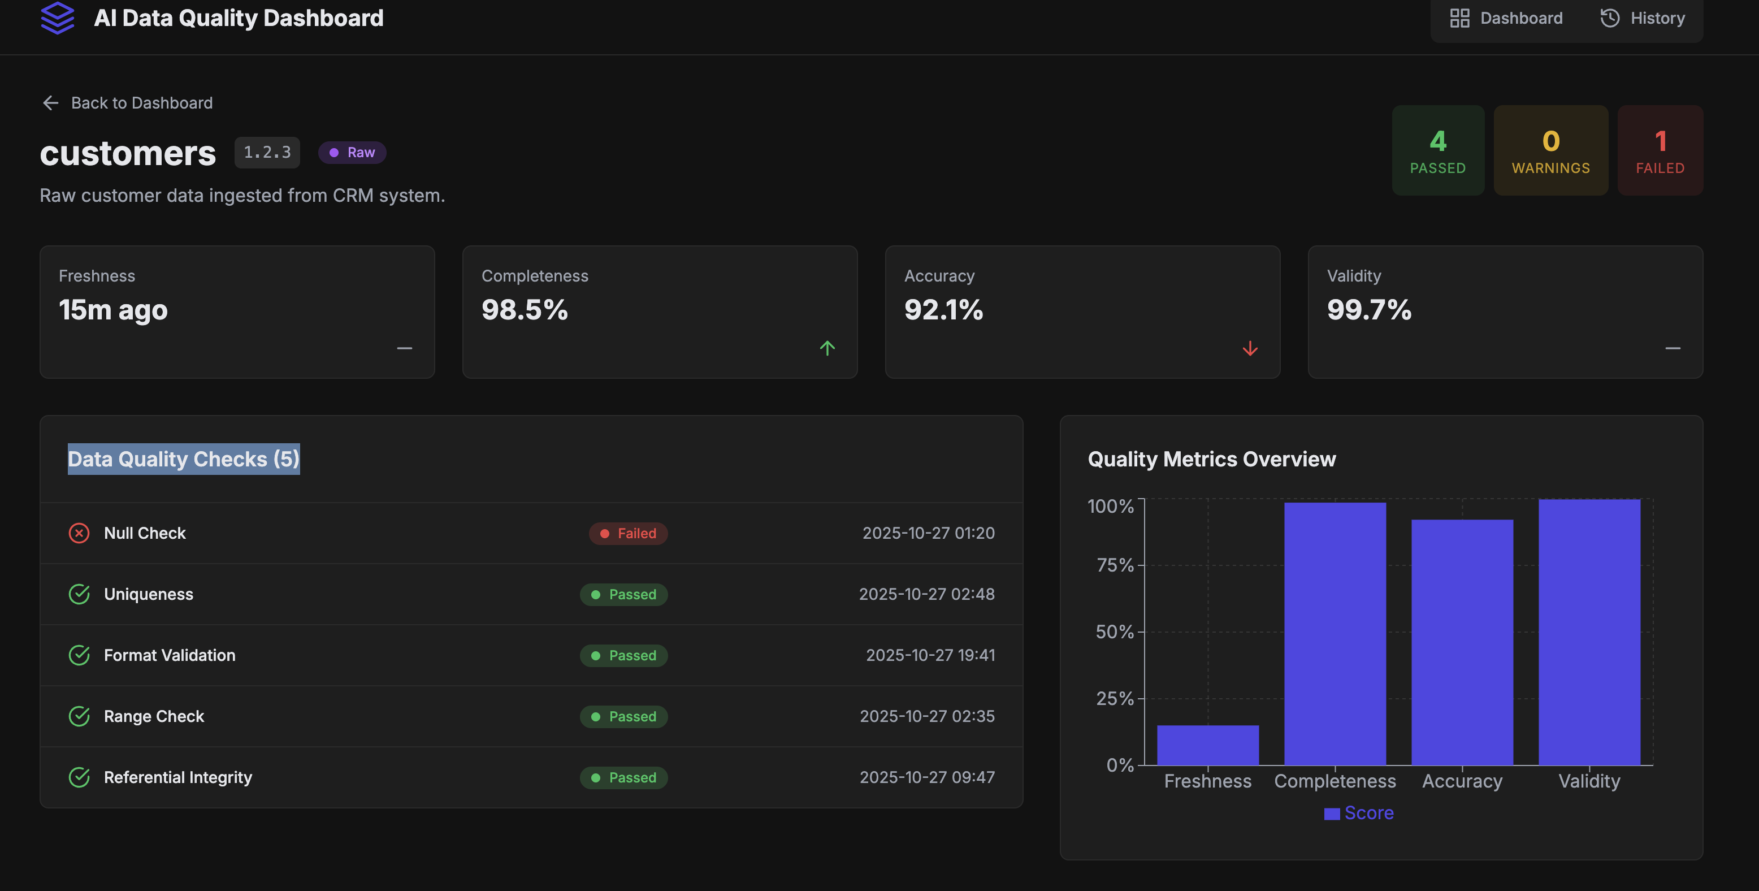
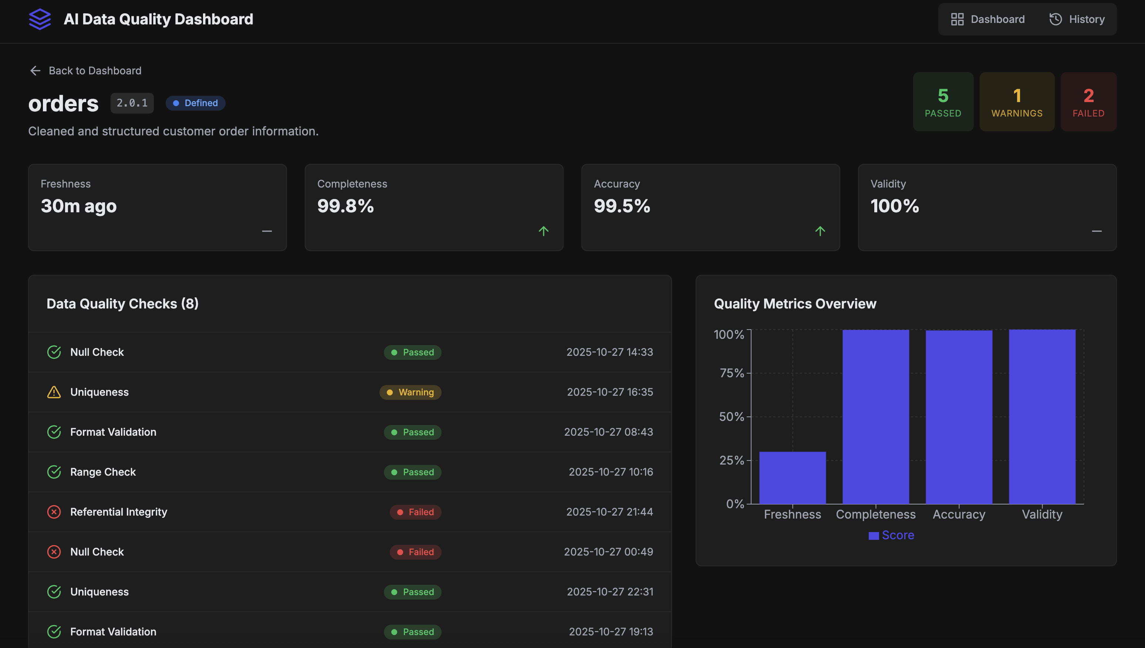
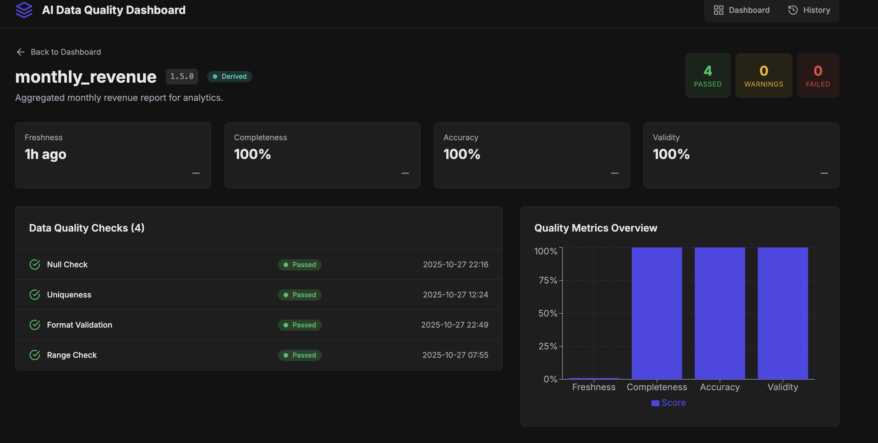
Demo and Example

Slide 6
Thank you
We learn a lot

