Slide 1


Ujama
Where parents help parents

Slide 2

Hugh Molotsi
Notes:
Innovator, Entrepreneur, Author
"The Intrapreneur's Journey - Empowering Employees to Drive Growth."
South African living in USA

Slide 3

About Us
Ujama helps parents help one another. We promote more joy and fewer logistics through the power of community, friendship and teamwork.
The name comes from the Swahili word ujamaa which means extended family.

Slide 4





Features
Find Your Village
PlayDates
Get The Kids a Ride
BabySitting
Give and Get Karma
Find and add Trusted Parents from your own contacts, school, neighborhood and extracurricular programs.
Ujama makes it easy to get the families together.
Take turns giving the kids a ride with other Trusted Parents. Discover who may be headed in the same direction.
Take turns babysitting with other Trusted Parents.
Ujama Karma Points make it easy to ask and give. Redeem for rewards, and earn or purchase more when running low.
Notes:
Never miss pickup
Get a schedule and notifications for upcoming playdates, carpools and babysitting.

Slide 5
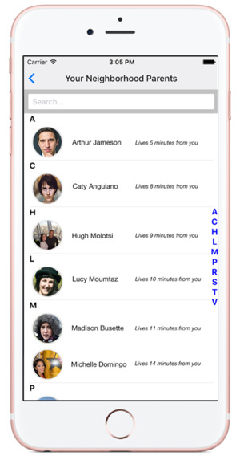
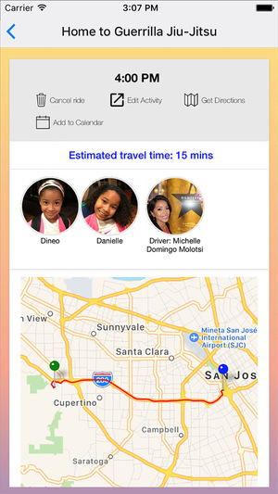
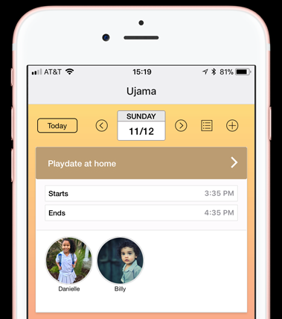

Mobile App Template
Parent Search
Location Search
Play Date Schedule

Slide 6


