Slide 1

Help YourShelf
By: Esther Farkas And Jade Marte

Slide 2
Description
My partner and I, are always looking for specific movie with a certain type of description or background. So we decided to create “Help YourShelf” where the webpage will classify the genre of the movie, helping the user find more they might be interested.
We are using natural language processing to come up with algorithim to predict the genre.

Slide 3
Goal
The goal of this webpage is to allow the user to give a description of what movie they like the webpage will choose and predict the genre.
In the future if possible, the same application will be used for books, and for other movies.

Slide 4
Features
Utilizing what we learnt in HW7, we created a model that uses MultinomialNB and Random Forests to classify the overview of the movie.
The CSV we are using is from Kaggle and it contains 2000 movies and tv shows, with their overviews and genres included.
We created a pipeline to trim the overviews- lowercase, stemming, removing stopwords etc.

Slide 5
Future Features and Corrections
Stemming the words also removes the end of some words
Dataset
The dataset is rather small so it might be helpful to find a bigger dataset
The overviews are short, making it difficult for the computer to gather enough information
Movies are subdivided by multiple genres, giving the computer too many categories and not enough concrete information
Potential Fixes: different datas sets, utilizing a list to search through combinations of genres.

Slide 6
Modivation

Slide 7
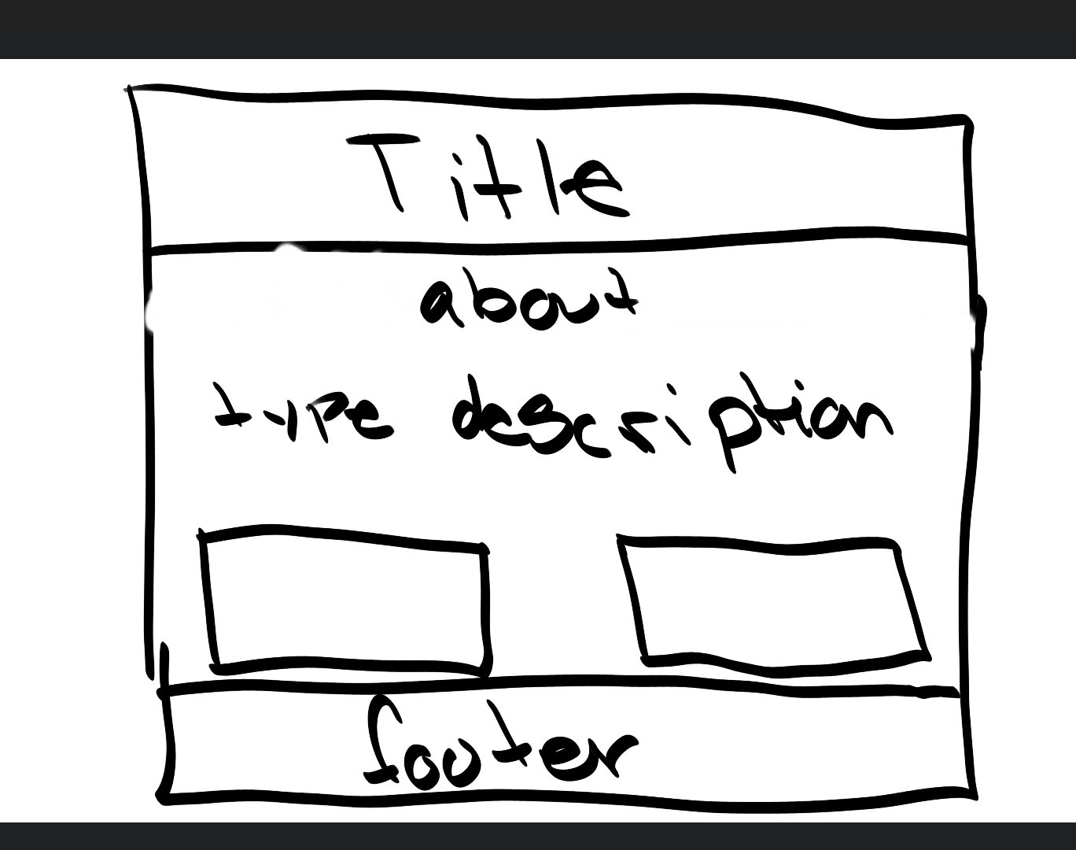
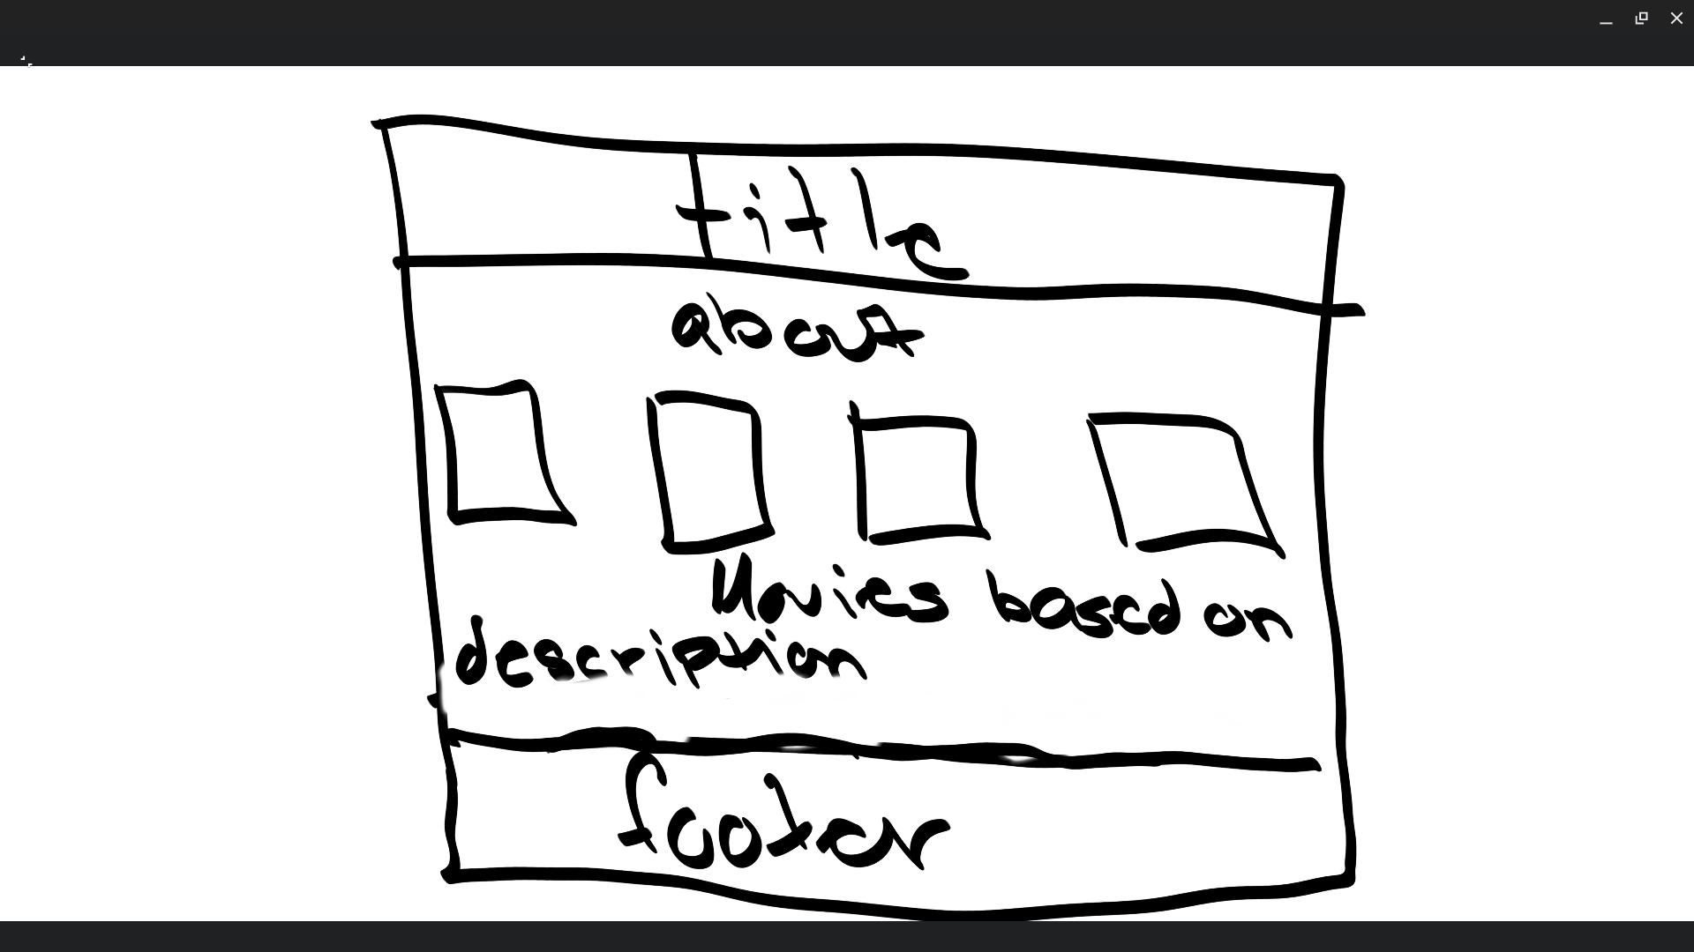
Visual plan
Before processing the description
After processing the description

