Slide 1

PowerPoint Outline: Uber Fares Dataset
Analysis
Title:
Uber Fares Dataset Analysis
Subtitle:
Course: Introduction to Big Data Analytic (INSY 8413)
Instructor: Eric Maniraguha
Date: July 2025
Student: Ishimwe Esther
Group:E
Introduction
Project overview: Analyze Uber fares to uncover fare patterns and trends.
Objective: Build an interactive Power BI dashboard.
Data-driven insights to support business decisions.
Methodology – Data Preparation
Downloaded dataset from Kaggle (uber.csv)
Loaded & cleaned in Python (pandas)
Removed missing values and unrealistic fares
Exported:

Slide 2
uber_fares_cleaned.csv
screenshot of your Python notebook or code
import pandas as pd
print(" Step 1: Load dataset")
# a) Load dataset
df = pd.read_csv('uber.csv')
print(" Loaded dataset")
print("Shape:", df.shape)
print("Columns:", df.columns.tolist())
print("Data types:\n", df.dtypes)
print("\n Step 1c: Initial data quality check") print("Missing
values per column:\n", df.isnull().sum()) print("\nDescriptive
statistics:\n", df.describe(include='all'))
# d) Handle missing values and remove invalid data
print("\n Step 1d: Clean data")
df_cleaned = df.dropna(subset=['fare_amount', 'pickup_datetime'])
df_cleaned = df_cleaned[df_cleaned['fare_amount'] > 0]
print("New shape after cleaning:", df_cleaned.shape)
print("Missing values after cleaning:\n", df_cleaned.isnull().sum())
# e) Export cleaned dataset
df_cleaned.to_csv('uber_fares_cleaned.csv', index=False)
print(" Exported: uber_fares_cleaned.csv")
# 3 Feature Engineering
print("\n Step 3: Feature engineering")
# Convert pickup_datetime
df_cleaned['pickup_datetime'] = pd.to_datetime(df_cleaned['pickup_datetime'], errors='coerce')
df_cleaned = df_cleaned.dropna(subset=['pickup_datetime'])
# Add new columns
df_cleaned['hour'] = df_cleaned['pickup_datetime'].dt.hour
df_cleaned['day'] = df_cleaned['pickup_datetime'].dt.day
df_cleaned['month'] = df_cleaned['pickup_datetime'].dt.month
df_cleaned['weekday'] = df_cleaned['pickup_datetime'].dt.weekday
# Peak hours flag
peak_hours = [7,8,9,16,17,18]
df_cleaned['is_peak'] = df_cleaned['hour'].apply(lambda x: 1 if x in peak_hours else 0)
print(" Added features: hour, day, month, weekday, is_peak")
print("Columns now:\n", df_cleaned.columns.tolist())
# Save enhanced dataset
df_cleaned.to_csv('uber_fares_enhanced.csv', index=False)
print(" Exported: uber_fares_enhanced.csv")
print("\n DONE! Your cleaned and enhanced datasets are ready for Power BI")
Methodology – Feature Engineering
Extracted: Hour, day, month, weekday
Created:is_peak feature for peak vs non-peak hours
Prepared dataset for visualization

Slide 3
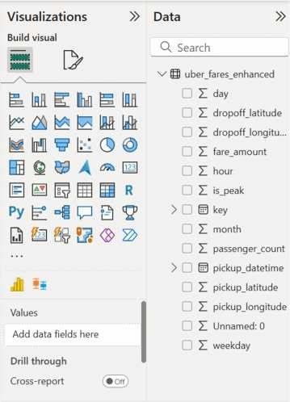
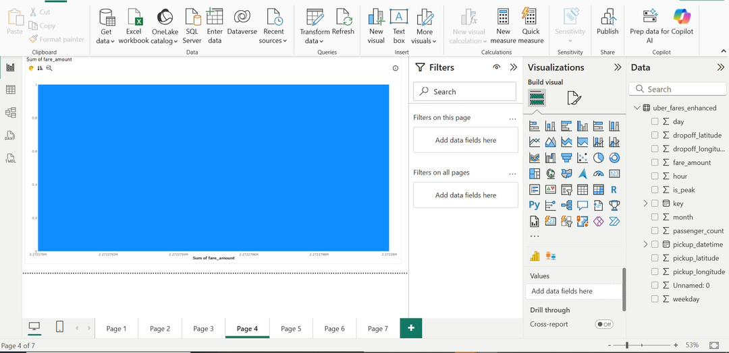
screenshot of dataset columns in Power BI
Visual: histogram or boxplot of fare_amount
Visual Analysis in Power BI

Slide 4
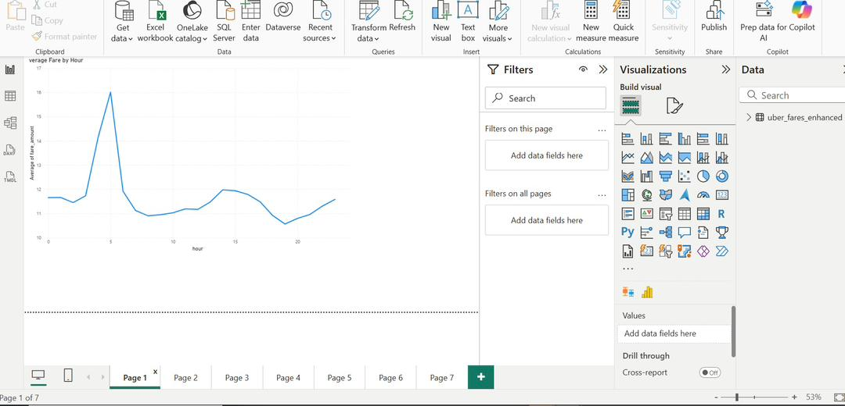
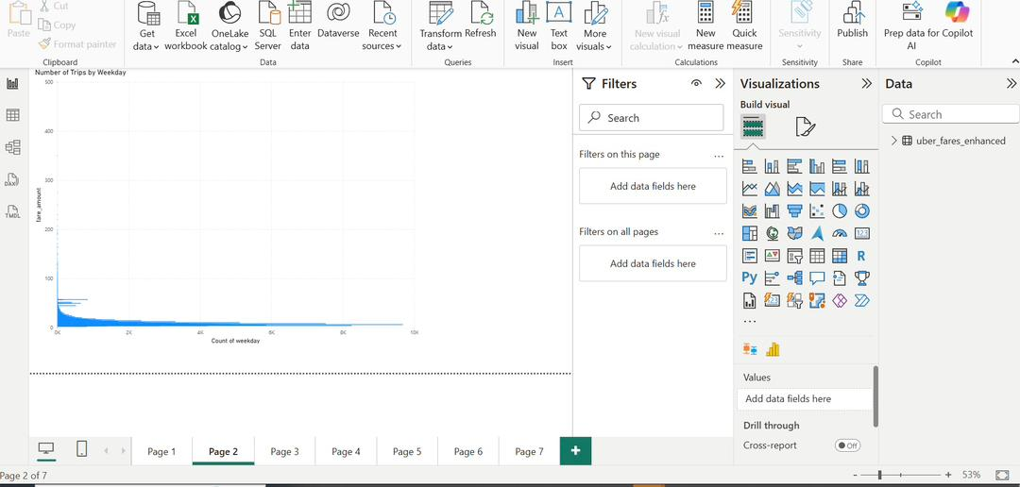
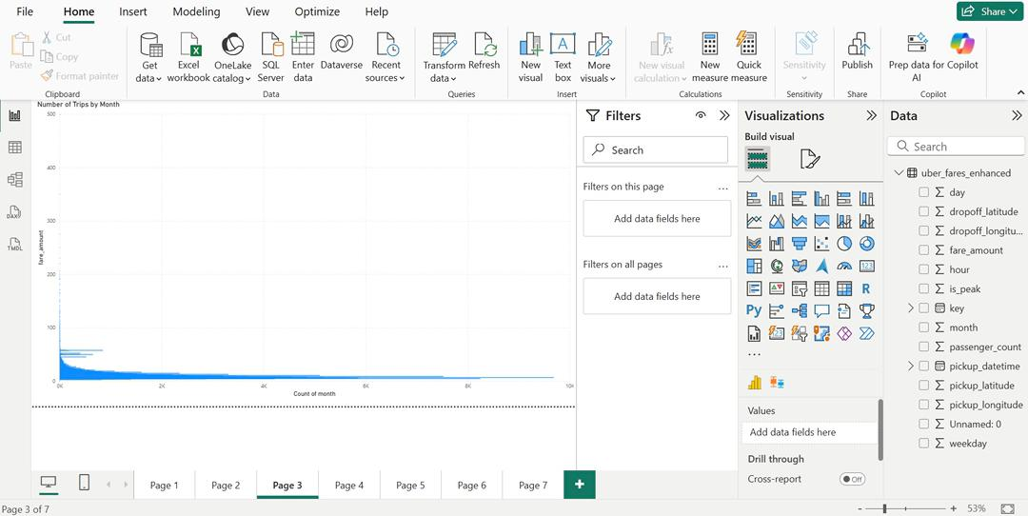
Line chart: average fare by hour
Bar chart: trips by weekday & month

Slide 5
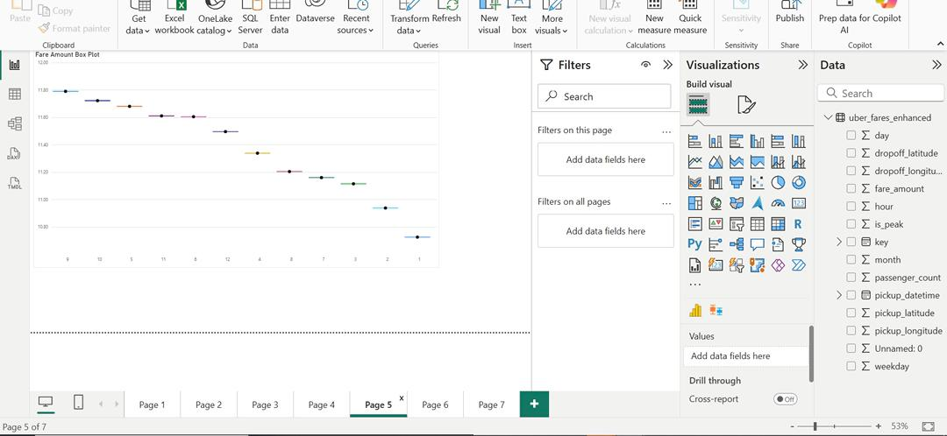
Map: pickup location
Results – Key Findings
Peak hours → higher average fares
More trips on Fridays & weekends
Dense pickup clusters around city center & airports
Clear seasonality in monthly patterns
Conclusion
Builtcleaned & enhanced dataset
Handled missing values & removed outliers
Added analytical features: hour, day, month, weekday, peak/off-peak
� Created interactive Power BI dashboard
Visualized fare patterns (histograms, box plots, time series)
Added filters & drill-downs for deeper exploration
� Identified key patterns
Higher fares during morning & evening peak hours

Slide 6
More trips on Fridays & weekends
Hotspots around airports & downtown areas
� Design suggestion
Title: Conclusion (bold, large font)
3 sections with small icons
Optionally add
Screenshot of dashboard (right side)
Footer: “Uber Fares Dataset Analysis | July 2025”
Recommendations
Use surge pricingin peak hours
Maximize revenue by adjusting fares during morning
evening rush hours
and
Focus marketing on high-demandareas
Target areas with high ride frequency, like city centers
and airports
Add external data (weather/events) for deeper analysis
Incorporate weather, holidays, and events to improve
demand forecasting
Tip
Use 3 bullet points only (as above) for clarity
Add icons (clock for surge, pin for location, cloud for weather) to make it
visual
Use green checkmark or colored icons to draw attention

