Slide 1
Group: GADE
Building a secondary school management System
Members: David Asante-Asare[Project manager], Esther Mensah [Front-end], Vanessa Adjei[Database], George Arthur [Back-end].

Slide 2

Presentation Outline
Background information on topic
Architecture and design
Implementation
Demo

Slide 3

BACKGROUND
Gade Central School is a secondary school in Ghana that needs help managing its operations as file based management system is bulky.
Functionalities
-Track Admission status of students who apply to attend the school.
-Track the boarding Info of Students
-Track teaching staff, non-teachingstaff and student info
-Track the registration of courses
-Track attendance and payment of fees of students

Slide 4

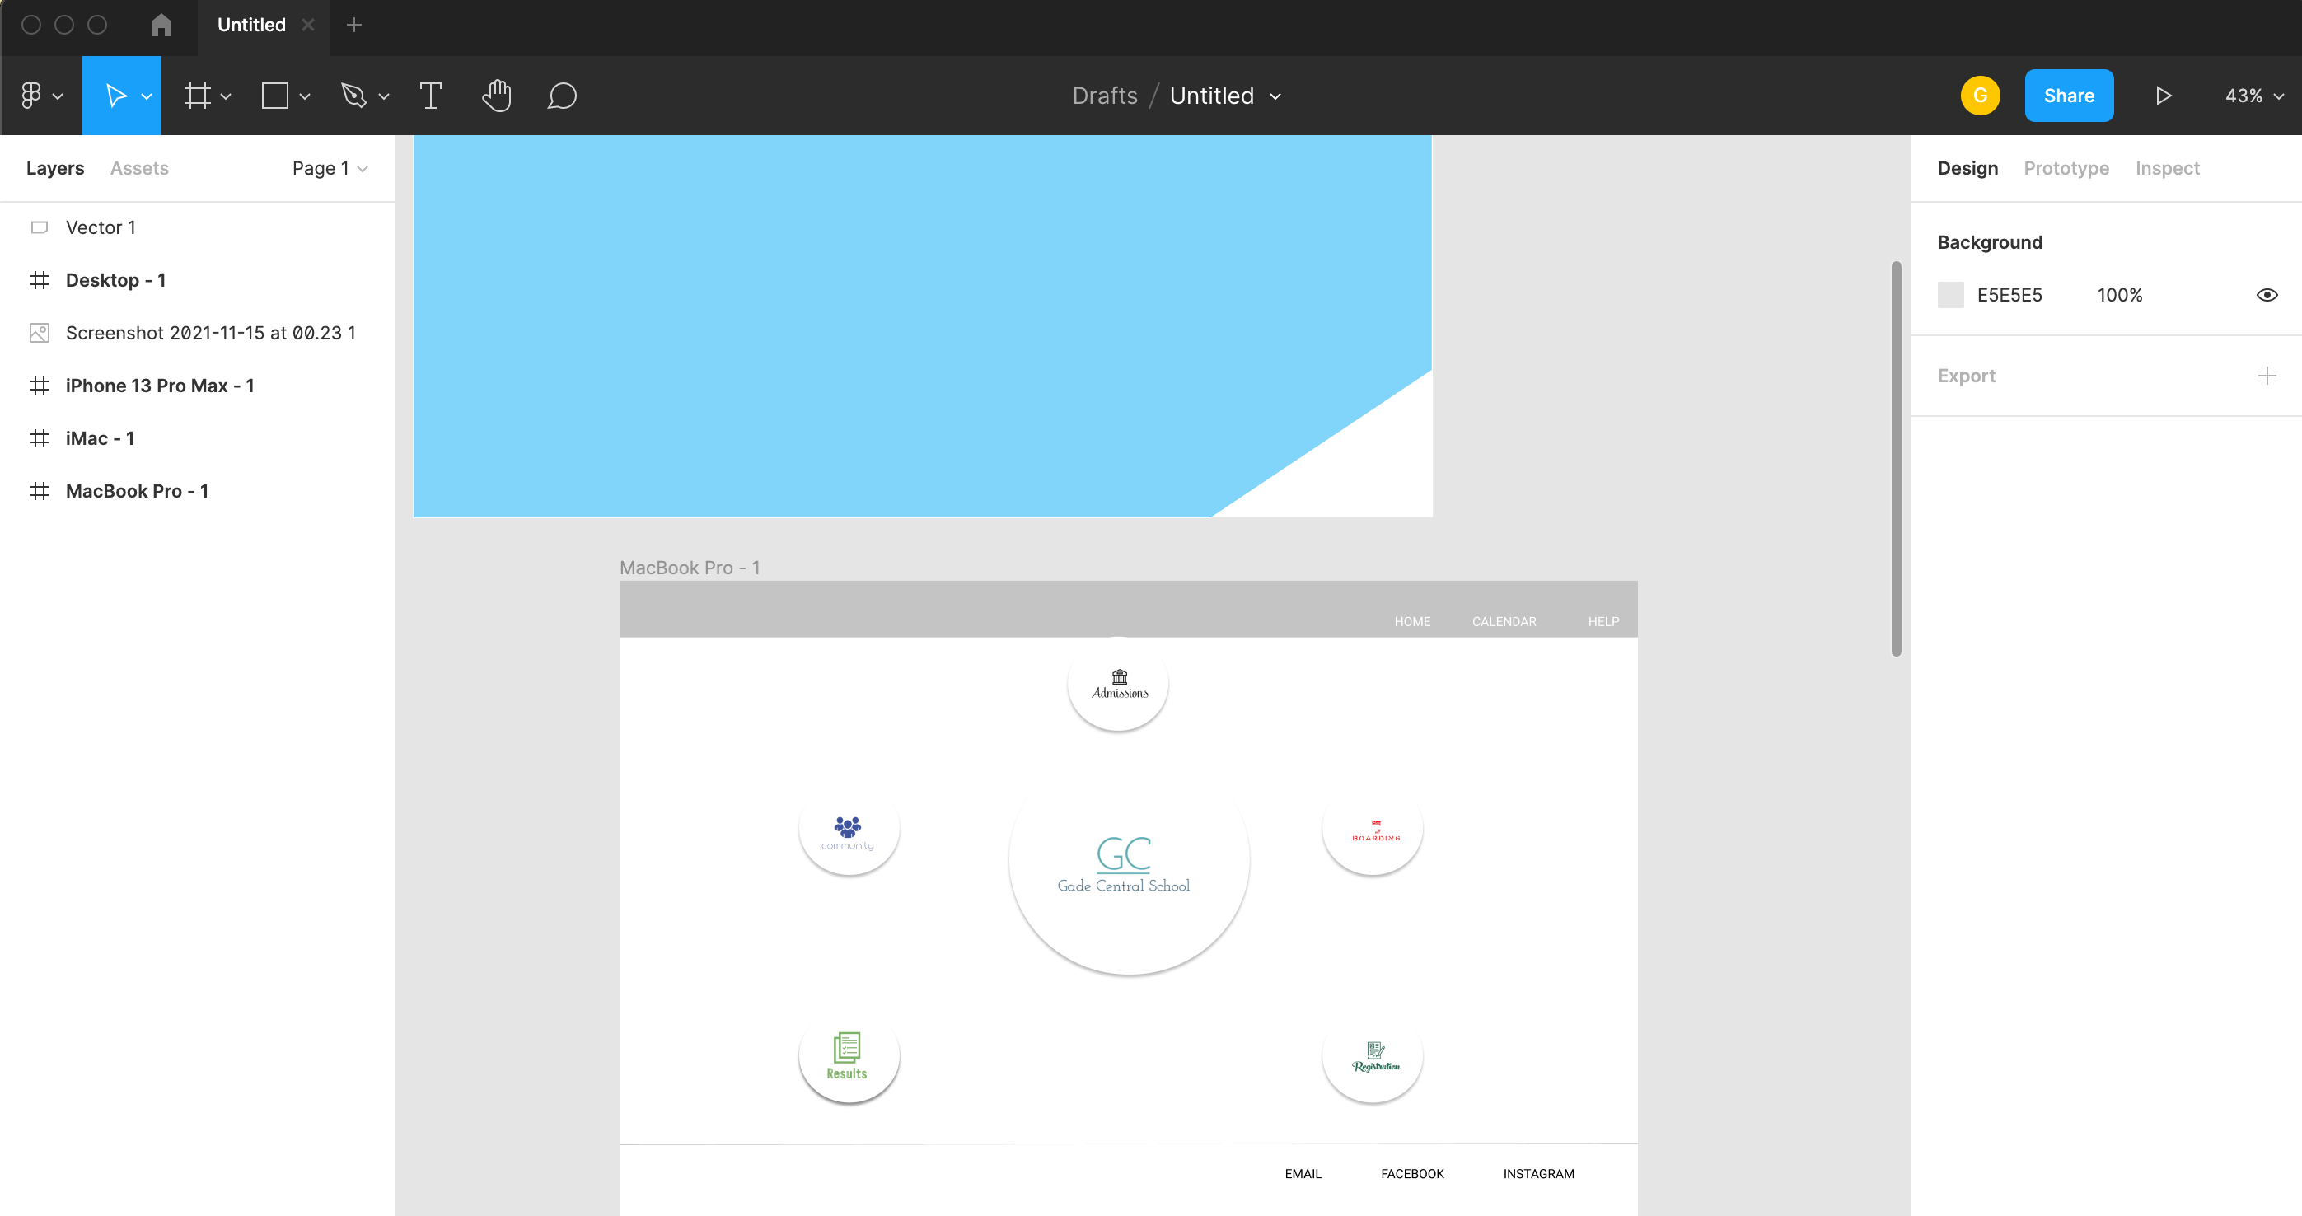
Architecture and Design
Initial Design using figma

Slide 5
Three Tier Architecture
Presentation Tier
CSS,HTML,Bootstrap
Application/Logic Tier
Php, JavaScript
Data Tier
Database: MySQL

Slide 6
Implementation Flowchart
Sign-Up
Login
Boarding
Community
Teaching Staff
Home
Students
Non-Teaching Staff
Course Registration
Admissions
Results

Slide 7
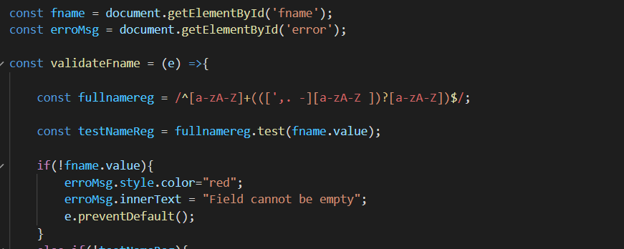
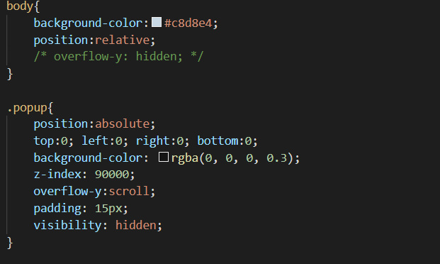
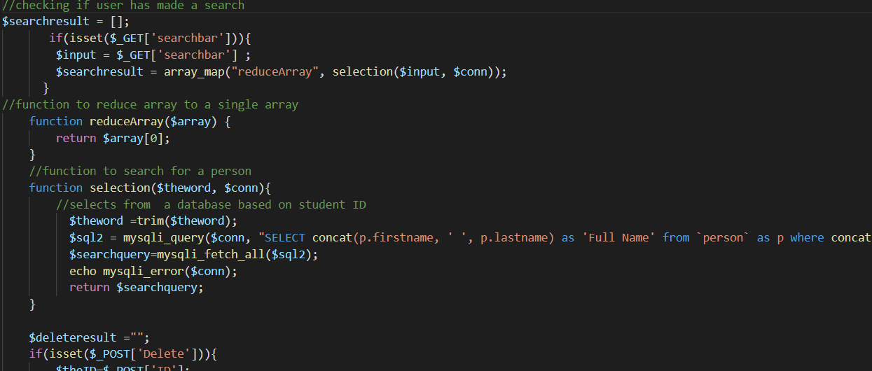
Snippets of Code Used

