Slide 1
Team 1:
Place Recognition
Derek Reiersen, Esther Vasiete, Shuzhe Zhang,
Kelly Kaoudis, Margaret Wheeler, Jeeeun Kim

Slide 2
Project Overview
Place recognition with two different methods
- Bag of Words with SIFT descriptors
- Features extracted from Convolutional Neural Network
Classify with One-Against-All SVM
Test for loop closure on Malaga Urban Dataset
Test for loop closure on custom local Boulder university urban campus dataset (clbuucd)

Slide 3
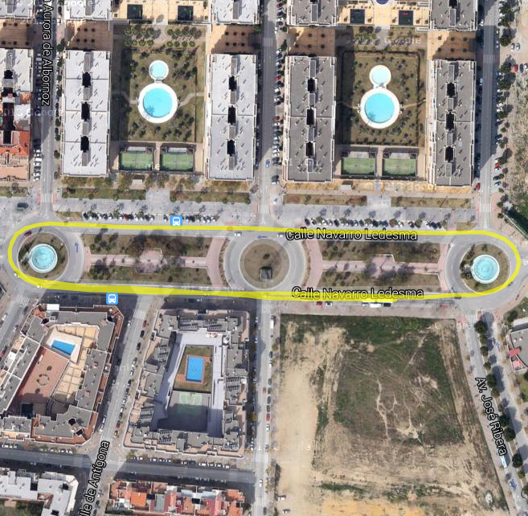
Malaga Urban Dataset Extract #7
“Short avenue loop closure”
~1700 raw stereo images
Dataset also includes camera data, GPS data, LIDAR data
Use left camera and GPS data
- camera for place recognition
- GPS data to visualize path and loop closure
http://www.mrpt.org/MalagaUrbanDataset

Slide 4
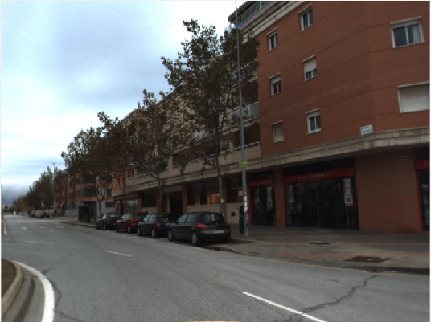
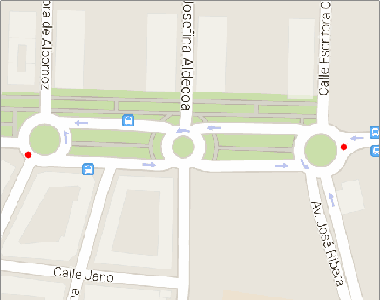

Slide 5
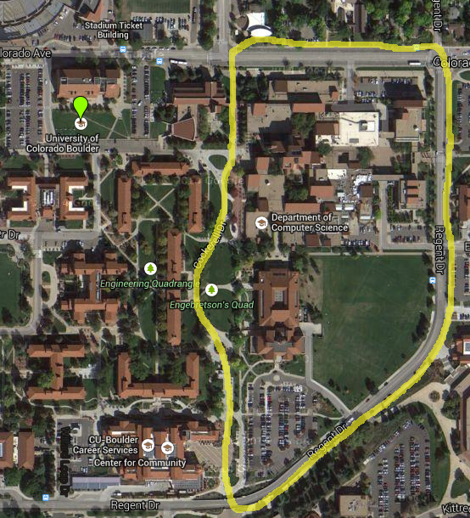
Campus Dataset, clbuucd
Short walking loop closure
248 images
Images distance ~22 ft
two complete loops
GPS data, mono images
Greater challenge than
Malaga Urban Dataset
- People in images
- Walking, not driving
- Fewer images overall

Slide 6
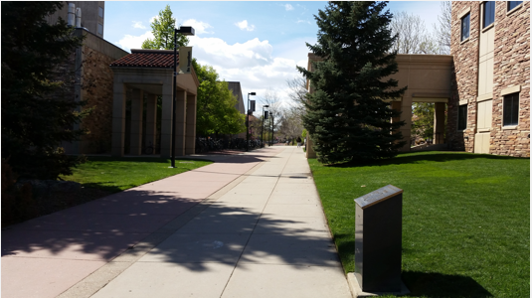
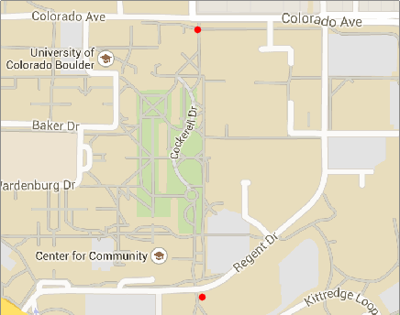

Slide 7
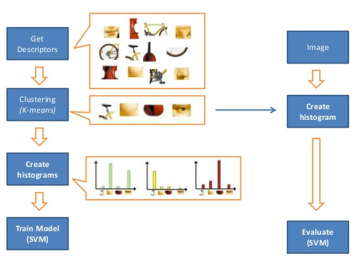
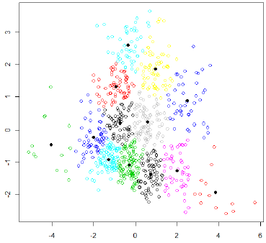
Method 1: Bag of Words
Def: treat an image like a text document, break up into visual “words”
Detect and extract dense SIFT feature descriptors
Normalize feature descriptors
K-Means clustering to create pictorial codebook
Create histogram(s) of visual words

Slide 8
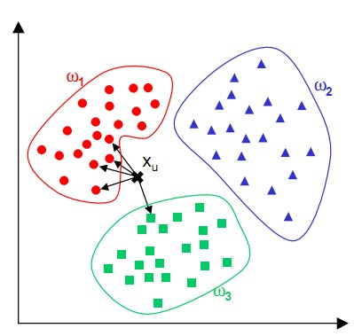
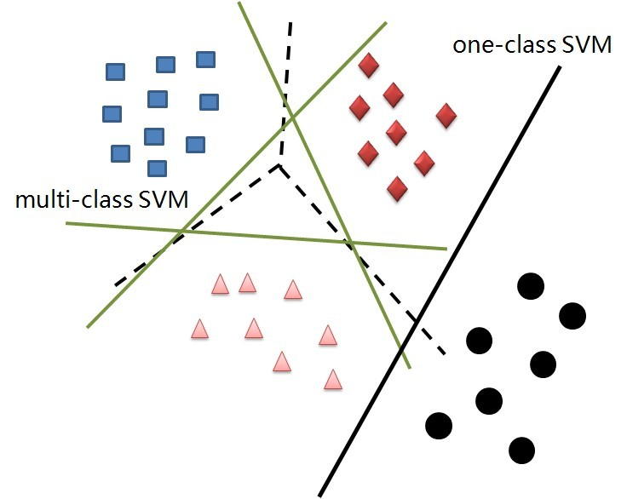
Bag of Words, continued
Use One-Against-All SVM to classify
K-Nearest Neighbours
(Video Google)
SVM
(Team 1)
Notes:
ADD IPCTURE HERE

Slide 9
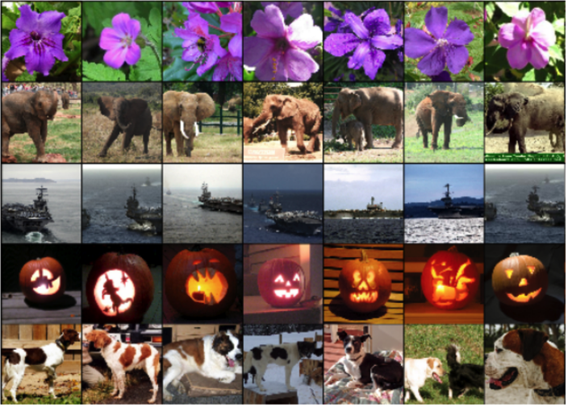
Method 2: CNN feature extraction
OverFeat
CNN =
image classifier,
feature extractor
Trained with the
Torch7 package on
the Imagenet
dataset
Linux only...

Slide 10
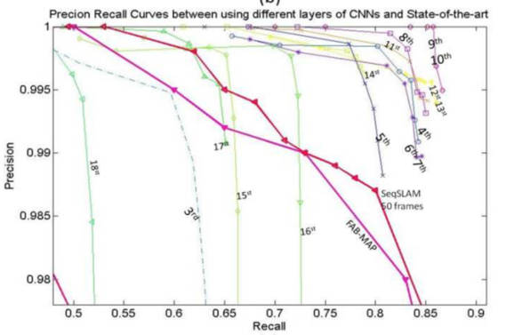
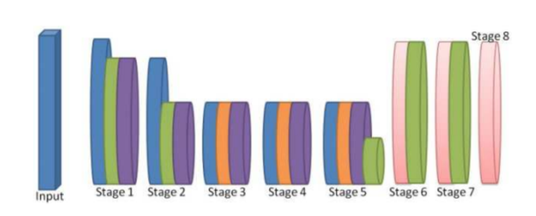
CNN features, continued
Feature: vector describing “pictorial word”
Extract features from layers 10 and 21
Convolutional Neural Network Based Place Recognition; Chen et al.

Slide 11
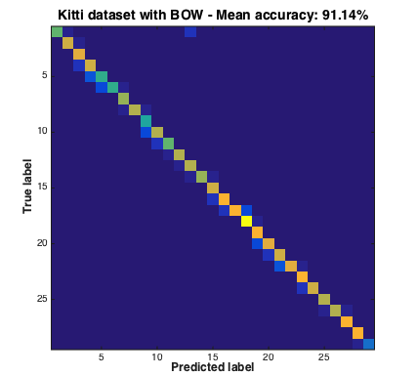
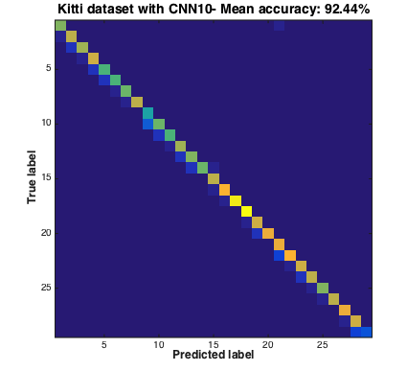
Confusion Matrices: Malaga Dataset

Slide 12
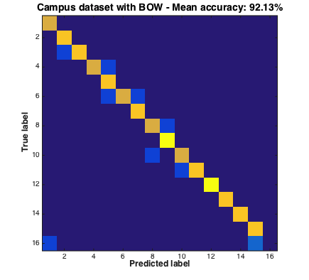
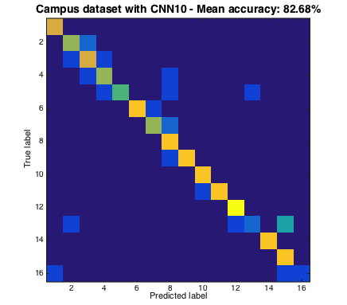
Confusion Matrices: clbuucd Dataset

Slide 13
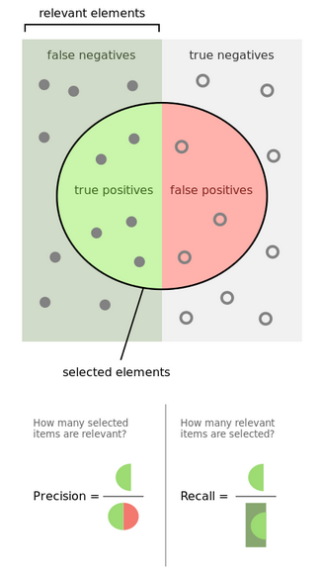
Precision-Recall Curve
How well does the model separate the classes?
Recall =
num relevant elements retrieved / num relevant elements overall
Precision =
num relevant elements retrieved / total # elements retrieved

Slide 14
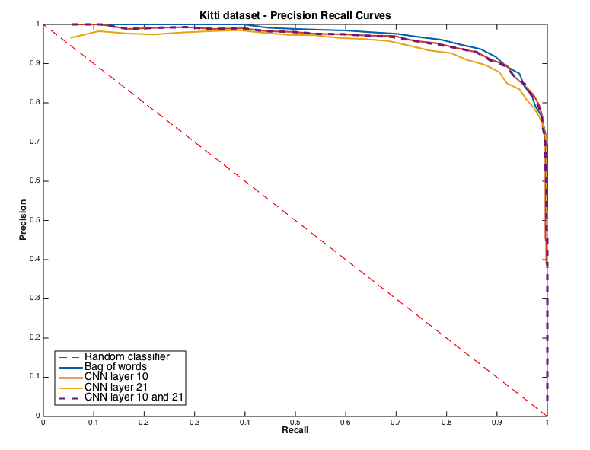
Malaga Precision-Recall

Slide 15
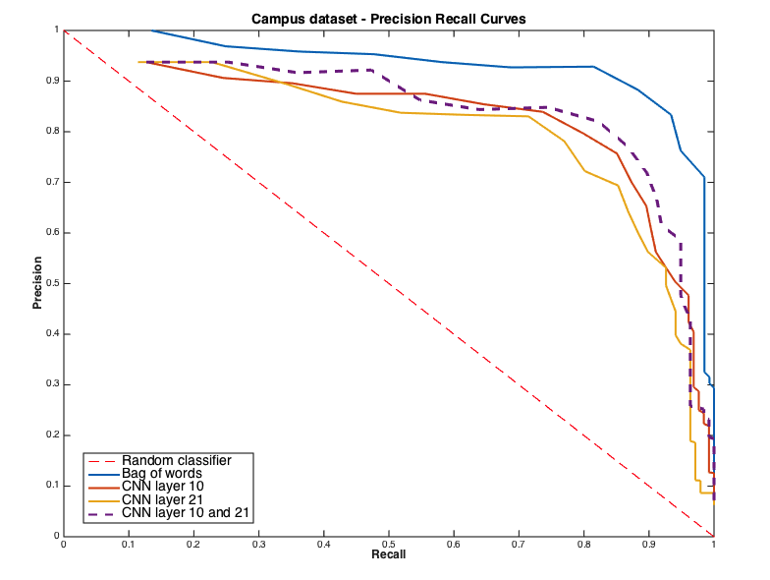
cluubcd Precision-Recall

Slide 16
Neural network training experiment
We made a pre-trained neural network work, how about trying to train a CNN on our own data?
Caffe: deep learning framework out of UC Berkeley
Imagenet framework on Malaga Dataset Extract #7
- train on images from first loop
- classify on images from second loop
Results may likely improve with a larger dataset
http://caffe.berkeleyvision.org/

Slide 17
Results and Future Work
Video Google-style BoW worked well on our
small datasets
OverFeat features also worked well
Caffe needs a little work
Trying larger datasets?
Combinations of features from different CNN layers?
HoG and other kinds of descriptors?

Slide 18
Sources
Video Google: robots.ox.ac.uk/~vgg/publications/papers/sivic03.pdf
Overfeat: github.com/sermanet/OverFeat
CAFFE: caffe.berkeleyvision.org/
CNN-Based Place Recognition: http://arxiv.org/pdf/1411.1509.pdf

