Slide 1
StarHotel Final course project by Esti Rabino & Omer Sroya

Slide 2
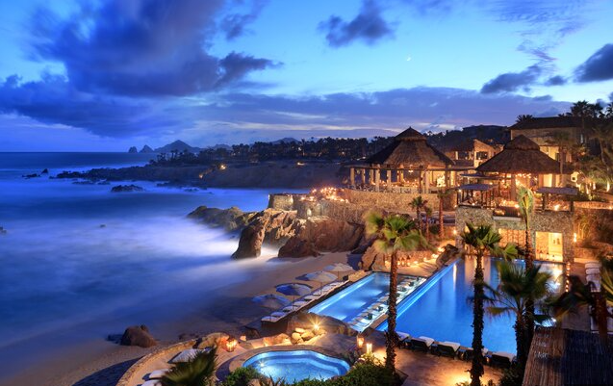
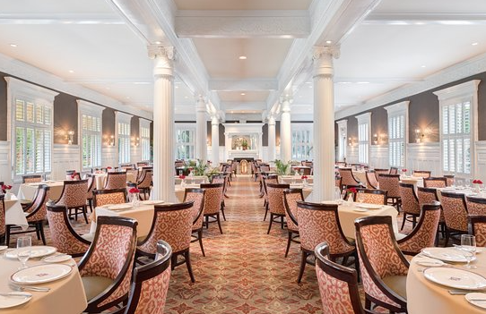

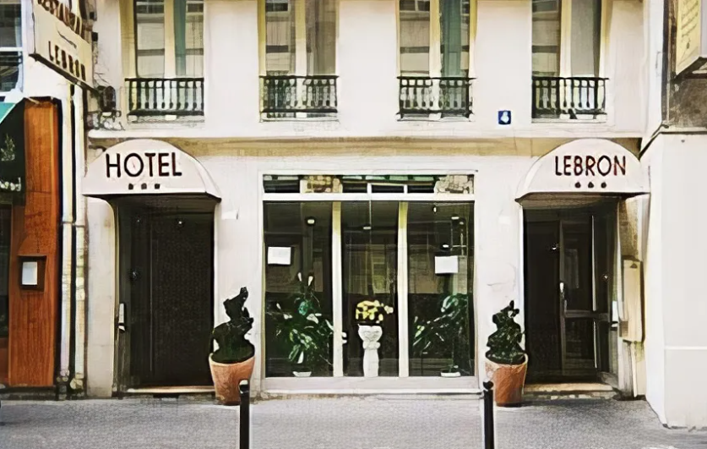


Is it possible to predict the level of a hotel given its facilities and the provided services?

Slide 3
4-STEPS PROCESS MODEL
Data acquisition
Data cleansing
01
02
EDA
Machine Learning
03
04
Crawling
Handle missing data, duplicates, Outliers, Data type casting
Visualization and Exploratory Data Analysis
KNN, Decision tree

Slide 4
Data acquisition
*Find source with a lot of data – Booking.com
*Extract hotel with its details, facilities and services
*Choosing which geographic area to focus on - First we chose Paris but we were worried that we might not reach 50K data… So, we expanded the choice to more cities in France And then we got enough data ☺

Slide 5
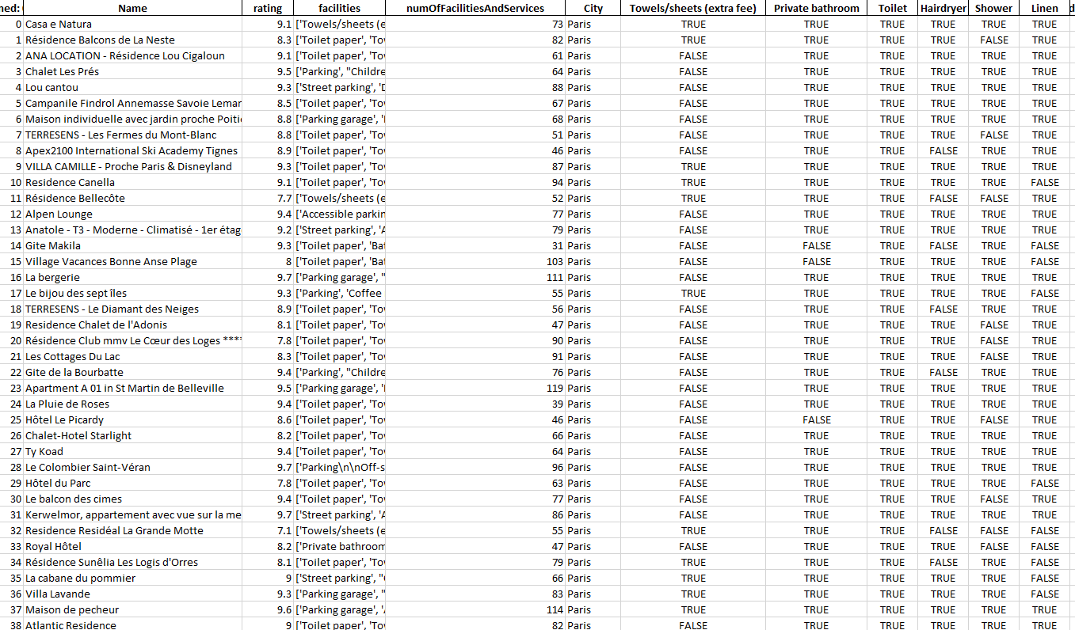
2.5M!!!!!!!!!!!!!!!!
More than …

Slide 6
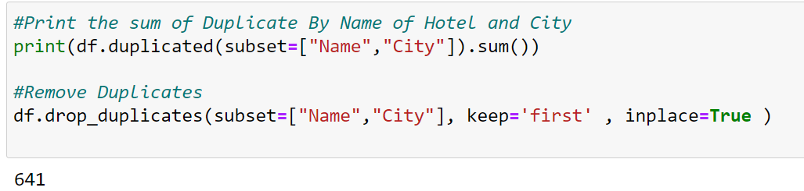

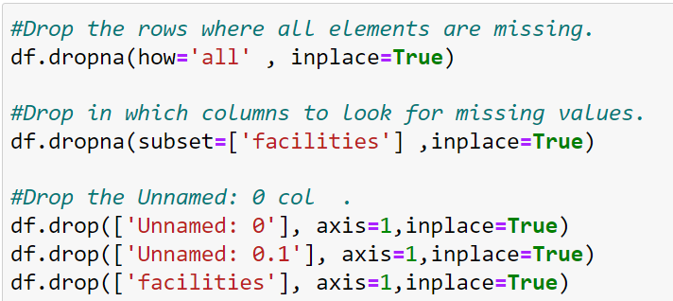
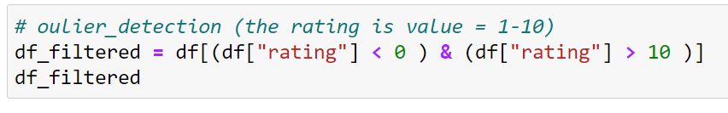
Data cleansing
*Data type casting
*Outliers
*Remove Duplicates
*Handle missing data

Slide 7
After the actions in the previous slide we got data frame with 4584 rows and 533 columns ~ 2,400,000
We realized that 533 columns is a huge number many of them are used by a low number of hotels. We decided to reduce this number and the final data frame included 4584 rows and 167 columns

Slide 8
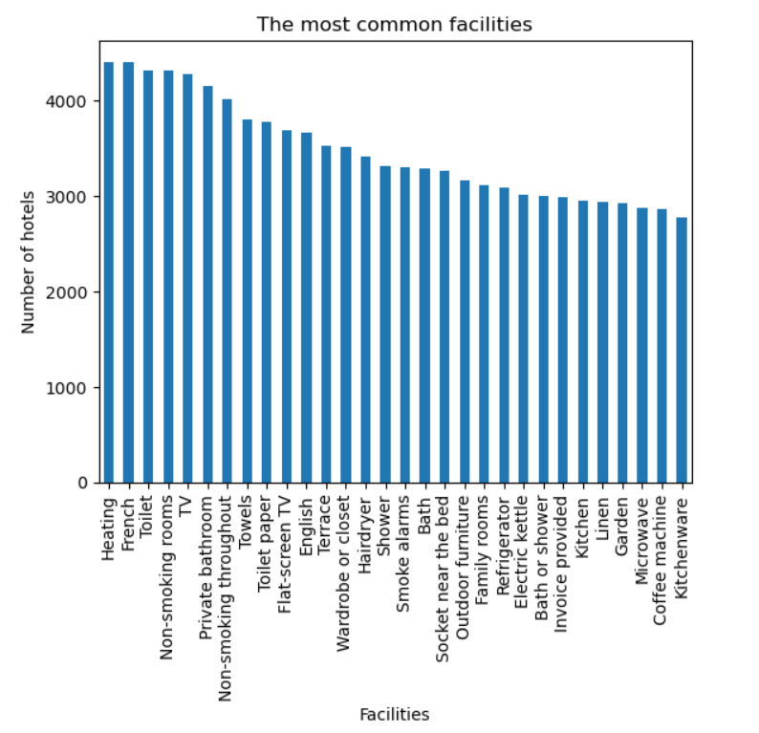
EDA
Here we can see the 30 most common facilities

Slide 9
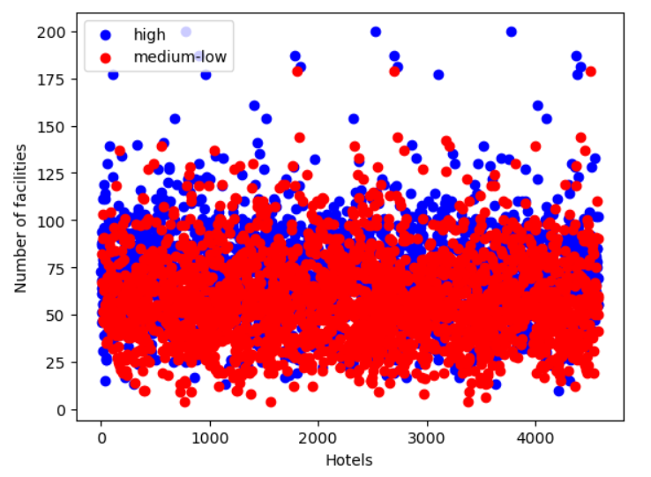
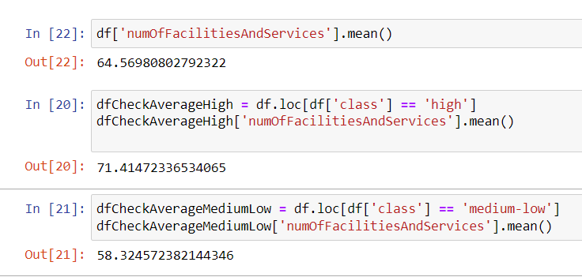
Here we can see a two-dimensional graph
There is no unequivocal conclusion, but we can see a slight tendency that hotels with the highest number of facilities are classified high class.
(and the hotels with the lowest number of facilities are classified as medium-low)
Averages:

Slide 10
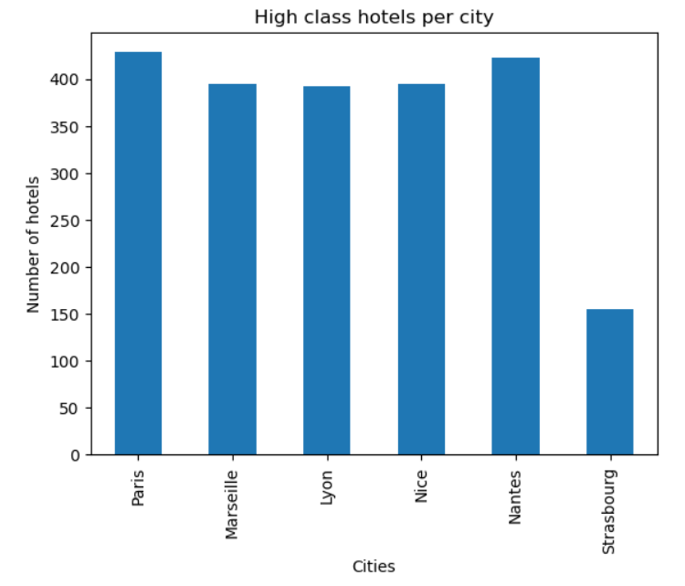
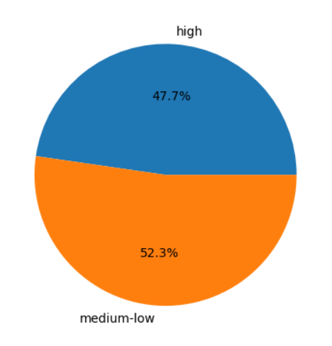
Here we can see the hotels distribution in all the tested cities

Slide 11
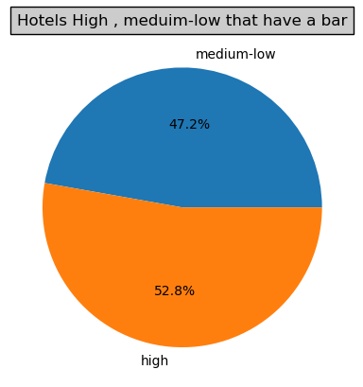
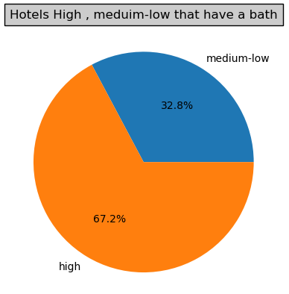
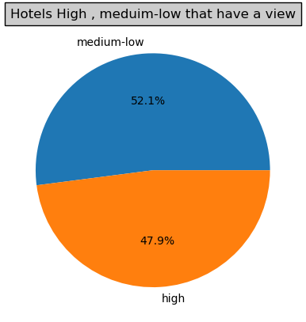

Slide 12
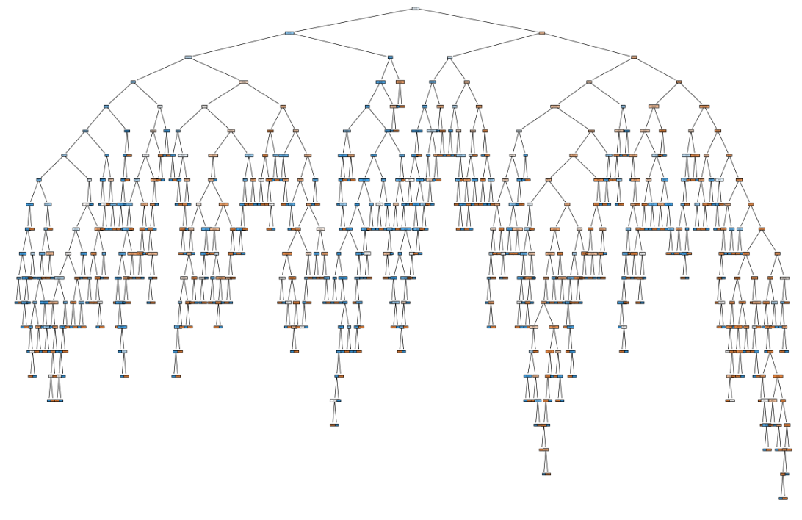
Machine Learning Decision tree & KNN
*Train Model
*Test Model
The accuracy score for the decision tree is: 0.8909487459105779
The accuracy score for the KNN is: 0.7535441657579062

Slide 13
Thank you!

