Slide 1
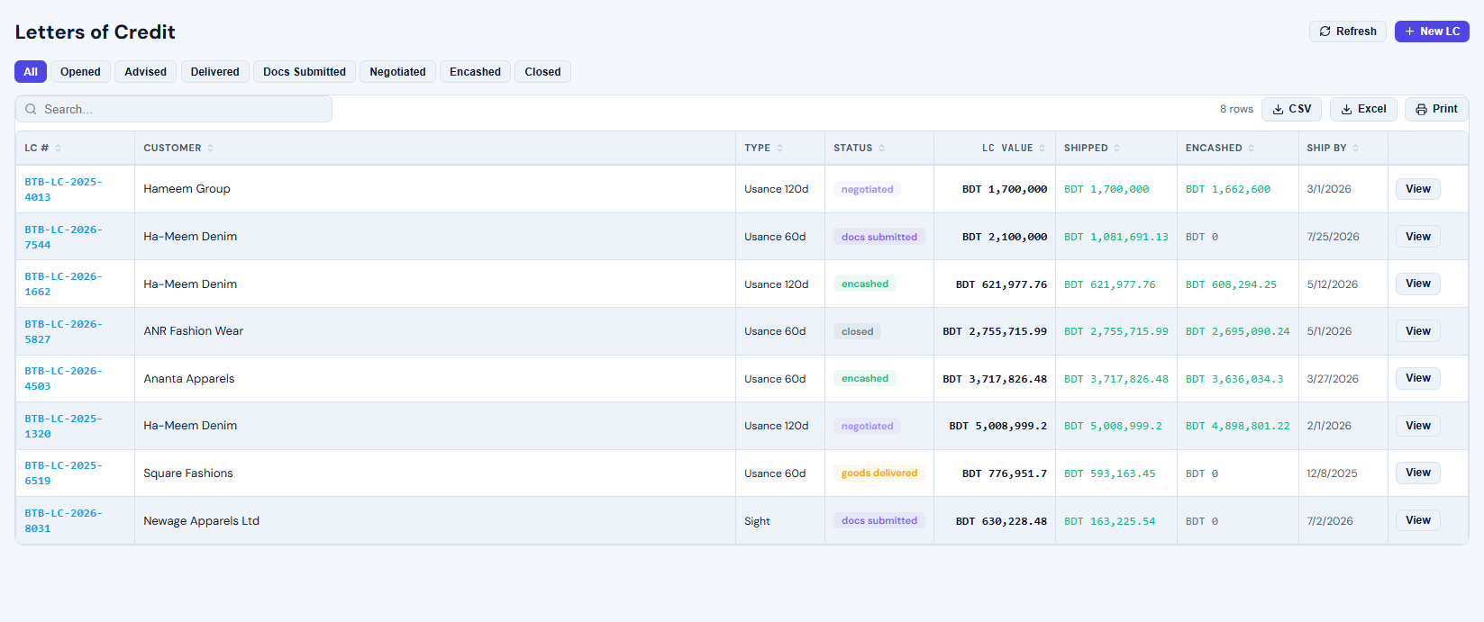
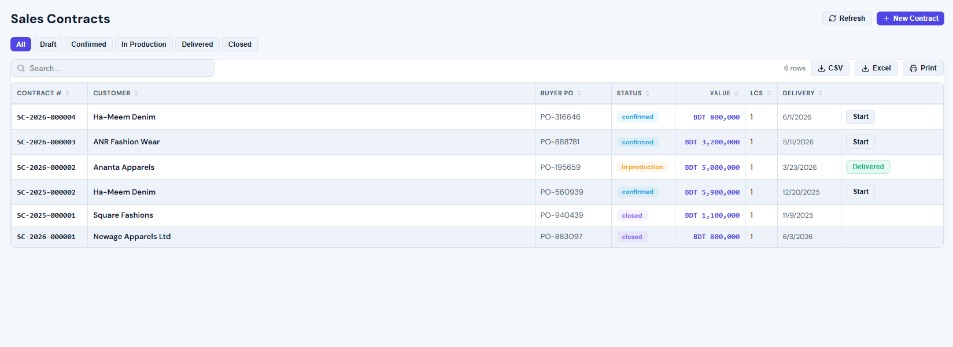
Trade Finance Training
Sales Contracts এবং Letters of Credit (LC)
Instructor deck for student class: screen flow, field meaning, demo script and practice tasks.
Buyer PO
Contract
LC
Shipment
Encash
Eden Resources ERP · Trade Finance
Notes:
Source: user-provided Eden Resources ERP screenshots. Title slide introduces end-to-end flow.

Slide 2
আজকের ক্লাসের লক্ষ্য
শিক্ষার্থীরা যেন পুরো Trade Finance workflow হাতে-কলমে করতে পারে
• Sales Contract list পড়া ও status filter ব্যবহার • New Contract form পূরণ করা • Letter of Credit list পড়া: value, shipped, encashed, ship-by • LC detail-এ delivery, charge, amendment এবং document add করা • Sight বনাম Usance payment timing বোঝা
Eden Resources ERP · Trade Finance
Notes:
Source: user-provided Eden Resources ERP screenshots. Learning goals based on visible screens.

Slide 3
Module Map: Order থেকে Cash
Business story আগে বলুন, তারপর screen demo করুন
১
২
৩
৪
৫
৬
৭
Buyer PO
Sales Contract
LC Opened/Advised
Shipment / Delivery
Docs Submitted
Negotiation / Encashment
Close
• Sales Contract হলো commercial order record • LC হলো bank-backed payment record • Delivery/Shipped amount বাড়লে LC progress দেখা যায় • Encashed amount ও bank charges final realization বুঝতে সাহায্য করে
Eden Resources ERP · Trade Finance
Notes:
Source: user-provided Eden Resources ERP screenshots. Conceptual flow prepared from the uploaded screenshots.

Slide 4
Sales Contracts List পড়া
প্রতিটি row একটি buyer-wise contract
Trainer points
• Filter: All / Draft / Confirmed / In Production / Delivered / Closed • Contract #, Customer, Buyer PO — primary identifiers • Value এবং Delivery Date দেখে priority বুঝুন • LCs column দেখে contract-এর সঙ্গে কয়টি LC linked আছে • Start / Delivered action দিয়ে operational progress দেখান
Eden Resources ERP · Trade Finance
Notes:
Source: user-provided Eden Resources ERP screenshots. Screenshot shows Sales Contracts table with filters and actions.

Slide 5
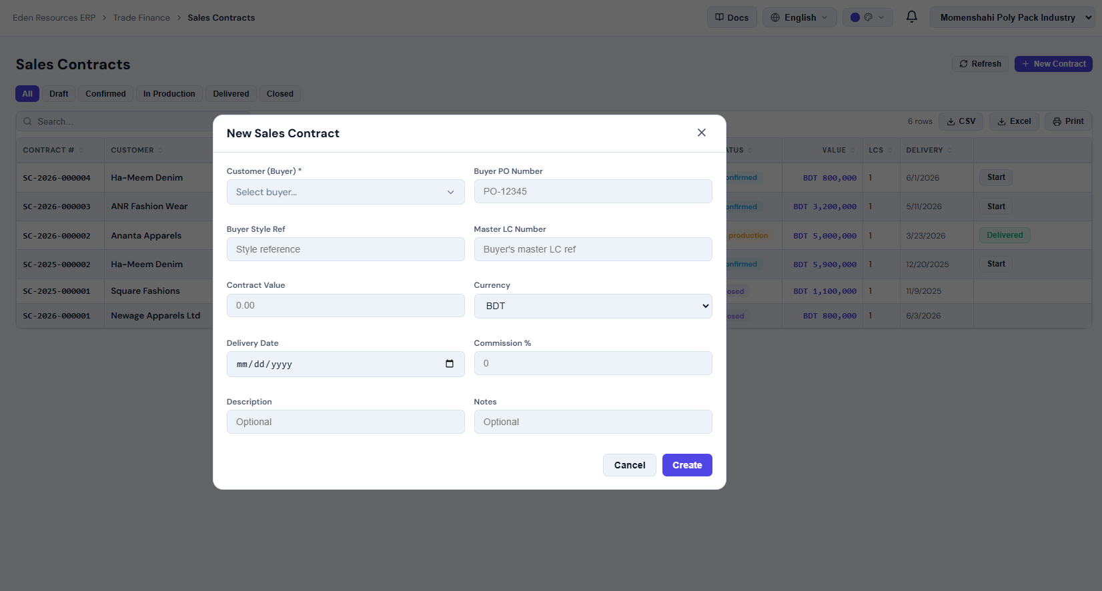
New Sales Contract Form
Mandatory field এবং business meaning
Field meaning
• Customer (Buyer): buyer selection; reporting-এর ভিত্তি • Buyer PO Number: buyer reference • Buyer Style Ref: production/style reference • Master LC Number: LC reference, known হলে দিন • Contract Value + Currency: commercial amount • Delivery Date: commitment date • Commission %: sales commission logic • Description/Notes: special instruction
Eden Resources ERP · Trade Finance
Notes:
Source: user-provided Eden Resources ERP screenshots. Screenshot shows New Sales Contract modal fields.

Slide 6
Sales Contract Demo Script
৫ মিনিটের hands-on flow
• Sales Contracts > + New Contract • Customer select করুন • Buyer PO, Style Ref, Contract Value লিখুন • Delivery Date ও Commission % দিন • Create করুন এবং list-এ নতুন row দেখান • Status filter ব্যবহার করে workflow explain করুন
Common mistake
Wrong customer বা wrong delivery date দিলে LC, shipment ও report mismatch হতে পারে।
Eden Resources ERP · Trade Finance
Notes:
Source: user-provided Eden Resources ERP screenshots. Class demo script for Sales Contract creation.

Slide 7
Letters of Credit List পড়া
LC value, shipped, encashed এবং deadline একসাথে দেখুন
Key columns
• LC #: detail open করার main link • Type: Sight / Usance terms • Status: opened থেকে encashed/closed পর্যন্ত lifecycle • LC Value: bank-backed limit • Shipped: delivery/shipment progress • Encashed: realized value • Ship By: shipment deadline / risk date
Eden Resources ERP · Trade Finance
Notes:
Source: user-provided Eden Resources ERP screenshots. Screenshot shows Letters of Credit table.

Slide 8
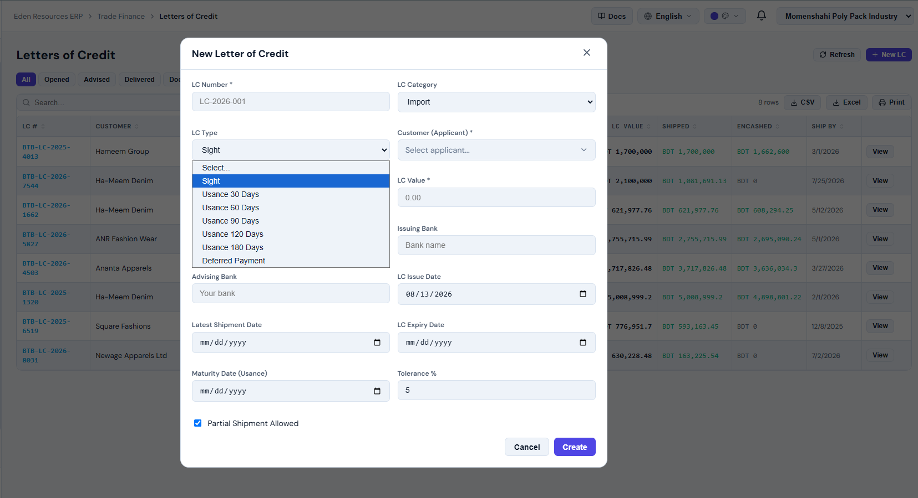
New Letter of Credit Form
LC terms ঠিক না বুঝলে payment timing ভুল হবে
Must explain
• LC Category: Import/Export context • LC Type: Sight, Usance 30/60/90/120/180, Deferred Payment • Customer (Applicant): buyer/applicant • LC Value এবং Tolerance % • Issuing Bank এবং Advising Bank • Issue, Latest Shipment, Expiry এবং Maturity dates • Partial Shipment Allowed হলে multiple delivery করা যাবে
Eden Resources ERP · Trade Finance
Notes:
Source: user-provided Eden Resources ERP screenshots. Screenshot shows LC creation modal and LC Type dropdown.

Slide 9
Sight বনাম Usance LC
Payment কখন হবে — এই পার্থক্য ছাত্রদের পরিষ্কার করতে হবে
Sight LC
Usance LC
• Documents bank accept/verify করলে দ্রুত payment • Button: Encashed (Sight) • Cash realization দ্রুত দেখান
• Accepted (Usance) হলে maturity পর্যন্ত wait • Usance 30/60/90/120/180 days • Maturity Date tracking জরুরি
Eden Resources ERP · Trade Finance
Notes:
Source: user-provided Eden Resources ERP screenshots. Comparison derived from LC form options and detail buttons in the screenshots.

Slide 10
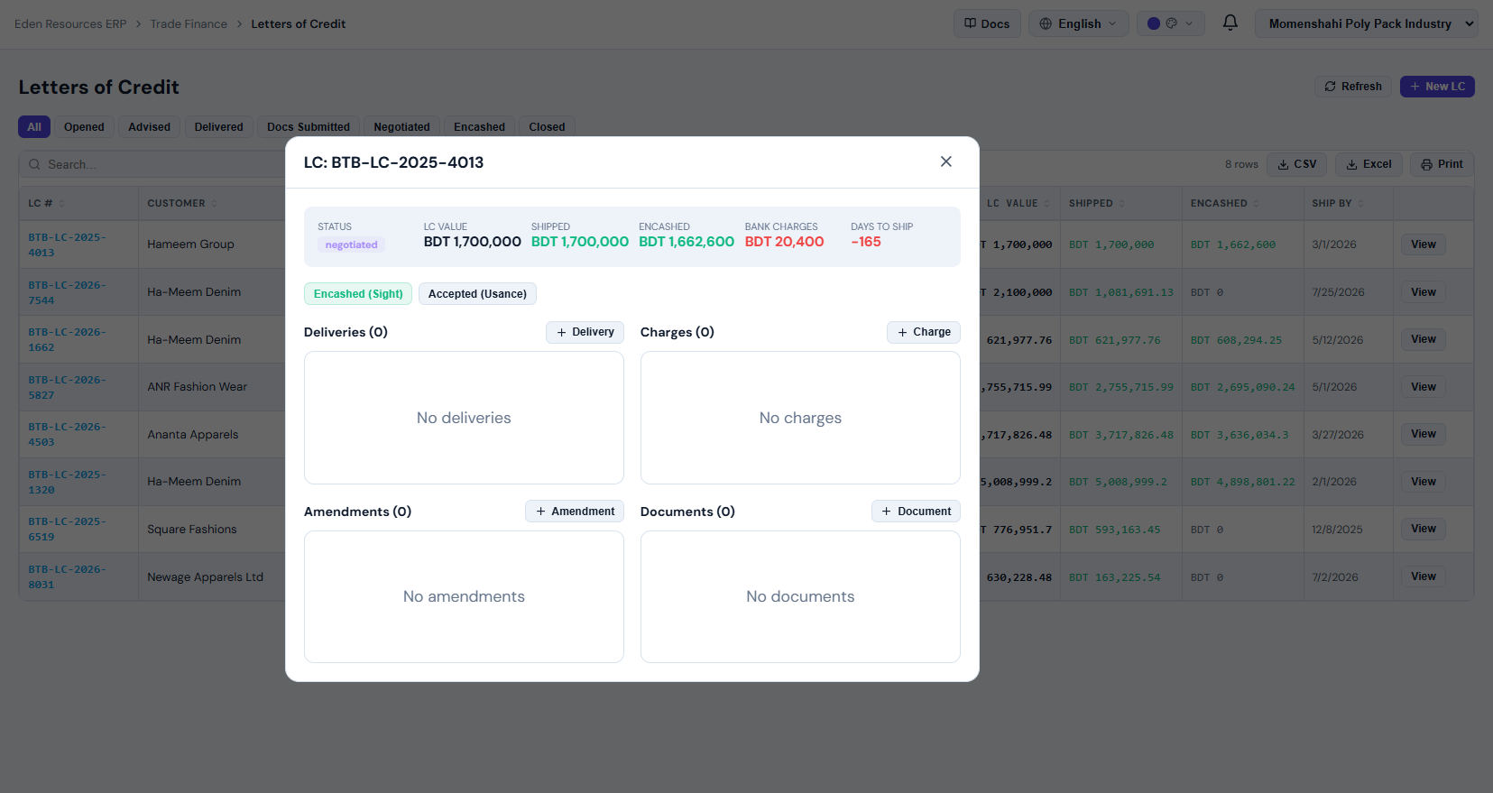
LC Detail: Summary পড়া
এই card দেখেই LC health বোঝা যায়
Read this first
• Status: negotiated / docs submitted / encashed / closed • LC Value বনাম Shipped: shipment complete কিনা • Encashed: bank থেকে realization কত • Bank Charges: cut/fees কত হয়েছে • Days to Ship negative হলে deadline passed • চারটি subsection: Deliveries, Charges, Amendments, Documents
Eden Resources ERP · Trade Finance
Notes:
Source: user-provided Eden Resources ERP screenshots. Screenshot shows LC detail summary modal.

Slide 11
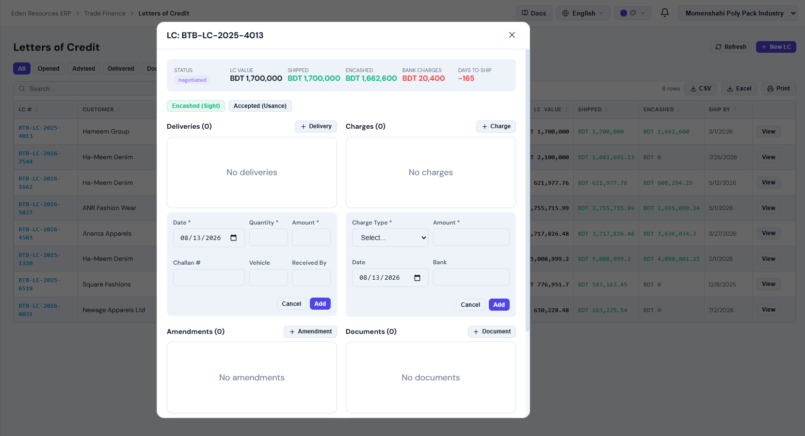
Delivery এবং Bank Charge Entry
Operational update এখানে করা হয়
Delivery
• Date, Quantity, Amount • Challan #, Vehicle, Received By • Add করলে shipped value বাড়ে
Charge
• Charge Type, Amount, Date, Bank • Bank fees reconciliation-এ কাজে লাগে • Realization বুঝতে charges track করুন
Eden Resources ERP · Trade Finance
Notes:
Source: user-provided Eden Resources ERP screenshots. Screenshot shows delivery and charge entry forms.

Slide 12
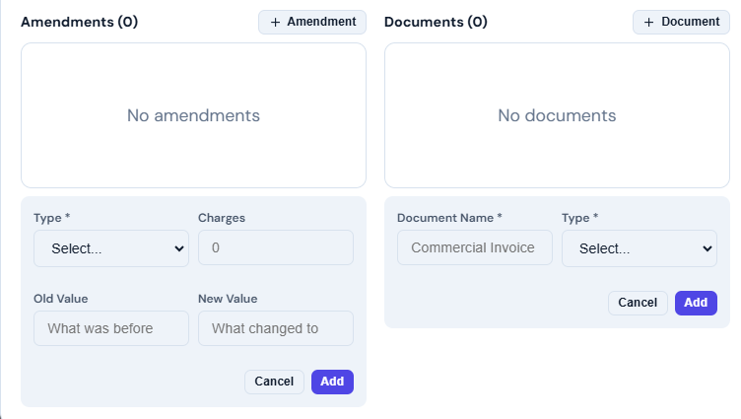
Amendments এবং Documents
LC পরিবর্তন ও document completeness track করুন
Amendment
Documents
• Type select করুন • Charges লিখুন • Old Value এবং New Value রাখুন • Date/value/terms change audit trail
• Document Name: Commercial Invoice etc. • Type select করুন • Docs Submitted / Negotiated status explain করুন • Missing document হলে LC realization delay হতে পারে
Eden Resources ERP · Trade Finance
Notes:
Source: user-provided Eden Resources ERP screenshots. Screenshot shows Amendment and Document entry sections.

Slide 13
Student Practice Lab
শেষ ২০ মিনিট hands-on কাজ
A
BDT 800,000 Sales Contract তৈরি
D
BDT 12,000 Bank Charge add
B
Usance 60 Days LC তৈরি
E
Commercial Invoice document add
C
BDT 300,000 Delivery add
F
Delivery date amendment add
Expected: list/status/summary counts update হবে।
Eden Resources ERP · Trade Finance
Notes:
Source: user-provided Eden Resources ERP screenshots. Practice tasks created from the workflows visible in the screenshots.

Slide 14
Trainer Closing Checklist
Class শেষ করার আগে verify করুন
• প্রতিটি student Sales Contract form পূরণ করতে পারে • LC Type dropdown থেকে Sight এবং Usance explain করতে পারে • LC detail summary থেকে value/shipped/encashed/charges পড়তে পারে • Delivery, Charge, Amendment, Document আলাদা entry করতে পারে • Status filter ব্যবহার করে pending/closed items identify করতে পারে
Eden Resources ERP · Trade Finance
Notes:
Source: user-provided Eden Resources ERP screenshots. Closing checklist for the instructor.

