Slide 1

Welcome to Our Presentation

Slide 2


CSE- 316 Project Presentation
Course Instructor- Mahmuda Rahman
Presented BY-
Name- Estiak Hasan Emon ID- 201002059
Name- Shamima Aktar ID- 201002265
Department Of Computer Science & Engineering
Green University Of Bangladesh

Slide 3
Group Chat App With Encrypted Messaging and Video Streaming

Slide 4
Contents
Introduction
System Analysis
End to End
Encryption
Implementation
Logical Design
Data-Flow
Diagram
Output Design
Security
Conclusion

Slide 5

Introduction

Slide 6

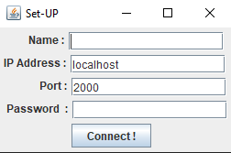
System Analysis
Group messaging apps are useful communication tools for getting in touch with several people at once. It also a good way to share information, make decisions, and even manage a project.

Slide 7
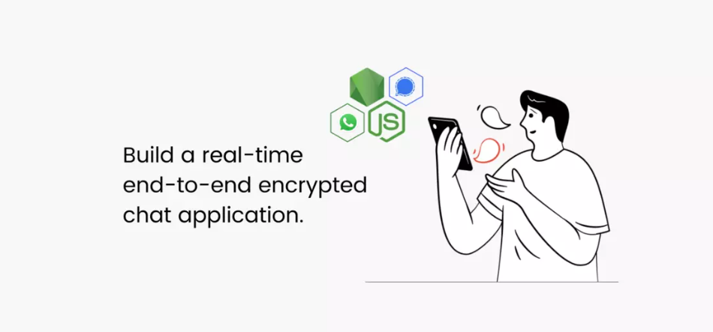
End To End Encryption
End-to-end (E2E) encryption in group chatting & video conferencing is a way to secure data that prevents third parties or intermediary servers, from accessing or tampering with it at every hop along the media pipeline.

Slide 8
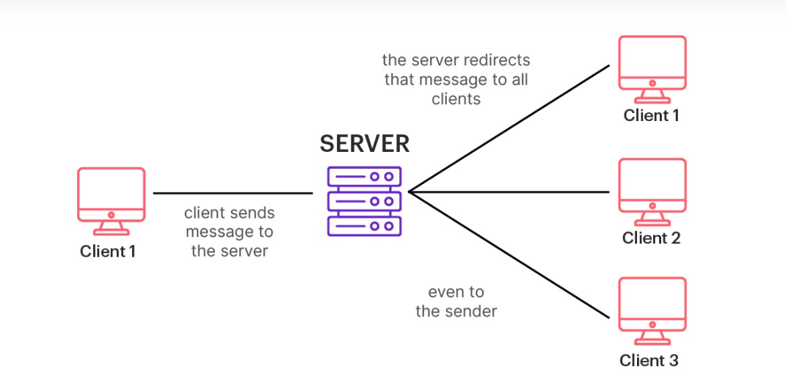
Implementation Group chat

Slide 9
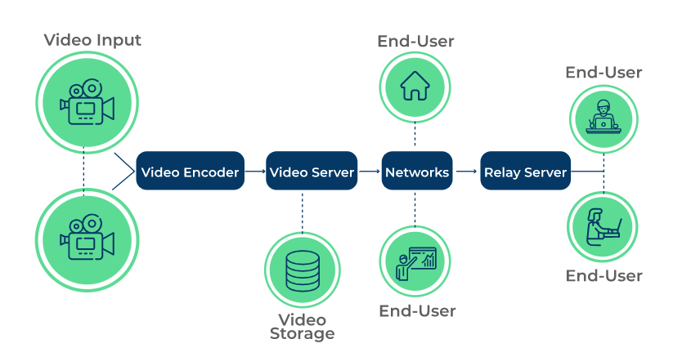
Implementation Video Streaming

Slide 10
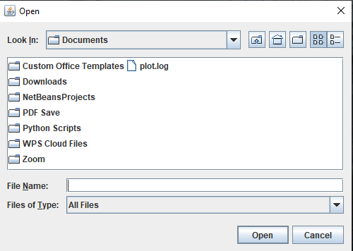
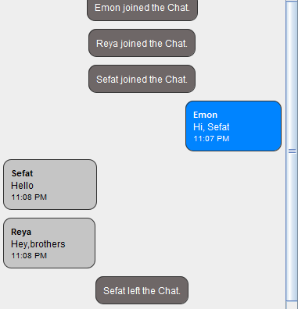

Logical Design

Slide 11
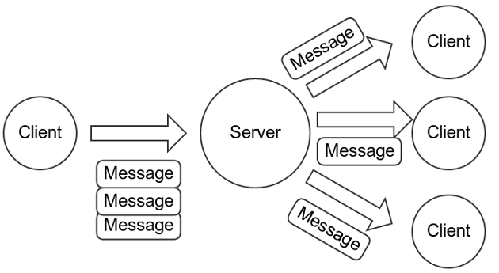
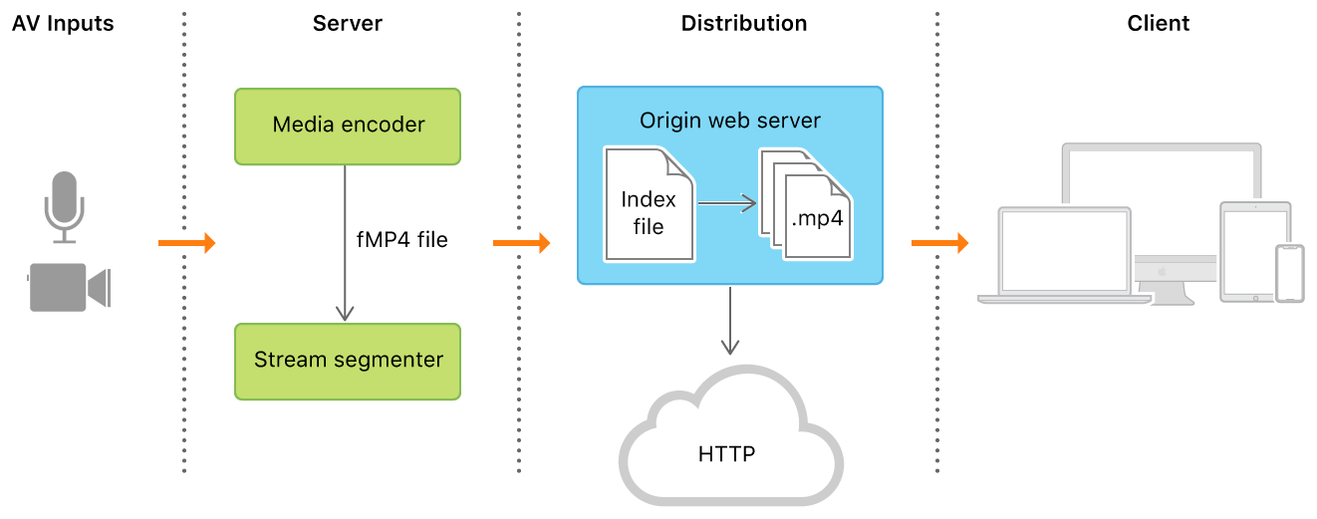
Data Flow Diagram

Slide 12
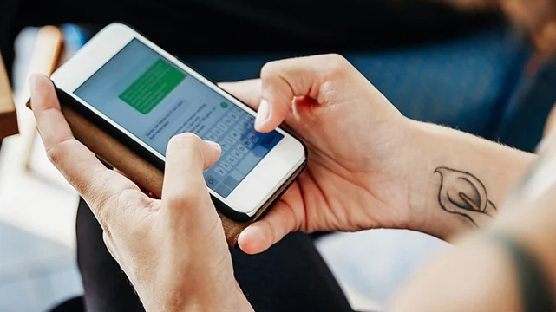
Testing

Slide 13
Security
Every message is encrypted with a new key using advanced vetted end-to-end encryption. The private chatting app never has access to your messages or your contact list, as no mobile number or email address is required to register on this app.

Slide 14

Scope Of Future Work
A chat application makes it easy to communicate with people anywhere in the world by sending and receiving messages in real time.

Slide 15
Conclusion
Privacy has become a major concern for the end user of free services provided by technology giants like Facebook and Google impacts of data falling into the wrong hands. Here I designed an end-to-end encrypted chatting application to address this issue. The user of my chatting application named “Fun” can stay anonymous throughout the chatting session. I have been inspired by several chatting/social media applications such as 4chan, reddit, discord and WhatsApp to design is extremely lightweight secure and portable and compatible on most of the popular operating systems. My solutions to the privacy concern of the users will help primarily the small to medium scale business internal and communication as the user data except the login credentials will be erased as soon as the session ends.

Slide 16
Thank You

