Slide 1


Beyond Coding: Lean Learning for real-world Software Engineering
Robert Chatley, Estibaliz Fraca, Jason Bailey,
Ivan Procaccini, Zaki Amin
Estibaliz Fraca
e.fraca@imperial.ac.uk
Department of Computing. Imperial College London
Notes:
Beyond Coding: Lean Learning for real-world Software Engineering

Slide 2
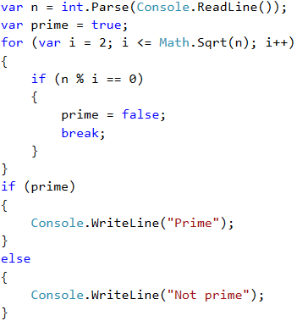
Beyond Coding
Check if a number is prime

Slide 3
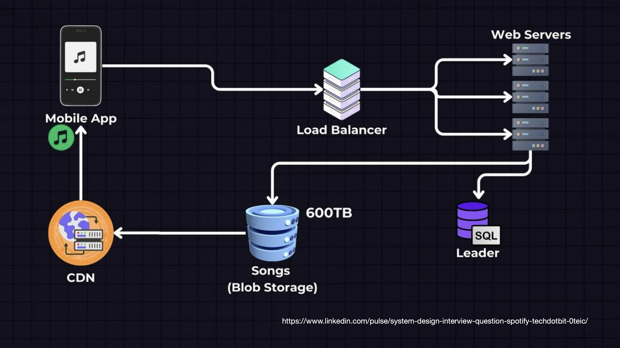
Beyond Coding
Nowadays…

Slide 4

What is Software Engineering?
“Software engineering is programming integrated over time”
Software engineering challenges arise from maintaining larger systems over time (Winters et al, 2020)
Winters, T., Manschreck, T., & Wright, H. (2020). Software Engineering at Google: Lessons Learned from Programming Over Time. O’Reilly Media. Available at https://abseil.io/resources/swe-book
Notes:
Software engineering encompasses a broader set of skills beyond just coding. It includes integration, deployment, testing, and collaboration. References include SFIA Foundation (2022) and Fowler (2019).

Slide 5
Beyond coding
Modern software engineering demands a broader set of skills beyond writing code.
Traditionally, CS curricula delay these skills.
Emphasize broader skills: integration, deployment, testing, collaboration.
Notes:
Modern software engineering demands a broader set of skills beyond writing code. Traditional computer science curricula often delay teaching these essential skills.

Slide 6
Our Case Study: Software Systems Engineering module
MSc conversion programme
Notes:
This case study focuses on an MSc conversion programme designed for students from non-CS backgrounds. The programme aims to teach industry-relevant skills within a short timeframe of 12 months.

Slide 7
Previous Module Design
Programming module
Term 1
Free form Team Projects
Term 2
Notes:
The previous module design focused on C++ in Term 1 and group projects in Term 2. However, this approach faced challenges such as inconsistent learning experiences, lack of support, and limited application of engineering practices.

Slide 8
Previous Module Design
Programming module
Term 1
Challenges identified
Inconsistent learning experiences
Lack of support
Limited application of engineering practices
Lack of collaboration early on
Disconnection between taught content and project needs
Students overwhelmed by self-study
Free form Team Projects
Term 2
Notes:
The previous module design focused on C++ in Term 1 and group projects in Term 2. However, this approach faced challenges such as inconsistent learning experiences, lack of support, and limited application of engineering practices.

Slide 9


Previous Module Design
Programming module
Programming
Software Systems Engineering
Term 1
Free form Team Projects
Term 2
Notes:
The previous module design focused on C++ in Term 1 and group projects in Term 2. However, this approach faced challenges such as inconsistent learning experiences, lack of support, and limited application of engineering practices.

Slide 10
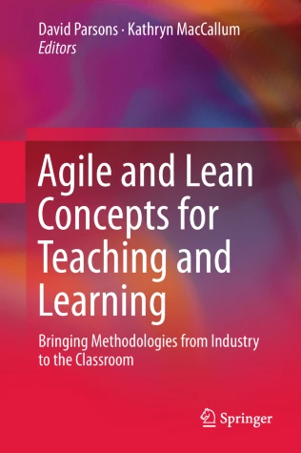

LEAN METHODOLOGY / APPROACH.
Notes:
Minimizing the time between starting to build something and delivering it.
So minimizing the time to teach/learn something
Without having to build up all the programming

Slide 11
Redesigning the Module
Lean learning approach (Chatley and Field, 2017)
Minimal theory – lectures with just enough background to support practical work
Weekly hands-on exercises – to enable a weekly rhythm, a focussed task (2-3 hours) applying a key practice
Easily assessable submission – a concrete deliverable easy to mark (e.g. a link to a live website, a GitHub repository, screenshots…)
Chatley, R. and Field, T. (2017) ‘Lean learning: Applying lean techniques to improve software engineering education’, In: 2017 IEEE/ACM 39th International Conference on Software Engineering: Software Engineering Education and Training Track (ICSE-SEET), pp. 117–126.
Notes:
The module was redesigned to introduce Software Systems Engineering (SSE) with a lean learning approach. Weekly cycles included minimal theory, hands-on activities, and assessable deliverables.
We wanted to have a weekly rhythm.

Slide 12
Topics Taught
Web Sites and Web Servers
Web Applications (Flask)
Build Pipelines (GitHub actions)
Continuous Integration / Continuous Delivery
Using APIs
Databases
Cloud (Azure)
Containers (Docker)
Microservices
Notes:
We tought topics which are relevant in SE nowadays.
For example: …. .
Github
Cloud
Consuming data through a API
This is broad, but
Our hypothesis is that it is a good idea, as they can learn just enough of each of the topics, so
Lean is ”just enough”

Slide 13
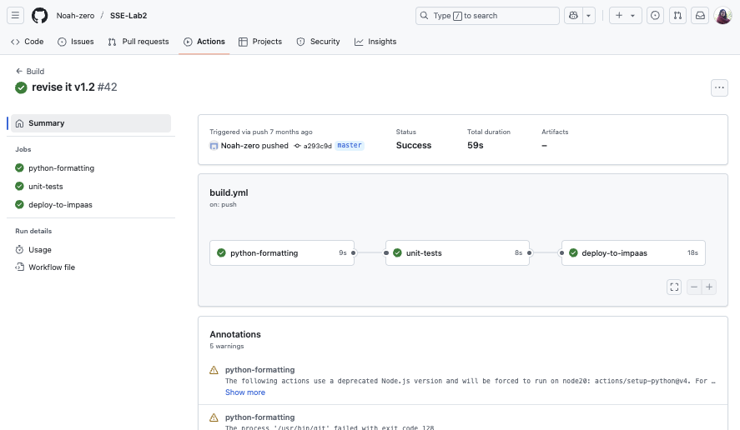
Example
Lab 3.
Build Pipelines
Lecture
Student is guided through
Screenshot
PDF spec
2 h lab
Submission
Notes:
This slide is reserved for a live or video demonstration of a student project or module output.
Explain what they need to do.
Then, say this is the way to assess it.
Build a pipeline is a key practice to ensure quality of the solution, particularly when many people work in the same system.

Slide 14
Evaluation
Students survey (aiming for qualitative data)
Do they find acceptable to learn “advanced” topics earlier in their degree, particularly without prior coding experience?
Did the “broad rather than deep, and practical rather than theoretical” module philosophy worked for them?
Do they feel industry ready?

Slide 15
Student Feedback
Broad rather than deep
“it was nice to do anything with the new topic in the seminars. Then, with foundations laid, it was easy to self-learn and go deeper”
“[…] learning about GitHub actions was definitely useful, not only in the practical sense but also in terms of better understanding […] during development”
Still to be improved how to present the harder topics
“I still don't really know how to use Docker”
Prepared for industry
“Getting very comfortable with git, testing, and automatic checks...”
“I actually had a question about GitHub actions in one of my job interviews...”
Notes:
Student feedback highlighted their comfort with git, testing, and automatic checks. One student mentioned being asked about GitHub actions in a job interview.

Slide 16
Discussion
Lean learning design
Weekly cycles build momentum and confidence
In opposition than old modules structure, students are able to apply professional software engineering techniques early on in the course
Software engineering skills taught broad rather than deep and practical rather than theoretical, following a lean approach
Students getting more industry ready!
Notes:
Conclusions drawn from the case study suggest that lean learning works well for breadth and engagement. Students feel more industry-ready, and weekly cycles help build momentum and confidence.

Slide 17
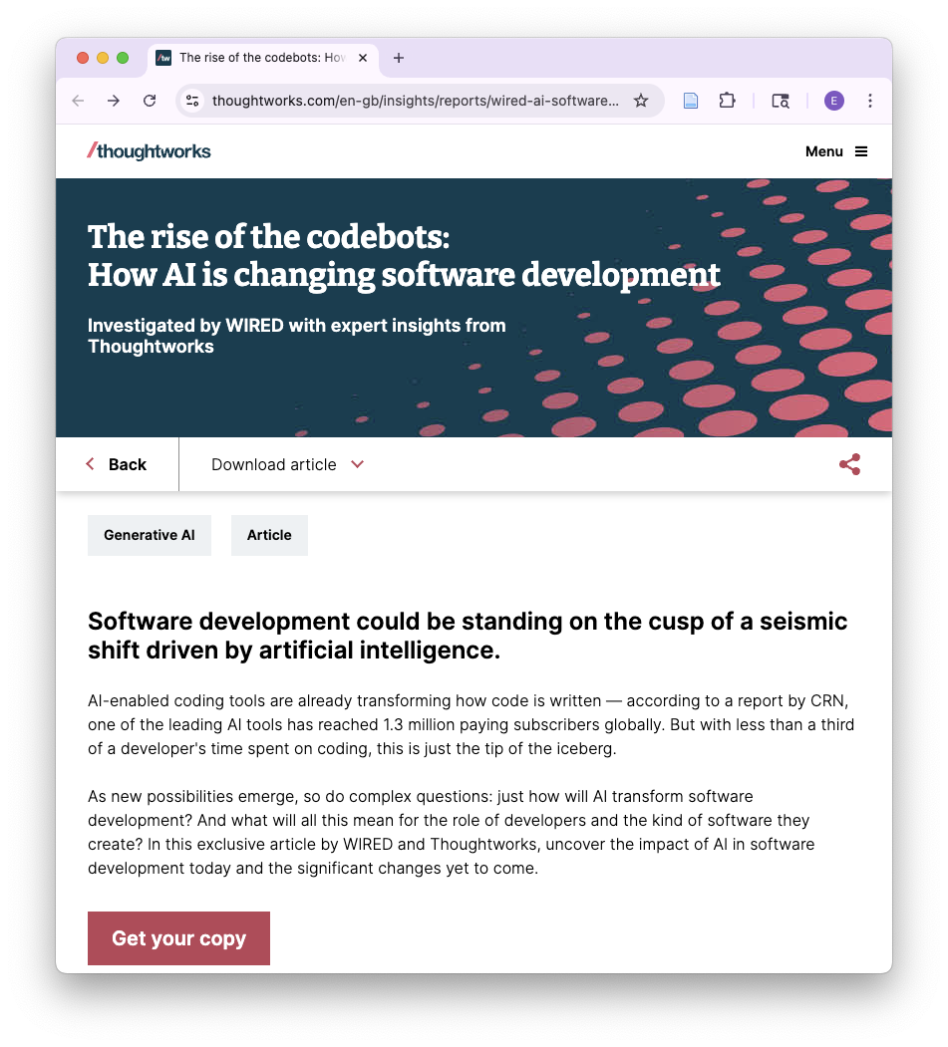
In this AI revolution, how should we re-think software engineering education?
Notes:
Software engineering has been evolved, and now faster with AI! Shall we teach fewer topics in depth down to the low-level fundamentals, or to focus on higher-level (data governance, security, cost awareness, energy usage and sustainability)?
How AI is changing software development?
More important the integration of components, rather than the specific coding tasks
The engineering bit has more protagonism than ever.
Article form a magazine saying: all these tools are coming, what are we going to do with the developers?

Slide 18
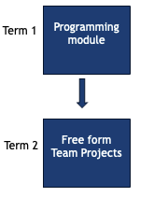
Conclusion
Minimal theory
Easily assessable submission
Weekly hands-on exercises
Challenges
…
Broad rather than deep
Professional SE skills from early on
Students ready for industry

Slide 19
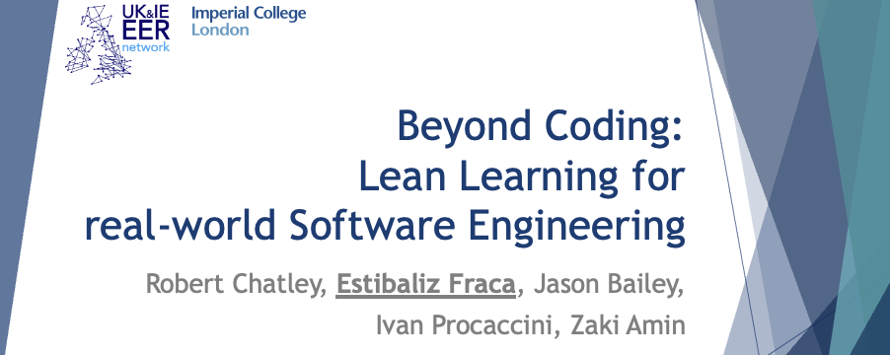
Conclusion
Minimal theory
Easily assessable submission
Weekly hands-on exercises
Challenges
…
Broad rather than deep
Professional SE skills from early on
Students ready for industry
Thank you!!! Any questions?

