Slide 1
(1/2) M(f+f_{c})
(1/2) M(f-f_{c})
M(f)
S(f)
f
f
0
-f_{c}
f_{c}
-B
+B
-f_{c}-B
-f_{c}+B
f_{c}-B
f_{c}+B

Slide 2
S_{USB}(f)
f
-f_{c}
f_{c}
-f_{c}-B
-f_{c}+B
f_{c}-B
f_{c}+B
S_{LSB}(f)
f
-f_{c}
f_{c}
-f_{c}-B
-f_{c}+B
f_{c}-B
f_{c}+B

Slide 3


Ideal LPF
s_{USB}(t)
2
$$m(t)$$
f
s_{LSB}(t)
-B
0
+B
$$cos⁡(2πf_{c}t)$$

Slide 4





m(t)
Re{ }
$$s_{QM}(t)$$
$$e^{j2πf_{c}t}$$
$$cos⁡(2πf_{c}t)$$
m_{R}(t)
$$s_{QM}(t)$$
m_{I}(t)
-
$$sin⁡(2πf_{c}t)$$

Slide 5





Ideal LPF
$$s_{QM}(t)$$
2
m(t)
f
-B
0
+B
$$cos⁡(2πf_{c}t)$$
$$e^{−j2πf_{c}t}$$
2
f
m_{R}(t)
-B
0
+B
$$s_{QM}(t)$$
2
m_{I}(t)
f
-B
0
+B
-$sin⁡(2πf_{c}t)$

Slide 6
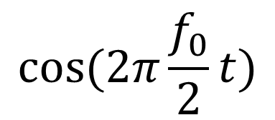
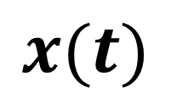
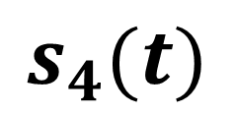
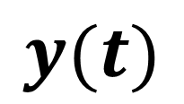
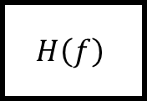
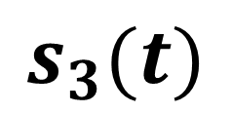
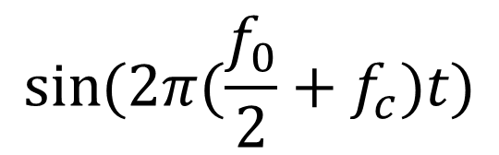
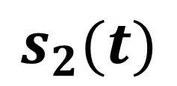
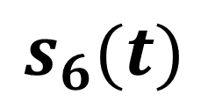
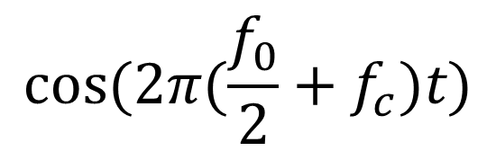
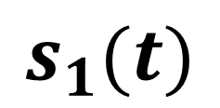
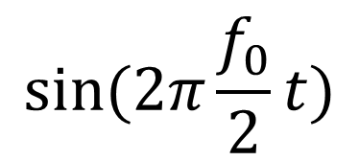
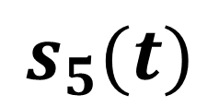
$$s_{1}(t)$$
$$s_{3}(t)$$
$$s_{5}(t)$$
$$H\left(f\right)$$
$$x(t)$$
$$y(t)$$
$$\sin{(2π\frac{f_{0}}{2}t)}$$
$$\sin{(2π(\frac{f_{0}}{2}+f_{c})t)}$$
$$H\left(f\right)$$
$$s_{2}(t)$$
$$s_{4}(t)$$
$$s_{6}(t)$$
$$\cos{(2π\frac{f_{0}}{2}t)}$$
$$\cos{(2π(\frac{f_{0}}{2}+f_{c})t)}$$

Slide 7


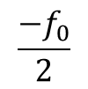





$$X(f)$$
$$H(f)$$
1
1
$$f$$
$$f$$
$${−f}_{0}$$
$$f_{0}$$
$$\frac{{−f}_{0}}{2}$$
$$\frac{f_{0}}{2}$$

Slide 8







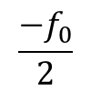






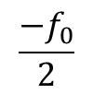
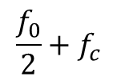



















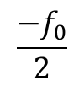


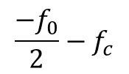


$$jS_{1}(f)$$
$$S_{2}(f)$$
$$\frac{1}{2}$$
$$\frac{1}{2}$$
$$\frac{{−f}_{0}}{2}$$
$$f$$
$$f$$
$$\frac{f_{0}}{2}$$
$$\frac{{−f}_{0}}{2}$$
$$\frac{f_{0}}{2}$$
$$\frac{−1}{2}$$
$$jS_{3}(f)$$
$$S_{4}(f)$$
$$\frac{1}{2}$$
$$\frac{1}{2}$$
$$\frac{{−f}_{0}}{2}$$
$$f$$
$$f$$
$$\frac{f_{0}}{2}$$
$$\frac{{−f}_{0}}{2}$$
$$\frac{f_{0}}{2}$$
$$\frac{−1}{2}$$
$$\frac{1}{4}$$
$$S_{5}(f)$$
$$\frac{1}{4}$$
$$\frac{1}{4}$$
$$S_{6}(f)$$
$$\frac{1}{4}$$
$$\frac{{−f}_{0}}{2}−f_{c}$$
$$f$$
$$f$$
$$\frac{f_{0}}{2}+f_{c}$$
$$\frac{{−f}_{0}}{2}−f_{c}$$
$$\frac{f_{0}}{2}+f_{c}$$
$$\frac{−1}{4}$$
$$\frac{−1}{4}$$
$$Y(f)$$
$$\frac{1}{2}$$
$$f$$
$$−f_{c}$$
$$f_{c}$$

