Slide 1




Ideal BPF
2B
2
$$s(t)$$
$$s_{i}(t)$$
f
$$f_{i}$$
$$cos⁡(2π{(f}_{c}−f_{i})t+θ)$$

Slide 2

Ideal BPF
2B
2
$$s(t)$$
$$s_{i}(t)$$
f
$$f_{i}$$
$$cos⁡(2πf_{o}t+θ)$$

Slide 3





-f_{i}-B
-f_{i}+B
f_{i}-B
f_{i}+B
Output $\left|f−f_{i}\right|≤B$
-f_{i}
f_{i}
f
Input $f>f_{o}$
f
-f
+f
LO $f_{o}$
f
-f_{o}
+f_{o}
Input $f<f_{o}$
f
-f
+f
Output $\left|f−f_{i}\right|≤B$
f
-f_{i}
f_{i}
-f_{i}-B
-f_{i}+B
f_{i}-B
f_{i}+B

Slide 4


Two “Image” Bands Passed Through the Filter
-f_{o}- f_{i}
-f_{o}+ f_{i}
f_{o}- f_{i}
f_{o}+ f_{i}
f
-f_{o}
+f_{o}
$$\left|f−(f_{o}−f_{i})\right|≤B$$
$$\left|f−(f_{o}+f_{i})\right|≤B$$

Slide 5





Ideal RF BPF
Ideal IF BPF
2B
2B
1
2
$$s(t)$$
$$s_{i}(t)$$
f
f
$${f_{o}±f}_{i}$$
$$f_{i}$$
“Image Reject” Filter
$$cos⁡(2πf_{o}t+θ)$$

Slide 6
Non-Ideal RF BPF
-B
+B
-f_{o}- f_{i}
-f_{o}+ f_{i}
f_{o}- f_{i}
f_{o}+ f_{i}
f
$$\left|f−(f_{o}−f_{i})\right|≤B$$
$$\left|f−(f_{o}+f_{i})\right|≤B$$

Slide 7
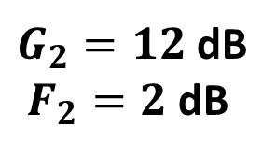
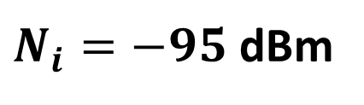

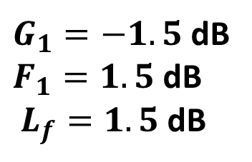
Noise
source
Bandpass
filter
Amplifier
$$N_{o}$$
$N_{i}=−95$ dBm
$G_{1}=−1.5$dB
$F_{1}=1.5$dB
$L_{f}=1.5$dB
$G_{2}=12$dB
$F_{2}=2$dB

