Slide 1


Fixed Tx
Components
Fixed Rx Components
$$R_{B}\left(t\right)$$
$$s_{B}(t)$$
The “Channel” Abstraction

Slide 2






$$s_{0}(t)$$
$$R_{0}(t)$$
$$s_{1}(t)$$
$$R_{0}(t)$$
$$s_{M−1}(t)$$
$$R_{M−1}(t)$$

Slide 3

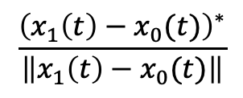


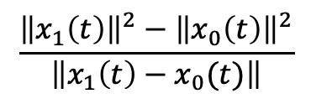


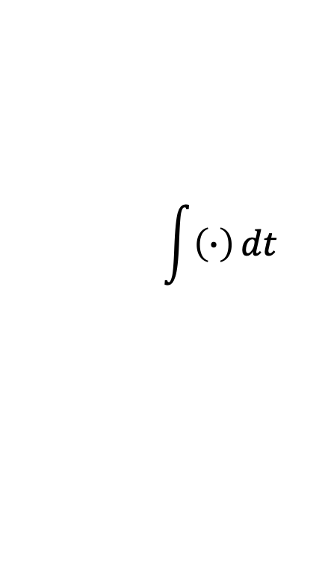

Slicer
$$\int{\left(∙\right)}dt$$
$$1$$
$$R(t)$$
$$2Re\left\{∙\right\}$$
$$0$$
$$\hat{B}$$
-
$$0$$
$$\frac{{\left(x_{1}\left(t\right)−x_{0}(t)\right)}^{∗}}{\left\|x_{1}\left(t\right)−x_{0}(t)\right\|}$$
$$\frac{{\left\|x_{1}\left(t\right)\right\|}^{2}−{\left\|x_{0}\left(t\right)\right\|}^{2}}{\left\|x_{1}\left(t\right)−x_{0}(t)\right\|}$$

