Slide 1


Ideal Resistor
$$R$$
Practical Resistor
+
$$w(t)$$
-

Slide 2


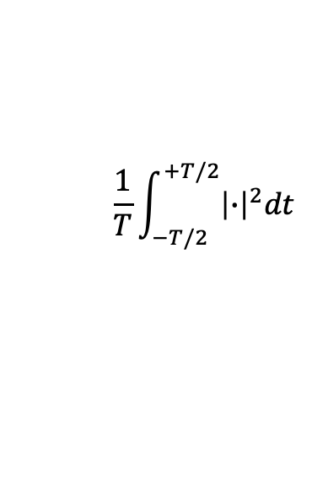




Narrowband Filter
Time Average Power
$$ε$$
$$\frac{1}{√ε}$$
$$\frac{1}{T}\int_{−T/2}^{+T/2}{{\left|∙\right|}^{2}dt}$$
$$w(t)$$
$$S_{w}(f_{0},ε,T)$$
$$f$$
$$f_{0}$$

Slide 3


Ideal LPF
1
$$w(t)$$
$$w_{B}(t)$$
f
-B
0
+B

Slide 4






$$w_{s}(t)$$
$$R_{s}$$
-
+
$$R_{l}$$
+
$$v_{out}(t)$$
$$s(t)$$
-
-
$$w_{l}(t)$$
+

