Slide 1

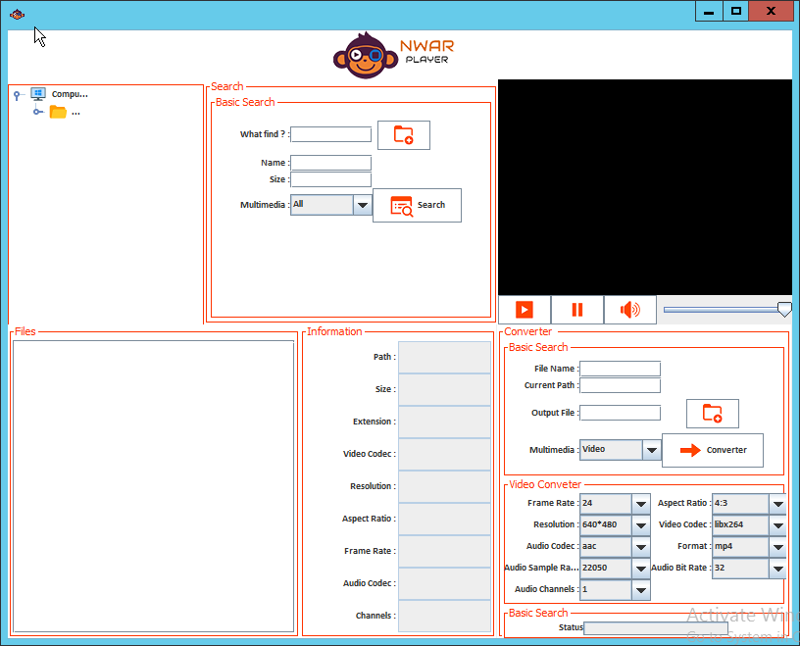
NWAR Converter DEMO
NESTOR OTONDO
ROGER Alvarez
ABEL MALLCU
Rodrigo Menacho

Slide 2
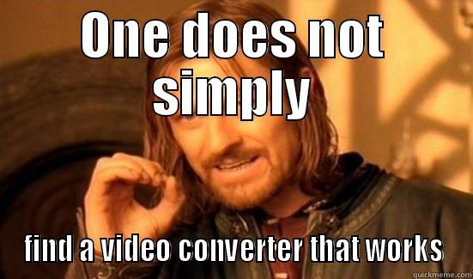
Introduction
Five weeks ago our trainer talked us about a dream, he would have like one app converter video files or audio files universal.
Notes:
Then we did put our hands to build app

Slide 3





Technologies
We used
Java
Log4j
VLC
VLCj
FFmpeg

Slide 4



Development Tools
We used
Intellij
Gradle
Github

Slide 5

Monkey NWAR Converter (Features)
- List video files only.
* Applying several video settings.
- Search audio files.
* Applying few audio settings.
- Display metadatas from file selected from result list.
- Play media from file selected from result list.
- The app can converter from media file selected from result list using several media file settings.
- Our app has logging utility.

Slide 6
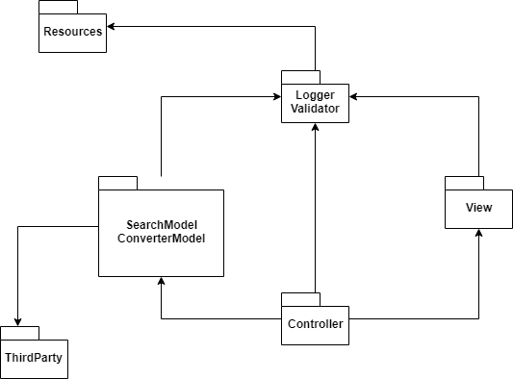
Packages

Slide 7
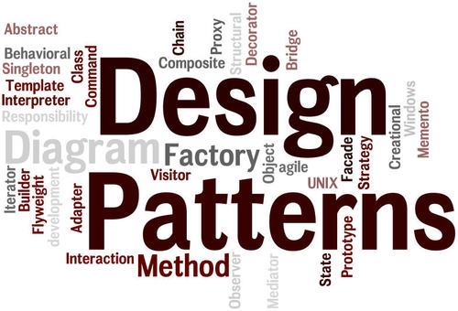
Design pattern is a general repeatable solution to a commonly occurring problem in software design.

Slide 8
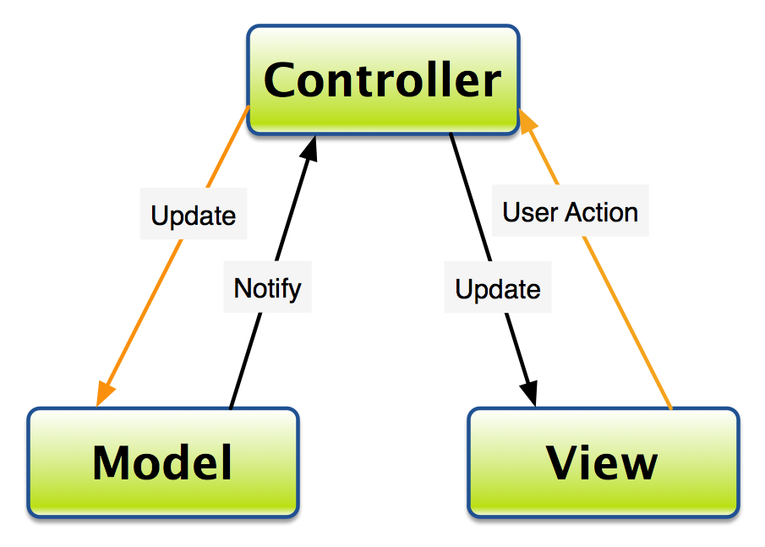
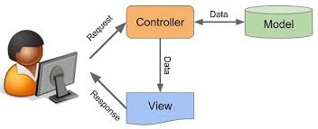
Model View Controller

Slide 9
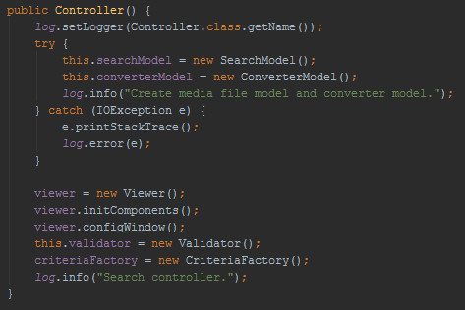
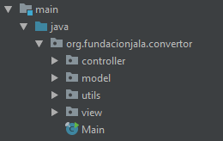
Model View Controller

Slide 10
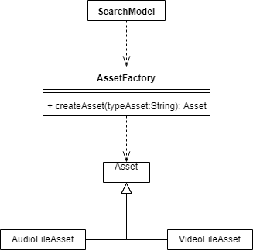
Factory
Define an interface for creating an object, but let subclasses decide which class to instantiate. Factory Method lets a class defer instantiation to subclasses.
That Design patter was used for the project in the Asset Creation

Slide 11
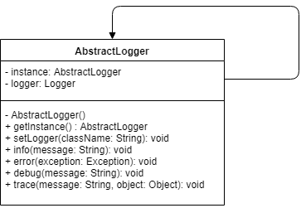
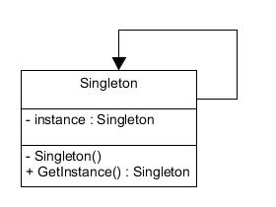
Singleton
Have private self-instance
Have private constructor
Have public method to get instance

Slide 12
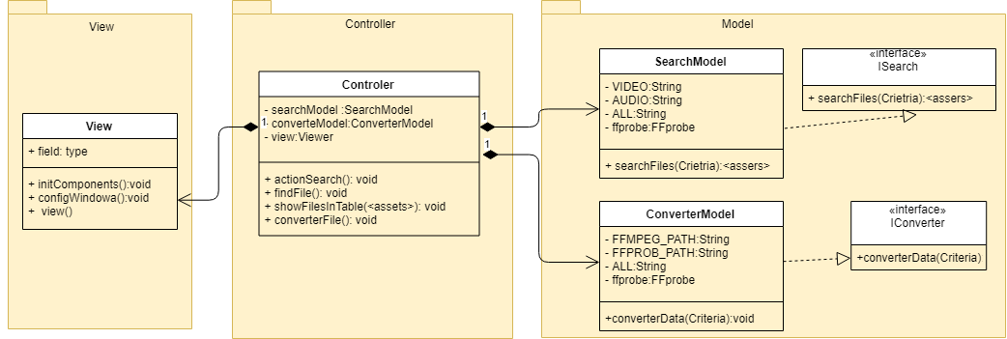
UML(Class Diagram)

Slide 13
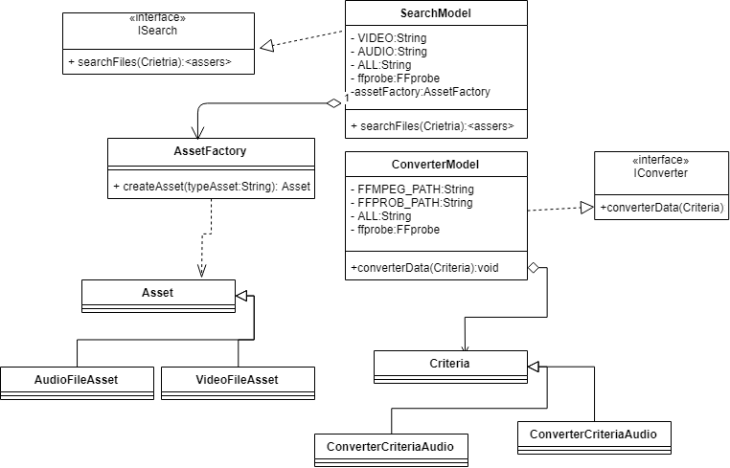
UML(Model)

Slide 14
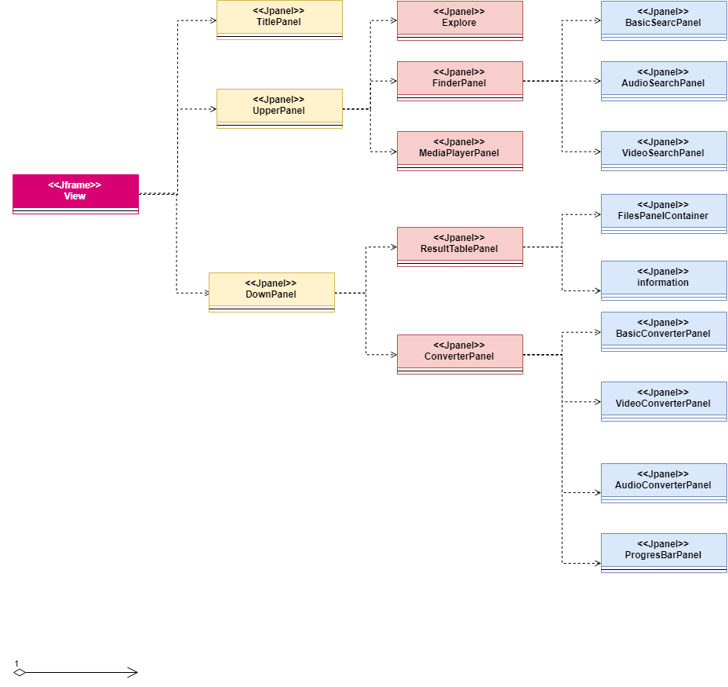
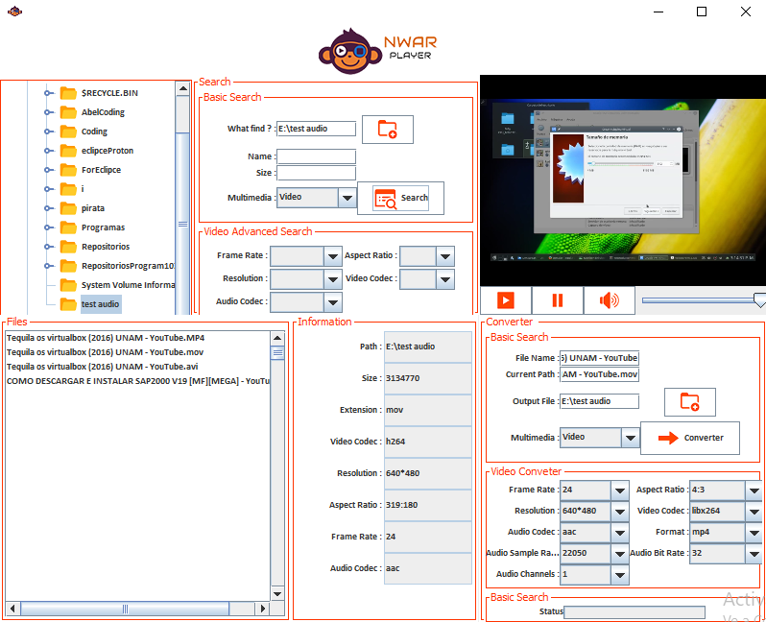
UML (View)

Slide 15
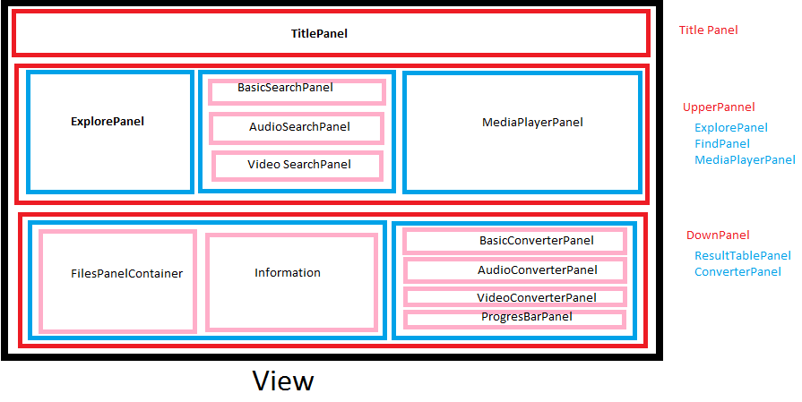
Model View

Slide 17
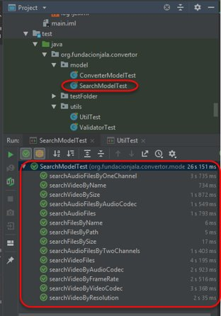
UNIT TEST

Slide 18
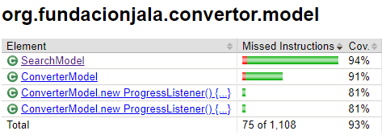
CODECOVERAGE

Slide 19
Fixed Bugs - UI
Bug | Priority
Uncontrolled Size of Panels Files, Converter , Information | 1
Oversized Main panel for Low resolutions | 1
Input Text field size not controlled for any input | 1
Incorrect aligned Label and ComboBox of AudioCodec | 3
Many Labels not aligned to the right | 3
Names of the Result Panel are not align to the left | 2
Is not possible minimize and maximize the window | 1
Icons of the application are inconsistent | 1
Size of the combo box of AudioChannel is to small | 2

Slide 20
Fixed Bugs - functional
Bug | Priority
Doesn't exist a warning message for reproduce files who are not multimedia files | 2
Doesn't exist an information message about the finished conversion | 2
It's not possible to convert video to a different format of AVI | 1
The Search feature doesn’t work its other environments | 2
It's not possible to convert video to audio | 1
It's not possible to convert audio files | 1
It's not possible maximize the reproduction player | 3
The reproduction should work in a new thread | 3
The libraries of the VLC are not included in the project | 1

Slide 21
Know Issues
Bug
It's not possible maximize the reproduction player
The converter should ask if it's possible override files with the same name
The Scroll bar of the Explorer Panel it's not good dimensioned
The Scroll bar of the Result Panel it's not dimensioned
The icon Start and pause in the first play doesn’t change to pause
Its not possible to see the progress of the audio/video

