Slide 1
Controlling a DC Motor with an Encoder
Real-Time Monitoring and Step Response Analysis in MATLAB and C Programming

Slide 2
Project Overview
Controlling a DC motor with an encoder using MATLAB and C Programming.
Serial communication used for real-time control and feedback.
Two modes of operation: Directional (sinusoidal) and Step response.
Motor speed is measured using encoder and plotted live.

Slide 3
Hardware Setup
Components:
DC motor with encoder
Microcontroller (e.g., Arduino)
Serial (COM5) communication
MATLAB scripts for control and plotting
Firmware Script in C (Arduino IDE)
Flow: MATLAB → Microcontroller → Motor + Encoder → Arduino IDE → MATLAB

Slide 4
Motor Control Firmware for Real-Time MATLAB Integration
This Arduino firmware sets up the motor control for real-time MATLAB simulation.
Key Features:
Sets up motor pin connections with Arduino (PWM, IN1, IN2, encoder pins).
Uses interrupts to read encoder data precisely
Converts encoder pulses into rotational speed (omega) in radians per second.
Implements a simple moving average filter for smoother omega data.
Listens for direction and PWM commands from MATLAB over Serial communication.
Controls motor direction and speed by setting PWM and IN1/IN2 pins accordingly.
Enables real-time monitoring and control in MATLAB using live plots and commands.
Why this is useful:
Provides real-time motor data to MATLAB, enabling accurate live plots.
Flexible: MATLAB sends (direction, PWM) commands, and the Arduino immediately responds.

Slide 5
Real-Time Data Visualization
Three real-time plots:
- Omega vs Time
- PWM vs Time
- PWM vs Omega
Updated every cycle using MATLAB’s plotting tools.

Slide 6
Directional Control (Motor_Directional.m)
Purpose: Apply a sinusoidal PWM signal to the motor.
PWM = amplitude × sin(2π/3 × t)
Direction determined by sign of PWM.
Plots generated:
Omega vs Time
PWM vs Time
PWM vs Omega

Slide 7
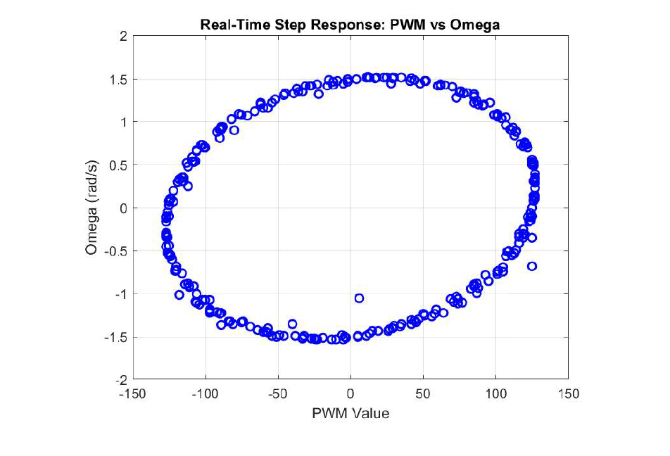
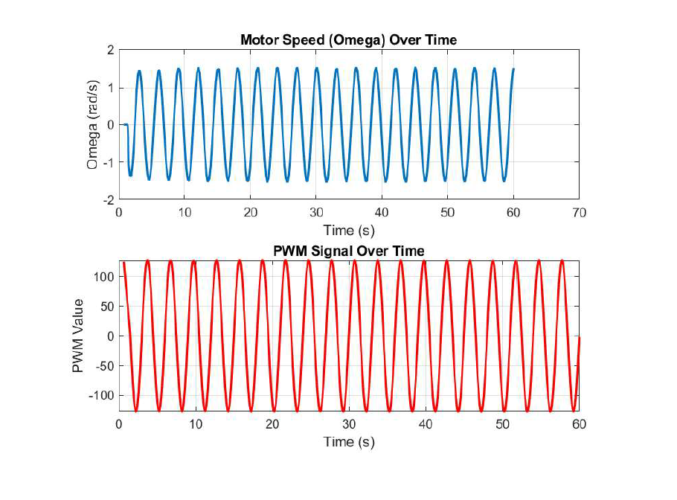
Observation: The Omega vs PWM plot clearly shows the nonlinearity of the motor's response. The relationship is not a straight line, indicating nonlinear dynamics.

Slide 8
Step Response Testing (Motor_Step.m)
Purpose: Sweep motor from -250 to +250 PWM in steps.
Hold each PWM value for 5 seconds.
Measures motor speed for each step.
Plots:
Omega vs Time
PWM vs Time
PWM vs Omega

Slide 9
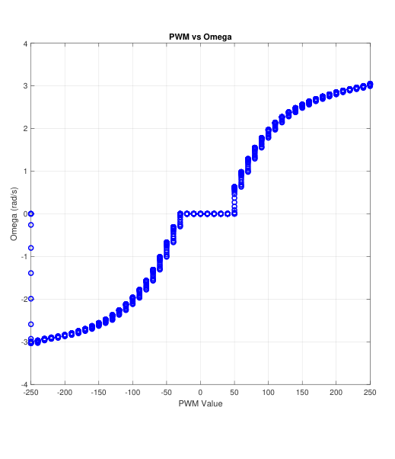
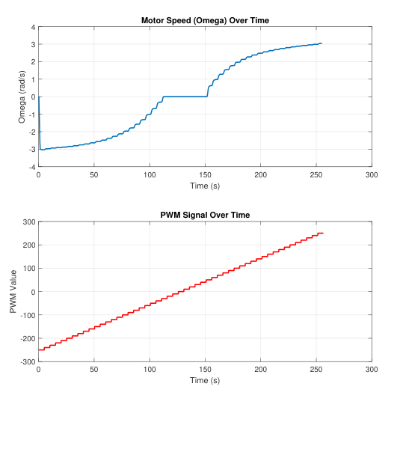
Observation: The Omega vs PWM plot clearly shows the nonlinearity of the motor's response. The relationship is not a straight line, indicating nonlinear dynamics.

Slide 10
Serial Communication & Callback
Serial setup on COM5 at 9600 baud.
Callback function reads encoder speed on newline.
Real-time data parsing and logging using `readMotorOmega`.
Updated plots during runtime using `set` and `drawnow`.

