Slide 1

The Battle of Neighborhoods
Eric S.

Slide 2
Data Acquisition

Slide 3
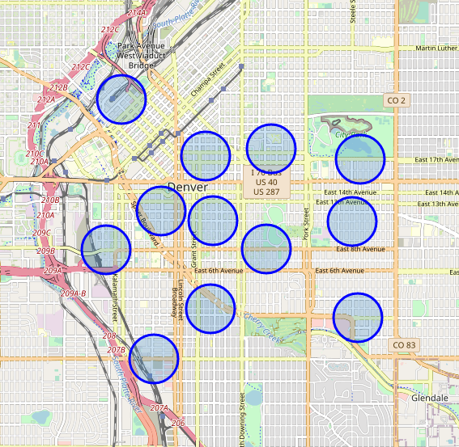
I got the neighborhood data from Wikipedia. This information included names and population of the area. I then used the python geocoder library to get geographical coordinates of neighborhoods Baker, Capitol Hill, Cherry Creek, Cheesman Park, City Park, Congress Park, City Park West, Civic Center, Country Club, Lincoln Park, North Capitol Hill, Speer, and Union Station.

Slide 4
Analysis

Slide 5
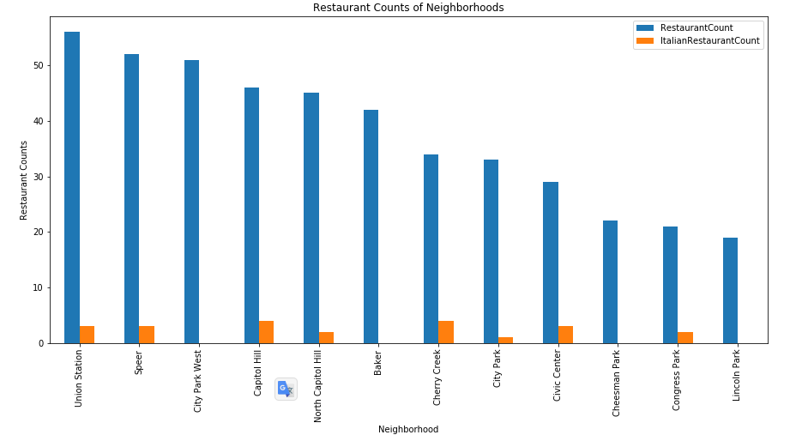
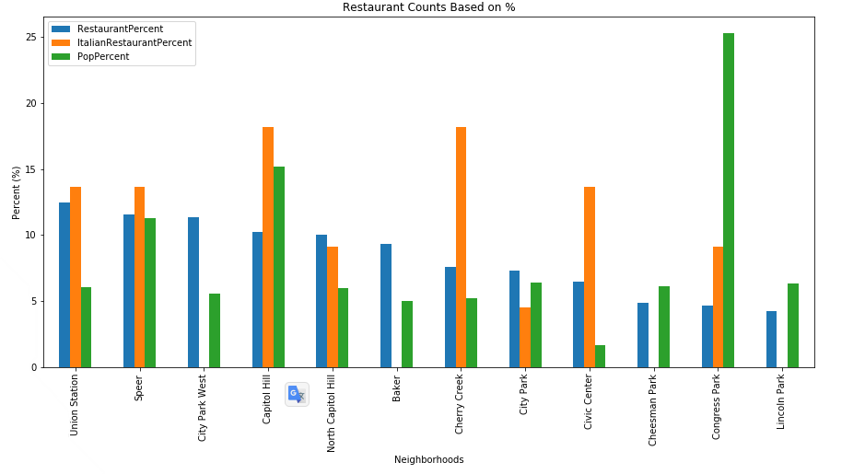
With the graphs shown it is easy to determine which neighborhoods we should remove from consideration.

Slide 6
Conclusion

Slide 7
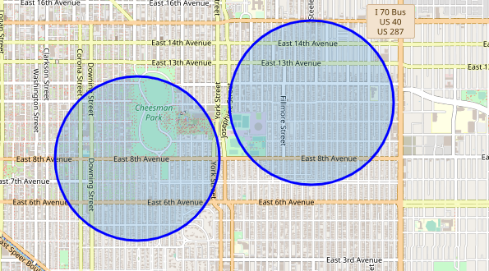
Since Congress Park and Cheesman Park neighbor each other on East 8th Ave, choosing a location between these two neighborhoods could allow the restaurant to pull people from both neighborhoods.

