Slide 1

Non-Probabilistic Supervised Classification
Yuxiao Xiong

Slide 2


Dataset
Gender Recognition by Voice
20 attributes: acoustic properties of the voice and speech
3,168 observations

Slide 3
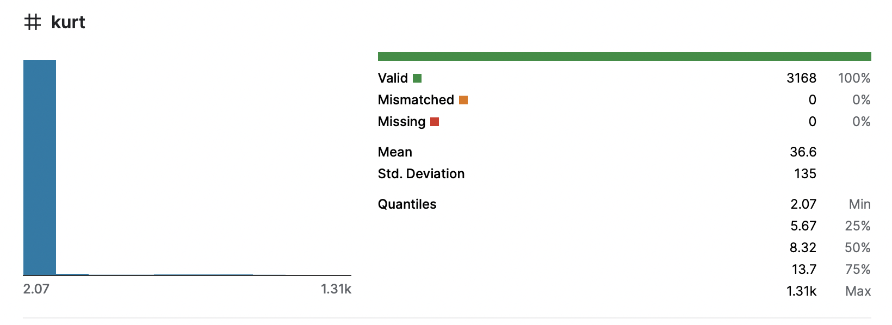
Pre-processing
Clean ✓
No empty values ✓
Normalization (Pandas, Sklearn)
Notes:
While the values of most attributes are between 0 and 2, kurt takes value from 2 to 1.31k.--> normalization

Slide 4
Algorithms
 | Parameters
KNN | Automatically best k value between 1 and 20
RIPPER | (default)
SVM | Non-linear
Multilayer Perceptron | 1 hidden layer, num_neurons = (num_attributes + num_classes) /2
C4.5 | (default)
Testing option: Cross-Validation with 10 folds

Slide 5
Feature Subset Selection
 | Attribute Evaluator | Method
Univariate | Gain Ratio (threshold = 0.1) | Ranker
Multivariate | CFS | Ranker
Wrapper | Wrapper | BestFirst

Slide 6
Results
Winner in every algorithm
Winner in every feature selection
 | KNN | RIPPER | SVM | NN | C4.5
All variables | 98.1061% | 96.8750% | 97.7273% | 97.6641% | 96.6856%
Univariate (7 variables) | 98.2955% | 97.0960% | 97.1907% | 97.6641% | 97.1907%
Multivariate (2 variables meanfun, IQR ) | 96.8750% | 97.0013% | 95.8018% | 96.8119% | 96.8119%
Wrapper | 98.4217% | 97.5379% | 97.6957% | 97.9482% | 97.5694%

Slide 7
Relevant and redundant attributes
Relevant
meanfun
Redundant
kurt

Slide 8
KNN
 | KNN
All variables | 98.1061%
Univariate (7 variables) | 98.2955%
Multivariate (2 variables meanfun, IQR ) | 96.8750%
Wrapper (7 variables) | 98.4217%
KNN is sensitive to irrelevant variables

Slide 9
RIPPER
 | RIPPER | Num of rules | Common rule
All variables | 96.8750% | 11 | meanfun + IQR → female
Univariate (7 variables) | 97.0960% | 8
Multivariate (2 variables meanfun, IQR ) | 97.0013% | 6
Wrapper (5 variables) | 97.5379% | 6 | meanfun + IQR → male
RIPPER is not very sensitive to irrelevant variables

Slide 10
SVM
 | SVM
All variables (20 variables) | 97.7273%
Univariate (7 variables) | 97.1907%
Multivariate (2 variables meanfun, IQR ) | 95.8018%
Wrapper (14 variables) | 97.6957%
Accuracy decreases when discarding attributes
Notes:
Accuracy decreases when discarding attributes

Slide 11
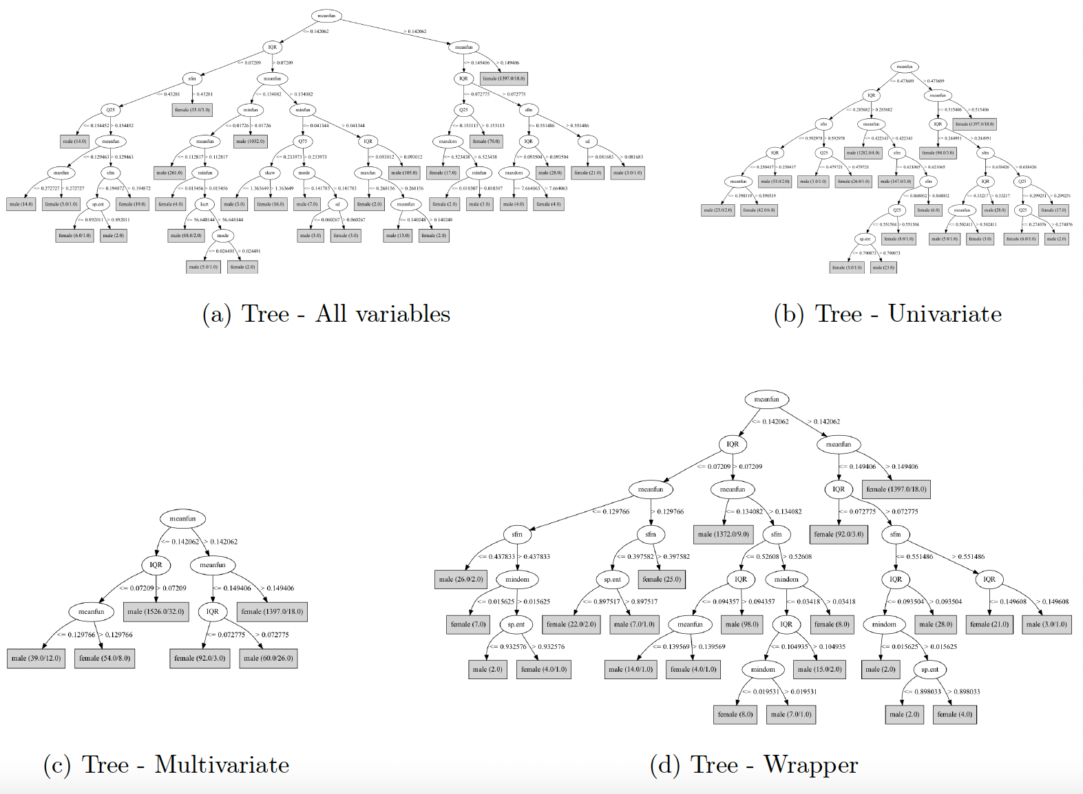
C4.5
 | C4.5
All variables | 96.6856%
Univariate (7 variables) | 97.1907%
Multivariate (2 variables meanfun, IQR ) | 96.8119%
Wrapper (5 variables) | 97.5694%

Slide 12
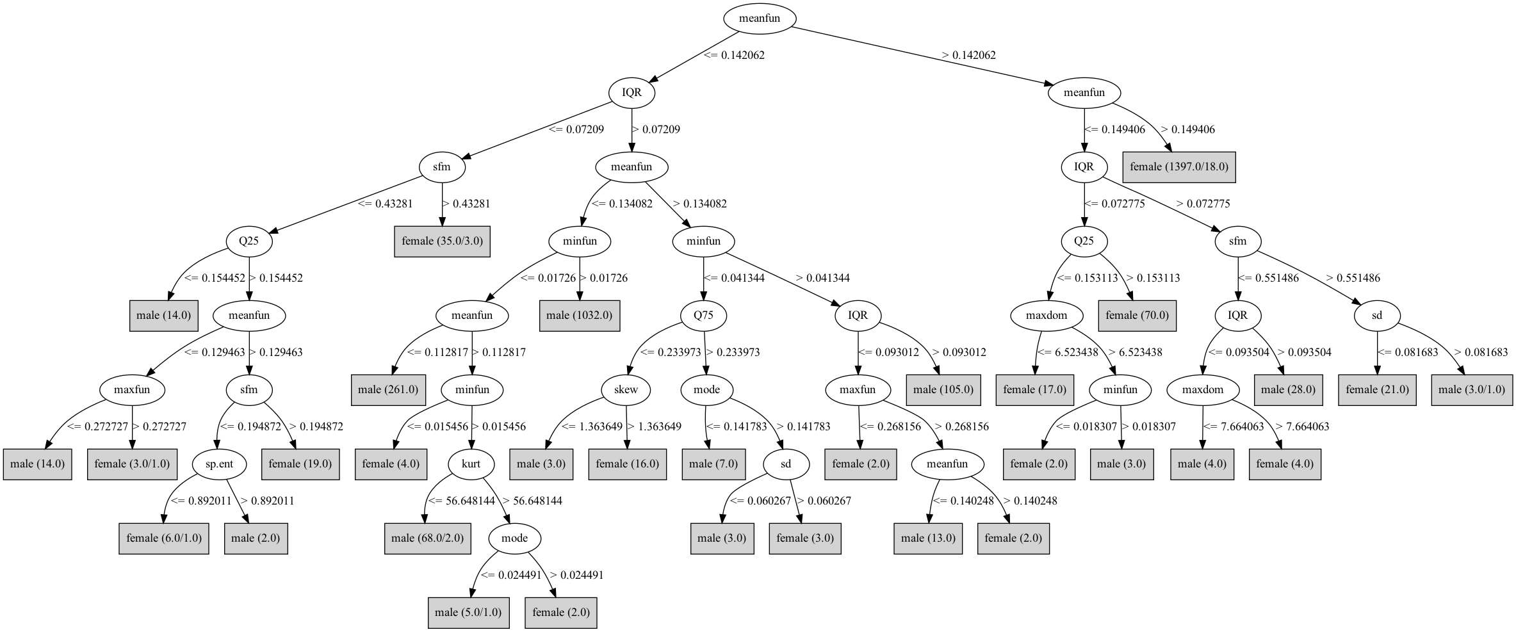
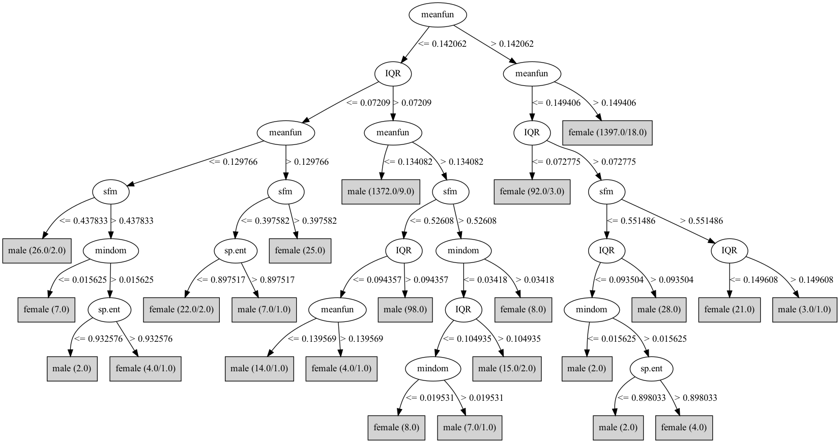
All variables
Wrapper (5 variables)

Slide 13
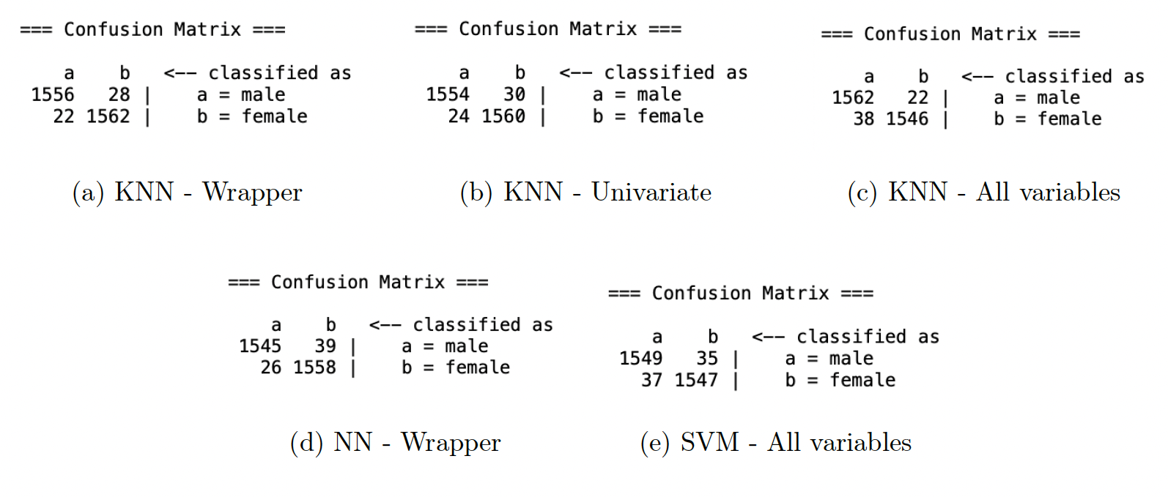
Confusion Matrix

Slide 14


Conclusion
KNN & RIPPER
Wrapper approach
meanfun & IQR → 95%

