Slide 1
Articulating the Enduring eCrime Challenges and Research Approaches to Engage Them
APWG/eCrime Researchers Summit
Tacoma, WA, October 21st, 2009
Joe St Sauver, Ph.D. (joe@uoregon.edu or joe@internet2.edu)
Security Programs Manager, Internet2
University of Oregon and Internet2
http://www.uoregon.edu/~joe/apwg2009/
Disclaimer: All opinions expressed in this presentation are those of the author, and do not necessarily represent the opinion of any other organization or entity.

Slide 2
Introduction
I'll keep these slides brief because (a) this is a panel, and
(b) these remarks are just meant to briefly describe a few of thoughts to "prime the pump" or to help "set the stage" -- they're not meant take up a disproportionate amount of the panel's time.
Our panel's charge is to "articulate the enduring ecrime challenges and research approaches to engaging them,"
and I do want to talk about a couple of those challenges.
Before we talk about the "enduring challenges" we face, however, I want to take a moment to recognize that we HAVE made tremendous collective progress against cyber criminals.
The model that seems to work is actually rather simple…

Slide 3
Data, Analysis, Collaboration, Action
Critical data-driven technical resources now inhibit the bad guys' ability to operate safely online (examples of these resources include, but are certainly not limited to, Spamhaus's block lists, SURBL, Phishtank, Virustotal, Threat Expert, ISC SIE, BFK Passive DNS, etc.)
Analyses based on these (and other) data sources have resulted
in action: civil enforcement is occurring, criminal investigations and prosecutions have happened, civil judgments are being obtained, exploitable online resources are being secured, etc.
Collaborations between academia, private sector entities, and government/law enforcement entities are strong and continue to improve.
A nice example of all this is the May 2009 DDCSW workshop.

Slide 4
Data Driven Collaborative Security Workshop (DDCSW) For High Performance Networks
DDCSW was an invitational 60 person Internet2 workshop sponsored by a grant from the US Department of Justice. It was
held at the U of MD Baltimore County, on May 21-22, 2009.
Attendees were split roughly in thirds between academia, private sector participants, and government/law enforcement people
DDCSW was based around the "data, analysis, collaboration, action" framework I've just mentioned, and a report from the workshop (including a pointer to the presentations is available, see http://www.uoregon.edu/~joe/ddcsw-fmm/ddcsw-fmm.pdf
Question: Should we hold another DDCSW in spring 2010?
If you're interested in hosting such a workshop (or presenting or attending DDCSW II, assuming we hold it), please let me know. We'd also love to hear about topics you'd like to see covered.

Slide 5
So What About These "Enduring Challenges?"
Assuming we don’t have the resources to work on "everything," what should be our top cyber crime priority today?
Notwithstanding the fact that I'm a senior technical advisor to the Messaging Anti-Abuse Working Group (MAAWG), I genuinely believe that spam continues to be at the core of the badness we see online, and spam certainly qualifies as a major "enduring challenge," too!
That said, there are many different kinds of spam out there, but the one particular kind of spam that particularly merits focused scrutiny by eCrime researchers is illegal pharmaceutical spam.
In support of that proposal, note that "Canadian Pharmacy" is Spamhaus's #1 worst spammer (see http://www.spamhaus.org/statistics/spammers.lasso ), and that organization is based in the United States (although they use resources from all around the world)

Slide 6
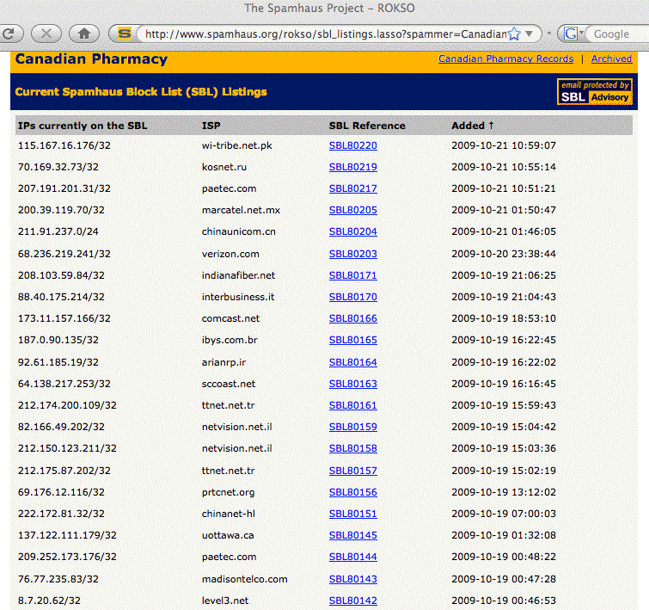
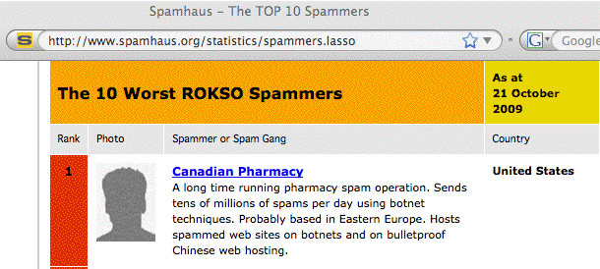

Slide 7
Pillz Sales From the Bad Guy's POV
At least some erectile dysfunction ("ED") drugs sell for ~$20/pill at neighborhood pharmacies, but just ~$2/pill online (and those pills only cost spammers pennies/pill in bulk from overseas manufacturers). Markups are quite good for this type of product.
Insurance plans won't cover ED drugs, and neither are ED drugs available as generics from large discount chain store under chain store $4 per-month-or-$10-for-a-90-day-supply plans. Unable to afford the real thing, users will do what they feel they must.
At least some users are embarrassed when it comes to getting a legitimate prescription from their family doctor and then buying ED drugs from a local pharmacy. Online, they're "anonymous."
Addicts who are unable to obtain legitimate prescriptions for narcotics and other scheduled controlled substances also like the apparent "anonymity" of online purchases (and they'll willingly pay a substantial premium for the drugs their bodies crave)

Slide 8
Pillz Sales From the Bad Guy's POV (2)
Law enforcement risks from selling pillz via spam are minimal (from the bad guy's point of view). Spam cases are complex and hard to prosecute, and spam, like most white collar crimes, isn't an viewed as being "on par" with crimes of violence. That is, you're unlikely to be investigated; if you are investigated, you're unlikely to be prosecuted; if you're prosecuted you're unlikely to be convicted; if you're convicted, you likely won't get hard time.
While the Drug Enforcement Administration focuses on criminal enforcement of laws relating to controlled substances, online pharmacies which carefully avoid controlled substances are under the jurisdiction of another agency, the Food and Drug Administration, a woefully understaffed and overworked agency.
Immigration and Customs Enforcement (ICE) can only inspect a small fraction of each day's flood of incoming parcels. Our borders are porous to most small packages containing pills.

Slide 9
Spammers Aren't Repacking Pillz in the Garage
Sometimes people have a mental image of spammers taking orders in their home office and then repacking bulk pillz into retail quantities in their garage or something of the sort. This is not a correct mental model (or at least it isn't most of the time)
A more realistic model would be a specialized ecosystem, with
various interlocking complimentary parts:
_x0011_ affiliate programs generate visits to pharma web sites,
typically via email spam or web spam
_x0011_ high risk payment processing firms specialize in processing
credit card payments for the online drug orders
_x0011_ drop shippers handle actual backend order fulfillment
_x0011_ bad guys make lots of $$$, and that's without hustling sales
leads themselves, or counting pills, or taking much risk.

Slide 10
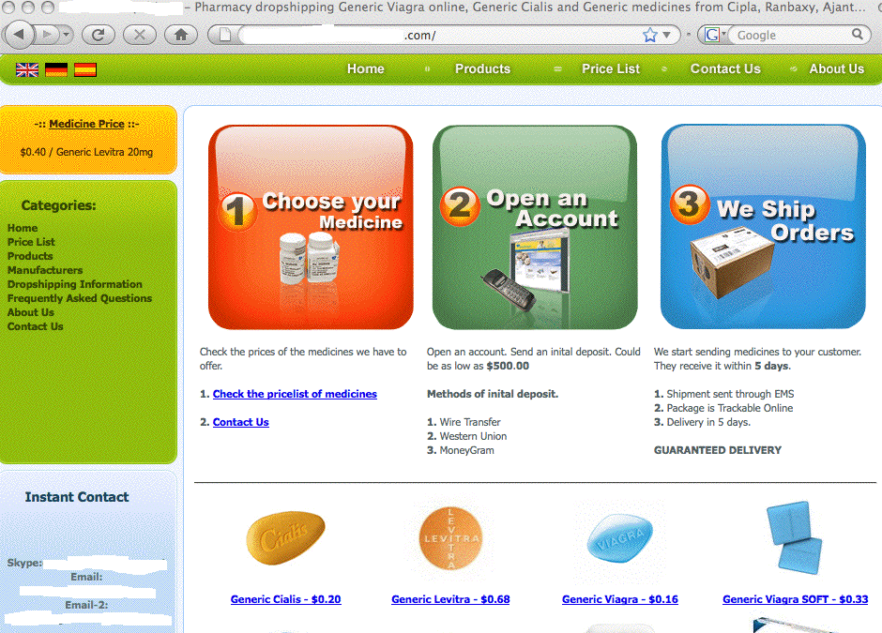

Slide 11
So What's The Problem With All This?
The bad guys deluge our servers with waves of inbound spam
They hijack our PCs and/or user credentials to send outbound spam, sometimes getting entire sites blocked.
This isn't just email spam; they also spam writable web pages
Many pillz sites collect credit card numbers (and other PII) via insecure (non-https) web pages
Pillz obtained online may be adulterated, have little or no active therapeutic ingredient, or end up never getting delivered at all.
Pharmaceutical companies are denied the right to earn a normal return on the products they develop and market.
Prices are pushed up for customers who play by the rules
A lot of money is going into the pockets of some pretty unsavory individuals. While some of that money "just" supports a lavish personal lifestyle, other parts may bankroll bad activities

Slide 12
What We Need For The Pillz Problem
More research on the pillz area in general
More research particularly on Canadian Pharmacy (and related brands used by the same gang):
_x0011_ Investigate/document resources used by Canadian Pharmacy, including online and real world resources
_x0011_ Investigate/document techniques (both technical approaches and business processes) they're using
Put pressure on their advertising/economic model
_x0011_ Search engine providers can track the cost of key products (such as various ED drugs) from legitimate PharmacyChecker approved sites, reporting the low values for suitable search terms
_x0011_ Make it easy for users to report spam-related search results (just as they can flag a spammy Blogspot site, for example)
Press registries for more transparency (e.g., zone file access for dot cn domains), and insist on accurate whois data (WDPRS)

Slide 13
Some Other Areas in Need of Attention
Advanced fee fraud ("419") scam spam is getting out of control. You *know* it is getting out of control when the thumb their nose at even the FBI, sending mail purporting to come from
FBI Executive Director Robert Mueller. (And yes, I know no one could possibly be dumb enough to fall for these scams, but…
yes, some people actually do).
Bulk web email account creation: if the bad guys can create
tens or hundreds of thousands web email accounts per day
(and they can and do!), can the abuse handling efforts of major providers respond to that flood of abuse? I have my doubts.
Our ability to investigate/block spam that only involves phone numbers as points of contact is crude. We need the equivalent of Spamhaus for the VoIP and throw away cell phone numbers used by diploma spammers, mortgage spammers, etc., including both a web interface and an API-oriented DNS-based interface.

