Slide 1
Successful Non-Governmental
Threat Attribution, Containment and Deterrence: A Case Study
Joe St Sauver, Ph.D.
joe@internet2.edu or joe@uoregon.edu
Internet2 Nationwide Security Programs Manager
November 2nd, 2010, 1:15-2:30 PM, Chancellor I
http://pages.uoregon.edu/joe/attribute-contain-deter/
Disclaimer: The opinions expressed are those of the author and
do not necessarily represent the opinion of any other party.

Slide 2
I. Introduction

Slide 3
Cyberspace: Anonymous and Undeterred?
General Keith Alexander, Director of the National Security Agency (DIRNSA), recently commented [1] that in cyberspace:
“It is difficult to deliver an effective response if the
attacker's identity isn't known,” and
“It is unclear if the government's response to cyber
threats and attacks have deterred criminals,
terrorists, or nations.”
That's a provocatively framed (if equivocal) assessment, and one worthy of careful consideration given its source.

Slide 4
Is The Concept of Deterrence Even Relevant to
Attacks on Private Critical Cyber Infrastructure?
In pondering that quote, I also note the National Research Council's (NRC's) “Cyber Deterrence Research and Scholarship” question number 39, [2] which asked:
How and to what extent, if at all, is deterrence applicable
to cyber attacks on private companies (especially those that
manage U.S. critical infrastructure)?
Since the Office of the Director of National Intelligence (ODNI) requested the NRC's inquiry into cyber deterrence, and since General Alexander is now leading the new United States Cyber Command as well as the National Security Agency, it is appropriate to consider these two questions jointly.

Slide 5
Can We Identify An Example of Successful Attribution and Cyber Deterrence?
If we are to prove that cyber deterrence is both relevant and possible, and that the difficulties associated with attribution can be overcome, we must be able to point to at least one example of successful attribution and cyber deterrence.
I believe that there is at least one noteworthy example
of successful non-governmental cyber threat attribution, containment and deterrence, and that’s in the area of spam.
I refer, of course, to the Spamhaus Project's
global anti-spam efforts.

Slide 6
But Is ANY Part of Information Technology Really “Critical Infrastructure?”
There's a temptation to paraphrase Mr. Justice Stewart's famous remark from his concurring opinion in
Jacobellis v. Ohio [3] -- when it comes to critical infrastructure, like some other things, "we know it when we see it.”
For example, if you were to ask average Americans to describe some "critical infrastructure," their responses would surely includes things such as the national power grid and key energy pipelines, dams, major airports, our interstate highways and critical bridges, banks and stock exchanges, chemical plants and refineries, etc.
It is inconceivable that anyone responsible for our homeland security would disagree that those facilities
are part of our nation’s "critical infrastructure.”

Slide 7
Formal Definitions of Critical Infrastructure
But did you know that critical infrastructure has a formal definition which has evolved over time? E.G., in 2004, in "Critical Infrastructure and Key Assets: Definition and Identification," the Library of Congress Congressional Research Service examined the evolution of the term "critical infrastructure" over a period of 20 years. [4] While infrastructure components were added or subtracted overt that time span, "information systems" (or "information technology") has been part of all definitions of "critical infrastructure" since 1998, and "telecommunications” has been part of "critical infrastructure" since at least 1996.
Some, such as Theodore Gyle Lewis, go so far as to assert that telecommunications was the earliest critical infrastructure sector, dating to the telecommunication failures of the Cuban Missile Crisis in 1962. [5]

Slide 8
Information Technology Unequivocally Remains
Part of “Critical Infrastructure” Today
The Department of Homeland Security makes it clear
that "Information Technology" remains a key part of critical infrastructure sector today. According to DHS, the Information Technology sector plays a role which is...
central to the nation's security, economy, and public
health and safety. Businesses, governments, academia,
and private citizens are increasingly dependent upon
IT Sector functions. These virtual and distributed
functions produce and provide hardware, software, and
IT systems and services, and -- in collaboration with
the Communications Sector -- the Internet. [6]

Slide 9
Critical IT Infrastructure Isn’t Just Hardware
In thinking about information technology and telecommunications, it is tempting to focus on just tangible assets -- computers, fiber and copper circuits, routers, switches, and other hardware.
"Infrastructure” unquestionably includes those sort of physical assets, but is that ALL it includes?
We must remember that physical information technology assets have little intrinsic value in and of themselves, divorced from the protocols, operating systems, and applications running on those assets, and the information, transactions, and relationships that that software and hardware combine to enable.
Applications can be critical, too.
So what happens if email isn't available?

Slide 10
Email Outages Can Be Paralyzing
Consider the January 2009 White House email outage which lasted over eight hours. [7]
While it was reported that "there was no indication that the outage caused any sort of national calamity," it was also reported that "several administration officials said that business had ground to a halt because of the disruption."
In general, however, because email is architected as a distributed and survivable service, even if email service fails at a single site (even a site as important as the White House), email usually continues to be available elsewhere.

Slide 11
How Might You “Kill” Email Worldwide?
We can, however, imagine scenarios under which email would NOT be available/usable worldwide.
Prime among those scenarios would be a failure of spam filtering.
Email may not be the New York Stock Exchange (NYSE) or the international air traffic control system, but email is unquestionably essential to every modern organization, a point which is quickly driven home when even brief partial outages occur.
Without effective anti-spam measures, email would quickly degenerate into unusability. Skeptics can verify this by briefly disabling their own spam filtering!
Spamhaus is a key part of protecting the email infrastructure worldwide. Let’s review a little about what Spamhaus offers to the community.

Slide 12
II. Understanding Spamhaus

Slide 13
A Brief Overview of the Spamhaus Project
Because many may never have heard of the Spamhaus Project, and even among those who have heard of it, there are often misconceptions about what the Spamhaus Project is, how it operates, the size of its user base, etc., let’s begin with a brief overview of it.
Since we're not members of the Spamhaus Project team, for the purpose of this talk we'll primarily rely on the description of the Spamhaus Project that's available from its website. [8]
Condensing that description into bullet format…

Slide 14
Spamhaus Organization and Mission
Organization: The Spamhaus Project is an international nonprofit organization, founded in 1998, and based in Geneva and London.
Mission: The Spamhaus Project's mission is to:
-- track the Internet's spam operations,
-- to provide dependable real time anti-spam protection
for Internet networks,
-- to work with law enforcement agencies to identify
and pursue spammers worldwide, and
-- to lobby governments for effective anti-spam
legislation.

Slide 15
Spamhaus Funding, Staffing and Leadership
Funding: Funding for operations is through sponsors and donations from industry, including from The Spamhaus Foundation, a private Foundation whose charter is to assure the long-term security of The Spamhaus Project and its work.
Staffing: The Spamhaus Project is staffed by volunteers, including 28 investigators and forensic specialists located in 8 countries.
Leadership: Steve Linford, Founder and CEO

Slide 16
Spamhaus Infrastructure, Market Presence, And Information Products
Infrastructure: Spamhaus has built one of the largest DNS infrastructures in the world. Its network of over 60 public DNSBL servers spread across 18 countries serves many billions of DNSBL queries to the public every day, free of charge.
Market Presence: The mailboxes of over 1.4 billion Internet users are currently protected by Spamhaus DNSBLs. [9]
Information Products: Spamhaus is best known for its real time block lists, such as the SBL (Spamhaus Block List).

Slide 17
SBL (The Spamhaus Block List)
Operationally, the Spamhaus Project provides its six primary anti-spam block lists via the domain name system (high volume sites make arrangements to do zone transfers and run private mirrors of the Spamhaus block list zones locally).
The first of those six block lists is the SBL. [10]
  The Spamhaus Block List ("SBL") Advisory is a database of IP addresses which do not meet Spamhaus's policy for acceptance of inbound email and therefore from which Spamhaus does not recommend the acceptance of electronic mail.
  IP addresses are listed on the SBL because they appear to Spamhaus to be under the control of, or made available for the use of, senders of Unsolicited Bulk Email ("spammers").
  The SBL database will normally include IPs identified to Spamhaus's best ability as likely direct spam sources, spammer hosting/DNS, spam gangs and spam support services. [...]

Slide 18
SBL (The Spamhaus Block List) (cont.)
The criteria for listing IP addresses in the SBL are:
  Spam Sources: Sources of unsolicited bulk email sent to Spamhaus spamtraps or submitted to Spamhaus by trusted 3rd party intelligence.
  Spam Services: Servers, including mail, web, dns and other servers identified as being an integral part of a spam operation or being under the direct control of spammers.
  Spam Operations: Known spam operations and gangs listed in Spamhaus ROKSO registry, including preemptively listing new IPs each time known spammers move to new hosts.
  Spam Support Services: Services providing service to known spam operations listed on ROKSO, services providing 'bullet-proof hosting' for spam service purposes, services obfuscating or anonymising spam senders, services selling or providing hosting for the sales or distribution of spamware or address lists, and networks knowingly hosting spammers as either stated or de facto policy.

Slide 19
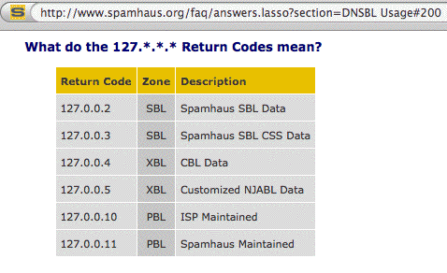
SBL Values Returned via DNS
The SBL returns coded DNS values to signal when a site has been listed. For example, manually checking 88.255.78.101:
% dig +short 101.78.255.88.sbl.spamhaus.org
127.0.0.2

Slide 20
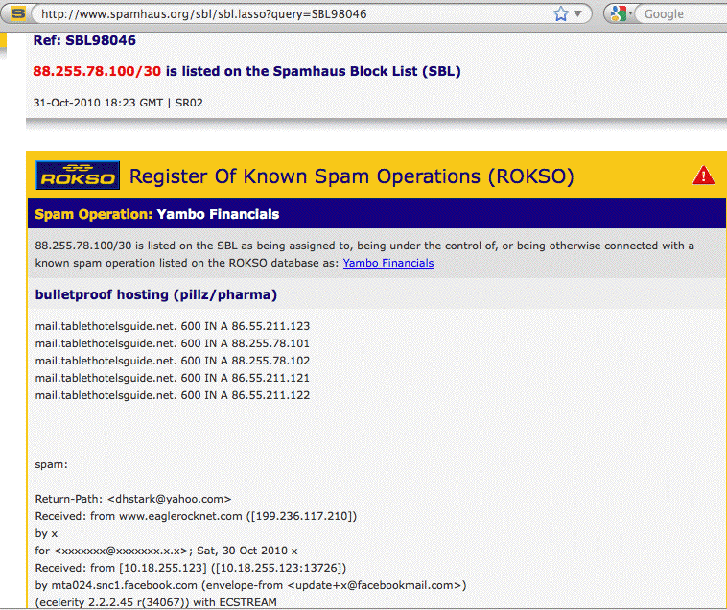
Sample SBL Listing Web Page

Slide 21
Key SBL Take-Aways
IP address ranges are manually added to the SBL (removal requests are also handled manually)
SBL listings list spammer controlled network resources
All SBL listings are documented on the Spamhaus web site
SBL listings are attributed/associated with spammers by name or spam outfit when that connection can be made
If spammers only spammed from their own dedicated address space, this would be all we’d need to block spam
But, because spammers find it difficult to spam once their network addresses have been listed, most spammers send via bots. Individual botted hosts are not listed on the SBL.
Botted hosts spewing spam are addressed via the XBL, derived from the CBL, which we’ll cover next.

Slide 22
XBL (The Spamhaus Exploits Block List)
The Spamhaus Exploits Block List (XBL) [11] is a realtime database of IP addresses of hijacked PCs infected by illegal 3rd party exploits, including open proxies (HTTP, socks, AnalogX, wingate, etc),
worms/viruses with built-in spam engines, and
other types of trojan-horse exploits. [...]
The XBL wholly incorporates data from two highly-trusted DNSBL sources, with tweaks by Spamhaus to maximize the data efficiency and lower False Positives. The main components are:
- the CBL (Composite Block List) from cbl.abuseat.org
- the NJABL Open Proxy IPs list from www.njabl.org.

Slide 23
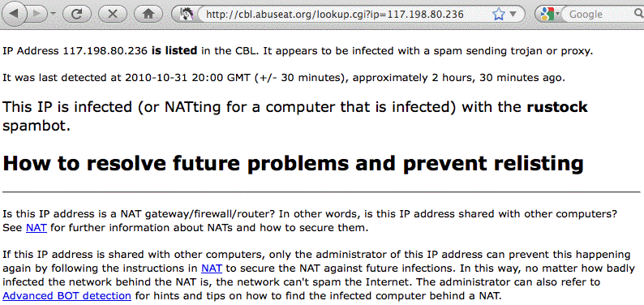
Sample CBL/XBL Listing

Slide 24
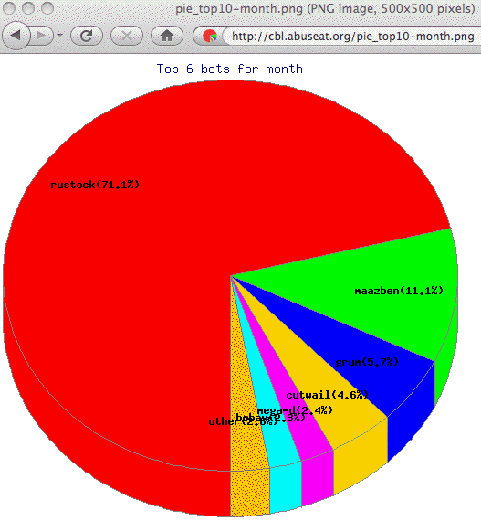
The CBL Has Many Interesting Statistics…
E.G., One Bot Dominates All Bot Spam Output

Slide 25
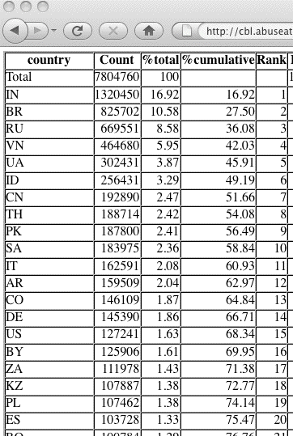
Bots in Just 20 Countries Do 75% of Bot Spam

Slide 26
Key XBL Takeaways
XBL lists individual IP addresses (not IP address ranges, as the SBL does)
XBL listings list compromised (or “botted”) malware infected end user hosts observed to be sending spam
IPs are mechanically/automatically listed on the XBL based on non-disclosed but apparently quite reliable indicia
IPs can be manually delisted by the system owner (after all, if they get used to send spam again, they’ll just end up quickly relisted).
IP addresses that haven’t been seen spamming for some time will be automatically “aged out”
Roughly 8 million hosts are currently on the XBL
Botted computers in just 20 countries account for 3/4ths of all the botted computers sending spam worldwide.

Slide 27
Non-Mail-Server Address Space
Consumer PCs normally get their IP address via DHCP.
This means that the address I use today may have been used by you an hour ago, and someone else yesterday, and still another person may use it tomorrow. There’s no way to meaningfully accumulate “reputation” information about senders on dynamic addresses because so many different people may sequentially be using a single IP.
Moreover, many ISPs prohibit consumers from running connections on dynamic addresses – if you want to run a mail server or web server, you’re supposed to be paying more to get a static IP address and a “business-class” connection which will explicitly permit you to run servers.
Consumers on dynamic addresses, therefore, should not be running servers on dynamic addresses.
The Spamhaus PBL (Policy Block List) formalizes that…

Slide 28
PBL (The Spamhaus Policy Block List)
The Spamhaus PBL [12] is a DNSBL database of end-user IP address ranges which should not be delivering unauthenticated SMTP email to any Internet mail server except those provided for specifically by an ISP for that customer's use.
The PBL helps networks enforce their Acceptable Use Policy for dynamic and non-MTA customer IP ranges. [...]
The PBL lists both dynamic and static IPs, any IP which by policy (whether the block owner's or -interim in its absence- Spamhaus' policy) should not be sending email directly to the MX servers of third parties.

Slide 29
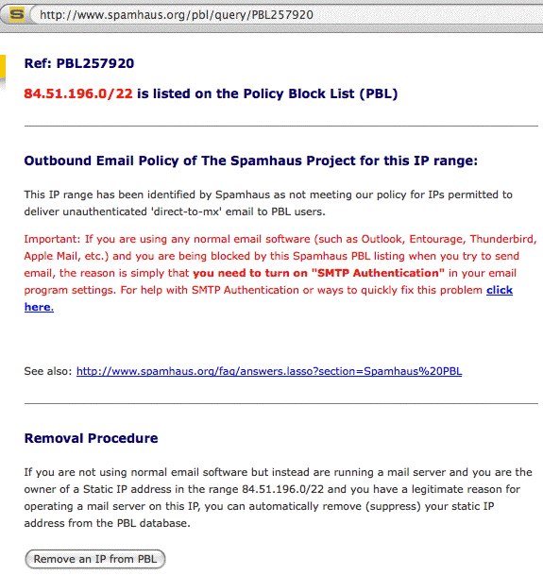
Sample PBL Listing

Slide 30
How Are End Users Supposed
To Send Email Then???
End users should be sending their outbound email via
the ISP’s own customer-facing mail server, and that customer-facing mail server should be accepting that end user email traffic on port 587 (the “Submit” service).
Port 587 traffic should be authenticated (e.g., the user should need to supply their username and password before being allowed to hand off their email traffic), and the port 587 traffic should be employing TLS encryption to protect those credentials from eavesdropping.
Note that email coming from sites that follow this recommendation will be attributable since those messages will have been injected by an authenticated user, and the ISP could record that identity as part of a clear text or cryptographic X-header added to each message.

Slide 31
ZEN: SBL+XBL+PBL
Q. “I’ve heard we use the Spamhaus ‘Zen’ block list – what’s that?”
A. For efficiency sake, Spamhaus offers a combined zone the includes all three of their main block lists: Zen is the union of the SBL+XBL+PBL, which means that a mail server can query all three lists with a single DNS lookup.

Slide 32
DBL (The Spamhaus Domain Block List)
The preceding block lists were all oriented toward IP addresses, or IP address ranges. But what about domain names? Domain names can accrue reputation as well…
The Spamhaus DBL [13] is a realtime database of domains (typically web site domains) found in spam messages.
Mail server software capable of scanning email message body contents for URIs can use the DBL to identify, classify or reject spam containing DBL-listed domains.
The DBL is queriable in realtime by mail systems throughout the Internet, allowing mail server administrators to identify, tag or block incoming email containing domains which Spamhaus deems to be involved in the sending, hosting or origination of Unsolicited Bulk Email (aka "Spam"). [...]

Slide 33
DBL (The Spamhaus Domain Block List) (cont.)
The DBL is both a domain URI Blocklist and RHSBL [“right hand side block list”].
It is intended primarily for message body URI checks but it can additionally be used for connection checks at the SMTP level and header domain checks (HELO, connecting IP rDNS domain, From & Reply-To domains, Message-ID domain) and other checks involving domains.
In a nutshell, if you see a domain in a mail message’s headers or a mail message body, think,
“I wonder if it’s on the Spamhaus DBL?”

Slide 34
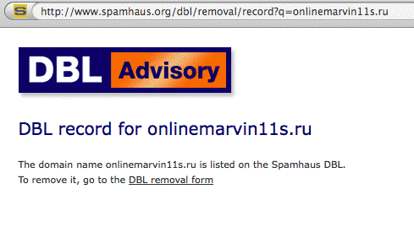
Sample Spamhaus DBL Entry

Slide 35
Spamhaus Whitelists: The SWL
The Spamhaus Whitelist [14] is a realtime database of IP addresses and domains which have passed security checks and whose owners/operators agree to the strict terms of the Spamhaus Whitelist program.
It allows internet mail servers to separate incoming email traffic into 3 categories: Good, Bad and Unknown, allowing mail server operators to block known bad email traffic, let known good email traffic pass safely, and heavily filter unknown email sources. […]
The IP Address whitelist, the SWL, is designed to contain both IPv4 and IPv6 addresses. Although initially it will contain predominantly IPv4 addresses, it's future primary intended usage is to enable networks to implement IPv6 mail services with control over IPv6 spam.

Slide 36
Whitelists: DWL
The Domain element of the whitelist, the DWL, enables automatic certification of domains with DKIM signatures.
If you’re not familiar with DKIM, it is a cryptographic signature applied to mail by an ISP when the ISP is willing to attest that the mail came from them (or more accurately one of their users). For more on DKIM, see [15].
See also Author Domain Signing Practices (“ADSP”) as described in RFC5617. ADSP is a related protocol which, if used, describes the ISP’s intentions when it comes to DKIM signing messages from its domain. Put simply, ADSP answers the question, “If there’s no DKIM signature on a message, should I accept it anyway?”

Slide 37
ROKSO
Two other Spamhaus information products are also available, although they are delivered via the world wide web, rather than via DNS:
ROKSO (The Spamhaus Register of Known Spam Operations): [16]
The Register of Known Spam Operations (ROKSO)
database collates information and evidence on known
professional spam operations that have been
terminated by a minimum of 3 Internet Service
Providers for spam offenses.

Slide 38
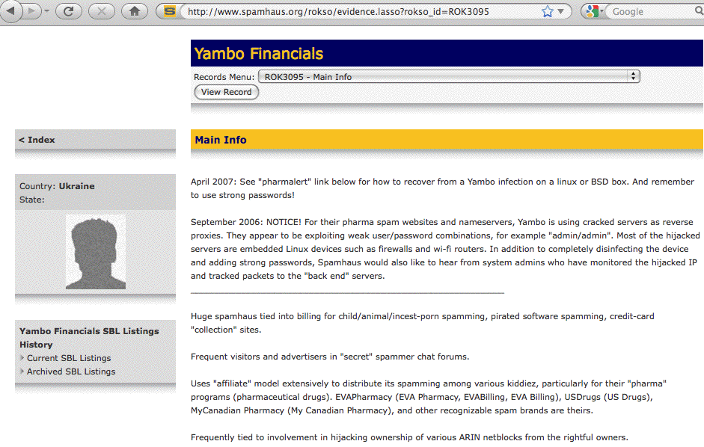
Sample ROKSO Entry

Slide 39
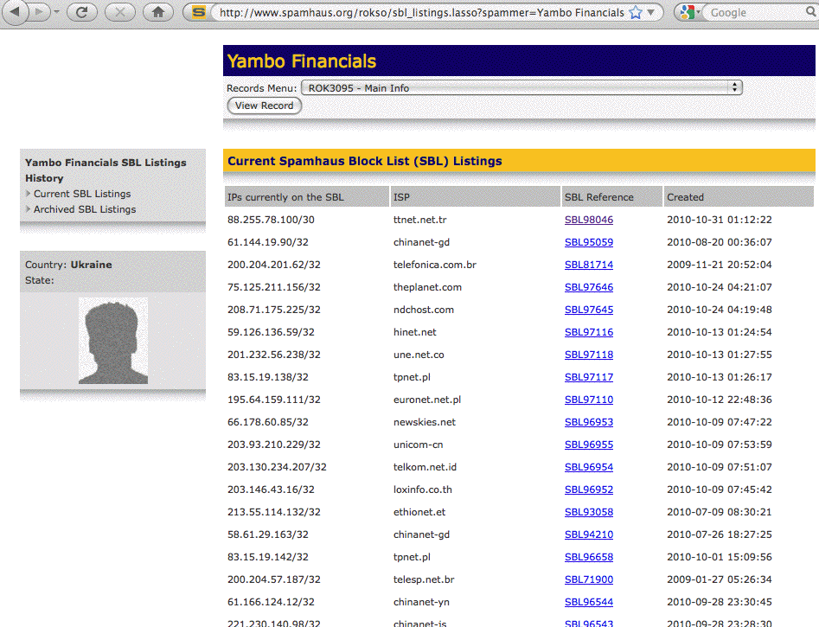
Sample ROKSO Current SBL Listing (Partial)

Slide 40
DROP
DROP (Don't Route Or Peer) [17] is an advisory "drop all traffic" list, consisting of stolen 'hijacked' netblocks and netblocks controlled entirely by professional spammers. DROP is a tiny subset of the SBL designed for use by firewalls and routing equipment.
The DROP list will not include any IP address space under the control of any legitimate network […] DROP will only include netblocks allocated directly by an established Regional Internet Registry (RIR) or National Internet Registry (NIR) such as ARIN, RIPE, AFRINIC, APNIC, LACNIC or KRNIC or […] "hijacked" IP address blocks that have been snatched away from their original owners (which in most cases are long dead corporations) and are now controlled by spammers or netblock thieves who resell the space to spammers.

Slide 41
Why Would A Site Use DROP?
When implemented at a network or ISP's 'core routers', DROP will help protect the network's users from spamming, scanning, harvesting, DNS-hijacking and DDoS attacks originating on rogue netblocks.

Slide 42
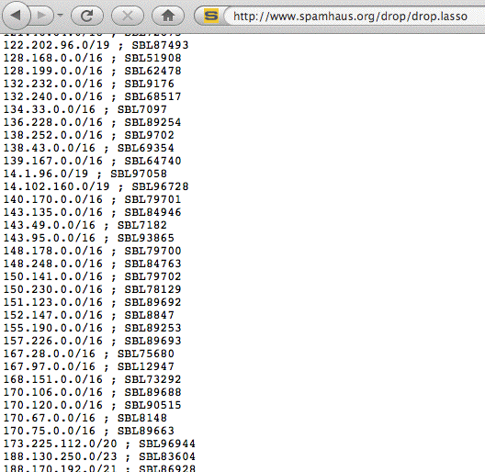
Part of the Current DROP List

Slide 43
Spamhaus Also Tabulates Three “Top Ten” Lists
In addition to everything else Spamhaus produces, they also produce three “top ten” summary lists based on SBL listings.
Those three top ten lists are:
-- the ten worst spam gangs
-- the ten worst spam support ISPs, and
-- the ten worst spam countries

Slide 44
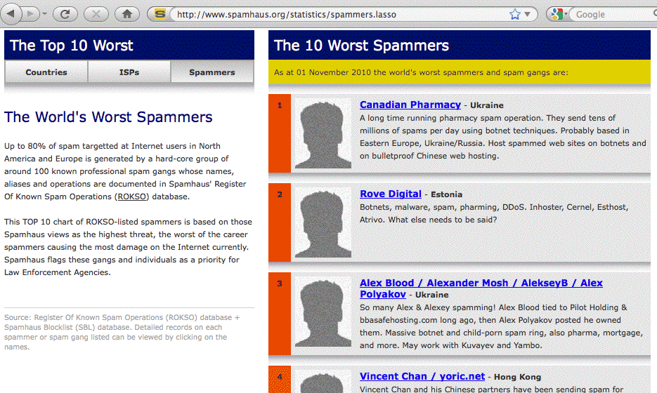
Spamhaus List of Top 10 Worst Spammers

Slide 45
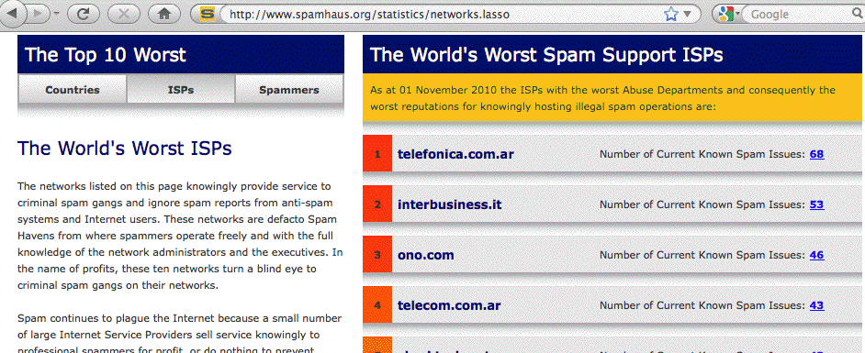
Spamhaus List of Top 10
Worst Spam Support ISPs

Slide 46
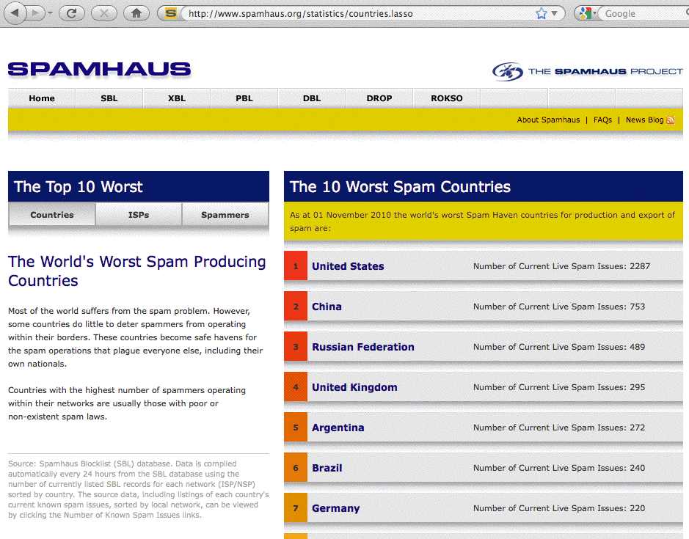
Spamhaus List of Top 10 Worst Spam Countries

Slide 47
We Recognize That’s a Blizzard of Data…
It is easy to be overwhelmed by the sheer volume of spam-related intelligence that Spamhaus tracks.
Let me make a shot at summarizing all those information products in a single table for you…

Slide 48
Spamhaus Information Product Summary
Name | Focus | Listing? | Auto? | Approx. Size? | DNS or HTTP? | Black or White?
SBL | Spammer Resources | CIDR | No | N Thousands | DNS | Black
XBL | Botted Hosts | IP | Yes | N Millions | DNS | Black
PBL | Non-Mail Server Addrs | CIDR | No | N Thousands | DNS | Black
DBL | Spam Domains | Domain | No | N Thousands | DNS | Black
SWL | Good IPv4/IPv6 IPs | CIDR | No | N Thousands | DNS | White
DWL | Good Domains | Domain | No | N Thousands | DNS | White
ROKSO | Professional spam gangs | Identity | No | ~Hundred | HTTP | Black
DROP | 100% Bad Netblocks | CIDR | No | ~Hundred | HTTP | Black
 | Top 10 Worst Spammers | Identity | Yes | Ten | HTTP | Black
 | Top 10 Worst ISPs | Identity | Yes | Ten | HTTP | Black
 | Top 10 Worst Countries | Identity | Yes | Ten | HTTP | Black

Slide 49
Those Information Products Are The Key To Spamhaus’ Online Impact and Influence
Collectively, that set of privately operated and maintained anti-spam information products comprise the most widely used and most widely respected cyber threat detection, attribution, containment and deterrence activity in existence on the Internet today.
Some Spamhaus resources, such as the industry-wide intelligence collected and presented in the Spamhaus Project's ROKSO database, literally exists nowhere else on the public Internet.
As a result, many ISPs rely on the SBL and the ROKSO in deciding what new customers to accept, and what existing customers to drop

Slide 50
ISPs Using the Spamhaus Lists For Customer AUP/TOS and Vetting Purposes
If you're a ROKSO-listed spammer, you may find it hard to find an ISP which will let you sign up. For example, consider the following excerpts from a number of providers' acceptable use policy/terms of service (emphasis added in each case by me):
Comcast Business: [18]
[...] any use of the Service or its features that results in your business' Service account, or any associated Comcast information, being listed on, for example, spam reporting web sites such as Spamhaus, SBL, ROKSO, TrendMicro Maps, or SenderScore Blocklist, or anti-phishing or anti-spyware services, may result in Comcast suspending or terminating your business' Service account.
Hostgator: [19]
No organization or entity listed in the ROKSO may be hosted on our servers. Any account which results in our IP space being blacklisted will be immediately suspended and/or terminated.

Slide 51
More Examples
Hurricane Electric: [20]
Blacklists - No customer shall do anything that could get any portion of Hurricane's IP space (or address space announced by Hurricane on behalf of Customer) put on blacklists such the SBL (Spamhaus Block List) as maintained by Spamhaus
(http://www.spamhaus.org/) or other similar organizations, or perform activities that would cause portions of the Internet to block mail or refuse to route traffic to any portion of Hurricane's IP space (or address space announced by Hurricane on behalf of Customer).
Level 3: [21]
Level 3 may in its sole discretion rely upon information obtained from anti-spamming organizations (including for example and without limitation spamhaus.org, spamcop.net, sorbs.net, and abuse.net) as evidence that a User is an active "spam operation" for purposes of taking remedial action under this Policy.

Slide 52
More Examples (2)
Limestone Networks: [22]
If any client or any third-party user that is a
customer of our client uses Limestone Networks services, network, or its physical infrastructure in a manner that causes Limestone Networks, or any IP addresses issued
by Limestone Networks to be "blacklisted" or "blocked", Limestone Networks reserves the right to suspend or terminate services of such client and/or suspend
or terminate the access to services, network, and/or its physical infrastructure. Operating Limestone Networks service on behalf of, or in connection with or reselling
any service to persons or firms listed in the Spamhaus Register of Known Spam Operations database at www.spamhaus.org shall constitute a violation of this AUP.

Slide 53
More Examples (3)
Rackspace: [23]
Complaints from email recipients and third party abuse agencies (e.g. SpamHaus or Spamcop) shall be deemed proof of the facts stated therein unless you provide compelling evidence to the contrary.
ThePlanet: [24]
Operating The Planet Service on behalf of, or in connection with, or reselling any service to persons or firms listed in the Spamhaus Register of Known Spam Operations database at www.spamhaus.org shall constitute a violation of this AUP. Block Removal – If, as a result of a Customer’s actions, The Planet’s mail servers or IP address ranges are placed on black hole lists or other mail filtering software systems, The Planet shall charge Customer $100 upfront and $100 per hour thereafter for any necessary remedial actions.

Slide 54
This Sort of Screening Is Partially
A Matter of ISP Self-Preservation
Once address space has gotten listed on block lists, it is most definitely “damaged goods,” and these days, as we get close to running out of IPv4 address space, no ISP wants to be stuck with huge blocks of IP addresses that have been abused into unusability by spammers.
After all, what “lucky” new customer would want to be reassigned some previously damaged block of addresses, and then have to spend substantial time and effort “rehabilitating” those addresses by getting them delisted from block lists all over the world?
Some IP addresses may even be on non-public block lists – how would you even know to ask to have your addresses delisted at those sites, eh? There’s no way you’d even know you had a delivery problem there…

Slide 55
III. Why Has Spamhaus
Been Able To Be So Influential?

Slide 56
1.4 Billion Users Are
Protected by Spamhaus
Why are over 1.4 billion users protected by Spamhaus?
Why do ISPs rely on Spamhaus Project intelligence when vetting their potential customers?
Could the United States government (or the European Union, or any government or consortium of governments elsewhere in the world) ever field an equally influential cyber security reputation resource?
If they wanted to even try, what would be the key success factors they’d need to heed?

Slide 57
Spamhaus Meets An Otherwise Unmet Need
Spam is a huge problem, and in blocking much spam outright, Spamhaus met an otherwise unsatisfied important need.
Since Spamhaus is effectively the “state of the art” for anti-spam block lists, any potential competitor to Spamhaus would need to offer at least as competitive a service, or at least help with some area they haven’t already covered (is there any such area? I’d love to hear your thoughts about anything they may have missed).
Let’s take a minute to talk about some other specific attributes.

Slide 58
High Level of Accuracy
Spamhaus is very, very, careful, and has an excellent reputation for "getting it right."
While no system maintained by humans can ever be totally error free, it is extremely rare for Spamhaus Project data to have "false positives," whether due to typos or other errors.
If a mistake does occur, it can be corrected, and typically does get corrected, extremely rapidly.
In some cases a user can even automatically de-list a listed IP (this is not as daring as it sounds because if the de-listed host is still spamming, it will rapidly be redetected and re-listed, with subsequent auto-delisting suppressed for that IP).

Slide 59
Well Documented
With the exception of the XBL, which uses proprietary methods (aka “secret sauce”) to detect and list botted hosts, [25] Spamhaus is meticulous when it comes to documenting the basis for each of its block list entries, usually showing at least one example for each SBL listing.
In the XBL’s case, because it is listing botted hosts, you will normally be able to scan a listed system with multiple anti-malware products, detecting viruses or other malware and thereby confirming the appropriateness of the listing.

Slide 60
Minimal Collateral Damage
The Spamhaus Project strives to minimize collateral damage by listing the absolute smallest range of IPs needed.
"Escalated" listings, (e.g., listing of larger encompassing network ranges or listings of corporate mail servers),
tend to be used only when an ISP is completely recalcitrant and totally disinterested in addressing its abuse issues.

Slide 61
Timeliness
The Spamhaus Project is very quick when it comes to listing new sources of spam and other abuse.
Because of that quickness, spam from many sources ends up getting blocked while spam runs from those IPs or domains are still in progress.
After all, it wouldn’t do much good to list spam sources a week after spam was last seen – by then, the spammer would have moved on to still other hosts.
Crisp operational execution is key when combating spam.

Slide 62
Equally Quick DE-listing
Spamhaus is unquestionably quick to list new abuse resources, but Spamhaus is also equally quick to delist abused resources once the problem with those resources has been resolved. This is important, because being block listed can really make things screech to a halt until that block listing gets resolved.
Spamhaus does not tend to accumulate a backlog of listings that should have been delisted days earlier.
Spamhaus also has never requested payment of a fee for delisting a site, unlike some other DNS block lists.

Slide 63
Fairness/Evenhandedness
Everyone gets treated the same way by Spamhaus. Spamhaus doesn’t play games and they don't play favorites.
Spamhaus has demonstrated a willingness to list the largest of well known ISPs on terms exactly the same as those applied to the smallest and most obscure.

Slide 64
Reliability and Availability
Due to the Spamhaus Project's distributed and replicated architecture (and the availability of data
via zone transfers for use in private mirrors), the Spamhaus Project is highly available and reliable,
even in the face of determined network attacks.
This is another critical factor. If you’re relying on a
3rd party resource for critical protective functions
such as spam filtering, that data has got to be reliably available. (If spam filtering were suddenly to fail, email might overwhelm provisioned resources, backlogging or crashing critical mail servers)

Slide 65
High Performance
The Spamhaus Project's chosen data distribution mechanism, the domain name system, is capable of delivering very high performance with very low latency.
If Spamhaus had chosen a higher-overhead, lower performing distribution channel (such as http), it is unlikely that they would have been able to achieve the performance that they currently deliver.

Slide 66
Coverage
The Spamhaus Project's coverage is worldwide.
It is not narrowly scoped to just cover one country or some small subset of providers or just one bot.
Its coverage is part of its impact, even though biting off a worldwide task isn’t a minor undertaking, particularly considering things such as language-related issues, time zone issues, etc.

Slide 67
An Ecosystem-Wide Approach
The Spamhaus Project understands that spammers need a variety of services to be able to successfully spam, and thus their coverage spans the breadth of that ecosystem, including things like spamware vendors, so-called "bullet proof hosting," and DNS providers.
Spammers would have a significantly easier time of it if they only had to worry about their actual mail emitting hosts getting block listed.

Slide 68
Standard Setting
Because Spamhaus is so broadly used, it has the ability to establish de facto standards industry wide, including things such as:
-- what constitutes reasonable email sending practices,
-- what's acceptable for list management practices, etc.
Spamhaus does a good job of documenting those best common practices on its website, and because they do, many senders follows those practices and avoid getting listed in the first place.
Spamhaus is also active in the Messaging Anti-Abuse Working Group (MAAWG), the carrier anti-spam forum.
Spamhaus has not been active in the IETF standardizing things such as block list response codes, however (block lists just return response codes as normal A records).

Slide 69
Willingness to Evolve
Spamhaus has been good about evolving its offerings as spammers have evolved their sending sending techniques.
This process has insured that the Spamhaus Project's data remains relevant and efficacious against newly emerging spam threats.
For example, Spamhaus just recently announced their new SWL and DWL white lists, a new approach that’s designed at least to part to allow sites to deal with the potential problem of spam from IPv6 addresses, given that traditional IP-by-IP block lists will scale poorly to the huge address spaces associated with IPv6.

Slide 70
“Best Choice of Multiple Alternatives”
As frustrating as it may be for an ISP to end up listed on any block list, being listed by Spamhaus is still far preferable to other alternatives.
For example, if the Spamhaus block lists didn't exist, a plethora of less professionally run block lists would probably get created, and getting delisted from myriad
ad hoc block lists would be orders of magnitude higher than getting delisted from just one professionally administered source.

Slide 71
IV. Discouraging Problems When Possible; When Deterrence Fails, Containment

Slide 72
Spamhaus Works Best When Its
Sheer Existence Deters Misbehavior
Like any international control regime, Spamhaus workS best when its sheer existence deters abuse.
For example:
-- Because Spamhaus is standing watch, ISPs avoid selling connectivity or web hosting to spammers.
-- Because Spamhaus cooperates with law enforcement, and law enforcement has been prosecuting botmasters, malware authors may be less likely to code and release new spam bots.

Slide 73
When Deterrence Fails, Containment
As influential as Spamhaus is, and it truly is very influential, a small number of spam gangs, typically less than a hundred worldwide, resist playing by the rules. When that happens, and they fail to be deterred from spamming, it is necessary to contain their misbehavior.
Blocking spam by listing IP addresses and domain names is the "stick" that backs up or "enforces" the Spamhaus Project's anti-spam policies. Once that happens, as far as the vast majority of the Internet is concerned, your mail traffic no longer exists. You may be able to try to send it, but most of the Internet simply won't accept it.
This voluntary "blockade," this global “banishment,” dwarfs anything that a national government might be able to orchestrate. That abuse has been effectively contained.

Slide 74
Containment at Origin, En Route, or at Destination?
When we talk about containment, we should recognize that we can potentially contain abuse at the point where it originates, or we can try to interdict that traffic while it is in transit, or we can contain that abuse at its destination network.
Traditional block lists (such as the SBL) protect destination networks by blocking unwanted traffic just before it would enter that destination network.
DROP (do not route or peer) is aimed at interdicting worst-of-the-worst traffic enroute, breaking connectivity between the source of the abuse and the destination.
The XBL and PBL potentially help ISPs to identify and contain unwanted customer traffic at its source.

Slide 75
Walled Gardens/Quarantines
For example, an ISP might decide that if a customer ends up listed on the XBL, they’ll automatically be shunted into a “walled garden” or quarantine VLAN, thereby insuring both:
(a) once quarantined, the botted customer can’t generate spam and other unwanted traffic and
(b) even though they’re quarantined, the botted customer can still access needed network resources to get themselves patched up-to-date and disinfected.

Slide 76
Managing Port 25
In other cases, the PBL has influenced providers to actively manage their port 25 traffic, declining to permit random customers to source or sink port 25 traffic “direct-to-MX.”
Providers who block port 25 traffic, requiring that their users authenticate and send their email via the email servers the provider creates for that purpose, are another nice example of containment at the origin.

Slide 77
Defense In Depth
Because no single containment point can guarantee to provide “leak free containment,” it is important to have “defense in depth.”
That way, if spam escapes from its origin network, it may still be blocked en route.
If not blocked en route, the spam might at least be blocked when it attempts to be delivered to its destination.
If it doesn’t get blocked by a block list at its destination, it may still get filtered based on a more in-depth analysis of the URLs in the body of the message.
This is effective containment via defense in depth.

Slide 78
V. Attribution

Slide 79
Spoofed Traffic
Often when we think about network attack traffic, we worry about things like spoofed UDP traffic: if source networks don’t filter spoofed traffic at their border, before it escapes, anyone can generate spoofed UDP traffic and use that traffic to attack other sites.
For example, at one time it was common for attackers to fake DNS queries, setting those queries up to appear as if they came from some target they want to attack, a target that would then gets crushed with hundreds of thousands or millions of DNS “replies” for questions they didn’t make in the first place.
We’re fortunate that email traffic is substantially more attributable, although it still suffers from spoofing issues.

Slide 80
You Shouldn’t Trust From: Headers
"From:" Header Identities Are Not Trustworthy!
Each RFC2822-format [26] email message can be thought of as having two parts:
-- the message headers, and
-- an (optional) message body (including potentially
attachments), which is separated from the
message headers by a blank lines.
Most email messages have a dozen or more lines worth of headers, with content that is largely cryptic or irrelevant to non-technical users.
To avoid distracting or confusing typical non-technical users, most popular email clients automatically suppress the display of most headers present in messages, showing users only the most commonly used fields by default.

Slide 81
Condensed Headers
For example, consider the condensed headers shown for a piece of pharmaceutical spam recently sent to my account:
Date: Mon, 5 Jul 2010 02:26:19 -0700
From: joe@uoregon.edu
To: joe@uoregon.edu
Subject: joe@uoregon.edu VIAGRA ? Official Site -29%
Superficial inspection of the forged message body "From:" header might lead you to believe that I sent that spam to myself in the middle of the night (needless to say, I didn’t).
But, you might ask, how is it possible for that message body "From:" address to be forged and completely bogus?

Slide 82
Trusting The Untrustworthy
You need to remember that the message body "From:" header values are constructed from user-supplied information, and can typically be set to any arbitrary value of the user's choosing.
For example, any email user can pretend to be Santa Claus at the North Pole simply by plugging in suitably incorrect values of their choosing when configuring their email client…

Slide 83
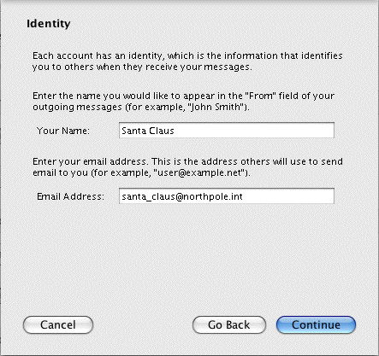
Configuring Your Identity in Thunderbird

Slide 84
Bottom Line: Don’t Trust “From:” Headers!
The ease with which one's email identity can be spoofed, even on consumer grade network clients such as Thunderbird (much less purpose-built spamware), should leave no doubt in your mind that "From:" headers are routinely untrustworthy, and thus unusable for attribution purposes.

Slide 85
What About The Received: Headers?
Received: Headers and the IP Address of the SMTP Handoff Host
When we ask to see the full headers for a message we've received, additional, critically important, headers get displayed. The most critical of those additional headers is the "Received:" header added when the message gets handed off to our local SMTP server:
Return-Path: <joe@uoregon.edu>
Received: from chello062178014011.5.11.vie.surfer.at
(chello062178014011.5.11.vie.surfer.at [62.178.14.11])
by smtp.uoregon.edu (8.14.3/8.14.3) with SMTP id o659QJDq001292
for <joe@uoregon.edu>; Mon, 5 Jul 2010 02:26:20 -0700
Date: Mon, 5 Jul 2010 02:26:19 -0700
Message-Id: <201007050926.o659QJDq001292@smtp.uoregon.edu>
From: joe@uoregon.edu
To: joe@uoregon.edu
Subject: joe@uoregon.edu VIAGRA ? Official Site -29%
MIME-Version: 1.0
Content-Type: text/html; charset="utf-8"
Content-Transfer-Encoding: 7bit

Slide 86
What About Received: Headers?
We can trust the IP address shown in the handoff host’s Received: header (bolded by us in the example shown above) because… [27]
All SMTP connections take place over TCP, a connection-oriented protocol (rather than over UDP, a connectionless protocol). Each TCP connection requires that a full three-way TCP handshake (SYN, SYN-ACK, ACK) must take place before application layer packets can be exchanged, and thus we know that the IP address of the handoff host cannot be spoofed (if an attempt was made to spoof the IP address of the handoff host, the three-way TCP handshake could not be completed).
At the time the handoff host connected to smtp.uoregon.edu, our server recorded the IP address associated with that connection, adding it to the message headers. (Other Received: headers, if any, may NOT be trustworthy since they're supplied along with the rest of the message by the external host).
Thus, we do have confidence that this spam actually did come to us via [62.178.14.11]. [28]
That IP then becomes the basis for reputation accumulation, and ultimately traffic management.

Slide 87
The Complication of Dynamic IP Addresses
Looking at that IP address, it’s a dynamic IP address, potentially used by different customers at different times, rather than a static IP address, dedicated to use by a single system or single customer.
For example, when we check whois [29] for the IP address, we're told that that address is part of a DHCP address pool:
% whois -h whois.ripe.net 62.178.14.11
[whois.ripe.net]
<snip>
inetnum: 62.178.0.0 - 62.178.250.255
netname: CHELLO
descr: UPC Telekabel
descr: DHCP Range <-- Note…
country: AT
admin-c: HMCB1-RIPE
tech-c: HMCB1-RIPE
remarks: Contact abuse@chello.at concerning criminal
remarks: activities like spam, hacks, portscans
<snip>

Slide 88

Because different customers may briefly use the same IP address, if we do try to accumulate IP reputation about that IP, we may see dramatically different behavior: at one point in time, that IP may be associated with a totally secure host, while at other times that same IP may end up in use by a thoroughly infested botted host.
Lacking any ability to externally identify the user of a dynamic IP address, and thus lacking the ability to meaningfully accumulate reputation (good or bad) for traffic from that dynamic IP, the community has no option but to "assume the worst" and block all email traffic sent directly from those IPs.
Spamhaus does this via their PBL ("Policy Block List"), which we've previously mentioned above.

Slide 89
We should also note one other attribution-related issue, and that relates to web email.
When a user connects to a web email service and sends a mail message, what’s the correct “origin” address for that message? Obviously it was composed at and sent from the web email server, but that’s used by millions of customers. What we often want is the IP address (and time stamp) associated with the host that connected to the web email service to inject that message.
Many web email services will include that IP address (and time stamp) in the headers. Sometimes it will be in plain text, other times it may be reversibly encoded, so that the user’s privacy is protected, but the web email service provider can pierce that veil if they need to do so.
Gmail is a notable exception to that general rule.

Slide 90
VI. A Government Role?

Slide 91
Should The U.S. Offer A National Blocklist?
Let me rephrase that question.
Should the world's critical email infrastructure rely on the efforts of a small handful of volunteers?
Isn't it time for the US government to be at least as worrisome to gray or black hat ISPs as Spamhaus when it comes to deterring abusers?

Slide 92
Sharing Data With The Community
The Internet community would love to know about the cybersecurity threats the federal government sees, if
only as a result of attacks on federal systems and networks, but the data that the federal government currently share with the community is too little, too
late, and is not subject to public documentation and
public scrutiny the way the Spamhaus Project's data is.
Federal cyber security data is also not delivered in an immediately operationally useful way (such as via a DNS block list); when I see data from federal authorities it is often embedded in a PDF-formatted report released days or weeks after the threat it describes ceases to be of primary concern. That’s just too dang slow.

Slide 93
These Issues Translate to a Lack of Influence
Because of these factors, the United States government's public attribution, deterrence and containment efforts in the cyber security realm have had limited operational impact to date, and objectively far less influence than what the private Spamhaus Project has been able to accomplish on shoestring resources.
If the United States is to ever have the ability to publicly attribute and deter unacceptable cyber behaviors itself, and to contain cyber malicious activity which empirically cannot be deterred, it needs to begin to publicly share timely, high quality, actionable, cyber intelligence much in the way that Spamhaus currently does.
Nothing less will give it the operational influence it wants and need.

Slide 94
Thanks For the Chance To Talk Today!
Are there any questions?
[bracketed references follow]

Slide 95
References
[1] Lolita C. Baldor, "Military asserts right to return cyber attacks", My Way News, April 14, 2010.
http://apnews.myway.com/article/20100414/D9F2PLP00.html
[2] "NRC Prize for Cyberdeterrence Research and Scholarship", Mar 11, 2010. http://sites.nationalacademies.org/CSTB/CSTB_056215#questions
[3] Jacobellis v. Ohio, 378 U.S. 184 (1964).
[4] "Critical Infrastructure and Key Assets: Definition and Identification," CRS Report for Congress RL32631, October 1st, 2004.
http://www.fas.org/sgp/crs/RL32631.pdf
[5] Theodore Gyle Lewis, "Critical Infrastructure Protection in Homeland Security: Defending a Networked Nation," Wiley-Interscience, 2006,
ISBN-13 978-0471786283 at pages 3 and 30-31.
[6] "National Infrastructure Protection Plan: Information Technology Sector," Department of Homeland Security. Undated.
http://www.dhs.gov/xlibrary/assets/nipp_snapshot_informationtechnology.pdf (linked from http://www.dhs.gov/files/programs/gc_1188479464996.shtm )

Slide 96
References (cont.)
[7] "E-Mail Outage Forces White House to Operate the Oldfangled Way," Washington Post, January 27th, 2009.
www.washingtonpost.com/wp-dyn/content/article/2009/01/26/AR2009012602087.html
[8] About Spamhaus. http://www.spamhaus.org/organization/index.lasso
[9] While Spamhaus doesn't generally publicly enumerate the sites that use its block lists, in October 2006, Steve Linford, Spamhaus CEO, disclosed that the Whitehouse, the U.S. Army, and the European Parliament were (and presumably still are) among the sites protected by its block lists. (see
http://www.foxnews.com/wires/2006Oct09/0,4670,AntiSpamLawsuit,00.html )
ISPs which have publicly disclosed that they use Spamhaus data for spam filtering include some of the largest and most professionally run ISPs in the world, including AOL (see
http://postmaster.aol.com/Postmaster.Errors.html ), Comcast (see
www.comcast.com/About/PressRelease/PressReleaseDetail.ashx?PRID =926 ),
Road Runner (see http://security.rr.com/mail_blocks.htm ) and Yahoo
( http://help.yahoo.com/l/us/yahoo/mail/postmaster/errors/550-bl23.html )
[10] The Spamhaus Block List. http://www.spamhaus.org/sbl/.
[11] The Spamhaus Exploits Block List. http://www.spamhaus.org/xbl/

Slide 97
References (cont.)
[12] Spamhaus Policy Block List. http://www.spamhaus.org/pbl/
[13] Spamhaus Domain Block Listhttp://www.spamhaus.org/dbl/
[14] Spamhaus White List http://www.spamhauswhitelist.com/en/about.htm
[15] http://www.dkim.org
[16] Spamhaus Register of Known Spam Operations. http://www.spamhaus.org/rokso/
[17] Spamhaus Don't Route or Peer List. http://www.spamhaus.org/drop/
[18] Comcat Business Class Acceptable Use Policy.
http://business.comcast.com/acceptable-use-policy/index.aspx
[19] Hostgator Terms of Service. http://www.hostgator.com/tos/tos.php

Slide 98
References (cont.)
[20] Hurricane Electric Acceptable Use Policy (AUP). http://he.net/aup.html
[21] Level 3 Acceptable Use Policy. http://www.level3.com/index.cfm?pageID=321
[22] Limestone Networks Acceptable Use Policy for Dedicated Servers.
http://www.limestonenetworks.com/service_info/aup.html
[23] Rackspace Acceptable Use Policy http://www.rackspace.com/apps/aup/
[24] The Planet Acceptable Usage Policy.
http://www.theplanet.com/content/Documents/legal/Planet-AUP.pdf
[25] Spamhaus XBL Frequently Asked Questions.
http://www.spamhaus.org/faq/answers.lasso?section=Spamhaus%20XBL
See also the CBL FAQ. http://cbl.abuseat.org/faq.html
[26] Internet Message Format. April 2001. www.ietf.org/rfc/rfc2822.txt
[27] Simple Mail Transfer Protocol. April 2001. www.ietf.org/rfc/rfc2821.txt

Slide 99
References (cont.)
[28] While that handoff host IP is non-spoofable, we must also recognize that it may still be subject to BGP hijacking via route injection. See, for example, "Route Injection and the Backtrackability of Cyber Misbehavior," Dec 5, 2006. http://www.uoregon.edu/~joe/fall2006mm/fall2006mm.pdf
[29] Whois data is accessible over the Internet from ARIN, RIPE, APNIC, LACNIC, AFRINIC, etc. Most Unix hosts support the whois command at the command prompt. For example:
% whois -h whois.ripe.net 62.178.14.11

