Slide 1
Capacity Planning: A Critical
Core Anti-Spam Competency
MAAWG 9th General Meeting, San Francisco CA
January 29th-31st, 2007
Joe St Sauver, Ph.D. (joe@uoregon.edu)
MAAWG Senior Technical Advisor
http://www.uoregon.edu/~joe/capacity/
Disclaimer: All opinions expressed in this document are solely those of the author and should not be taken as representing those of any other entity.

Slide 2
Why Pay Attention to
Capacity Planning?

Slide 3
“Logistics sets the campaign's operational limits.”
-- Joint Pub 1: Joint Warfare of the Armed Forces of
the United States
“He conquers who endures.”
--Aulus Persius Flaccus, 34-62 A.D.

Slide 4
We Are In An Arms Race
With The Spammers
It is common to hear the phrase, “We’re in an arms race with the spammers,” typically after the spammers unleash some new type of tricky-to-filter spam, such as the recent image-based stock and pillz spam. However, that sort of “victory through technical innovation” strategy is subordinate to the real spam “arms race.”
The real spam arms race is one of sheer volume, where the ultimate outcome of the war will be driven by the volume of traffic the spammer can send, versus the volume of traffic that you, the ISP, can successfully deliver/filter.
If you want to prevail in the “war on spam,” your ability to do so will be, at root, a function of your ability to correctly plan for and provision the capacity you’ll need to deal with what spammers try to throw at you and your customers.

Slide 5
The Spammer Response To Most Difficulties They Face: Send More
ISPs deploying better filtering? Send more spam (at least some will probably end up getting through).
Users less interested in what’s being spammed? Send more spam (eventually maybe they’ll get curious).
Not clearing the sort of money you wanted to be making as a spammer? That’s easy to fix: send more spam.
New product available for spamvertising? Great (says the spammer), I’ll just send more spam and promote it, too!
KEY POINT: When in doubt or facing a problem, spammers will send more spam. Spammers have very scalable delivery infrastructures, and they are generally NOT capacity constrained, so when in
doubt, their first instinct is to “hit the gas.”

Slide 6
Spammers Could Also Use Their Excess Delivery Capacity Very Aggressively
On one level, if spammers have excess delivery capacity, you might imagine they’d just send more of what they’re currently sending, and in pretty much the same way, and that’s often the case. Spammers could, however, use their excess capacity far more “aggressively.” For example:
-- many content based filters don’t scan content larger than
some threshold size (such as 250KB/message); what if
spammers suddenly began sending jumbo messages
instead of their current comparatively small messages?
-- currently spammers smear their sending capacity out
over multiple ISP targets; but what if a spammer began
concentrating ALL their capacity upon just one ISP
target, eventually moving (on a rolling basis) to another
solitary target, etc. Would each ISP be able to keep up?

Slide 7
Why Pay Attention to
Capacity Planning NOW?

Slide 8
Spam Volumes Are Surging And The Type of Spam Being Sent is Changing
According to data from Barracuda Networks, an enterprise security appliance vendor in Mountain View, Calif., there has been a 67 percent increase in overall spam volume and a 500 percent increase in image spam since Aug. 2006.
'Pump-and-Dump' Spam Surge Linked to Russian Bot Herders
http://www.eweek.com/article2/0,1895,2060241,00.asp
November 16, 2006
Who could have anticipated a surge of that size, or such a radical change in the type of spam being received? No one!
But what’s driving that dramatic jump in spam volumes?

Slide 9
“Template-Based” Spam…
“Inside of acting as a proxy for spam senders, each SpamThru client is its own spam engine, downloading a template containing the spam, random phrases to use as hash-busters, random "from" names, and a
list of several hundred email addresses to send to.”
Joe Stewart,_x000b_http://www.secureworks.com/research/_x000b_threats/view.html?threat=spamthru
Thus, spam “pipelines” (e.g., traditional spam zombies functioning as anonymizing proxies) are being replaced with spam “factories.”
So what’s the big deal about that, eh? Well…

Slide 10
Billion Spam/Day Botnets…
“[…] SpamThru acts as massive distributed engine for sending spam, but without the cost of maintaining static servers. Total spam capacity is fairly high - with 73,000
bots, given an average SMTP transaction time of 5
seconds, the botnet is theoretically capable of
sending a billion spams in a single day. This number assumes one recipient per message, however in reality, most spams are delivered in a single message with
multiple recipients at the same domain, so the actual number of separate spams landing in different
inboxes could be even higher, assuming the
spammer possesses that many email addresses.”
Joe Stewart, http://www.secureworks.com/research/_x000b_threats/view.html?threat=spamthru-stats

Slide 11
Another Report Regarding
The “Spam Template” Method
“[…] since August 16th, a well-known Russian spammer is also suspected of using the MS06-040 exploit technique to target unpatched corporate email servers in order to gain control and use them for distributing spam via Pro Mailer DMS, the notorious spam sending software. DMS is potentially more devastating than most spam-sending software since it is able to use the newer “spam cannon” technique that employs a powerful mail-merge of addresses with pre-prepared spam templates. This approach enables the spammer to maximize throughput and distribute millions of spam messages per hour through a single compromised computer, as mentioned in MessageLabs Intelligence Report May 2006.” www.londonactionplan.org/files/messagelabs/MessageLabs%20Intelligence%20Report%20-%20August%202006.pdf

Slide 12
Expect Higher Volumes
From Real Mail Servers, Too
Traditionally, many mail servers software products have offered relatively high throughput, but the bar may be about to be raised still higher.
Based on testing of the Postfix 2.4 queue manager done by Victor Duchovni (which he shared with me on December 26, 2006 and which he agreed to my sharing with you today), it looks like Postfix 2.4 running on a single well-tuned and well-connected Opteron-class system will be able to deliver well over 150 million messages/day. That’s ONE single relatively inexpensive system running an MTA that does things “by the book,” and doesn’t “cut corners”
If you don’t immediately find that sort of throughput to be impressive, let me provide some numerical context…

Slide 13
What’s Currently a “Lot” of Messages From a Single Domain or a Single Host?
Checking Senderbase.com on 27 January 2007, the single hottest-running domain, as an entire domain, “only” did an estimated 320 million messages per day
The hottest single IP listed by Senderbase? That domain “only” did an estimated 16.2 million messages per day
Clearly, if a mail sender -- whether good or bad -- wanted to move to a higher performance MTA such as Postfix, there’s still room for an order of magnitude (10X) increase over the delivery levels of even the hottest-running current single IP traffic source reported by Senderbase… and a problematic sender might have scores of servers available.
Template spam and hotter-running real mail servers are not the only things driving the increase in mail volume, though.

Slide 14
More Servers (Instead of Consumer PCs) Are Going To End Up Compromised
While traditionally most spam has been sent from compromised consumer PCs running Windows, increasing pressure has recently been put on Unix/Linux-based servers.
Why the change in miscreant focus? A number of reasons.
It is becoming increasingly hard to send mail direct-to-MX from dynamic space because of things like port 25 filters,
SPF records, descriptive rDNS nomenclature, restrictive
client side port filters integrated into some popular antivirus products, the new Spamhaus PBL, and now even Windows Vista -- all those reduce the chance that a bad guy will be able to successfully get his message out via spam zombies.
The bad news? Many Unix/Linux servers (up to 70%?) have Web 2.0-related vulnerabilities. Server class systems may also have more horsepower and better network connectivity.

Slide 15
There Will Always Be Newer and
“Better” [e.g., worse] Worms, etc.
As if regular traffic and spam traffic isn’t enough, you should also recognize and plan for the fact that there will also almost certainly be one or more newer and “better”
worms or rapidly propagating viruses in the days ahead.
Most miscreants have come to recognize that overwhelming the Internet with overly aggressive worms and viruses is bad for their own personal profitability, but mistakes still get made, and miscalculations still occur… and your servers and network links need to be ready to stay up and functional regardless.

Slide 16
New International Broadband Markets Continue to Come Online
For example, I am particularly interested in the effect we may see when consumer broadband grows in popularity in India and Pakistan -- there are tremendous numbers of potential users there, and many of them are fluent english speakers eager to engage western family members and business partners -- that’s more real mail for your customers
Given the volume of potential broadband subscribers in India and other parts of central Asia, I would be surprised if there aren’t also at least a couple new major spammers who emerge along with all those legitimate new customers, too.
Finally there will also probably be a whole pile of new spam zombies, too, at least until the users in these new markets learn to harden their systems, just as has been the case in the United States, Europe, the Far East, South America, etc.

Slide 17
We Should Also Not Discount the Possibility of Online Attack Traffic
Computer network operations (“CNO”) are now an accepted part of US and foreign cyberwar doctrine, and because many military and governmental networks are blocking large parts of the regular Internet, major commercial service providers may be the only “soft” online strategic target left (heck, they need to have SOMETHING they can still attack, right?)
Similarly, if we believe terrorists might target tangible western interests at home and abroad, is there any reason to believe that western online activities are not also at risk?
Even if you discount both military computer network operations and cyber terrorism, cyber crime (other than spam) may still end up targeting your systems or you network, with the same result: you’d need more capacity.

Slide 18
Bottom Line, It’s Time to
Review Your Current Capacity Levels
Regardless of whether it is new template-based spam cannons, more capable legitimate mailers used by both the good and the bad guys, more capable machines getting popped, a virus/worm that may have gotten out of control, new markets (and new spam sources) coming on line, or attack traffic targeting your servers as part of cyberwar activity, it will be just a matter of time, in my opinion,
before things end up getting pretty hot out there….
For all these reasons, you may want to review your current capacity, and decide if it might be prudent to increase your system and network capacity now or in the immediate future.
Let’s talk a little more about that.

Slide 19
Capacity and the Service Provider

Slide 20
Sending’s Easy But Receiving
(And Filtering Spam) Is Hard!
Each message that’s sent by the spammer needs to be received (or at least filtered) by the ISP, and receiving and filtering messages is much more demanding than just sourcing that same traffic -- this is an asymmetric issue.
One source of that asymmetry is the ISP’s need to meet customer expectations (perhaps expressed in the form of a rigid SLA). Customers may be very sensitive to any delays in the receipt of legitimate mail, and any outages caused by a failure to handle surges in volume can have immediate and ongoing financial impacts.
Spammers, on the other hand, can decide both when and how much to spam, and spammers are generally not under any time or performance pressures (except perhaps in the case of some spammer-for-hire scenarios).

Slide 21
Capacity Thus Becomes A
Critical ISP Defensive Strength
Need to deploy additional computationally intensive filters to address some new type of spam that’s being seen? If you have “lots of capacity” that will be an option for you. If you don’t have enough capacity you’ll just need to muddle along.
New email worm or email born virus? If you have “lots of capacity” you can soak up the associated surge in volume without having that unexpected increase in volume impact delivery of legitimate mail.
Competitive environment change? For example, are your competitors offering customers twice as much (or ten times as much!) disk space as they used to? If you have sufficient capacity, you can directly match that competitive threat.

Slide 22
Upgrades, Safety Margins and the Unexpected
Many companies do equipment upgrades or equipment replacement on a scheduled basis, or when utilization reaches a defined threshold. Sometimes though, tight budgets might lead decision makers to “stretch” server replacement plans or to defer network upgrade plans just a little bit further. Who among us hasn’t heard…
“Well, the servers and bandwidth have held up so far,
and surely there’s a little engineering safety margin built
in… I bet that they’ll be okay for another quarter or two
(or year or two!)… won’t they?”
Of course, if you run through any safety margins, you’re not going to be in very good shape when the unexpected occurs.

Slide 23
Additional Capacity Is Cheap Insurance for Uncertain Times
If there is one message you take away from this somewhat noisy talk, make it be this one:
We live in uncertain times when it comes to spam, and additional capacity is cheap insurance that prevents or ameliorates a lot of ills. Don’t run out of gas in the middle of the war. Insure you have sufficient capacity!

Slide 24
One Slight Problem:
Capacity Costs Money
If money were no object, we’d all just deploy an “infinite” amount of capacity, and voila, life would be grand.
Unfortunately:
-- capital is constrained at most companies
-- an investment in hardware capacity in one area may
result in an a reduction in funds available for use in
another area (for example, you may have a choice
between purchasing more server capacity or more disk
storage, and hiring more staff to respond to complaints or
to help users clean up their compromised systems)
-- truly excess capacity accomplishes nothing, and may hurt
some performance metrics (such as ROI)
-- deployed technology can quickly become obsolete;
you don’t want to deploy capacity until you need it

Slide 25
Personnel Capacity Constraints
It is tempting to focus just on just hard capacity constraints, things such as CPU, memory, I/O, and network capacity, but you must also keep personnel-related capacity constraints in mind.
The servers you add do need to be administered by someone, and even with the use of modern, highly scalable approaches to server management, you still need to make sure that you’re not stretching system administration staff to the breaking point.
Key point: ongoing personnel costs may likely dwarf one time capital expenditures for systems or ongoing expenditures for networks!
Nonetheless, you must scale server administration staff up along with the hardware you deploy.

Slide 26
A Second Slight Problem: We Need Lead Time To Add Capacity
If we could add capacity on demand with zero advance notice (or zero “lead time”) we’d have a far easier time when it comes to managing our capacity requirements.
If there was no need to plan ahead, we could just add (or remove) capacity as required, adjusting our capacity to meet our empirically observed requirements.
In Real Life™, however, we need to “pull the trigger” on orders for additional capacity in advance of the time we actually need that capacity. It takes time for orders to be approved, and for purchase orders to be cut, and for systems to be built or customized, and for gear to be shipped and installed and burned in and configured and integrated into production. We need to plan ahead.

Slide 27
A Third Slight Problem: We Can Only Add Capacity in “Chunks”
A “chunk” may be the amount of capacity a new server delivers, or a “chunk” may be going from a fast ethernet to a gigabit ethernet or from a gigabit ethernet to a ten gigabit ethernet link, or a “chunk” may be some other unit of incremental capacity.
Because of this “chunking” phenomena, capacity will typically not always get added in a smooth, continuous way, but in a series of discontinuous increments.
Chunking means we may have a choice between too much (which can be bad), and too little (which can be worse).

Slide 28
A Final Slight Problem: Our Crystal Ball Is Still a Little Cloudy
If we could forecast the future with perfect certainty, we’d know (with perfect certainty) the amount of capacity we’d need, and we could then very efficiently plan to deploy just that much and no more.
In this world, though, none of us are “Svengalis” and we need to do the best we can with the information we have available to us.
One thing we need to decide is what we need to measure: what are our fundamental capacity constraints?

Slide 29
Multiple Potential Capacity Constraints
If we think about a typical mail server, multiple potential capacity constraints may exist. For example, a server may be:
-- CPU bound,
-- Memory bound,
-- Disk subsystem bound (disk space, inodes, I/O’s, etc.),
-- Network throughput limited (due to the TCP/IP stack),
-- Network throughput limited (due to the speed of its
local connection)
-- Limited by how the server was (mis)-configured, etc.
Sets of servers may also be subject to aggregate constraints that may not apply to any individual server, such as:
-- limits to the rack space available in the data center
-- limits to available power,
-- limits to available cooling,
-- limits to available aggregate wide area bandwidth, etc.

Slide 30
All Applicable Constraints May Not Be Immediately/Simultaneously Knowable
Eliminating one constraint may expose a new constraint, in a fashion that’s often referred to as uncovering “rolling bottlenecks.”
Because of the “rolling bottlenecks” phenomena, you may need to do multiple successive capacity upgrades before you truly all the capacity constraints a given system is laboring under.
In some cases, you may even run into situations where by fixing one capacity constraint, you make another capacity constrained situation more dire still. For example, fixing a network bottleneck may put more I/O load on your disks.
Capacity constraints do not respect neat little departmental boundaries, either…

Slide 31
Strict Division of Duties Can Hurt Your
Ability to Do Capacity Planning
How much capacity do you currently have? “A lot?” “Just the amount you currently need?” “Too little even to meet even your current requirements?”
I’m not really going to ask, but at least some providers here today may not even KNOW the current capacity of some critical assets. For example, if you’re a “server guy” you may not know if your network bandwidth is currently sufficient, and if you’re a router guy you may not have the slightest idea if your company’s mail servers have enough physical memory, and if you’re doing MTA administration you may have no idea whether or not DNS servers are struggling or coasting. That needs to change.To properly do capacity planning, someone needs to understand the impact of capacity limitations in ALL relevant areas.

Slide 32
Capacity Planning
Needs to Be Data Driven
Your job is to be, or to become, a data driven son-of-a-gun
-- you can’t plan without data, so your first objective is (or should be!) to start collecting data.
There are many different ways you can potentially gather data for tracking and planning purposes, a few of which include:
-- Analysis of log files
-- SNMP
-- Agent-based reporting
Because each of those approaches has limitations, most providers will want to gather data via multiple methods.

Slide 33
Analysis of Log Files
Many providers start their capacity review by analyzing their server’s log files:
-- How many messages per day are being accepted?
-- How many messages per day are being rejected at
connection time?
-- How many messages per day are being subsequently
identified as spam after being accepted for delivery?
-- etc., etc., etc.
Data derived from log files is usually summarized over a period of time, such as a day, or perhaps hour-by-hour.
Summarization is required for anyone to be able to glean usable nuggets from the otherwise overwhelming volume of data that’s often found in log files, but aggregation or summarization in that fashion inescapably leads to “loss” or “condensation” of some information.

Slide 34
Log File Data Needs to Be Accessible
In order for log file data to be analyzed, it needs to be accessible, but at least in some cases, log files live only on each physical machine and access to them is then often limited. If you’re not currently doing centralized syslogging, you may want to consider doing so.
Centralized syslogging also reduces the chance that :
-- too-small local log partitions will overflow
-- log data will end up getting lost or overlooked,
-- logs will get tampered with in the event of an intrusion or
other security event, etc.
A popular replacement central syslogger is syslog-ng, see
http://www.balabit.com/products/syslog_ng/

Slide 35
Log File Summarization/Analysis Tools
Ultimately, many people find they want custom summaries and end up doing their own custom log file summarization and reporting, but there are many free and commercial log analysis tools one can try first, instead, such as Analog (see http://www.analog.cx/ ), or even log analyzers which may come with your MTA

Slide 36
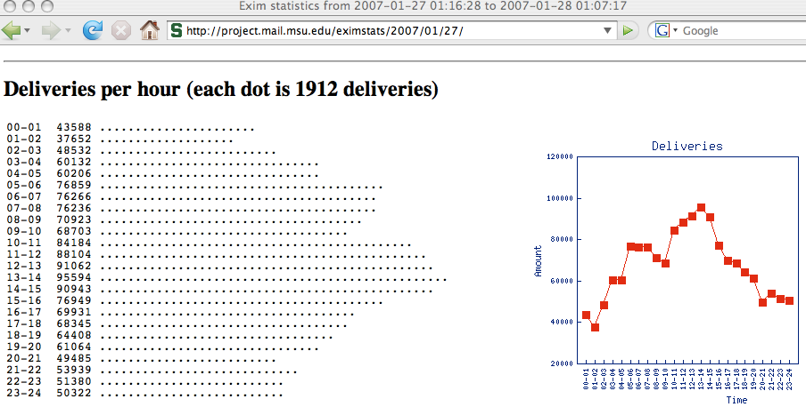
One Part of Exim’s Log Analysis

Slide 37
A Warning About
Synchronous Logging
On some systems, logging is done synchronously, and can materially slow system performance or increase system load.
If asynchronous logging is supported by your system, you may want to test it as an option (if it is supported, enabling it may be as simple a matter as adding a dash prefix to the logfile name in the configuration file).

Slide 38
Watching “Now” Data Instead of Looking Backward
Log file analysis is retrospective, or “backwards looking” -- the “rearview mirror” on your server.
Most of us are more interested in what’s happening now or what’s going to happen in the future.
SNMP data is an excellent way of focusing on the “now” data.

Slide 39
A Quick & Incomplete Overview of SNMP
SNMP is the “Simple Network Management Protocol” and has traditionally been associated with monitoring and managing things like routers and switches, but SNMP can also be used as a way to collect data from host systems.
SNMP data is collected by polling SNMP-enabled devices via a network management system, snmpget, or other tool.
To retrieve data, a user typically needs:
-- the FQDN or IP address of the SNMP managed device
-- the “community string” (or password) for SNMP access
(all too often this is just “public” for read-only access)
-- the object ID (or variable name) of the MIB (management
information base) of interest, normally a series of
numeric values separated by dots
The value of that OID can then be periodically polled, and will often be graphed using MRTG or RRDtool.

Slide 40
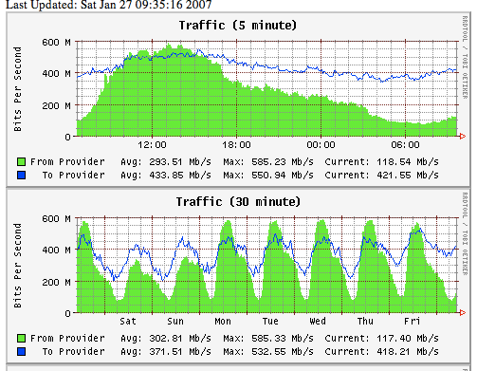
Sample SNMP-Derived Graphs

Slide 41
SNMP Limitations
SNMP is truly a very SIMPLE (“primitive?”) protocol. E.G.:
SNMPv1 was not very secure (commands, data and community strings were all passed “in the clear,” and thus were easy to eavesdrop upon)
It was tedious to walk all subelements of a MIB branch
Counters would often roll over rapidly due to their limited range
General access to SNMP data would often have to be limited via firewalls or router ACLs, because SNMP-using devices would often not have the ability to control access themselves
Subsequent versions of the SNMP protocol addressed these issues -- but at a price of additional device complexity. As a result you may still see many simple network devices that only “speak” SNMPv1
SNMP is still hugely popular and useful for collecting data.

Slide 42
Warning
There has recently been increased security interest in network monitoring and management software, with material vulnerabilities found in some popular packages. It is extremely important that you keep all software you use on your network management station up to date, and you should harden and shelter your network monitoring and management station from miscreant attention.
An example of the sort of thing that’s being found is shown on the following slide…

Slide 43
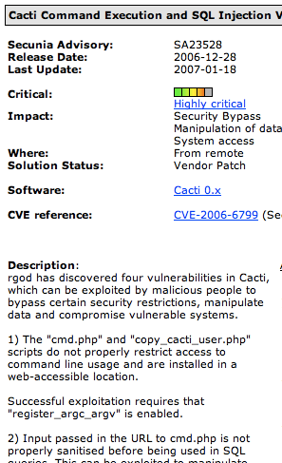

Slide 44
Agent Based Reporting
An alternative to having an external agent poll systems or devices (SNMP style) is to have systems “phone home” or “report back” with the required data, pushing the data to a central collection host. This can be very convenient for hosts where filter rules do not allow externally instigated connections to be made.
The process of collecting the required data and then pushing it out is usually coordinated by a software “agent” (or reporting program) running on the system being monitored.
One example of a free agent-based reporting tool is BigSister (see http://www.bigsister.ch/ ). A list of BigSister agents (or “plugins”) is at http://www.bigsister.ch/plugins.html
BigSister is also able to do direct SNMP queries when that may be more convenient.

Slide 45
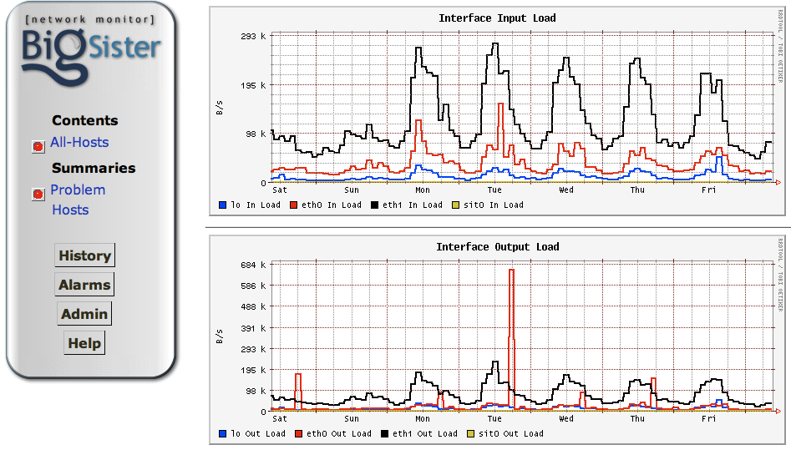
Sample Big Sister Output

Slide 46
“I Think I AM Seeing Capacity Issues”

Slide 47
That’s Great!
Well, you know what I mean. It is great that you’re paying attention to capacity and it is great that you’ve identified what may be a bottleneck, not that you HAVE a bottleneck.
The next step is probably to discuss what you’re seeing with all relevant parties. Do not assume that a bottleneck you’re seeing will always require you to immediately purchase new gear -- tuning or other steps may allow you to overcome the bottleneck you’ve identified at no out of pocket cost.
Be sure to document any changes you make!
Having found one issue, don’t stop there…After you correct that first problem, go back and look again -- you may very well find additional issues.

Slide 48
What About Formal Capacity Forecasting Models?

Slide 49
We Can’t Cover Statistical Capacity Forecasting Models in Half an Hour
I considered attempting to include a quick introduction to statistical approaches to capacity requirements planning (e.g., covering regression analysis and/or ARIMA models for example) but then decided that wouldn’t make sense given the limited time available.
Would that be an area of interest for a possible longer future tutorial session?

Slide 50
Thanks for the Chance to Talk Today!
Are there any questions?

