Slide 1
Cloud Computing Security Considerations
Joe St Sauver, Ph.D.
Security Programs Manager, Internet2
joe@uoregon.edu or joe@internet2.edu
Internet2 Joint Techs
Salt Lake City, Utah
4:10-4:30PM, Tuesday, 2/2/2010
http://www.uoregon.edu/~joe/cloud-computing-security/
Disclaimer: all opinions strictly my own.

Slide 2
Introduction

Slide 3
Some Cautions About Today's Talk/Topic
As you likely already know, there's a LOT of hype associated with cloud computing. I'm sorry about that (but I can't fix that)
Cloud computing is a huge topic. It encompasses diverse models and technologies, even though users and the trade press tend to lump them under a common name. Covering all potential security issues in 20 minutes is simply impossible.
For that matter, please note that we're still discovering many of the security issues which will challenge cloud computing!
Why? In part, that's because cloud computing is still a work-in-progress. Because it is rapidly evolving, what I tell today you may quickly become irrelevant or obsolete.
Nonetheless, there's so much thrust behind cloud computing that we simply don't have the option of sitting back and waiting to understand address cloud computing security issues.

Slide 4
What's Driving Cloud Computing? Drivers Include…
Thought leaders: Amazon, Google, Microsoft and many other Internet thought leaders have all aligned behind the cloud
The economy: Because cloud computing should theoretically help sites avoid major new capital expenditures (capex) while also controlling some ongoing operational expenses (opex), cloud computing is potentially a "lifesaver" for financially strapped businesses, including many major universities.
The Feds: Cloud computing has substantial momentum in Washington DC: it was featured in the just-released federal IT budget; Vivek Kundra, the federal CIO, has championed creation of http://apps.gov/ , a “one-stop shop” for cloud computing services for federal agencies; DISA has created a very successful cloud computing project called "RACE;" and Howard Schmidt, the new federal cyber security coordinator, has said that securing cloud computing will be a top priority.

Slide 5
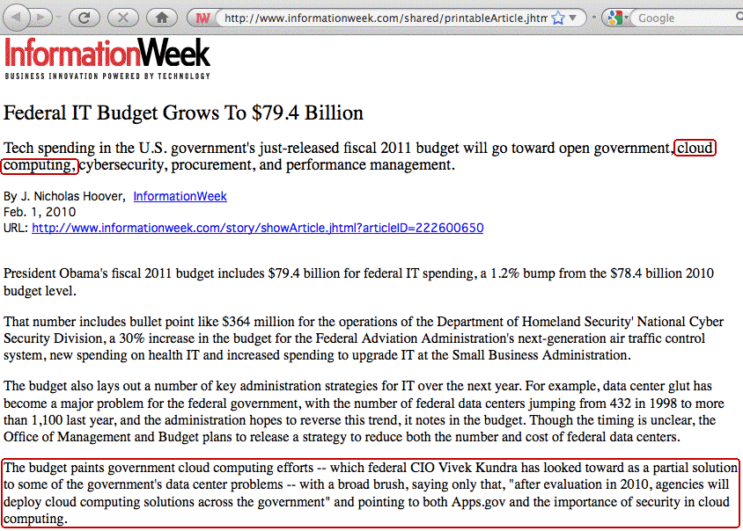

Slide 6
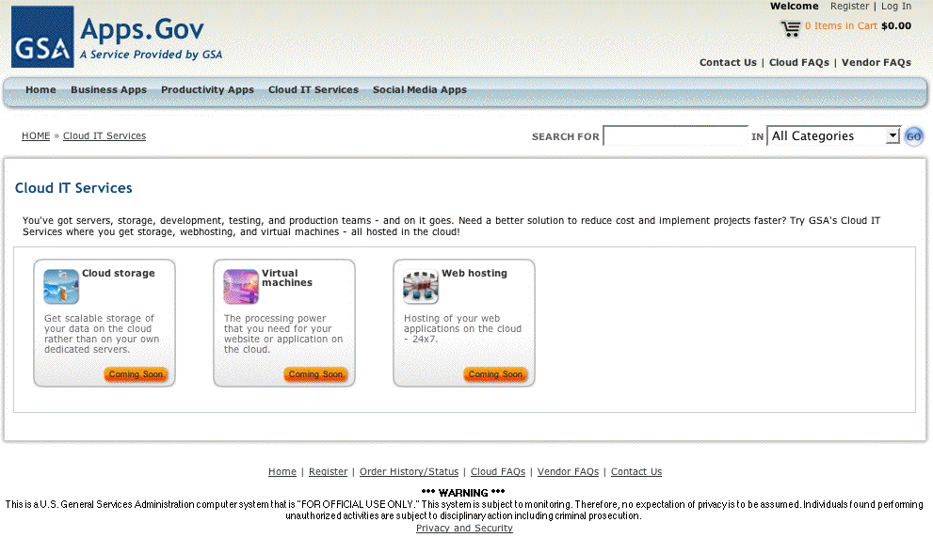
Apps.Gov (Currently a Bit of A Work In Progress)

Slide 7
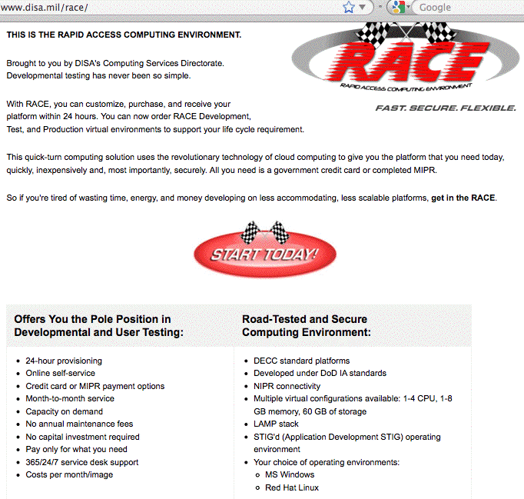
DISA's RACE

Slide 8
Our Community Is Also Pressing Ahead
Cloud computing seem to be turning up on pretty much every networking and security mailing list I'm on
You've heard/will be hearing a number of cloud computing talks during this week's meeting, which is probably not surprising since cloud computing was one of Joint Tech's explicit focus areas.
But I'm seeing clouds everywhere, not just here at Joint Techs.
Heck, I'm even seeing "clouds" (with frequent references to security!) appear in things like the last Internet2 Member Meeting "Introduction to Internet2" talk

Slide 9
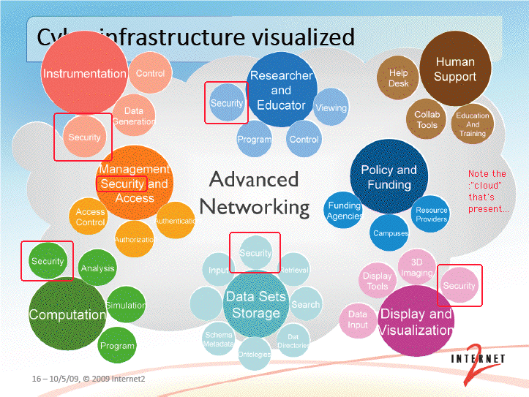
"Cyberinfrastructure Visualized:"
A Cloud, With Lots of "Security" References

Slide 10
Why Is "Security" Everywhere on That Slide?
Security is generally perceived as a huge issue for the cloud:
During a keynote speech to the Brookings Institution policy forum, “Cloud Computing for Business and Society,” [Microsoft General Counsel Brad] Smith also highlighted data from a survey commissioned by Microsoft measuring attitudes on cloud computing among business leaders and the general population.
The survey found that while 58 percent of the general population and 86 percent of senior business leaders are excited about the potential of cloud computing, more than
90 percent of these same people are concerned about the security, access and privacy of their own data in
the cloud.
http://www.microsoft.com/presspass/press/2010/jan10/1-20BrookingsPR.mspx

Slide 11
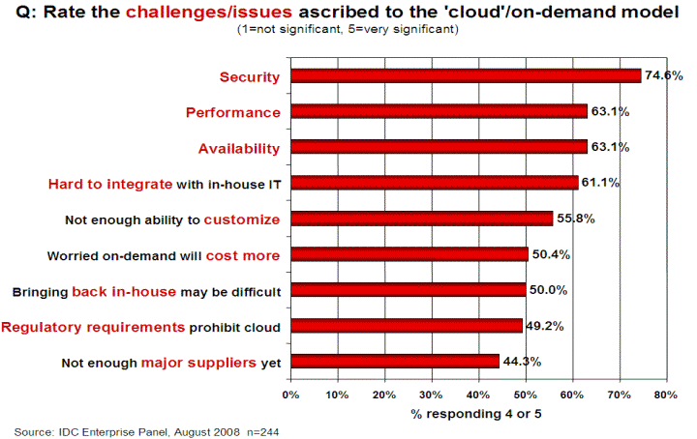
Another Data Point for Clouds and Security
Source: http://www.csrc.nist.gov/groups/SNS/cloud-computing/cloud-computing-v26.ppt
at slide 17

Slide 12
Cloud Computing Is Many Different
Things to Many Different People
All of the following have been mentioned from time to time as examples of “cloud computing:”
-- Amazon Web Services including the Elastic Compute
Cloud (EC2), Amazon Simple Storage Service (S3), etc.)
-- Rackspace Cloud (formerly Mosso)
-- Google’s App Engine
-- Windows’ Azure Platform (production/for-fee as of today!)
-- the OGF (including its Open Cloud Computing Interface)
-- SETI@Home, Folding@Home, distributed.net, etc.
-- outsourced campus email service (to Gmail or Live.com),
or outsourced spam filtering (e.g., to Postini or Ironport)
-- use of virtualization (e.g., VMware) to host departmental
systems either on local servers, or on outsourced VPS
In reality, some of those activities are not (strictly speaking) what's usually defined as "cloud computing,"

Slide 13
Some Generally Accepted Characteristics
Most people would agree that true cloud computing…
-- usually has low or zero up front capital costs
-- largely eliminates operational responsibilities (e.g., if a disk
fails or a switch loses connectivity, you don’t need to fix it)
-- for the most part, cloud computing eliminates knowledge of
WHERE one’s computational work is being done; your job
is being run “somewhere” out there in the “cloud”
-- offers substantial elasticity and scalability: if you initially
need one CPU, that’s fine, but if you suddenly need 999
more, you can get them, too (and with very little delay!)
If/when demand drops, you can scale your usage back, too
-- cloud computing leverages economies of scale (running
mega data centers with tens of thousands of computers is
far less expensive (per computer) than running a small
machine room with just a modest cluster of systems)

Slide 14
Some "Clouds" Won't Necessarily
Have All of Those Characteristics
For instance, if your site is running a local private cloud:
-- there WILL be capital expenditures up front,
-- you (or someone at your site) WILL still care about things
like hardware failures, and
-- you likely WON'T have the illusion of a seemingly infinite
inventory of processors (or memory or disk)
Nonetheless, a local private cloud service may functionally work the same way as a public cloud service, and hybrid cloud models may even combine private and public cloud services in a fairly seamless way.
Ubuntu's enterprise cloud offering is a nice example of this.

Slide 15
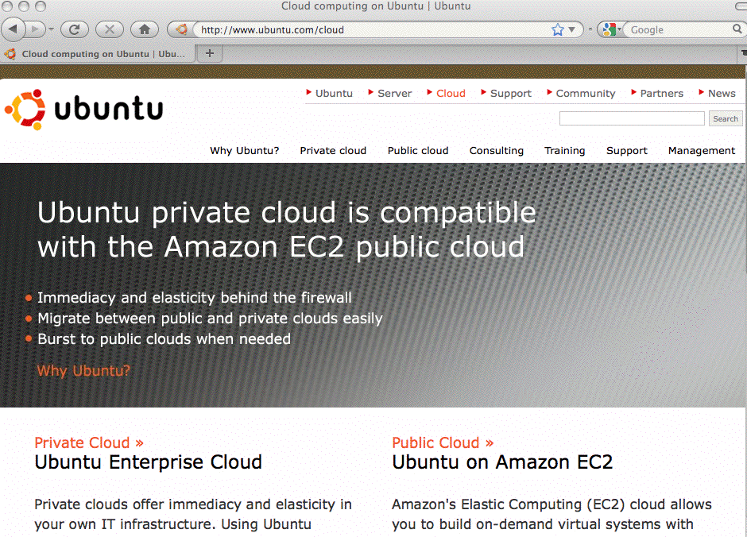

Slide 16
Will Your Campus Offer Private Cloud Services?
If you haven't been thinking about offering private cloud services, I would suggest that you might want to, including thinking hard about any potential security issues associated with doing so.

Slide 17
So What About Security in the Cloud?
For the remainder of this talk, we'll outline some of the security issues you might run into when using cloud computing

Slide 18
In Some Ways, "Cloud Computing Security"
Is No Different Than "Regular Security"
For example, many applications interface with end users via the web. All the normal OWASP web security vulnerabilities
-- things like SQL injection, cross site scripting, cross site request forgeries, etc., -- all of those vulnerabilities are just
as relevant to applications running on the cloud as they are to applications running on conventional hosting.
Similarly, consider physical security. A data center full of servers supporting cloud computing is internally and externally indistinguishable from a data center full of "regular" servers. In each case, it will be important for the data center to be physically secure against unauthorized access or potential natural disasters, but there are no special new physical security requirements which suddenly appear simply because one of those facilities is supporting cloud computing

Slide 19
There Are Some Unique Cloud-Related Areas Which We're NOT Going To Worry About Today
Contracting for Cloud Services: Even though contractual terms (including things like SLAs) can be used to mitigate some risks, I'm not a lawyer, and I'm not going to pretend to be one, so we're not going to cover issues related to contracting for cloud services. Fortunately, NACUA did a great job discussing this topic in a recent seminar, see www.nacua.org/meetings/VirtualSEminars/december2009/home.html
Compliance, Auditing and eDiscovery: Because this meeting is primarily about research and education, not business processes and university administration, we will not consider the potential need for cloud computing to be compliant with Payment Card Industry security standards, FERPA, HIPAA, GLBA, or other related compliance mandates.
So what are some cloud-related security issues?

Slide 20
The "A" in The Security "C-I-A" Objectives
Computer and network security is fundamentally about three goals/objectives:
-- confidentiality (C)
-- integrity (I), and
-- availability (A).
Availability is the area where cloud based infrastructure appears to have had its largest (or at least most highly publicized) challenges to date.
For example, consider some of the cloud-related
outages which have been widely reported…

Slide 21
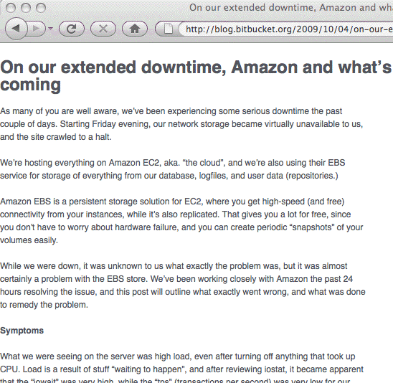
Bitbucket, DDoS'd Off The Air

Slide 22
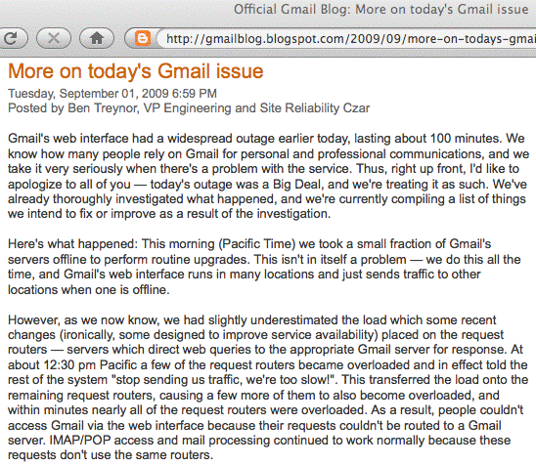
Maintenance Induced Cascading Failures

Slide 23
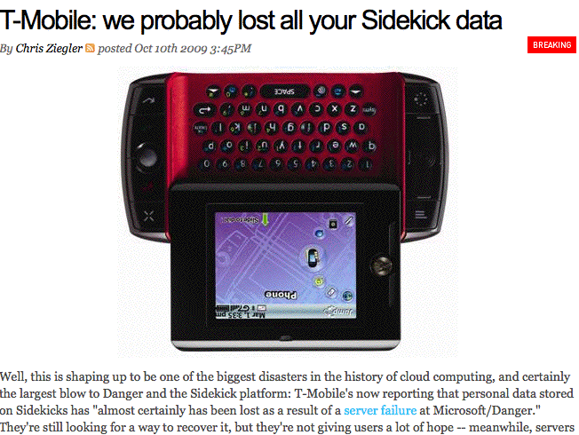
It's Not Just The Network: Storage Is Key, Too
See http://www.engadget.com/2009/10/10/t-mobile-we-probably-lost-all-your-sidekick-data/
However, see also: Microsoft Confirms Data Recovery for Sidekick Users
http://www.microsoft.com/Presspass/press/2009/oct09/10-15sidekick.mspx

Slide 24
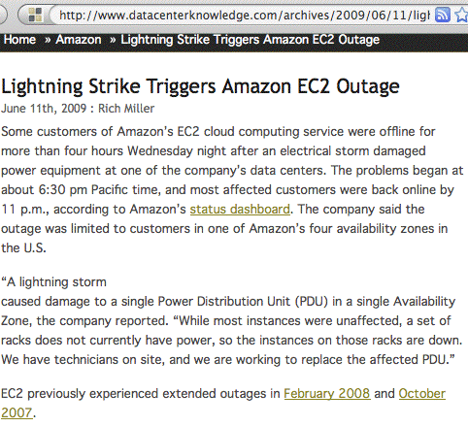
And Let's Not Forget About Power Issues

Slide 25
Mitigating Cloud Computing Availability Issues
Risk analysts will tell you that when you confront a risk, you can try to eliminate the risk, you can mitigate/minimize the impact of the risk, or you can simply accept the risk.
If you truly require non-stop availability, you can try using multiple cloud providers, or you could use public and private cloud nodes to improve redundancy.
Some cloud computing services also offer service divided into multiple "regions." By deploying infrastructure in multiple regions, isolation from "single-region-only" events (such as the power outage mentioned previously) can be obtained.
Availability issues may also be able to be at least partially mitigated at the application level by things like local caching.
Sometimes, though, it may simply make financial sense for you to just accept the risk of a rare and brief outage. (Remember, 99.99 availability==> 52+ minutes downtime/yr)

Slide 26
Mitigating Data Loss Risks
The risk of data loss (as in the T-Mobile Sidekick case) is an exception to the availability discussion on the preceding slide. Users may be able to tolerate an occasional service interrup-tion, but non-recoverable data losses can kill a business.
Most cloud computing services use distributed and replicated global file systems which are designed to insure that hardware failures (or even loss of an entire data center) will not result in any permanent data loss, but I believe there is still value in doing a traditional off site backup of one's data, whether that data is in use by traditional servers or cloud computing servers.
When looking for solutions, make sure you find ones that backs up data FROM the cloud (many backup solutions are meant to backup local data TO the cloud!)

Slide 27
Cloud Computing And Perimeter Security
While I'm not a huge fan of firewalls (as I've previously discussed at the Spring 2008 I2MM in "Cyberinfrastructure Architectures, Security and Advanced Applications," see http://www.uoregon.edu/~joe/architectures/architecture.pdf ), at least some sites do find value in sheltering at least some parts of their infrastructure behind a firewall.
There may be a misconception that cloud computing resources can't be sheltered behind a firewall (see for example "HP's Hurd: Cloud computing has its limits (especially when you face 1,000 attacks a day)," Oct 20th, 2009, http://blogs.zdnet.com/BTL/?p=26247 )
Contrast that with "Amazon Web Services: Overview of Security Processes" (see the refs at the back). AWS has a mandatory inbound firewall configured in a default deny mode, and customers must explicitly open ports inbound.

Slide 28
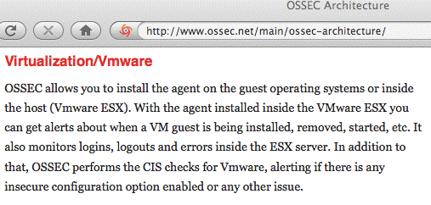
Cloud Computing & Host-Based Intrusion Detection
While I'm not very enthusiastic about firewalls, I am a big fan of well-instrumented/well-monitored systems and networks.
Choosing cloud computing does not necessarily mean forgoing your ability to monitor systems for hostile activity.
One example of a tool that can help with this task is OSSEC (the Open Source Host-Based Intrusion Detection System), an IDS which supports virtualized environments:

Slide 29
Cloud Computing Also Relies on the Security of Virtualization
Because cloud computing is built on top of virtualization, if there are security issues with virtualization, then there will also security issues with cloud computing.
For example, could someone escape from a guest virtual machine instance to the host OS? While the community has traditionally been somewhat skeptical of this possibility, that changed with Blackhat USA 2009, where Kostya Kortchinsky of Immunity Inc. presented "Cloudburst: A VMware Guest to Host Escape Story", see
http://www.blackhat.com/presentations/bh-usa-09/KORTCHINSKY/
BHUSA09-Kortchinsky-Cloudburst-SLIDES.pdf
Kostya opined: "VMware isn't an additional security layer, it's just another layer to find bugs in" [put another way, running a virtualization product increases the attack surface]

Slide 30
Choice of Cloud Provider
Cloud computing is a form of outsourcing, and you need a high level of trust in the entities you'll be partnering with.
It may seem daunting at first to realize that your application depends (critically!) on the trustworthiness of your cloud providers, but this is not really anything new -- today, even if you're not using the cloud, you already rely on and trust:
-- network service providers,
-- hardware vendors,
-- software vendors,
-- service providers,
-- data sources, etc.
Your cloud provider will be just one more entity on that list.

Slide 31
Cloud Provider Location
You actually want to know (roughly) where your cloud lives.
For example, one of the ways that cloud computing companies keep their costs low is by locating their mega data centers in locations where labor, electricity and real estate costs are low, and network connectivity is good.
Thus, your cloud provider could be working someplace you
may never have heard of, such as The Dalles, Oregon,
where power is cheap and fiber is plentiful, or just as easily someplace overseas.
If your application and data do end up at an international site, those systems will be subject to the laws and policies of that jurisdiction. Are you comfortable with that framework?
Are you also confident that international connectivity will remain up and uncongested? Can you live with the latencies involved?

Slide 32
Cloud Provider Employees
If you're like most sites, you're probably pretty careful about the employees you hire for critical roles (such as sysadmins and network enginers). But what about your cloud provider? If your cloud provider has careless or untrustworthy system administrators, the integrity/privacy of your data's at risk.
How can you tell if your cloud provider has careful and trustworthy employees? Ask them!
-- Do backgrounds get checked before people get hired?
-- Do employees receive extensive in-house training?
-- Do employees hold relevant certifications?
-- Do checklists get used for critical operations?
-- Are system administrator actions tracked and auditable on
a post hoc basis if there's an anomalous event?
-- Do administrative privileges get promptly removed when
employees leave or change their responsibilities?

Slide 33
Cloud Provider Transparency
You will only be able to assess the sufficiency of cloud provider security practices if the cloud provider is willing to disclose its security practices to you.
If your provider treats security practices as a confidential or business proprietary thing, and won't disclose their security practices to you, you'll have a hard time assessing the sufficiency of their security practices. Unfortunately, you may need to consider using a different provider.
Remember: "Trust, but verify." [A proverb frequently quoted by President Reagan during arms control negotiations]
I'm not known for being a big Microsoft cheerleader, but Microsoft deserves recognition for promoting both their Cloud Computing Advancement Act and pressing cloud vendors to police themselves when it comes to transparency. See www.microsoft.com/presspass/presskits/cloudpolicy/

Slide 34
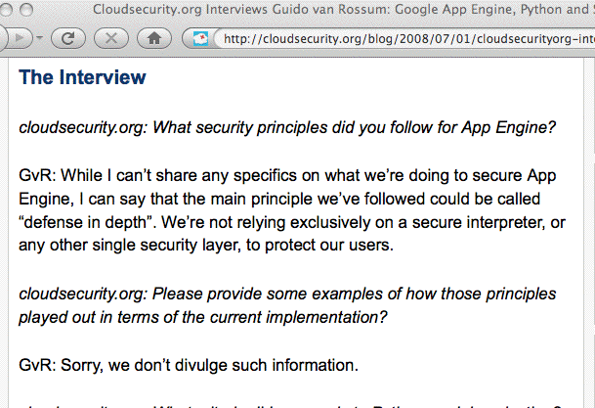
An Example of The Wrong Approach
Source: http://cloudsecurity.org/blog/2008/07/01/
cloudsecurityorg-interviews-guido-van-rossum-google-app-engine-python-and-security.html

Slide 35
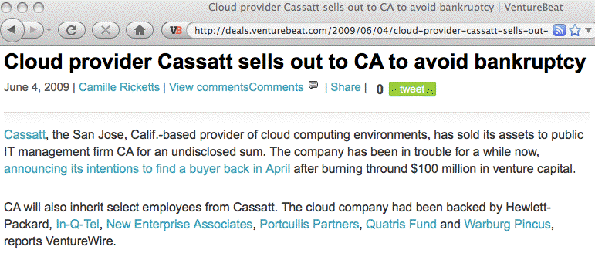
Provider Failures Are Also A Real Possibility
Even for a red-hot technology like cloud computing, there is no guarantee that your providers will financially survive. What will you do if your provider liquidates?

Slide 36
Pen Testing; Working Incidents In The Cloud
Standard pen testing processes which you may use on your own infrastructure may not be an option in an outsourced environment (the cloud provider may not be able to distinguish your tests from an actual attack, or your tests may potentially impact other users in unacceptable ways)
If you do have a security incident involving cloud-based operations, how will you handle investigating and working that incident? Will you have the access logs and network traffic logs you may need? Will you be able to tell what data may have been exfiltrated from your application?
What if your system ends up being the origin of an attack? Are you comfortable with your provider's processes for disclosing information about you and your processes/data?

Slide 37
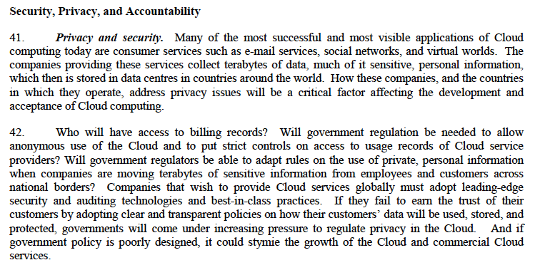
OECD, The Cloud, and Privacy
Cloud Computing and Public Policy, 14 October 2009
http://www.olis.oecd.org/olis/2009doc.nsf/ENGDATCORPLOOK/NT00004FC6/$FILE/JT03270509.PDF

Slide 38
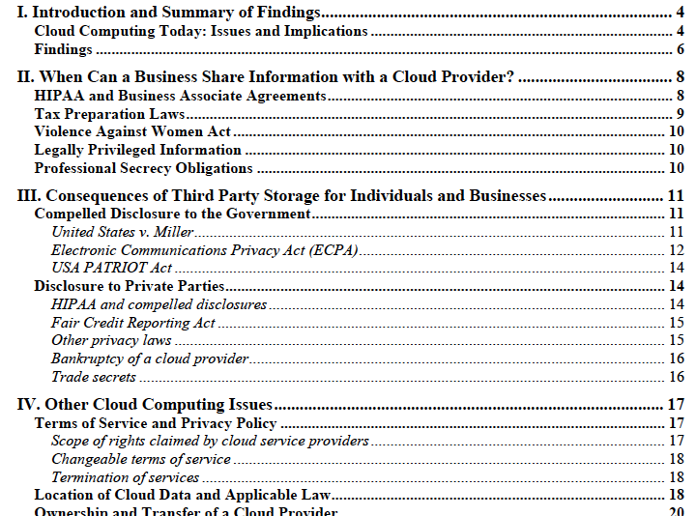
World Privacy Forum Privacy In The Clouds Report
From: "Privacy in the Clouds: Risks to Privacy and Confidentiality from Cloud Computing,"
Released February 23, 2009, http://www.worldprivacyforum.org/cloudprivacy.html

Slide 39
Additional Cloud Computing Security Resources
"AWS Security Whitepaper," http://s3.amazonaws.com/
aws_blog/AWS_Security_Whitepaper_2008_09.pdf
"Cloud Computing Security: Raining On The Trendy New Parade," BlackHat USA 2009,
www.isecpartners.com/files/Cloud.BlackHat2009-iSEC.pdf
“ENISA Cloud Computing Risk Assessment,” November 20th, 2009, www.enisa.europa.eu/act/rm/files/deliverables/
cloud-computing-risk-assessment/at_download/fullReport
“Presentation on Effectively and Securely Using the Cloud Computing Paradigm v26,” 10/7/2009, NIST, http://www.csrc.nist.gov/groups/SNS/cloud-computing/
cloud-computing-v26.ppt
“Security Guidance for Critical Areas of Focus in Cloud Computing, V2.1,” December 2009, Cloud Security Alliance,
http://www.cloudsecurityalliance.org/csaguide.pdf

Slide 40
Thanks for The Chance To Talk Today!
Are there any questions?

