Slide 1
Digging Into Unlawful Email Messages
Economic Fraud and Digital Evidence
September 22nd, 2005
Valley River Inn, Eugene OR
Joe St Sauver, Ph.D. (joe@uoregon.edu)
University of Oregon Computing Center
http://www.uoregon.edu/~joe/digging-in/

Slide 2
I. Introduction

Slide 3
Our Agenda Today
Today we’re going to talk a little about how you can dig into the illegal email (spam, fraud, phishing, etc.) which you may run into. Our goals are to help you think about:
-- what’s involved in selecting email messages to pursue
-- identifying where a particular email really came from
-- tracking websites spamvertised in the body of
email messages
-- overcoming obfuscatory techniques and methods

Slide 4
It Can Be Amazing To See How Far
You Can Get From Public Sources
The approaches discussed in this talk are not meant as a replacement for more traditional methods such as:
-- making a targeted buy and then following the money (and/or the fulfillment channels) back up stream, or
-- infiltrating criminal organizations with undercover officers, or
-- passively collecting information based on lawful intercept orders (although frankly, I’m not seeing lawful intercept getting much used in attacking cybercrime right now; see www.uscourts.gov/wiretap04/contents.html )
This talk is meant to illustrate how far you can get just by tugging a little on some of the “loose threads” that have been unintentionally left by the bad guys (another analogy you’ll hear is “following the trail of crumbs”)

Slide 5
II. Picking The Right
Messages To Investigate

Slide 6
The Reality of Cybercrime Today
Unfortunately, there is a true flood of illegal activity online today. Given a steady stream of reports relating to unlawful online activity, your first chore is determining which reports represent ones worth pursue (unless you have infinite investigative capacity, you will need to be selective!)
Of course, standard considerations (such as subject matter jurisdiction and geographical jurisdiction) pertain just as they always do, but before proceeding with a particular investigation that includes cybercrime-related components, there are some additional factors you may want to consider.

Slide 7
Condition of The Submitted Email
When it comes to crimes perpetrated by email, a prime consideration is the quality or condition of the email message you’re starting with. If it is of poor quality, you’re building your “house” on an unsound foundation.
What makes a message “poor quality”?
-- message is incomplete, exists only in printed form,
as a screen capture, etc.
-- message was sent more than 48 hours ago
-- message was forwarded via one or more mailing lists
-- message does not include full headers
-- message does not include the raw message body
-- message does not include one or more attachments
-- message has been “munged”/otherwise altered
Sometimes you need to play what you’ve been given, but if you have a choice, pick wisely.

Slide 8
Why Is Message Timeliness Important?
Cybercriminals are inherently agile, and part of their defensive strategy, like terrorists, involves never staying
too long in one place. If you begin to work an incident based on mail that is days (or even weeks) old, the bad guys may already have moved (possibly more than once). You need to be as nimble as they are, and you also need
to recognize that the bad guys are working nights and weekends. M-F 8-12 and 1-5 just won’t cut it anymore.
You also need to recognize that internet service providers, ISPs, are handling so many customers and so much traffic that if you want a particular bucket of water from the river, you need to let them know before it hits the ocean and is lost forever. Logs rotate. Records get deleted. Servers get reformatted and reused. If you need evidence, you need to get it while it still exists.

Slide 9
Look For “Triple Word Score” Opportunities
Just like a traffic cop, you’ll see lots of relatively minor incidents as well as more serious ones. If you don’t correctly pick the right incidents to work, you’ll be tied up working a “five-over” when a drunken driver comes by (doing eighty) (in a school zone) (where there’s active construction work) (in a stolen car). Pick your shots….
I’d suggest looking for incidents that:
-- are of material volume (e.g., involving the distribution of hundreds of thousands or millions of messages)
-- use compromised systems (aka “spam zombies”) for the distribution of their messages
-- include violations of substantive laws, such as sale or attempted sale of a controlled substance, inherently fraudulent schemes, child porn related incidents, etc…
-- involve .gov/.mil hosts

Slide 10
Some Other Suggested Priority Categories
Incidents involving:
-- easily-documented large out-of-pocket losses
-- known Spamhaus.org ROKSO spammers or
particularly Spamhaus.org “top 10” spammers
-- new exploits
-- custom spamware
-- so-called “bullet proof hosting”
-- so-called “bullet proof domain name registration”
-- anonymous online payment channels
-- spam “affiliate programs”
-- incidents involving known repeat offenders
-- incidents targeting children or the elderly
-- topically current/newsworthy incidents
-- “low hanging fruit,” etc.
Pick incidents that will make a difference, and which prosecutors can run with and get good convictions

Slide 11
Ones to Skip (For Now)
Incidents that don’t have clean, complete and current sample emails
Low volume incidents
Poorly targeted/unlikely to be effective messages (e.g., spam with botched links, Korean language spam sent to largely-english-only audiences, etc.)
Common spam that would be easily blocked using routine technical means
Incidents already being worked by another agency
Viruses/worms/spyware (that sort of malware is a different animal requiring specialized expertise)
Okay, so let’s assume you’ve picked a spam or phishing mail message of interest -- now what?

Slide 12
III. Where Did The
Message Come From?

Slide 13
Why Do You Need Full Headers?
Virtually all the headers you routinely see displayed in a mail reading program like Outlook can be (and are) forged by spammers in an effort to evade detection. The key exception: the topmost/last-added “Received” header(s)…
“Received” headers will usually be present but are only visible only when you enable full (expanded) headers.
“Received” headers are intended to show the hop-by-hop path that a message takes as it goes from its origin to its destination.
A “Received” header gets added by each host as it accepts the message from the preceding host.
New “Received” headers get added above the existing “Received” headers.
Spammers may add (“preload”) bogus Received: headers

Slide 14
Mechanics of Getting Full Headers
The mechanics of getting full headers on a given mail message will vary from mail client to mail client; the way you do it on Thunderbird is not the same way you do it on Eudora which in turn is not the same way you do it on Outlook. Each client is different.
We have information for the clients UO users commonly use at http://micro.uoregon.edu/fullheaders/
For other email clients not listed, check Google; it will probably show one or more recipes for getting full headers from the client of interest (beware PC vs. Mac recipe differences, and version-related differences)
Note that some users send in spam or phishing complaints and then dump those messages; in some cases, after submitting w/o full headers, they may not be able to go back and resubmit properly.

Slide 15
Sample Full Message Headers
Return-Path: <amit@punjabagro.com>
Received: from mail.punjabagro.com ([202.164.51.114])
by smtp.uoregon.edu (8.13.4/8.13.4) with ESMTP id j8MD2iXC018790
for <joe@oregon.uoregon.edu>; Thu, 22 Sep 2005 06:02:50 -0700
Received: by mail.punjabagro.com (Postfix, from userid 503)
id B843480899E; Thu, 22 Sep 2005 06:16:02 +0530 (IST)
To: joe@oregon.uoregon.edu
Subject: PayPal Security Measures
From: paypal@paypal.com
Content-Type: text/html
Message-Id: <20050922004602.B843480899E@mail.punjabagro.com>
Date: Thu, 22 Sep 2005 06:16:02 +0530 (IST)
<title>paypal</title>
<p><A href="http://www.paypal.com/cgi-bin/webscr?cmd=_home"><IMG
src="https://www.paypal.com/en_US/i/logo/paypal_logo.gif" border=0></A>
</p>

Slide 16
The Topmost Received Header
The key bit of the topmost “Received” header is the IP address of the host that handed the message to the receiving system.
IP addresses are often also called “dotted quads” because they consist of four numbers separated by dots. An example IP address is 128.223.142.13
Host names, such as darkwing.uoregon.edu, get translated to numeric addresses (such as 128.223.142.13) by the Domain Name System (DNS).
The DNS record that normally does that sort of host-name to dotted quad mapping is called an “A” record.
The DNS record that normally does dotted quad to hostname mapping is called an “inverse address” record (or an “in-addr”). In-addr’s often won’t be present.

Slide 17
Hostname-IP Factoids
Multiple hostnames can resolve to the same dotted quad. This is common in situations such as at web hosting farms where dozens or hundreds of hosts may all live on a single shared IP address.
One hostname can resolve to multiple dotted quads. This is common when you’re dealing with a particularly popular site that is “spread out over” multiple servers to handle the load.
IP addresses normally resolve to only a single in-addr. That hostname may or may not actually exist. :-;
Hostnames may not resolve to the same thing in the forward and reverse directions. (Trivial example: if you have fifty hostnames all pointing at a single IP address, if you check that IP address, it will normally only resolve to a single hostname (maybe one of the fifty, maybe not))

Slide 18
Actually Doing The DNS Translation
So how do you actually mechanically do the DNS translation we’ve been talking about?
If you’re using a Unix/Linux box, or a Macintosh, you can pop up a terminal window and then use any of several different commands. Dig is probably the most popular DNS tool among professionals, but nslookup is another option that’s easy to use:
% nslookup
> darkwing.uoregon.edu
Server: 128.223.32.35
Address: 128.223.32.35#53
Name: darkwing.uoregon.edu
Address: 128.223.32.35

Slide 19
What If You Don’t Have a Unix Box or a Mac?
While you can buy a $300 Dell and run Linux on it, or pay $500 for a Mac Mini, some users only have a PC running Windows.
That’s okay -- you can still do nslookup on a vanilla Windows XP PC too
Start --> Programs --> Accessories --> Command Prompt
C:\> nslookup
128.223.32.35 (or whatever)
You can also do nslookup using any of a variety of web sites -- as long as you’ve got a web browser, you can do DNS “stuff” online. :-) One such example is:
http://www.zoneedit.com/lookup.html

Slide 20
Your Goal In Doing nslookup
Start with the dotted quad, translate it to the hostname, translate the hostname to the dotted quad until you either run into a hostname or dotted quad that doesn’t resolve, or you find a consistent dotted quad to hostname to dotted quad mapping.
Why bother going through that process? Well, spammers have been known to try to lie about their inverse addresses. For example, you might look up a dotted quad, only to find that it resolves to something improbable like nowayamigoingtoletyoubustme.com
On the other hand, if you resolve a dotted quad to a hostname and then that hostname in turn resolves to that same dotted quad, you can have some confidence that the hostname really is associated with that dotted quad.

Slide 21
DNS “Problems”
Spammers may not define ANY inverse address records for their dotted quads (non-spammers may ALSO not do this; this sloppiness is particularly common in parts of the world where DNS does not do a great job of handling the local character set (e.g., Korean, Chinese, Vietnamese, etc.)
You can access “synthetic” inverse addresses for at least some of these IP addresses by checking the
RUS-CERT Passive DNS Server. It synthetically associates IP addresses with hostnames by logging A records as they get resolved, and then allowing searches on the dotted quads which were logged as well as the A hostname values. Of course, this approach only works if the folks providing RUS-CERT with data have seen queries for the IP address that’s of interest.

Slide 22
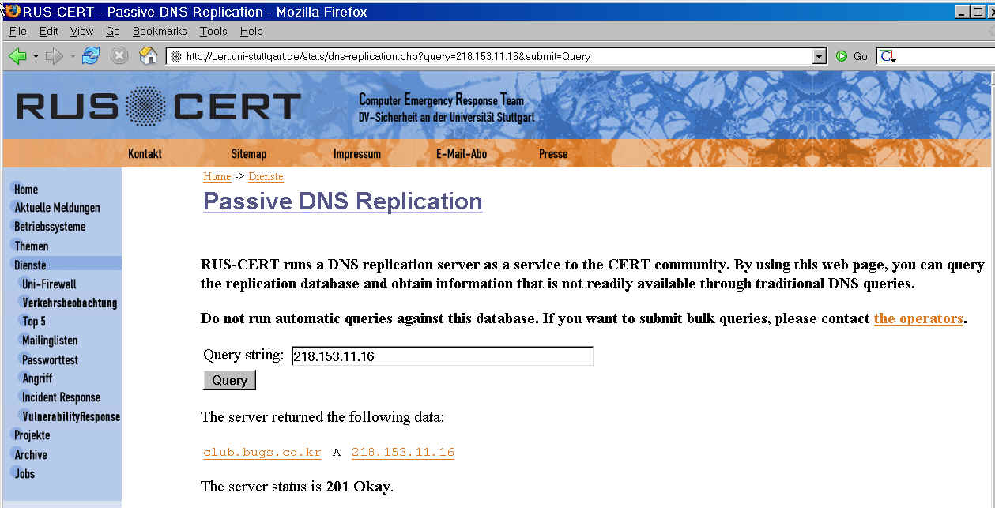
RUS-CERT Example

Slide 23
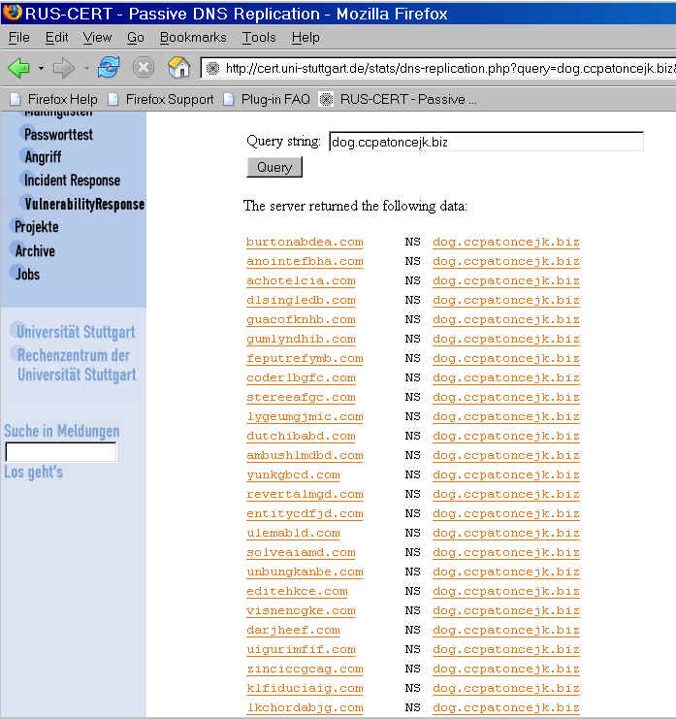
Passive DNS Replication Also Lets You See The Domains Using a Common Name Server (unrelated example)

Slide 24
What Else Can We Do With the Dotted Quad?
In addition to seeing what a dotted quad resolves to by checking its in-addr (or RUS-CERT), we can also see who has been officially assigned that address range.
Understanding IP address assignment requires a brief detour to explain how IP addresses are obtained.
Normally an end user, like Cousin Bob or Aunt Edna, just temporarily uses IP addresses that have been assigned to their internet service provider (ISP).
What if Aunt Edna RAN her own ISP, however? Where would she get IP addresses then? These days, if she’s a small ISP, she’d still end up getting IP addresses from her upstream provider (in her case she’d get a chunk (or “block” of IP addresses instead of just one, and she’d get them assigned for the duration of her contract with her upstream provider, rather than just a brief time).

Slide 25
How Are Long Term IP Address
Assignments Documented?
Any customer assignment that is at least a /29 or larger has to be defined using SWIP (shared whois IP service) or rwhois (referral whois).
Whoa -- I see I need to back up and explain one more concept, and that’s CIDR address block notation.
In the old days, IP addresses were assigned on “classful boundaries” -- e.g., at “dot” boundaries. If you needed a block of addresses, you either got a “class C” block (256 addresses), a “class B” block (65,534 addresses), or a “class A” block. Unfortunately, classful network allocations are sort of like Goldilocks: some are too big, some are too small, and it is hard to get one that’s just right.
If we had infinite addresses, then who’d care, but unfortunately IP addresses are a finite resource.

Slide 26
CIDR to the Rescue (And It Isn’t Hard CIDR!)
CIDR said, “Hey, who cares about where the dot is? We’ll give you a block that’s the size you need.
CIDR blocks are written as a starting address followed by a slash and the size of the allocation.
A single IP address is a /32.
Two IP addresses make up a /31.
Four IP addresses make up a /30.
Eight IP addresses are a /29.
Sixteen IP addresses are a /28.
Etc, etc., etc.
Remember, allocations that are at least a /29 or larger are required to be documented. If someone has eight IP addresses, we should be able to “look that assignment up” and see “whois responsible” for them.

Slide 27
Whois trivia
Whois differs from nslookup in that whois is less seamless. You need to “know” where to start when it comes to looking up IP addresses.
There are four normal starting points:
-- whois.arin.net (for North American IP addresses)
-- whois.ripe.net (for European IP addresses)
-- whois.apnic.net (for Asian Pacific IP addresses)
-- whois.afrinic.net (for African IP adddresses)
If you guess wrong, you’ll normally be redirected to the right registry. If not, just try another one at random. :-)
After a while, you’ll develop an instinctive sense for which registry to go to for particular numeric blocks of addresses (addresses are assigned to registries in relatively large “clumps”).

Slide 28
Looking Up IP Assingments With Whois
The process of looking up an IP address assignment involves using the cleverly named whois command. Like nslookup, whois is something that you can run directly from the Unix shell prompt if you have a Linux box or a Mac:
% whois -h whois.arin.net 128.223.32.35
In some cases you may end up with more than one whois entry that “matches” a given IP address (to understand this, remember that a medium size ISP might have a /19, from which they make assignments of /24’s to smaller downstream ISPs, who in turn might make assignments of /29’s to small web hosting concerns). When that happens, you can rerun whois specifying the name of the most-specific block mentioned to usually get the “right” party using a given IP.

Slide 29
Faking It On A PC
Most PCs running Windows don’t come with a whois client, but you can “pretend” to be a whois program on a PC, by popping up a DOS window and entering:
C:\> telnet nameofthewhoisserver 43
then plug in the IP address that’s of interest

Slide 30
Disappointments
Whois data does not always work out the way you’d like it to… For example, you may see:
-- whois report a HUGE block of addresses belonging to a large provider like Comcast or Qwest, typically for temporary use by casual retail customers (like Cousin Bob). To find out who had that IP address at a given point in time, you’ll need to hit the provider with a suitable bit of legal paperwork, as well as the IP address and a time stamp, to get the identity of the user at that time. (note: the logs needed to make that association may be rolled over/destroyed relatively quickly; if you’re interested in this data, you will want to ask the provider to preserve the records required to do that IP to customer mapping (at least you now know what provider to ask to do that!)

Slide 31
An Aside: Why Do You Need Timestamps?
You should routinely note and provide timestamps in conjunction with requests for information about who had an IP address at a given time because dynamic pools of IP addresses get continually reused. That is, when one person finishes using an IP address, it gets returned to the pool of available addresses and then another person will eventually be given that IP. This sort of address assignment normally happens via something known as “DHCP” or “Dynamic Host Configuration Protocol.”
Without a time stamp, there might be a dozen or more users who were “on” a DHCP pool IP address during the course of a typical day. On the other hand, sometimes addresses may nominally be “dynamic” yet practically never change. Think of these as “pseudo static” IP addressses.

Slide 32
That’s Not the Only Possible Disappointment
You may also run into a “private residence” registration, e.g., a block of IP’s that are in use by someone who’s just a regular person, not a company.
Regular people are allowed to have their address information witheld from IP whois listings to preserve the privacy of their residence address.
Law enforcement can, of course, use legal process to compell the ISP to disclose the customer information associated with such an IP address range, regardless off the preferences of the customer.

Slide 33
A Third Way Things Can Go Wrong
You should also be prepared for the possibility that the IP block was hijacked, or used without authorization. In such a situation, a spammer identifies a network block and convinces an ISP to begin advertising it (letting the spammer use those addresses), typically by providing the ISP with a fraudulent LOA (letter of authorization).
A list of known hijacked IP blocks can be found at
http://www.completewhois.com/
See also http://www.spamhaus.org/drop/index.lasso
We’ll talk more about routing later.

Slide 34
Whois data for 202.164.51.114
whois -h whois.apnic.net 202.164.51.114
inetnum: 202.164.51.112 - 202.164.51.119
netname: PUNJABAGRO
country: IN
descr: KHARAR
admin-c: RS341-AP
tech-c: RS341-AP
status: ASSIGNED NON-PORTABLE
changed: sanjay.kumar@hfclconnect.com 20050717
mnt-by: MAINT-IN-RAVINDER
source: APNIC
person: Ravinder Singh
nic-hdl: RS341-AP
e-mail: ravinder.singh@hfclconnect.com
address: B-71 , Industrial Area Phase VII
address: Mohali
phone: +91-172-5090114
country: IN
changed: pankaj.mehta@hfclconnect.com 20050428
mnt-by: MAINT-NEW

Slide 35
Whois Can Also Tell You About Domains
Whois can also be used to tell you about who is responsible for domain names:
% whois okiodata.net
Domain Name: OKIODATA.NET
Registrar: ENOM, INC.
Whois Server: whois.enom.com
Referral URL: http://www.enom.com
Name Server: NS1.AXARNET.NET
Name Server: NS2.AXARNET.NET
Status: ACTIVE
Updated Date: 16-aug-2005
Creation Date: 13-aug-2003
Expiration Date: 13-aug-2006

Slide 36
Note the Referral…
The whois server that was queried by default didn’t have detailed information about the domain in question, but it did know where to send us if we wanted to get that info (e.g., it “referred us” to whois.enom.net)
This is common for whois…

Slide 37
Sample detailed whois data for a domain
% whois -h whois.enom.com okiodata.net
Registration Service Provided By: Axarnet Comunicaciones SL
Contact: info@axarnet.es
Visit: https://www.axarnet.es/renovar.asp
Domain name: okiodata.net
Registrant Contact:
Okiodata Iberica Software
Pascual Raga (pascualraga@okiodata.com)
+34.963467277
Fax: +34.963465409
Profesor Beltran Baguena, 5,6, 20-21
Valencia, Valencia 46009
ES

Slide 38
Sample detailed whois data for a domain (cont.)
Administrative Contact:
Axarnet Comunicaciones SL
Jesus Pinazo (info@axarnet.es)
+34.952544569
Fax: +34.952546363
C/ Dr. Flemming, 2-2
Torre del Mar, MALAGA 29740
ES
Billing Contact:
Axarnet Comunicaciones SL
Jesus Pinazo (info@axarnet.es)
+34.952544569
Fax: +34.952546363
C/ Dr. Flemming, 2-2
Torre del Mar, MALAGA 29740
ES

Slide 39
Sample detailed whois data for a domain (cont. 2)
Technical Contact:
Axarnet Comunicaciones SL
Jesus Pinazo (info@axarnet.es)
+34.952544569
Fax: +34.952546363
C/ Dr. Flemming, 2-2
Torre del Mar, MALAGA 29740
ES
Status: Locked
Name Servers:
ns1.axarnet.net
ns2.axarnet.net
Creation date: 13 Aug 2003 04:29:54
Expiration date: 13 Aug 2006 04:29:54

Slide 40
Whois Privacy Services
When investigating interesting domain name registrations in whois, you should be prepared to see both blatantly bogus information, and information that’s “hidden” from public view by means of whois privacy protection service providers.
Blatantly incorrect whois data should be reported to
http://wdprs.internic.net/
Data hidden from public whois access may require suitable paperwork compelling disclosure for investigatory purposes
Note that in some cases, the spammer or phisher may be the registration service provider…

Slide 41
OK, So What?
Once you have contact info for a message source, you then have the ability to contact that source for:
-- information about the customer of interest (likely will require suitable paperwork)
-- mitigation of the compromised systems (and yes, many of the systems that you run into WILL be compromised) -- for more information on how ISPs are beginning to approach those zombies, see my paper
“Spam Zombies and Inbound Flows to Compromised Customer Systems” that’s at http://www.uoregon.edu/~joe/zombies.pdf

Slide 42
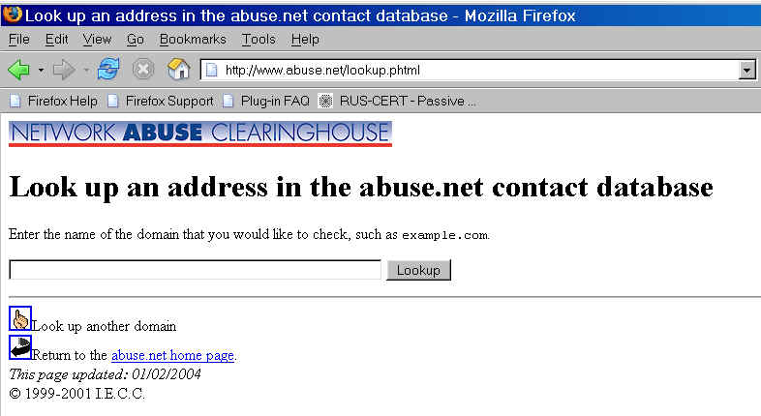
Who Should I Contact About A Given Domain?
All domain's should have a preferred reporting
addresses on file!

Slide 43
Investigating a Host’s/Domain’s Reputation
There are a number of resources online which will help you to investigate a host/IP address/domain/netblock’s reputation. Some you may want to try include:
-- http://www.spamhaus.org/
-- http://www.senderbase.org/
-- http://www.mynetwatchman.com/
-- http://www.openrbl.org/
-- http://www.spamcop.net/

Slide 44
Routing of IP Address Space
While you are now familiar with whois as a way of finding out who is responsible for a given block of IP addresses or a specific domain name, there is one other piece to the puzzle that you need to know about…
Blocks of IP addresses get routed, or announced to the Internet, by ISPs. The ISP announcing a given block may or may not be the same party that shows up in whois as being responsible for those addresses.
To see who’s routing a given address block, or who’s “upstream,” from a site, beginning users will often try using traceroute. Traceroute will show you one path by which packets get to a given site of interest, but they may miss many others which are equally or more important.

Slide 45
Sample Traceroute
traceroute www.amazon.com
traceroute to www.amazon.com (207.171.166.102), 30 hops max, 40 byte packets
1 vlan214.uonet2-gw.uoregon.edu (128.223.214.3) 154.805ms 4.114ms 0.689ms
2 0.ge-0-0-0.uonet8-gw.uoregon.edu (128.223.2.8) 1.318ms 2.484ms 0.49ms
3 eugn-car1-gw.nero.net (207.98.64.65) 0.658 ms 0.54 ms 0.609 ms
4 eugn-core2-gw.nero.net (207.98.64.169) 0.513 ms 0.573 ms 0.499 ms
5 ptck-core2-gw.nero.net (207.98.64.2) 2.898 ms 2.831 ms 4.799 ms
6 ptck-core1-gw.nero.net (207.98.64.137) 7.654 ms 2.871 ms 2.932 ms
7 so-6-1.hsa2.seattle1.level3.net (63.211.200.245) 5.937ms 6.201ms 5.957ms
8 ae-1-52.mp2.seattle1.level3.net (4.68.105.33) 6.296ms 6.167ms 7.289ms
9 as-1-0.bbr1.washington1.level3.net (4.68.128.201) 70.789 ms 70.869 ms
as-2-0.bbr2.washington1.level3.net (209.247.10.130) 70.336 ms
10 ge-3-0-0-55.gar3.washington1.level3.net (4.68.121.132) 70.662 ms
ge-4-0-0-52.gar3.washington1.level3.net (4.68.121.36) 70.49 ms
ge-4-0-0-56.gar3.washington1.level3.net (4.68.121.164) 70.296 ms
11 amazon-com.gar3.washington1.level3.net (4.79.192.10) 70.674 ms 70.792 ms
70.768 ms
12 72.21.201.24 (72.21.201.24) 70.918 ms 70.892 ms 70.984 ms
13 * * *
[etc]

Slide 46
A More Sophisticated Approach
A more sophisticated approach to figuring out who’s “upstream” of a site involves checking the Internet routing tables. The University of Oregon Route Views project (see http://www.routeviews.org/ ) coincidentally has what is perhaps the world’s finest collection of real time Internet routing data
See the discussion at
http://www.uoregon.edu/~joe/one-pager-asn.pdf
for information on how to work with that data
You should also know about the Team Cymru public whois server, which does IP to ASN mapping…

Slide 47
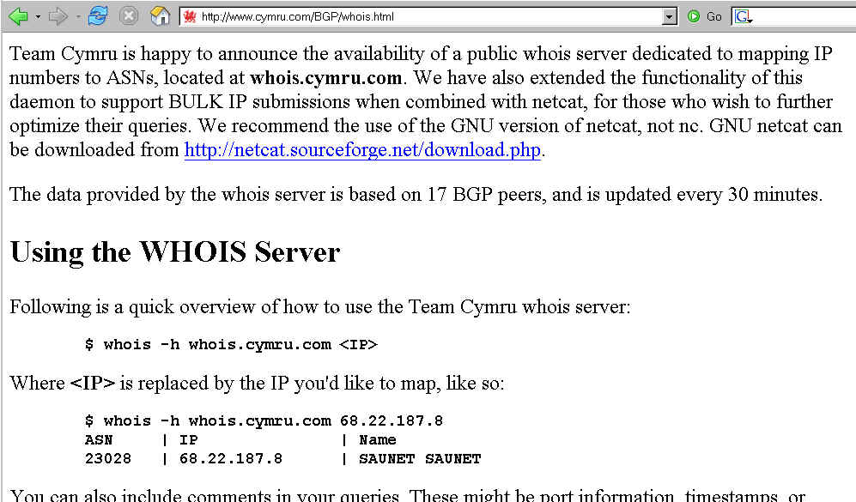
Team Cymru Whois Server

Slide 48
IV. What About The
Body of the Message?

Slide 49
In The Body of the Message, You’re Basically Looking for the Spamvertised Website…
When we were focussed on the message headers, the emphasis was on finding where the message came from. When we move to the message body, the emphasis changes, and becomes one of figuring out where the spammer or phisher wants you to go.
Sometimes the target destination will be a phone number or mailing address, but most often the target destination -- the purpose for the mail -- will be a web site.
You can use the same tools we’ve already talked about (nslookup, IP whois, domain whois, etc.) to look at those links, but there are some additional tricks you should know about.

Slide 50
curl
Normally you retrieve web pages using a web browser such as Internet Explorer or Firefox. When you do so, the browser automatically handles some things in a transparent way that may not be in your best interest if you’re interested in following the breadcrumbs.
A handy alternative you should know about is “curl”
Curl is included in many current versions of Unix, or you can download it online from http://curl.haxx.se/
Curl will let you see both the headers and the full raw body of a web page

Slide 51
Mechanics of Using Curl
I recommend redefining curl to be:
alias curl ‘curl -i --no-buffer --junk-session-cookies’
Then say, for example:
% curl "http://www.ppmort.net/j.php" > ppmort.txt
When you then look at the content of ppmort.txt, you see…
% more ppmort.txt
<!DOCTYPE HTML PUBLIC "-//W3C//DTD HTML 4.0
Transitional//EN">
<html>
<head>
<title>Refinance With US!</title>
<meta http-equiv="REFRESH" content="0;url=index.php?id=j38"></HEAD>
<BODY>
</BODY>
</HTML>

Slide 52
Things Curl Will Show You
When you start looking at spamvertised web pages with curl, you should expect to routinely start seeing:
-- http meta refresh redirection
-- status code-based redirection
-- framing of the “real” site that’s under the spamvertised
site
-- javascript redirection
Note that what you are shown may depend on what the spamvertised site sees for a default “agent type” (e.g., what sort of browser you seem to be using). Curl will let you set the browser agent string to anything you like which should allow you to defeat that sort of thing.

Slide 53
Obfuscation
Some spammers may attempt to obfuscate the URLs of their web sites, either by %-encoding them or by other means. You should be aware that it will normally be possible to de-obfuscate those links using online tools. For example, you may want to try cutting and pasting a %-encoded block of text into:
http://www.uoregon.edu/~joe/xl-cgi.pl
to deobfuscate it.
There are numerous other decoders for other types of text (e.g., raw base64 mime attachments, etc.)

Slide 54
A Caution for Those of You
Working From Windows
When ripping into the bodies of messages, it is possible that you will bump into hostile content, usually targeting Windows computers.
Beware of what you retrieve, and how you then look at that content. In particular, if you retrieve an executable program mentioned in the body of a piece of spam, be particularly wary of “just running it.” Quick checks that will often (but NOT ALWAYS) detect problematic executables can be found at:
-- http://www.virustotal.com/
-- http://virusscan.jotti.org/
see also the Norman Sandbox Information Center:
-- http://sandbox.norman.no/

Slide 55
V. Ripping Apart a Sample Phish

Slide 56
Ripping Apart A Sample Phish
This example is a real eBay phish, received on Saturday night, April 23rd, 2005, and forwarded to us by the recipient on Sunday morning. The reporting user,
like most of our users, has been trained to supply spam samples complete with FULL HEADERS as described at http://micro.uoregon.edu/fullheaders/
Unfortunately the vast majority of spam samples reported by casual email users, whether to ISPs or to government agencies, lack expanded headers (a fact which delights typical spammers, obviously).
Make sure the victims you work with know how to
enable full headers!

Slide 57
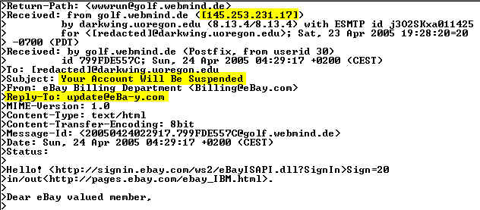
Headers From The Sample eBay Phish
Let's start with stuff from the full header, specifically the IP address that handed us the message. (After we get done poking at that, then we'll come back to the rather interesting Reply-To: address.)

Slide 58
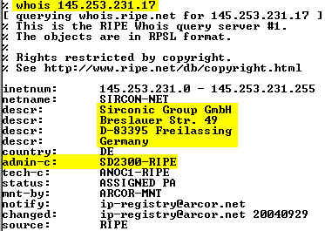
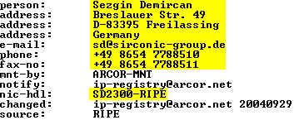
The Phish Was Received From 145.253.231.17

Slide 59

What Does Whois say about sirconic-group.de?
Dot de (German) domain registrations have taken privacy concerns to an absurd length, with the result that little if anything of use is shown for many .de domain names (unlike IP whois records, as shown on the preceding page).
In this case, if we wanted to (e.g., to try to get this phishing site torn down), we could also look at the web site for the domain for contact information.
We'll stay with the dotted quad (e.g., the IP address).

Slide 60
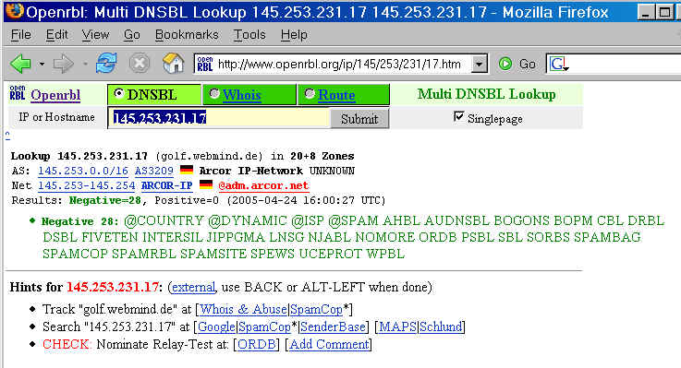
145.253.231.17 Isn't Blocklisted

Slide 61
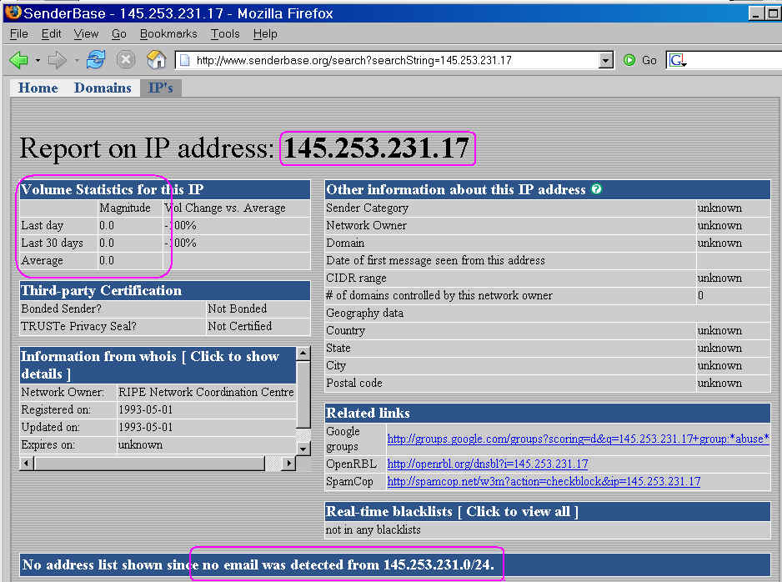
145.253.231.17 Has No Senderbase History

Slide 62
Conclusion About This IP…
145.253.231.17 is likely a newly hijacked IP address at
a compromised host, perhaps running a vulnerable web cgi-bin application of one sort or another (note the "wwwrun" Return-path in the phish, a username commonly associated with cgi-bin execution environments)

Slide 63
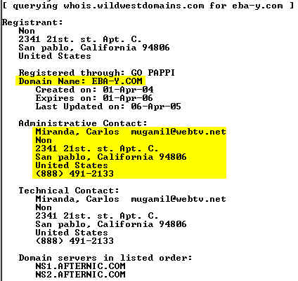
What About That Odd Reply-To Address?

Slide 64
A Note On Email Addresses in Spam/Phishing Headers -- Real or Possibly Just "Joe Jobs"
An email address seen in a mail message header may be one really controlled by the person sending the mail, or it may be a spoofed address (an address that has no connection to the spam/phishing message whatsoever).
Why would a spammer potentially use a real address?
A real address might be getting used to collect messages that bounce, or to handle communications with victims who try to reply to the phishing message (rather than visiting the phishvertised web form)
A spoofed address might ALSO be used to misdirect the curious, or in an attempt to implicate a competitor or to punish an innocent party (such as an antispammer)
Let's see if our conclusions are helped by "vetting" the whois data we just saw…

Slide 65
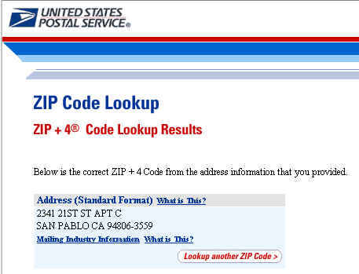
Is The Street Address Used for The Domain Whois Superficially Valid? Yes…
http://www.usps.gov/zip4/

Slide 66
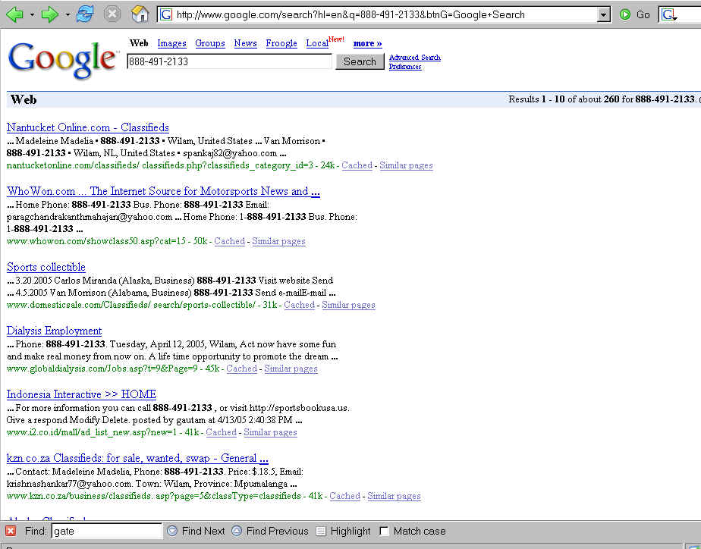
Do We See the 1-888 Number Used In That Domain Registration Show Up Anywhere? Yes

Slide 67
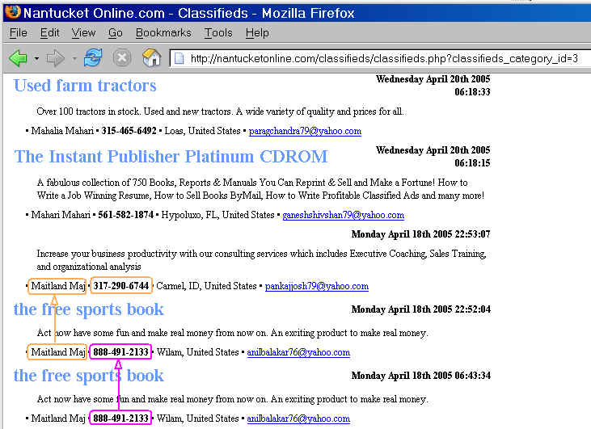
Can We Use Our Original Phone
Number to Find Additional Ones? Yes

Slide 68
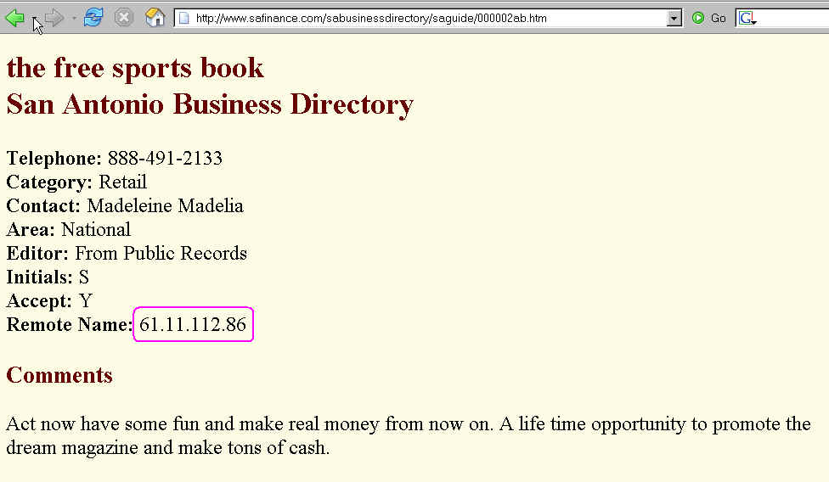
Some Free Classified Add Sites Record
Where Postings Apparently Come From…

Slide 69
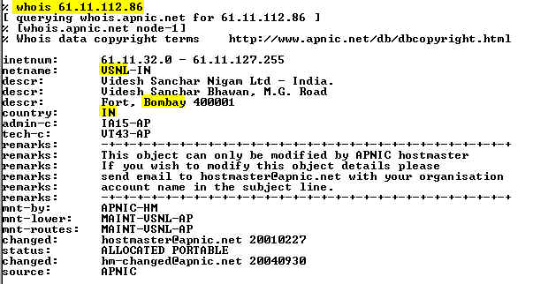
That's A Bombay, India Address

Slide 70
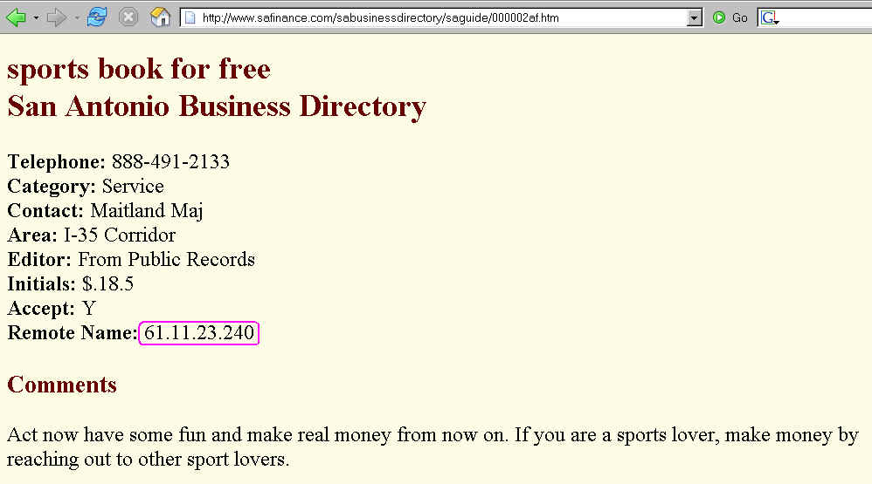
Here's Another One from 61.11…

Slide 71
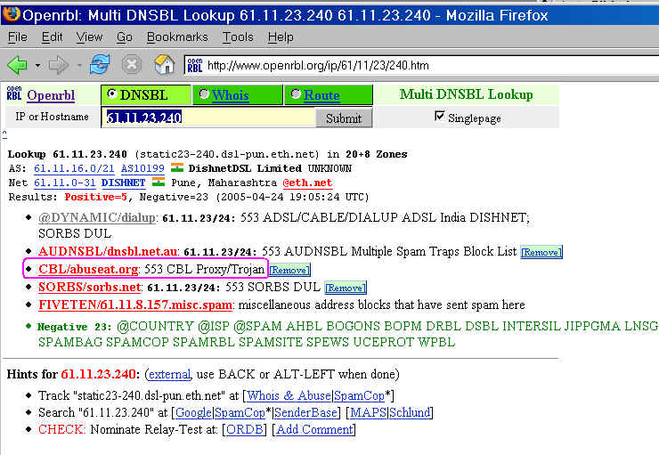
But Those Posting May Not Have Really Originated From Someone In India: Proxies!

Slide 72
An Aside: If You're Interested in Open Proxies or Spam Zombies, You May Want to See…
"The Open Proxy Problem: Should I Worry About Half a Million Trivially Exploitable Hosts?"
http://darkwing.uoregon.edu/~joe/jt-proxies/
open-proxy-joint-techs.ppt (or .pdf)
"Spam Zombies And Inbound Flows to Compromised Customer Systems,"
http://darkwing.uoregon.edu/~joe/zombies.pdf

Slide 73
Nutshell Summary for Accounts
Associated with 888-491-2133
That phone number is seen in conjunction with a wide variety of free/throw-away email accounts (often with stereotypical central asian-related names). At least some of the names used in conjunction with those accounts appear to be names of famous celebrities.
Maitland Maj anilbalakar76@yahoo.com
Margot Morrison pradeepbala74@yahoo.com
Madeleine Madelia krishnashankar77@yahoo.com
Van Morrison spankaj82@yahoo.com
Keanu Reeves paragchandrakanthmahajan@yahoo.com
David Bradshaw sowmyakrish82@yahoo.com
Maitland Maj chandrakantmahajan78@yahoo.co.in
Sam Dek paragsphade@yahoo.com
RekhaRekha rekhasanjaypatil74@rediffmail.com
Guyton Wanda DocNoah7@aol.com
raghu hms_raghavendra@yahoo.co.in
Rosalba Rosalia hms_1204ar8@yahoo.co.in
Aminah Amine iliashuss70@yahoo.com

Slide 74
Any Additional Data?
888-491-2133 was also seen in conjunction with sportsbookusa.us, a (domain registered to Carlos Miranda, 234 21st (apparently a typo) and/or 2341 21st. st. Apt. C., San Pablo, California, mugamil@yahoo.com (instead of mugamil@webtv.net) -- look familiar to
what you saw for the eba-y.com whois? :-;
Sportsbookusa.us and eba-y.com both live on 216.168.41.230 (that IP is part of a block allocated to digital.forest, Inc., 19515 North Creek Parkway, Suite 208, Bothell WA, 98011), and routed by AS11739 (digital.forest, Inc.).
Someone interested in eba-y.com (like ebay.com, for example) would probably next go after the identity of the customer hosting those two domains at digital.forest
using suitable legal paperwork.

Slide 75
Enough With The Headers, What Can We
See In The Body of The Message?
So far, remember that we've just been looking at the message headers.
What can we see if we actually proceed down into the text of the body of the message? Quite a bit, actually, since our user submitted the actual raw text of the message the user received, rather than some HTML-rendered representation…

Slide 76
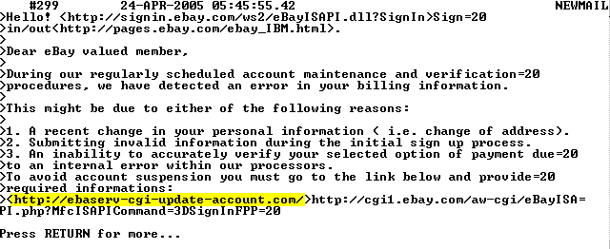
Raw Body of the Phishing Message…
Obviously, http://ebaserv-cgi-update-account.com/
is the phishvertised link that we'll want to pursue –
it is a classic example of a underlying-link-not-agreeing-
with-what-user-normally-sees-for-link-text vector.

Slide 77
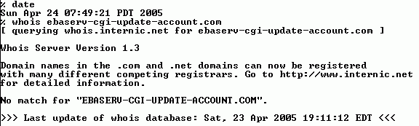
Hmm… That Domain
"Doesn't Exist…"
One of the phishers favorite new phishing tricks is to
register a new domain name and then IMMEDIATELY
begin using it, "making hay while the sun shines" prior
to the time the domain shows up in the whois database.
(Once the domain shows up in whois, the likelihood that
trademark infringing names will be noticed and potentially
contested increases dramatically.)

Slide 78
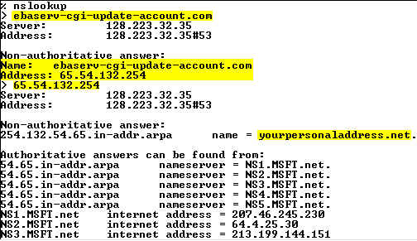
But It Does Exist, and It Resolves Just Fine

Slide 79
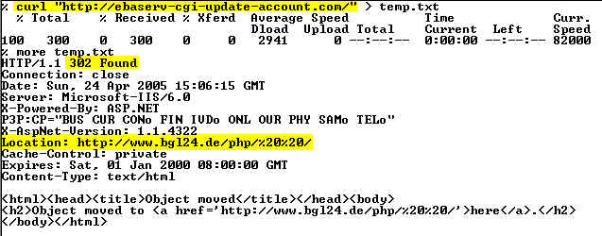
We Can Also Use Curl To Visit That Site

Slide 80
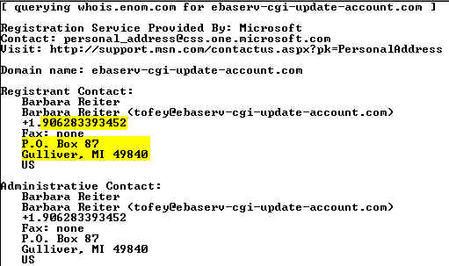
Eventually, We Get To See The Domain Whois...
The whois data for the phishvertised domain begins…
I would be exceedingly surprised if that information proves to be in any way shape or form "valid" and associated with the person truly controlling that
domain. That page is just a redirector, anyhow…

Slide 81
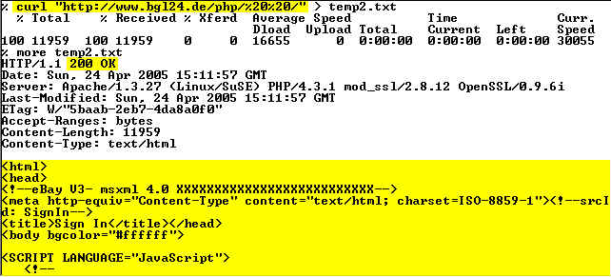

Let's Look At The Real Site…

Slide 82
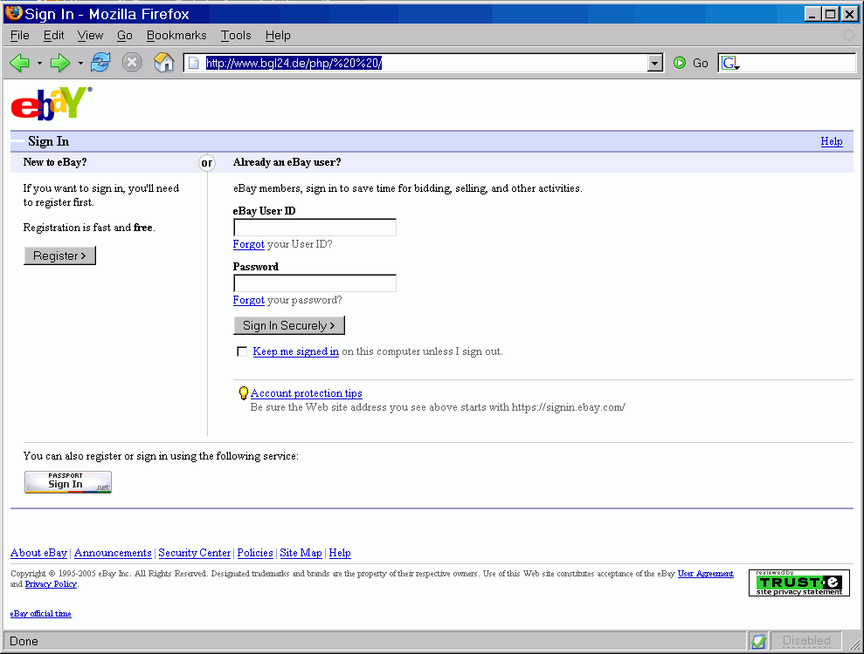
Rendered, The Phishvertised Page Looks Like:

Slide 83
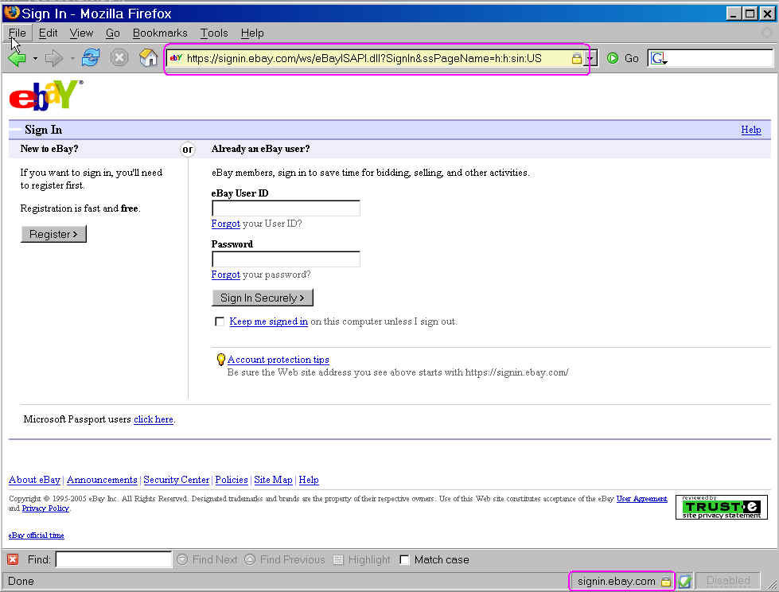
For Comparison, The Real eBay Sign In Page:

Slide 84
What Do We Know About www.bgl24.de ?
www.bgl24.de (that's an ell, not a one, after the bg) turns out to resolve to 145.253.231.16…. Hmm, now doesn't THAT look familiar. Ah! That's because it is yet another host in the now-familiar 145.253.231.0/24 netblock.
If you look at the URL to which you get redirected, it includes to hex-encoded spaces (%20's) as part of the path. That sort of trick is symptomatic of someone who's attempting to hide a directory from casual discovery rather than the sort of name that someone would normally use on a system they directly administered.
The SIRCON-NET host not only sourced the phishing message, they're also hosting the phishvertised site. Dealing with that site now becomes more important… and in fact, after contacting German authorities, the site was torn down. Example endeth.

Slide 85
Thanks for the chance to talk today!
Are there any questions?

