Slide 1
DNSSEC BoF
Internet2 Member Meeting
October 15th, 2008
Noon, Napoleon A2
http://www.uoregon.edu/~joe/dnssec-bof-fall-2008

Slide 2
Agenda
I. Introductions and
Signing Up For the DNSS List
II. DNSSEC-Related Sessions Here at the Member Meeting
(1) This BOF
(2) DNSSEC at LSU, Allie Hopkins, Today, 3PM, Maurepas
III. Just in Case Folks Haven't Heard…
One More Time: The Kaminsky Vulnerability
IV. Some Brief Updates
(1) Signing the Root
(2) ICANN Security and Stability Advisory Committee
(3) Dot Gov and DNSSEC
(4) Nominet/Corecom Test of Broadband Routers and Firewalls
(5) ccTLDs and other TLDs

Slide 3
I. Introductions

Slide 4
Welcome!
Please tell us a little about yourself (e.g., your name and institution)
We'd also love to hear anything else you'd like to share, such as:
-- what's spurring your interest in DNSSEC
-- the status of DNSSEC testing or deployment at your site
-- DNSSEC-related issues you'd like help resolving
-- or?

Slide 5
Signing Up For the Internet2 DNSSEC List…
We don't want to spam you, but if you're interested, please feel free to join the Internet2 DNSSEC mailing list:
https://mail.internet2.edu/wws/subrequest/dnssec
See also the Shinkuro DNSSEC Deployment Working Group and
mailing list at http://www.dnssec-deployment.org/wg/

Slide 6
II. DNSSEC Sessions Here at
The Member Meeting

Slide 7
DNSSEC at Louisiana State University
Abstract:
DNSSEC has become an increasingly popular topic over the last few years amongst DNS administrators worldwide. The recent DNS cache poisoning exploit caused this interest to skyrocket. The importance of DNSSEC is much more apparent now than it has ever been before. We, at LSU, were already on the way to exploring this topic and plan to have it implemented before the close of the New Year. An even better goal is to have something implemented before October. I plan to discuss why DNSSEC is so important to the internet community, how we tackled this seemingly daunting task, and the obstacles/successes encountered along the way.
Session will be today at 3PM, Maurepas

Slide 8
III. Just In Case Folks Haven't Heard…

Slide 9
Test, and If Necessary, Patch Your Resolvers!
Problem: Dan Kaminsky discovered a very efficient way to do DNS cache poisoning; DNSSEC would fix the issue, but until then you watch to be sure to patch your resolvers. For more information, see http://www.kb.cert.org/vuls/id/800113
To Test: https://www.dns-oarc.net/oarc/services/dnsentropy
(an example of what you'd like to see can be found on the following slide)
If Necessary, Patch: If your resolvers don't pass, patch 'em!
Providers ARE Getting Hit: For example, see "China Netcom DNS cache poisoning" (08/19/2008): http://securitylabs.websense.com/content/Alerts/3163.aspx
While patching is critical, and certainly better than nothing, DNSSEC is needed to definitively address this issue.

Slide 10
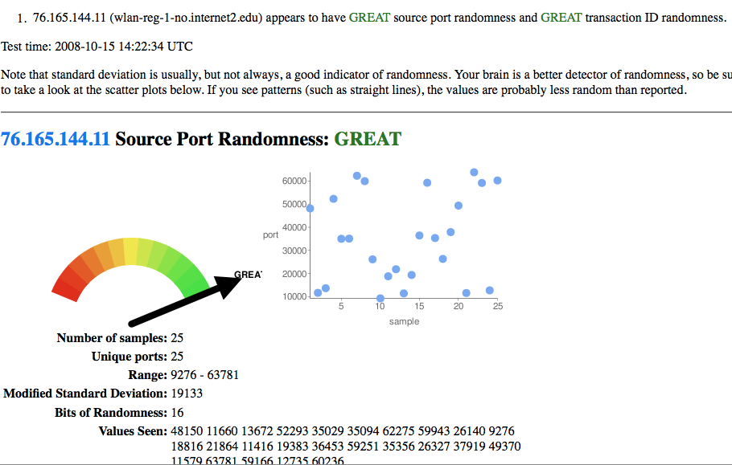

Slide 11
IV. Updates

Slide 12
Update 1: Signing The Root

Slide 13
NTIA Notice of Inquiry: "Enhancing the Security and Stability of the Internet's Domain Name and Addressing System," October 9th
http://edocket.access.gpo.gov/2008/E8-23974.htm
SUMMARY: The Department of Commerce (Department) notes the increase in interest among government, technology experts and industry representatives regarding the deployment of Domain Name and Addressing System Security Extensions (DNSSEC) at the root zone level. The Department remains committed to preserving the security and stability of the DNS and is exploring the implementation of DNSSEC in the DNS hierarchy, including at the authoritative root zone level. Accordingly, the Department is issuing this notice to invite comments regarding DNSSEC implementation at the root zone.
DATES: Comments are due on November 24, 2008
The NTIA's questions are…

Slide 14
Questions on DNSSEC Deployment Generally
In terms of addressing cache poisoning and similar attacks on the DNS, are there alternatives to DNSSEC that should be considered prior to or in conjunction with consideration of signing the root?
What are the advantages and/or disadvantages of DNSSEC relative to other possible security measures that may be available?
What factors impede widespread deployment of DNSSEC?
What additional steps are required to facilitate broader DNSSEC deployment and use? What end user education may be required to ensure that end users possess the ability to utilize and benefit from DNSSEC?

Slide 15
General Questions Concerning
Signing of the Root Zone
Should DNSSEC be implemented at the root zone level? Why or why not? What is a viable time frame for implementation at the root zone level?
What are the risks and/or benefits of implementing DNSSEC at the root zone level?
Is additional testing necessary to assure that deployment of DNSSEC at the root will not adversely impact the security and stability of the DNS? If so, what type of operational testing should be required, and under what conditions and parameters should such testing occur?
What entities (e.g., root server operators, registrars, registries, TLD operators, ISPs, end users) should be involved in such testing?

Slide 16
General Questions Concerning
Signing of the Root Zone (continued)
How would implementation of DNSSEC at the root zone impact DNSSEC deployment throughout the DNS hierarchy?
How would the different entities (e.g., root operators, registrars, registries, registrants, ISPs, software vendors, end users) be affected by deployment of DNSSEC at the root level? Are these different entities prepared for DNSSEC at the root zone level and /or are each considering deployment in their respective zones?
What are the estimated costs that various entities may incur to implement DNSSEC? In particular, what are the estimated costs for those entities that would be involved in deployment of DNSSEC at the root zone level?

Slide 17
Operational Questions Concerning
Signing of the Root Zone
The Department recognizes that the six process flow models discussed in the appendix may not represent all of the possibilities available. The Department invites comment on these process flow models as well as whether other process flow model(s) may exist that would implement deployment of DNSSEC at the root zone more efficiently or effectively.
Of the six process flow models or others not presented, which provides the greatest benefits with the fewest risks for signing the root and why? Specifically, how should key management (public and private key sets) be distributed and why? What other factors related to key management (e.g., key roll over, security, key signing) need to be considered and how best should they be approached?

Slide 18
Operational Questions Concerning
Signing of the Root Zone (continued)
We invite comment with respect to what technical capabilities and facilities or other attributes are necessary to be a Root Key Operator.
What specific security considerations for key handling need to be taken into account? What are the best practices, if any, for secure key handling?
Should a multi-signature technique, as represented in the M of N approach discussed in the appendix, be utilized in implementation of DNSSEC at the root zone level? Why or why not? If so, would additional testing of the technique be required in advance of implementation?

Slide 19
Appendix A: The Six Models
The first three of the process flows described below assign the responsibilities of Root Zone Signer, Root Key Operator, and key publishing among the existing parties to the root zone file management process or to a new, as yet unspecified, third party without materially changing the other pre- existing roles and responsibilities. The fourth model represents a variation of previous models, while changing the current root zone management process flow. The fifth model is also a variation of previous models, while maintaining the current root zone management process flow. The sixth model describes a process flow in which more than one third party, as yet unspecified, are introduced as Root Key Operators, which can be applied to all the previous process flows. [continues]
See http://www.ntia.doc.gov/DNS/dnssec.html

Slide 20
Update 2: ICANN Security and Stability
Advisory Committee Memorandum

Slide 21
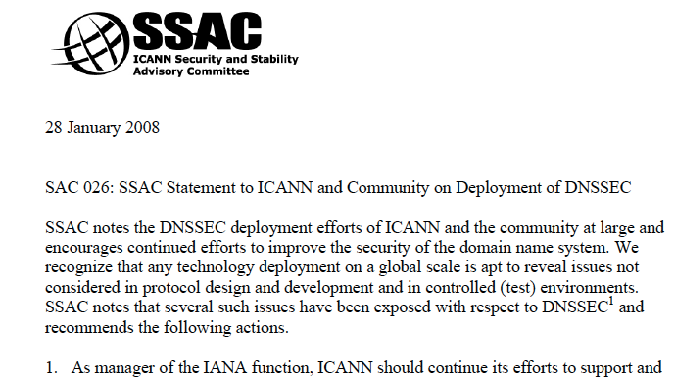
http://www.icann.org/en/committees/security/sac026.pdf

Slide 22
Update 3: Dot Gov and DNSSEC

Slide 23
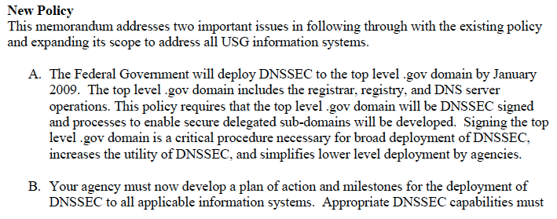
OMB: dot gov will be signed by January 2009
http://www.whitehouse.gov/omb/memoranda/fy2008/m08-23.pdf
August 22nd, 2008

Slide 24
Update 4: Nominet/Corecom Test of
Broadband Routers and Firewalls
http://download.nominet.org.uk/dnssec-cpe/
DNSSEC-CPE-Report.pdf

Slide 25
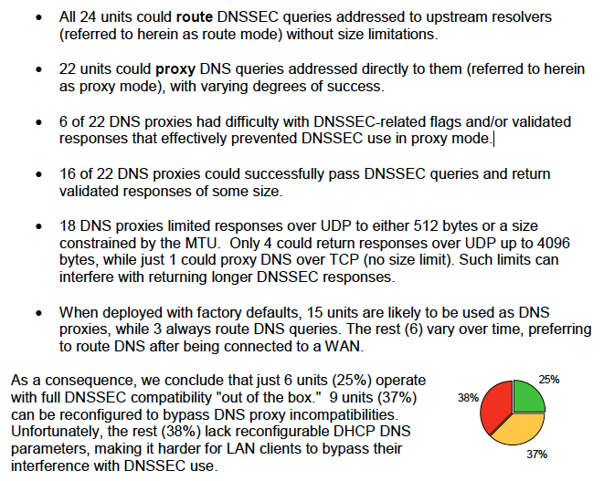

Slide 26
Update 5: ccTLDs (and other TLDs)

Slide 27
Signed ccTLDs (and Other TLDs)
bg
br
cz
museum
pr
se
Sure love to see dot edu join that list :-)
Dot org may beat us to it, however.

Slide 28
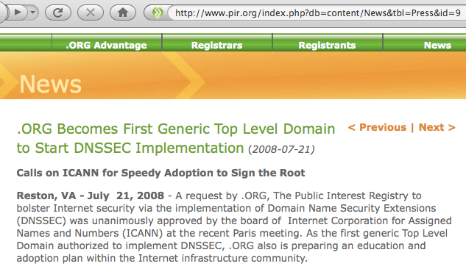
Dot Org

Slide 29
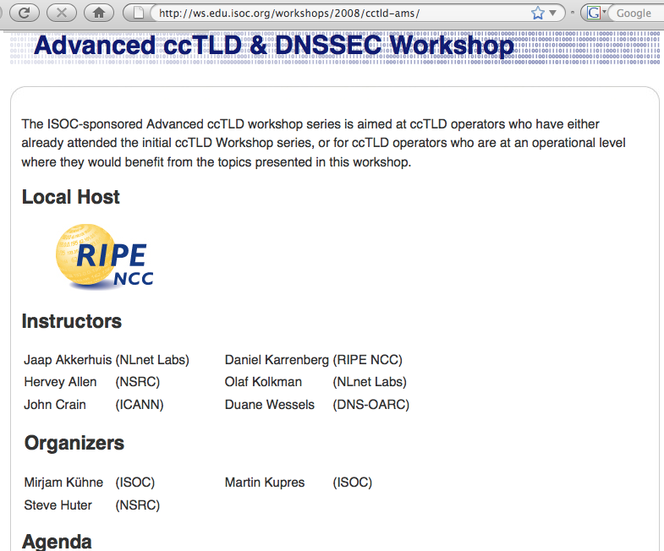

Slide 30
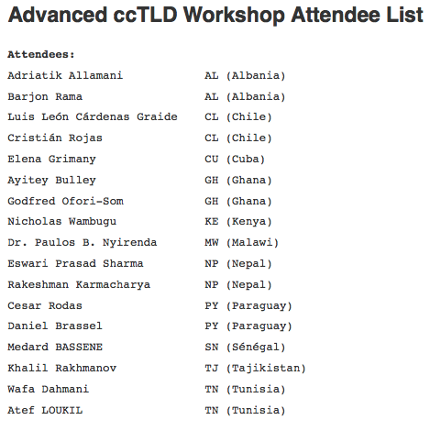

Slide 31
