Slide 1
Route Injection and the Backtrackability of Cyber Misbehavior
Fall 2006 Internet2 Member Meeting
Chicago, Illinois, Dec 5th, 2006
4:30-5:30PM, CC10D
Joe St Sauver, Ph.D. (joe@uoregon.edu)
University of Oregon Computing Center
http://www.uoregon.edu/~joe/fall2006mm

Slide 2
A Note About The Format of
This Talk and A Disclaimer
I've prepared this talk in some detail so that it can be followed by those not present when the talk was
originally given, and to minimize the need for the
audience to jot down notes; doing so also help keep
me on track.
Disclaimer: all opinions expressed in this
document are strictly my own.
Independently verify any/all data presented.
Portions of this presentation have previously been
shared at closed meetings for non-higher ed audiences.

Slide 3
I. IP Addresses, Routing, and the Connections You See

Slide 4
"Where Did THAT Traffic Come From?"
A fundamental tasks performed in most every cybersecurity investigation is attributing network traffic to a responsible party. That's not always easy.
Miscreants obviously want to hide and avoid attribution, and have been known to employ a variety of strategies and techniques in an effort to hinder backtracking.
For example, it is well known that open proxies or spam zombies may be used in an effort to keep an investigator from successfully "working back upstream" to the ultimate source of spam traffic, and similarly everyone has seen forged headers or other misleading data that may be provided as part of a spam message's headers, just to mention a couple of approaches.
In general, however, most investigators DO "rely on" the IP address of a system that directly connects to a trusted host.

Slide 5
For Example…
Assume you saw a connection on your server from 128.223.142.13…
If you checked the DNS for that address on a Unix box, or if you checked whois, you'd associate that address with UO:
% host 128.223.142.13
13.142.223.128.in-addr.arpa domain name pointer darkwing.uoregon.edu.
% host darkwing.uoregon.edu
darkwing.uoregon.edu has address 128.223.142.13
% whois –h whois.arin.net 128.223.142.13
OrgName: University of Oregon
OrgID: UNIVER-193
Address: 1225 Kincaid St
City: Eugene
StateProv: OR
PostalCode: 97403-1212
[etc]

Slide 6
In Reality, However…
Just because some IP addresses are shown as having been assigned or allocated to someone doesn't mean that they're the ones actually USING those addresses.
For example, a miscreant may be able to arrange to have a third party ISP announce ("route") a range of IP addresses which they don't legitimately control. That announcement can be persistent, or temporary (e.g., brought up just long enough to be abused and then withdrawn), a processes commonly known as "address space hijacking."
Address space hijacking may have important implications for cybercrime investigations which rely on the backtracking of observed connections.
If you've not verifying the routing of the TCP connections at the time IP addresses of interest were used, you may end up going after the wrong party.

Slide 7
The Feds Are Also Focused on IP Usage and Attribution Information
The belief that if you "know" an IP (and a timestamp/time zone) you "should" be able to tell who's associated with that address is also reflected in ISP customer record retention requirements mentioned as part of…
-- The Attorney General's remarks at the NCMEC:
www.usdoj.gov/ag/speeches/2006/ag_speech_060420.html
-- Congresswoman Diana DeGettes's ISP data retention
requirement amendment:
energycommerce.house.gov/108/Markups/04262006/degette_001_XML.PDF
-- EU/International data retention programs
www.epic.org/privacy/intl/data_retention.html
It is probably important that policy makers understand that apparent Internet traffic sources should not be taken at face value; route hijacking must also be considered.

Slide 8
II. A "Hand Waving"
Introduction To Routing

Slide 9
What Do You Mean by "Routing?"
A "route" can (informally) be thought of as the path that network traffic takes as it proceeds from its source to its destination. Anyone who's used the traceroute command
has seen examples of network paths. For example, lets trace
to 128.223.142.13 from a "looking glass" server in Seattle
(for a list of looking glass sites see http://www.traceroute.org):
Tracing the route to darkwing.uoregon.edu (128.223.142.13)
1 so-3-0-0.gar1.Seattle1.Level3.net (209.0.227.133) 0 ms 4 ms 0 ms
2 ge-11-1.hsa2.Seattle1.Level3.net (4.68.105.103) [AS 3356] 0 ms
ge-10-2.hsa2.Seattle1.Level3.net (4.68.105.135) [AS 3356] 0 ms
ge-11-1.hsa2.Seattle1.Level3.net (4.68.105.103) [AS 3356] 0 ms
3 nero-gw.Level3.net (63.211.200.246) [AS 3356] 12 ms 4 ms 4 ms
4 ptck-core2-gw.nero.net (207.98.64.138) [AS 3701] 4 ms 4 ms 4 ms
5 eugn-core2-gw.nero.net (207.98.64.1) [AS 3701] 8 ms 4 ms 8 ms
6 eugn-car1-gw.nero.net (207.98.64.165) [AS 3701] 8 ms 8 ms 8 ms
7 uonet8-gw.nero.net (207.98.64.66) [AS 3701] 4 ms 8 ms 4 ms
8 ge-5-1.uonet2-gw.uoregon.edu (128.223.2.2) [AS 3582] 8 ms 8 ms 8 ms
9 darkwing.uoregon.edu (128.223.142.13) [AS 3582] 8 ms 4 ms 8 ms

Slide 10
Looking At That Traceroute…
That traceroute shows the hop-by-hop path that traffic took going from a host in Seattle to 128.223.142.13. Because that traceroute was done from a "looking glass" running on a router, besides showing us "normal" traceroute stuff (such as IP addresses and host names for each router hop in the path), it also shows us some additional numbers, e.g.:
"AS 3356," "AS 3701," and "AS 3582."
Those numbers represent the "autonomous systems" through which network traffic might pass when going from our source host to our destination host. AS3356 represents Level3, AS3701 represents NERO (Oregon's higher education network), and AS3582 represents the U of O. That is a perfectly reasonable path for traffic to take in this case.
Traffic from a different destination will likely take a different path. For example, what about traffic from Switzerland?

Slide 11
Traceroute From a Site in Switzerland
Tracing the route to darkwing.uoregon.edu (128.223.142.13)
1 switch.rt1.gen.ch.geant2.net (62.40.124.21) [AS 20965] 4 ms 0 ms 0 ms
2 so-7-2-0.rt1.fra.de.geant2.net (62.40.112.22) [AS 20965] 8 ms 8 ms 16 ms
3 abilene-wash-gw.rt1.fra.de.geant2.net (62.40.125.18) [AS 20965] 128 ms 124 ms 112 ms
4 nycmng-washng.abilene.ucaid.edu (198.32.8.84) [AS 11537] 112 ms 108 ms 108 ms
5 chinng-nycmng.abilene.ucaid.edu (198.32.8.82) [AS 11537] 132 ms 132 ms 128 ms
6 iplsng-chinng.abilene.ucaid.edu (198.32.8.77) [AS 11537] 144 ms 132 ms 136 ms
7 kscyng-iplsng.abilene.ucaid.edu (198.32.8.81) [AS 11537] 152 ms 160 ms 140 ms
8 dnvrng-kscyng.abilene.ucaid.edu (198.32.8.13) [AS 11537] 164 ms 156 ms 152 ms
9 snvang-dnvrng.abilene.ucaid.edu (198.32.8.1) [AS 11537] 184 ms 176 ms 176 ms
10 pos-1-0.core0.eug.oregon-gigapop.net (198.32.163.17) [AS 4600] 192 ms 188 ms 192 ms
11 uo-0.eug.oregon-gigapop.net (198.32.163.147) [AS 4600] 192 ms 200 ms 212 ms
12 ge-5-1.uonet1-gw.uoregon.edu (128.223.2.1) [AS 3582] 192 ms 188 ms
ge-5-1.uonet2-gw.uoregon.edu (128.223.2.2) [AS 3582] 192 ms
13 darkwing.uoregon.edu (128.223.142.13) [AS 3582] 192 ms 188 ms 192 ms
Now the path we see is AS20965 (Geant), to AS11537 (I2) to AS4600 (the Oregon Gigapop) to AS3582 (UO). If we checked other sites, we'd see still other paths, but in each case we could use the ASNs we see to compactly represent the path.

Slide 12
What Is An ASN?
An Autonomous System Number is a number assigned to a group of network addresses managed by a particular network operator which share a common routing policy.
Most ISPs, large corporations, and university networks have an ASN. For example, Google uses AS15169, Sprint uses AS1239, Intel uses AS4983, and so on. Some large networks with particularly complex routing policies may have multiple ASNs; others, with simple routing policies and only a single upstream network provider, may have none (their network blocks get announced using their upstream provider’s ASN).
You may want to think of an ASN as a number that "maps to" or represents a particular provider or network. ASNs are nice to work with because in most cases a given entity will only have one, no matter how many IP addresses or netblocks or customers they may have.

Slide 13
ASNs are New to Me. How Do I
Translate the ASNs I See to Names?
You can look ASNs up in the ARIN, RIPE, APNIC, LACNIC, AFRINIC, JPNIC, TWNIC (etc.) whois databases, just like IP addresses, either checking with a whois client or via the web whois interface provided by each of those registrars.
If you don't find an ASN in the ARIN whois (for example), you may be redirected appropriately, or you may just need to try the other regions (e.g., check RIPE, check APNIC, check LACNIC, etc., etc.), until you finally get a match.
Usually you'll preface the actual number with AS when looking it up, e.g., AS3582, but if you have difficulty getting a match with the AS included as a literal part of the query, try querying on just the actual AS number itself (this can help when the ASN you're trying to translate is part of a range of ASNs documented via a single entry in the database).

Slide 14
Example of Looking Up an ASN
Assume, for example, we want to know who owns AS20965:
% whois -h whois.ripe.net AS20965
[snip]
aut-num: AS20965
as-name: GEANT
descr: The GEANT IP Service
[snip]
role: DANTE Operations
address: City House, 126-130 Hills Road
address: Cambridge CB2 1PQ, UK
phone: +44 1223 371300
fax-no: +44 1223 371371
[snip]

Slide 15
The Origin AS; Detecting Hijacking
Coming back to the traceroutes we did from Seattle and Switzerland, in each case the last AS in the path was the same: AS3582. That's the "origin AS."
In our case, 128.223.142.13 belonged to UO and AS3582 also belonged to UO, so we can feel fairly comfortable that the 128.223.142.13 address was being used by an appropriate party. If bad traffic was seen from 128.223.142.13, UO should indeed be the ones to hear about it.
But what if we'd seen some other AS other than 3582? If/when a network address block gets hijacked, the ASN we'd normally expect to see ends up getting replaced with a different ASN, the ASN of the network that's injecting an unauthorized route for the hijacked netblock.
Are YOU checking the ASNs that are associated with the IPs connecting to YOUR servers?

Slide 16
Doing IP==>ASN Checks En Masse
While doing a traceroute from a looking glass is a handy way of illustrating the concept of network paths and ASNs, it won't scale as a solution for checking thousands (much less millions!) of IP addresses per hour.
Fortunately, a more scalable option is available – you can simply query the $REVIP.asn.routeviews.org zone via DNS for txt records, either with dig or with host, or via equivalent programmatic calls. For example, to check to see what ASN is associated with 128.223.142.13, you'd say:
% host –t txt 13.142.223.128.asn.routeviews.org
13.142.223.128.asn.routeviews.org text "3582" "128.223.0.0" "16"
(Non-routed IPs return a magic "AS" value of 4294967295)
For those who want to run that ASN zone from a local DNS server, you can retrieve a copy of the routeviews ASN zone:
ftp://archive.routeviews.org/dnszones/originas.zone (bzip2 compressed copies are also available in that same directory)

Slide 17
What's that "128.223.0.0" & "16"?
The routeviews data shown in the example on the previous page provided an ASN, but it also returned two other values:
"128.223.0.0" & "16" – what are those all about?
Those values show the origin address and the CIDR length associated with that IP addresses "most specific encompassing prefix." Decoding that just a bit…
Routing rules in the global routing table normally don't specify routes on a host-by-host basis, they normally work with larger chunks. Those chunks are normally referred to as "prefixes."
In our example, the most specific route encompassing 128.223.142.13 was 128.223.0.0/16, or the range of addresses beginning at 128.223.0.0 and going through 128.223.255.255 (65,536 addresses in all).
Note: just checking 128.223.142.13 won't detect any more specific routes for IPs other in the 128.223.0.0/16 block.

Slide 18
Table of Common CIDR Prefix Lengths
/8 ==> 16,777,216 addresses /23 ==> 512
/9 ==> 8,388,608 /24 ==> 256
/10 ==> 4,194,304 /25 ==> 128
/11 ==> 2,097,152 /26 ==> 64
/12 ==> 1,048,576 /27 ==> 32
/13 ==> 524,288 /28 ==> 16
/14 ==> 262,144 /29 ==> 8
/15 ==> 131,072 /30 ==> 4
/16 ==> 65,536 /31 ==> 2
/17 ==> 32,768 /32 ==> 1
/18 ==> 16,384
/19 ==> 8,192
/20 ==> 4,096
/21 ==> 2,048
/22 ==> 1,024

Slide 19
Where Does The IP To ASN
Zone Data Come From?
The IP to ASN zone is produced by Routeviews, a project that Dave Meyer has here at the University of Oregon. See
http://www.routeviews.org/
A publicly available command line interface is also available:
% telnet route-views.routeviews.org
Username: rviews
route-views.oregon-ix.net> show ip bgp 128.223.142.13
BGP routing table entry for 128.223.0.0/16, version 68025
Paths: (45 available, best #44, table Default-IP-Routing-Table)
6395 3356 3701 3582
216.140.2.59 (inaccessible) from 216.140.2.59 (216.140.2.59)
Origin IGP, metric 20, localpref 100, valid, external
Community: 6395:200
16150 3549 3356 3701 3582
217.75.96.60 from 217.75.96.60 (217.75.96.60)
Origin IGP, metric 0, localpref 100, valid, external
Community: 3549:2681 3549:31528 16150:63392 16150:65321
16150:65326 [etc]

Slide 20
Interpreting Routeviews CLI Output
Routeviews shows network paths from 45 different points on the Internet (just like our two sample traceroutes, which differed when run from Seattle and from Switzerland)
Just like our sample traceroutes, the LAST (rightmost) ASN shown is the one that will usually be the one of interest
Sometimes we do care about who's UPSTREAM of the last ASN; using the command language interface makes it easy to see that, too. See also the Routeviews aspath zone:
% host -t txt 13.142.223.128.aspath.routeviews.org
13.142.223.128.aspath.routeviews.org text "22388 11537 4600 3582"
"128.223.0.0" "16"
Other CLI queries are also possible via routeviews, e.g.:
route-views.oregon-ix.net> show ip bgp regex _3582$
will show a list of all prefixes originated by AS3582

Slide 21
Why Does Routeviews Bother Showing Routing Data from 45 Sites?
Hosts on the Internet may be multihomed (multihoming is the practice of connecting to the Internet via multiple service providers). For example, a large corporation may purchase connectivity from Level3, from Sprint, and from Cogent in an effort to get provider diversity and redundancy. When you do a traceroute from the one site to the other site, you'll only see ONE such path into a site.
The Routeviews CLI shows you the paths into a site from 45 different locations, thereby maximizing the chance that you'll see multiple (all? most?) different routes into a site of interest, thereby giving you a better sense of how that site is connected to the Internet at large. Instead of saying, "That site connects to the Internet via Level3," you may learn that it connects via Level3, AND Sprint AND Cogent, for example.

Slide 22
ICMP, BGP and TCP/UDP Traffic
Occasionally folks may find a situation where the path shown by traceroute (an ICMP-based tool) differs radically from the path shown in routeviews BGP data, or in other cases, actual TCP or UDP application traffic follows a radically different path than the path implied by BGP data. There may be multiple reasons for this, including (just to mention a few)
-- BGP reports the signaling path associated with routing
update messages, which will usually be the same as the
traffic forwarding path (but sometimes may not be)
-- Traffic may be selectively filtered, tunneled or otherwise
handled in ways which can easily obfuscate or mislead
-- there are a number of other possible causes of anomalies.
Nice discussion of this can be found in Mao et. al.'s "Towards an Accurate AS-Level Traceroute Tool,"
http://www.acm.org/sigs/sigcomm/sigcomm2003/papers/p365-mao.pdf

Slide 23
One Last Note for This Section:
ASN-tag IPs As You See Them
Routing information is time sensitive/dynamic. If you wait to check the routing associated with an IP address, during that interval the routing may have changed, and you may tag an IP with the wrong ASN. For example, you may want to add ASN tags to mail at the time the email is received. If it turns out you don't need the ASN info, it is just one more header you've added to the mail (which you can ignore); if you do need or want the ASN data, you'll be dang glad it's there.
Note: the ASN zone updates/reloads at 11:45 and 23:45 UTC; the plans is to increase that frequency in the future...
Karsten Self has released procmail code he uses to tag his incoming mail at delivery time with a X-ASN: header at
http://linuxmafia.com/~karsten/Download/procmail-asn-header
Similar things can be done for other applications.

Slide 24
III. Miscreant Motivations for Doing Address Space Hijackings

Slide 25
Why Would a Miscreant Not Just Get Their Own Legitimate Address Space?
Bad guys and bad gals have several problems when it comes to getting and using legitimate address space…
-- as quickly as they get new address space and begin to
use it for evil purposes, that space gets blocked/filtered (at
which point the usability of that space drops dramatically)
-- if miscreants get address space legitimately, there's an
administrative trail leading right back at 'em; very handy
for law suits and criminal prosecutions!
-- requests for more address space need to be justified, and
"I've heavily abused all the network address space I've
currently got, and now that space is all heavily filtered
damaged goods I can no longer use," doesn't "cut it"
-- miscreants want to "fly under the radar" if they can, and
concentrated abuse from one's own IP space stands out

Slide 26
So What's a Miscreant,
Such As A Spammer, To Do?
Well, we know that spammers will try to send their spam via spam zombies, but that's not working as well for them as it used to.
Is there anything else they could do? Well, if you're a spammer and not particularly worried about doing bad
things, the "expedient" thing to do might be to just take
some IP addresses that don't belong to you (if you're accustomed to hijacking PCs and using them as spam zombies, hijacking network address blocks probably
won't feel particularly daring).
Heck, stealing otherwise unused address space may be LESS legally risky than hijacking PCs and turning them
into zombies…

Slide 27
Taking That Which Doesn't
Belong to You Is Stealing, Right?
Hijacking a netblock is clearly "wrong" and "bad," but a
non-rhetorical, non-flip, truly serious question…
Is hijacking a not-otherwise-in-use netblock a crime?
If so, is it a felony or misdemeanor? What statute is
being violated? How many netblock hijackers have
been successfully prosecuted to-date?
Would there be the willpower to actually prosecute a netblock hijacker (or would this be just yet another technical violation that never actually gets charged)?
Will this require some really grotesque routing-based denial of service incident to motivate official attention and new law?
And what about netblock hijackings overseas?

Slide 28
CAN-SPAM And Hijacked IP Addresses
18 USC Sec. 1037. Fraud and related activity in connection with electronic mail
(a) IN GENERAL- Whoever, in or affecting interstate or foreign commerce,
knowingly--
* * *
(5) falsely represents oneself to be the registrant or the legitimate
successor in interest to the registrant of 5 or more Internet Protocol
addresses, and intentionally initiates the transmission of multiple
commercial electronic mail messages from such addresses, or
conspires to do so, shall be punished as provided in subsection (b).
(b) PENALTIES- The punishment for an offense under subsection (a) is--
(1) a fine under this title, imprisonment for not more than 5 years,
or both, if--
(A) the offense is committed in furtherance of any felony under the laws of the United States or of any State; or
(B) the defendant has previously been convicted under
this section or section 1030, or under the law of any State
for conduct involving the transmission of multiple
commercial electronic mail messages or unauthorized
access to a computer system;

Slide 29
Zero Prosecutions…
To the best of my knowledge, that's a section of the United States criminal code that's never been the basis of any federal prosecution.
Happy to hear about examples I may have missed in this area…

Slide 30
Well, Even If Hijacking A Netblock
Isn't Something That's Routinely Prosecuted...
Wouldn't someone at least notice/care if a miscreant hijacked a prefix?
Maybe yes, maybe no. It depends in part on what prefixes the miscreant announces, and how they use/announce it.

Slide 31
Announcing an Already-Used Prefix
If a miscreant announces an already-used prefix, this will typically end up being noticed because at least some legitimate traffic will be diverted from its intended destination, and connectivity to the normal hosts using that prefix will break.¹ Of course, one could imagine a miscreant intentionally announcing an already-used prefix as part of a denial of service attack, or as part of an effort to obtain traffic to sniff, etc. (see RFC4272 at 1-2) but for the purpose of this spam-oriented discussion, we'll disregard those possibilities.
Given that the miscreant wants to "fly below the radar," his/her quest becomes one of finding an address block, or at least part of an address block, that's not currently in use.
----
1. How much traffic will be diverted depends on whether the unauthorized user announces a prefix that is of the same specificity or granularity as the real user
or one or more more-specific prefixes, as well as a variety of other factors.

Slide 32
Unallocated/Reserved Space?
Some folks may assume that when we talk about address space that's "not currently in use" we're talking about IP address space that's reserved or which has
yet-to-be-allocated by IANA ("bogon space").
See http://www.iana.org/assignments/ipv4-address-space
and http://www.cymru.com/Documents/bogon-list.html
Unallocated/reserved space would not work well for stealthy spammer use because unallocated/reserved space is well documented, widely filtered, and any use of that space will typically be quickly noticed and publicized (see the next slide for examples where unallocated/reserved space is reportedly in use, generally/presumably with no malicious intent).

Slide 33
http://thyme.apnic.net/ap-data/ 2006/12/03/0400/mail-global
Advertised Unallocated Addresses
--------------------------------
Network Origin AS Description
132.0.0.0/10 721 DLA Systems Automation Center
137.0.0.0/13 721 DLA Systems Automation Center
158.0.0.0/13 721 DLA Systems Automation Center
172.33.1.0/24 7018 AT&T WorldNet Services
176.16.0.0/16 7908 Comsat Argentina S.A.
192.44.0.0/24 5501 Fraunhofer Gesellschaft
192.44.0.0/19 702 UUNET - Commercial IP service
192.70.164.0/24 25689 National Research Council of
192.172.0.0/19 721 DLA Systems Automation Center

Slide 34
Forgotten/Ignored Prefixes
Most persistent hijackings are associated with forgotten/ignored "zombie" network prefixes which bad guys notice, "resurrect," and then begin to use as their own.
Forgotten/ignored prefixes are often the result of legacy address allocation provided to a now-out-of-business company. When that company folded or was acquired, if its address space was no longer required, it should have been returned to ARIN/RIPE/APNIC/etc. (e.g., see http://www.arin.net/policy/nrpm.html at 8.1) but often the employees of a company in "freefall" have other, more personal, priorities.
Since the now-out-of-business company doesn't exist any more, and thus has no networking staff, and thus no one to notice/complain that its IP address space is being used w/o authorization, the hijackers have the addresses they want.

Slide 35
Another Possibility:
Underutilized Prefixes
Underutilized prefixes arise when an entity has access to more address space than it currently needs. When that's the case, a miscreant may "borrow" a chunk of that address space that's not currently being actively used, and begin to advertise that space via a more specific route for the hijacker's own nefarious purposes.
So what's the role of universities, gigapops, regional optical networks and Internet2 when it comes to preventing the announcement of unauthorized prefixes?

Slide 36
IV. Hijacked Blocks,
Universities, Gigapops,
Regional Optical Networks and Internet2

Slide 37
"I've Got A New Prefix I'd Like to Route"
Most edu's connecting to I2 take great care to only
announce their own IP address space, or portable address space legitimately controlled by their partners, filtering all other prefixes which may be seen from a downstream source. [Most commercial ISPs are also quite careful with their prefixes, too.]
Internet2 helps double check that process by reviewing all prefixes which a connector asks to announce. Prefixes are specified via the PDF form that's at:
http://abilene.internet2.edu/AbilenePrefix2.pdf
Prefixes seen via networks with which I2 peers with
are NOT filtered.

Slide 38
Whois and Hijacked Blocks
Because all conscientious providers check whois details when asked to route a new prefix, some IP address hijackers create new entities with names that "look like" the name of a company that originally received a prefix they want to use. They then attempt to socially engineer the registrar into "updating" the whois data that's associated with the targeted prefix to use the look-alike company's contact information.
Bad guys have historically also attempted to mechanically update whois data when that data is only secured by
MAIL-FROM authentication, but this is now less commonly possible. See: http://www.ripe.net/db/news/mailfrom.html
http://www.apnic.net/meetings/14/sigs/db/minutes.html
http://www.arin.net/CA/ca_faq.html
Nice historical discussion of mntner object security at
www.trustmatta.com/downloads/Matta_NIC_Security.pdf

Slide 39
Routing Registries
ISPs sometimes require all customer prefixes to be registered in a routing registry ("RR"), either one run by the ISP itself, or in a community RR serving a wider constituency.
A list of routing registries is available online at http://www.irr.net/docs/list.html
You can query the RADB at http://www.radb.net/
RR's usually use "RPSL" to express objects in the database; see RFC2622 and RFC2650 for information about RPSL.
Among other data, routing registries list routes (or route-sets) and the ASNs that should be originating those routes.
When use of a RR is required, and that data is kept accurate and current, ISPs can use that data to mechanically build prefix filters (e.g., using tools from the IRRToolSet) and thus avoid accidentally accepting unauthorized/typo'd prefixes
Unfortunately, use of RRs is not universally compulsory.

Slide 40
Routing Registries and Internet2
Once upon a time… there used to be an active I2 Routing Working Group, and one of the good projects which that
group worked on was an I2 routing registry. See
http://routing.internet2.edu/wg-meetings/
20010130-I2rwg-slides/sld004.htm
Unfortunately the service referred to is no longer in operation:
% whois -h whois.internet2.edu AS25
[Querying whois.internet2.edu]
[whois.internet2.edu: Name or service not known]
[Unable to connect to remote host]
You *could* use an alternative routing registry, however! :-)

Slide 41
Detecting Route-Related Anomalies
Routing registries can make it easy to detect routing anomalies, but we can detect some unusual things
even with incomplete routing registry usage.
For example, let us consider a brief digression:
singly-homed ASN usage.

Slide 42
ASNs and Multihoming
ASNs have historically been scarce resources, and as a matter of policy, ASNs are only supposed to be allocated to multihomed entities (e.g., sites with two or more upstream service providers). See, for example:
http://www.ripe.net/docs/asn-assignment.html which states:
"Current guidelines require a network to be multi-homed
for an AS Number to be assigned."

Slide 43
So Are There ASNs
Which Aren't Multihomed?
You bet. Go to http://www.cidr-report.org/bgp-originas.html and scroll down to the bottom. Now "drill down" (click on) some of those toward-the-bottom-of-the-list ASNs. Notice how many of them have only a single upstream provider? Unless they have additional upstream connectivity which isn't externally discernable, those apparently single-homed sites should not have their own ASN.
You may ask, "Heck, who cares if they get an ASN or not? What's it to you?" Well, 16 bit traditional ASNs are scarce (there are only 64510 available) and unfortunately we've been blowing through them at a very high rate of speed.
Think about ASNs consumed by those single homed sites when you can no longer just do 16 bit ASNs, and you need
to begin upgrading gear to deal with 32 bit ASNs…

Slide 44
For Those Not Following 32 Bit ASNs:
Fwd: The IESG Approved the Expansion of the AS Number Registry (Mon, 27 Nov 2006 )
http://www1.ietf.org/mail-archive/web/ietf/current/
msg44519.html
BGP Support for Four-octet AS Number Space
http://www.ietf.org/internet-drafts/draft-ietf-idr-as4bytes-12.txt

Slide 45
32 Bit Timeline…
5.1 16-bit and 32-bit AS Numbers
Commencing 1 January 2007, ARIN will process applications that specifically request 32-bit only AS Numbers and assign such AS numbers as requested by the applicant. In the absence of any specific request for a 32-bit only AS Number, a 16-bit only AS Number will be assigned.
Commencing 1 January 2009, ARIN will process applications that specifically request 16-bit only AS Numbers and assign such AS Numbers as requested by the applicant. In the absence of any specific request for a 16-bit only AS Number, a 32-bit only AS Number will be assigned.
Commencing 1 January 2010, ARIN will cease to make any distinction between 16-bit only AS Numbers and 32-bit only AS Numbers, and will operate AS number assignments from an undifferentiated 32-bit AS Number pool.
Terminology
"16-bit only AS Numbers" refers to AS numbers in the range 0 - 65535
"32-bit only AS Numbers" refers to AS Numbers in the range 65,536 - 4,294,967,295
"32-bit AS Numbers" refers to AS Numbers in the range 0 - 4,294,967,295
Source: http://www.arin.net/policy/nrpm.html#five1

Slide 46
"Defensively Deaggregated" Announcements
One last thing that should be mentioned in the context of ISPs and route hijacking is what might be called "defensive deaggregation" of routes in an effort to prevent hijackers from announcing more specific routes.
Recall that the most specific match in the routing table will be used to route bits. Thus, if you announce a nicely aggregated /19, but a hijacker announces two /20's, his more specific routes will "win" and traffic will flow toward his network rather than toward yours. To proactively discourage this, some providers intentionally deaggregate their own prefixes and announce "more specifics" (e.g., often a whole pile of /24's).
Obviously, this is NOT desirable when it comes to containing routing table bloat, but a (perception) of private benefits may once again outweigh public costs.

Slide 47
Route Filtering Policies
If an ISP announces a pile of /24's, you might wonder what would keep a miscreant from simply announcing a larger pile of more specific /25's, etc. ISP route filtering policies normally kick in to help limit overly specific routes. Example: http://www.ip-plus.net/technical/route_filtering_policy.en.html
Many providers ignore routes more specific than a /24
It is also common for providers to reserve the right to aggregate (where feasible) more specific announcements they see from customers.
Nonetheless, you should not be surprised to see LOTS of deaggregated prefixes announced, e.g., check out the CIDR Report: http://www.cidr-report.org/ For example, on 3 Dec 2006, AS4134 could have announced 282 routes, but gave the Internet 1206 less-aggregated routes instead…
[Stipulated: There are/can be legitimate technical reasons for announcing more specifics]

Slide 48
Route Filtering on Abilene
Prefix Length Routing Policy
http://www.abilene.iu.edu/abilene/documentation/
policy-statements/prefix-length-routing-policy.html
The following was sent to the Abilene operations list on 17 January 2003.
Abilene encourages its connectors to aggregate advertised prefixes
as an internet best practice. Therefore, we will accept approved IPv4 prefixes up through /27. However, we realize that in unusual special cases, prefixes more specific than /27 must be advertised, so if there is an important reason a prefix more specific than /27 must be advertised, explain your need and we will try to accomodate you.
Since connectors are the only ones from whom specific prefixes are accepted, this policy applies so far only to Abilene connectors (i.e. not
to peer networks).

Slide 49
"Accidental" Classful Summarization
Feedback from a person who looked at an earlier version of this talk included the comment that the reason they intentionally deaggregate is to protect against problems with people who ended up "accidentally" doing bgp auto-summary with disastrous results.
Grease pencil on a match book version: downstream customer ended up with two different widely separated /24's, router was set to do BGP auto-summary, and customer ended up announcing a rather overlarge classful prefix.
Nice discussion about auto-summary from Cisco at
"How does BGP behave differently with auto-summary enabled or disabled?"
www.cisco.com/warp/public/459/bgpfaq_5816.shtml#five
Fortunately auto-summary is now disabled by default! :-)

Slide 50
Is Anyone Watching For Hijackings?
It would be great if ARIN/RIPE/APNIC/LACNIC or some other technical body was watching the entire Internet's address space for hijackings, but in general they are neither charged nor equipped to generally do so (RIPE does deserve credit for running an ASN-by-ASN opt-in route monitoring service called myASN, however)
To the best of my knowledge, the federal government also doesn't monitor the Internet routing table looking for hijackings, or if they do do so, they don't do so in any general/publicly advertised way.
Just as in many things spam- or network security-related, private parties carry the load…:-)

Slide 51
CompleteWhois, Spamhaus DROP, Etc
For example, the CompleteWhois folks have a list of over
125 known or suspected netblock hijacks documented at http://www.completewhois.com/hijacked/index.htm ; see also the Spamhaus DROP (Do not Route Or Peer) Advisory Null List ( http://www.spamhaus.org/drop/ ) and the UNM Internet Alert Registry ( http://cs.unm.edu/~karlinjf/IAR/index.php )
Two other route monitoring resources are RIPE's myASN service (http://www.ris.ripe.net/myasn.html), and the Colorado State's Prefix Hijack Alert System (PHAS) http://netsec.cs.colostate.edu/phas/
There are even commercial projects such as Renesys' Routing Intelligence Service, see http://www.renesys.com/ products_services/routing_intelligence.shtml

Slide 52
Who Has Announced Hijacked
Netblocks Flagged by CompleteWhois?
In order for a hijacked netblock to be useful, it needs to be announced by an ISP, at which point it becomes associated with that ISP's Autonomous System Number. The next slide shows ASNs that were listed by CompleteWhois as having announced one or more potentially hijacked netblocks.
Couple of things to note:
-- some of those ASNs are familiar and unquestionably "white
hat;" others may be comparatively unknown or may have
less uniformly favorable reputations.
-- ASNs were mapped to entity names this Summer; it is
possible that some ASNs have changed to an unrelated
3rd party since the time that they were listed (although
most will have a stable assignment and usage history)

Slide 53
ASNs from CompleteWhois' List
3491: BTNA (VA)
5042: Discnet (CT)
6216: Turfway Park (KY)
7438: Telefonica Data Mexico
7474: SingTel Optus Pty Ltd (NSW Aus)
8001: NAC (NJ)
8121: TCH Network Svcs. (CA)
8129: CAI Wireless (VA)
8143: Publicom Corp. (FL)
8167: TELESC (BR)
9723: ISEEK Ltd. (Qld. Aus)
9826: iLink.net Ltd (HK)
9929: China Netcom Corp. (CN)
10741: Wam Net Entr. Inc. (FL)
10912: Internap (GA)
13419: 2Access.net, Inc (OH)
13768: Peer1 (NY)
13953: Bisco Industries Inc. (CA)
14492: DataPipe (NJ)
15188: Diali Internet (FL)
16631: Cogent (DC)
18747: IFX Comm (FL)
19151: WV Fiber LLC (TN)
20290: Lynch Intl. (GA)
20473: NetTransactions (NJ)
21844: The Planet (TX)
22653: Global Compass (GA)
22938: BigCity Networks (TX)
23131: Starlan Comm. (NY)
23184: Persona Comm. (Nfld. Can.)
23401: NAC (NJ)
23352: Server Central Network (IL)
25847: ServInt Corp (VA)
26522: Netwave Tech. Inc. (NY)
26797: SIMRAD (Norway)
[continued next slide]

Slide 54
ASNs from CompleteWhois' List
26857: Web Design House (NY)
26891: INGS (IN)
26978: Sterling Network Svcs (AZ)
27255: VMX, Inc. (NY)
27526: Endai Corp. (NY)
27595: InterCage, Inc. (CA)
28706: Stream TC (Ukraine)
29698: INVESTools Inc. (TX)
29713: ITV Direct Inc. (MA)
29761: OC3 Networks (CA)
29893: Bombay Co. (TX)
29994: Iskimaro (CA)
30080: Arnold Mag. Tech. (NY)
See the individual Completewhois listings
for details associated with each ASN.

Slide 55
Investigating a Prefix (Beyond Just Finding What ASN Is Announcing It)
Unfortunately, it can be quite difficult to investigate a potentially hijacked prefix beyond finding the ASN that's announcing it:
-- whois data may be inaccurate/questionable
-- the announcing ISP may be less than cooperative if the
hijacked block is associated with a lucrative/bad customer
-- just as netblocks can be hijacked, ASNs can also
be hijacked/used without authorization
-- if you get "too close" the hijacked prefix may get replaced
with a new one; rinse, lather, repeat
-- working route hijacking issues will likely require the
involvement of your corporation's network engineers, and
may be time consuming

Slide 56
The Network Engineer Perspective vs. The Anti-Spam Perspective
I've come to understand that network engineers view route hijacking risks differently than anti-spammers.
Routing geeks generally worry about someone hijacking their own prefixes, or a customer trying to slide a hijacked prefix past the local NOC's staff.
Anti-spammers, on the other hand, care about ANY hijacked netblock that may be used to emit spam, provide spammer DNS service, host spamvertised web sites, etc.
Some antihijacking/route-monitoring projects focus on the routing geek perspective, others follow the anti-spam perspective.
I suggest taking each project on its own merits, because each can be valuable in different ways.

Slide 57
V. Transient Routing of Large Prefixes

Slide 58
What About Possible Short-Lived Hijackings of Large Prefixes?
See "Short-Lived Prefix Hijacking on the Internet," by Peter Boothe, et. al. (Peter's with the UO CIS Department),
http://www.nanog.org/mtg-0602/pdf/boothe.pdf which states that there were between 26 and 96 successful prefix hijackings in December 2005 (95% confidence level)
Do spammers use those sort of short-lived prefix hijackings? Well, seee "Understanding the Network Level Behavior of Spammers," A. Ramachandran and Nick Feamster, Georgia Tech, http://www.nanog.org/mtg-0606/pdf/nick-feamster.pdf :
"Common short lived prefixes and ASes
61.0.0.0/8 4678
66.0.0.0/8 21562
82.0.0.0/8 8717"

Slide 59
How Would Announcing x/8 Work?
Any traffic addressed to parts of x/8 which are NOT covered by some other route would go to a general route covering x/8.
Because that's a very large announcement, any more
specific announcement will be preferred over it; if you're someone who's legitimately announcing some smaller chunk of x/8 you'll never notice the larger covering announcement.
Spammers announcing the large covering x/8 WILL have the ability to use onesie-twosie addresses scattered throughout
all the otherwise unrouted parts of "their" large prefix… no need to cluster all their spam traffic in a single, compact, easily-identified and easily-filtered range.
"Nice" side effect: complaints will also often end up being directed to inappropriate parties, or just fall on the floor.
This is obviously potentially very, very, evil.

Slide 60
"Problems" of Advertising Large Blocks
There's only a small number of /8's that can potentially be announced.
If you know to look for those announcements, it is awfully easy to spot them.
Once you know they exist, you can work on getting them filtered or otherwise eliminated at a technical level.
Other bad guys can "take" "your" /8 by advertising more specific covering routes, such as /9's (or /10's, or /11's, etc.)
There's one other issue that sometimes is raised when the possibility of doing transient announcement of large blocks comes up… damping.

Slide 61
What Do We Currently (12/2/06) See For 61/8?
% telnet route-views.oregon-ix.net
Username: rviews
route-views.oregon-ix.net>show ip bgp 61.0.0.0/8
BGP routing table entry for 61.0.0.0/8, version 531810282
Paths: (3 available, no best path)
Not advertised to any peer
3303 15412 4678 (history entry)
164.128.32.11 from 164.128.32.11 (164.128.32.11)
Origin IGP, localpref 100, external
Community: 3303:3008 15412:603 15412:621 15412:803 15412:1301
Dampinfo: penalty 928, flapped 1 times in 00:01:43
7500 2518 4678 (history entry)
202.249.2.86 from 202.249.2.86 (203.178.133.115)
Origin IGP, localpref 100, external
Dampinfo: penalty 1964, flapped 3 times in 00:15:32
2497 4678 (history entry)
202.232.0.2 from 202.232.0.2 (202.232.0.2)
Origin IGP, localpref 100, external
Dampinfo: penalty 488, flapped 1 times in 00:15:36

Slide 62
What Do We Know About The Introduction and Withdrawal of These Routes Over Time?
If an announcement is put up just long enough for a brief spam run, only to be torn down immediately thereafter, and that behavior gets repeated, as hypothesized by some, we should see those changes show up in a BGP updates log, such as the web-based one that's offered by Potaroo…
For example, see the update report for AS4678 on the following slide…
http://bgpupdates.potaroo.net/cgi-bin/generate_as_log?as=4678
Sure enough, interesting announcement and withdrawal activity is seen for that ASN (although we have no way of knowing if that activity is associated with spam)

Slide 63
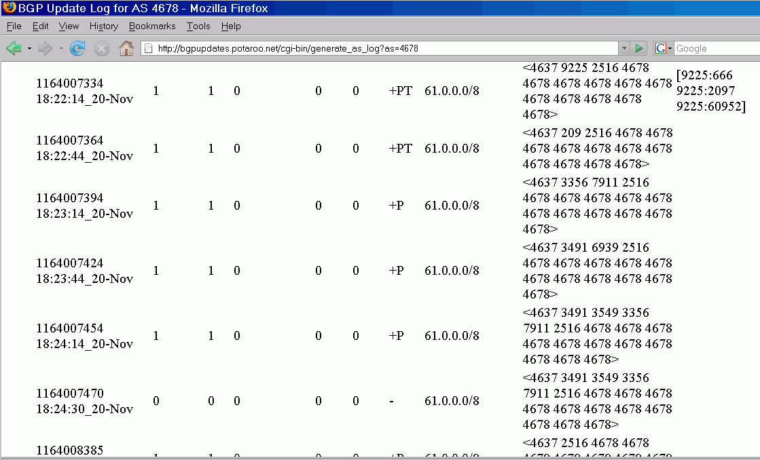

Slide 64
Route Flap Damping
Something to ponder: if the bad guys inject a route for a short period of time and then withdraw it, and then re-advertise it repeatedly, they may trigger route-flap damping.
Damping holds down, or suppresses, an oscillating route for a period of time. See RFC2439, November 1998.
Route-flap damping was introduced to improve the stability of the Internet core's routing table and to control the CPU load placed on core routers, and has been widely deployed.
If spammers are rapidly introducing and withdrawing routes, per Feamster's talk, wouldn't they get damped? Maybe, maybe not. For example, the RIPE Routing Working Group has now recommended that ISPs NOT do damping
(see http://www.ripe.net/ripe/docs/ripe-378.html).
See also http://www.nanog.org/mtg-0210/ppt/flap.pdf
Obviously, at least in the 61/8 case, we do see damping.

Slide 65
What To Make of Those Route Flaps?
If you advertise a route for whatever's not more specifically routed within a large prefix, you may want to make sure you have a LOT of bandwidth available to absorb random packets that will likely end up coming your way… failure to do so might conceivably result in starvation of the control plane (but see "BGP Vulnerability Testing: Separating Fact from FUD," http://www.nanog.org/mtg-0306/pdf/franz.pdf at pp.16).
Then again, this flapping might be caused by something else entirely (see, for example, "A Study of BGP Origin AS Changes and Partial Connectivity," by Ratul Mahajan, et. al., http://www.cs.washington.edu/homes/ratul/bgp/nanog.pdf )
Widespread route-flap damping, however, should limit the practical usefulness of some short-lived announcements.
Just interested in route-flap damping data? See
http://archive.routeviews.org/oix-route-views-damp/

Slide 66
VI. Historical Routing Data

Slide 67
Historical Routing Data
More about Route-Views data… Route-views has both:
-- CLI format data (similar to what you'd see if you telnet'd to route-views) routing data archived back to November 1997 (see http://archive.routeviews.org/oix-route-views/ ) and
-- MRT format routing data that goes back to October 2001.
The easiest way to access at least a limited subset of that
data is via Merit's web-based BGP-Inspect-Routeviews, see
http://bgpinspect.merit.edu/
Sample BGP-Inspect query form, and resulting output excerpts can be seen on the following slides…

Slide 68
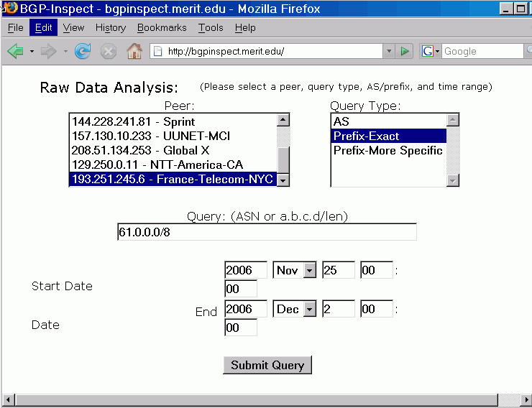

Slide 69
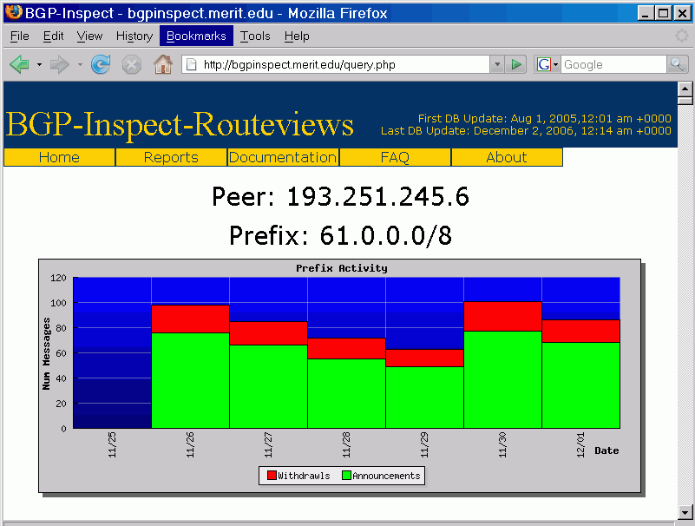

Slide 70
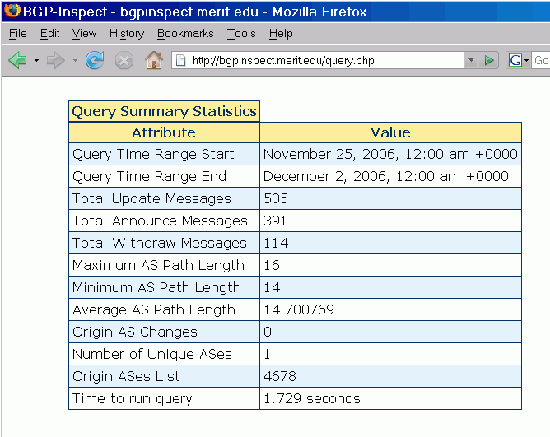

Slide 71
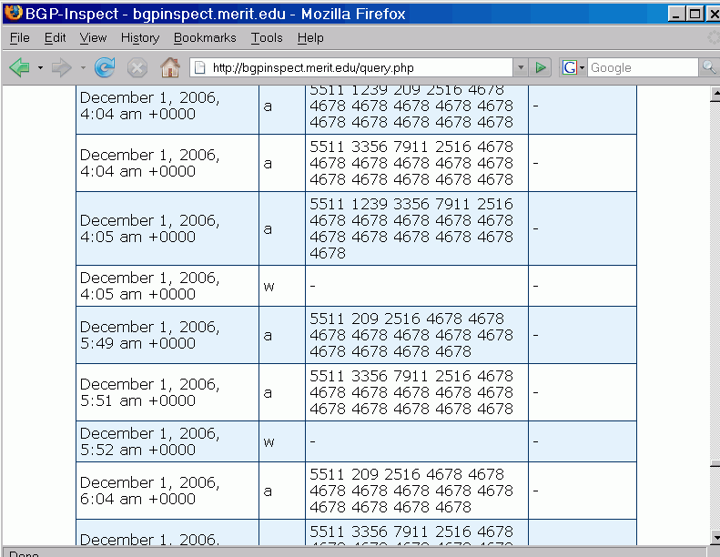

Slide 72
Some Notes About That Output
The announcements you're seeing in that report are awfully brief (and thus most likely are not spam-related).
Some ASNs are repeated in the reported routes; that's called "AS path prepending" and is generally done in an effort to force traffic AWAY from that route (for two equally specific routes, the one with the shorter path will usually get used)
The last column (with dashes in it) is for community strings. Community strings are "tags" that get applied to routes by ISPs. The tags may signal the source of routes, or be used to control where routes get advertised, for example. Each ISP may use its own unique community string naming conventions. These conventions may be described on a public web page, in whois information for their ASN, or be company proprietary/undisclosed. See, for example:
http://www.cenic.net/operations/documentation/
BGPCommunities.shtml

Slide 73
Working Directly With The Routeviews Zebra Format MRT Data
While Merit's BGP-Inspect interface is convenient for casually looking at a month's worth of data at a time, sometimes you may want to look at historical routing data over a longer time span, or as part of a script.
Thus, you should also know that in addition to collecting data in Cisco "show ip" CLI format, Route-Views also collects data in Zebra MRT format (for example, Route-Views collects data in that format via the Equinix Route-Views box).
Marco d'Itri's Zebra Dump Parser tools can be convenient for working with MRT format data. For a copy of his tools, see:
http://www.linux.it/~md/software/zebra-dump-parser.tgz

Slide 74
For Example, Who's Announcing /8's?
Assume you'd like to know who's announcing /8 network blocks. Install Marco d'Itri's Zebra Dump Parser tools if you've not already done so.
Retrieve a sample mrt format dataset (mind the wrap!):
% wget ftp://archive.routeviews.org/route-views.eqix/ bgpdata/2006.12/RIBS/rib.20061202.2348.bz2 <== large!
Uncompress the dataset, run it through the parser, and show any slash eight's seen:
% bzcat rib.20061202.2348.bz2 | ./zebra-dump-parser.pl | sort | uniq | grep "\/8" <== that's "backslash slash eight"!
The output on the next page has been annotated for ease of interpretation.
Each /8 represents 16,777,216 IP addresses

Slide 75
Prefix ASN ASN Name
3.0.0.0/8 80 General Electric's block and ASN
4.0.0.0/8 3356 Level3's block and ASN
8.0.0.0/8 3356 ditto
10.0.0.0/8 16559 RFC1918 space, RealConnect, Washington DC
12.0.0.0/8 7018 AT&T Worldnet's block and ASN
15.0.0.0/8 71 Hewlett-Packard's block and ASN
16.0.0.0/8 71 ditto
17.0.0.0/8 714 Apple's block and ASN
18.0.0.0/8 3 MIT's block and ASN
32.0.0.0/8 2686 AT&T Global Network Services block and ASN
33.0.0.0/8 721 DOD's block and ASN
35.0.0.0/8 237 Michnet/Merit Network's block and ASN
38.0.0.0/8 174 Cogent/PSI Network's block and ASN
44.0.0.0/8 7377 Amateur Radio block, UCSD ASN (consistent POC)
45.0.0.0/8 2381 Interop Show Network block, U Wisc-Madison ASN
53.0.0.0/8 31399 Cap Debis CCS, c/o Mercedes Benz, Stuttgart
block; Daimler Chrysler ASN
55.0.0.0/8 721 DOD's Block and ASN
57.0.0.0/8 2647 SITA (FR)'s block, EQUANT (FR)'s ASN
126.0.0.0/8 17676 BB Technology Japan's Block and ASN
214.0.0.0/8 721 DISA CONUS

Slide 76
VII. A Brief Exercise
If We Have Time

Slide 77
[whois.arin.net]
OrgName: SITA-Societe Internationale de Telecommunications Aeronautiques
OrgID: SIDTA
Address: 112 Avenue Charles de Gaulle
Address: Neuilly, 92522 Cedex
Country: FR
NetRange: 57.0.0.0 - 57.255.255.255
CIDR: 57.0.0.0/8
NetName: SITA-A
NetHandle: NET-57-0-0-0-1
NetType: Direct Assignment
NameServer: NS1.EQUANT.NET
NameServer: NS2.EQUANT.NET
NameServer: NS3.EQUANT.NET
RegDate: 1993-06-21
Updated: 2000-02-02
RTechHandle: SITA-NOC-ARIN
RTechName: SITA EQUANT Network Operations Center
RTechPhone: +33 4 92 96 63 66
RTechEmail: noc@sita.net

Slide 78
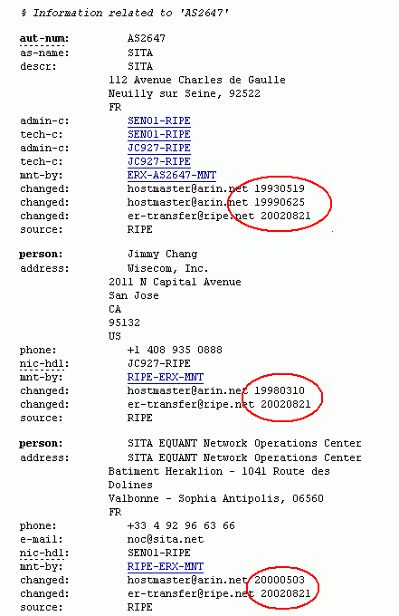

Slide 79
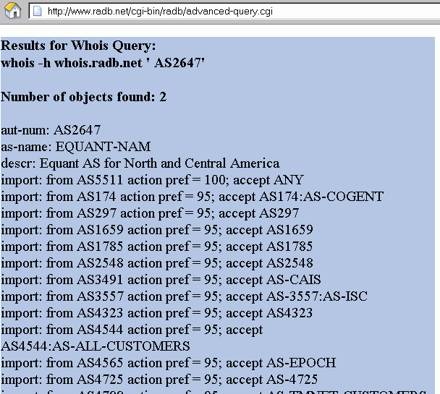
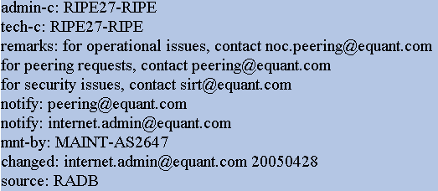
What Does the RADB Show
Beyond the AS2647 whois data?

Slide 80
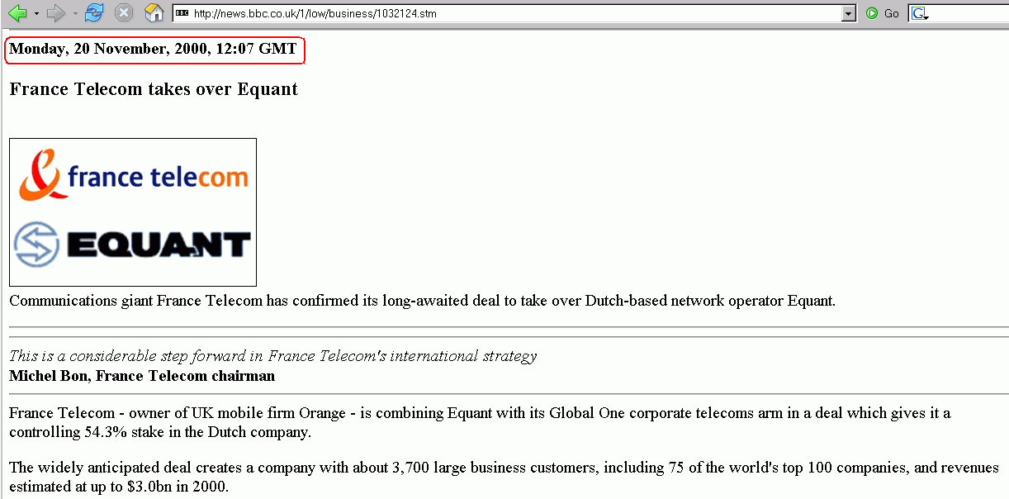
France Telecom Buys Equant…

Slide 81
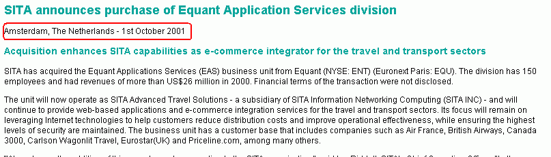
Or SITA Buys Equant Application Services?

Slide 82
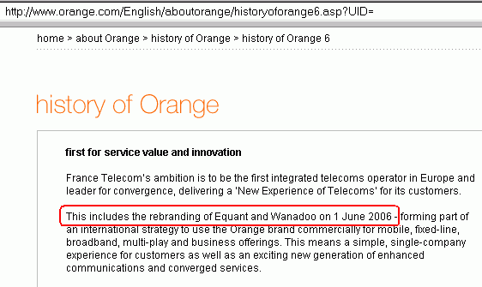
Maybe Equant Is Now Orange?

Slide 83
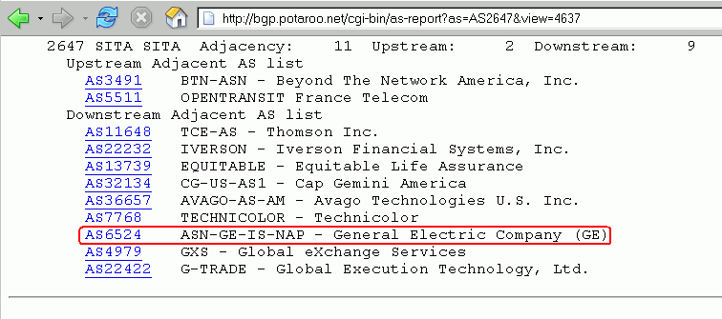
Sigh. So What ASNs Does Potaroo
See Downstream of AS2647?

Slide 84
[whois.arin.net]
OrgName: General Electric Company (GE)
OrgID: GECG
Address: Information Services (MC7D)
Address: 401 N. Washington St.
City: Rockville
StateProv: MD
PostalCode: 20850
Country: US
ASNumber: 6524
ASName: ASN-GE-IS-NAP
ASHandle: AS6524
Comment:
RegDate: 1996-05-15
Updated: 1998-05-01
RTechHandle: BS3030-ARIN
RTechName: Suskind, Barry
RTechPhone: +1-301-340-4667
RTechEmail: alf_of_melmak@yahoo.com

Slide 85
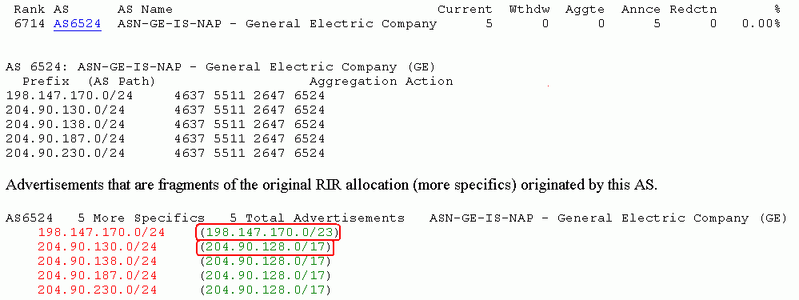
What Prefixes Does Potaroo
See AS6524/"GE" Announce?

Slide 86
[whois.arin.net]
OrgName: GE Information Services, Inc.
OrgID: GEIS
Address: 100 edison park drive
City: Gaithersburg
StateProv: MD
PostalCode: 20878
Country: US
NetRange: 198.147.170.0 - 198.147.174.255
CIDR: 198.147.170.0/23, 198.147.172.0/23, 198.147.174.0/24
NetName: GEIS-198-BLK
NetHandle: NET-198-147-170-0-1
Parent: NET-198-0-0-0-0
NetType: Direct Allocation
RegDate: 1993-06-04
Updated: 2000-04-07
RTechHandle: ZG28-ARIN
RTechName: GE Information Services
RTechPhone: +1-301-340-4000
RTechEmail: genictech@ge.com

Slide 87
[whois.arin.net]
OrgName: Global eXchange Services
OrgID: GES-54
Address: 100 Edison Park Drive
City: Gaithersburg
StateProv: MD
PostalCode: 20878
Country: US
NetRange: 204.90.128.0 - 204.90.255.255
CIDR: 204.90.128.0/17
NetName: GXS
NetHandle: NET-204-90-128-0-1
Parent: NET-204-0-0-0-0
NetType: Direct Allocation
NameServer: NS.GXS.COM
NameServer: NS.GEIS.COM
RegDate: 1994-09-12
Updated: 2005-06-06
OrgTechHandle: BVI3-ARIN
OrgTechName: Vink, Ben
OrgTechPhone: +31-20-503-5591
OrgTechEmail: Ben.Vink@gxs.com

Slide 88
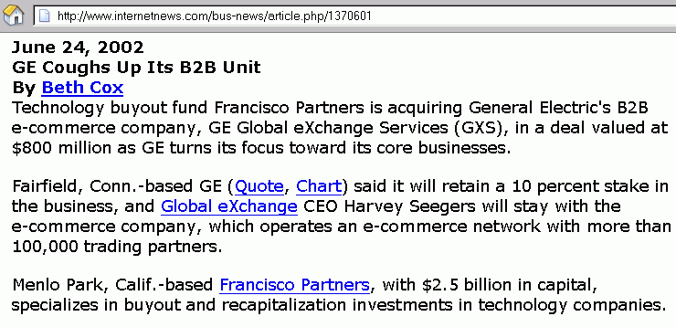
GXS Acquired…

Slide 89
So…
57/8: SITA? Equant? France Telecom? Orange?
Someone else?
AS2647: SITA? Equant? Wisecom? France Telecom? Orange? Someone else?
AS6524: General Electric? Global Exchange Services?
Francisco Partners? Someone else?
MY POINT: It can be really hard to figure out who is
using a given address block, or who should be using a given address block, even for a block as large as a /8.
Route injection/prefix hijacking is a real risk, but
out-of-date/inaccurate whois data is also an important
(if far less "cool") contributing issue.

Slide 90
Thanks for the Chance to Talk Today!
Are there any questions?

