Slide 1
Just How Bad Is It?
Oregon Safe Cyberspace Initiative
February 22nd, 2008
Joe St Sauver, Ph.D. (joe@uoregon.edu)
http://www.uoregon.edu/~joe/howbad/
Disclaimer: all opinions are strictly my own, and do not necessarily represent the opinion of any other party

Slide 2
1. Introduction

Slide 3
Sean Asked Me
"So Just How Bad Is It Online?"
My answer is, "It really depends."
For example, things can really be pretty bad if you have an unpatched older Windows system with no firewall, no antivirus, and no antispyware software installed. Life gets even worse if you're using an Internet Service Provider which doesn't filter email spam, or you use an out-of-date web browser to surf in seedy neighborhoods on the web, or you pick a weak password for your account.
In fact, if pretty much any of those things are true, I can virtually guarantee that your computer will quickly become infected with a virus or other malware, and probably begin spewing spam. If/when that happens, your ISP will usually cut you off, and you may have a very hard time getting your system secured.

Slide 4
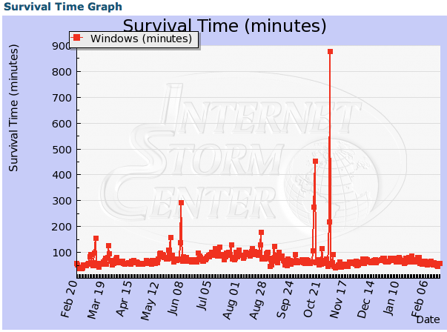
Source: http://isc.sans.org/survivaltime.html

Slide 5
On The Other Hand, If…
You use an operating system that's less commonly targeted by cyber attackers (for example, I run and like Mac OS X)
And you keep your operating system (and apps!) up-to-date
And you run antivirus and antispyware software
And use a software (and/or hardware) firewall
And your ISP helps you out by doing a good job filtering spam, phishing and malware that may be sent to you via email
And you use a secure web browser, and do your best to avoid bad neighborhoods online
And you avoid P2P file sharing and instant messaging apps
And you pick a long, tough-to-crack password
And you stay alert and skeptical about what you see…
WELL, THEN there's an excellent chance that you'll do just fine and have no problems online (although there are no guarantees)

Slide 6
Let's Just Briefly Consider
A Few Other Areas of Concern
Spam
Malware
Unauthorized Access to Information
DDoS
Fraud
Control Systems
Non-Technical Vulnerabilities (Insiders and Acts of God)

Slide 7
2. Spam

Slide 8
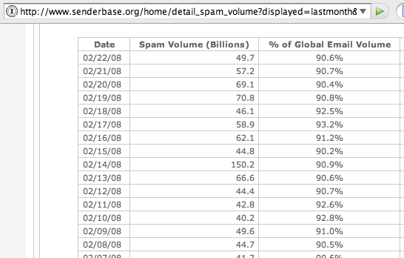
Spam Has Reached Absurd Levels

Slide 9
Millions of Compromised PCs
Are Used To Send Spam
For example, there are roughly 5.5 million systems listed on the CBL DNS (http://cbl.abuseat.org/) blocklist, all systems which were added to that block list for having sent spam
While spam is unquestionably annoying (and an insidious drain on business productivity and email usability), those same compromised systems could just as easily be used for a host of other far more nefarious purposes including:
-- hosting phishing sites, malware, pirated software or child porn
-- scanning the network to find other vulnerable hosts
-- sniffing traffic on the wire to compromise passwords
-- DDoS’ing online businesses or even
-- attacking US government sites or critical online infrastructure.
Most of those compromised hosts, however, will be used to send spam. How much spam can a single host send?

Slide 10
Billion Spam/Day Botnets…
“[…] SpamThru acts as massive distributed engine for sending spam, but without the cost of maintaining static servers. Total spam capacity is fairly high - with 73,000 bots, given an average SMTP transaction time of 5 seconds, the botnet is theoretically capable of sending a billion spams in a single day. This number assumes one recipient per message, however in reality, most spams are delivered in a single message with multiple recipients at the same domain, so the actual number of separate spams landing in different inboxes could be even higher, assuming the
spammer possesses that many email addresses.”
Joe Stewart, http://www.secureworks.com/research/_x000b_threats/view.html?threat=spamthru-stats

Slide 11
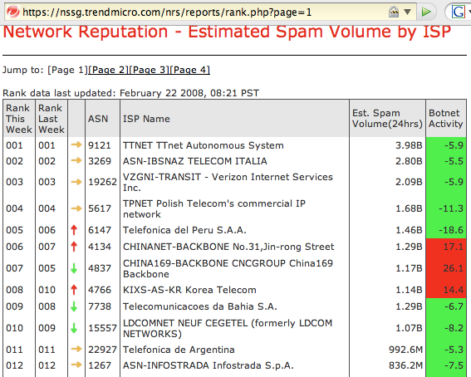

Slide 12
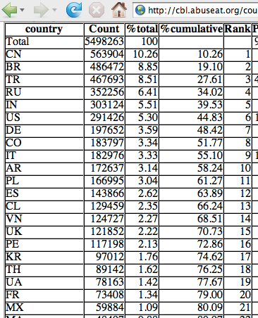
Where Do Spamming Botted Hosts Live?

Slide 13
3. Malware

Slide 14
What Compromises All Those Systems?
While some of those systems may have had weak passwords or other vulnerabilities, most of those systems were compromised by malware: viruses, trojan horses, worms and other things that go bump in the night…
Q. But how is this possible? Isn't everyone running antivirus software?
A. Most people do run an antivirus program, but even when do you run antivirus software, you can still end up infected.

Slide 15
The Problem With AV Products
Most AV products are "signature based," and identify viruses based on peculiarities ("signatures") unique to each virus.
New virus signatures only get released by the vendor and downloaded by the end user perhaps once a day, while miscreants can release new not-yet-detectable versions of their malware as often as they want (e.g., multiple times a day). The virus writer can thus guarantee that they will have a period of time during which user systems will be vulnerable.
Virus writers also enjoy another key advantage: they can empirically test and repeatedly tweak their code and its packaging until their exploit doesn't get detected by current popular antivirus products. Thus, it is a virtual certainty that at least some malware will get past your current AV solution… But most users don't understand that... AV software is way too nice of a convenient security blanket

Slide 16
The Pace of Malware Release
Is Accelerating
"At the start of 2007, computer security firm F-Secure had about 250,000 malware signatures in its database, the result of almost 20 years of antivirus research. Now, near the end of 2007, the company has about 500,000 malware signatures.
"'We added as many detections this year as for the previous 20 years combined,' said Patrik Runald, security response manager at F-Secure.
http://news.yahoo.com/s/cmp/20071206/tc_cmp/204701370
December 5th, 2007

Slide 17
Example: "Video Codec" malware
If you Google for a sex-related term and limit the returned results to the cn (China) domain, one or more of the top returned pages will likely be a web page which will attempt to trick you into downloading a "new codec" that's "required" for you to view free sex-related videos.
If you do intentionally or accidentally download and run that "new codec" you will actually be infecting your system with poorly detected malware (checking an example of this malware at Virustotal, only 5 of 32 antivirus products detected this malware, and the two antivirus products with the largest market share, Symantec and McAfee, don't catch it at all).
See the report on the next page…

Slide 18
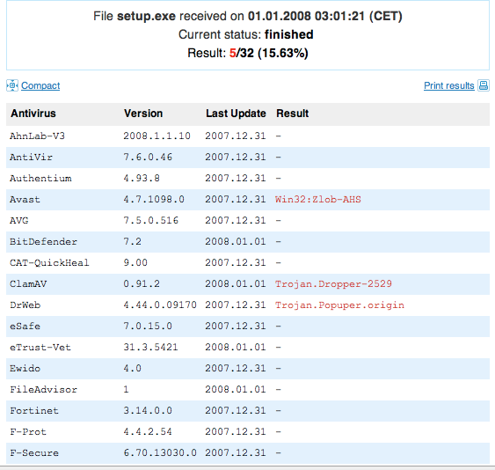

Slide 19
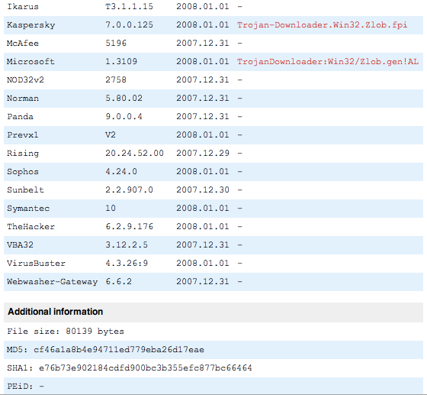

Slide 20
"A Worst Case Worm"
Weaver and Paxson, "A Worst Case Worm," June 8, 2004, http://www.icir.org/vern/papers/worst-case-worm.WEIS04.pdf
"Abstract
"Worms represent a substantial economic threat to the U.S. computing infrastructure. An important question is how much damage might be caused, as this figure can serve as a guide to evaluating how much to spend on defenses. We construct a parameterized worst-case analysis based on a simple damage model, combined with our understanding of what an attack could accomplish. Although our estimates are at best approximations, we speculate that a plausible worst-case worm could cause $50 billion or more in direct economic damage by attacking widely used services in Microsoft Windows and carrying a highly destructive payload."

Slide 21
4. Unauthorized Access to Information

Slide 22
Unauthorized Access to Information:
The 2nd Most Expensive Type of Information Security Incident
According to the 11th Annual CSI/FBI Computer Crime and Security Survey (see page 16 of
http://i.cmpnet.com/gocsi/db_area/pdfs/fbi/FBI2006.pdf ):
-- viruses were the single most expensive type of information security incident (costing 313 respondents a total loss of $15,691,460, an average of $50,132 each)
-- unauthorized access to information was the second most expensive type of information security incident, costing those same respondents a total loss of $10,617,000 (an average of $33,920 each).

Slide 23
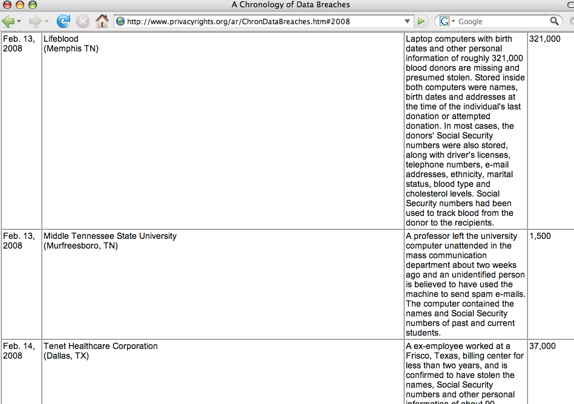

Slide 24
5. Distributed Denial of Service (DDoS) Attacks

Slide 25
Distributed Denial of Service Attacks
"More than five years after the initial flurry of network attacks,
and the news articles and research papers that followed, DDoS remains the number one concern for large IP network operators. Sixty-four percent of the survey participants said, 'DDoS
is the most significant operational security issue we face today.'"
Worldwide ISP Security Report, September 2005
http://www.arbornetworks.com/downloads/
Arbor_Worldwide_ISP_Security_Report.pdf

Slide 26
"What Is A Distributed
Denial of Service Attack?"
In a distributed denial of service attack, network traffic from thousands of hacked computer systems -- often systems located all over the Internet -- gets used in a coordinated way to overwhelm a targeted network or computer, thereby preventing it from doing its normal work. For example:
-- a company's connection or connections to the Internet may
be made to overflow with unsolicited traffic (a so-called
"packet flood")
-- web servers may be inundated with malicious repeated
requests for web pages
-- an ISPs name servers may become swamped so that
customers have problems visiting either local web sites or
web sites on the Internet

Slide 27
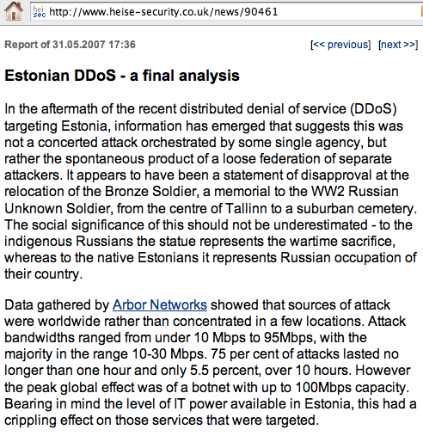

Slide 28
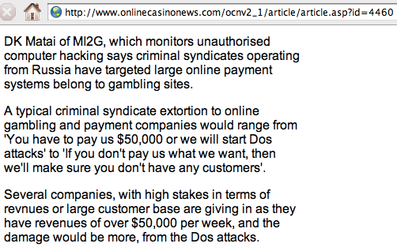
Gambling Site DDoS Extortion Threats

Slide 29
"What If We Treat A DDoS Like A Blizzard, And Just Try To 'Ride It Out?'"
While there is a certain insouciance to the idea of having
"denial-of-service days" (sort of like more traditional
"snow days"), you should understand that denial of service attacks can be sustained for days -- or even weeks or more -- at a time. For example, Spamhaus, a major anti-spam activist organization, was subject to an attempted denial of service attack that lasted for three months. (http://www.spamhaus.org/news.lasso?article=13 )
Taking an entire denial-of-service quarter off would have material impacts on pretty much any organization's ongoing operations, and probably would simply be unacceptable.

Slide 30
6. Fraud

Slide 31
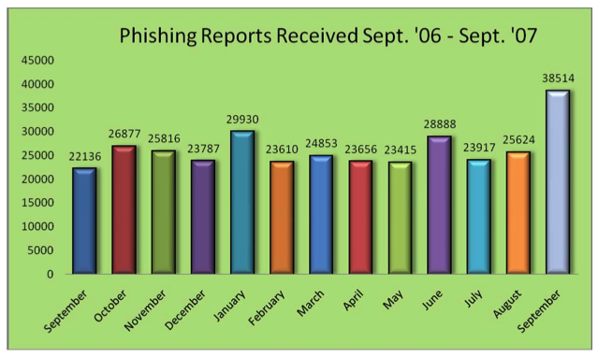
[Total phishing reports made to APWG 10/06-9/07: 318,887]

Slide 32
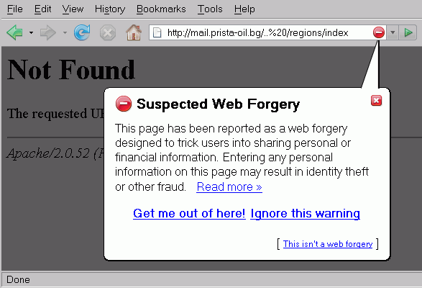
What A Firefox User Sees When Attempting to Visit Most Phishing Sites

Slide 33
Internet Auction Fraud
"In 2006, IC3 processed more than 200,481 complaints that support Internet crime investigations by law enforcement and regulatory agencies nationwide. [* * *]
Internet auction fraud was by far the most reported offense, comprising 44.9% of referred complaints.
2006 Internet Crime Report,
[FBI] Internet Crime Complaint Center, http://www.ic3.gov/media/annualreport/2006_IC3Report.pdf
at pdf pages 3 and 7.

Slide 34
Pay-Per-Click Click Fraud
Many leading Internet companies earn a majority of their revenue by selling pay-per-click advertisements. In pay-per-click (PPC) advertising models, true to the model's name, an advertiser agrees to pay whenever someone clicks on one of their ads.
PPC ads are placed both on things like search engine results, and on relevant syndicated web pages authored by 3rd parties. To compensate 3rd parties for inserting ads on their web pages, the company shares part of what they've been paid with the 3rd parties.
Priority for ad placement is determined by what advertisers are willing to pay -- the highest bids get the best placement on a given page which contains the term of interest

Slide 35
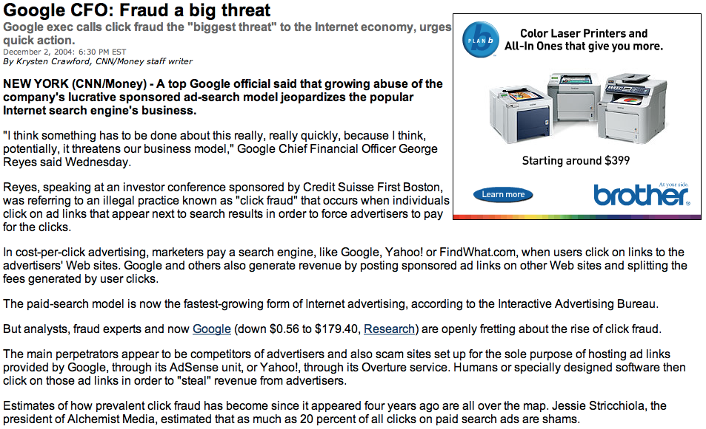

Slide 36
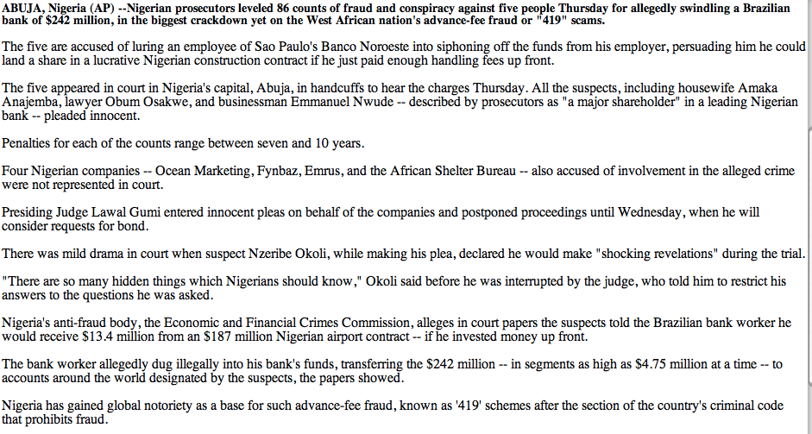
419: Truth Can Be Stranger Than Fiction
http://www.cnn.com/2004/WORLD/africa/02/05/nigeria.419.trial.ap/index.html

Slide 37
SEC Charges Two Texas Swindlers In Penny Stock Spam Scam Involving Computer Botnets
Washington, D.C., July 9, 2007 - The Securities and Exchange Commission has filed securities fraud charges against two Texas individuals in a high-tech scam that hijacked personal computers nationwide to disseminate millions of spam emails and cheat investors out of more than $4.6 million. The scheme involved the use of so-called computer "botnets" or "proxy bot networks," which are networks comprised of personal computers that, unbeknownst to their owners, are infected with malicious viruses that forward spam or viruses to other computers on the Internet. The scheme began to unravel, however, when a Commission enforcement attorney received one of the spam emails at work.
The Commission alleges that Darrel Uselton and his uncle, Jack Uselton, both recidivist securities law violators, illegally profited during a 20-month "scalping" scam by obtaining shares from at least 13 penny stock companies and selling those shares into an artificially active market they created through manipulative trading, spam email campaigns, direct mailers, and Internet-based promotional activities. Scalping refers to recommending that others purchase a security while secretly selling the same security in the market.
[ http://www.sec.gov/news/press/2007/2007-130.htm ]

Slide 38
7. Control Systems

Slide 39
“The Most Monumental Non-Nuclear Explosion and Fire Ever Seen From Space."
Thomas C. Reed, Ronald Regan’s Secretary of the Air Force, described in his book At The Abyss (Ballantine, 2004, ISBN
0-89141-821-0) how the United States arranged for the Soviets
to receive intentionally flawed process control software for use in conjunction with the USSR's natural gas pipelines, pipelines which were to generate critically needed hard currency for the USSR.
Reed stated that "The pipeline software that was to run the pumps, turbines, and values was programmed to go haywire, after a decent interval, to reset pump speeds and valve settings to produce pressures far beyond those acceptable to pipeline joints and welds." The result? A three-kiloton blast in a remote area of Siberia in 1982, which, only by some miracle, apparently didn't result in any deaths. (For context, the Halifax Fire Museum lists the massive 1917 Mont Blanc ship explosion in the Halifax Harbor at a force of 2.9 kilotons.)

Slide 40
($50B) 9/14/03 US Blackout
“Starting around 14:14, FE [FirstEnergy] control room operators lost the alarm function that provided audible and visual indications when a significant piece of equipment changed from an acceptable to problematic status. Analysis of the alarm problem performed by FE after the blackout suggests that the alarm processor essentially “stalled” while processing an alarm event. With the software unable to complete that alarm event and move to the next one, the alarm processor buffer filled and eventually overflowed. After 14:14, the FE control computer displays did not receive any further alarms, nor were any alarms being printed or posted on the EMS’s alarm logging facilities.
“FE operators relied heavily on the alarm processor for situational awareness, since they did not have any other large-scale visualization tool such as a dynamic map board. The operators would have been only partially handicapped without the alarm processor, had they known it had failed. However, by not knowing that they were operating without an alarm processor, the operators did not recognize system conditions were changing and were not receptive to information received later from MISO and neighboring systems. The operators were unaware that in this situation they needed to manually, and more closely, monitor and interpret the SCADA information they were receiving.”
ftp://www.nerc.com/pub/sys/all_updl/docs/blackout/
NERC_Final_Blackout_Report_07_13_04.pdf [emphasis added]

Slide 41
8. Not All Network Vulnerabilities And Issues Are Technical:
Insiders and Acts of God

Slide 42
An Insider Attack?
“According to reports, Canadian telecommunications company Aliant (aliant.com) suffered an attack of vandalism on its network Tuesday night. The vandals reportedly cut fiber optic cables, leaving thousands of users in Nova Scotia and Newfoundland without phone and Internet service. Approximately 125,000 people in Newfoundland (half its population) and 5,000 in Nova Scotia were affected. Services were taken down at about 10:30 p.m. Service was not restored until 7:00 a.m. Cables were cut in two separate locations. In Newfoundland, a connection to the main network and the backup was targeted. In Nova Scotia, one piece of fiber optic cable was cut. According to Aliant, the individual or individuals responsible had extensive knowledge of telecommunications networks. Aliant is currently embroiled in a major labor dispute with its 4,200 employees. Several reports have already noted the possible link between the dispute and the attack. The Royal Canadian Mountain Police are investigating. As of Thursday, Aliant said service had been almost completely restored.”
http://www.thewhir.com/marketwatch/van061004.cfm

Slide 43
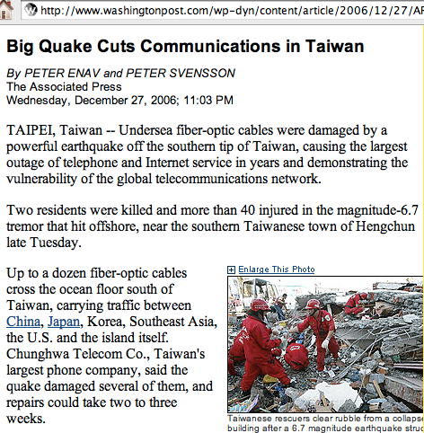

Slide 44
Conclusion
It can be a pretty rough-and-tumble world out there
There are some steps you can take to avoid at least some of those issues, and if you do so, the Internet remains pretty livable
There are some issues (like control system vulnerabilities, intentional acts by insiders and acts of God) which remain difficult for individuals to directly control
It's going to continue to take a lot of effort by everyone to work on dealing with all these issues
Thanks for the chance to talk today!
Are there any questions?

