Slide 1
IPv6 and The Security of Your Network and Systems
Internet2 Member Meeting
Arlington VA, April 28th, 2009 8:45AM-10AM
Joe St Sauver, Ph.D.
Manager, Internet2 Security Programs
(joe@uoregon.edu or joe@internet2.edu)
http://www.uoregon.edu/~joe/i2mm-spring2009/
Disclaimer: The opinions expressed in this talk do not
necessarily reflect the opinion of any other party.

Slide 2
Some Notes Before We Get Started
Goals of This Talk: This talk is meant to help the community make progress getting IPv6 deployed while avoiding both:
-- paralysis associated with non-specific/speculative security worries and
-- action catalyzed solely by unfounded hopes for security improvement.
We want you to get native IPv6 deployed, but security should neither be the main reason for deploying IPv6 nor a deployment roadblock.
I’m also going to use this talk to introduce some new security topics that you might want to begin thinking about, such as what you are (or aren’t) doing with IPsec, and how you should be handling IPv6 multihoming.
Technical Level of This Talk: Because the Internet2 Member Meeting draws a varied audience, I’ve set the technical level of this talk at a level that has something for both technical and non-technical attendees.
Disclaimer and Acknowledgement: While I’m solely responsible for the content of this talk, I’d like to acknowledge the extremely helpful discussions that have occurred on the Internet2 IPv6 mailing list, as well as via private email with a number of you. Thank you very, very much!

Slide 3
Format of This Talk
This talk has been prepared in my customary overly detailed format. I use that format because:
-- doing so helps to keep me on track when I have limited time
-- audience members don’t need to scramble to try to take notes
-- if there are hearing impaired members of the audience, or
non-native-English speakers present, a text copy of the talk
may facilitate their access to this material
-- a detailed copy of the talk makes it easy for those who are
not here today to go over this talk later on
-- detailed textual slides work better for search engines than terse,
highly graphical slides
-- hardcopy reduces problems with potential mis-quotation.
BUT I promise that won’t read my slides to you.

Slide 4
1. IPv6: It’s Time!
(And Be Sure Your Downstream Folks
Are Ready to Do IPv6 Too!)

Slide 5
The Classic Era of IPv4 Abundance Is Ending
Geoff Huston of APNIC has done excellent work building a model forecasting the time it will take for IANA (the Internet Assigned Numbers Authority) to allocate its remaining IPv4 address blocks to the RIRs (regional internet registries, such as ARIN, RIPE, APNIC, LACNIC and AFRINIC), and for the RIRs to allocate their remaining IPv4 addresses to large ISPs and other direct customers._x000b_
As of 27 Apr 2009 www.potaroo.net/tools/ipv4/index.html says:
Projected IANA Unallocated [IPv4] Address Pool Exhaustion:
21-Aug-2011 [4/27/2009 --> 8/21/2011 = 846 days or 2y 3m 25d]
Projected RIR Unallocated [IPv4] Address Pool Exhaustion:
12-May-2012 [4/27/2009 --> 5/12/2012 = 1111 days or 3y 0m 15d]
Obviously we don’t have very much time left.

Slide 6
Plus Or Minus…
Those are only estimates, and twill change from day to day. I think they’re good estimates, but you may end up with more or less time.
For example, the rate of address consumption might increase:
-- what if there are multiple new major broadband build out
efforts either here in the US or abroad, needing many more
IPv4 addresses for newly connected broadband customers?
(remember the Administration’s Economic Stimulus packages)
-- some sites may engage in “last minute”/“panic’d”
speculative requests for additional IPv4 addresses “just in case”
Alternatively, the rate of consumption may flatten out:
-- sites may act responsibly, and make a real effort to
consciously limit requests for additional IPv4 address space
-- the community, through the RIRs, may tighten up requirements
for receiving IPv4 address space, thereby slowing the depletion
Some existing/already-allocated address space might be returned, thereby increasing the pool of available addresses (but I wouldn’t count on large miracles happening very often)

Slide 7
You’ve Got a Lot To Do In A Short Time
I mention the dwindling amount of time not to scare you, but to help make the point that the classic era of IPv4 abundance is rapidly drawing to a close, and a new blended IPv4/IPv6 era is dawning.
You and your institution should be thinking about what you’re going to do when it comes to supporting IPv6, and you should be doing that brainstorming and planning now.
Why now, rather than a year or two from now as the pool of IPv4 addresses gets closer to depletion? Well, if you think you have “lots of time” to get ready for IPv6, remember, you’ll need time to:
-- develop a plan if you don’t have one already,
-- train your staff and users,
-- order replacement gear where required,
-- get that gear installed, tested and debugged
-- get systems and applications updated for IPv6, etc.
At some point everyone else will also begin to do this, and there isn’t a huge amount of excess capacity to handle a sudden IPv6 surge. If you wait too long, you may find you’re out of luck.

Slide 8
Many of You Have Already Begun (Thank You!)
The Internet2 community has many technological leaders, so it isn’t surprising that many of you already have IPv6 deployed in production use on your campuses or RONs/Gigapops, while others are at least be actively planning how you’re going to do so.
A copy of the Internet2 IPv6 deployment map from earlier this year can be seen on the next slide
I do have ongoing concern, however, that IPv6 deployment at the campus level (and among sponsored participants/SEGPs), is not where it needs to be. It is critical that native IPv6 be supported by the RONs/Gigapops, but native IPv6 *REALLY* needs to be supported end to end, all the way to servers and desktop.
I like to keep an eye on the IPv6 status survey that’s available at http://www.mrp.net/IPv6_Survey.html -- how does your site look on that summary table? I’m still seeing a LOT of red boxes…
Site of interest not listed? Try www.mrp.net/cgi-bin/ipv6-status.cgi

Slide 9
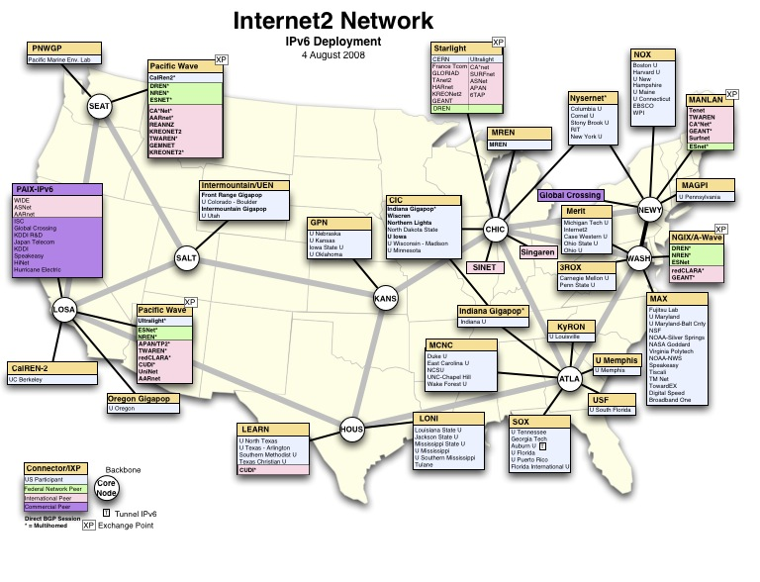

Slide 10
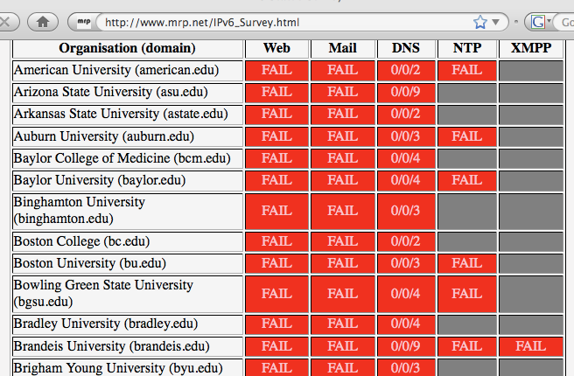
http://www.mrp.net/IPv6_Survey.html

Slide 11
Notes On The Preceding Slide
The table excerpt shown on the preceding slide was grabbed April 27th, 2009. If you look at this talk after the fact, revisit the URL on the proceeding page to get updated deployment information.
Although I showed the top of the alphabetized chart (in order to be able to include column headings), universities and companies farther down the alphabet are doing about the same, with only a few exceptions. There are MANY red cells in that table.
For those who may not recognize some of the column headings
in that table:
-- XMPP is the protocol used by Jabber, a popular instant
messaging/chat server
-- NTP is the network time protocol
-- DNS is the domain name system, the service that translates
symbolic names (such as www.yahoo.com) to IP addresses
(such as 209.131.36.158)

Slide 12
IPv6 Is Neither A Magic Bullet, Nor A Poison Pill
Some sites may be stalled wondering, “Well, if we do begin to deploy IPv6, will it help or hurt us when it comes to security?”
As we’ll discuss today, deploying IPv6 is neither a magic bullet
nor a poison pill when it comes to your site’s security. It may
help in some areas, and it may make things harder in others, but
it doesn’t really matter if it helps or hurts because in the final analysis, you still need to bear down and get IPv6 deployed,
and so do your downstream sites! Talk to folks at your campuses and sponsored participants/SEGP sites!
As you do, please don’t let them try to use “security, SECURITY!” as a reason for not deploying IPv6!
At the same time, remain highly skeptical of any snakeoil claims you may hear that IPv6 will magically improve your network’s security (because I don’t think it will do that, either)
Let’s look at some of the arguments you’ll hear explaining why deploying IPv6 will somehow make you more (or less) secure.

Slide 13
2. Myth: IPv6 Improves Security Because
“All IPv6 Traffic Gets Encrypted With IPSec”

Slide 14
IPv6 and IPsec
IPsec is not new with IPv6; in fact, IPsec dates to the early 1990’s.
What’s different when it comes to IPv6 is that support for IPsec was made “mandatory” for IPv6 (see for example “Security Architecture for IP,” RFC4301, December 2005 at section 10, and “IPv6 Node Requirements,” RFC4294, April 2006 at section 8.)
If actually used, IPsec would have the potential to provide:
-- authentication
-- confidentiality
-- integrity, and
-- replay protection
All great and wonderful security objectives -- IF IPsec were used.
Unfortunately, as we’ll show you, what many had expected to be the cornerstone of the Internet’s security architecture has proven in fact to be widely non-used.

Slide 15
How Might IPsec Be Used?
IPsec can be used to authenticate (using AH (the Authentication Header), RFC4302), or it can encrypt and (optionally) authenticate (using ESP (the Encapsulating Security Protocol), RFC4303)
IPsec can be deployed in three architectures:
-- gateway to gateway (e.g., securing a network segment from one
router to another)
-- node to node (e.g., securing a connection end-to-end, from one
host to another)
-- node to gateway (for example, using IPsec to secure a VPN
connecting from a mobile device to a VPN concentrator)
IPsec has two main encrypting modes:
-- tunnel mode (encrypting both payload and headers)
-- transport mode (encrypting just the payload)
IPsec also supports a variety of encryption algorithms (including “null” and md5 (yech)), and a variety of key exchange mechanisms
These alternatives obviously provides tremendous flexibility, but that flexibility also brings along a lot of complexity.

Slide 16
But IPsec Isn’t Getting Much Use
Raw IPsec traffic (AH+ESP, protocols 50 & 51) isn’t seen much on the commercial IPv4 Internet.
For example, Jose Nazario of Arbor Networks estimated IPsec traffic at 0.9% of octets (statistic courtesy the ATLAS project).
CAIDA (thanks kc!) also has passive monitoring data available; see
http://www.caida.org/data/passive/monitors/equinix-chicago.xml
You can see the protocol distribution from a couple of CAIDA’s monitors for one recent day on the next couple of slides.
IPsec traffic is basically too small to be seen for the most part.

Slide 17
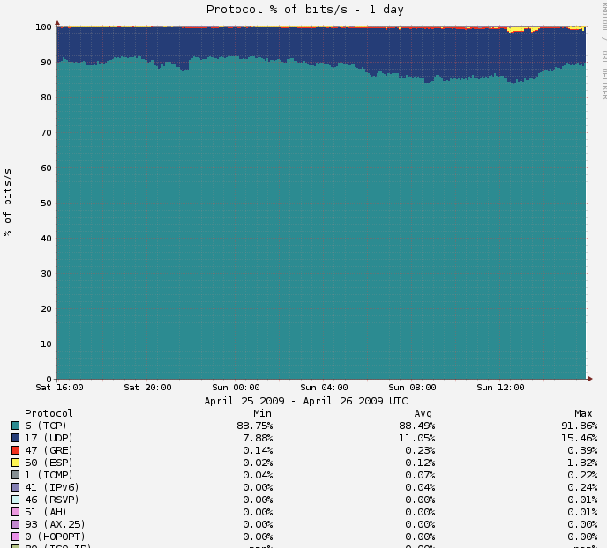
Protocol Distribution From One of CAIDA’s Passive Monitors

Slide 18
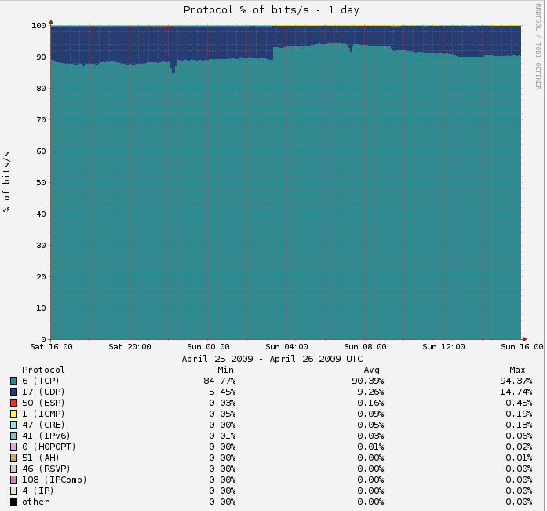
And The CAIDA Distribution Seen From Another Monitored Link

Slide 19
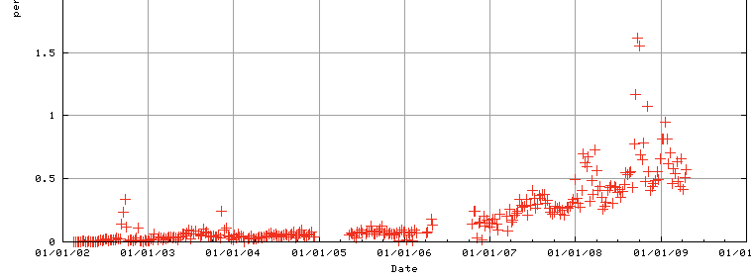
IPv4 IPSec Traffic on Internet2
Raw IPv4 IPsec traffic is quite rare on Internet2 as well, usually running well under <1% of octets (see table 7, http://netflow.internet2.edu/weekly/20090112/ ).
Raw IPv4 IPsec traffic has been (gradually) growing, however.
See Internet2 IPv4 IPsec ESP traffic levels as a percent of all
octets over time by way of example:

Slide 20
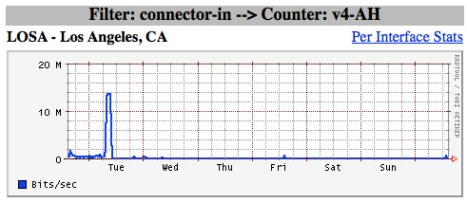
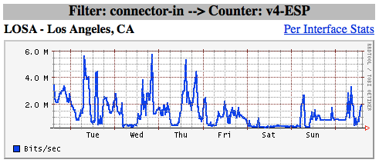
IPv4 IPsec Traffic May Be Associated With A Limited Number of Users/Systems (IPsec VPNs?)
Protocols that are used by a small number of users or systems tend to exhibit “spikey” or rapidly varying patterns while protocols which are in ubiquitous use tend to “average out” or “smooth out.”
The appearance of these new (thanks Brent!) firewall-based graphs (see http://vixen.grnoc.iu.edu/jfirewall-viz/index-bits.html ) are consistent with IPsec traffic from a few users (IPsec VPN traffic?)
V4-AH (LOSA)
V4-ESP (LOSA)

Slide 21
IPv6 Traffic Visibility on The Backbone
Ideally, for production IPv6 traffic, one would want full IPv6 SNMP support and full IPv6 Netflow (V9) support. Regretably, native IPv6 SNMP support and IPv6 V9 Netflow support remains elusive. That’s increasingly unfortunate for IPv6 as a production protocol that is, or should be, on par with IPv4.
One way to improve IPv6 visibility on the Internet2 backbone, at RONs/Gigapops, and on our campuses would be to deploy at least
a limited number of dedicated, IPv6-aware, passive measurement appliances. For instance, one IPv6 working group participant expressed pleasure on the mailing list about IPv6 support available from InMon Corporation’s Traffic Sentinel product (e.g., see
http://www.inmon.com/products/trafficsentinel.php )
In the mean time, we at least have the ability to get some sense of traffic volumes (packets and octets) from logging firewall ACLs, see http://dc-snmp.wcc.grnoc.iu.edu/i2net/

Slide 22
Backbone IPv6 IPsec Traffic on Internet2
Brent Sweeny was also kind enough to send me raw IPv6 interface firewall byte statistics for some interfaces, so I didn’t have to try to interpolate values from the graphical displays. Looking at the statistics for one of the interfaces he sent me:
Protocol IPv6 Interface “X” (Input) IPv6 Interface “X” (Output)
TCP 309451387384 (~70.1%) 129179860235 (~43.2%)
UDP 130213671989 (~29.5%) 168081323562 (~56.1%)
Other 1786083367 (~0.4%) 2119234653 (~0.7%)
------------------ ------------------
Total 441451142740 299380418450
If we assume that all IPv6 IPsec protocol traffic lands in the “other” bucket, at least in the case of this example interface, at this point in time, we can bound the amount of IPv6 IPsec traffic as being no more than 0.7% This is consistent with the commercial Internet IPv4 IPsec traffic levels which we mentioned earlier.
On the other hand, w/o DPI we can’t rule out the possibility that some of that large amount of UDP traffic MAY be UDP encapsulated IPsec ESP traffic
[e.g., see “UDP Encapsulation of IPsec ESP Packets,” RFC3948, from Jan 2005] Then again, this could just as easily be something else, like IPv6 Bittorrent traffic (for more on IPv6-ified Bittorrent see http://www.sixxs.net/tools/tracker/ ).

Slide 23
Why Aren’t We Seeing More IPSec Traffic?
Sites may not be deploying IPsec because IPsec (like many
crypto-based security solutions) has developed a reputation as:
-- not completely baked/still too-much under development
-- too complex
-- hard to deploy at significant scale
-- less than perfectly interoperable
-- firewall issues
-- potentially causing a performance hit (crypto overhead issues)
-- congestion insensitive (UDP encapsulated IPsec traffic)
-- something which should be handled as an end-to-end matter by
interested system admins (from a network engineer perspective)
-- something to be handled at the transport layer router-to-router
(from an overworked system administrator’s perspective)
-- duplicative of protection provided at the application layer
(e.g., encryption is already being done using ssh or ssl)
-- complicating maintaining/debugging the network, etc., etc., etc.
Regardless of whether those perceptions are correct (some may be, some may not be), IPsec adoption hasn’t happened much to date.

Slide 24
But That’s All Moot Relative to The Key Point…
It would be foolhardy to expect IPsec to provide any material improvement to your site’s security since the vast majority of your aggregate traffic (including virtually all your IPv4 traffic) will NOT be IPsec secured.
On the other hand, the “good news” is that a lack of IPsec usage in the IPv6 world is substantively no worse than a lack of IPsec usage in the IPv4 world.
Let’s look at another potential security issue.

Slide 25
3. Another Myth: “If We Don’t Deploy
Native IPv6, We’ll Be Able to Control Whether Our Users Are Able to Get
At IPv6-Served Content”

Slide 26
Even If Your Site “Officially” Foregoes IPv6,
Your Users May Decide to “Informally” Try It…
Some sites which rely heavily on firewalls and perimeter security may decide to forego or postpone deployment of native IPv6. Having made the decision to do so, folks may emit a big relieved sigh, believing that by “sitting this dance out,” they will have foreclosed any possibility of user access to IPv6-only resources.
Unless that policy is very carefully enforced on a technical basis, you may be in for a surprise or two because users may be able to easily work their way around your non-implementation or filters.
This is particularly important if you’re relying primarily on perimeter filtering to control either the infiltration of malware (or other unwanted content, e.g., “adult entertainment” concerns in K12 school environments, c.f. http://www.ipv6experiment.com/ ), or the exfiltration of site-sensitive information (as at some federal sites).
BTW, a very cool IPv6 web hack is sixxs.org’s IPv6 web gateway: try www.cnn.com.sixxs.org (for example), from an IPv6-ified box

Slide 27
My Point? Your Users Will Be Fulfilled
It is natural and entirely appropriate that your users will want to try new things, such as things they may hear about from their friends and colleagues. One of those things may be IPv6.
If a technology they’re interested in (such as IPv6) isn’t one that you’re currently supporting, they may search for and find “ad hoc” approaches which they can try without “having to bother you.”
Sometimes there’s a hope that obscurity or technical difficulty will keep users from trying some work-arounds, but I wouldn’t count on “security through obscurity” in the case of IPv6.
For example, if a user is on a Mac at a “non-IPv6 site” and that site also doesn’t have a perimeter or interior firewall, one option would be for him to enable “6to4.” How hard would that be?
As another example, assume a user is behind a firewall and is
using a PC running Windows XP at a “non-IPv6 site.” How hard would it be for her to enable Teredo as a way to get IPv6 access?

Slide 28
Enabling 6to4 on a Mac
N.B.: 6to4 (RFC3056) usually won’t work behind a firewall
-- Apple Menu ==> System Preferences ==> Network ==>
Show: Network Port Configuration
-- If no 6 to 4 port already exists, click “New”
-- Select 6 to 4 for the port from the pull down list of ports
-- Enter “6 to 4” for the port’s name
-- Click OK
-- Make sure “6 to 4” is checked as “On”
-- Click “Apply Now”
[the above details may vary on some versions of OS X]
If you’re using Firefox 2.x on a Mac, you may also need to tell Firefox to allow IPv6 DNS resolution to occur
-- In Firefox go to the URL about:config
-- Filter on the string IPv6
-- Set network.dns.disableIPv6 to be false
-- Try going to http://ipv6.google.com/ (the logo should dance)
To disable 6to4, use System Preferences to set 6to4 to be “Off”

Slide 29
Enabling Teredo on a Windows XP SP2 PC
Teredo (RFC4380) will work even behind a firewall/NAT box
(unless the firewall blocks outgoing IPv4 traffic on 3544/UDP).
To set up IPv6 and Teredo on a Windows XP SP2 system, do:
Start ==> Accessories ==> Command Prompt
netsh interface ipv6 install
netsh interface ipv6 set teredo client
In Firefox 3.x, try going to http://ipv6.google.com
You should see the Google logo dance
If you’re running something other than Windows and you’re
behind a firewall and you want a Teredo-like solution, check out
Miredo ( http://www.remlab.net/miredo/ )

Slide 30
Neither of Those Tasks Were Very Tough
In my opinion, pretty much any “reasonably motivated” semi technical user will be able to successfully enable 6to4 or Teredo on their desktop or laptop, even if they don’t fully understand the technology or the implications of having done so.
And even if you block 6to4 and Teredo, users can still use RFC3053 IPv6 tunnel brokers (there’s a nice list of them at
http://en.wikipedia.org/wiki/List_of_IPv6_tunnel_brokers for example), and so on and so forth.
On the other hand (and for interesting reasons), there is still
no IPv6 version of Tor (the onion routing protocol) yet, see
http://wiki.noreply.org/noreply/TheOnionRouter/TorFAQ
at section 8.13
Anyhow, rather than playing “IPv6 cat and mouse” with your users, why not just buckle down and run native IPv6 instead? Trying to fight transition mode IPv6 traffic will ultimately become really trickier and trickier over time, particularly if
users encrypt.

Slide 31
6to4 & Teredo May Rely on “Remote Resources”
In addition to things like 6to4 and Teredo traffic posing surprises for things like border filtering and traffic monitoring, tunneled traffic may also rely on comparatively remote resources.
Depending on how far away some of those resources may be, the additional latency associated with reaching those gateways may impact the performance of untuned network connections.
Remote resources may also be a sign that there’s only a limited pool of available gateways (if the pool was large and well distributed, presumably you’d be using a nearby gateway rather than a remote one). When the pool of available resources is constrained, it may eventually get “loved to death” (overloaded).
One could also imagine a site run by a cyber criminal, kindly offering free gateway services in an effort to attract your customer’s traffic for surreptitious MITM-ish monitoring.
Services such as 6to4 and Teredo which do not require any sort of registration or authentication may also end up being abused by bad guys just as open SMTP relays once were.

Slide 32
Magic Addresses
6to4 uses 192.88.99.1 as a magic address, anycast via the magic prefix 192.88.99.0/24 (see RFC3068 at 2.3 and 2.4)
Do you know where your 192.88.99.1 traffic is going? (simple test: traceroute to 192.88.99.1 from a machine at your home site)
[Maybe you want to routinely monitor the path to 192.88.99.1?]
When I looked at some examples from public traceroute servers, (examples which I’ll omit here), I’ve seen:
-- large academic sites whose customers may end up using
anycast 6to4 relays located clear across the country,
-- government mission networks whose customers may rely on
6to4 anycast relays hosted on the campus of academic sites
-- commercial providers whose customers may rely on anycast
6to4 relays hosted by some of their competitors.
Or consider Teredo -- Teredo relies on Teredo servers and Teredo relays. Do you know which ones your folks may be using?
http://technet.microsoft.com/en-us/library/cc722030.aspx
mentions the Teredo server teredo.ipv6.microsoft.com

Slide 33
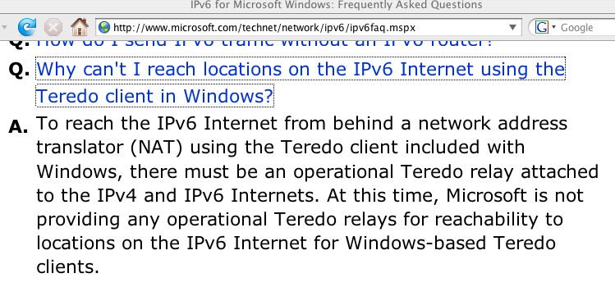
But What About Teredo Relays, Where the Bandwidth Intensive “Heavy Lifting” Happens?

Slide 34
Sites Which Are Advertising 2001:0::/32
RFC4380 at 2.6 specifies 2001:0::/32 for the Teredo relay service.
Martin Levy recently presented “IPv6 Traffic Levels on Hurricane Electric’s Backbone,” (see www.nanog.org/meetings/nanog45/ presentations/Tuesday/Levy_traffic_level_hurricane_N45.pdf ):
“[Teredo] traffic is all eastward across the Atlantic
Flows toward teredo.bit.nl AS12859 via AMS-IX
2001::/32 announce by other networks including
AS12637 Seeweb, AS1257 Tele2, etc.” [emphasis added]
If you telnet to one of the IPv6 aware routeviews.org nodes (such
as route-views.linx.routeviews.org), you can see sites advertising
2001:0::/32 by using the command “show ipv6 bgp 2001:0::/32”
When I check, I’m seeing 2001:0::/32 from AS1257 (Tele2), AS6939 (Hurricane), AS12637 (Seeweb), AS12859 (Bit.NL) and AS21155 (ProServe).
If you are globally advertising 2001:0::/32, but for some reason your ASN isn’t listed here, I’d love to hear from you.

Slide 35
‘So Are You Telling Me That I Should Try To “Break” or “Disable” 6to4 and/or Teredo?’
Encountering 6to4 or Teredo is like encountering extra-terrestrial intelligence. Squelch any immediate reptilian instinct to smash/ kill/eat anything which is new/different/potentially threatening. :-)
At the same time, let’s avoid philosophically overanalyzing this. We should not let “the perfect” get in the way of the “adequate.” While I really want to see native IPv6 deployed end-to-end,
6to4 or Teredo (at least as long as it works and isn’t being abused), is better for many users than no IPv6 service at all.
Thus, notwithstanding some of the issues mentioned on previous slides, please refrain from breaking 6to4 or Teredo.
You should consider fielding a carefully monitored version of those services, accessible only by your local users, thereby soaking up the local demand for those services (and if you do see folks using ’em, nudge them toward native IPv6 instead)

Slide 36
4. Myth: “Wide Area Native IPv6 Connectivity Is Just Like Wide Area IPv4 Connectivity”

Slide 37
Remember, “Security” Includes “Availability”…
Is IPv6 architected as robustly as production IPv4 services?
In IPv4, the “standard of care” for provisioning high availability wide area Internet connectivity is multihoming. Sites which are multihomed buy upstream transit connectivity from multiple providers (and/or peer with other networks), announcing their own “provider independent” (PI) address space via BGP. This approach works well. By multihoming, if one upstream provider has an outage, experiences “peering wars,” imposes outrageous terms and conditions or has other issues, the customer’s other provider(s) can “pick up the slack.”
When IPv6 was being designed, however, great attention was paid to the problem of growth in the size of the global Internet routing table. Therefore, in architecting IPv6, significant emphasis was placed on hierarchicically assigning IPv6 addresses so that providers could announce just a single (yes, just one!) aggregated prefix rather than hundreds or thousands of customer routes.

Slide 38
Multiple IPv6 Addresses Per Host
In that idealized hierarchical IPv6 address assignment model, address space which is obtained from one IPv6 upstream provider can’t also be announced by other upstream providers.
So what was the IPv6 solution to this issue? Simple: if a site wanted to multihome using multiple IPv6 providers, assign multiple IPv6 addresses per host, one for each upstream provider.
The “tricky bit” <cough> is getting outbound traffic written with the “right” IPv6 address chosen from a slate of several possibilities, and handling things like rapidly responding to link failures (and other topology changes). See, for example, http://www.shim6.org/
Fortunately the IPv6 routing table is still small, so we still have some slack, and work on scalable IPv6 multhoming can continue.
In the mean time, many sites have transferred the classic IPv4 PI multihoming approach over to IPv6, obtaining and announcing their
own PI IPv6 space across multiple IPv6 transit providers and/or IPv6 peering points.

Slide 39
Internet2 Participants With PI IPv6 Allocations
To see these, at http://routerproxy.grnoc.iu.edu/internet2/ select a node and then do:
show route table inet6.0 community 11537:950 terse (you’re looking for non 2001:468 prefixes)
[BGP community info is at www.abilene.iu.edu/i2network/maps--documentation/cookbooks.html ]
2001:4d0:9c00::/40 NASA
2001:4e0::/32 WiscNet
2001:5e8::/32 Pittsburgh Supercomputing Center
2001:1458::/32 CERN
2001:1860::/34 Pacific Northwest Gigapop
2001:1860:c000::/34 Pacific Northwest Gigapop
2001:18d8::/32 Columbia U
2001:18e8::/32 Indiana U
2001:1948::/32 Utah Education Network
2001:4898::/32 Microsoft
2001:48a8::/32 Merit
2001:48d0::/32 San Diego Supercomputer Center
2001:4930::/32 State of North Dakota ITD
2001:49d0::/32 Kansas Research and Education Network
2001:49d8:40::/42 Commonwealth of PA - OA / Integrated Network Management Services
2002::/16 6to4
2607:f010::/32 UCLA
2607:f140::/32 Berkeley
2607:f290::/32 UC Riverside
2607:f378::/32 UC Santa Barbara

Slide 40
2607:f388::/32 U Wisconsin Madison
2607:f390::/32 Louisiana Board of Regents/Louisiana Optical Network Initiative
2607:f3b0::/32 NJEDge.Net, Inc.
2607:f470::/32 U Pennsylvania
2607:f558::/32 South Dakota Board of Regents
2607:f5c0::/32 WPI
2607:f600::/32 NYU
2607:f7b8::/32 GaTech
2607:f808::/32 Alabama Supercomputer Center
2610:8::/32 Penn State
2610:20:8000::/35 US Dept of Commerce
2610:28::/32 NCREN
2610:48::/32 U Maine System
2610:58::/32 Boston U
2610:a8::/32 OARnet
2610:130::/32 Iowa Communications Network
2610:148::/32 Georgia Tech
2610:1e0::/32 Kentucky Educational Computing Network
2620:0:270::/48 U Texas Health Science Center at Houston
2620:0:bc0::/48 George Mason U
2620:0:c30::/48 U South Florida
2620:0:c80::/48 NCSA
2620:0:d60::/46 Alabama Supercomputer Network
2620:0:df0::/48 Bryant U, RI
2620:0:e10::/48 UIUC
2620:0:e50::/48 U Iowa

Slide 41
Internet2 Members with Non-PI IPv6 Address Assignments From Internet2’s IPv6 Allocation
Internet2’s IPv6 address block is 2001:0468::/32
You can see documented assignments from within that block via whois. If you have a Linux box or Mac, pop up a terminal window and then enter…
% whois -h whois.arin.net \>\ 2001:468::
There’s also an HTML page that lists all assignments from within
that block: http://ipv6.internet2.edu/Abilene_Allocations.shtml

Slide 42
If Your Site Wanted To Get PI IPv6 Space
In the ARIN region, the Number Resource Policy Manual describes the minimum requirements which a LIR (e.g., a service provider such as a RON/Gigapop) must meet in order to receive an initial minimum allocation of an IPv6 /32
(see http://www.arin.net/policy/nrpm.html#six ):
6.5.1.1. Initial allocation criteria
To qualify for an initial allocation of IPv6 address space, an organization must:
1. be an LIR;
2. not be an end site;
3. plan to provide IPv6 connectivity to organizations to which it will assign IPv6
address space, by advertising that connectivity through its single aggregated
address allocation; and
4. be an existing, known ISP in the ARIN region or have a plan for making
at least 200 end-site assignments to other organizations within 5 years.

Slide 43
Some Networks May Not Need IPv6 Multihoming
Some networks may only see limited IPv6 traffic volumes to date, or may be treating IPv6 as an experimental service and therefore may decide to forego IPv6 multihoming at least for now.
In those cases, sites will normally use Internet2-supplied IPv6 address space and rely exclusively on Internet2 for all their IPv6 bandwidth, including their IPv6 commodity transit bandwidth.
This is somewhat different from the model that is employed by Internet2 sites for their commodity IPv4 transit connectivity.
I don’t want people to infer that I’m saying this alternative IPv6 commodity transit model is an “issue” or a “problem” (because at least for now I don’t think that it is an issue or a problem), but because this model is different, we should be thinking now about
(a) how growth in IPv6 transit requirements will be handled, and (b) whether there are any operational implications to this sort of non-multihomed IPv6 architecture (for example, should it make scheduling of IPv6 maintenance windows more of a “big deal?”)

Slide 44
Gratuitous Provision of IPv6 Transit
Another example of how IPv6 connectivity can be at times less robust than IPv4 can be seen in problems associated with things like the “gratuitous provision of global transit.”
While offering to route anyone’s IPv6 transit traffic at no charge and without prearrangement may seem like an incredibly generous thing to do, it can cause problems when production IPv6 traffic suddenly follows a “shorter” (BGP) path that flows indirectly via geographically remote parts of the world (or attempts to flow via circuits not provisioned to carry a material fraction of the whole world’s IPv6 transit bandwidth). Fortunately, better BGP filtering has largely reduced or eliminated this issue today.
A set of IPv6 BGP filters meant to provide a nice start at reducing the number of “problematic” global IPv6 routes is available at
http://www.space.net/~gert/RIPE/ipv6-filters.html
As always, the more strictly you filter, the more carefully/closely you’ll need to work at keeping your filters updated.

Slide 45
Mitigating DDoS Attacks Against IPv6 Sites
Another example of a security-related routing issue that may arise in conjunction with IPv6 sites is mitigating distributed denial of service (DDoS) attacks. In the IPv4 world, a common option to avoid having DDoS traffic saturate downstream links is the use of blackhole routes.
For example, Internet2’s IPv4 BGP policy allows connectors to advertise BGP discard routes tagged with the BGP Community 11537:911 and a mask length from /24 to /32, in which case all packets arriving for that route will be discarded by all Internet2 Network routers, before those packets can saturate downstream customer links.
The Internet2 community should consider whether or not a comparable policy, obviously adjusted for IPv6 address lengths and prefix usage patterns (e.g., perhaps accepting masks from /64 to /128) should be implemented for IPv6 on Internet2.

Slide 46
5. IPv6 Support in
Security Appliances and
Security Applications

Slide 47
IPv6 Support In Security Appliances
'IP version 6 transport is not broadly supported by commercial firewalls. If organizations attempt to “go native IPv6” today, they will be limited to choosing among the 31% of the firewall products surveyed that support IPv6 transport. […] We find the limited support for IPv6 stateful packet inspection across the commercial firewall product sector quite worrisome.' David Piscitello,
"Are Commercial Firewalls Ready For IP Version 6?"
www.usenix.org/publications/login/2008-04/pdfs/piscitello.pdf
This may or may not be a problem for your site, depending on:
-- your architecture (e.g., no firewalls? firewall issues obviously
aren’t going to be very relevant for you)
-- your vendor (some have good IPv6 support, others none)
-- the nature of your traffic mix (if you have "exotic" traffic, you
will likely trigger more corner case bugs than if you’re "vanilla")
-- you and your site’s willingness to be an unpaid beta tester :-)

Slide 48
More on IPv6 and Firewalls
One of the nicest reviews of IPv6 firewall support is Peter Bieringer's "Status of Open Source and Commercial IPv6 Firewall Implementations," http://www.guug.de/veranstaltungen/
ecai6-2007/slides/2007-ECAI6-Status-IPv6-Firewalling-Peter
Bieringer-Talk.pdf Unfortunately that document is now a couple of years old and this is a fairly fast moving area, but at least that document gives you some starting points.
A more recent document is dot SE's "IPv6 Support In Firewalls," from Fall 2008, see www.iis.se/docs/IPv6-firewalls.pdf (although its focus is <100Mbps firewalls)
I would also draw your attention to the Department of Defense's Joint Interoperability Test Command (JITC)'s IPv6 certification program, and some of its IPv6 security device assessments:
-- http://jitc.fhu.disa.mil/apl/ipv6.html#security

Slide 49
IPv6 and Packet Shapers
Some campuses use packet shapers to manage network usage by some users and some applications (such as peer-to-peer file sharing applications).
Unfortunately support for IPv6 in some packet shaping appliances is still limited. See, for example, in the case of Blue Coat (formerly Packeteer):
-- https://mailman.stanford.edu/pipermail/packeteer-edu/
2008-October/001410.html and
-- http://listserv.educause.edu/cgi-bin/wa.exe?A2=SECURI
TY%3BlEOIsw%3B20090205132059-0800
Allot lists their Net Enforcer AC10000 packet shaper as being IPv6 "Ready" (see www.cv-data.com/pdf/AC-10000.pdf )

Slide 50
IPv6 and IDS/IPS
One of the most popular IDS/IPS applications is Sourcefire/Snort.
Sourcefire does support IPv6 rules on their gigabit/10 gigabit 3D9800 appliance (see http://www.darkreading.com/security/
management/showArticle.jhtml?articleID=208804611 )
Another popular solution in this space is Bro.
Bro supports IPv6; see www.bro-ids.org/wiki/index.php/IPv6

Slide 51
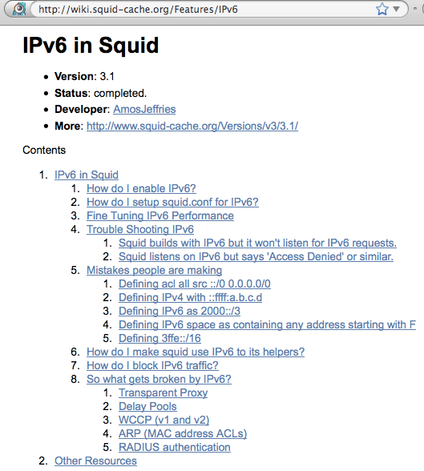
IPv6 Support: Web Proxies

Slide 52
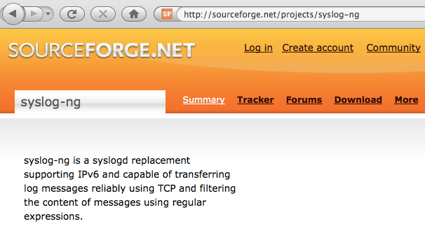
IPv6 Support: Centralized Syslogging

Slide 53
IPv6 SNMP Support?
Some network devices may support IPv6 on the data plane and the control plane, but not on the management plane.
Press your vendors for full IPv6 SNMP support on parity with IPv4 (unless it is already present)

Slide 54
6. Support for IPv6 in DNS Blocklists

Slide 55
IPv6 DNS Blocklist Support
Many higher ed sites rely on DNS-based blocklists for things like spam control. Support for IPv6 address listings by blocklist providers still doesn’t exist, and even attempting to query DNS block lists for IPv6 addresses may result in undesirable consequences (see, for example, Randy Bush’s experiences with
an IPv6 enabled server, a copy of Exim and one anti-spam DNSBL at http://ran.psg.com/~randy/ipv6-westin.html )
If you are aware of a block list that is now listing IPv6 IP
addresses or netblocks, I’d really love to hear about it.
Until IPv6-aware DNSBLs are available, you may want to handle IPv6 SMTP abuse problems on a case by case basis (since there are relatively few IPv6 providers right now, the IPv6 world is a lot more like the “good old days” when people actually took care of their abuse issues than our current miscreant overrun IPv4 Internet). Eventually, IPv6 SMTP whitelists may be a solution.

Slide 56
rbldnsd and IPv6
Many sites use DNS block lists as part of their anti-spam strategy. The most common way of serving DNS block lists is via rbldnsd (see http://www.corpit.ru/mjt/rbldnsd/ ).
Rbldnsd does not currently support block listing of IPv6 addresses and address ranges.
Among other projects, Internet2 proposed a Google Summer of Code project which would have resulted in a version of rbldnsd extended to support listing of IPv6 addresses and address ranges. Unfortunately Google did not select that project.We'd love to see the community step forward and help code this critical extension.
One cautionary note: because the rbldnsd and IPv6 both use :'s, some disambiguation/explicit version declaration and/or contextualized config file processing may be required to tell the difference between fiel's separated by colons and IPv6 address.

Slide 57
7. IPv6, Privacy, and Reconnaissance

Slide 58
IPv6 and Privacy
Privacy is another important issue that came up while IPv6 was being designed. One concern was the proposed use of an IPv6 node’s ethernet MAC address as part of the generated stateless autoconfigured IPv6 address assigned to that system.
Because each MAC address is assigned to a single ethernet device and is unique worldwide, it serves as a persistent potential
"unique system serial number" allowing for easy tracking and network traffic analysis by marketers or other hostile parties.
A solution for this problem has been proposed: see RFC4941 (“Privacy Extensions for Stateless Address Autoconfiguration in IPv6,” Sep 2007). Accumulation of reputation data for such IP addresses will obviously be, um, "difficult."
At the same time, sites have a legitimate need to be able to associate network traffic on a particular IP with a particular customer, so that they can deal with abuse-related issues, etc.

Slide 59
Pre-Attack Network Reconnaissance
It is common for miscreants to remotely scan IPv4 network addresses in an effort to identify active addresses, operating systems in use, open ports, etc., intelligence which may help
them plan an attack against you. An increasingly common (if unfortunate) response to that threat has been to insert a firewall between the Internet and local users, thereby deflecting some scans and probes, albeit at the cost of a loss of transparency.
Because IPv6-connected sites typically have a far larger number of addresses than IPv4-only sites, and end-to-end connectivity was another key objective of IPv6’s architecture, some have suggested that it might be harder for attackers to do exhaustive scans of IPv6 sites simply because of the vastly larger number of addresses involved. That’s true, as far as it goes, but that’s not the whole story. If you haven’t seen RFC 5157 (“IPv6 Implications for Network Scanning,” March 2008), I’d urge you to look it over.

Slide 60
Why Does This Bother Me? (Because It Does)
% ping6 -I eth0 ff02::1
% ping6 -I eth0 ff02::2
[ http://www.iana.org/assignments/ipv6-multicast-addresses/ ]

Slide 61
8. Lest We Forget: Some Memorable Moments In IPv6 Security History

Slide 62
IPv6 Neighbor Discovery (ND) RFC 2461 and Address Autoconfiguration RFC 2462
RFC3756, "IPv6 ND Trust Models and Threats," May 2004 (references omitted, emphasis added):
The RFCs that specify the IPv6 Neighbor Discovery and Address Autoconfiguration protocols contain the required discussion of security in a Security Considerations section. Some of the threats identified in this document were raised in the original RFCs. The recommended remedy was to secure the involved packets with an IPsec AH header. However, that recommendation oversimplifies the problem by leaving the AH key management for future work. For example, a host attempting to gain access to a Public Access network may or may not have the required IPsec security associations set up with the network. In a roaming (but not necessarily mobile) situation, where a user is currently accessing the network through a service provider different from the home provider, it is not likely that the host will have been preconfigured with the proper mutual trust relationship for the foreign provider's network, allowing it to directly authenticate the network and get itself authenticated.
As of today, any IPsec security association between the host and the last hop routers or other hosts on the link would need to be completely manually preconfigured, since the Neighbor Discovery and Address Autoconfiguration protocols deal to some extent with how a host obtains initial access to a link. Thus, if a security association is required for initial access and the host does not have that association, there is currently no standard way that the host can dynamically configure itself with that association, even if it has the necessary minimum prerequisite keying material. This situation could induce administration hardships when events such as re-keying occur.
RFC3971, "SEcure Neighbor Discovery", March 2005
draft-ietf-csi-hash-threat-03.txt, "SeND Hash Threat Analysis," March 2009 and other work, see
http://tools.ietf.org/wg/csi/

Slide 63
RH0 Source Routing Header
Remember IPv4 source routing? It wasn't such a hot idea…
we now have no ip source-route
Now fast forward to 2007: "IPv6 Routing Header Security," www.secdev.org/conf/IPv6_RH_security-csw07.pdf
One of the more famous IETF screeds, Theo De Raadt's note… http://www.ietf.org/mail-archive/web/ipv6/current/msg07323.html
The only people who I see discounting accountability (on various lists) are the ones who
either don't understand the scope and impact of the problem, or are to escape the impact of the disaster that IETF has thrown at the IPV4 operators who now suddenly face this problem of IPV6-over-tunnels on the networks they operate. Talk to some operators. It's no longer DoS. You take your DoS, you IPV6 it, and voila -- it's DoS x 100, at least. You wait and see.
So, why do we need to wipe the slate clean? Why not should we not identify the academics involved in IETF who are unaware of the pushback against source routing that happened in 1992-1995? If people are unaware if how IPV4 source routing was pushed back against, should they be at all involved in an any future IETF process that rubber stamps their kind of bullshit in a "New generation" protocol? If you don't blame the people who pushed for this crap, who will you blame? Noone?
Sanity reclaimed: RFC5095, "Deprecation of RH0"

Slide 64
Rogue IPv6 Router Advertisements
draft-chown-v6ops-rogue-ra-03, March 2009:
"In observing the operation of deployed IPv6 networks, it is apparent that there is a problem with undesired or 'bogus' IPv6 Router Advertisements (RAs) appearing on network links or subnets. By 'bogus' we mean RAs that were not the intended configured RAs, rather RAs that have appeared for some other reason. While the problem appears more common in shared wireless environments, it is also seen on wired enterprise networks also.
"The problem with rogue RAs is that they can cause partial or complete failure of operation of hosts on an IPv6 link. […]"
[Multiple scenarios may cause this. We'll just consider one…]

Slide 65
Rogue IPv6 Router Advertisements (2)
draft-chown-v6ops-rogue-ra-03, March 2009 explains:
"In this case a user's device 'accidentally' transmits RAs onto the local link, potentially adding an additional default gateway and associated prefix information.
"This seems to typically be seen on wireless (though sometimes wired) networks where a laptop has enabled the Windows Internet Connection Sharing service (ICS) which turns a host into a 6to4 [RFC3056] gateway; this can be a useful feature, unless of course it is run when not intended. This service can also cause IPv4 problems too, as it will typically start a 'rogue' DHCPv4 server on the host."

Slide 66
9. Future Alternatives to IPv6…
Carrier Grade NAT, A+P, etc.

Slide 67
IPv6 Long Term, CGN, A+P, Etc.
One of my colleagues, Dave Meyer, did an excellent talk for the Jan ’09 NANOG: “It’s The End of the World As We Know It (aka “The New Internet Architecture”), see www.nanog.org/meetings/ nanog45/presentations/Monday/Meyer_iteotwawki_N45.pdf
Dave’s a very sharp guy and it is well worth your time to read and think about his very provocative perspective on how the IPv6 rollout has gone so far, and where it may be going in the future. One of his conclusions, from slide 14, is that “Carrier Grade NAT (et al) will be deployed” [I wouldn’t assume that DMM likes or dislikes it from that statement, just that he believes it will happen]
For info on an alternative “A+P” (address plus port) approach see Maennel et. al.’s “A Better Approach Than Carrier-Grade-NAT,”
http://mice.cs.columbia.edu/getTechreport.php?techreportID=560 which mentions, among other things, “CGNs pose a security threat and/or an administrative nightmare…” Read the paper to see why!

Slide 68
Thanks for the Chance to Talk!
Are there any questions?

