Slide 1
Electromagnetic Pulse (EMP)
Infragard, Eugene, Oregon
Eugene Public Safety Center
8:30-9:30 AM, April 30th, 2009
Joe St Sauver, Ph.D. (joe@uoregon.edu)
http://www.uoregon.edu/~joe/infragard-2009/
Notes: All opinions expressed in this talk are strictly those of the author.

Slide 2
I. Introduction

Slide 3
National Scale Threats, Including EMP
“We need to plan for a class of national scale disasters that pose a significantly greater challenge than local or even regional disasters such as Hurricane Katrina. Examples include nuclear EMP [Electromagnetic Pulse] and national scale epidemics.
Such national scale disasters deserve particular attention to preparedness and recovery since assistance from non-affected regions of the nation could be scarce or non-existent. A major problem with such disasters is maintaining communication and transportation line connectivity. Communities and regions become isolated making it difficult to maintain their survival.”
Proceedings of the 2006 Spring Research Symposium, Homeland Security: Engaging the Frontlines, Institute for Infrastructure and Information Assurance, James Madison University, in cooperation with the National Academies of Sciences Federal Facilities Council, IIIA Publication 07-02, “Emergent Themes” section, section 1, page 5 [emphasis added]
www.jmu.edu/iiia/webdocs/symposiums/2006%20Proceedings.pdf , pdf pg. 11

Slide 4
“What Is EMP?”
We’ll talk about electromagnetic pulse in more detail later in this talk, but just to give you the one page summary version now…1) Electromagnetic pulse effects are caused by the detonation
of a nuclear weapon at high altitudes (40 km or higher)
2) Electromagnetic pulse effects can damage electronic devices
(such as computers) while also damaging the power grid
3) A single EMP device at a high enough altitude could cause
damage over a very wide area (e.g., the entire West Coast or
even the entire United States), I kid you not.
4) Electronics and electrical equipment can be protected against
the effects of EMP with appropriate shielding and filtering
5) Because the United States is heavily dependent on computers,
computer networks, and the power grid, damage from EMP
may be catastrophic.
6) EMP-like effects might also occur naturally as the result of
extreme sun spots and other severe space weather.

Slide 5
Authorities Have Been Trying To Warn Us
About EMP-Related Risks Since at Least 1997
"EMP does not distinguish between military and civilian systems. Unhardended systems, such as commercial power grids, telecommunications networks, and computing systems, remain vulnerable to widespread outages and upsets due to HEMP. While DoD hardens assets it deems vital, no comparable civil program exists. Thus, the detonation of one or a few high-altitude nuclear weapons could result in devastating problems for the entire U.S. commercial infrastructure."
Statement of Dr. George W. Ullrich, Deputy Director, Defense Special Weapons Agency, Threats Posed by Electromagnetic Pulse to U.S. Military Systems and Civilian Infrastructure, July 16, 1997, House Military Research & Development Subcommittee [emphasis added] http://www.fas.org/spp/starwars/congress/1997_h/h970716u.htm

Slide 6
And Those Efforts Have Continued Over Time... Congressman Roscoe Bartlett, 2004:
"On the same day [that] the 9/11 Commission Report asked
our country to look in the rear view mirror to find out why
America failed to prevent that terrorist attack, Congress was warned that we are vulnerable and virtually unprotected against an EMP attack that could damage or destroy civilian and military critical electronic infrastructures, triggering catastrophic consequences that could cause the permanent collapse of our society.
"The Commission to Assess the Threat to the United States
from Electromagnetic Pulse (EMP) Attack reported on July 22, 2004 that “the current vulnerability of our critical infrastructures can both invite and reward an [EMP] attack if not corrected.
[continues on the next slide]

Slide 7
"A single unsophisticated nuclear missile detonated at high altitude could produce an EMP attack that damages or destroys electronic systems across the entire continental United States. Satellites in low earth orbit would also be damaged. Millions of Americans could die from starvation and disease as an indirect consequence of an EMP attack that disrupts the infrastructures for transportation, medical services, food and water. However, the most important finding of the EMP Commission is that this threat can be greatly mitigated at modest cost and in 3-5 years.
"Responding to the EMP Commission report, The Wall Street Journal editorialized on August 12, 'All we can say is, we hope someone in Washington is paying attention.'"
[emphasis added]
Letter from Congressman Roscoe G. Bartlett, Ph.D. (R-MD) http://www.house.gov/hensarling/rsc/doc/Bartlett--EMP.pdf

Slide 8
Have We As a Nation Been Paying
Attention To These Warnings?
Unfortunately, no. The report of the Congressional Blue Ribbon EMP Commission* came out the same day as the Congressional 9/11 Commission report, so the findings of the EMP Commission appear to have largely gotten "lost in the noise."
Four years later, while many key recommendations of the 9/11 Commission have been implemented,** the recommendations of the EMP Commission have largely been overlooked. Evidence of this can be seen in the fact that most Americans don't know about EMP -- they don’t know what EMP is, how EMP occurs, or how critical infrastructure can be protected from it.
An April 2008 report from the Commission fared no better.***
* See www.globalsecurity.org/wmd/library/congress/2004_r/04-07-22emp.pdf
** http://homeland.house.gov/SiteDocuments/
20070727182653-51415.pdf (URL wrapped due to length)
*** http://www.empcommission.org/docs/A2473-EMP_Commission-7MB.pdf

Slide 9
Why Hasn't The Government Worked to Harden Civilian Infrastructure Against The EMP Threat?
Some people don’t even believe that electromagnetic pulse is a “credible threat.” For example, in 1997, during the Clinton era, General Robert T. Marsh, Retired, Chairman of the President's Commission on Critical Infrastructure Protection stated,
“I do not see any evidence that suggests capabilities seriously threatening our critical infrastructure. [...] There are many easier, less costly, and more dramatic ways for terrorists to use nuclear weapons than delivery to a high altitude. Such an event is so unlikely and difficult to achieve that I do not believe it warrants serious concern at this time. The administration's policy is to prevent proliferation and unauthorized access.”
http://www.fas.org/spp/starwars/congress/1997_h/has197010_1.htm

Slide 10
So If You Were A Rogue Nuclear State Or
A Nuclear Terrorist, How Would You Use
A Nuclear Weapon?
If you had just one or two nuclear weapons and wanted to cause maximum damage to the United States, how would you use them? Would you…
-- use that weapon against Washington DC?
-- use that weapon against some other major city, such as NYC?
-- use that weapon against one of our enemies, in an attempt to
kindle a “retaliatory” nuclear strike against the U.S. (even though
the United States had no actual involvement in the staged attack?)
No, no and no.
You’d use that nuclear weapon to produce EMP effects.

Slide 11
Experts Confirm That Assertion
"If you had a few or perhaps only one or two nuclear weapons, you probably would want to use them in the fashion which imposes the largest damage expectancy on the United States and its military forces.
"If you are going to go after the military forces and you only have a
few, by far and away the most effective way that you could potentially use
it is an EMP laydown. If you were going against the American civilization itself, again, the largest damage you could expect to see by far is that
associated with EMP laydown.
"As I said earlier, a large laydown over the lower 48 States has a
damage expectancy which can be reckoned in trillions of dollars. Not 10 trillion, but well above a trillion dollars. So what you get the most bang
for your nuclear buck out of, you get it out of most heavily damaging your adversary in either the military sense or the sense of civilian infrastructure. EMP is the attack mode of choice."
Dr. Lowell Wood, LLNL, Congressional Hearings on the Threat Posed by Electromagnetic Pulse (EMP) to U.S. Military Systems and Civil Infrastructure, July 16, 1997, www.fas.org/spp/starwars/congress/1997_h/has197010_1.htm
[emphasis added]

Slide 12
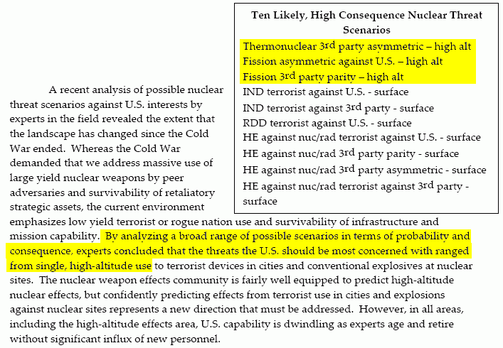
Defense Threat Reduction Agency (DTRA) Report to the
Defense Science Board (DSB) Task Force on Nuclear Weapon Effects Test, Evaluation, and Simulation, April 2005
http://www.acq.osd.mil/dsb/reports/2005-04-NWE_Report%20_Final.pdf at pdf pp. 121

Slide 13
Foreign Entities Are Also Clear
About Our EMP-Related Vulnerabilities
Peter V. Pry wrote: Chinese military writings are replete with references to the dependency of United States military forces and civilian infrastructure upon sophisticated electronic systems, and to the potential vulnerability of those systems. For example, consider this quote from an official newspaper of the PLA: “Some people might think that things similar to the ‘Pearl Harbor Incident’ are unlikely to take place during the information age. Yet it could be regarded as the ‘Pearl Harbor Incident’ of the 21st century if a surprise attack is conducted against the enemy’s crucial information systems of command, control, and communications by such means as...electromagnetic pulse weapons....Even a superpower like the United States, which possesses nuclear missiles and powerful armed forces, cannot guarantee its immunity...In their own words, a highly computerized open society like the United States is extremely vulnerable to electronic attacks from all sides. This is because the U.S. economy, from banks to telephone systems and from power plants to iron and steel works, relies entirely on computer networks....When a country grows increasingly powerful economically and technologically...it will become increasingly dependent on modern information systems....The United States is more vulnerable to attacks than any other country in the world.” (Zhang Shouqi and Sun Xuegui, Jiefangjun Bao, 14 May 1996)
Dr. Peter V. Pry, EMP Commission Staff, before the US Senate Subcommittee on Terrorism, Technology and Homeland Security, March 8, 2005; see http://kyl.senate.gov/legis_center/subdocs/030805_pry.pdf at page 3. [emphasis added]

Slide 14
Isn't There At Least Some Federal Agency Tasked
With Explicit Responsibility for EMP Issues?
The National Communications System, a branch of DHS which was formerly an office under the Department of Defense, is the focal point for EMP preparedness in as it relates to telecommunications.
See Part 215, Title 47, Chapter II, Code of Federal Regulations, http://ecfr.gpoaccess.gov/cgi/t/text/text-idx?c=ecfr&tpl=/ecfrbro
wse/Title47/47cfr215_main_02.tpl
You can visit the National Communications System website at http://www.ncs.gov/ EMP is not the focal point of that site. The
most recent major EMP-related document I found there was NCS Directive 4-2, dated January 31st, 1992 and signed by Brent Scowcroft. Among other things, it defines telecommunications as excluding power transmission systems, and directs that "The NCS will support development of appropriate protection from EMP effects on telecommunication facilities."

Slide 15
Unfortunately NCS Appear To Be Primarily
Concerned With Telephones, Not the Internet, and
They May Be Rather Overly Optimistic
"We have tested thoroughly our current generation of core telecommunication switches and have determined that there is minimal lasting EMP effect on these switches. Furthermore, most of our core communications assets are in large, very well constructed facilities which provide a measure of shielding. This situation will evolve as we move to Next Generation Networks, NGN, but we are monitoring this network evolution by testing critical components of the NGN and leveraging DOD testing."
Dr. Peter M. Fonash, Acting Deputy Manager, NCS, March 8, 2005, "Terrorism and the EMP Threat to Homeland Security," Subcommittee on Terrorism, Technology and Homeland Security of the Committee on the Judiciary, available online at http://www.terrorisminfo.mipt.org/pdf/s-hrg109-30.pdf at pdf pp. 9.

Slide 16
Speaking of Civilian Telecom System Tests...
"I am familiar with some of the civilian telecommunications tests, in particular a number five electronic switching system test that was done in the Aries simulator, which I did the preliminary design for in 1968. The cables that normally extend hundreds of miles into that system were represented by cables coiled up and placed under the mobile vans it was carried in. So, as we mentioned earlier, that is certainly not a good representation of the stress that the system would receive. I am not trying to say that this is the complete work that has been done, but it is indicative of the concerns that a review of the subject by your committee might find both informative for you and beneficial for the defense authorities."
William Graham, President and CEO, National Security Research,
http://commdocs.house.gov/committees/security/has280010.000/
has280010_0.HTM October 7th, 1999

Slide 17
What About EMP and Power Delivery?
Because power transmission is explicitly excluded from NCS' EMP responsibilities, who in the federal government would logically have responsibility for insuring the security of that area? That would be DOE (see HSPD-7 at paragraph 18 (d), http://www.fas.org/irp/offdocs/nspd/hspd-7.html ).
Specifically, the relevant office would be the Department of Energy’s Office of Electricity Delivery and Energy Reliability Infrastructure Security and Energy Restoration Programs, see http://www.oe.energy.gov/our_organization/iser.htm (other DOE activities, such as national lab resources, would obviously also be relevant to dealing with the EMP threat to civilian power infrastructure). Unfortunately, I see no evidence that protecting civilian power infrastructure from electromagnetic pulse is a public priority for that office. If I've missed it, my apologies,
and if folks would let me know where I can find public info about federal EMP power hardening activities, that would be great.

Slide 18
II. Technical Aspects of EMP

Slide 19
How EMP Effects Are Generated
Electromagnetic pulse (EMP) effects are typically caused by the detonation of a nuclear weapon at high altitude, typically burst altitudes of 40 to 400 kilometers.
Prompt gamma rays from such an explosion travel outward and are captured in the uppermost atmosphere in what's known as a “deposition region.”
Within the deposition region, those gamma rays interact with air molecules via multiple effects, with the largest number of highly energetic free electrons being produced via the Compton Effect.
Those highly energetic free electrons, generated within an extremely short time and interacting with the earth's geomagnetic field, can result in voltages in excess of 50kV capable of upsetting or killing sensitive electrical and electronic gear over a wide area.
Chapter XI, Glasstone & Dolan, "Effects of Nuclear Weapons,"
http://www.princeton.edu/~globsec/publications/effects/effects.shtml

Slide 20
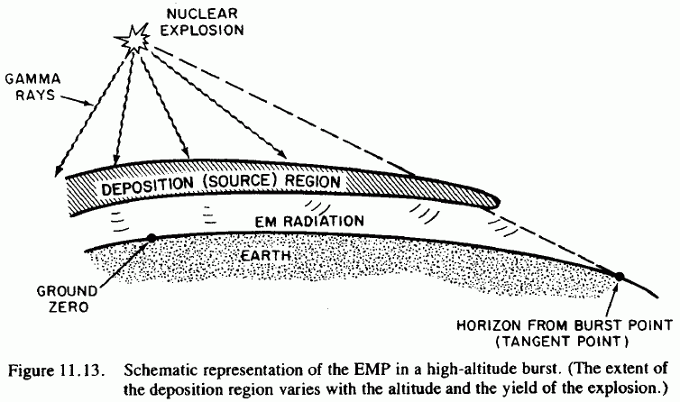
Source: http://www.princeton.edu/~globsec/publications/effects/effects11.pdf

Slide 21
EMP: A Line of Site Phenomena
These effects all occur within line of site of the burst. To compute the extent of the effect, calculate the tangent radius as:
R(tangent)=R(earth) cos⁻¹ ( R(earth) / (R(earth) + HOB))
where R(earth) equals approximately 6371 km
Height of burst: Approximate effects radius:
40 km 712 km
50 km 796 km
100 km 1,121 km
200 km 1,576 km
300 km 1,918 km
400 km 2,201 km*
* Note: assuming detonation occurred over Kansas, a 2,201 km
radius would include virtually the entire continental U.S.

Slide 22
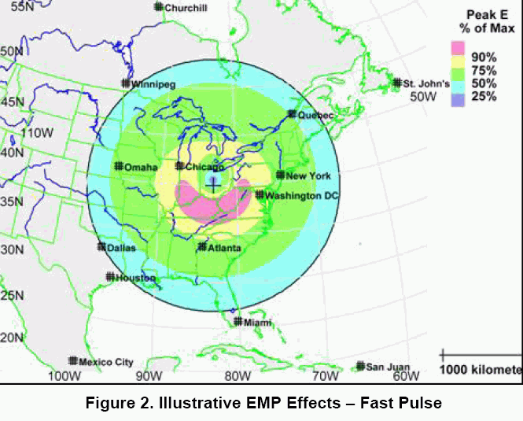
Source: Report of the Commission to Assess the Threat to the United States from Electromagnetic Pulse (EMP) Attack (burst height unspecified, but apparently on the order of 150km given the coverage extent shown)

Slide 23
A 50kV and Nanosecond Rise Time Threat
MIL-STD-2169, a classified document, apparently provides detailed information about the EMP threat wave forms. For all
of us (including me!) without access to classified documents like that one, an unclassified version of the EMP threat wave form
has been released, and it describes a 50kV potential which
develops in literally just nanoseconds.
This is important because:
-- 50 kV is a very high voltage, more than enough to zap sensitive
unprotected electronic devices
-- a few nanosecond rise time is so fast that most conventional
surge suppressing technologies (aimed at much slower-building
pulses, such as lightning), typically wouldn't have time to react
It is also worth noting that besides the prompt ("E1") high voltage threat, there's also a longer duration wide area magneto-hydrodynamic ("E3") component which is also important.

Slide 24
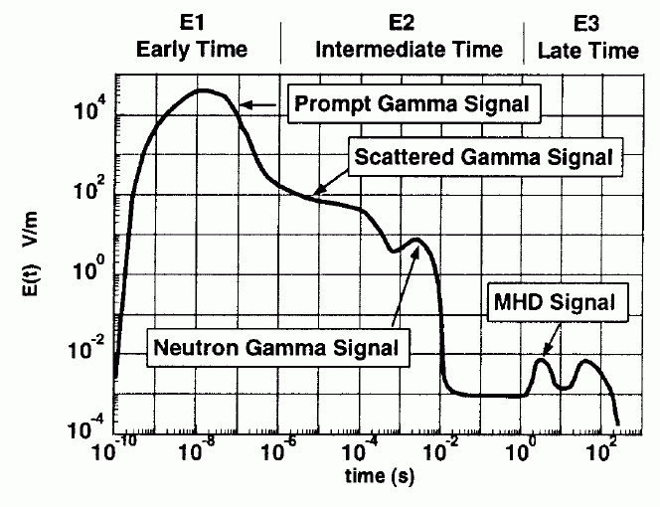
Source: EMP Environment (MIL-STD-464, "Electromagnet Environmental Effects Requirements For Systems", http://www.tscm.com/MIL-STD-464.pdf ).
Note log-log axes used on this graph.

Slide 25
MHD-EMP ("E3" or "Heave") Signal
"MHD-EMP is the late time (t > 0.1 second) component of EMP caused by a high-altitude nuclear burst. [...] MHD-EMP fields have low amplitudes, large spatial extent, and very low frequency. Such fields can threaten very long landlines, including telephone cables and power lines, and submarine cables."
from "Engineering and Design - Electromagnetic Pulse (EMP) and Tempest Protection for Facilities," DA EP 1110-3-2, 31 Dec 1990; http://www.fas.org/nuke/intro/nuke/emp/toc.htm , Ch. 2, pdf pp. 5
[See also:
(1) "Nuclear Magnetohydrodynamic EMP, Solar Storms, and Substorms," http://arxiv.org/ftp/physics/papers/0307/0307067.pdf (2) "Solar Storm Threat Analysis," http://personals.galaxyinternet.net/tunga/SSTA.pdf and
(3) "EMP radiation from nuclear space bursts in 1962"
http://glasstone.blogspot.com/2006/03/
emp-radiation-from-nuclear-space.html -- see also the next slide ]

Slide 26
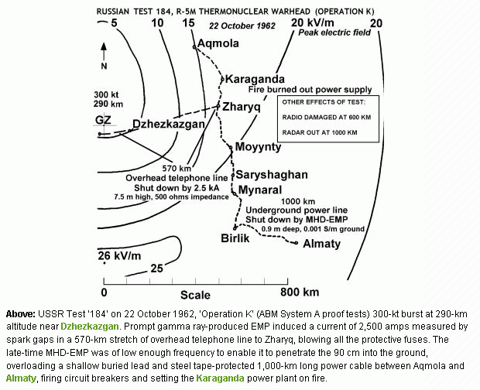

Slide 27
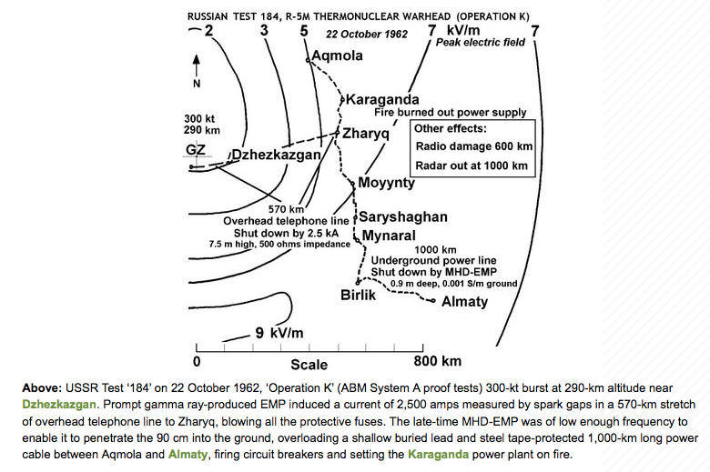
Oddly, While Rechecking That Page, I Noticed Some Changes To The Field Strength Values…

Slide 28
Some Other EMP Effects
We're Not Going to Consider…
For the purposes of this talk, we're not going to consider other electromagnetic pulse-related effects, such as source region EMP and system generated EMP effects.
Surface burst effects, such as source region EMP, are likely to be practically dominated by direct weapon effects such as thermal and shock wave damage, so we will not consider SREMP further in this talk.
System generated EMP (SGEMP) effects require the affected system to be directly exposed to the impinging gamma and x-rays from a high altitude detonation, and thus would primarily apply to military systems and spacecraft aloft, components which are also beyond the scope of this talk.

Slide 29
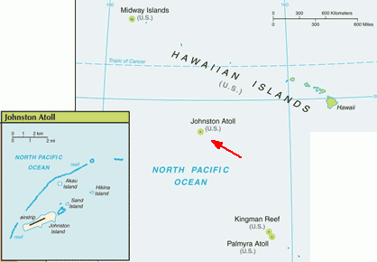
So Where Does US Empirical
Data About EMP Come From?
Virtually all US empirical information about electromagnetic pulse comes from high altitude nuclear testing done 45 years ago in remote areas of the Pacific, such as the 1962 tests done near Johnston Atoll, over 700 miles southwest of Hawaii:
Map source: https://www.cia.gov/
library/publications/
the-world-factbook/geos/um.html

Slide 30
The Starfish Prime Shot, July 8th, 1962
The most important of those nuclear tests was the Fishbowl Event series, part of Operation DOMINIC I. Those nuclear tests were done to evaluate the potential of high altitude nuclear explosions as a possible defense against incoming ballistic missiles, and weren't focused on EMP effects per se. The Starfish Prime shot of that series took place at 2300 Hawaiian time, July 8th, 1962, and consisted of a 1.45 MT warhead which was carried aloft to an altitude of 400 km by a Thor missile, 32km south of Johnston.
“At zero time at Johnston, a white flash occurred, but as soon as one could remove his goggles, no intense light was present. […]
No sounds were heard at Johnston Island that could be definitely attributed to the detonation.”
--------
See "A 'Quick Look' at the Technical Results of Starfish Prime. Sanitized Version," August 1962, http://handle.dtic.mil/100.2/ADA955411

Slide 31
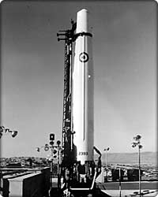
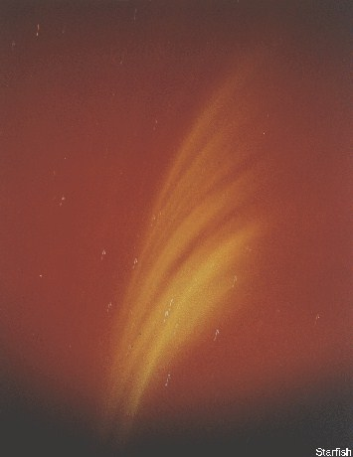
Thor Missile; Starfish Prime Skyglow
Credits: Thor missile image courtesy Boeing. Starfish Prime sky glow image from AtomicArchive.com

Slide 32
Weapon Effects… a Long Ways Away
In Hawaii, over 700 miles from Johnston Island, some resorts were reportedly holding "rainbow bomb" parties the night of the Starfish Prime shot, anticipating a spectacular auroral light show.*
What was not expected was:
-- to have about 300 streetlights go out in Honolulu
-- to have burglar alarms go off
-- to have inter-island microwave communication links fail or
-- to have telephone systems fail.
The government promptly clamped a lid on these unexpected weapon effects, and in fact, high altitude nuclear weapons effects info even has its own chapter in the declassification manual.**
--------
* “Nuclear Explosions in Orbit,” Scientific American, June 2004.
** Department of Energy “Historical Records Declassification Guide,” CG-HR-1, Chapter 8, October 16, 1995.

Slide 33
Some Comments to Congress in 1997
'The first American high-altitude nuclear weaponry experiments after the Soviet breaking of the nuclear test moratorium of '58-'61 revealed a wealth of phenomenology of completely unprecedented - and largely completely unanticipated - character. Most fortunately, these tests took place over Johnston Island in the mid-Pacific rather than the Nevada Test Site, or ''electromagnetic pulse'' would still be indelibly imprinted in the minds of the citizenry of the western U.S., as well as in the history books. As it was, significant damage was done to both civilian and military electrical systems throughout the Hawaiian Islands, over 800 miles away from ground zero. The origin and nature of this damage was successfully obscured at the time - aided by its mysterious character and the essentially incredible truth." Testimony of Dr. Lowell Wood, http://www.fas.org/spp/starwars/congress/1997_h/h970716w.htm

Slide 34
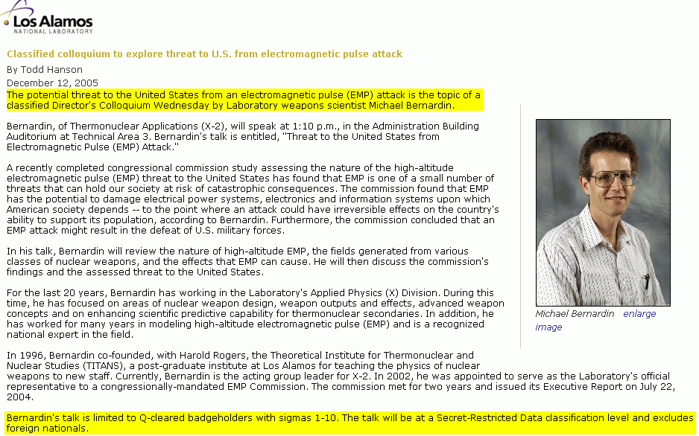
Some Aspects of Electromagnetic Pulse Effects Continue to Be Sensitive Today...

Slide 35
Coming Back to the 1962 Tests, Those Tests
Also Impacted Operational Satellites...
The 1962 high altitude nuclear explosions pumped the Van Allen belts, creating persistent bands of radiation from the explosions. That radiation negatively affected satellite electronics, causing multiple satellites to prematurely fail:*
-- Satellite Ariel, launched April 26, 1962; died four days after
Starfish Prime due to deterioration of solar cells.
-- Transit 4B: stopped transmitting 25 days after Starfish Prime.
-- Research Satellite Traac, in operation 190 days, ceased
transmitting data 34 days after Starfish Prime.
--------
* United States High-Altitude Test Experiences: A Review Emphasizing the Impact on the Environment, LA-6405, Issued October 1976,
http://www.fas.org/sgp/othergov/doe/lanl/docs1/00322994.pdf

Slide 36
An Aside: Satellites Remain Vulnerable to Lingering High Altitude Radiation Today
"Perhaps the most devastating threat could come from a low-yield nuclear device, on the order of 50 kilotons, detonated a few hundred kilometers above the atmosphere. A nuclear detonation would increase ambient radiation to a level sufficient to severely damage nearby satellites and reduce the life time of satellites in low earth orbit from years to months or less. The lingering effects of radiation could make satellite operations futile for many months. Even nuclear detonations in the 10-kiloton range could have significant effects on satellites for many months […]
To execute this mission, all that is needed is a rocket and a simple nuclear device. "
Report of the Commission to Assess United States National Security, Space Management and Organization, Donald Rumsfeld (e.g., future SECDEF), Chairman, Jan 11, 2001 http://www.fas.org/spp/military/commission/report.htm

Slide 37
III. EMP Shielding

Slide 38
Our Primary Focus Today Isn't On Satellites,
It's On Managing Terrestrial EMP Effects
Are current electrical and electronic devices at risk?
How can they be protected?
What have empirical nuclear EMP high altitude tests since Starfish Prime shown us?
At least one of those questions, the last question, is an easy one to address – there haven't been further atmospheric high altitude nuclear tests since Starfish Prime.

Slide 39
Why Haven't There Been Further High
Altitude Atmospheric Nuclear Tests?
In 1963, the Limited Test Ban Treaty* was signed, banning nuclear tests in the atmosphere, in outer space and under water. Because of the LTBT, Starfish Prime gave us the “last best”
in situ US experimental data available.
An interesting topic for speculation over beers some time: what inspired the United States and Russia to consummate the LTBT? Was it the result of the Cuban Missile crisis (October 14th-28th, 1962)? Growing concern over domestic environmental effects of above ground nuclear contamination? Worries about loss of additional satellites to lingering radiation effects? Or was it recognition that EMP-related effects might just be too serious
to explore further?
--------
* http://www.state.gov/t/ac/trt/4797.htm

Slide 40
Electrical and Electronic Gear in 1962, and Electrical and Electronic Gear Now
Ironically, the nation was in better shape, at least with respect to EMP-vulnerable electrical and electronic devices, in 1962 than it is now. Why? Well, in 1962 vacuum tubes were still common, and integrated circuits were virtually non existent. Now, that's reversed, and VLSI integrated circuits are very EMP sensitive.
For a discussion of the types of electrical components which are most at risk of damage from electrical effects, see Department of the Air Force “Engineering Technical Letter (ETL) 91-2: High Altitude Electromagnetic Pulse (HEMP) Hardening in Facilities”
available at http://www.wbdg.org/ccb/AF/AFETL/etl_91_2.pdf
4 March 1991.
An excerpt from that report is shown on the following slide (boxes added by me for emphasis).

Slide 41
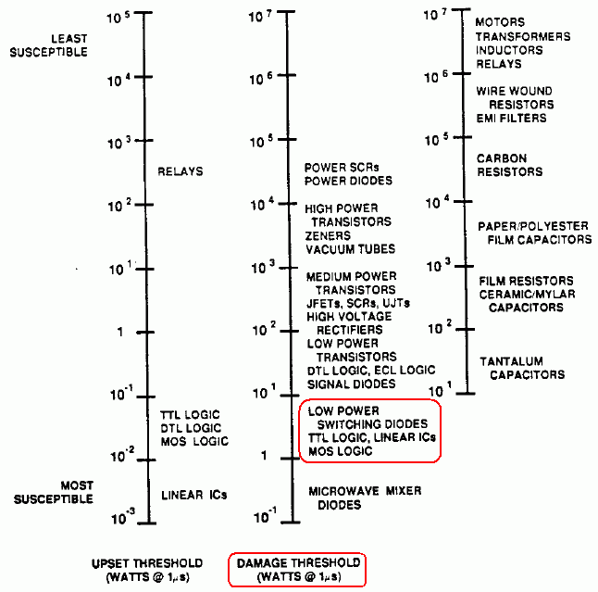

Slide 42
What's The Difference Between
“Upset” and “Damage?”
You may have noticed two different scales on the preceding chart – one for “upset” and one for “damage,” and you may wonder, “what's the difference?” I quote from EP 1110-3-2, available at:
http://www.fas.org/nuke/intro/nuke/emp/c-2body.pdf at pdf pp. 17:
“Upset is a nonpermanent change in system operation that is
self-correcting or reversible by automatic or manual means. Damage is an unacceptable permanent change in one or more system parts.”
In the civilian world our focus is obviously primarily on damage, but in a military setting even having systems simply be temporarily upset can be catastrophic if that upset occurs during a critical time, such as while a plane is engaged in crucial flight operations.

Slide 43
Integrated Circuit Density Has Continued to Increase Since That 1991 Report...
“[...] due to size and power reductions, modern electronics are inherently more vulnerable to some of the effects produced by a nuclear detonation. And each new generation, smaller and needing less power, exacerbates these vulnerabilities. Furthermore, as we make greater use of more affordable commercial parts and components, we potentially introduce new vulnerabilities into our military systems. Additionally, the military's increasing reliance on commercial space-based systems makes it more vulnerable to the nuclear weapon effects being discussed.”
Comments of Dr. George W. Ullrich, Deputy Director, Defense Special Weapons Agency http://www.fas.org/spp/starwars/congress/1997_h/h970716u.htm

Slide 44
Just In Case There's Still Any Doubt
“It is a reasonable projection that most, if not all, modern computer systems exposed to referenced EMP field levels—which are 50 kilovolts per meter, not just 10—but the very high levels you might see in most of the United States—most modern computer systems ranging from laptops to mainframes would wilt. By wilting, they would at least cease to function. In many cases, they would be burned out. So it would require very major maintenance before they could be restored to operation.
“Not just computers in aircraft but computers everywhere, other than in this type of very high integrity metallic enclosures that Dr. Ullrich sketched in his opening statement. Computers in any other enclosure than that type would be compromised, if not destroyed outright.”
Testimony of Dr. Lowell Wood, http://commdocs.house.gov/
committees/security/has197010.000/has197010_1.HTM

Slide 45
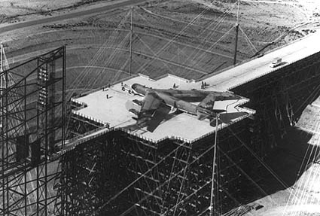
But If We Haven't Done High Altitude Atmospheric Testing Since 1962...
... how do we know what's vulnerable and what's not, or how to effectively protect critical systems? Answer: EMP simulators, such as the Trestle facility at Kirtland AFB in NM, the largest wood-and-glue lam structure in the world.
See also http://www.ece.unm.edu/summa/notes/trestle.html

Slide 46
Other EMP Simulation Facilities
A list of electromagnetic pulse simulation facilities, at least as of 1994, can be found at pdf pp. 8 of http://stinet.dtic.mil/cgi-bin/Ge
tTRDoc?AD=ADA278230&Location=U2&doc=GetTRDoc.pdf , “Test Operations Procedures (TOP), 1-2-612 Nuclear Environment Survivability,” 15 April 1994. See also
http://commdocs.house.gov/committees/security/has197010.000/
has197010_1T.HTM
As discussed in that Congressional hearing, it is believed than many EMP simulators have been mothballed or decommissioned, thereby limiting opportunities for empirical testing of equipment under simulated EMP signals (for example, the Trestle facility shown on the preceding page is no longer operational).
My main interest, however, is the Internet. So have critical Internet components, such as core network routers, switches and optronics been hardened, and “proof tested” for EMP hardness?

Slide 47
There Is No Indication That Core Routers, Switches and Optronics Are EMP Hardened
After reviewing a number of major vendors web sites for information about the EMP hardening status of routers and switches, and after visiting with a number of vendor staff members, I was unable to find any public indication that any major vendor's routers and switches are EMP hardened by
default. (If you are a manufacturer of routing or switching
gear, or optronics, and your gear *is* EMP hardened and that information can be publicly shared, please let me know.)
Thus, unless a vendor explicitly tells you otherwise, assume that ALL critical Internet core routers, switches, optronics and other key equipment will need supplemental EMP shielding or hardening.

Slide 48
Fiber Optic Cable Maybe Immune to EMP,
But OEO Equipment Probably Isn't…
When thinking about critical network equipment, PLEASE don't forget about electronics deployed in support of optical networks.
While fiber is largely EMP resistant (modulo a reference or two I've seen associated with potential "fiber fogging"), the
optical-electrical-optical ("OEO") retime/reshape/reamplify
("3R") optronics probably aren't EMP resistant (again, unless
a vendor tells you explicitly to the contrary).
Just as you should provide supplementary shielding for critical routers and switches, you should ALSO plan to provide supplemental external EMP shielding for any optronic devices you may have deployed.

Slide 49
What's Involved in Hardening or Providing External EMP Shielding For Critical Gear?
The goal is to isolate key equipment from potentially dangerous RF energy by providing a continuous metal shield (such as 10 gauge/3.416 mm or better steel) around vulnerable equipment.
A very conservative hardening target is 100dB worth of attenuation from 1kHz to 10GHz, with no waveguide beyond cutoff (WBC) penetration (discussed later) larger than 1.0 cm;
see, for example "Guide Specifications for HEMP/TEMPEST Shield Doors, Electrical Filter/ESA Assemblies, and Other Shield Penetrations," Rev 1, Jun 1988, at pdf page 120, available online at http://www.custompowersystem.com/images/hemp.pdf
A less stringent protection EMP hardening target would be 50db from 14kHz to 1GHz, with no WBC penetration larger than 10.0cm

Slide 50
Providing EMP Shielding For Systems...
Much of the effort (and cost!) involved in constructing EMP shielded areas is associated with the careful design, essentially perfect craftsmanship, and extensive conformance testing that's required to verify required protection.
EMP shielded areas also require extra space, which may be an issue for some space-constrained facilities. Ideally there should be at least 3 feet of access space around the shielded area for ongoing EMP testing and for maintenance access to penetrations
If you're out of space before you even start, now might be a good time to think about a secondary data center, connected by fiber...

Slide 51
Doors and EMP Enclosures
Doors are one of the most difficult areas when it comes to providing unimpaired EMP shielding.
Doors for personnel and equipment access will often be specially constructed to use a double knife edge seal with beryllium copper fingerstock contacts.
Ideally doors will be configured in pairs, arranged at right angles, separated by a vestibule, and protected from being opened simultaneously by an interlock mechanism (see the illustration on the next slide)

Slide 52
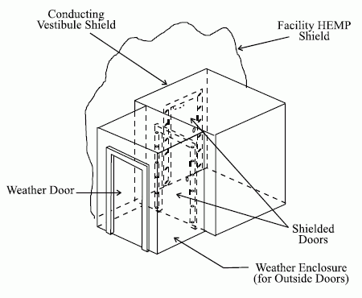
Sample Double Door EMP
Vestibule Style Entrance
http://www.wbdg.org/ccb/FEDMIL/std188_125_1.pdf at pdf pp. 31

Slide 53
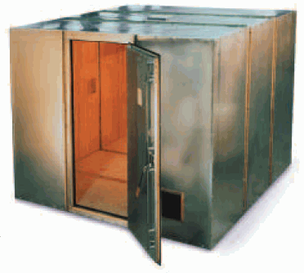
Sample Modular Steel EMP Enclosure
Photo courtesy ETS-Lindgren.

Slide 54
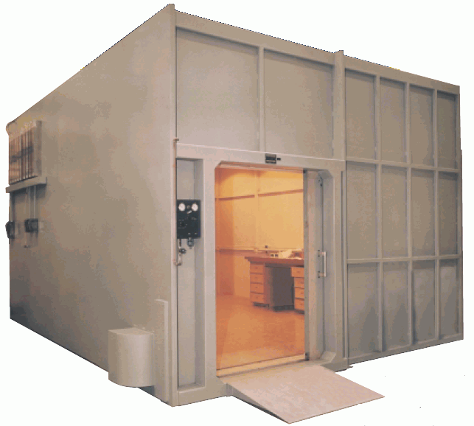
Sample Welded Steel EMP Enclosure
Photo courtesy ETS-Lindgren.

Slide 55
You May Also Just Want to Shield Gear From EMP On A Rack-by-Rack Basis
Looking at those previous EMP shielded areas, one might get the impression that they represent the smallest areas which can
be EMP shielded. That would be incorrect. You can also purchase EMP hardened enclosures built around 19" telco racks.
Those enclosures can even be embedded within a GSA approved security container (aka a safe) if physical security of equipment is also a concern (hey, you lock your guns up in a gun safe when you're not using them, right? so why not protect a couple hundred hundred thousand dollar router at least equally well?)

Slide 56
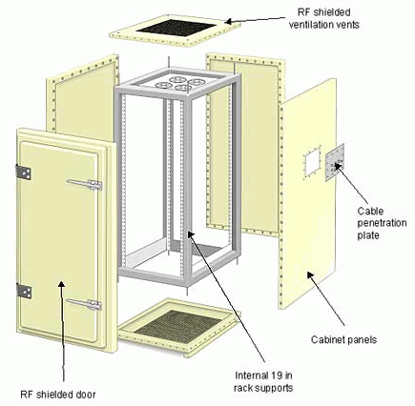
Sample EMP Shielded
19" Rack Enclosure
Photo courtesy of European
EMC Products Limited

Slide 57
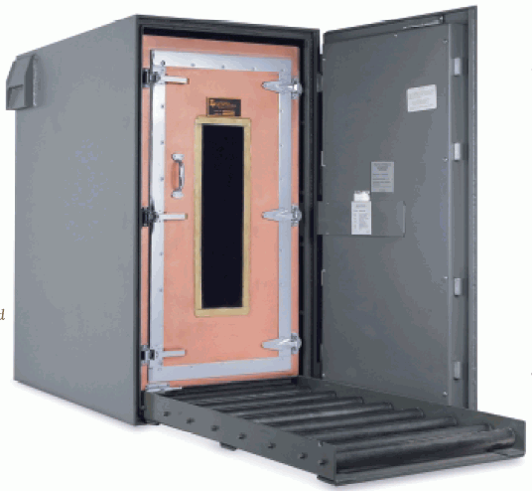
Sample TEMPEST (and GSA Class 5
Security Container) Enclosure
Photo courtesy ETS-Lindgren.

Slide 58
Waveguide Beyond Cutoff Penetrations
Shielded enclosures can't be sealed as tightly as a can of soup. :-) Among other things, there needs to be some way to safely pass fiber optic data cables through the shielding of the enclosure, and some way to provide air for personnel as well as ventilation to keep gear from overheating.
The way this normally gets handled is via "waveguide beyond cutoff" (WBC) penetrations.
The maximum diameter of the allowed WBC aperture varies with the target cutoff frequency, but a diameter no larger than 10cm is specified by MIL-STD-188-125-1 for protection through 1GHz, with a length that's at least 5 times that diameter. The waveguide must be made of metal, continuously circumferentially welded to the facility EMP shield, and there must be no conductors present within the waveguide. See the illustrations on the following slides from MIL-STD-188-125-1

Slide 59
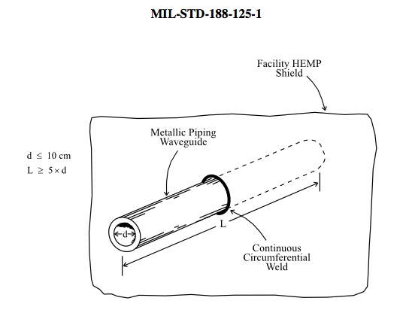
Waveguide Beyond Cutoff (cont.)

Slide 60
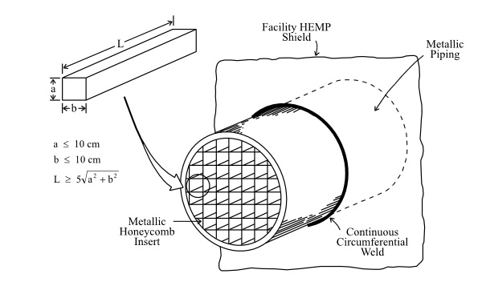
Honeycomb WBC for Larger Penetrations

Slide 61
EMP Shielded Facilities and Electrical Feeds
Power for equipment located within the EMP shielded enclosure must be provided via specially filtered lines (e.g., normal surge suppressors don't react fast enough to protect critical equipment against EMP). For some examples of EMP electrically protective filters, see:
-- http://www.ets-lindgren.com/pdf/N2556.pdf
-- http://www.ramayes.com/EMI_RFI_Filters.htm
-- http://www.custompowersystem.com/Efilters/products4.htm
All EMP shielded enclosures must also be carefully electrically bonded and grounded.

Slide 62
Spares and Recovery
Review stockpiles of spare parts, including fuses, replacement power supplies, spare fans and hard drives, etc. – do so NOW while you can easily order additional spares which might prove useful. Too many products to easily stock spares? Maybe it is time to think about standardizing and consolidating on a smaller number of unique devices!
When it comes to equipment which has been damaged beyond what you can repair yourself, recognize that the primary source of replacement gear may be out-of-region or from overseas, and that in some cases replacement gear may be effectively unobtainable in any relevant time frame. For that reason, consider stockpiling replacement gear (or even just recently replaced equipment!) in an EMP-secure warehouse for use as replacement gear in the event current shielded gear somehow gets damaged by an EMP strike.

Slide 63
But, Beware The "Single-Event Fallacy"
"Avoid the single-event fallacy. In assessments of potential tactical situations, don't assume that EMP will occur once and then be over. The contrary may be the case. An aggressor may initiate a precursor attack with high altitude EMP to initially damage unprotected equipment, and then follow-up with additional high altitude or surface-burst explosions to exploit the tactical situation." (see FM 3-3-1, http://www.globalsecurity.org/wmd/
library/policy/army/fm/3-3-1_2/Appc.htm )
Thus, if you try to "hedge your bets" by not hardening systems in place, but simply caching replacement gear which you can drag out and installed if needed, recognize that your replacement gear might very well end up getting killed by a follow on attack just as your original gear was. Hardening is the only real answer...

Slide 64
IV. But Is There Really Even A Threat?

Slide 65
EMP Shielding Isn't Cheap to Build Out
I'll freely concede that hardening critical equipment in your facility with EMP shielding isn't cheap, either to install or to maintain.
You don't want to embark on an expensive program of EMP hardening your facilities if you aren't pretty dang sure that there's a real threat out there...
I encourage you to make up your own mind – this might all be nothing to worry about, and you can just ignore this whole talk.
On the other hand, here are some additional bits of data to chew on while you sit there happily un-EMP-shielded.

Slide 66
Components of a Credible EMP Threat
For there to be a credible EMP threat, you need five things:
1) a means to get to the required altitude, such as a missile
2) a suitable target,
3) a motive for conducting an EMP attack,
4) the absence of a deterrent, and
5) a nuclear weapon for the missile to deliver.

Slide 67
1) Missiles
The type of missile required to get a nuclear least 40 km above the earth need not be particularly advanced. I quote:
"The Scud rockets used by the Iraqis [...] flew to altitudes of 150 kilometers, which is imminently satisfactory for the type of regional EMP laydowns I have been referring to. [...] Scud-type rockets exist in copy to the extent of over 15,000 Scud class rockets owned by over 30 nations in the world at the present time. So getting to the threshold of space and carrying a nuclear explosive there is something that, unfortunately, is a regrettably potentially widespread – maybe actually widespread capability."
Statement of Dr. Lowell Wood,
http://www.fas.org/spp/starwars/congress/1997_h/h970716w.htm

Slide 68
What Does the Congressional
Research Service Think?
"About three dozen countries have been publicly identified as having ballistic missiles, and half of those countries are in Asia and the Middle East. About 30 of these countries have, or are developing, ballistic missiles that can deliver a 500- kilogram warhead 300 kilometers or further. Of the non-European countries, fourteen have produced ballistic missiles (Argentina, China, Egypt, India, Iran, Iraq, Israel, North Korea, Pakistan, South Korea, Syria, Taiwan, Ukraine, and South Africa which no longer produces missiles). In addition to these regional powers, which are often discussed as missile proliferators, several Western and Eastern European countries and republics of the former Soviet Union have missiles." [emphasis added]
"Missile Survey: Ballistic and Cruise Missiles of Foreign Countries," Congressional Research Service Report RL30427, Updated March 5, 2004, pdf pages 7-8.

Slide 69
One Scenario Which Has Been Mentioned
Quoting Peter V. Pye from March 2005:
"Iranian flight-tests of their Shahab-3 medium-range missile, that can reach Israel and U.S. forces in the Persian Gulf, have in recent years involved several explosions at high altitude, reportedly triggered by a self-destruct mechanism on the missile. The Western press has described these flight-tests as failures, because the missiles did not complete their ballistic trajectories. Iran has officially described all of these same tests as successful. The flight-tests would be successful, if Iran were practicing the execution of an EMP attack.
"Iran, as noted earlier, has also successfully tested firing a missile from a vessel in the Caspian Sea. A nuclear missile concealed in the hold of a freighter would give Iran, or terrorists, the capability to perform an EMP attack against the United States homeland, without developing an ICBM, and with some prospect of remaining anonymous. Iran’s Shahab-3 medium-range missile, mentioned earlier, is a mobile missile, and small enough to be transported in the hold of a freighter."
http://kyl.senate.gov/legis_center/subdocs/030805_pry.pdf [emphasis added]

Slide 70
SCUD-Class Missiles Even Appear to
Have Been Available on the Open Market...
U.S. seizes Scud missile imported by weapons collector
http://www.cnn.com/US/9809/25/missile.seizure/ (Sept. 25, 1998)
LOS ANGELES (CNN) -- U.S. Custom officials are investigating how an operational Russian-designed Scud B missile was imported into California. […] The missile has been identified as a Scud B SS-1C that was manufactured in Czechoslovakia in 1985. Officials are trying to determine whether the wealthy California weapons collector who they say imported the missile from London falsified customs documents and claimed the missile was "demilitarized." […] the missile was fully operational because it has a guidance system and an engine. It did not, however, come with a warhead or fuel. [continues]

Slide 71
Or Could Even A High Altitude Balloon
Reach EMP-Relevant Altitudes?
http://www.csbf.nasa.gov/balloons.html says
"Standard NASA scientific balloons are constructed of polyethylene film; the same type material used for plastic bags. This material is only 0.002 centimeters (0.0008 inches) thick, about the same as an ordinary sandwich wrap. […]
"These very large balloons can carry a payload weighing as much as 3,600 kilograms (8,000 pounds), about the weight of three small cars. They can fly up to 42 kilometers (26 miles) high and stay there for up to two weeks."
So yes, a specialized high altitude scientific balloon could loft a warhead to EMP-effect relevant altitudes.

Slide 72
2) A Suitable Target
Because of the nature of the EMP effect, electromagnetic pulse effects are not suitable for use against all conceivable targets.
For example, because a minimum height of burst is needed to achieve EMP-related effects, and because even a 40 km height of burst will affect sites within a 700 km radius, an EMP weapon cannot be used if an target is too close to unhardened friendly assets. [One is reminded of the (unrelated) exhortation to "keep your friends close, and your enemies closer!"]
EMP effects are not precise/surgical. Atmospheric effects and weapon related effects mean that EMP effects may vary from projections, or from shot to shot, and limited empirical test data means that EMP weapons cannot be treated like a precision guided munition. They are an area weapon, not a point weapon.
EMP weapons are also obviously not appropriate if a target is
pre-industrialized, or widely hardened against EMP.

Slide 73
Coastal vs Mid Continental Use
Are there considerations which might lead an attacker to conduct a high altitude nuclear burst over one coast or the other rather than attempting to achieve full continental coverage with a high altitude high yield burst over the Great Plains?
Maybe yes. Consider the following potential factors:
-- The attacker has a lift vehicle with limited altitude potential,
or the attacker has a comparatively low yield weapon. Given
those limitations, a mid-continent burst strategy wouldn't be
assured of reaching high value areas on the coasts
-- The attacker might want to launch from offshore, in
international waters; coastal targeting would also reduce flight
time (and thus exposure to potential anti-missile defenses)
-- An attacker might want to impede military operations from
one coast while being indifferent to those on the other coast
-- If only half the country has been hit, the attacker can still use
threats of attacks against the other half as a potential deterrent.

Slide 74
Example of A Possible Coastal Use Scenario
"Not a movie made for TV" (October 3rd, 2007) http://washingtontimes.com/apps/pbcs.dll/article?AID=/20071003/
COMMENTARY/110030040/1012&template=printart
"James G. Zumwalt - An innocent-looking freighter sails 200 miles off the East Coast of the United States. In international waters, it appears to be no threat. However, its true intentions soon become evident. During the ship's transit over thousands of miles from a port in a country unfriendly to the United States, a SCUD missile remained concealed but is now being prepared for launch from the freighter's deck.
"The warhead of the soon-to-be fired SCUD — a relatively inexpensive missile abundant around the world — is not designed to detonate on American soil or to inflict massive civilian casualties via a chemical, biological or nuclear weapon. This warhead's targeted impact is purely economic, for it is armed with an EMP (Electromagnetic Pulse) payload — tailor-made to inflict as much such damage as possible. And, as a recent study concludes, detonation over the Baltimore-Washington-Richmond corridor could result in economic output losses (exclusive of infrastructure replacement costs) exceeding $770 billion
or 7 percent of the nation's annual gross domestic product." [articles continues]

Slide 75
3) Motive For Conducting An EMP Attack
Potential motives for conducting an EMP attack are as numerous as our potential enemies, including ideological/political/religious reasons, economic reasons, or military reasons.
One could even imagine environmental motives -- perhaps we might face an attacker who thinks the US is consuming more
than its share of world resources, or is irreversibly damaging the environment, etc. An EMP strike against the United States might
be viewed by such a person as something which would cause a reversion to a utopian and somehow economically gentler pre-industrialized era (although it is unclear how that goal would be realized if the rest of the world remained industrialized). In that regard, it was rather eerie to hear Osama Bin Laden talking about things like "global warming resulting to a large degree from the emissions of the factories the major corporations," see http://www.timesonline.co.uk/tol/news/world/middle_east/article2414656.ece

Slide 76
EMP Attacks Are A Type of
Strategic "Cyber Warfare”
Occasionally people will speculate on the topic of cyber warfare, usually congering up attacks involving distributed denial of service attacks, worms and other sorts of malware, targeted computer intrusions, etc. While all those sorts of cyber attacks are/might be part of the cyber warriors arsenal, they're all fundamentally conventional/tactical attacks of limited scope and scale, and all are subject to mitigation (if only by selective isolation of targeted systems from parts of the Internet which are attacking them).
What would be the equivalent of a strategic nuclear attack in the context of cyber war? I assert that when it comes to a strategic attack in a cyberwar context, the ONLY true strategic attack that I can think of would be an EMP-based attack.
For more on cyber war, see: “Cyber War, Cyber Terrorism and Cyber Espionage,” www.uoregon.edu/~joe/cyberwar/cyberwar.pdf

Slide 77
4) Absence of A Deterrent
Currently traditional nuclear attacks are deterred by:
-- pragmatic recognition that a nuclear attack will be met by a
withering response in kind, and
-- world condemnation which would accompany any attack which
resulted in widespread direct loss of life.
Note that attacks employing EMP-related effects would perturb that equation:
-- They could potentially be conducted in a way which would
make attribution, and thus retribution in kind, very difficult
-- EMP-based attacks may be launched by entities who are
largely or completely immune to EMP attacks in return (either
because of collateral damage considerations, or their society's
pre-industrialized status)
-- An EMP laydown would not directly result in widespread loss
of life (although deaths may be widespread as indirect effects)

Slide 78
5) Availability of A Nuclear Weapon
I won't spend time speculating on terrorist access to nuclear weapons; let's just focus on the states known to have nuclear weapons available. There are nine of those: the U.S., Russia, the U.K., France, China, Israel, India, Pakistan, and North Korea (South Africa previously had the bomb, but has disarmed).
At a minimum, therefore, we are safe in saying that there are nine countries which have weapons would could be used for the purpose of conducting at least a rudimentary EMP laydown.
Some of those countries are even known to have devoted special attention to producing or maintaining weapons which have been tailored to produce elevated levels of electromagnetic pulse....

Slide 79
Some Nuclear Weapons Have Been Intentionally
Designed to Have Enhanced EMP Effects
For example, we know from Congressional testimony that the United States has developed nuclear weapons which have been intentionally designed to produce enhanced EMP effects:
"In the late '70s and early '80s, I worked on ''Third Generation'' nuclear weaponry, a major component of which was nuclear explosive-driven generators of electromagnetic pulses of potentially greatly increased efficiency and military effectiveness; spinoffs involving non-nuclear means of generating potent EMP also engaged my attention."
Statement of Dr. Lowell Wood,
http://www.fas.org/spp/starwars/congress/1997_h/h970716w.htm

Slide 80
The Soviets and "Super-EMP" Weapons
'In the 1990s, the [Russian] General Staff was aware of U.S. research into super-EMP nuclear weapons, which would generate a particularly powerful electromagnetic pulse capable of destroying even protected electronic systems. "From the early 1980s, U.S. military scientists ... aimed at creating ... a super-EMP [weapon] with intensified electromagnetic radiation output," General Belous accurately observed. "They figure to use it to increase the intensity of the field at the Earth's surface to several hundred kilovolts per meter." [War Scare: Russia and America on the Nuclear Brink, by Peter V. Pry]
Reportedly the Soviets were content with a simpler strategy: they simply retained very large (25MT) thermonuclear warheads in
their stockpile for EMP-related use instead. A somewhat crude
and inelegant strategy, but one which would certainly do the job.

Slide 81
“So Does That Mean You'd Need A
Thermonuclear Weapon To Get EMP?”
No. Sometimes, when folks notice that Starfish Prime was 1.45MT, or hear that Soviets retained large 25MT warheads for EMP-related purposes, or learn that the US devoted significant effort to tailoring EMP-enhanced weapons, they speculate that lesser nuclear weapons (such as non-thermonuclear fission weapons) might not be sufficient to produce EMP. Clearly, if that were to be the case, that would dramatically increase the threshold which would need to be surmounted in order to inflict an EMP attack.
The testimony of weapons scientists, however, confirms that even modest fission weapons would be sufficient to produce significant EMP effects, and those modest yields might be all that's required to take advantage of the altitudes available from developing world launch vehicles.

Slide 82
Didn't Some Sort of "EMP Bomb"
Already Get Used In Iraq or Kosovo?
You may be thinking of the so-called “Blackout Bomb” or
“Soft Bomb” which shorted out power station transformers with conductive carbon fiber or graphite filaments – see
the discussion and illustrations at
http://www.fas.org/man/dod-101/sys/dumb/blu-114.htm
There's also an interesting discussion of high power microwave devices in the Congressional Research Service's
“High Altitude Electromagnetic Pulse (HEMP) and
High Power Microwave (HPM) Devices: Threat Assessments,”
http://www.fas.org/man/crs/RL32544.pdf

Slide 83
Oh Yes: If You Did Want to Worry About Terrorist Access to Nuclear Material
Check out GAO 02-426, "NUCLEAR NONPROLIFERATION: U.S. Efforts to Help Other Countries Combat Nuclear Smuggling Need Strengthened Coordination and Planning,"
http://stinet.dtic.mil/cgi-bin/GetTRDoc?AD=ADA403144&Lo
cation=U2&doc=GetTRDoc.pdf discussing 181 confirmed cases of smuggling nuclear materials between 1993 and 2002.
I'd also recommend PBS' "Loose Nukes: Investigating the Threat of Nuclear Smuggling," see
http://www.pbs.org/wgbh/pages/frontline/shows/nukes/
Fair warning: that site correctly includes a quotation of a
Russian proverb: "The less you know, the better you sleep."

Slide 84
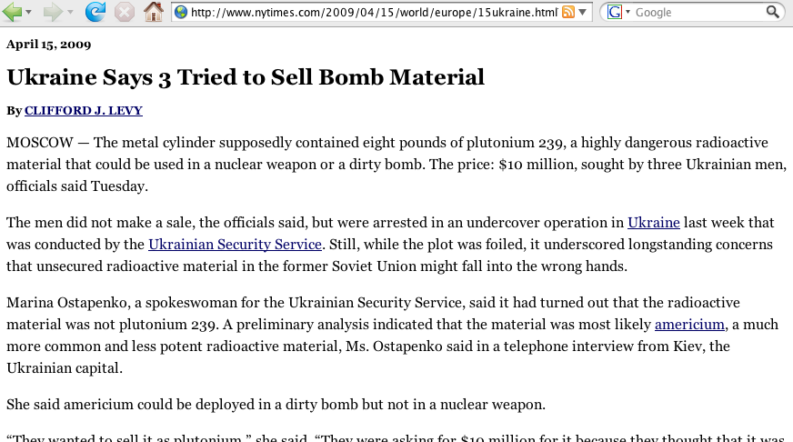
Example of An Attempt To Obtain Nuclear Material

Slide 85
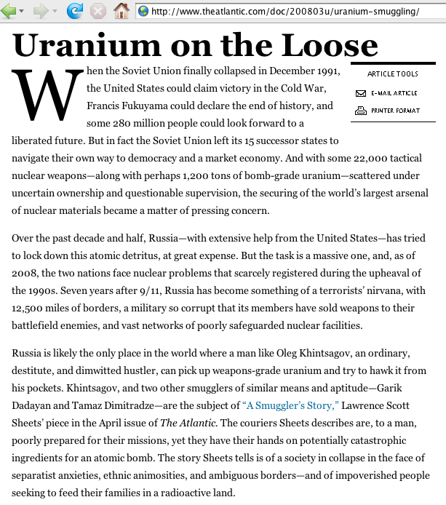

Slide 86
Thus I Believe All Requirements Which Need to Be Satisfied for An EMP Attack to Be Deemed
A Credible Threat Have Been Met
I believe, based on the information that’s currently publicly available, that all the requirements needed to render potential use of EMP weapons against the United States as a plausible threat have been met.
An EMP strike may not happen today or tomorrow or even next year, but I'd be extremely surprised if we don't see an EMP attack sometime within the next decade.
Let me also make sure I explain why YOU should care about this risk, even if all it does is “just” kill some computers, computer networks, and power grids.

Slide 87
V. Conclusion

Slide 88
Our Society Isn’t Just Enhanced By The Existence of the Internet, It Is Dependent On The Internet
There may be an inclination to discount the impact that loss of computers, the Internet and America’s power grid might cause.
For example, some might be tempted to joke, “Haha, well at least
I guess we’ll all at least be getting less spam after that, right?”
Unfortunately, I believe that without computers, the Internet, and the electrical power grid, our society would be prone to collapse.
There would rapidly be regional or national shortages of food, water, critical medicines, basic consumer goods and gasoline.
Business would slow to a standstill, unable to access capital, order raw materials, or accept new orders. Jobs would disappear.
The government would be very hard pressed to maintain order.
The potential effects of an EMP laydown are thus very serious and we need to do our utmost to insure we take appropriate precautions.

Slide 89
What Precautions Should We Be Taking?
Harden systems, networks and power sources against EMP-related damage now, while we still have time and can easily do so. Stockpiled critical spare parts in a shielded environment.
Plan for how you or your neighbor’s business would continue to operate without the availability of many electronic devices, electrical power, or the Internet. Are you ready to employ manual backup processes? Do you have more than just-in-time levels of inventory on hand? Could you operate on a cash-only basis? What if you can’t scan items to find out what they’re supposed to cost?
Don’t forget your own family. Do you have multiple months worth of food on hand? How would you get drinking water? If an attack happened in winter, would you have fuel to stay warm while the electricity’s out? Do you have reserves of any medicines you need?
Work to insure that our officials are thinking about these issues, and insist that they plan and take other appropriate steps.

Slide 90
Some Final “Take Aways”
Even if you aren’t a specialist in nuclear weapons effects, credible government experts have been trying to tell us for years that electromagnetic pulse is a serious issue. We need to listen to them.
We can protect against EMP through use of shielding and filtering. Most electronic devices come with relatively little inherent protection, so we need to add supplemental external shielding to obtain protection. We can add that shielding gradually, beginning with our highest value/most irreplaceable electronic assets.
Given that little attention is being paid to this issue on the national scale, we need to pay attention to this issue on the local/regional scale, particularly since if an EMP attack does occur, emergency support resources will likely be overwhelmed over a large area. Lane County will likely need to fend for itself.
Simple technologies and once-common skills from a hundred years ago may unfortunately once again become very useful.

