Slide 1
IPv6 Training
Joe St Sauver, Ph.D. (joe@oregon.uoregon.edu)
NCFTA, Pittsburgh, PA May 5th, 2010
http://www.uoregon.edu/~joe/ipv6-training/

Slide 2
Part 1. Do We Need IPv6?

Slide 3
Why Do We Need IPv6?
There Are Many Legitimate Reasons
Such as…
1.1 We’re running out of IPv4 addresses (this is the one
reason which everyone always thinks of)
1.2 IPv6 may allow us to regain end-to-end
transparency (widely overlooked but very important)
1.3 Long term, we need to contain route table bloat
1.4 IPv6 has been mandated in some environments (e.g.,
theoretically for federal government networks)

Slide 4
Reasons for Deploying IPv6 Which
Don’t Tend to Survive Scrutiny
1.5 IPv6 will inherently improve Internet security (it
won’t -- in particular, IPSec is NOT being
universally deployed on all IPv6 links!)
1.6 IPv6 will simplify renumbering, improve routing
performance by simplifying packet formats,
improves support for QoS (sigh!), facilitate mobility,
etc. -- these may or may not be properties of IPv6
as actually deployed, but it doesn’t matter because
people aren’t leveraging these even if they are.
So let me emphasize that these are all non-reasons for folks to be deploying IPv6. If you hear people tell you to deploy IPv6 for these reasons, be very skeptical.

Slide 5
Some Real Reasons for NOT Deploying IPv6
Some sites may NOT be in any particular rush to
deploy IPv6 because…
1.7 Their site already has abundant IPv4 space
1.8 Anything that’s available via IPv6, is also available
via IPv4 (at least for now)
1.9 Their network uses middleboxes (such as firewalls
or network load balancers) that are not fully
IPv6 aware
1.10 Their network provider is still dragging their
heels when it comes to providing IPv6 connectivity.

Slide 6
Bogus “Reasons” for NOT Deploying IPv6
There are also many, many bogus “reasons” why some sites may NOT want to deploy IPv6, including:
1.11 “I’m too busy working on more important things.”
1.12 “This whole IPv4 exhaustion thing is a bunch of
malarky -- folks will figure out some way to
stretch out what space we’ve still got available.”
1.13 “IPv6 and those super long addresses are just too
weird/hard.”
1.14 “Bottom line, customers (except you!) just aren’t
asking for IPv6 support.”

Slide 7
The Real Reason Why The Bad Guys/
Bad Gals Are Interested in IPv6
The real reasons why the Bad Guys/Bad Gals are interested in IPv6 is that at many sites:
-- IPv6 network traffic isn’t monitored on par with IPv4
traffic (if it is monitored at all), so IPv6 can be a
great covert channel
-- IPv4 security measures (such as perimeter firewalls
or filter ACLs) are often not replicated for IPv6
-- Law enforcement isn’t ramped up to deal with online
badness that involves IPv6 (example: I suspect that
few if any cybercrime cops have IPv6 connectivity

Slide 8
1.1 IPv4 Address Exhaustion

Slide 9
IPv4 Addresses: A Scarce Resource
There is a finite pool of available IPv4 addresses, and we’re really, really close to running out.
Based on the best available forecasts, see http://www.potaroo.net/tools/ipv4/index.html , the last IPv4 blocks will be allocated by IANA on 18-Sep-2011
The regional internet registries (RIRs), such as ARIN, RIPE, APNIC, LACNIC and AFRINIC will exhaust the address space they’ve received from IANA less than a year later, around 29-Apr-2012
These best estimates are based on current trends, and actual exhaustion might accelerate (or might slow) depending on what the community does (but probably not by much). From now till June 12th, 2012 is roughly two years and one month away. That’s not much time.

Slide 10
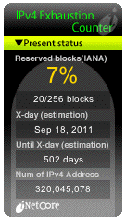
inetcore.com/project/ipv4ec/index_en.html

Slide 11
Just 25 Months…
Twenty five months isn’t much time if you’re an ISP and you don’t already have an IPv6-capable infrastructure (or plans and processes underway for getting there).
You may need to do some “forklift upgrades” to at least some of your gear, you’ll need to arrange to get IPv6 address space, and you’ll need to update your provisioning systems and network monitoring systems, and you’ll need to train your staff and end users, and…
There’s a lot to do, and not a whole lot of time left in which to do it.
Moreover, there are a relatively limited number of people with IPv6 expertise available to help you through any rough spots you may encounter.
Fortunately, this is something of a slow-speed “crash.”

Slide 12
The Internet, Post-IPv4 Run Out
Running out of IPv4 addresses isn’t like running out of water in the desert, or air while SCUBA diving -- if you already have IPv4 address space, the IPv4 address space you already have will continue to work just fine.
People who WILL run into problems, however, include:
-- growing ISPs who need more IPv4 IP addresses
-- new ISPs who need IPv4 addrs just to get rolling
-- customers of existing IPv4-based ISPs who may need
to access network resources available ONLY via IPv6
-- customers behind weird/broken stopgap kludges
Eventually, we risk the bifurcation of the Internet: part of the Internet may cling to IPv4 addressing, while the rest may end up having no choice but to use IPv6 addressing. Eventually, this will be a serious issue.

Slide 13
1.2 Internet Transparency

Slide 14
“But What About NAT?”
While some sites (including uoregon.edu) assign each system on campus a globally routable IP address, other sites (including many home users and many corporate sites) routinely employ network address translation (or “NAT”). NAT (actually PAT) makes it possible for multiple workstations to all use a single shared globally routable IPv4 address. If all you do is browse the web or use a web email service such as Hotmail, or Yahoo! Mail, or Gmail, NAT may superficially work fine for your needs.
On the other hand, if you want to do Internet video conferencing, or use peer-to-peer applications, or you’re trying to track down and fix malware-infested hosts connecting from behind a NAT, you may find that NAT will make your head explode.

Slide 15
NAT: A (Semi) Protocol-Aware Protocol
Some network protocols (such as H.323) embed IP addresses in the traffic generated by those protocols.
Because NAT rewrites network addresses, it needs to know HOW each protocol embeds IP addresses in network traffic streams. That is, NAT boxes need to
be “protocol aware,” and thus networks using NAT
are NOT “end-to-end transparent.” (Packets get rewritten during transport while passing through a NAT)
If a NAT box faces traffic of a type that it doesn’t know how to handle, such as some new protocol, it can’t rewrite that traffic, and as a result that application will fail when run behind a NAT. This is very commonly the case for H.323 video conferencing, for example.
Because of this, NAT’d networks can stifle application layer network innovation, or at least make it far harder!

Slide 16
The “Two Port Internet”
Because of the problems that application developers face getting past NAT boxes (and restrictive firewalls!) it is common for developers to implement new protocols over http instead of developing new native protocols. Some of my colleagues refer to this as the “two port Internet”
-- in this model, virtually all user traffic is either http (port 80) or https (port 443).
Obviously this is something of an exageration (they forgot about DNS for example :-)), but it isn’t entirely an argument w/o merit. All you need to do is look at network traffic and try to identify what applications make up most of the packets or most of the octets to see the problem -- you can’t do it just based on ports.
C.F.: “A Look at the Unidentified Half of Netflow,”
www.uoregon.edu/~joe/missing-half/missing-half.pdf

Slide 17
End-To-End Transparency
If you’d like to read about the importance of end-to-end transparency, some excellent starting points are:
-- RFC2775, “Internet Transparency,” B. Carpenter,
February 2000, http://tools.ietf.org/rfc/rfc2775.txt
-- RFC4924, “Reflections on Internet Transparency,”
B. Aboba and E. Davies, July 2007,
http://tools.ietf.org/rfc/rfc4924.txt
While Internet transparence is less often mentioned than imminent IPv4 address exhaustion as a reason why we need to deploy IPv6, transparency is nonetheless a very important underlying motivation for IPv6.

Slide 18
1.3 IPv6 and Controlling Route-Table Bloat

Slide 19
Controlling Route Table Bloat
Another important (if little recognized) reason for promoting use of IPv6 has been the need to control the growth in the size of the global routing table. In fact,
RFC4984 ( http://www.ietf.org/rfc/rfc4984.txt ) states,
“[…] routing scalability is the most important problem
facing the Internet today and must be solved […]”
If you’re not a network engineer, you likely don’t think much about growth in the size of the global routing table, so let’s step back and do a little backfill on this topic.

Slide 20
What Is “Routing?”
You may have wondered how packets know how to get from site A to site B. The answer is “routing.”
When a server at a remote location has network traffic for a site, a series of hop-by-hop decisions get made:
at each router, a packet needs to decide where to go to get closer to its ultimate destination. A packet comes in on one interface, and may have a choice of two, three, or even a dozen or more outbound interfaces for the next step in its journey. Which path should it take next?
Each router has a table of network IP address prefixes which point at outbound router interfaces, and that table guides packets on the next step of their journey.
After the packet traverses that link, the process is then repeated again at the next router for the next link, etc

Slide 21
Most Little Sites: No Impact on Table Size
If you’re a small and simple site with just a single upstream provider, that upstream ISP may aggregate the network addresses you use with other customers it also services. Thus, the global routing table might have just a single table entry servicing many customers.
Once inbound network traffic hits the ISP, the ISP can then figure out how to deliver traffic for customer A, traffic for customer B, etc. The ISP handles that, the Internet doesn’t need to know the gory local details
Similarly, outbound, if you’re a small site with just a single upstream provider, your choice of where to send your outbound traffic is pretty simple: you’ve only got one place you can send it. This allows you to set a “default route,” sending any non-local traffic out to your ISP for eventual delivery wherever it needs to go.

Slide 22
Sites With Their Own IP Address Space
Sometimes, however, sites have their own address space.
For example, UO has the prefix 128.223.0.0/16,
the IPv4 addresses 128.223.0.0--128.223.255.255.
That address block is not part of any ISP’s existing address space.
If UO wants to receive traffic intended for those addresses, it needs to announce (or “advertise”) that network address block to the world.
When UO’s route gets announced, each router worldwide adds that route to its routers’ routing tables, and thus know how to direct any traffic it may see that’s destined for UO, to UO.
Without that route, our address space would be unreachable.

Slide 23
Some Sites Have Multiple Prefixes
Sometimes sites have more than one chunk of network address space. For example, Indiana University has 129.79.0.0/16, 134.68.0.0/16, 140.182.0.0/16, 149.159.0.0/16 149.160.0.0/14, 149.165.0.0/17, 149.166.0.0/16, 156.56.0.0/16, and 198.49.177.0/24, and IU has nine slots in the global routing table associated with those prefixes.
Other sites may have a range of addresses which could be consolidated and announced as a single route, but they intentionally “deaggregate” that space, perhaps announcing a separate route for each /24 they use. For example, BellSouth announces roughly 4,000 routes globally, even though it could aggregate those routes down to less than 300 routes if they were so inclined.

Slide 24
“So What? Who Cares About Route Growth?”
Each route in the global routing table need to be carried by routers at every provider in the world.
Each route in the route table consumes part of a finite pool of memory in each of those routers. When routers run out of memory, "Bad Things" tend to happen. Some routers even have relatively small fixed limits to the maximum size routing table they can handle (see
http://tinyurl.com/route-table-overflow ).
Each route in the route table will potentially change whenever routes are introduced or withdrawn, or links go up or down. The larger the route table gets, the longer it takes for the route table to reconverge following these changes, and the more CPU the router requires to handle that route processing in a timely way

Slide 25
An Aside on Route Table
Growth and Convergence
There are some indications that we're getting luckier with route table performance than we might have expected; see Geoff Huston "BGP in 2009" talk from
the recently completed ARIN Meeting in Toronto:
https://www.arin.net/participate/meetings/reports/
ARIN_XXV/PDF/Monday/Huston-bgp.pdf

Slide 26
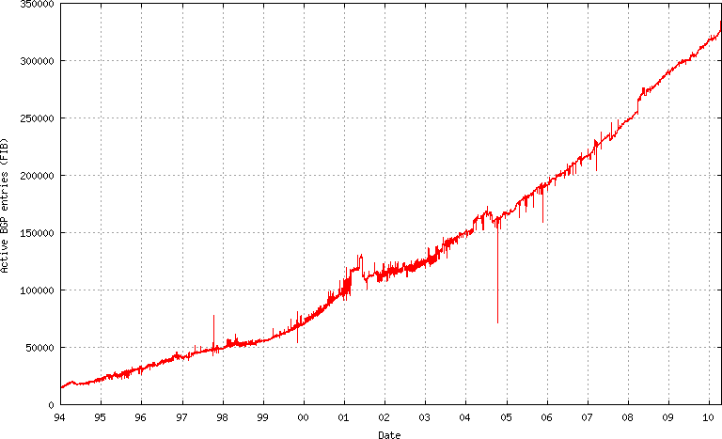
The IPv4 Route Table
DOES Continue to Grow…
350,000
Source: http://bgp.potaroo.net/as6447/

Slide 27
IPv6 Was Supposed to Help Fix That
When IPv6 was designed, address assignment was supposed to be hierarchical. That is, ISPs would be given large blocks of IPv6 address space, and they’d then use chunks of that space for each downstream customer, and only a single entry in the IPv6 routing table would be needed to cover ALL the space used by any given ISP and ALL their downstream customers (see RFC1887, “An Architecture for IPv6 Unicast Address Allocation”)
But now, let’s pretend that my Internet connectivity is important to me, so I don’t want to rely on just a single ISP -- I want to connect via multiple ISPs so that if one provider has problems, the other ISPs can still carry traffic for my site. This connection to multiple sites is known as “multihoming.”

Slide 28
If I’m Multihomed, Whose
Address Space Do I Use?
When I get connectivity from sites A, B and C, whose address space would I announce? Address space from A? Address space from B? Address space from C? No…
-- A doesn’t want me to announce part of its address
space via B and C
-- B doesn’t want me to announce part of its address
space via A and C
-- C doesn’t want me to announce part of its address
space via A and B.
I need to either assign each host multiple addresses (e.g., one address from A, one from B, and one from C), or I need to get my own independent address space which I can use for all three ISPs, but which will then take up a slot in the global routing table.

Slide 29
The Original Multiple IP Approach in IPv6
The multiple IP approach was the original “answer” to this question in the IPv6 world.
But if I assign multiple IPs to each host, one for each upstream ISP I connect to, how do I know which of those IP addresses I should use for outbound traffic generated by each host? Do I arbitrarily assign the address from A to some traffic? The address from B to other traffic? What about the address from C?
Which of those addresses do I map to my web site or other servers via DNS? Do I use just A’s address? Just B’s? Just C’s? All three of those addresses? What if one of my providers goes down? Will traffic failover to just the other two providers quickly enough?

Slide 30
The Multihoming Reality Today
IPv6 multihoming without use of provider independent address space is one of the unsolved/open issues in the IPv6 world today. Operationally, in the real world, ISP customers who need to multihome request their own provider independent IPv6 address space (cue Sonny and Cher: “The beat goes on, and the beat goes on…”)
Route table growth may be a critical issue facing the Internet in the long term, but for now, the community has “dropped back into punt formation,” and we’re doing what needs to be done (at least for now) to get IPv6 deployed in a robust way (e.g., with multihoming). The good news is that the IPv6 table is still small (so we still have time to solve the IPv6 routing table growth issue); the bad news is that the IPv6 table is still small (which means many people still haven’t deployed IPv6!)

Slide 31
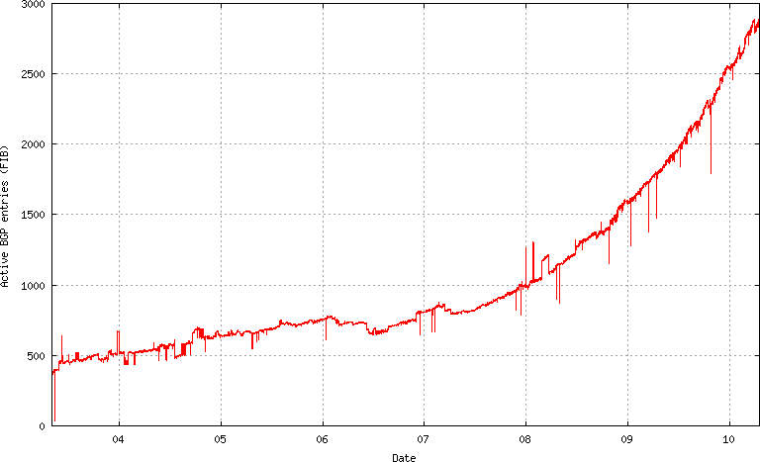
IPv6 Route Table Growth
3000
Source: http://bgp.potaroo.net/v6/as6447/

Slide 32
1.4 IPv6 and Regulatory Compliance

Slide 33
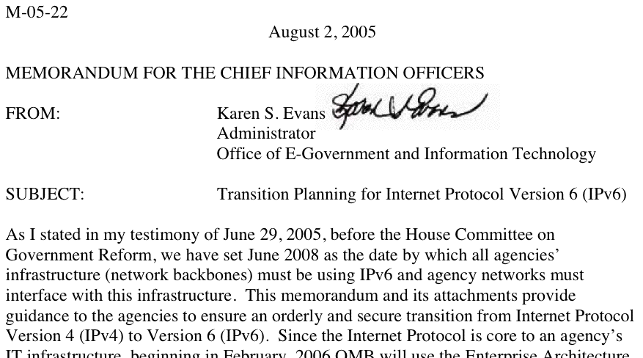
Federal Networks, For Example,
Are Supposed to Be IPv6 Ready
Source: www.whitehouse.gov/omb/memoranda/fy2005/m05-22.pdf

Slide 34
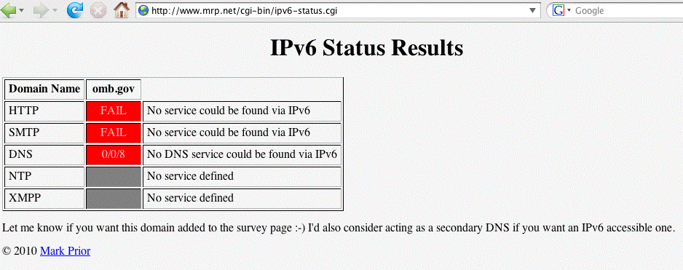
Theoretically All Federal Networks (At Least Temporarily) Met That Mandate, But…
Reportedly many federal networks, having passed one IPv6 packet (and thus, however briefly, demonstrated that their backbones were IPv6 capable), promptly
“re-disabled” IPv6 (ugh!)
Check your favorite fed sites -- are they v6 accessible? See: http://www.mrp.net/cgi-bin/ipv6-status.cgi

Slide 35
IPv6 and Fed Scorecard Network Homepages?
www.dhs.gov --> no
www.doc.gov --> no
www.dod.gov --> no
www.doe.gov --> no
www.dot.gov --> no
www.ed.gov --> no
www.epa.gov --> no
www.hhs.gov --> no
www.hud.gov --> no
www.doi.gov --> no
www.doj.gov --> no
www.dol.gov --> no
www.nasa.gov --> no
www.nsf.gov --> no
www.nrc.gov --> no
www.opm.gov --> no
www.sba.gov --> no
www.ssa.gov --> no
www.state.gov --> no
www.usaid.gov --> no
www.usda.gov --> no
www.ustreas.gov --> no
www.va.gov --> no
Or pick another federal agency of your choice: the pattern is pretty consistent I’m afraid…

Slide 36
“Planning Guide/Roadmap Toward IPv6
Adoption Within the US Government”
This is a new document (ca. May 2009) from the Federal CIO Council Architecture and Infrastructure Committee, Technology Infrastructure Subcommittee, Federal IPv6 Working Group, see http://tinyurl.com/fed-cios-ipv6
I quote: “The purpose of this document is to provide U.S. government agency leaders with practical and actionable guidance on how to successfully integrate Internet Protocol version 6 (IPv6) throughout their enterprise. […] without a concentrated effort by Federal agencies to effectively and efficiently deploy secure IPv6 network services, the Government’s technical advancement and ability to meet its mission needs will be critically impacted during the next 2 to 3 years.”

Slide 37
A Major Potential Stumbling Block:
Non-IPv6 Content Delivery Networks (CDNs)
Many federal web sites (and key commercial web sites) use Akamai (or another CDN) in order to handle huge online audiences, deliver good performance worldwide, and to resist DDoS attacks.
For example, www.irs.gov is actually just a cname for www.edgeredirector.irs.akadns.net; whois confirms that akadns.net actually belongs to Akamai.
If Akamai doesn’t do IPv6, will current major Akamai customers (such as Apple, Cisco, Microsoft, RedHat, the Whitehouse, etc.) be willing to deploy IPv6 for critical sites without them?
BTW, at least one vendor, Limelight, DOES offer an IPv4 and IPv6 CDN service…

Slide 38
The Issue Isn’t Just Web CDNs…
A growing number of sites outsource their email operations.
Unfortunately some email-as-a-service (and some
cloud-based spam filtering services) don’t support
IPv6, thereby limiting the ability of their customers to integrate IPv6 into their existing IPv4-based services.
CDNs and outsourced email and spam filtering services aren’t the only reason why IPv6 adoption has been slow at some major Internet sites, but those are certainly important stumbling blocks that will need to get resolved.

Slide 39
1.5 Well, Won’t IPv6 At Least Improve “Network Security” Due to IPv6 Having “Mandatory” IPSec?
(Sorry, No)

Slide 40
IPv6 and IPsec
IPsec is not new with IPv6; in fact, IPsec dates to the early 1990’s. What’s different when it comes to IPv6 is that support for IPsec was made “mandatory” for IPv6 (see for example “Security Architecture for IP,” RFC4301, December 2005 at section 10, and “IPv6 Node Requirements,” RFC4294, April 2006 at section 8.)
If actually used, IPsec has the potential to provide:
-- authentication
-- confidentiality
-- integrity, and
-- replay protection
All great and wonderful security objectives -- IF IPsec gets used. Unfortunately, as we’ll show you, what was supposed to be the cornerstone of the Internet’s security architecture has proven in fact to be widely non-used.

Slide 41
How Might IPsec Be Used?
IPsec can be used to authenticate (using AH (the Authentication Header), RFC4302), or it can encrypt and (optionally) authenticate (using ESP (the Encapsulating Security Protocol), RFC4303)
IPsec can be deployed in three architectures:
-- gateway to gateway (e.g., securing a network segment from one
router to another)
-- node to node (e.g., securing a connection end-to-end, from one host
to another)
-- node to gateway (e.g., using IPsec to secure a VPN connecting
from a mobile device to a VPN concentrator)
IPsec has two main encrypting modes:
-- tunnel mode (encrypting both payload and headers)
-- transport mode (encrypting just the payload)
IPsec also supports a variety of encryption algorithms (including “null” and md5 (yech)), and a variety of key exchange mechanisms
These alternatives obviously provides tremendous flexibility, but that flexibility also brings along a lot of complexity.

Slide 42
But IPsec ISN’T Getting Used “Everywhere”
IPv6 can be brought up without IPSec getting enabled, and in fact this is routinely the case -- see an example on the next slide.
More broadly, if people are doing cryptographically secured protocols of *any* sort, they inevitably run into problems -- crypto stuff just tends to be inherently complex and hard to learn to use. For example, how many of you routinely use PGP or GPG to cryptographically sign or encrypt your email, eh? How many of you are doing DNSSEC to cryptographically protect the integrity of your DNS traffic?
Now think about how often you see people moaning about problems they’re having getting IPSec to work with IPv6
-- do you EVER see that sort of thing on the mailing lists or discussion groups you’re on? No, right? That’s because hardly anyone is doing IPSec with IPv6.

Slide 43
Some IPv6 Traffic Statistics
From A Mac OS X Host
# netstat -s -finet6
[snip]
ip6:
124188 total packets received
[snip]
84577 packets sent from this host
[snip]
ipsec6:
0 inbound packets processed successfully
0 inbound packets violated process security policy
[snip]
0 outbound packets processed successfully
0 outbound packets violated process security policy
[snip]

Slide 44
IPsec (Even on IPv4!) Isn’t Getting Much Use
Raw IPsec traffic (AH+ESP, protocols 50 & 51) isn’t seen much on the commercial IPv4 Internet.
For example, about one year ago, Jose Nazario of Arbor Networks estimated IPsec traffic at 0.9% of octets (statistic courtesy the ATLAS project).
CAIDA (thanks kc!) also has passive network monitoring data available; see
http://www.caida.org/data/passive/monitors/equinix-chicago.xml
You can see the protocol distribution from a couple of CAIDA’s monitors for one recent day on the next couple of slides. IPsec traffic is basically too small to even be seen for the most part.

Slide 45
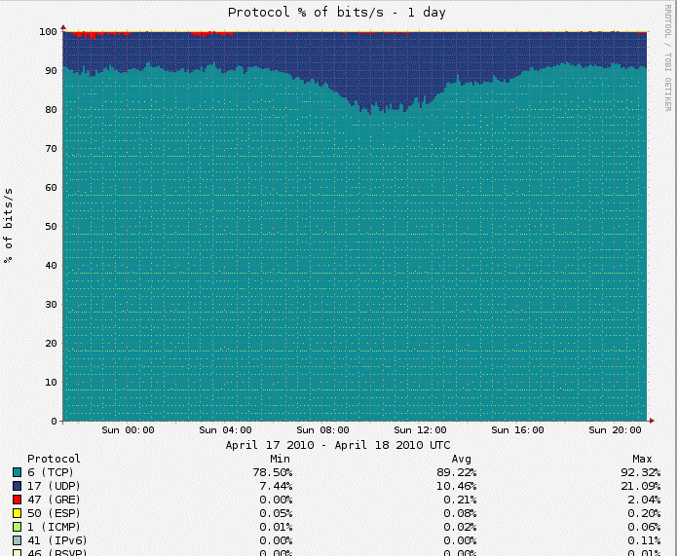
Protocol Distribution From One of CAIDA’s Passive Monitors

Slide 46
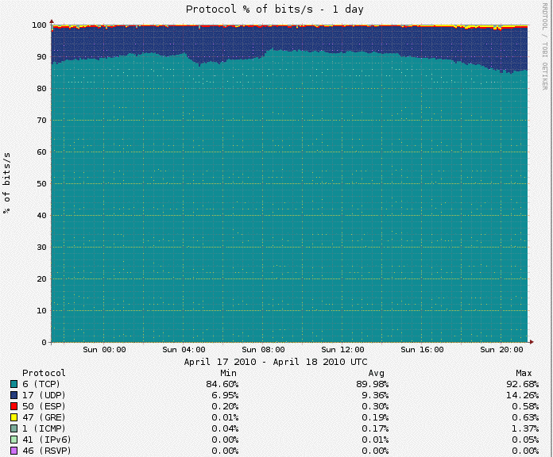
And The CAIDA Distribution Seen From Another Monitored Link

Slide 47
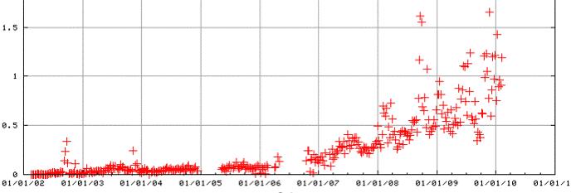
IPv4 IPSec Traffic on Internet2?
Raw IPv4 IPsec traffic is quite rare on Internet2 as well, usually running well under 1.5% of octets (see table 7, http://netflow.internet2.edu/weekly/20100208/ ).
Raw IPv4 IPsec traffic has been (gradually) growing, however. See Internet2 IPv4 IPsec ESP traffic levels (as a percent of all octets over time) by way of example:

Slide 48
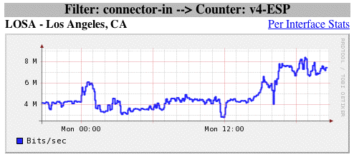
IPv4 IPsec Traffic May Be From A Limited Number of Users/Systems (IPsec VPNs?)
Protocols that are used by a small number of users or systems tend to exhibit “spikey” or rapidly varying aggregate traffic patterns while protocols which are in ubiquitous use tend to “average out” or be “smooth.”
The appearance of the firewall-based graph below (see http://vixen.grnoc.iu.edu/jfirewall-viz/index-bits.html )
is consistent with IPsec traffic from just a few users (FWIW, total IPv4 traffic on this link runs ~25-40Gbps)

Slide 49
An Aside: IPv6 Traffic Visibility
Ideally, for production IPv6 traffic, one would want full IPv6 SNMP support and full IPv6 Netflow (V9) support. Regretably, native IPv6 SNMP support and IPv6 V9 Netflow support remains elusive. That’s increasingly unfortunate for IPv6 as a production protocol that is, or should be, on par with IPv4.
One way to improve IPv6 visibility on ISP backbones would be to deploy at least a limited number of dedicated, IPv6-aware, passive measurement appliances. For instance, some network measurement researchers have been pleased with the IPv6 support available from InMon Corporation’s Traffic Sentinel product (e.g., see
http://www.inmon.com/products/trafficsentinel.php ) or
Lancope's StealthWatch (see http://www.lancope.com/ )

Slide 50
What About IPv6 and Lawful Intercept?
While network traffic visibility, including IPv6 traffic visibility, is important for network management and operations, network operators also need to meet their obligations to provider access for lawful intercept by law enforcement or the national security/homeland security community. It's not clear that all (any?) commercial or open source lawful intercept solutions fully support IPv6.
I discussed this shortcoming years ago in "Upcoming Requirements from the US Law Enforcement Community to Technically Facilitate Network Wiretaps," May 2007, www.uoregon.edu/~joe/calea-requirements/terena.pdf
But coming back to IPSec…

Slide 51
Why Aren’t We Seeing More IPSec Traffic?
Sites may not be deploying IPsec because IPsec (like many crypto-based security solutions) has developed a reputation as:
-- not completely baked/still too-much under development
-- too complex
-- hard to deploy at significant scale
-- less than perfectly interoperable
-- likely to cause firewall issues
-- potentially something of a performance hit (crypto overhead issues)
-- congestion insensitive (UDP encapsulated IPsec traffic)
-- something which should be handled as an end-to-end matter by
interested system admins (from a network engineer perspective)
-- something to be handled at the transport layer router-to-router
(from an overworked system administrator’s perspective)
-- duplicative of protection provided at the application layer
(e.g., encryption is already being done using ssh or ssl)
-- complicating maintaining/debugging the network, etc., etc., etc.
Regardless of whether those perceptions are correct (some may be, some may not be), IPsec adoption hasn’t happened much to date.

Slide 52
But That’s All Moot
Relative to The Key Point…
It would be foolhardy to expect IPsec to provide any material improvement to your site’s security since the vast majority of your aggregate traffic (including virtually all your IPv4 traffic) will NOT be IPsec secured.
On the other hand, the “good news” is that a lack of IPsec usage in the IPv6 world is substantively no worse than a lack of IPsec usage in the IPv4 world.

Slide 53
1.6 “IPv6 Will Simplify Renumbering, Improve Routing Performance By
Simplifying Packet Formats,
Will Improve Support For QoS,
Will Facilitate Mobility, etc.”
(maybe, but frankly, no one cares)

Slide 54
I Really Don’t Mean to Sound Harsh, But…
IPv6 may very well bring many cool new features to networking, but quite frankly, all of these incidental
new features really don’t matter -- they’re not “make
or break” drivers when it comes to adoption of IPv6.
I’d love to hear hard evidence to the contrary, but truly, I’ve seen no indication that any of these other factors carry much weight in helping to shape the IPv6 go/no-go decision.
On the other hand, there are some genuine reasons why people adamantly do NOT want to do IPv6.

Slide 55
1.7 One Real Reason For NOT
Caring About IPv6: Some Sites
Have Abundant IPv4 Space

Slide 56
If You Have Abundant IPv4 Address Space, It Can Be Hard to Get Excited About IPv6
The definition of “abundant” will vary from site to site, but many colleges and universities have legacy /16’s, and 2^16 (or roughly 65,500 addresses per /16) can seem like “a lot” of addresses (even though they can go awfully fast when you have a campus of 20,000-25,000 people, most of whom have multiple networked devices, plus lots of printers and other networked infrastructure).
Others, however, have /8’s (2^24, or roughly 16,777,200 addresses per /8), and that may be large enough to eliminate worries at those sites about address scarcity.
If you haven’t recently looked at the list of who has /8’s, you can check http://www.iana.org/assignments/
ipv4-address-space/ipv4-address-space

Slide 57
Considering Just Large Federal Netblocks…
The US government (typically as the US Department of Defense) controls a relatively large fraction of the entire Intenet IPv4 name space, including a dozen slash 8’s: 6/8, 11/8, 21/8, 22/8, 26/8, 28/8, 29/8, 30/8, 33/8, 55/8, 214/8, and 215/8 (to say nothing of additional /8 blocks controlled by defense industrial contractors with close/ extensive military contracts, plus miscellaneous smaller netblocks scattered hither and yon). Given that level of public IPv4 address space availability, one can understand that some federal agencies may not feel a particularly pressing need to move to IPv6 real ricky-ticky soon now.
An aside about those large federal netblocks: even though addresses from some of those block may not show up in public routing tables, they are still being used, you’re just not seeing them in some public routing tables.

Slide 58
Another Manifestation of the “Oh, No Worries, I’ve Got Plenty of Address Space” Phenomena
While there are obviously only a comparative handful of sites which have their own public /8, many sites use RFC1918 “private” non-publicly routable address space, such as addresses from 10/8.
If NAT currently meets your needs, as long as you have 10.0.0.0-10.255.255.255 (and 172.16.0.0-172.31.255.255, and 192.168.0.0-192.16.255.255) available, again, you may feel like your private IPv4 addressing needs are generally being well met (provided, of course, that you can also get the comparative handful of public IPv4 addresses you may also need).
But, as we’ll see later, use of NAT forecloses some of the easiest IPv6 transition mechanisms, such as use of 6to4.

Slide 59
1.8 Anything That’s Available Via IPv6,
Will Also Be Available via IPv4
(So You Won’t Suddenly Get Access To Lots of “Cool New Stuff” if You Start Doing IPv6)

Slide 60
An Important/Subtle Point to Understand
Sometimes folks ask, “So if I begin to do IPv6, what new stuff can I get at that I can’t get at already?”
Can you imagine Google, or Amazon, or Microsoft, or CNN, or <fill in the name of an important Internet site here> making their web site or other online resources ONLY available via IPv6? No, probably not.
Any/all important Internet resources will ALWAYS be available via IPv4, even if those resources are ALSO available via IPv6.
Thus moving to IPv6 does NOT magically give you access to new stuff that you couldn’t get to via IPv4 (well, technically there are a few IPv6-only things mentioned at http://www.sixxs.net/misc/coolstuff/ , but nothing in
and of itself that’s enough to justify deploying IPv6)

Slide 61
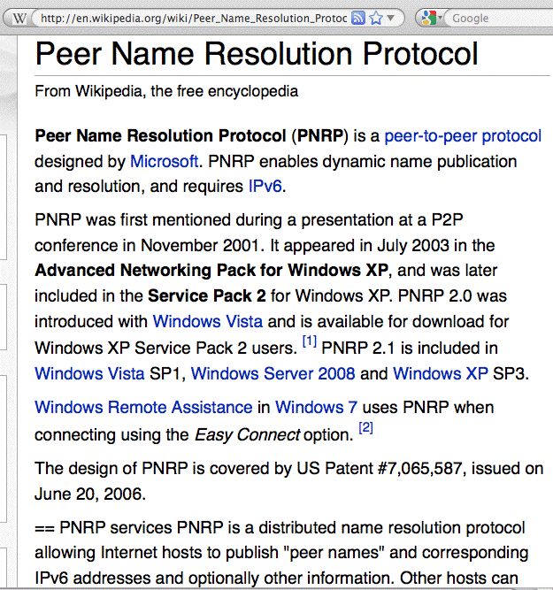
Aside: Is PNRP An Exception to the Rule?

Slide 62
At Some Point In The Future,
Though, The Default Will Change
At some point in the future, people will eventually ask, “So if I still do IPv4, what sort of ‘old stuff’ can I get at that I can’t get at already via IPv6?”
We’re still a LONG way off from that point, but it WILL eventually happen.
Remember when people used to carry AppleTalk or IPX or DECNet on their local area networks? They sure don’t anymore (or at least no one I know still does!)

Slide 63
1.9 “I’d Love to Move to IPv6,
But My Network Uses Critical Middleboxes (Such as Firewalls or Network Traffic Load Balancers) That Aren’t Fully IPv6 Aware”

Slide 64
Middleboxes Are Potentially A Major PITA
The more I talk with sites about IPv6, the more I
hate network middleboxes such as firewalls or network traffic load balancers. Sometimes those devices simply
do not understand IPv6 at all. Other times they may have a primitive or incomplete implementation of IPv6,
or require users to license an expensive “enhanced”
software image to support IPv4 and IPv6.
In general, I’d recommend moving firewalls as close to the resources they’re protecting as possible (e.g., down to a subnet border, or even down to the individual ethernet port level), assuming you can’t get rid of them altogether
If you need to pay extra for IPv6 support in middleboxes, complain to your vendor or vote with your checkbook. IPv6 support is a core feature, not an enhanced or optional one

Slide 65
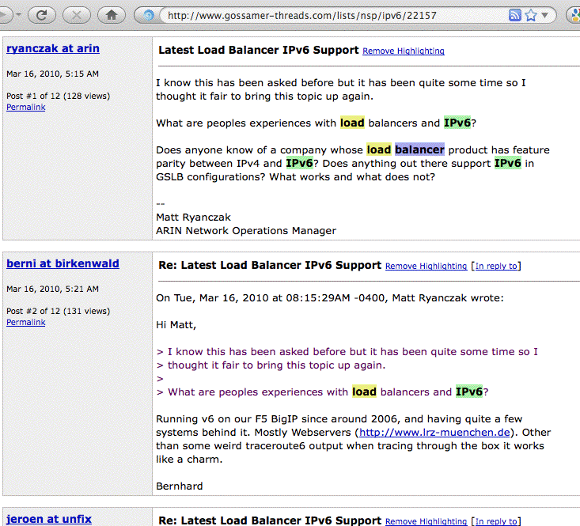
Loadbalancers: Not ALWAYS Broken

Slide 66
Broadband Customer
Premises Equipment (CPE)
Lots of Broadband CPE does NOT support IPv6
One list of products that does have at least some IPv6 support can be found at http://www.getipv6.info/index.php/Broadband_CPE
Customer security software can also be a source of frustration…

Slide 67
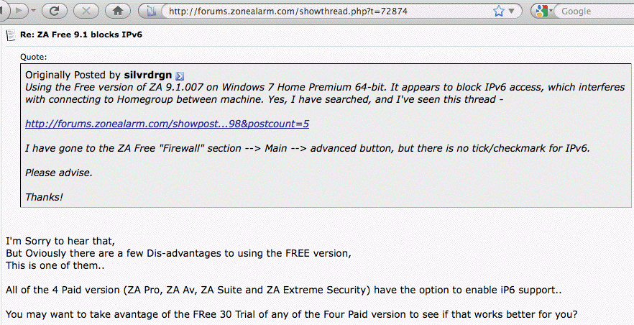
Zone Alarm and IPv6

Slide 68
1.10 “My Network Provider
Is Still Dragging Their Heels When It Comes to Providing IPv6 Connectivity”

Slide 69
IPv6 Transit Providers (e.g., NSPs)
We’ll talk about some other options later, but at least for now you should know that MANY major network service providers DO offer IPv6 transit; see the list at http://www.sixxs.net/faq/connectivity/?faq=ipv6transit
That list includes most of the usual suspects, including:
AS701 Verizon
AS1239 Sprint
AS2686 AT&T
AS2914 NTT/Verio
AS3356 Level3
AS6939 Hurricane Electric
plus many others…
Higher education users should also know that Internet2 has long supported native IPv6 on its national backbone.

Slide 70
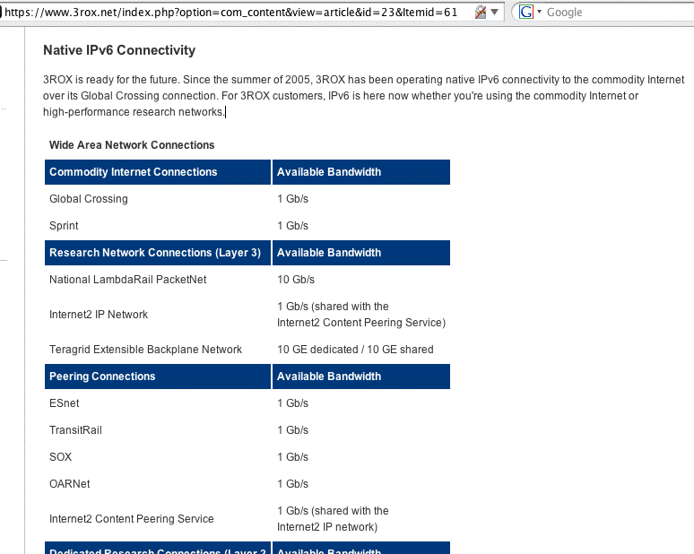
And Since We’re Here In Pittsburgh…

Slide 71
IPv6 Access Providers (e.g., ISPs)
But what if you’re an end user, and you just want connectivity via your ISP?
There are IPv6 access providers offer native IPv6 service to end user customers. Examples of IPv6-enabled access providers can be found at:
http://www.sixxs.net/faq/connectivity/?faq=native
End users whose ISP doesn’t offer native IPv6 may want to explore tunneled IPv6 connectivity from a tunnel broker; see:
http://www.sixxs.net/tools/aiccu/brokers/
Other users may only need IPv6 web hosting (and yes, it is available from a variety of providers)
We’re also starting to hear exciting news from some major broadband ISPs in the US…

Slide 72
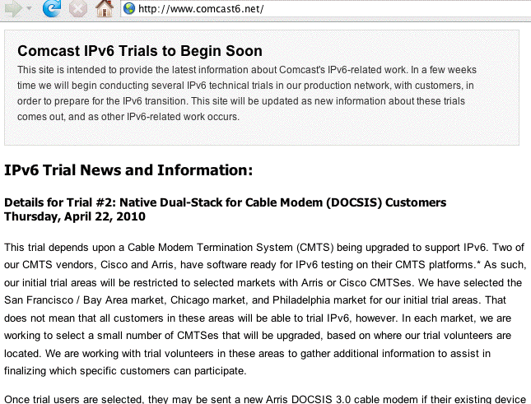
Comcast IPv6 Trials

Slide 73
Other Comcast IPv6 Trials
In addition to native dual stack, Comcast will also be doing other IPv6 trials, including tests of:
-- 6RD (see RFC5569 and http://en.wikipedia.org/wiki/IPv6_rapid_deployment )
-- Dual Stack Lite (see
http://smakd.potaroo.net/ietf/idref/draft-ietf-softwire-dual-stack-lite/index.html )

Slide 74
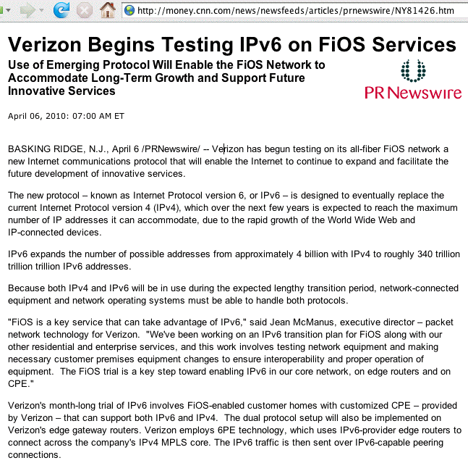
Verizon IPv6 Trials

Slide 75
1.11 “I’m Too Busy Working on More Important Things”

Slide 76
Track Your Time For a Week;
Make a Prioritized To-Do List
Many people have no idea how they spend their time, nor do they have any sort of formal prioritized to-do list with deadlines -- stuff just gets handled, and the wheel that currently squeaking the loudest gets greased.
Try tracking your time 24/7 for a week. Where does it all go? How much of it is spent attending meetings? Conference calls? Paperwork? Anything you could skip?
What would happen if you got sick or went on vacation? Could you pretend you were sick and then work on IPv6?
What’s on your prioritized to-do list ahead of doing IPv6? When do the higher priority items need to be done? If you’ve actually got some slack time, maybe you can use some of that time to do IPv6 stuff.

Slide 77
You Need To Take Control Of Your Time
I would assert that if you can’t take control of your schedule at least to the point where you can make some time to do something really important (like getting radiating chest pains diagnosed, :-), or getting IPv6 installed), you may have bigger problems than just IPv4 exhaustion.
Try reducing your contact channels: you don’t need to have a desk phone and email and an instant messenger client and your cell phone hitting you with calls and text messages plus <fill in the blank> all strobing interrupts at you around the clock.
Cut back. Stop using some of those channels, or at least turn some stuff off for part of the day. (And for that matter, spend some time with your spouse/kids/friends!)

Slide 78
1.12 “This Whole IPv4 Exhaustion Thing Is A Bunch of Malarky -- Folks Will Figure Out Some Way To Stretch Out What IPv4 Space We’ve Still Got Available.”

Slide 79
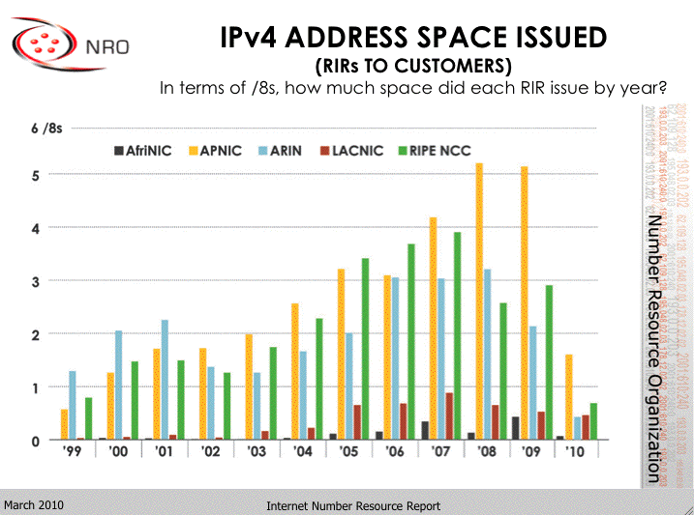
We’re Not The (Only) Ones Driving
The Address Consumption Bus!
http://www.arin.net/participate/meetings/reports/ARIN_XXV/PDF/Monday/Nobile_NRO_joint_stats.pdf

Slide 80
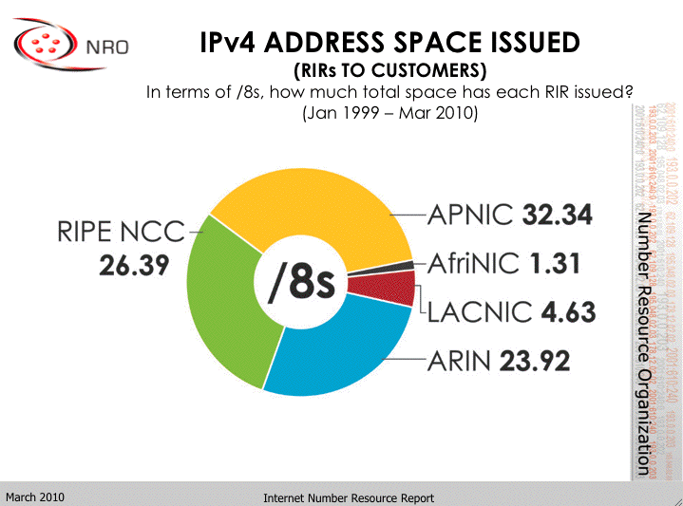
A Cumulative View
http://www.arin.net/participate/meetings/reports/ARIN_XXV/PDF/Monday/Nobile_NRO_joint_stats.pdf

Slide 81
What If IPv4 Address Usage Was Proportionate to Regional Population?
Population % /8’s % Ratio
Asia: 4,121,097 60.3% 32.34 36.5% 0.605
Africa: 1,009,893 14.7% 1.31 1.4% 0.095
Europe: 732,206 10.7% 26.39 29.7% 2.775
L. Amer.: 582,418 8.5% 4.63 5.2% 0.611
N. Amer.: 348,360 5.1% 23.92 27% 5.29
Oceania: 35,387 0.5%
Total: 6,829,360 88.56
Population in thousands, mid year 2009 estimates
Note: Oceania’s addresses are handled by APNIC (e.g., Asia)
http://esa.un.org/unpd/wpp2008/jpg/WPP2008_Wall-Chart_Page_1.jpg

Slide 82
The Future: Notice Relatively “Tiny” Africa
Historically, Africa’s IP address usage to date has been minimal, less than one and a half /8s.
This was likely due to a variety of factors, but at least one important factor was the high cost of connectivity (thousands of dollars per Mbps per month vs. just dollars per Mbps per month in the US (for large customers)).
Another driver was widespread use of satellite Internet connectivity, with high latency, NAT’d connections and IPs provided by the satellite operator.
Improved fiber connectivity is changing all that. Some of the world’s largest and most densely populated regions in both Africa and Asia are now coming online, and I believe the improved connectivity to those areas will result in a substantial demand for new IPv4 addresses.

Slide 83
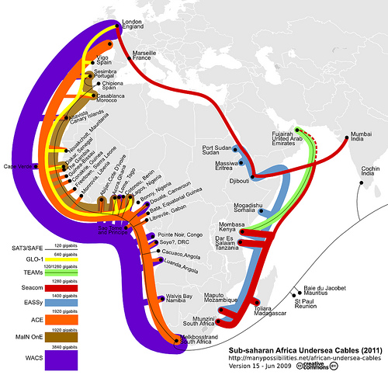
http://blog.foreignpolicy.com/files/images/090618_africa_underseas_cables.jpg

Slide 84
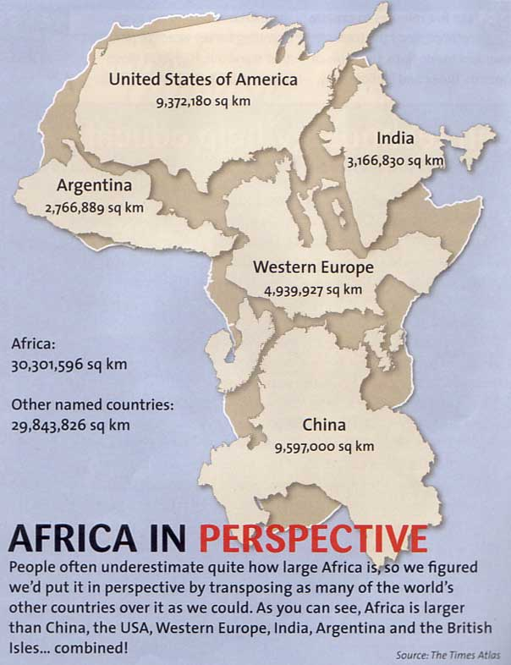
http://strangemaps.files.wordpress.com/2006/11/africa_in_perspective_map.jpg

Slide 85
If You Believe We Have Enough IPv4 Addresses
Given the preceding slides, you must also believe in miracles! :-)
In my case, I’d rather be prepared for IPv6 :-)

Slide 86
1.13 “IPv6 and Those Super Long Addresses Are Just Too Weird/Hard.”

Slide 87
We’ll See What You
Think After This Workshop
I’ll let you make up your own mind about this
particular point.

Slide 88
1.14 “Customers Just Aren’t Asking
For IPv6 (Except You!)”

Slide 89
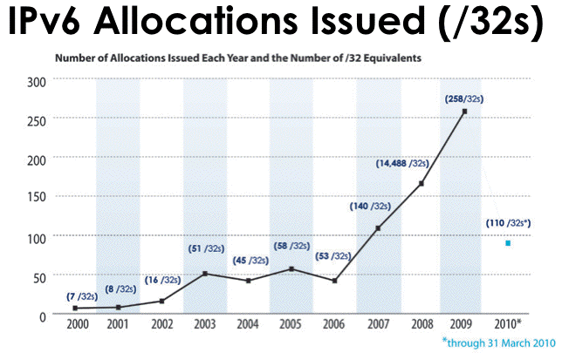
That’s Not The Impression I’m Getting…
Source: https://www.arin.net/participate/meetings/reports/ARIN_XXV/PDF/Wednesday/Nobile_RSD.pdf

Slide 90
An Anecdote from NANOG
> What I heard at a recent (within the past six months)
> conference was that "there is no customer demand for v6" so it
> isn't on the immediate needs list. He said they had a lot of
> inquiries about v6, but to date not having native v6 wasn't a
> deal breaker with anyone
I watched a vendor at one conference tell 20 people in a row that each one of them was the only one asking for IPv6. I mentioned to him that he should have his short-term memory loss checked out by a physician. At first he was confused. When I pointed out what I had just seen him do, he went from confused to embarrassed and admitted that it was the party line from his marketing department and they knew IPv6 was important, but, didn't have a story to tell yet, so, they were trying to spin for delay.
http://seclists.org/nanog/2010/Apr/71

Slide 91
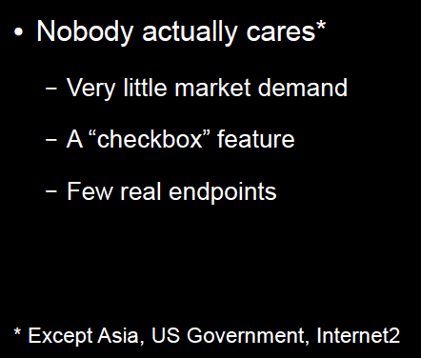
But The Perception Persists…
www.metasploit.com/data/confs/sector2008/exploiting_ipv6.pdf

Slide 92
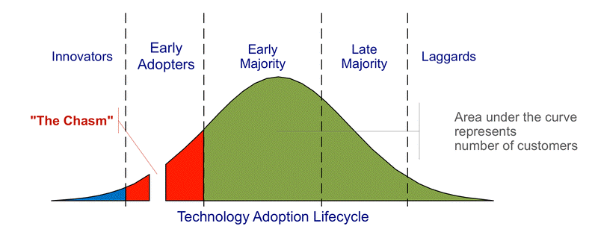
The Question That’s Really Being Asked Is…
“What’s the business case?”
Vendors who ask that question obviously fail to understand the technology adoption lifecycle:
http://commons.wikimedia.org/wiki/File:Technology-Adoption-Lifecycle.png

Slide 93
We’re Crossing “The Chasm” Right Now
The companies that are ready to support IPv6 will be well positioned to support emerging customer needs and to thrive in an IPv6 environment
The companies that are not ready will find their customers doing what they need to do (nothing personal, it’s just business, and since “no one but me” cares about IPv6, I’m sure you won’t mind that I’m taking my business elsewhere, see ya…)

Slide 94
A Brief Exercise
Form groups of four to six people. Half of each group will initially advocate deployment of IPv6, the other half will initially argue against deployment of IPv6.
After arguments have been aired, group participants may select either of the two positions, according to how they feel after listening to arguments both ways.
Hypothetical factors that may potentially impact your decision with regard to IPv6:
1) Costs associated with implementing IPv6, either now or
on a crash basis later, will come out of your budget
2) If an IPv6 project proceeds, you will be in charge of it
3) Your agency's network continues to expand rapidly
4) Your agency has zero tolerance for downtime or
negative publicity

Slide 95
Part II. Basics of The Technology

Slide 96
2.1 IPv6 Addresses

Slide 97
Starting With What We Know: IPv4
IPv4 addresses are 32 bits long
2^32=4,294,967,296
Normally represented in “dotted decimal” format:
-- four 8 bit octets (0 to 255 decimal)
-- each octet is seperated from the next by a dot
-- leading zeroes in each octet may be omitted
Examples:
-- 127.0.0.1
-- 128.223.142.89
-- 64.170.98.32

Slide 98
Something A Little Different: IPv6
IPv4 addresses are 128 bits / 32 hexadecimal digits long
2^128=340,282,366,920,938,463,463,374,607,431,768,211,456
(e.g., 3.4x10^38 addresses)
Normally represented in “colon separated” format:
-- eight sets of four hex digits (0000 to FFFF hex)
-- chunks are separated with colons (:)
-- leading zeroes in each chunk may be omitted
-- for convenience, :: (two successive colons) may replace
one or more all-zero chunks, but only once in any addr
Examples:
2001:48a8:6880:0095:0000:0000:0000:0021
::1
2001:468:d01:d6::80df:d617
fe80::203:93ff:fecf:b638

Slide 99
Quick Quiz
Structurally/superficially valid or invalid?
If invalid, why?
A) 2001:468:0d01:003c:0000:0000:80df:3c15
B) 2001:468:0d01:003c::80df:3c15
C) 2001:468:d01:3c::80df:3c15
D) 2001:760:2e01:1::dead:beef
E) 2001:480:10:1048:a00:20ff:fe9a:58c1:80
F) 2001:500::4:13::80
G) 2001:13G7:7002:4000::10
H) 2607:f278:4101:11:209:5bff:fe8f:6609
I) fe80::209:3dff:fe13:fcf7
J) ::

Slide 100
Quick Quiz Answers
Structurally/superficially valid or invalid?
If invalid, why?
A) Valid
B) Valid
C) Valid
D) Valid
E) Invalid (nine chunks instead of eight)
F) Invalid (double colons appear more than once)
G) Invalid (G is not a valid hexadecimal digit)
H) Valid
I) Valid
J) Valid (albeit as the IPv6 “unspecified address”)

Slide 101
2.2 IPv6 Prefixes

Slide 102
Starting With Something We Know:
IPv4 Prefixes
We originally had class A, class B and class C addresses:
Name CIDR equiv Number Addresses Per Block
Class A /8 128 16,777,216
Class B /16 16,384 65,536
Class C /24 2,097,152 256
Like goldilocks, some of those were too large, and some of those were too small. We needed something a little more flexible, and that’s what we got from CIDR, or Classless Inter-Domain Routing.

Slide 103
Common IPv4 CIDR Prefix Lengths
/8 ==> 16,777,216 addresses /23 ==> 512
/9 ==> 8,388,608 /24 ==> 256
/10 ==> 4,194,304 /25 ==> 128
/11 ==> 2,097,152 /26 ==> 64
/12 ==> 1,048,576 /27 ==> 32
/13 ==> 524,288 /28 ==> 16
/14 ==> 262,144 /29 ==> 8
/15 ==> 131,072 /30 ==> 4
/16 ==> 65,536 /31 ==> 2
/17 ==> 32,768 /32 ==> 1
/18 ==> 16,384
/19 ==> 8,192
/20 ==> 4,096
/21 ==> 2,048
/22 ==> 1,024
It’s common for IPv4 subnets to be /24’s (or maybe /23’s or /25’s)

Slide 104
IPv6 Uses Prefixes, Too
The prefixes are just usually a “little” bigger…
Prefix IPv6 Addresses
/32 2^(128-32) =
79,228,162,514,264,337,593,543,950,336
(4,294,967,296 /64 subnets)
/48 2^(128-48) =
1,208,925,819,614,629,174,706,176
(65,536 /64 subnets)
/56 4,722,366,482,869,645,213,696
(256 /64 subnets)
/64 18,446,744,073,709,551,616 IPv6 addresses

Slide 105
General Rules for IPv6 Allocations/Assignments/Subneting
Local Internet Registries (LIRs), e.g., ISPs, statewide networks, etc., will get one (or more) IPv6 /32 from ARIN, RIPE, APNIC, etc.
Large sites will get an IPv6 /48 from their LIR’s /32
Small sites needing only a few subnets over 5 years will get an IPv6 /56 from their LIR’s /32
If one and only one subnet is needed, that entity gets an IPv6 /64
Hosts get one or more IPv6 /128s out of a /64
ALL SUBNETS at most sites will normally be /64s (even if they have only a small handful of hosts. Do NOT try to get clever and do something exotic when it comes to subnetting.
[BTW, don’t the /32, /48, /56 cut points feel a lot like the old IPv4 classful address days? They sure do to me…]

Slide 106
2.3 Types of IPv6 Addresses

Slide 107
Types of IPv6 Addresses
Global Unicast: 2000::/3
Link Local Unicast: FE80::/1
Loopback: ::1/128
6to4: 2002::/16
Teredo: 2001:0000::/32
Unique Local Unicast: FC00::/7
Multicast: FF00::/8
IPv4-Mapped: ::ffff:128.223.214.23
Deprecated: Site Local addrs and IPv4-Compatible addrs.
For more on IPv6 addresses, see RFC4291 (+ other RFCs).
For the most part, we primarily care about global unicast, link local unicast, and loopback addresses

Slide 108
Address Type Discussion
Global Unicast addresses are globally unique, “real” IP addresses. These are the way you’ll normally refer to most IPv6 hosts
Link Local Unicast addresses are used for some purposes local to a particular link; outside the extent of that link, they don’t get used.
Loopback addresses -- just like 127.0.0.1 in IPv4 space, the IPv6 loopback address (::1/128) is an internal virtual address that the server can use to refer to itself.
6to4 and Teredo addresses are special IPv4-to-IPv6 transition mode technologies. We’ll talk about them later.
Unique Local Unicast addresses (RFC4193) are the IPv6 equivalent of RFC1918 IPv4 addresses. Don’t use them.
Multicast addresses are just like multicast in IPv4, except that in IPv6 they’re used extensively on the LAN, but IPv6 multicast traffic rarely appear on the wide area Internet, unlike IPv4 where the exact opposite is largely true.
IPv4-Mapped addresses allow hosts that only bind IPv6 sockets to also accept IPv4 addresses.

Slide 109
IPv4-mapped Addresses in *BSD
“One complicating factor for Apache administrators is whether or not an IPv6 socket can handle both IPv4 connections and IPv6 connections. Handling IPv4 connections with an IPv6 socket uses IPv4-mapped IPv6 addresses, which are allowed by default on most platforms but are disallowed by default on FreeBSD, NetBSD, and OpenBSD in order to match the system-wide policy on those platforms.”
http://httpd.apache.org/docs/2.0/bind.html
“In FreeBSD, enabling IPv4-mapped addresses is done by adding ipv6_ipv4mapping="YES" to /etc/rc.conf (in addition to ipv6_enable="YES").”
www.washington.edu/imap/documentation/IPv6.txt.html
NEVER SEEN ON THE WIRE!

Slide 110
Anycast
IPv6 also uses "anycast" addresses. Anycast addresses look just like regular global unicast addresses, however the same prefix gets advertised from multiple locations.
Through the magic of routing, users automatically connect to the closest anycast instance when accessing a UDP service (such as DNS) hosted on an anycast prefix.
If one anycast instance goes down, routes adjust, and the other anycast instances seamlessly assume the additional load.

Slide 111
2.4 IPv6 Scoping

Slide 112
Scoping Is A Corner Case
Quoting “IPv6 Addresses,”
http://msdn.microsoft.com/en-us/library/aa921042.aspx
“The scope ID identifies a specific area within the
reachability scope for non-global addresses. A node
identifies each area of the same scope with a unique
scope ID.”
Scoped IPv6 addresses are rarely used by anyone except Microsoft, and generally you should ignore this concept. For justification, see the discussion of scoping at section 2.1 of “Deprecating Site Local Addresses,” http://www.rfc-editor.org/rfc/rfc3879.txt

Slide 113
2.4 Addresses and Systems

Slide 114
Expect Multiple Addresses
When you look at the interfaces on an IPv6-enabled system, it will be routine for it to have multiple addresses/interface.
Sometimes this will just be a single globally unique unicast address, plus a link local address, plus some other bits and pieces, other times you may see multiple globally unique unicast addresses.
Do not let this shake you up.
Speaking of multiple addresses, most hosts will have
both IPv6 AND IPv4 addresses on some interfaces. This is known as being “dual stacked” and is perfectly normal and acceptable.

Slide 115
Looking at Addresses on Interfaces on Linux
% ifconfig -a
eth0 Link encap:Ethernet HWaddr 00:09:3D:13:FC:F7
inet addr:128.223.142.32 Bcast:128.223.143.255 Mask:255.255.254.0
inet6 addr: 2001:468:d01:8e:209:3dff:fe13:fcf7/64 Scope:Global
inet6 addr: fe80::209:3dff:fe13:fcf7/64 Scope:Link
UP BROADCAST RUNNING MULTICAST MTU:1500 Metric:1
RX packets:1187468996 errors:0 dropped:1805 overruns:0 frame:0
TX packets:1338373204 errors:0 dropped:0 overruns:0 carrier:0
collisions:0 txqueuelen:1000
RX bytes:232065679216 (216.1 GiB) TX bytes:915094219311 (852.2 GiB)
Interrupt:185
[snip]
lo Link encap:Local Loopback
inet addr:127.0.0.1 Mask:255.0.0.0
inet6 addr: ::1/128 Scope:Host
UP LOOPBACK RUNNING MTU:16436 Metric:1
RX packets:8143461 errors:0 dropped:0 overruns:0 frame:0
TX packets:8143461 errors:0 dropped:0 overruns:0 carrier:0
collisions:0 txqueuelen:0
RX bytes:4295055907 (4.0 GiB) TX bytes:4295055907 (4.0 GiB)

Slide 116
Looking at Addresses on
Interfaces on Mac OS X
% ifconfig -a
lo0: flags=8049<UP,LOOPBACK,RUNNING,MULTICAST> mtu 16384
inet6 ::1 prefixlen 128
inet6 fe80::1 prefixlen 64 scopeid 0x1
inet 127.0.0.1 netmask 0xff000000
en0: flags=8863<UP,BROADCAST,SMART,RUNNING,SIMPLEX,MULTICAST> mtu 1500
inet 128.223.214.23 netmask 0xfffffe00 broadcast 128.223.215.255
inet6 fe80::203:93ff:fecf:b638 prefixlen 64 scopeid 0x4
inet6 2001:468:d01:d6::80df:d617 prefixlen 64
ether 00:03:93:cf:b6:38
media: autoselect (1000baseTX <full-duplex>) status: active
supported media: none autoselect 10baseT/UTP <half-duplex> 10baseT/UTP <full-duplex> 10baseT/UTP <full-duplex,hw-loopback> 100baseTX <half-duplex> 100baseTX <full-duplex> 100baseTX <full-duplex,hw-loopback> 1000baseTX <full-duplex> 1000baseTX <full-duplex,hw-loopback> 1000baseTX <full-duplex,flow-control> 1000baseTX <full-duplex,flow-control,hw-loopback>
[etc]

Slide 117
How Addresses Get On Interfaces: IPv4
Starting with something you know, IPv4, most end-user workstations get their IP addresses automatically assigned via DHCP.
Besides IPv4 addrs, RFC2132 describes additional useful bits that a host can get from a DHCP server, including:
-- subnet mask
-- router address(es)
-- time server(s)
-- domain name server(s)
-- the host name
-- the domain name
-- MTU information
-- broadcast address
-- plus an amazing amount of other bits and pieces
(check it out if you don’t believe me!)

Slide 118
How Addresses Get On Interfaces: IPv4 (2)
Some sites may use host-specific DHCP entries to configure servers, too, but most IPv4 servers tend to be manually configured by a system administrator with a statically assigned IP addresses, host name and domain information, name server information, broadcast address, MTU information, etc.
Some large sites which manage hundreds or thousands of IPv4 servers may use automatic host configuration tools such as Puppet (see http://www.puppetlabs.com/ ) or cfengine (see http://www.cfengine.org/ ) to help automate and improve the scalability and accuracy of bulk server configuration (and to keep their server admins from going nutz from tedious repetition).

Slide 119
How Addresses Get On Interfaces: IPv6
In IPv6 world, most user workstations will get IPv6 addresses from state-less address auto configuration, or SLAAC. SLAAC runs on a router (not on a separate DHCP server), and as you might expect from the name, the IPv6 addresses that one gets via SLAAC are not maintained in a table anywhere (no “state” gets created when an IPv6 address is assigned via SLAAC).
So how does the router know that it won’t accidentally give you the same address as someone else (e.g., assign a duplicate address) if it doesn’t keep track of who it has given an address to? Answer: it derives the address it gives you from something only you have, namely the MAC (hardware ethernet) address of your NIC

Slide 120
IPv6 Modified EUI-64 Format Identifier
So, we need to take the 48 bit MAC address from your NIC, and convert that into a 64 bit dynamically assigned address. What do we do?
-- The left most 24 bits of the MAC form the left most
24 bits of the EUI-64 format identifier
-- The right most 24 bits of the MAC form the right
most 24 bits of the EUI-64 format identifier
-- We cram the constant FFFE in the middle 16 bits
-- We tweak bit 7 (counting from the left) from zero to
one (this is the “universal/local” bit)
The “front half” of the 128 bit address comes from the network (remember our rule that all subnets are /64s!)

Slide 121
“But Joe!”
“The whole world will know my unique and unvarying hardware MAC address! Evil marketers will track and correlate my every move wherever I may connect my IPv6 device based on my MAC address! This is worse
than cookies!”
True (especially the evil marketers bit).
This concern spawned another type of IPv6 address, so-called RFC3041 Privacy Addresses. These addresses effectively use a random address for the low order 64 bits of the IPv6 address, instead of a value derived from the host’s MAC address. We may also change those addresses from time to time.

Slide 122
“BUT JOE!!!!!”
“That’s NOT what I wanted! If we give users random network addresses, how will we be able to track down abusers??? The same user may have one IPv6 address now, and another completely different IPv6 address later, and I don’t see how we’d keep track of who’s got what address when!!! What a pain!”
One bit of potential happiness: NDPmon (think of this as “arpwatch for IPv6”). See ndpmon.sourceforge.net
Another potential option: control network access just as you currently control network access for wireless networks (e.g., use 802.1x or a homegrown authentication solution)

Slide 123
Selecting/Deselecting Privacy Addresses
Windows: privacy addresses are enabled by default when IPv6 is enabled on Windows XP. To disable them, see the next slide.
Macs: privacy addresses are disabled by default.
To enable them:
# sysctl net.inet6.ip6.use_tempaddr=1
Linux: like Macs, privacy addresses are disabled by default. To enable them:
# sysctl net.ip6.conf.all.use_tempaddr=2
# sysctl net.ip6.conf.default.use_tempaddr=2
Periodically recheck your assigned addresses if this is a big deal for you, and remember, this is NOT life-and-death privacy, it is just “something-to-make-life- hard(er)-for-intrusive-marketers”-grade privacy.

Slide 124
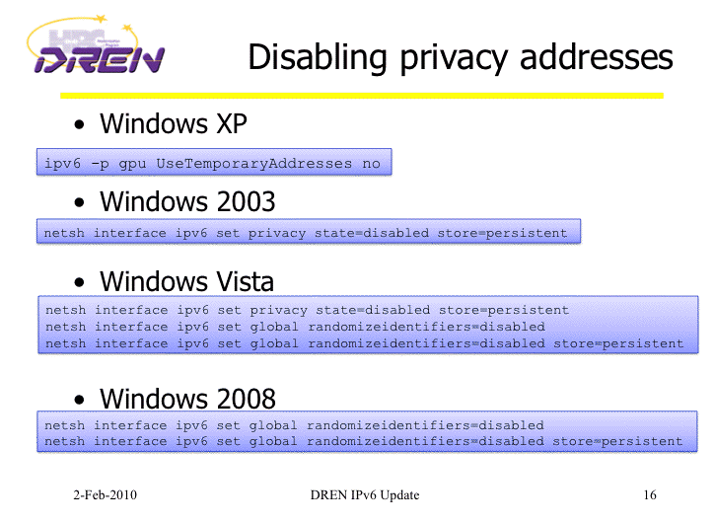
Disabling IPv6 Privacy Addresses
http://www.internet2.edu/presentations/jt2010feb/20100202-broersma.pdf

Slide 125
An Aside: Trying to Anonymize IPv6 Flow Data
Speaking of IPv6 and privacy…
Internet2 routinely makes anonymized Netflow data available for researcher use (see, for example
·”A Look at the Unidentified Half of Netflow (With an Additional Tutorial On How to Use the Internet2 Netflow Data Archives),”
www.uoregon.edu/~joe/missing-half/missing-half.pdf
In the IPv4 case, the anonymization process is easy: the low order 11 bits of each IPv4 address are zeroed.
The IPv6 case is significantly more complex. For a copy of the draft policy Internet2 finally approved, see http://www.uoregon.edu/~joe/ipv6-mask.pdf

Slide 126
A Stateful Alternative to SLAAC: DHCPv6
An alternative to SLAAC for workstations is DHCPv6, much like DHCP for IPv4.
One critical difference: while DHCPv6 is well supported by IPv6ified versions of Microsoft Windows, at least some important vendors (read that as “Apple”) do not support DHCPv6 at this time (and may never do so).
If you’re using a Mac OS X box and you want or need to do DHCPv6, you will need to run a third party DHCPv6 client (Dibbler is a commonly suggested option, see http://klub.com.pl/dhcpv6/ , but note the comment there that “Due to work on my Ph.D, the Dibbler project is in the maintenance mode. Active development and
non-critical bug fixing is on hold, until I finish my dissertation. Sorry.”)

Slide 127
Another DHCPv6 “Oddity:” “M vs. O” Flags
DHCPv6 can be used in two different modes, often referred to as “M” and “O” modes:
M :
1-bit "Managed address configuration" flag. When set, it
indicates that Dynamic Host Configuration Protocol [DHCPv6] is
available for address configuration in addition to any addresses
autoconfigured using stateless address autoconfiguration. The
use of this flag is further described in [omited].
O :
1-bit "Other configuration" flag. When set, it indicates that
[DHCPv6lite] is available for autoconfiguration of other
(non-address) information. Examples of such information are
DNS-related information or information on other servers within
the network.
See http://tools.ietf.org/id/draft-ietf-ipv6-ra-mo-flags-01.txt

Slide 128
An Aside: “M” vs “O” in Cisco IOS
While most of you will not be configuring routers to do DHCPv6, just in
case:
Router(config-if)#ipv6 nd ?
dad Duplicat Address Detection
managed-config-flag Hosts should use DHCP for address config
ns-interval Set advertised NS retransmission interval
other-config-flag Hosts should use DHCP for non-address config
prefix Configure IPv6 Routing Prefix Advertisement
ra-interval Set IPv6 Router Advertisement Interval
ra-lifetime Set IPv6 Router Advertisement Lifetime
reachable-time Set advertised reachability time
suppress-ra Suppress IPv6 Router Advertisements

Slide 129
What If We’re Not Doing DHCPv6 “O” Mode?
If you’re running a Mac, or the local IPv6 network isn’t doing “O” mode DHCPv6, you may wonder how you learn things like the DNS servers you should be using.
The default answer (a bit of a disappointment, but c’est la vie) is that often users will rely on IPv6-aware name servers which have IPv4-transport, typically name servers learned from IPv4 DHCP.
The alternative answer is that users may need to manually configure one or more IPv6-aware name servers. In the absence of more specific guidance, you may want to use Google’s intentionally open name servers at 8.8.8.8 and 8.8.4.4 -- they’re IPv6-aware.

Slide 130
Manually Assigned Native IPv6 Addresses
Just like in IPv4, you also have the option of manually assigning native IPv6 addresses for things like servers. Recipes for some common OS’s:
-- FreeBSD and Friends:
http://www.cyberciti.biz/faq/freebsd-configure-ipv6-networking-static-ip-address/
-- Redhat/CentOS:
http://www.cyberciti.biz/faq/rhel-redhat-fedora-centos-ipv6-network-configuration/
-- SuSE Linux:
http://www.cyberciti.biz/faq/configuring-ipv6-in-sles10-opensuse-linux/
-- Ubuntu Linux:
http://www.cyberciti.biz/faq/ubuntu-ipv6-networking-configuration/
-- Windows Server 2008/R2
http://technet.microsoft.com/en-us/library/cc732106.aspx
Mac user? Just set a static IP in System Preferences
-> Network -> Configure -> Configure IPv6 -> Manually

Slide 131
“What’s My Subnet Length and Router Addr?”
When statically configuring…
Unless you’re told otherwise, as a general rule of thumb, the subnet length will always be /64
Unless you’re told otherwise, again as a rule of thumb, the router address will always have the same first 64 bits as your host’s static address, followed by ::1
Don’t forget to also define IPv6-aware name servers. If you don’t have a suitable local alternative, Google’s intentionally open name servers, 8.8.8.8 and 8.8.4.4 will usually work fine as long as you have IPv6 AND IPv4 connectivity to your host.
Q. “In IPv4 I usually configure a broadcast address. What’s my broadcast address for IPv6?”
A. Broadcast isn’t needed and doesn’t exist in IPv6.

Slide 132
2.5 IPv6 Internet Connectivity

Slide 133
Native IPv6 Connectivity
Native IPv6 connectivity is preferred.
Native IPv6 connectivity is the IPv6 analog of normal IPv4 connectivity, and would ideally come from your current network service provider.
UO, for example, has native IPv6 connectivity from Internet2 via the Oregon Gigapop.
If you have the bad luck to have a non-IPv6 aware service provider, see the pointers to IPv6 options at section 1.10 earlier in this talk.

Slide 134
IPv6 Peering
Large providers doing IPv6 should also be aware that there may be opportunities for IPv6 peering (e.g., the exchange of customer traffic, and only customer traffic, over IPv6).
A good presentation on this topic is available at:
www.nanog.org/meetings/nanog43/presentations/Levy_IPv6_%20Peering_N43.pdf

Slide 135
Manually Configured IPv6 Tunnels
Another alternative is to arrange for a manually configured IPv6 tunnel from an IPv6 tunnel broker.
Free tunneled IPv6 connectivity is available from a variety of providers, including most notably:
-- Hurricane Electric, http://tunnelbroker.net/
-- SixXS, https://www.sixxs.net/main/
When establishing a manually configured IPv6 tunnel, beware of tunneling to a very distant tunnel endpoint -- all your traffic will have to make that long trip, and that will add (potentially substantial) latency. Keep tunnels as short as possible!
Also beware of firewall issues. If you have a firewall between you and your tunnel provider, it will need to permit proto 41 (“6in4”) traffic.

Slide 136
Manually Configured Tunnel Security
Manually configured tunnels are subject to a number of security vulnerabilities, including endpoint spoofing/traffic injection (unless specific precautions, such as using IPSec are taken, which we’ve already established is normally not the case).
For an interesting non-malicious discussion of tunnel endpoint spoofing, see
http://www.dia.uniroma3.it/~compunet/tunneldiscovery/
Remember, use native IPv6 whenever you possibly can, and always encrypt all your traffic end to end.

Slide 137
“Automatic” IPv6 Connectivity: 6to4
Another alternative to native IPv6 connectivity or manually configured IPv6 tunnels is 6to4.
6to4 was meant as a temporary transition mechanism, to help people use IPv6 until they could get native IPv6 (or at least tunneled IPv6) deployed.
Two issues with 6to4:
-- it sends traffic to 192.88.99.1, part of the anycast
block 192.88.99.0/24; you *will* use the “closest”
192.88.99.0/24 that’s out there, whether friend or
foe :-;
-- 6to4 cannot traverse a firewall (including those
ubiquitous little blue Linksys boxes); Mac Airport
Express and Airport Extreme boxes reportedly DO
know how to handle 6to4 correctly, however.

Slide 138
Enabling 6to4 on a Mac
N.B.: 6to4 (RFC3056) usually won’t work behind a firewall
-- Apple Menu ==> System Preferences ==> Network ==>
Show: Network Port Configuration
-- If no 6 to 4 port already exists, click “New”
-- Select 6 to 4 for the port from the pull down list of ports
-- Enter “6 to 4” for the port’s name
-- Click OK
-- Make sure “6 to 4” is checked as “On”
-- Click “Apply Now”
[the above details may vary on some versions of OS X]
If you’re using Firefox 2.x on a Mac, you may also need to tell Firefox to allow IPv6 DNS resolution to occur
-- In Firefox go to the URL about:config
-- Filter on the string IPv6
-- Set network.dns.disableIPv6 to be false
-- Try going to http://ipv6.google.com/ (the logo should dance)
To disable 6to4, use System Preferences to set 6to4 to be “Off”

Slide 139
Teredo/Miredo
Teredo is another automatic IPv6 tunneling protocol; this one differs from 6to4 in that it can successfully traverse network firewall boxes (unless the firewall blocks outgoing IPv4 traffic on 3544/UDP)
Teredo ships with Microsoft Windows; if you’re running Linux, you’ll need to install Miredo for Teredo functionality. Miredo is available from
http://www.remlab.net/miredo/

Slide 140
Enabling Teredo on a Windows XP SP2 PC
To set up IPv6 and Teredo on a Windows XP SP2 system, do:
Start ==> Accessories ==> Command Prompt
netsh interface ipv6 install
netsh interface ipv6 set teredo client
To disable it:
netsh interface ipv6 set teredo disabled
netsh interface ipv6 uninstall

Slide 141
The Special Case of IPv6 Unexpectedly
Not Working Under Windows Vista
Vista users should have IPv6 work "out of the box," although Firefox users will need to tweak their browser to enable IPv6 DNS
But what if you're a Vista users and IPv6 doesn't work even when you use the latest version of IE (or some web browser other than Firefox?) You may be on a managed laptop where the system administrator has "intentionally broken" IPv6 (see http://support.microsoft.com/kb/929852).
We can fix that, but in some cases it can involve editing the registry (yuck), while in other cases you may "just" need to
re-enable use of IPv6 (Start ==> right click on Network, select Properties, click on Manage Network Connections. Right click on the wireless connection. Select Properties. Tick the IPv6 box.)
Note: if you "unbreak" IPv6 on your official laptop, visit with
your system admin after you return home to confess your sins. :-)

Slide 142
Key Point: Even If Your Site “Officially” Foregoes IPv6, Users May Still Decide to Try It…
Some sites which rely heavily on firewalls and perimeter security may decide to forego or postpone deployment of native IPv6. Having made the decision to do so, folks may emit a big relieved sigh, believing that by “sitting this dance out,” they will have foreclosed any possibility of user access to IPv6-only resources.
Unless that policy is very carefully enforced on a technical basis, you may be in for a surprise or two because users may be able to easily work their way around your non-implementation or filters.
This is particularly important if you’re relying primarily on perimeter filtering to control either the infiltration of malware (or other unwanted content, e.g., “adult entertainment”), or the exfiltration of site-sensitive information (as at some federal sites).
BTW, a very cool IPv6 web hack is sixxs.org’s IPv6 web gateway: try www.cnn.com.sixxs.org (for example), from an IPv6-ified box

Slide 143
Your Users Will Be Fulfilled
It is natural and entirely appropriate that your users will want to try new things, such as things they may hear about from their friends and colleagues. One of those things may be IPv6.
If a technology they’re interested in (such as IPv6) isn’t one that you’re currently supporting, they may search for and find “ad hoc” approaches which they can try without “having to bother you.”
Sometimes there’s a hope that obscurity or technical difficulty will keep users from trying some work-arounds, but I wouldn’t count on “security through obscurity” in the case of IPv6.
For example, if a user is on a Mac at a “non-IPv6 site” and that site also doesn’t have a perimeter or interior firewall, one option would be for him to enable “6to4.” You’ve seen how easy that was…
As another example, assume a user is behind a firewall and is
using a PC running Windows XP at a “non-IPv6 site.” You’ve also seen how easy that was…

Slide 144
Immense Technical Skill Is Not Required
In my opinion, pretty much any “reasonably motivated” semi technical user will be able to successfully enable 6to4 or Teredo on their desktop or laptop, even if they don’t fully understand the technology or the implications of having done so.
And even if you block 6to4 and Teredo, users can still use RFC3053 IPv6 tunnel brokers (there’s a nice list of them at
http://en.wikipedia.org/wiki/List_of_IPv6_tunnel_brokers for example), and so on and so forth.
On the other hand (and for interesting reasons), there is still
no IPv6 version of Tor (the onion routing protocol) yet, see
http://wiki.noreply.org/noreply/TheOnionRouter/TorFAQ
at section 8.13
Anyhow, rather than playing “IPv6 cat and mouse” with your users, why not just buckle down and run native IPv6 instead? Trying to fight transition mode IPv6 traffic will ultimately become really trickier and trickier over time, particularly if
users encrypt.

Slide 145
6to4 & Teredo May Rely on
“Remote Resources”
In addition to things like 6to4 and Teredo traffic posing surprises for things like border filtering and traffic monitoring, tunneled traffic may also rely on comparatively remote resources.
Depending on how far away some of those resources may be, the additional latency associated with reaching those gateways may impact the performance of untuned network connections.
Remote resources may also be a sign that there’s only a limited pool of available gateways (if the pool was large and well distributed, presumably you’d be using a nearby gateway rather than a remote one). When the pool of available resources is constrained, it may eventually get “loved to death” (overloaded).
One could also imagine a site run by a cyber criminal, kindly offering free gateway services in an effort to attract your customer’s traffic for surreptitious MITM-ish monitoring.
Services such as 6to4 and Teredo which do not require any sort of registration or authentication may also end up being abused by bad guys just as open SMTP relays once were.

Slide 146
Magic Addresses
6to4 uses 192.88.99.1 as a magic address, anycast via the magic prefix 192.88.99.0/24 (see RFC3068 at 2.3 and 2.4)
Do you know where your 192.88.99.1 traffic is going? (simple test: traceroute to 192.88.99.1 from a machine at your home site)
[Maybe you want to routinely monitor the path to 192.88.99.1?]
When I looked at some examples from public traceroute servers, (examples which I’ll omit here), I’ve seen:
-- large academic sites whose customers may end up using
anycast 6to4 relays located clear across the country,
-- government mission networks whose customers may rely on
6to4 anycast relays hosted on the campus of academic sites
-- commercial providers whose customers may rely on anycast
6to4 relays hosted by some of their competitors.
Or consider Teredo -- Teredo relies on Teredo servers and Teredo relays. Do you know which ones your folks may be using?
http://technet.microsoft.com/en-us/library/cc722030.aspx
mentions the Teredo server teredo.ipv6.microsoft.com

Slide 147
Where’s UO’s Closest 192.88.99.1?
% traceroute 192.88.99.1
traceroute to 192.88.99.1 (192.88.99.1), 30 hops max, 46 byte packets
1 vl-142.uonet2-gw.uoregon.edu (128.223.142.3) 0.341 ms 0.231 ms 0.667 ms
2 3.xe-1-3-0.uonet10-gw.uoregon.edu (128.223.3.10) 0.180 ms 0.159 ms 0.152 ms
3 vl-105.ge-2-0-0.core0-gw.pdx.oregon-gigapop.net (198.32.165.89) 2.805 ms 2.682 ms 2.679 ms
4 vl-101.abilene-losa-gw.oregon-gigapop.net (198.32.165.66) 24.511 ms 24.567 ms 24.548 ms
5 xe-0-1-0.0.rtr.hous.net.internet2.edu (64.57.28.97) 56.585 ms 56.555 ms 56.525 ms
6 xe-2-3-0.0.rtr.atla.net.internet2.edu (64.57.28.113) 130.461 ms 79.937 ms 79.949 ms
7 xe-0-2-0.110.rtr.ll.indiana.gigapop.net (149.165.254.20) 95.113 ms 95.063 ms 95.068 ms
8 xe-0-0-0.1.rtr.ictc.indiana.gigapop.net (149.165.254.25) 115.358 ms 95.126 ms 95.102 ms
9 rtr3.ul.indiana.gigapop.net (149.165.255.129) 95.359 ms * 95.302 ms

Slide 148
Example From The Local Hotel's Network
% traceroute 192.88.99.1
traceroute to 192.88.99.1 (192.88.99.1), 64 hops max, 40 byte packets
1 83.7.210.65.in-addr.arpa.noptr.antlabs.com (65.210.7.83) 1.941 ms 1.034 ms 0.992 ms
2 81.7.210.65.in-addr.arpa.noptr.antlabs.com (65.210.7.81) 1.935 ms 1.472 ms 3.285 ms
3 * mfr103-500.gw3.pit1.alter.net (152.179.63.201) 5.896 ms *
4 518.at-4-0-0.cl1.pit1.alter.net (152.63.36.250) 179.161 ms * 17.748 ms
5 0.so-6-0-0.xl3.iad8.alter.net (152.63.0.138) 89.683 ms 37.278 ms 14.802 ms
6 tengige0-6-1-0.gw1.iad8.alter.net (152.63.35.137) 167.029 ms 164.967 ms tengige0-6-0-0.gw1.iad8.alter.net (152.63.36.45) 42.621 ms
7 teliasonera-gw.customer.alter.net (63.125.125.42) 91.004 ms 14.806 ms 14.778 ms
8 ldn-bb1-link.telia.net (80.91.251.206) 187.366 ms 97.65.248.213.in-addr.arpa.noptr.antlabs.com (213.248.65.97) 94.529 ms ldn-bb2-link.telia.net (80.91.251.208) 98.843 ms
9 ldn-b5-link.telia.net (80.91.250.168) 211.678 ms 91.400 ms 90.145 ms
10 * * *
11 * * *
12 * * *

Slide 149
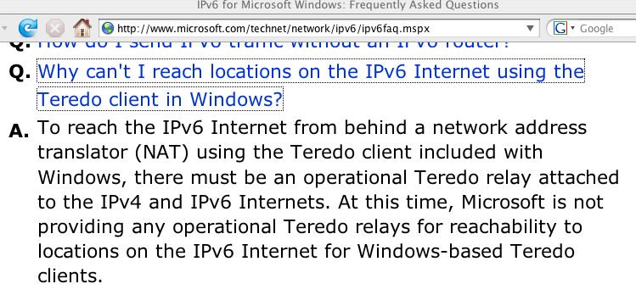
But What About Teredo Relays, Where the Bandwidth Intensive “Heavy Lifting” Happens?

Slide 150
Sites Which Are Advertising 2001:0::/32
RFC4380 at 2.6 specifies 2001:0::/32 for the Teredo relay service.
Martin Levy recently presented “IPv6 Traffic Levels on Hurricane Electric’s Backbone,” (see www.nanog.org/meetings/nanog45/ presentations/Tuesday/Levy_traffic_level_hurricane_N45.pdf ):
“[Teredo] traffic is all eastward across the Atlantic
Flows toward teredo.bit.nl AS12859 via AMS-IX
2001::/32 announce by other networks including
AS12637 Seeweb, AS1257 Tele2, etc.” [emphasis added]
If you telnet to one of the IPv6 aware routeviews.org nodes (such
as route-views.linx.routeviews.org), you can see sites advertising
2001:0::/32 by using the command “show ipv6 bgp 2001:0::/32”
When I last checked, I saw 2001:0::/32 from AS1257 (Tele2), AS6939 (Hurricane), AS12637 (Seeweb), AS12859 (Bit.NL) and
AS21155 (ProServe).
If you are globally advertising 2001:0::/32, but for some reason your ASN isn’t listed here, I’d love to hear from you.

Slide 151
‘So Are You Telling Me That I Should Try To “Break” or “Disable” 6to4 and/or Teredo?’
Encountering 6to4 or Teredo is like encountering extra-terrestrial intelligence. Squelch any immediate reptilian instinct to smash/ kill/eat anything which is new/different/potentially threatening. :-)
At the same time, let’s avoid philosophically overanalyzing this. We should not let “the perfect” get in the way of the “adequate.” While I really want to see native IPv6 deployed end-to-end,
6to4 or Teredo (at least as long as it works and isn’t being abused), is better for many users than no IPv6 service at all.
Thus, notwithstanding some of the issues mentioned on previous slides, please refrain from breaking 6to4 or Teredo.
You should consider fielding a carefully monitored version of those services, accessible only by your local users, thereby soaking up the local demand for those services (and if you do see folks using ’em, nudge them toward native IPv6 instead)

Slide 152
Historical Trivia: What Was the “6Bone?”
The 6bone was an IPv6 testbed using configured tunnels.
6bone IPv6 addresses began with 3FFE (sadly, you may still see some people trying to use 3FFE addresses today, even though the 6bone officially was decommissioned in June 2006)
For historical information about this experiment, see
http://go6.net/ipv6-6bone/

Slide 153
What About ISATAP?
ISATAP is yet another IPv6 transition mechanism, this one defined in RFC5214 (seems like they’re millions of transition mechanisms, doesn't it?)
It violates fundamental network layering principles.
ISATAP also relies on the presence of a magic isatap.<domain> domain name. You are making sure that no one else is registered that magic name, right?
Just as you’re making sure no one except your authorized proxy admin registers wpad.<domain>?
I explicitly urge you NOT to deploy ISATAP at your site!
Nonetheless, if you want to see an example of how one could set up ISATAP, see
http://technet.microsoft.com/en-us/magazine/2008.03.cableguy.aspx

Slide 154
2.6 IPv6 Switching and Routing

Slide 155
This Is Not A Switching/Routing Tutorial
I’m not a network engineer, and neither are most of you
This is just enough background to make you dangerous/get you started…
On most hosts, IPv6 routing Just Works as shipped.
At layer 2 (e.g., over ethernet switches), ethernet switches only care about MAC addresses, so when it comes to layer 2, IPv6 generally Just Works there too.
Locally at layer 3, IPv6 may be routed by OSPF3 or ISIS.
See your favorite vendor’s documentation for details.
IPv6 uses BGP4 in the wide area, just like IPv4. A nice quick IPv6 BGP recipe for native IPv6 peering with Internet2 can be found in the Internet2 IPv6 Cookbook, see http://noc.net.internet2.edu/i2network/ipv6-cookbook.html
See also "Configuring IPv6 for Cisco IOS" by Sam Brown, et. al.

Slide 156
What About Open Source Routing Product?
If you don’t have large piles of IPv6-capable name brand routers floating around on which to experiment, but you do have some surplus PCs, you may want to check out Quagga, an open source/GPL licensed software routing suite which supports IPv6.
As a sign of how we feel about it, I’d note that
Oregon Routeviews uses Quagga for some of its RouteViews boxes.
See http://www.quagga.net/ for more information
Also worthy of note for those using Linux:
www.linuxfoundation.org/collaborate/workgroups/networking/iproute2

Slide 157
Routing Gone Wrong #1:
Rogue RAs
http://tools.ietf.org/html/draft-chown-v6ops-rogue-ra-03
When deploying IPv6, whether IPv6-only or dual-stack, routers are configured to send IPv6 Router Advertisements to convey information to nodes that enable them to autoconfigure on the network. This information includes the implied default router address taken from the observed source address of the Router Advertisement (RA) message, as well as on-link prefix information. However, unintended misconfigurations by users or administrators, or possibly malicious attacks on the network, may lead to bogus RAs being present, which in turn can cause operational problems for hosts on the network. In this draft we summarise the scenarios in which rogue RAs may be observed and present a list of possible solutions to the problem. We focus on the unintended causes of rogue RAs in the text. The goal of this text is to be Informational, and as such to present a framework around which solutions can be proposed and discussed.

Slide 158
Routing Gone Wrong #2:
Gratuitous Provision of IPv6 Transit
Another example of how IPv6 connectivity can be at times less robust than IPv4 can be seen in problems associated with things like the “gratuitous provision of global transit.”
While offering to route anyone’s IPv6 transit traffic at no charge and without prearrangement may seem like an incredibly generous thing to do, it can cause problems when production IPv6 traffic suddenly follows a “shorter” (BGP) path that flows indirectly via geographically remote parts of the world (or attempts to flow via circuits not provisioned to carry a material fraction of the whole world’s IPv6 transit bandwidth). Fortunately, better BGP filtering has largely reduced or eliminated this issue today.
A set of IPv6 BGP filters meant to provide a nice start at reducing the number of “problematic” global IPv6 routes is available at
http://www.space.net/~gert/RIPE/ipv6-filters.html
As always, the more strictly you filter, the more carefully/closely you’ll need to work at keeping your filters updated.

Slide 159
DDoS Attacks Against IPv6 Sites
Another example of a security-related routing issue that may arise in conjunction with IPv6 sites is mitigating distributed denial of service (DDoS) attacks. In the IPv4 world, a common option to avoid having DDoS traffic saturate downstream links is the use of blackhole routes.
For example, Internet2’s IPv4 BGP policy allows connectors to advertise BGP discard routes tagged with the BGP Community 11537:911 and a mask length from /24 to /32, in which case all packets arriving for that route will be discarded by all Internet2 Network routers, before those packets can saturate downstream customer links.
The Internet2 community has discussed offering a comparable policy, obviously adjusted for IPv6 address lengths and prefix usage patterns (e.g., perhaps accepting masks from /64 to /128) should be implemented for IPv6 on Internet2.

Slide 160
Looking at Local IPv6 Routes on Mac OS X
% netstat -nr -finet6
Routing tables
Internet6:
Destination Gateway Flags Netif
default 2001:468:d01:d6::1 UGSc en0
::1 ::1 UH lo0
2001:468:d01:d6::/64 link#4 UC en0
2001:468:d01:d6::1 0:d0:1:95:e0:0 UHLW en0
2001:468:d01:d6::80df:d617 0:3:93:cf:b6:38 UHL lo0
fe80::/64 fe80::1 Uc lo0
fe80::1 link#1 UHL lo0
fe80::/64 link#4 UC en0
fe80::203:93ff:fecf:b638 0:3:93:cf:b6:38 UHL lo0
fe80::2d0:1ff:fe95:e000 0:d0:1:95:e0:0 UHLW en0
fe80::/64 link#5 UC fw0
fe80::203:93ff:fecf:b638 0.3.93.ff.fe.cf.b6.38 UHL lo0
ff01::/32 ::1 U lo0
ff02::/32 ::1 UC lo0
ff02::/32 link#5 UC fw0

Slide 161
Mac OS X NDP (e.g., Layer 2 Neighbors)
% ndp -a
Neighbor Linklayer Address Netif Expire St Flgs Prbs
vl-214-gw.uoregon.edu 0:d0:1:95:e0:0 en0 23h46m55s S R
canard.ipv6.uoregon.edu 0:3:93:cf:b6:38 en0 permanent R
fe80::1%lo0 (incomplete) lo0 permanent R
fe80::203:93ff:fecf:b638%en0 0:3:93:cf:b6:38 en0 permanent R
fe80::2d0:1ff:fe95:e000%en0 0:d0:1:95:e0:0 en0 23h47m4s S R
fe80::203:93ff:fecf:b638%fw0 0:3:93:ff:fe:cf fw0 permanent R

Slide 162
Looking at Local IPv6 Routes and Neighbors on Linux
% netstat -r --inet6
Kernel IPv6 routing table
Destination Next Hop Flags Metric Ref Use Iface
localhost/128 * U 0 7264 2 lo
2001:468:d01:8e:209:3dff:fe13:fcf7/128 * U 0 17551 2 lo
2001:468:d01:8e::/64 * UA 256 7935 0 eth0
fe80::209:3dff:fe13:fcf7/128 * U 0 242 2 lo
fe80::209:3dff:fe13:fcf8/128 * U 0 0 2 lo
fe80::/64 * U 256 0 0 eth0
fe80::/64 * U 256 0 0 eth0
fe80::/64 * U 256 0 0 eth1
ff00::/8 * U 256 0 0 eth0
ff00::/8 * U 256 0 0 eth1
*/0 fe80::2d0:1ff:fe95:e000 UGDA 1024 650 0 eth0
% ip -6 neighbor list
fe80::2d0:1ff:fe95:e000 dev eth0 lladdr 00:d0:01:95:e0:00 router nud stale

Slide 163
Magic Multicast Addresses
% ping6 -I eth0 ff02::1
% ping6 -I eth0 ff02::2
% ping6 -I eth0 ff02::5
[See http://www.iana.org/assignments/ipv6-multicast-addresses/ ]

Slide 164
Magic Multicast Address Output
% ping6 -I en0 ff02::1
PING6(56=40+8+8 bytes) fe80::203:93ff:fecf:b638 --> ff02::1
16 bytes from fe80::203:93ff:fecf:b638, icmp_seq=0 hlim=64 time=0.248 ms
16 bytes from fe80::20f:1fff:fe98:e548, icmp_seq=0 hlim=64 time=0.761 ms(DUP!)
16 bytes from fe80::213:faff:fe01:a6a4, icmp_seq=0 hlim=64 time=0.898 ms(DUP!)
16 bytes from fe80::2e0:29ff:fe3c:9a3a, icmp_seq=0 hlim=64 time=0.951 ms(DUP!)
16 bytes from fe80::2e0:dbff:fe10:75c, icmp_seq=0 hlim=64 time=1.254 ms(DUP!)
16 bytes from fe80::2d0:1ff:fe95:e000, icmp_seq=0 hlim=64 time=1.376 ms(DUP!)
16 bytes from fe80::2e0:dbff:fe10:7c6, icmp_seq=0 hlim=64 time=1.832 ms(DUP!)
16 bytes from fe80::216:d3ff:fe15:3045, icmp_seq=0 hlim=64 time=6.647 ms(DUP!)
16 bytes from fe80::21e:bff:fe17:b2a2, icmp_seq=0 hlim=64 time=202.283 ms(DUP!)
16 bytes from fe80::217:f2ff:fe08:93e4, icmp_seq=0 hlim=64 time=634.863 ms(DUP!)
[etc]
% ping6 -I en0 ff02::2
PING6(56=40+8+8 bytes) fe80::203:93ff:fecf:b638 --> ff02::2
16 bytes from fe80::2d0:1ff:fe95:e000, icmp_seq=0 hlim=64 time=5.206 ms
[etc]

Slide 165
Pre-Attack Network Reconnaissance
It is common for miscreants to remotely scan IPv4 network addresses in an effort to identify active addresses, operating systems in use, open ports, etc., intelligence which may help them plan an attack against you. An increasingly common (if unfortunate) response to that threat has been to insert a firewall between the Internet and local users, thereby deflecting some scans and probes, albeit at the cost of a loss of transparency.
Because IPv6-connected sites typically have a far larger number of addresses than IPv4-only sites, and end-to-end connectivity was another key objective of IPv6’s architecture, some have suggested that it might be harder for attackers to do exhaustive scans of IPv6 sites simply because of the vastly larger number of addresses involved. That’s true, as far as it goes, but that’s not the whole story. If you haven’t seen RFC 5157 (“IPv6 Implications for Network Scanning,” March 2008), I’d urge you to look it over.
So why did I mention ff02::1? If a miscreant can get a toehold on a local IPv6 connected host, they can obviously easily discover all the other hosts on that same subnet… :-;

Slide 166
2.7 IPv6 Address Space

Slide 167
Ironically, Until Now, We Haven’t Talked Much About Getting IPv6 Address Space
That’s in part because getting IPv6 address space is rather easy.
If you’re an end user, your friendly local router or your local DHCPv6 server or your DNS admin will give you an address
If you’re running your own site, need less than a /32, and don’t need to multihome, your LIR (e.g., your ISP) can fix you up with the addresses you need.
If you need to multihome, or you need a /32 or more, you’ll want to get provider independent (PI) IPv6 address space from ARIN…

Slide 168
Internet2 Participants With
PI IPv6 Allocations
To see these, at http://routerproxy.grnoc.iu.edu/internet2/ select a node and then do:
show route table inet6.0 community 11537:950 terse (you’re looking for non 2001:468 prefixes)
[BGP community info is at www.abilene.iu.edu/i2network/maps--documentation/cookbooks.html ]
2001:4d0:9c00::/40 NASA
2001:4e0::/32 WiscNet
2001:5e8::/32 Pittsburgh Supercomputing Center
2001:1458::/32 CERN
2001:1860::/34 Pacific Northwest Gigapop
2001:1860:c000::/34 Pacific Northwest Gigapop
2001:18e8::/32 Indiana U
2001:1948::/32 Utah Education Network
2001:4898::/32 Microsoft
2001:48a8::/32 Merit
2001:48d0::/32 San Diego Supercomputer Center
2001:4930::/32 State of North Dakota ITD
2001:49d0::/32 Kansas Research and Education Network
2001:49d8:40::/42 Commonwealth of PA - OA / Integrated Network Management Services
2002::/16 6to4
2607:f010::/32 UCLA
2607:f140::/32 Berkeley
2607:f290::/32 UC Riverside
2607:f320::/32 U Nebraska-Lincoln
2607:f378::/32 UC Santa Barbara

Slide 169
I2 Participants With PI IPv6 Alloc. (cont.)
2607:f388::/32 U Wisconsin Madison
2607:f390::/32 Louisiana Board of Regents/Louisiana Optical Network Init
2607:f3b0::/32 NJEDge.Net, Inc.
2607:f470::/32 U Pennsylvania
2607:f600::/32 NYU
2610:8::/32 Penn State
2610:20:8000::/35 US Dept of Commerce
2610:28::/32 NCREN
2610:48::/32 U Maine System
2610:58::/32 Boston U
2610:a8::/32 OARnet
2610:d0::/32 Cisco
2610:e0::/32 U Missouri - dba the Missouri Research and Education Net
2610:130::/32 Iowa Communications Network
2610:148::/32 Georgia Tech
2610:1e0::/32 Kentucky Educational Computing Network
2620:0:270::/48 U Texas Health Science Center at Houston
2620:0:bc0::/48 George Mason U
2620:0:c30::/48 U South Florida
2620:0:c80::/48 NCSA
2620:0:df0::/48 Bryant U, RI
2620:0:e50::/48 U Iowa

Slide 170
I2 Members with Non-PI IPv6 Address Assignments From I2’s IPv6 Allocation
Internet2’s IPv6 address block is 2001:0468::/32
You can see documented assignments from within that block via whois. If you have a Linux box or Mac, pop up a terminal window and then enter…
% whois -h whois.arin.net \>\ 2001:468::
There’s also an HTML page that lists all assignments from within that block: http://ipv6.internet2.edu/Abilene_Allocations.shtml

Slide 171
If Your Site Wanted To Get PI IPv6 Space
In the ARIN region, the Number Resource Policy Manual describes the minimum requirements which a LIR (e.g., a service provider such as a RON/Gigapop) must meet in order to receive an initial minimum allocation of an IPv6 /32 (see http://www.arin.net/policy/nrpm.html#six ):
6.5.1.1. Initial allocation criteria
To qualify for an initial allocation of IPv6 address space, an organization must:
1. be an LIR;
2. not be an end site;
3. plan to provide IPv6 connectivity to organizations to which it will assign
IPv6 address space, by advertising that connectivity through its single
aggregated address allocation; and
4. be an existing, known ISP in the ARIN region or have a plan for making
at least 200 end-site assignments to other organizations within 5 years.

Slide 172
Once You Have Address Space,
Decide On An IPv6 Address Plan
You can use IPv6's vastly expanded address space to try new and innovative architectures, but you can also just map your static IPv4 address space to your IPv6 address space as UO does. For example:
% dig phloem.uoregon.edu +short
128.223.32.35
% dig phloem.uoregon.edu aaaa +short
2001:468:d01:20::80df:2023
128 ==> 80
223 ==> df
32 ==> 20
35 ==> 23
See also http://www.getipv6.info/index.php/IPv6_Addressing_Plans and
http://www.ipv6book.ca/allocation.html

Slide 173
2.8 IPv6 DNS

Slide 174
If You Run Your Own Name Servers:
Make Your Name Servers IPv6 Aware
You'll need to think about making your name servers IPv6 aware. By this I mean your recursive resolvers and your authoritative name servers should both "know about" AAAA records.
BIND from ISC, the most common name server, is fully able to support IPv6
Your access to your name servers need not change -- you can continue to access them over IPv4 -- you just need to make sure that they understand AAAA records.
If you have off site secondary name servers, make sure that those secondary name servers are also IPv6 aware
A new option for folks is to outsource recursive DNS to Google -- 8.8.8.8 and 8.8.4.4 are already IPv6 aware

Slide 175
IPv6 DNS Is Fairly Similar to IPv4 DNS
In IPv4 world, servers and other hosts use “A” records to map fully qualified domain names to dotted quads:
% dig www.uoregon.edu a +short
128.223.142.89
In IPv6 world, we use “AAAA” (“quad A”) records instead of A records to map fully qualified domain names to IPv6 addresses:
% dig network-services.uoregon.edu aaaa +short
2001:468:d01:3c::80df:3c15

Slide 176
Inverse Address Records Are Also Similar
IPv4 world:
% dig -x 128.223.142.89 +short
www.uoregon.edu.
IPv6 world:
% dig -x 2001:468:d01:3c::80df:3c15 +short
network-services.uoregon.edu.
If you need a web-accessible IPv6 dig interface, try
http://www.digwebinterface.com/

Slide 177
Complication: IPv6 Inverse Address Records
There aren’t a lot of good solutions for IPv6 inverse address record creation (other than manually creating them for servers, publicly visible network links, etc.).
Dynamic DNS isn’t such a hot idea, nor is building an inverse address record for millions of IPv6 addresses which may never get used!
Ron Broersam from DREN described one potential approach in a talk he did at Joint Techs, see: http://www.internet2.edu/presentations/jt2010feb/20100202-broersma.pdf
but it is unclear if the code he mentions there will be available for others to also use. (I hope it will be!)

Slide 178
Complications: IPv6 AND IPv4 Domain Names
If a fully qualified domain name is bound to both IPv4 and IPv6 addresses, which one gets used? Which one should be “preferred?” The IPv6 one or the IPv4 one?
This may be determined by the application (e.g., it may ask for both, and then use its own internal precedence information to determine which it will use), or by the DNS server (if it can give you an IPv6 address for a host, it will, and it will then stop; this is a problem if you advertise an IPv6 address for a host but then don’t actually offer IPv6 connectivity for that domain name!)
One sort of kludgy solution: put the IPv6 address in a subdomain. E.g., www.example.com (IPv4 only) might also have a related domain www.ipv6.example.com (IPv6 only)

Slide 179
What Address Do I Appear to Be Using?
Sometimes you just want to know what address your system appears to be using.
When that’s the case, try:
http://whatismyv6.com/
If you find yourself routinely curious about whether you're connecting to a site via IPv4 or IPv6, you can install the ShowIP Firefox addon available from
https://addons.mozilla.org/en-US/firefox/addon/590
It will then report the IP address that it is using for each web site you visit, green for IPv6 and red for IPv4

Slide 180
Protocol Precedence More Generally
Assume you now have at least IPv4 connectivity as well as IPv6 connectivity via Teredo (you may also have native IPv6 connectivity, IPv6 connectivity via 6to4, IPv6 connectivity via ISATAP, IPv6 connectivity via a configured tunnel, etc.).
If a host is available via IPv4 and at least one IPv6 connection modality, what’s the right order (or precedence) with which traffic to that dual stack host should be tried? Should traffic go over IPv4 whenever possible, or over IPv6 whenever possible? Obviously IPv4 is the old-and-proven familiar/safe/production quality choice, but the object of this whole exercise is to try IPv6, right?
On the other hand, some IPv6 connectivity (such as Teredo) may be less direct/more circuitous than production IPv4 connections, with greater latency and maybe even some packet loss. Do we really want to force as much traffic as possible over that sort of disadvantaged route?

Slide 181
Protocol Precedence More Generally (2)
In IPv6, where a single computer may have multiple IPv6 addresses assigned, protocol preferences also influence which of multiple IPv6 address will be used when composing outbound IPv6 traffic. To see the current policy for a Windows IPv6 host, in a terminal window use the command:
C:\> netsh interface ipv6 show prefixpolicy
For example, a typical default prefix policy (matching well with RFC3484 recommendations) might look like:
Precedence Label Prefix ----------------------------------------------------------------- 5 5 2001::/32 <== Teredo-tunneled IPv6 connectivity (least preferred)
10 4 ::ffff:0:0/96 <== IPv4 connectivity (represented here in IPv6 mapped format) 20 3 ::/96 <== deprecated; see RFC4291 at section 4
30 2 2002::/16 <== 6to4 IPv6 connectivity
40 1 ::/0 <== native IPv6 connectivity
50 0 ::1/128 <== IPv6 localhost (like 127.0.0.1 in IPv4) (most preferred)
While theoretically you can change those preferences with netsh commands, in practice it appears difficult to force IPv6 to be prefd over IPv4 in practice under Windows XP Service Pack 2 when a hostname resolves to both an IPv6 and an IPv4 address. This is actually probably a good thing in practice, although it means that if you want to insure that traffic to a given host goes via IPv6, you may need an IPv6-only address for that host (e.g., www.ipv6.example.com is a common format for IPv6-only web servers)

Slide 182
3. Enabling IPv6 in Operating Systems

Slide 183
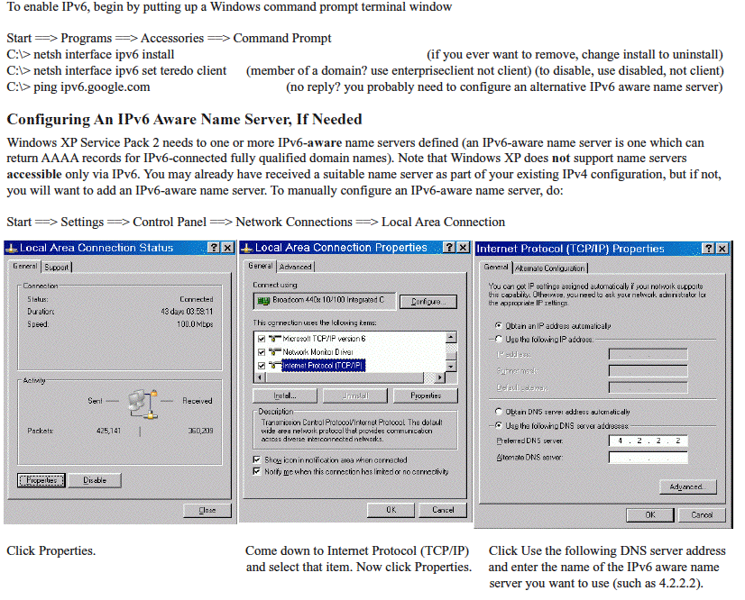
Most OS's Will Autoconfigure (Except XP)

Slide 184
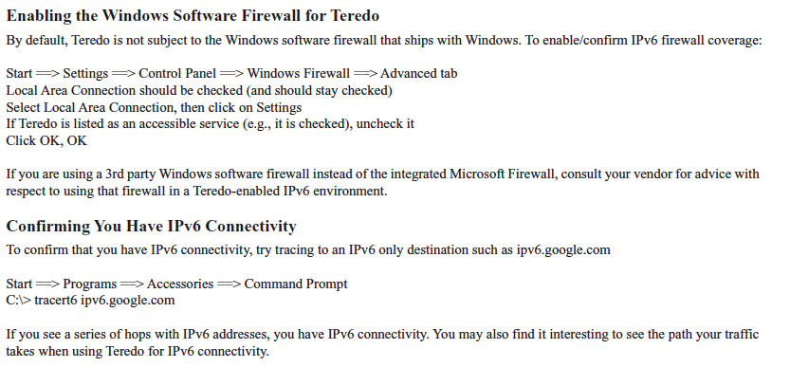
http://www.uoregon.edu/~joe/ipv6/windows-xp-ipv6-with-teredo.pdf

Slide 185
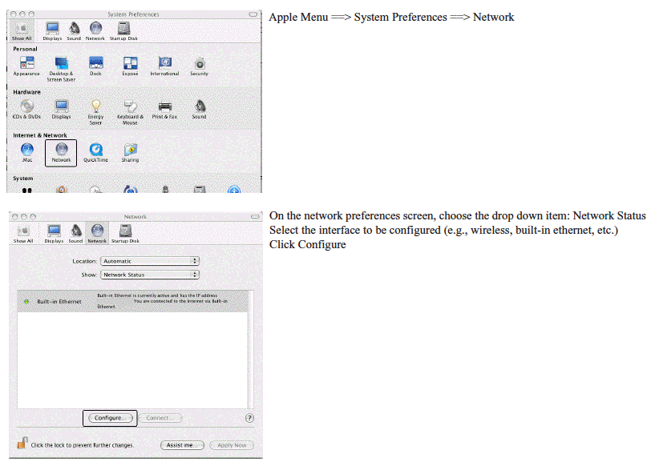
Mac OS X

Slide 186
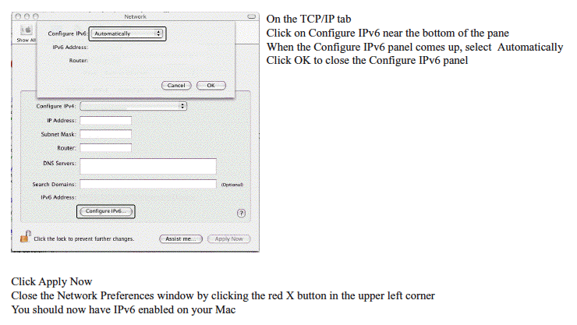

Slide 187
4. IPv6 Client Applications

Slide 188
4.1 IPv6 Web Browsers

Slide 189
Enabling IPv6 in Firefox for the Web
If you don’t already have Firefox, download it from:
http://www.mozilla.com/firefox/
Firefox are IPv6 aware, but may need to be tweaked the first time you use it (it will remember this setting after that):
-- Launch Firefox
-- In the address bar, enter about:config and hit return
-- Filter on ipv6
-- Make sure network.dns.disableIPv6 is set to false
-- If it isn’t, double click on it to toggle it to false
Now go to http://ipv6.google.com/ -- you should see the Google icon “dance”

Slide 190
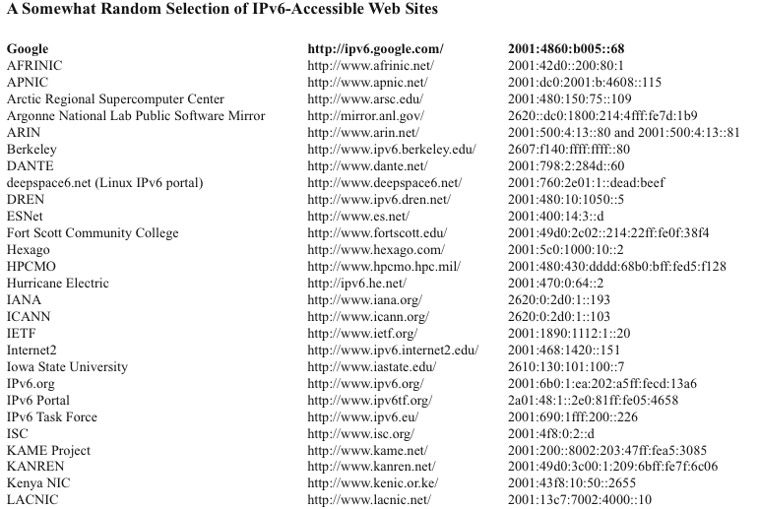

Slide 191
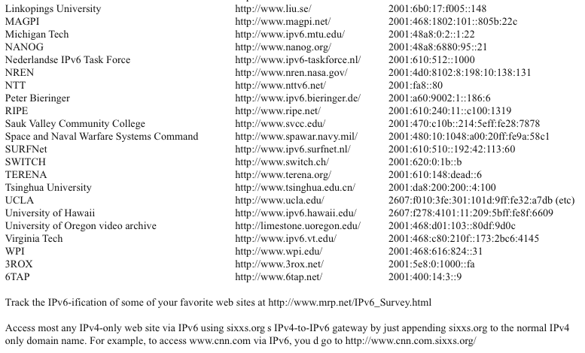

Slide 192
What About Other GUI Web Browsers?
Opera ( http://www.opera.com/ ) is ready to use IPv6 as shipped with no tweaking required, likewise Internet Explorer 8.
Safari is IPv6 enabled, but some versions of Safari may prefer IPv4 to IPv6 when both are available. To reverse that preference for dual stack sites:
1) In a Mac terminal window (Applications --> Utilities
--> Terminal) enable the Safari Debug menu by entering:
defaults write com.apple.Safari IncludeDebugMenu 1
You can then close the terminal window.
2) Launch Safari, then go to Safari’s Debug Menu (on the far right side of the main Safari menu), and come all the way down to Supported Protocols and uncheck http: (Simple Loader). You only need to do this once.

Slide 193
lynx and IPv6
Get and build lynx from http://lynx.isc.org/
Remember when ./configure’ing to include the option
--enable ipv6
If a site is available via both IPv6 and IPv4, lynx will prefer IPv6 by default
Visiting an IPv6 site via the site’s hex IPv6 address? Remember to use brackets around the literal address:
% lynx "http://[2001:48a8:6880:95::21]"

Slide 194
wget and IPv6
Get and build wget from ftp://ftp.gnu.org/gnu/wget/
To force retrieval of a web page via IPv6, add -6:
% wget -6 ”http://www.example.com”
To force retrieval of a web page via IPv4, add -4:
% wget -4 ”http://www.example.com”
Need to specify an IPv6 hex literal? Remember brackets!
% wget ”http://[2001:48a8:6880:95::21]”

Slide 195
curl and IPv6
Get curl from http://curl.haax.se/download.html
(see also the additional libraries at
http://curl.haxx.se/docs/libs.html )
To force retrieval of a web page via IPv6, add -6:
% curl -6 ”http://www.example.com”
To force retrieval of a web page via IPv4, add -4:
% curl -4 ”http://www.example.com”
Need to specify an IPv6 hex literal? Remember brackets
and -g ( http://curl.haxx.se/docs/knownbugs.html at 30)
% curl -6 -g ”http://[2001:48a8:6880:95::21]”

Slide 196
4.2 IPv6 Email Clients

Slide 197
Modern MUAs Support IPv6
Apple Mail.App
Opera Mail client
Outlook 2007
(see http://support.microsoft.com/kb/924469 )
Thunderbird: (see the next slide)
Other MUAs?

Slide 198
Enabling IPv6 in Thunderbird for Email
Thunderbird (Mozilla’s graphical email client, sibling application to the Firefox web browser) may ship with IPv6 DNS queries disabled by default.
Enabling IPv6 DNS queries requires you to:
-- Start Thunderbird
-- Go to Thunderbird --> Preferences
-- Go to Advanced (the “sprocket” or “gear” at the top)
-- Click the “Config Editor” button near the bottom
-- In the about:config window’s Filter: box, enter ipv6
-- You should see:
network.dns.disableIPv6 [etc] false
-- If, however, that setting is true, double click true
to toggle it to false

Slide 199
alpine and IPv6
Alpine (a replacement for good old pine) offers the ability to both do email and usenet news over IPv6.
Get alpine from http://www.washington.edu/alpine/acquire/
(you may also need to install OpenSSL from
http://www.openssl.org/source/ if you don’t
already have it)

Slide 200
Public IPv6-Accessible Web Email
As another example of IPv6 email lagging relative to where it should be, consider web-based email, one of the most popular and widely used applications on the Internet today.
To the best of my knowledge, there is currently only ONE (1) public web email provider which has even an experimental web email service accessible via IPv6, and that's http://ipv6.rollernet.us/
Technically, if you're able to manipulate your local hosts file, you can also access Google's Gmail via IPv6, see
http://jeremy.visser.name/2008/11/25/
how-to-access-gmail-and-google-reader-over-ipv6/ (URL wrapped due to length), but that's hardly the sort of thing that a typical user should be expected to be able to do.
If you're aware of any additional IPv6-accessible public web email service providers, I'd love to know about them.

Slide 201
4.3 ssh for IPv6

Slide 202
ssh and IPv6
ssh supports IPv6. To get OpenSSH (5.5p1 was released 4/15/2010!) go to www.openssh.com/portable.html (be sure you’re also running the latest OpenSSL -- 1.0.0 was released 3/29/2010 -- see www.openssl.org/ and don’t forget to set a sane installation prefix!)
To force ssh to use IPv6, use:
% ssh -6 joe@example.com
To force ssh to use IPv4, use:
% ssh -4 joe@example.com

Slide 203
4.4 Usenet and IPv6

Slide 204
Reading Usenet News via alpine and IPv6
Edit .pinerc, setting nntp-server=newszilla6.xs4all.nl
(other free IPv6 news servers are also available, see
http://www.xsnews.com/ipv6/ipv6_aanvraag.php and
http://www.xsnews.com/ipv6/ for IPv6 traffic graphs!)
% alpine
L (go to folder list or news group to view)
n (go down to pick the news server you’ve configured)
return (to go to that new server)
A (to add newsgroups to your subscribed list)
^T (get list of all available newsgroups; caution, large!)
move up and down with your arrow keys/spacebar
s (subscribe)
e (exit subscribe mode)
You can also use Thunderbird if you like GUI clients

Slide 205
5. IPv6 Server-Side Applications

Slide 206
5.1 Web Servers

Slide 207
What About YOUR Web Site?
Is your agency's web site IPv6 accessible? If not, why not? The most popular web servers, e.g., Apache and Microsoft IIS, both support IPv6 these days! So what's the "holdup," eh?
Often, your site may not have IPv6 connectivity (but it should!)
Another potential roadblock to explore is whether hardware load balancers are IPv4 only. Hardware load balancers commonly sit in front of multiple physical computers, making a pile of systems act as if it were one computer. Some popular hardware load balancers license IPv6 functionality separately from IPv4.
Other times the issue may be the use of outsourced content delivery networks (CDNs) which may not be IPv6-enabled (previously discussed)
Lastly, at least sometimes, no one may every have asked, "Hey, why isn't our web site IPv6 accessible?" Perhaps that's a question that YOU should ask once you're done with this training?

Slide 208
Apache Web Server and IPv6
Get Apache 2.2.15 (or whatever’s the latest stable version) from http://httpd.apache.org/
Review httpd.apache.org/docs/2.2/bind.html#ipv6
but otherwise build, install and configure as normal
When configuring for IPv6, in /etc/httpd/httpd.conf, bind to an appropriate static IPv6 address:
BindAddress [2001:468:d01:d6::80df:d617]
Check your config and start httpd; typically:
/usr/local/apache2/bin/apachectl configtest
/usr/local/apache2/bin/apachectl start
Confirm that you can connect OK to your IPv6 httpd:
% telnet 2001:468:d01:d6::80df:d617 80
GET / (note: case matters, GET, not get)
Problems? Likely a firewall thing, as “always!” :-;

Slide 209
ip6fw on a Mac
# ip6fw list <-- see what rules are currently defined
# ip6fw list > orig.txt <-- grab a copy of those rules before we play…
# ip6fw flush <-- dump all rules (e.g., permit all traffic)
# ip6fw add 100 deny ipv6 from any to any <-- block all traffic
# ip6fw delete 100 <-- delete rule 100
Note: rule order counts! First match “wins” (that’s why you get (and
need!) the ability to specify rule numbers (and thus precedence))
If you need to reload orig.txt, edit that file and add ip6fw add
in front of each saved line; if there are any wildcards (e.g., *’s) in the
rules, escape those with a \ to prevent unintended shell expansion.
Then execute that file, watching for any issues.
# sh -x orig.txt

Slide 210
How Can I See What’s Running Using IPv6?
# lsof -i6
COMMAND PID USER FD TYPE DEVICE SIZE/OFF NODE NAME
syslogd 81 root 4u IPv6 0x01c01f20 0t0 UDP *:syslog
mDNSRespo 167 nobody 8u IPv6 0x01c01220 0t0 UDP *:mdns
xinetd 307 root 5u IPv6 0x021bee80 0t0 TCP *:ssh
couriertc 3680 root 3u IPv6 0x0362a970 0t0 TCP canard.ipv6.uoregon.edu:imap
master 21204 root 13u IPv6 0x021be610 0t0 TCP *:smtp (ESTABLISHED)
httpd 29156 root 5u IPv6 0x021be2b0 0t0 TCP canard.ipv6.uoregon.edu:http (CLOSED)
httpd 29253 daemon 5u IPv6 0x021be2b0 0t0 TCP canard.ipv6.uoregon.edu:http (CLOSED)
httpd 29254 daemon 5u IPv6 0x021be2b0 0t0 TCP canard.ipv6.uoregon.edu:http (CLOSED)
httpd 29255 daemon 5u IPv6 0x021be2b0 0t0 TCP canard.ipv6.uoregon.edu:http (CLOSED)
httpd 29256 daemon 5u IPv6 0x021be2b0 0t0 TCP canard.ipv6.uoregon.edu:http (CLOSED)
httpd 29257 daemon 5u IPv6 0x021be2b0 0t0 TCP canard.ipv6.uoregon.edu:http (CLOSED)
httpd 29259 daemon 5u IPv6 0x021be2b0 0t0 TCP canard.ipv6.uoregon.edu:http (CLOSED)

Slide 211
Don’t Forget About IPv6 Addrs in Log Files
# cd /usr/local/apache2/logs
# cat access_log
[…]
2001:468:d01:d6::80df:d617 - - [23/Apr/2010:10:20:29 -0700]
"GET / HTTP/1.1" 200 54
[etc]
Does your log file analyzer product support IPv6 addresses?
Some, like AWStats from http://awstats.sourceforge.net/
require a separate plugin to enable some IPv6 functionality;
other functionality, like mapping addresses to geographic
locations, may simply not be available for IPv6)

Slide 212
5.2 IPv6 SMTP and IMAP Servers

Slide 213
Email Is The "Forgotten"
Application of IPv6
While many people are very excited about the thought of using IPv6 for web servers, for some reason there seems to be less excitement about using IPv6 for email.
Let's consider a few examples of this:
-- Many mainstream mail software products support IPv6,
but relatively few mail administrators apparently
enable IPv6 support
-- IPv6 DNS Blocklist suport is missing
-- IPv6-accessible public web email services are nearly
nil
But some sites ARE deploying IPv6-accessible mail servers right now. For example…

Slide 214
Sample Institutional IPv6 Enabled MX
% dig ucla.edu mx +short
5 smtp.ucla.edu.
% dig smtp.ucla.edu a +short
169.232.46.240
169.232.46.241
169.232.46.242
169.232.46.244
etc.
% dig smtp.ucla.edu aaaa +short
2607:f010:3fe:302:1013:72ff:fe5b:60c3
2607:f010:3fe:102:101c:23ff:febe:116e
2607:f010:3fe:102:101c:23ff:febf:cfa7
2607:f010:3fe:102:101c:23ff:fed0:918c
etc.

Slide 215
IPv6 Support In Mainstream
Email Software Products
Virtually all modern mail transfer agents support IPv6:
-- Exchange 2007 SP1 (only under Windows Server 2008, and
only with both IPv4 and IPv6 enabled); see
http://technet.microsoft.com/en-us/library/bb629624.aspx
-- Exim ( http://www.exim.org/exim-html-current/doc/html/
spec_html/ch04.html at section 4.8)
-- Postfix ( http://www.postfix.org/IPV6_README.html )
-- Qmail (via Qsmtp, see http://opensource.sf-tec.de/Qsmtp/ )
-- Sendmail (see the Sendmail Installation and Operation Guide)
What about Procmail as a local mail delivery agent? Umm…
see http://www.procmail.org/todo.html

Slide 216
IPv6 Support for imapd
Yep, imapd support under IPv6 is available as well…
For example:
-- Courier: http://www.courier-mta.org/imap/features.html
-- Dovecot: http://www.dovecot.org/
-- UW: www.washington.edu/imap/documentation/IPv6.txt.html
-- etc.

Slide 217
An Example of How the Email World Is Lagging in IPv6 Space: DNS Blocklists
DNS blocklists, such as those offered by Spamhaus, are a key
anti-abuse tool in today's IPv4-dominated Internet, directly blocking spam while also encouraging ISPs to employ sound
anti-abuse practices.
Virtually all sites that use DNS-based blocklists rely on rbldnsd
(see http://www.corpit.ru/mjt/rbldnsd/rbldnsd.8.html ).
rbldnsd does NOT support IPv6 records at this time
Spamhaus (and all other block list operators I'm aware) also do not maintain any IPv6 blocklists.
How, then, is the mail community to block abusive traffic sources coming from IPv6 space?
If we cannot support IPv6 entries in blocklists, I believe we have a fundamental deficiency we still need to address.

Slide 218
Redeeming Features of IPv6 Email
Just as in the "good old days" of IPv4, most of the people who are doing IPv6 email today are pretty responsible folks so thankfully there hasn't been much IPv6-delivered abuse.
At some point, however, we will begin to see unwanted traffic coming in over IPv6, and at that point it would sure be great if we were ready to block it, eh?
Some anti-abuse email technologies are ready today, e.g., SPF does support IPv6 (see http://www.openspf.org/SPF_Record_Syntax )

Slide 219
Enabling IPv6 in postfix
Get postfix 2.7 (or whatever’s the latest stable version) from http://www.postfix.org/download.html
Review http://www.postfix.org/IPV6_README.html
When configuring for IPv6, in /etc/postfix/main.cf,
set inet_protocols = ipv6, ipv4 (if you’re dual stacking)
Also include in /etc/postfix/main.cf the address you want to use for outgoing IPv6 SMTP connections:
smtp_bind_address6 = 2001:468:d01:d6::80df:d617
Check your config and start postfix; typically:
/usr/sbin/postfix check
/usr/sbin/postfix start
Confirm that you can connect OK to your IPv6 smtpd:
% telnet 2001:468:d01:d6::80df:d617 25
quit

Slide 220
imapds and IPv6
There are many different SSL-secured imap servers (for example, at UO we run dovecot), but just for something different, let’s do http://www.courier-mta.org/imap/
Build Courier imapd the way you normally would (e.g., begin by viewing 00README.NOW.OR.SUFFER :-), and
be sure to create an imapd cert with mkimapdcert)
Then, as part of the configuration process, cd to
/usr/lib/courier-imap/etc and edit imapd-ssl so that the PORT line lists the IPv6 address of your server with a dot 993 at the end. For example:
PORT=2001:468:d01:d6::80df:d617.993
Start Courier as you normally would, e.g.:
/usr/lib/courier-imap/libexec/imapd-ssl.rc start

Slide 221
5.3 IPv6 Usenet Servers

Slide 222
Usenet Servers and IPv6
INN supports IPv6, as does Leafnode
Get INN inn-2.5.2.tar.gz from
ftp://ftp.isc.org/isc/inn
Get Leafnode from
http://leafnode.sourceforge.net/

Slide 223
5.4 IPv6 IRC Servers

Slide 224
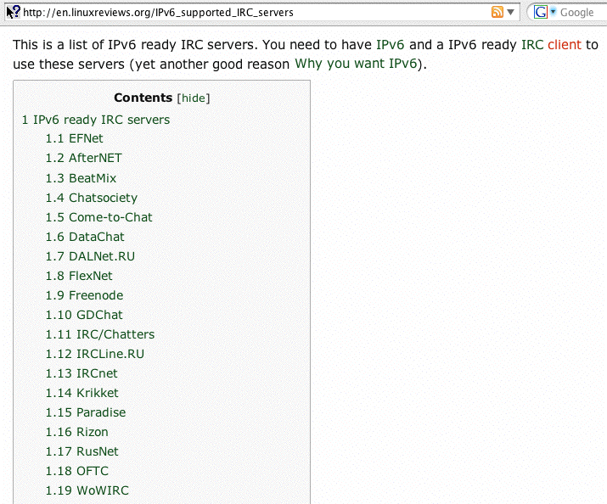
IRC Servers Running on IPv6

Slide 225
6. Miscellaneous Tools and IPv6

Slide 226
6.1 IPv6 Ping
Ping in IPv6 works basically the same as ping in IPv4 (although you may need to use the command name “ping6” instead of just “ping” or you may need to add a flag to tell ping to use IPv6 instead of IPv4).
For example:
% ping6 www.nanog.org
PING www.nanog.org(s1.nanog.org) 56 data bytes
64 bytes from s1.nanog.org: icmp_seq=0 ttl=55 time=107 ms
64 bytes from s1.nanog.org: icmp_seq=1 ttl=55 time=106 ms
64 bytes from s1.nanog.org: icmp_seq=2 ttl=55 time=107 ms
64 bytes from s1.nanog.org: icmp_seq=3 ttl=55 time=107 ms
[etc]

Slide 227
Some Notes About IPv6 Ping
If you need to do an IPv6 ping from a Windows system, open a CMD window and use the “ping6” command
Need a web-accessible IPv6 ping’er? Try:
www.subnetonline.com/pages/ipv6-network-tools.php
You can also ping from Route-Views. To do so, telnet to
route-views.oregon-ix.net , login as rviews (no password required) then use “ping ipv6”. For example:
% telnet route-views.oregon-ix.net
Username: rviews
route-views>ping ipv6 www.ietf.org
Type escape sequence to abort.
Sending 5, 100-byte ICMP Echos to 2001:1890:1112:1::20, timeout is 2 seconds:
!!!!!
Success rate is 100 percent (5/5), round-trip min/avg/max = 196/197/200 ms

Slide 228
6.2 IPv6 Traceroute
Traceroute in IPv6 works basically the same as traceroute in IPv4 (although you may need to use the command name “traceroute6” instead of just “traceroute” or you may need to add a flag to tell traceroute to use IPv6 instead of IPv4)
% traceroute6 www.ietf.org
[snip]
1 vl-142-gw.uoregon.edu (2001:468:d01:8e::1) 2.337 ms 1.039 ms 0.941 ms
2 vl-3.uonet9-gw.uoregon.edu (2001:468:d01:3::9) 0.3 ms 0.261 ms 0.259 ms
2001:468:d00:3::1 (2001:468:d00:3::1) 2.717 ms 2.725 ms 2.71 ms
2001:468:ffff:54d::1 (2001:468:ffff:54d::1) 24.577 ms 24.595 ms 24.569 ms
pao-ipv6.gblx.net (2001:504:d::37) 33.242 ms 169.607 ms 33.134 ms
2001:1890:1fff:308:192:205:34:77 (2001:1890:1fff:308:192:205:34:77)
82.432 ms 82.434 ms 82.478 ms [etc]

Slide 229
Some Notes About IPv6 Traceroutes
Need to do an IPv6 traceroute from a Windows system? Open a CMD window and use the “tracert6” command
Need a web-accessible IPv6 traceroute server?
One’s available at http://4or6.com/
Want a traceroute augmented with routing information? telnet to route-views.oregon-ix.net , login as rviews (no password required) then use “traceroute ipv6”
Many hops in an IPv6 traceroute may lack rDNS (in-addrs are often something of an afterthought)
IPv6 traceroute paths will often follow bizarre paths due to poor route filtering policies (or the use of IPv6 transition technologies or IPv6 tunnel provider services)
IPv4 and IPv6 traceroute paths may routinely follow radically different paths; make no assumptions!

Slide 230
6.3 tcptraceroute (via ndisc6)
“NDisc6 is a small collection of useful tools for IPv6 networking. It includes the following programs :
ndisc6: ICMPv6 Neighbor Discovery tool […]
rdisc6: ICMPv6 Router Discovery tool […]
tcptraceroute6: lightweight IPv6 tcptraceroute […]
traceroute6: IPv6 traceroute […]
rdnssd: Recursive DNS Servers discovery Daemon […]
isatapd: ISATAP daemon […]”
See http://www.remlab.net/ndisc6/
But note: I see errors when building; YMMV

Slide 231
6.4 Routeviews and IPv6
IPv6 aware route servers are available; one list of IPv6-enabled route servers can be found at www.bgp4.net/wiki/doku.php?id=tools:ipv6_route_servers
% telnet route-views.eqix.routeviews.org
route-views.eqix-ash> show ipv6 bgp 2001:468:d01:d6::80df:d617
BGP routing table entry for 2001:468::/32
Paths: (9 available, best #9, table Default-IP-Routing-Table)
Not advertised to any peer
33437 6939 11537
2001:504:0:2:0:3:3437:1 from 2001:504:0:2:0:3:3437:1 (66.117.47.226)
(fe80::2b0:c2ff:fe13:b01c)
Origin IGP, localpref 100, valid, external
Last update: Thu Apr 29 16:46:47 2010
4436 11537
2001:504:0:2::4436:2 from 2001:504:0:2::4436:2 (69.31.31.244)
[etc]

Slide 232
6.5 nc6 (netcat for IPv6)
Quoting from http://www.deepspace6.net/projects/netcat6.html
“In the simplest usage, "nc6 host port" creates a TCP connection to the given port on the given target host (using either IPv4 or IPv6 as appropriate). Your standard input is then sent to the host, and anything that comes back across the connection is sent to your standard output. This continues indefinitely, until the network side of the connection shuts down. […] Netcat6 can also function as a server, by listening for inbound connections on arbitrary ports and then doing the same reading and writing when a client connects. With minor limitations, netcat doesn't really care if it runs in "client" or "server" mode -- it still shovels data back and forth until there isn't any more left. Netcat6 can also be used over UDP […]”

Slide 233
nc6 example (from man nc6)
Server:
% nc6 --continuous --exec cat -l -p 2345
-- continuous (act like inetd)
-- exec (exec this command)
cat (the regular old unix cat command)
-l listen for inbound connects
-p on port number…
Client:
% telnet <ipv6 addr of server> 2345
hello world <-- your input
hello world <-- echo’d back
Use ^C to kill the server, ^] q to kill the client

Slide 234
6.6 tcpdump and IPv6
Build and install tcpdump (4.1.1) and libpcap (1.1.1) from http://www.tcpdump.org/
For IPv6, add the tcpdump ip6 option. For example:
# tcpdump -xvs0 ip6 and tcp port 80
x --> print each packet (except link layer hdr) in hex
v --> slightly verbose
s0 --> capture the whole packet, not just 68 bytes
ip6 --> ipv6 traffic only
tcp port 80 --> only tcp traffic on port 80
If IPSec is being used on IPv6 links, obviously traffic may be obfuscated (unless you know the IPSec key)

Slide 235
Sample tcpdump output (ipv6.google.com)
tcpdump: listening on en0, link-type EN10MB (Ethernet), capture size 65535 bytes 09:15:39.691986 canard.ipv6.uoregon.edu.59761 >
pv-in-x68.1e100.net.http: P [tcp sum ok] 3681843577:3681844207(630) ack 2324549898 win 65535 <nop,nop,timestamp 365589597 2712339760> (len 662, hlim 64)
0x0000: 6000 0000 0296 0640 2001 0468 0d01 00d6 `......@...h....
0x0010: 0000 0000 80df d617 2001 4860 b006 0000 ..........H`....
0x0020: 0000 0000 0000 0068 e971 0050 db74 7979 .......h.q.P.tyy
0x0030: 8a8d d10a 8018 ffff 7235 0000 0101 080a ........r5......
0x0040: 15ca 745d a1ab 0530 4745 5420 2f20 4854 ..t]...0GET./.HT
0x0050: 5450 2f31 2e31 0d0a 486f 7374 3a20 6970 TP/1.1..Host:.ip
0x0060: 7636 2e67 6f6f 676c 652e 636f 6d0d 0a55 v6.google.com..U
0x0070: 7365 722d 4167 656e 743a 204d 6f7a 696c ser-Agent:.Mozil
[snip]
09:15:39.755859 pv-in-x68.1e100.net.http > canard.ipv6.uoregon.edu.59761: . [tcp sum ok] 1:1209(1208) ack 630 win 285 <nop,nop,timestamp 2712558929 365589597> (len 1240, hlim 54)
0x0000: 6000 0000 04d8 0636 2001 4860 b006 0000 `......6..H`....
0x0010: 0000 0000 0000 0068 2001 0468 0d01 00d6 .......h...h....
0x0020: 0000 0000 80df d617 0050 e971 8a8d d10a .........P.q....
0x0030: db74 7bef 8010 011d 05d1 0000 0101 080a .t{.............
0x0040: a1ae 5d51 15ca 745d 4854 5450 2f31 2e31 ..]Q..t]HTTP/1.1
0x0050: 2032 3030 204f 4b0d 0a44 6174 653a 2053 .200.OK..Date:.S
0x0060: 6174 2c20 3031 204d 6179 2032 3031 3020 at,.01.May.2010.
0x0070: 3136 3a31 353a 3339 2047 4d54 0d0a 4578 16:15:39.GMT..Ex
[etc]

Slide 236
Watch An Amsterdam Street Cam via IPv6
http://www.terena.org/webcam/
(you can use tcpdump to confirm that yes, it really IS transmitting via IPv6, e.g.:
# tcpdump -i en0 -xvs0 ip6
will show traffic from wowza.terena.org)

Slide 237
Additional ipv6 tcpdump commands
Want more? All IPv6 traffic verbosely:
# tcpdump -xxvvves0 ip6
Want less? Just IPv6 traffic to/from a specific host:
# tcpdump -xvs0 ip6 host foo.example.com or
# tcpdump -xvs0 ip6 host fe80::203:93ff:fecf:b6a2
Multiple interfaces? You can specify a specific interface (use ifconfig -a or tcpdump -D to see what’s available to pick).
For example, want to see if any ping6’s are getting through on en0?
# tcpdump -i en0 icmp6
IPv6 multicast traffic can be interesting:
# tcpdump -i en0 ip6 multicast
Capture/replay tcpdump files:
# tcpdump -i en0 -w sample.dump ip6
[after a while, ^C]
# tcpdump -r sample.dump
Need the contents of tunneled IPv6 traffic? Check out teredont:
http://speakeasy.wpi.edu/teredont/

Slide 238
IPv6 Packet Formats
Cool little pocket guide from SANS:
http://www.sans.org/security-resources/ipv6_tcpip_pocketguide.pdf

Slide 239
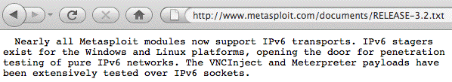
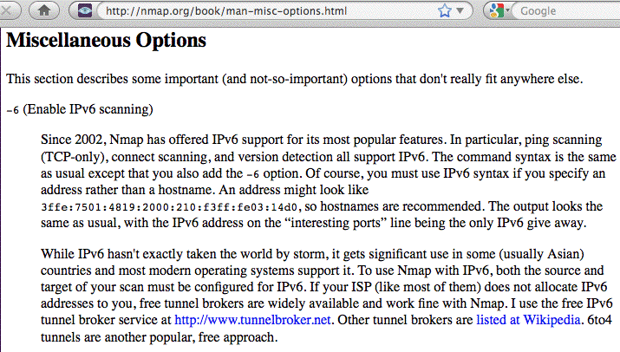
6.7 A Couple Other Staple Security Tools

Slide 240
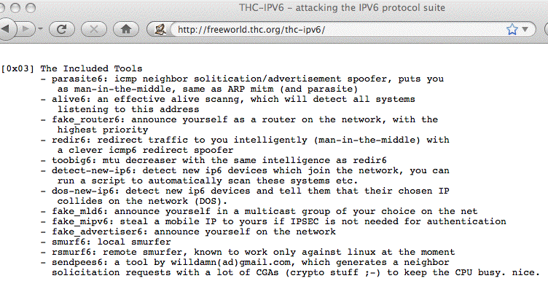
6.8 IPv6 Attack/Pen Testing Tools?

Slide 241
7. IPv6 Network Management

Slide 242
7.1 Network Device Monitoring
Monitoring devices
-- Are all your network devices accessible via
IPv6 ssh for CLI-based management chores?
-- Can you do TFTP (if you need to) over IPv6
transport?
-- Do all those devices support SNMP over IPv6
transport?
-- Do all the device MIBs know about IPv6 SNMP
data structures? For example, can you query
and get just IPv6 octets in/out each interface?

Slide 243
7.2 Netflow
Netflow is a fundamental tool for monitoring and managing your network, however the version of netflow that most sites run, Netflow v5, doesn’t know about IPv6.
In a mixed IPv4/IPv6 environment, you need Netflow v9.

Slide 244
7.3 NTP (Network Time)
Keeping closely synchronized time is another important network management (and system management function).
For more information about NTP, see
http://www.ntp.org/
A list of NTP Stratum 2 servers is available at:
http://support.ntp.org/bin/view/Servers/StratumTwoTimeServers
Some of those servers appear to be available via IPv6…

Slide 245
Some IPv6 NTP Stratum 2 Servers
2001:12f0:4c1:6643::1
2001:12ff::8
2001:1418:1d7:1::1
2001:1470:ff80::12
2001:1af8:4201:1011::1
2001:41d0:1:ac7b::1
2001:4530:2::2:98
2001:4530:2::2:99
2001:470:1f04:a77::2
2001:470:9aad:123::1
2001:470:b407:123::1
2001:470:b409:123::1
2001:470:b8b9::2
2001:470:d:1c2:1:1:123:1
2001:638:504:2000::32
2001:638:504:2000::33
2001:6f8:128a:123::1
2001:6f8:1c00:3f::2
2001:738:5001::1
2001:7a8:810:260::c111:c0d3
2001:7b8:325:1::2
2001:828:100:2001:4::1
2002:58bf:b62::1
2002:8ac3:802d:1243::53
2801:82:0:1::2
2a01:238:4346:a200:cafe:babe:cafe:babe

Slide 246
8. IPv6 Programming

Slide 247
Porting IPv4 Code to IPv6
The best advice I’ve found on porting IPv4 code to IPv6 is from http://owend.corp.he.net/ipv6/
What other resources would people suggest?

Slide 248
9. Who’s Using IPv6?
Don't forget the list
of IPv6 web sites in Section 4.1!

Slide 249
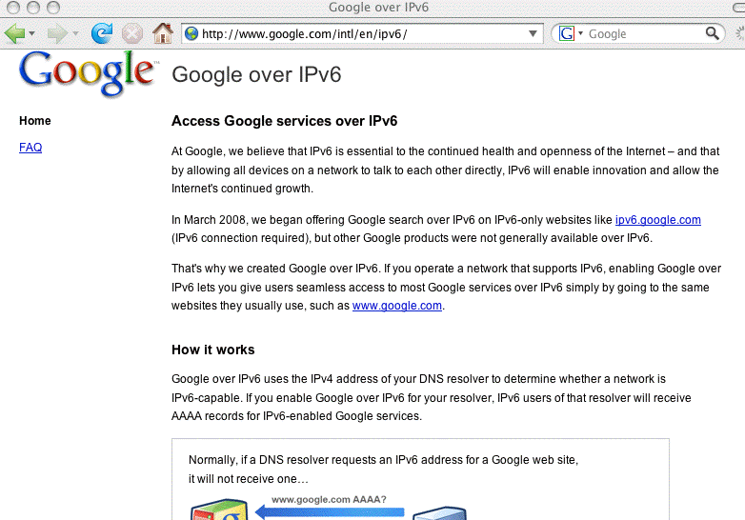
Google Is Promoting Access to Google via IPv6

Slide 250
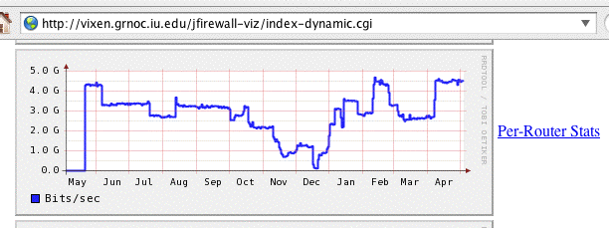
Internet2 Is Carrying Substantial IPv6 Traffic
Notes: This is over the last year and
the Y axis is from 0-5 Gbps
Source: http://vixen.grnoc.iu.edu/jfirewall-viz/index-dynamic.cgi

Slide 251
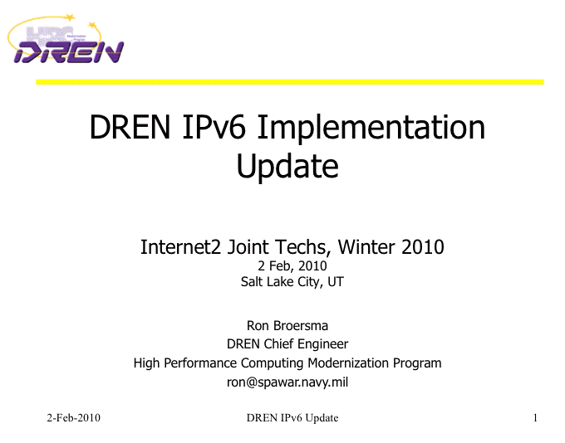
DREN Is Widely Using IPv6
http://www.internet2.edu/presentations/jt2010feb/20100202-broersma.pdf

Slide 252
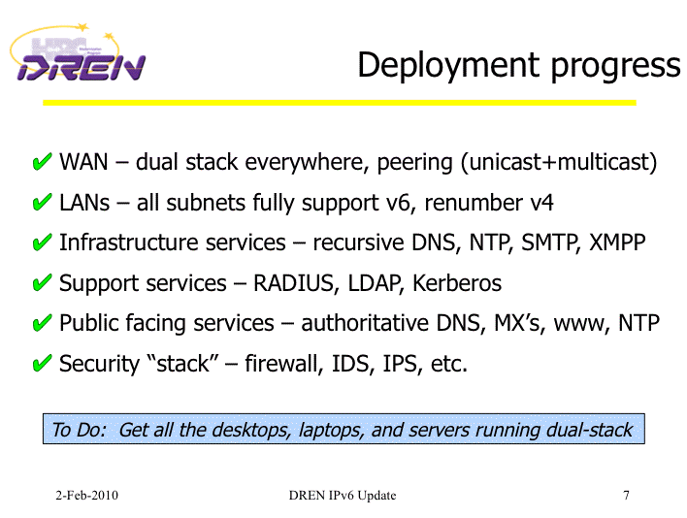
DREN Is Widely Using IPv6 (2)
http://www.internet2.edu/presentations/jt2010feb/20100202-broersma.pdf

Slide 253
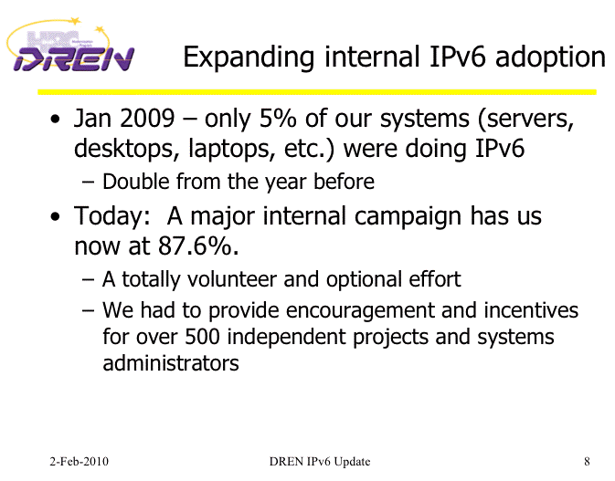
DREN Is Widely Using IPv6 (3)
http://www.internet2.edu/presentations/jt2010feb/20100202-broersma.pdf

Slide 254
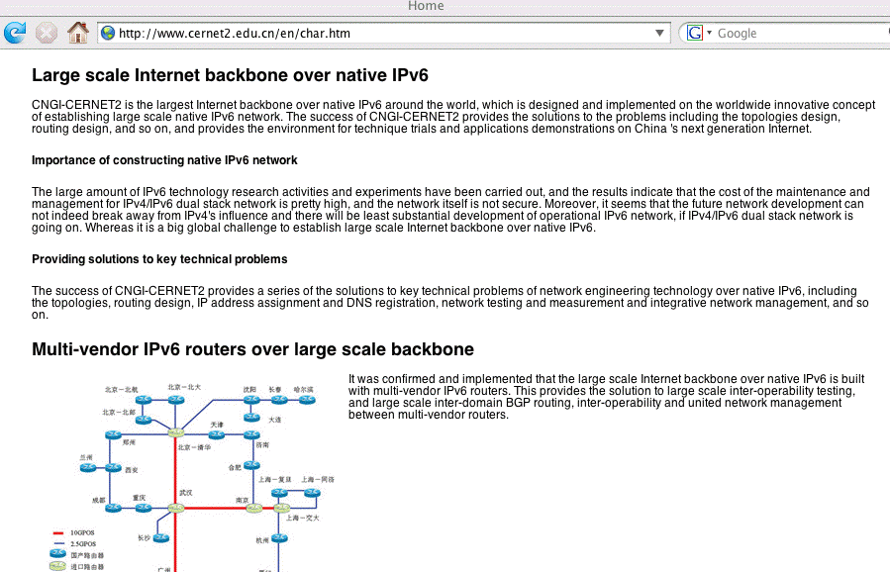
CERNET2 (China) Is IPv6 ONLY
http://www.cernet2.edu.cn/en/char.htm

Slide 255
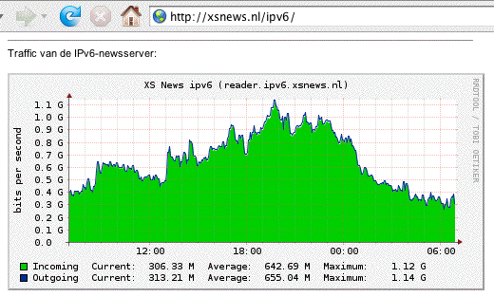
IPv6 Is Carrying A Lot of Usenet Traffic

Slide 256
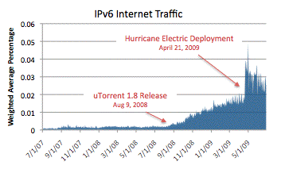
IPv6 Is Also Being Used for P2P
See http://asert.arbornetworks.com/2009/09/who-put-the-ipv6-in-my-internet/

Slide 257
What About YOU?
You Should Be Getting Ready for IPv6!
If you're not currently deploying IPv6 locally, or at least experimenting with IPv6 in a lab setting, the time has come for you to begin to do so.
Deploying IPv6 support will be a team effort, so make sure your conversation includes:
-- your network engineers
-- your domain name server administrators
-- your system administrators
-- your support staff
-- your security and abuse handling people
-- your vendors
Deployment can be incremental. You can take baby steps, you don't need to boil the ocean on day one.

Slide 258
Learning More About IPv6: Books
A nice online reference: 6Net IPv6 Cookbook, www.6net.org/publications/deliverables/D3.1.2v2.pdf
Traditional printed books about IPv6 are also available. If you go to Amazon's book section and search for IPv6, for example, you get 809 hits. That's a bit better than in the old days. :-)
When considering which of those books might work for you, recognize that some are written for specific audiences (like programmers), and those sort of books may not meet your particular needs (unless you're a coder and you're trying to come up to speed for IPv6).
Also recognize that IPv6 is rapidly evolving, so beware of any books that haven't been recently updated.

Slide 259
Thanks For the Chance To Talk!
Are there any questions?

