Slide 1
The Tragedy In Japan: A 9.0 Earthquake, Massive Tsunami, Large Scale Radiological Contamination, …
Joe St Sauver, Ph.D.
joe@internet2.edu or joe@oregon.uoregon.edu
Internet2 Nationwide Security Programs Manager
Salsa-DR (Disaster Planning and Recovery) BOF
7:30-8:30AM Tuesday, April 19th, 2011
Internet2 Member Meeting, Arlington VA
http://pages.uoregon.edu/joe/japan-tragedy/

Slide 2
1. Introduction

Slide 3
The Terrible Tragedy in Japan
Those of us who are outside Japan, and far away from the disasters it has suffered, can only imagine what our Japanese friends and colleagues are going through, but our sympathy and prayers goes out to all of you -- particularly those of you who may have lost family members, friends, or colleagues to that awful event.
If possible, please consider donating generously to the Red Cross to help those in Japan during this time of need.
While many of the lessons that we will ultimately take away from that disaster are still unfolding, we did want to at least begin to talk about what we might be able to learn from that event, so that we might perhaps be able to be prepared if a similar (or even worse) natural disaster were to happen to us here in the United States.

Slide 4
Our Objective Today: Preparedness
Obviously we CAN’T *prevent* earthquakes, tsunamis, radiological release events, etc.
We CAN, however, be *prepared* to understand, mitigate, and respond to their effects on our facilities and users.
Our desire to minimize the effects of these sort of disasters on our facilities and users should not be taken as a criticism of what others have or haven’t done – everyone’s trying their best to do what they can.
At the same time, though, we have an obligation to look unflinchingly at what we face, and what must be done.
Just this past month, we have tangible proof that the White House understands this issues and gets the need for us, as a nation, to be prepared…

Slide 5
PPD-8: National Preparedness
I’d urge everyone to review Presidential Policy Directive 8: National Preparedness, dated March 30, 2011,
http://www.dhs.gov/xabout/laws/gc_1215444247124.shtm
“This directive is aimed at strengthening the security and resilience of the United States through systematic preparation for the threats that pose the greatest risk to the security of the Nation, including acts of terrorism, cyber attacks, pandemics, and catastrophic natural disasters. Our national preparedness is the shared responsibility of all levels of government, the private and nonprofit sectors, and individual citizens. Everyone can contribute to safeguarding the Nation from harm. As such, while this directive is intended to galvanize action by the Federal Government, it is also aimed at facilitating an integrated, all-of-Nation, capabilities-based approach to preparedness. [continues]”

Slide 6
2. The Earthquake

Slide 7
The Tohoku Quake: 2:46 PM Local Time, 3/11/2011
The tragedy in Japan started with an earthquake.
At 2:46 PM on April 11th, 2011, a 9.0 magnitude earthquake occurred at 38.322 degrees N, 142.369 degrees E, at a depth of 19.9 miles, near the east coast of Honshu Island.
The epicenter of that submarine quake was:
80 miles East of Sendai, Honshu (population 1 million+)
109 miles East of Yamagata, Honshu
109 miles East North East of Fukushima, Honshu
231 miles Northeast of Tokyo (population 13 million+)
See: http://earthquake.usgs.gov/earthquakes/
eqinthenews/2011/usc0001xgp/

Slide 8
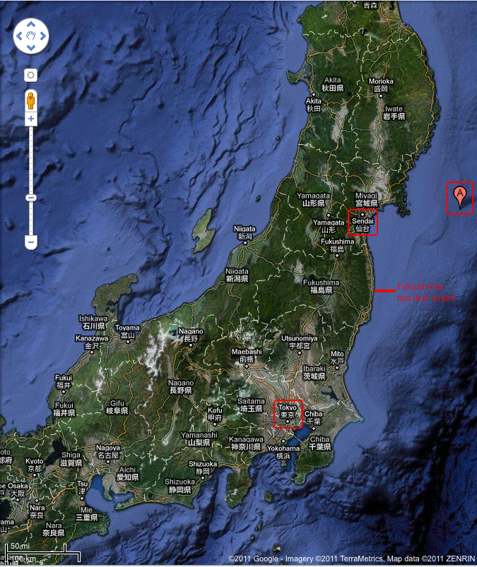

Slide 9
It Was the 4th or 5th Largest Quake Since 1900
At magnitude 9.0, the Tohoku earthquake was the largest quake in Japan since Japan began tracking earthquakes 130 years ago, and the 4th or 5th largest quake worldwide since 1900. Some other extremely serious earthquakes:
-- 1960 Valdivia Chile Earthquake (magnitude 9.5)
-- 1964 Prince William Sound Alaska Earthquake (9.2)
-- 2004 Indian Ocean Earthquake (9.1-9.3 (est.))
-- 1952 Kamchatka Earthquake, USSR (9.0)
-- 1833 Sumatra, Indonesia Earthquake (8.8-9.2 (est.))
-- 1906 Ecuador-Colombia Earthquake (8.8)
-- 2010 Chile Earthquake (8.8)
-- 1700 Cascadia Earthquake (8.7-9.2 (est.))
-- 1730 Valparaiso, Chile, Earthquake (8.8-9.0 (est.)
See http://en.wikipedia.org/wiki/Lists_of_earthquakes

Slide 10
There Have Been Strong/Major “Aftershocks,” Too
Mag UTC Date/Time Lat Long Depth (km)
7.1 2011/04/07 14:32:41 38.253 141.640 49.0
NEAR THE EAST COAST OF HONSHU, JAPAN
6.6 2011/04/11 08:16:13 37.007 140.477 10.0 EASTERN HONSHU, JAPAN
6.2 2011/04/11 23:08:16 35.406 140.542 13.1
NEAR THE EAST COAST OF HONSHU, JAPAN
6.1 2011/04/13 19:57:23 39.587 143.357 11.2
OFF THE EAST COAST OF HONSHU, JAPAN
6.1 2011/04/09 12:57:49 30.013 131.810 21.3 KYUSHU, JAPAN
http://earthquake.usgs.gov/earthquakes/recenteqsww/Maps/region/Asia_eqs.php

Slide 11
3. The Tsunami

Slide 12
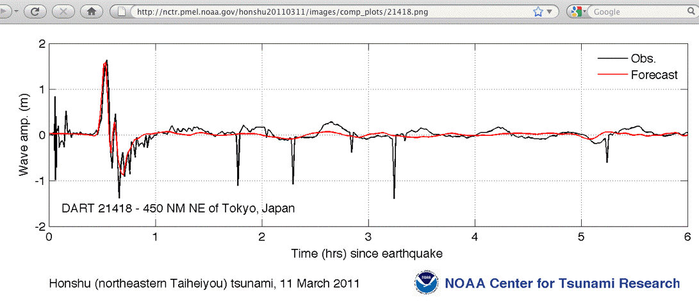
The Quakes Were Only The Beginning: The Tsunami
As often happens, the large offshore earthquake triggered an extremely destructive tsunami with waves heights on land of 6 to 10 meters or more, compounding the damage directly caused by the earthquake.

Slide 13
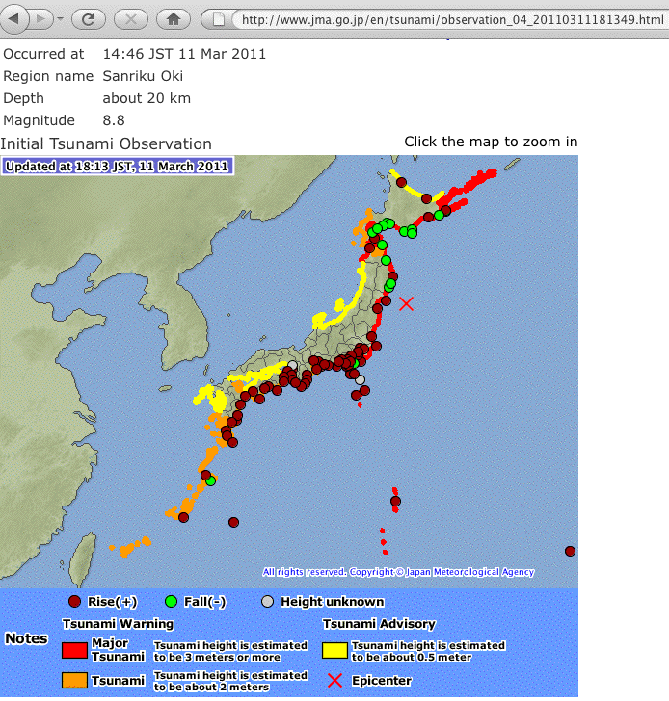
Tsunamis Were Experienced Along Much of Japan’s Coastline

Slide 14
Loss of Life and Property Damage
The dead and missing now number 28,232,* and that number is still increasing. An additional 4,916 were injured by the disasters in Japan. Nearly 60,000 pieces of property were completely destroyed, and over 158,000 were partially damaged.
For comparison, 4,081 people died from Hurricane Katrina, and 2,976 people died from the attacks on 9/11.
* National Police Agency of Japan, Emergency Disaster
Countermeasures Headquarters, April 14th, 2011, 7:00PM
http://www.npa.go.jp/archive/keibi/biki/index_e.htm

Slide 15
The Most Expensive Natural Disasters
Emerging estimates are that this earthquake and resulting tsunami will be the most expensive natural disasters in history.
The World Bank released an early estimate* that damage might reach $235 billion, but the Japanese Cabinet Office has mentioned costs of up to 25 trillion yen** ($309 billion)… and those costs do not include lost economic productivity due to power outages, or the broader impact of the nuclear crisis.
Hurricane Katrina, for comparison, cost an estimates $81 billion.
* http://siteresources.worldbank.org/INTEAPHALFYEARLYUPDATE/Resources/550192-1300567391916/EAP_Update_March2011_japan.pdf
** http://hosted2.ap.org/APDEFAULT/cae69a7523db45408eeb2b3a98c0c9c5/
Article_2011-03-23-AS-Japan-Earthquake-Economy/
id-b7f626429b4a4900bfb1731387d50e7f

Slide 16
Numbers Don’t Really Tell The Story, However
One of the most compelling ways to understand the destruction caused by this disaster is by seeing video or pictures of it…
http://news.nationalgeographic.com/news/2011/03/pictures/110315-nuclear-reactor-japan-tsunami-earthquake-world-photos-meltdown/
http://www.nytimes.com/interactive/2011/03/13/world/asia/satellite-photos-japan-before-and-after-tsunami.html
Truly, the earthquake and the tsunami were horrible disasters in their own right. That’s only the beginning, however…

Slide 17
3. The Radiological Release

Slide 18
The Earthquake and The Tsunami In Turn Resulted in
Damage to The Fukushima-Daiichi Nuclear Complex
The most detailed and seemingly authoritative analysis of the damage to the six reactors may be the NRC Reactor Safety Team’s assessment and recommendations of 2100 hrs 3/26/2011 as distributed at http://cryptome.org/0003/daiichi-assess.pdf on 4/7/2011
On the morning of April 12th, 2011, Japan Today was reporting that the Nuclear Safety Commission of Japan believed that the Fukushima-Daiichi plant had been releasing up to 10,000 terabecquerels of radioactive material per hour, a finding which was prompting the Japanese government to raise the incident’s severity level to 7 (a level that only Chernobyl has heretofore attained).
See http://www.japantoday.com/category/national/view/japan-may-raise-nuclear-accident-severity-level-to-highest-7-from-5 [emphasis added]

Slide 19
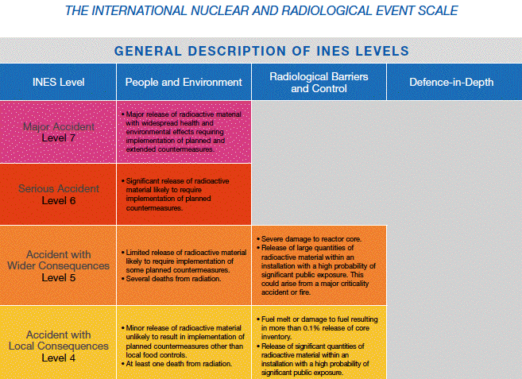

Slide 20
What Are All These Weird Units of Radiation?
Metric Traditional
Activity: Becquerel (Bq) Curie (Ci)
Absorbed Dose: Gray (Gy) Rad (1 rad=0.01Gy)
Effective Dose: Sievert (Sv) Rem (1 rem=0.01Sv)
Equivalent Dose: Sievert (Sv) Rem
Exposure: Columbs/kg in air Roentgen (R)
Activity: counts/second
Absorbed dose: amount of radiation absorbed by any material
Equivalent Dose: the equivalent dose weights the absorbed dose by the type of radiation involved (gamma radiation is 1, neutrons have weights that range up to 10, alpha particles are 20, etc.)
Effective Dose: adjusts the equivalent dose by a tissues weighting factor (representing the tissues which were exposed)
The use of the Roentgen as a unit of measurement is deprecated/strongly discouraged by NIST

Slide 21
Radiation Effects
0-250 mSv: None noticeable (but chromosome damage and
sperm anomalies may be present at 150 mSv)
250-1,000 mSv: Nausea; loss of appetite; damage to bone marrow
lymph nodes, and spleen.
1,000-3,000 mSv: Mild to severe nausea; loss of appetite; infection;
fatigue; more severe bone marrow, lymph node and
spleen damage; recovery probable, not assured.
3,000-6,000 mSv: Severe nausea; loss of appetite; hemorrhaging;
infection; diarrhea; skin effects; sterility;
50% may die within one month w/o acute care
after 3,500-4,000 mSv
6,000 mSv: 50% may die within one month with acute care.
6,000-10,000 mSv: As for 3,000-6,000 mSv plus central nervous
system impairment; death expected.
>10,000 mSv: Incapacitation and death in >90% of cases even
with acute care.
Conversion: 1,000 mSv --> 1 Sv, 100 rem --> 1 Sv.
Average annual exposure in the US: 6 mSv (or 600 millirem)

Slide 22
What Are Levels on The Ground Near the Site?
Unfortunately, we still just don’t know.
The radiation measuring devices that were deployed in the relevant prefectures have apparently all been destroyed by the tsunami, and hard as it may be to believe, they may not have been replaced since that time.
Sites such as http://www.bousai.ne.jp/eng/index.html
report that radiation levels in Fukushima and Miyagi are “under survey” as of April 14th, 2011.

Slide 23
Some Estimates on the Total Radiological Release
“[Hidehiko Nishiyama, Deputy Director General of Japan’s Nuclear Regulator, the Nuclear and Industrial Safety Agency] said that emissions totaled 370,000 terabecquerels; a terabecquerel is a trillion becquerels. The agency's figure is 20 percent of the former Soviet Union's official estimate of emissions from Chernobyl. But most experts say that the true emissions from Chernobyl were 1.5 to 2.5 times as high as the Soviet Union acknowledged. Mr. Nishiyama's agency appears to have assumed that true emissions from Chernobyl were twice the official figure, and so calculated that the current nuclear accident had released 10 percent as much as Chernobyl.
Mr. Nishiyama's agency is part of the Ministry of Economy, Trade and Industry, which promotes the use of nuclear power. Mr. Shiroya's [Japanese Nuclear Safety Commission], which is independent from nuclear power operators and their equipment providers, issued an estimate that emissions totaled 630,000 terabecquerels. Although Mr. Shiroya did not provide a comparison to Chernobyl, that works out to 34 percent of the official Soviet estimate of emissions and 17 percent of the unofficial higher estimate Mr. Shiroya also said there was a threefold margin for error involved. The outside estimates of total releases would range from as low as 6 percent to as high as 51 percent of the unofficial totals from Chernobyl.”
http://www.nytimes.com/2011/04/13/world/asia/13japan.html (April 12th, 2011)
[emphasis added; formatting adjusted to fit the available space]

Slide 24
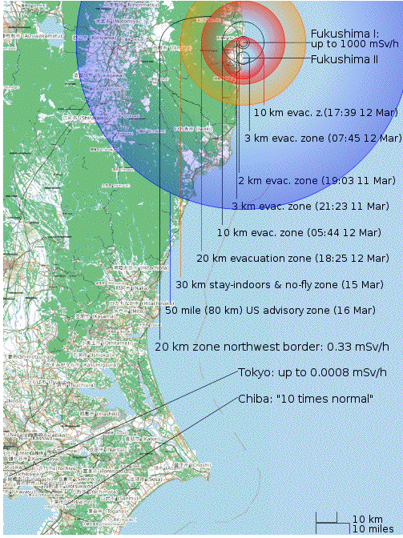
The Evacuation and Shelter-in-Place Zones in Japan
Source: http://en.wikipedia.org/wiki/File:Fukushima_accidents_overview_map.svg

Slide 25
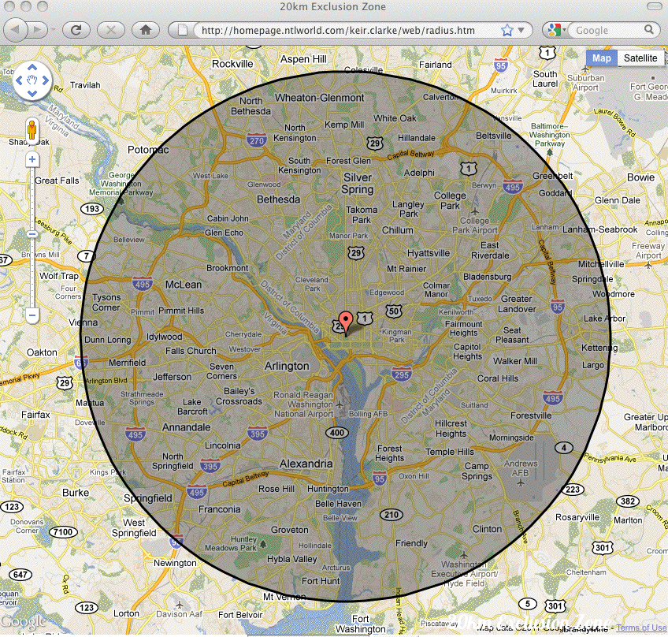
What Would Even A 20KM Exclusion Zone Look Like for DC?

Slide 26
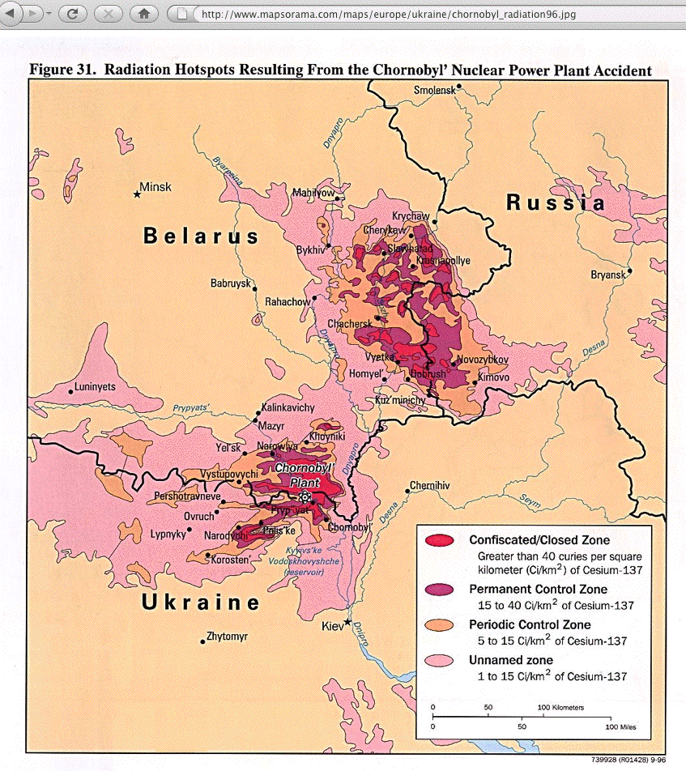
For Comparison, The Chernobyl Exclusion Zone Has A Nominal
Radius of 30KM*, But The Actual Shape is Less Regular
* http://www.iaea.org/newscenter/features/chernobyl-15/cherno-faq.shtml

Slide 27
4. Power Outages, Transportation Outages, Food Shortages, Water Supply Shortages, Emergency Housing Requirements, Emergency Medical Services, Impacts on Education,
Etc., Etc., Etc.

Slide 28
Electric Power
Generating capacity was lost (www.washingtonpost.com/
wp-srv/special/world/japan-power-grid/) at the Fukushima Daiichi complex, but also at additional sites:
-- Nuclear plants: Fukushima Daini and Tokai, and
-- Thermal plants: Akita, Haramati, Higashi-Ohigishima,
Hitachinaka, Kashima, Noshiro, Ohi, and Onagawa
Loss of those plants, coupled with limitations associated with the Japanese power grid (see “How A Legacy From the 1800s Is Making Tokyo Dark Today,” http://www.wired.com/gadgetlab/2011/03/tech-legacy-tokyo/ ) resulted in more than a million households being without electrical service and rolling blackouts happening in some parts of Japan.
The total power shortfall will likely worsen as summer approaches (and the demand for air conditioning increases)
There are also problems moving power around the country due to half the country using 50Hz and half 60Hz

Slide 29
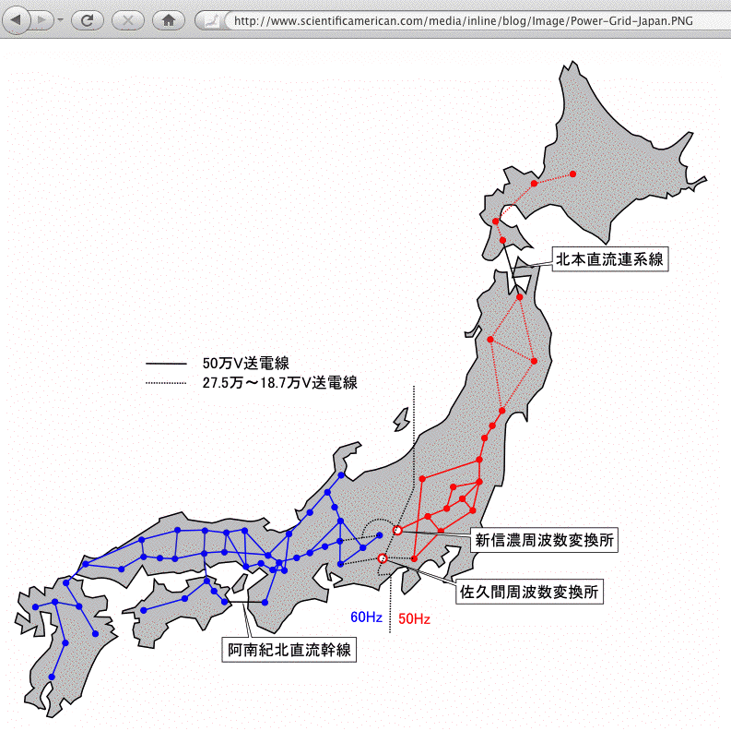
The Japanese Power Grid: 50 Hz vs. 60 Hz
Note: Tokyo is in the Northern
50Hz zone affected by the
disaster

Slide 30
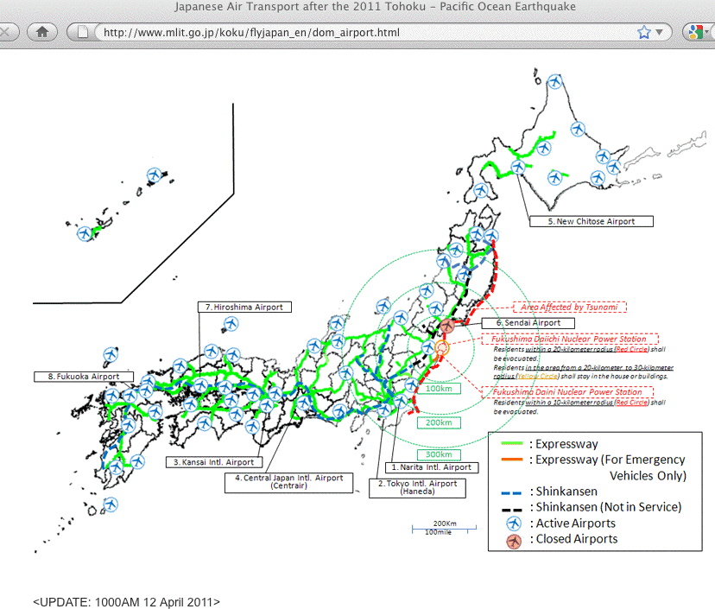
Transportation Was Also Affected

Slide 31
Food, Water, Shelter, and Emergency Medical Help
Given general levels of disruption, along with problems specific to the electrical supply and the transportation system, along with mandatory evacuation orders or mandatory orders to shelter in place, it is hardly surprising that basic necessities such as food, potable water, shelter and emergency medical assistance have been scarce in some area.
We could go on, but you get the point: this is close to a worse-case disaster scenario.
The US State Department has issued a travel warning recommending that US citizens defer non-essential travel to Tokyo, Yokohama and a variety of other sites in Japan.

Slide 32
Japanese Schools Have Also Been Impacted
Elementary and secondary schools in the affected regions of Japan have been impacted in multiple ways:
-- Some schools have lost students or teachers to the
disasters
-- Others have had facilities that may have been damaged
or destroyed
-- Still other schools have generously opened their
gymnasiums, assembly halls or grounds for use for
emergency shelter
There’s a strong desire in Japan to get those schools “back to normal” to help communities get “back to normal”

Slide 33
Has All This Directly Affected US Universities?
Yes.
Many of us have had exchange programs with Japanese partner institutions, and in some cases, the decision has been made to temporarily suspend those programs and bring those students home from Japan.
For example…

Slide 34
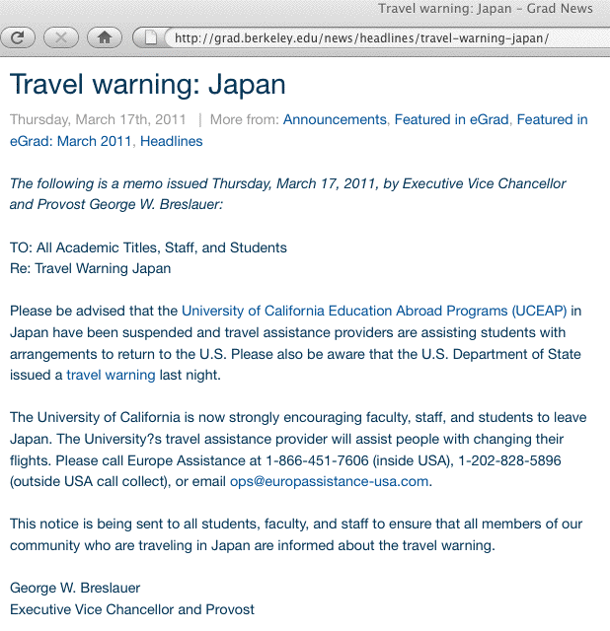

Slide 35
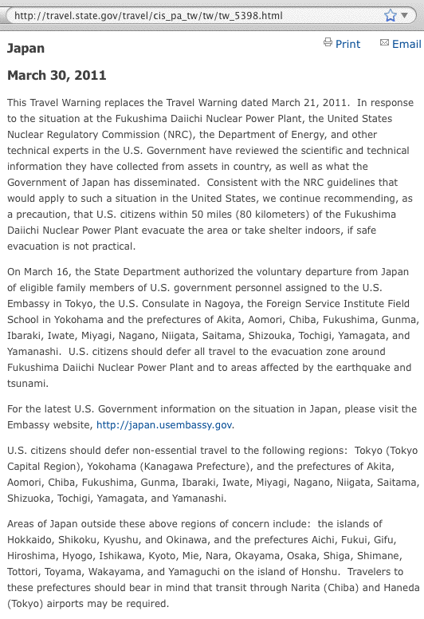

Slide 36
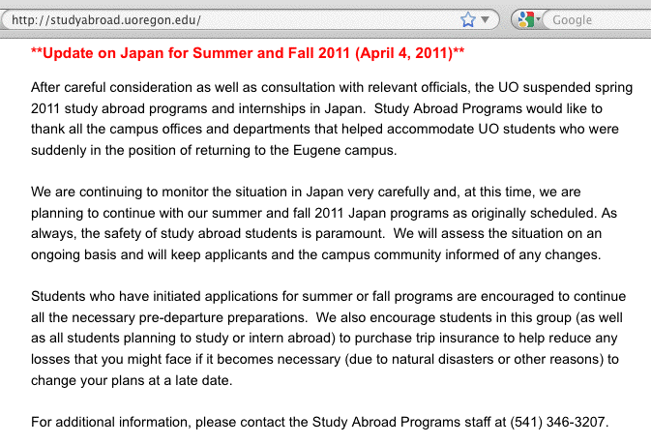
The Real Question: What About Preparing For Next Year?

Slide 37
5. Preparedness…

Slide 38
What Can The Community Do To Get Prepared?
Let’s consider each of the disaster threats in turn (earthquake, tsunami, radiological release, etc.)
We can think about pre-disaster preparation, how to react during a disaster, and how we can recover from a disaster.

Slide 39
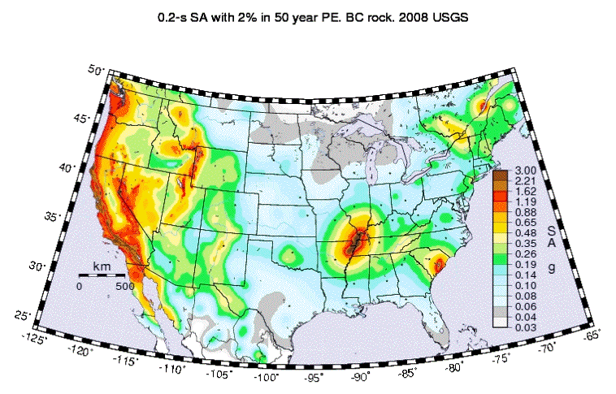
Step #1: Understand If You’re In A Quake Zone…
http://earthquake.usgs.gov/hazards/products/conterminous/2008/maps/

Slide 40
Step #2: Conduct a Seismic Audit and Retrofit
Not all facilities are equally ready to ride out an earthquake.
A sitewide seismic audit can identify facility vulnerabilities, and help you to develop strategies to retrofit your facility to mitigate those vulnerabilities. Talk to an architect or engineering firm specializing in seismic risk management!
While all campus buildings are important, your datacenters are often particularly high value facilities and should be at or near the top of your facility priority list.
When reviewing your datacenter, be particularly alert to things like un-braced raised flooring, and “floating” server cabinets that are not tied down.
Simple and cheap steps can also help: move heavy objects to lower shelves in your offices, tie tall furniture to wall studs with flexible strapping, etc.

Slide 41
During An Earthquake: If Indoors
DROP to the ground; take COVER by getting under a sturdy table or other piece of furniture; and HOLD ON until the shaking stops. If there isn’t a table or desk near you, cover your face and head with your arms and crouch in an inside corner of the building.
Stay away from glass, windows, outside doors and walls, and anything that could fall, such as lighting fixtures or furniture.
Stay in bed if you are there when the earthquake strikes. Hold on and protect your head with a pillow, unless you are under a heavy light fixture that could fall. In that case, move to the nearest safe place.
Use a doorway for shelter only if it is in close proximity to you and if you know it is a strongly supported, loadbearing doorway.
Stay inside until the shaking stops and it is safe to go outside. Research has shown that most injuries occur when people inside buildings attempt to move to a different location inside the building or try to leave.
Be aware that the electricity may go out or the sprinkler systems or fire alarms may turn on.
DO NOT use the elevators.
Source: http://www.fema.gov/hazard/earthquake/eq_during.shtm

Slide 42
During An Earthquake: If Outdoors
If outdoors, stay there.
Move away from buildings, streetlights, and utility wires.
Once in the open, stay there until the shaking stops. The greatest danger exists directly outside buildings, at exits and alongside exterior walls. Many of the 120 fatalities from the 1933 Long Beach earthquake occurred when people ran outside of buildings only to be killed by falling debris from collapsing walls. Ground movement during an earthquake is seldom the direct cause of death or injury. Most earthquake-related casualties result from collapsing walls, flying glass, and falling objects.
www.fema.gov/hazard/earthquake/eq_during.shtm

Slide 43
If Driving or Trapped By Debris
If in a moving vehicle during an earthquake
Stop as quickly as safety permits and stay in the vehicle. Avoid stopping near or under buildings, trees, overpasses, and utility wires.
Proceed cautiously once the earthquake has stopped. Avoid roads, bridges, or ramps that might have been damaged by the earthquake.
If trapped under debris during an earthquake
Do not light a match.
Do not move about or kick up dust.
Cover your mouth with a handkerchief or clothing.
Tap on a pipe or wall so rescuers can locate you. Use a whistle if one is available. Shout only as a last resort. Shouting can cause you to inhale dangerous amounts of dust.
http://www.fema.gov/hazard/earthquake/eq_during.shtm

Slide 44
Tsunamis
Even more so than is the case for earthquakes, you may have limited options for dealing with tsunamis, except for avoiding tsunami zones and being prepared to evacuate if a tsunami warning is issued.
If you do live in a tsunami evacuation zone, and you feel an earthquake or hear a tsunami warning, follow your tsunami evacuation plan or at least move to higher ground (an excellent 12 page tsunami brochure is available from the International Tsunami Information Centre,
http://ioc3.unesco.org/itic/contents.php?id=169 )
The amount of time you may have to react will be in part a function of where the tsunami was generated, and how quickly you learn of it.
Do you have a weather emergency alert system radio?
(Tsunami warnings are broadcast over the same system used for other alerts, see the list of covered events at
http://www.weather.gov/os/eas_codes.shtml )

Slide 45
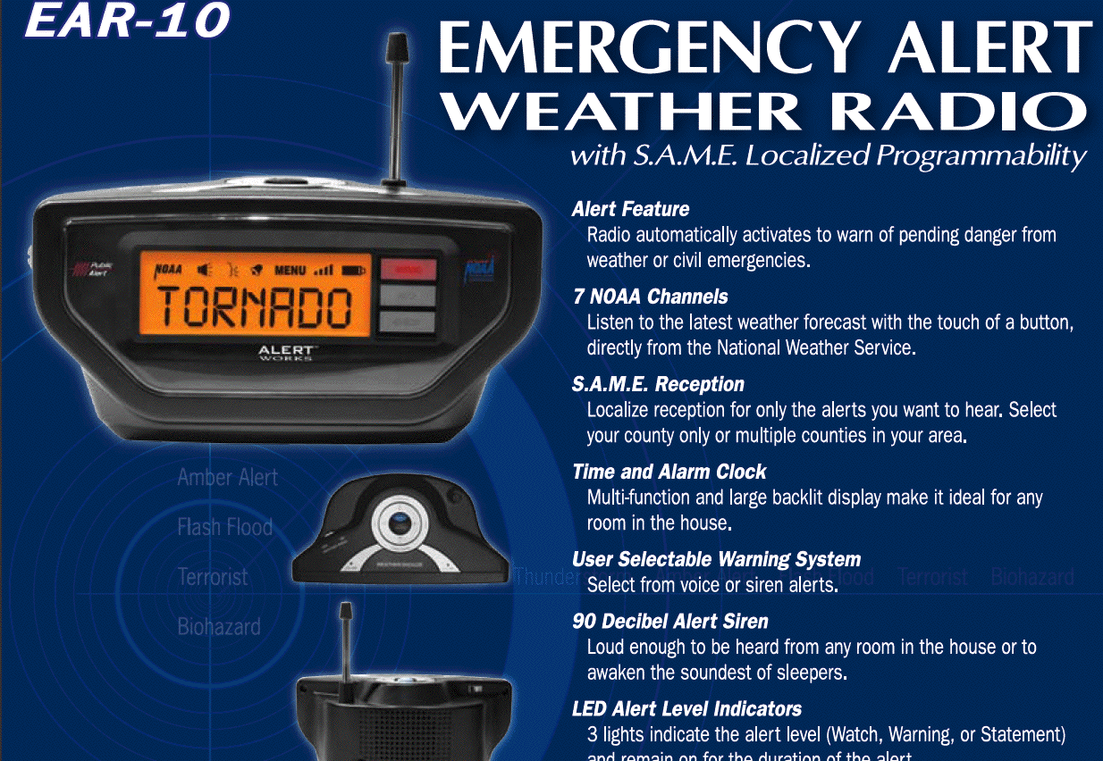
Sample Emergency Alert Weather Radio (Weather Radios Should Be As Common As Smoke Detectors!)

Slide 46
Local Potential Radiological Release Sources
You may want to understand potential local and regional radiation sources, such as nuclear power plants.
Note that there are multiple types of nuclear facilities here in the United States, including:
-- production power reactors
-- research and test reactors
-- Department of Energy and Department of Defense
nuclear facilities
35 “agreement states” may also issue state licenses for byproduct materials, source materials, and special nuclear materials in “quantities insufficient to form a chain reaction”, as well as “naturally occurring and accelerator produced radioactive materials.” It may be difficult or impossible to obtain location information for state-licensed nuclear facilities (sorry about that).

Slide 47
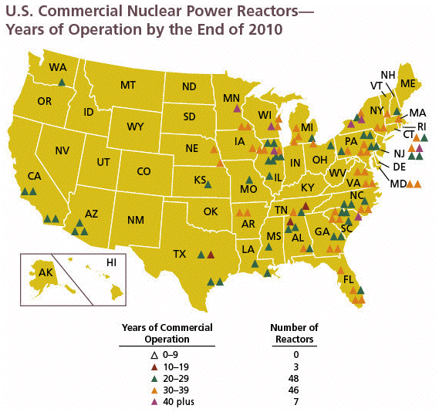
Production Power Reactors in the US

Slide 48
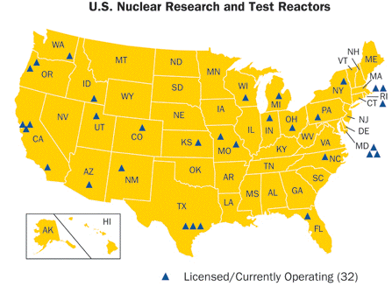
Research and Test Reactors in the US

Slide 49
DOE and DOD Nuclear Facilities
The Department of Energy (DOE) and the Department of Defense (DOD) also have a large number of nuclear facilities, sites which are often less well-known/less well-publicized than civilian nuclear power sites. These may include National Nuclear Security Administration sites involved in nuclear weapon production and storage, or DOD sites hosting missiles, bombers, or submarines.
On the 5th of May, 2009, the US Government Print Office released a 267 page document describing the location and purpose of all US nuclear sites required to be disclosed to the International Atomic Energy Agency (IAEA). That document is classified by the IAEA as “highly confidential safeguards sensitive” but the US classifies it solely as “sensitive but unclassified.” Copies of that document remain available over the Internet.

Slide 50
Preparing For Radiation Emergencies
State public health offices may provide information about preparing for potential radiation emergencies. For example, here in Oregon, the State Public Health Office offers
a “Radiation Emergencies Frequently Asked Questions” doc,
http://public.health.oregon.gov/HealthyEnvironments/RadiationProtection/Documents/radiationemergencies.pdf
That 36 page document provides specific recommendations for how you can prepare for radiation emergencies, including offering suggestions for evacuation, sheltering-in-place, recommended emergency supplies you may want to stockpile, etc. There are many items on that recommended supplie list that, when you hear them mentioned, are immediate “Oh yeah, that WOULD be really helpful to have!” items, so be sure to check it out.

Slide 51
Questions?
Are there any questions?

