Slide 1
MAAWG IPv6 Training for Senders and Others
Joe St Sauver, Ph.D. (joe@oregon.uoregon.edu)
MAAWG, Washington DC, October 4th-6th, 2010
www.uoregon.edu/~joe/maawg-senders-ipv6-training/
Disclaimer: All opinions expressed in this talk are strictly my own, and do not necessarily represent the opinions of any other entity. This talk is provided in a detailed written form to insure accessibility, and for ease of web indexing.

Slide 2
Welcome to the DC Area and MAAWG’s IPv6 Training for Senders (and Others)!
We’re excited to be with you here today to talk for about seventy five minutes about what you might want to know about IPv6 if you’re a sender.
Just to get started, let’s go around the room and have each person briefly say:
-- who they are
-- what they do
-- the company you’re with
-- a little about your interest in/experience with IPv6
-- your technical level (non-technical, semi-technical,
hard-core geek, or whatever)

Slide 3
PART I.
Basic IPv6 For Senders

Slide 4
1. Do Mail Senders Really
Need IPv6 Today?

Slide 5
If You’re A Mail Sender, Do You
Really Need IPv6 Today? Well, No.
You obviously already have IPv4 address space.
The sites you’re sending to, with perhaps just a few exceptions, will not have IPv6-enabled mail transfer agents (MTAs), so even if you wanted to talk to them
via IPv6, they may not be ready for you to do so.
If the sites you’re sending to do have IPv6-enabled MTAs, in virtually every case those MTAs will be actually be “dual stack,” e.g., they’ll support both IPv6 and IPv4 transport, they won’t be IPv6-only MTAs.
So, if you can already reach a site via IPv4, why bother trying IPv6 instead, particularly if some of that IPv6 connectivity may be tunnelled and indirect, slow, lossy,
or otherwise lower quality than also-available IPv4 links?

Slide 6
But, Even If You Don’t Need To
Move to IPv6 As A Sender, Others Do
For example, within a year or two, there will not be any more IPv4 address space to allocate to growing ISPs working hard to hook up new customers, or ISPs trying to accommodate a growing number of devices/customer.
Alternatives to IPv6, such as using Network Address Translation (NAT) with private address space, pose some really ugly operational challenges for ISPs (particularly for things like tracking down malware-infested customers living behind a NAT box)
Software and hardware vendors that need to service a market that’s moving to IPv6 also need to “make the IPv6 leap” and enable IPv6 in their products as a result of their customers’ emerging requirements.

Slide 7
Bottom Line
Since you’re already here, you might as well at least learn a little about IPv6, and maybe even give it a try when you get back home
The process doesn’t have to be painful, and if you don’t like it, as a sender you can always “back it back out” and go back to just using IPv4.
The first part of this talk will be for those of you who are bsuy and goal oriented: we’ll start by looking at what you’d need to do if you did want to begin sending email traffic from an IPv6-enabled server on an
IPv6-enabled network.

Slide 8
2. IPv6 and SMTP

Slide 9
Email Is The "Forgotten"
Application of IPv6
While many people are very excited about the thought of using IPv6 for the web, for some reason there seems to be a lot less excitement about using IPv6 for email.
Thus, while many mainstream mail software products support IPv6, relatively few mail administrators apparently bother to enable IPv6 support.
But some sites ARE deploying IPv6-accessible mail servers right now. For example…

Slide 10
Sample Institutional IPv6 Enabled MX
% dig ucla.edu mx +short
5 smtp.ucla.edu.
% dig smtp.ucla.edu a +short
169.232.46.240
169.232.46.241
169.232.46.242
169.232.46.244
etc.
% dig smtp.ucla.edu aaaa +short
2607:f010:3fe:302:1013:72ff:fe5b:60c3
2607:f010:3fe:102:101c:23ff:febe:116e
2607:f010:3fe:102:101c:23ff:febf:cfa7
2607:f010:3fe:102:101c:23ff:fed0:918c
etc.

Slide 11
Examples of Other IPv6 Enabled Domains/MXs
brocade.com (mx10.brocade.com)
maine.edu (mail-relay.maine.edu)
vt.edu (inbound.smtp.vt.edu)
iij.ad.jp (omgi.iij.ad.jp)
ams-ix.net (betonmix.noc.ams-ix.net)
apnic.net (hoisin.apnic.net)
arin.net (smtp2.arin.net)
dren.net (drenmail.dren.net)
es.net (mail.es.net)
he.net (he.net)
jpnic.net (mx15.nic.ad.jp)
lacnic.net (mail.lacnic.net)
ripe.net (postgirl.ripe.net)
icann.org (pechora2.icann.org)
ietf.org (mail.ietf.org)
isc.org (mx.ams1.isc.org)
kth.se (mx.kth.se)

Slide 12
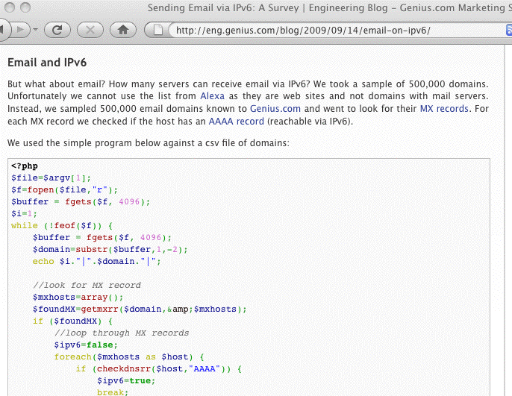
Code To Check for IPv6 MX Records
<-- must be php5 (for getmxrr)
<-- ($buffer,0,-1)
<-- ($domain,&$mxhosts)
[continues; see the original site for the full code]

Slide 13
Important Note:
While we may be curious to find out who’s currently running with SMTP enabled over IPv6, we do NOT need to manually keep track of those sites, NOR do we need to change any of the addresses we mail to once both the sender and receiver are IPv6 enabled and IPv6 accessible.
In most cases, mail servers will simply automatically select IPv6 transport if both the sender and the receiver support IPv6.
As a sender, then, you simply need to:
-- get IPv6 connectivity (and IPv6 address space)
-- enable IPv6 for your server’s operating system
-- enable IPv6 for your MTA
Go over ALL the things you’ll need to do before you start ordering connectivity and start modifying gear, etc.!

Slide 14
3. Obtaining Native IPv6 Connectivity
And Address Space

Slide 15
Add IPv6 Internet Transit Connectivity
This task is largely a business office/financial one.
Contact your account manager at your current colo or network service provider and tell him/her that you’d like to add IPv6 transit to your existing IPv4 connectivity.
While you’re at it, ask them for IPv6 address space, too. You’ll probably get a /48 worth of IPv6 address space by default (we’ll talk about that later); a /48 should be fine.
If your account manager doesn’t know what IPv6 transit connectivity is, press them to ask their sales engineering support person (or otherwise escalate your question).
If they check and they really don’t offer native IPv6 (or they do, but not at your location/not for you, etc.), see the list of providers who do have IPv6 transit available at
http://www.sixxs.net/faq/connectivity/?faq=ipv6transit

Slide 16
How Much IPv6 Connectivity Do I Need?
Your initial IPv6 connectivity requirements will probably be relatively modest. Ideally, your IPv6 connectivity and your IPv4 connectivity will share your existing bandwidth and links, and if you’re able to do that, then you won’t end up needing to purchase separate IPv6 connectivity.
If you do need to purchase separate IPv6 connectivity, perhaps because your current provider isn’t able to deliver IPv6 connectivity to you, I’d suggest starting modestly, maybe with IPv6 transit capacity at no more than 10-15% of your current IPv4 transit bandwidth level.
You’ll probably have more capacity than you’ll initially need, but you’ll find that usage will grow over time. Be sure that whatever plan you select gives you flexibility to adjust your IPv6 transit capacity if you need to do so.

Slide 17
“What About Just Using a Free Tunnel?”
An alternative to getting IPv6 transit connectivity from a network service provider is getting a free IPv6 tunnel from a tunnel broker, such as Hurricane Electric (see
http://tunnelbroker.net/ ).
Their free tunnel service, and similar tunnel services, are great as far as they go, but IPv6 tunnel services tend to be oriented toward developers and experimenters, and since you’re a sender, you’re going to want production grade native IPv6 service instead.
If you can’t get native IPv6 connectivity, I’d probably wait until you can do so before “taking the IPv6 leap.”

Slide 18
Networking Equipment: Routers and Switches
Depending on your setup, you may have your own customer premises equipment (CPE), such as a Cisco or Juniper border router, or you may just get a 100Mbps or gigabit ethernet handed to you from your provider, perhaps fanned out across some layer 2 ethernet switches.
Virtually all layer 2 ethernet switches will transparently pass IPv6 traffic without requiring any tweaking or adjustment.
If you have your own layer 3 device, such as a Cisco or Juniper router, you will need to have your network engineer enable IPv6 on it.
Note that some older-generation Ciscos may not be able to process IPv6 at full wirespeed; you should be planning to upgrade or replace geriatric equipment of that sort.

Slide 19
Networking Equipment: Firewalls
Some sites may have an IPv4 hardware or software firewall configured in front of their servers. Two things to be aware of…
First, some firewalls may not be “IPv6 aware” and may just drop any IPv6 packets they see. Those firewalls may need to be upgraded, replaced or bypassed.
Second, assuming your existing firewall is able to handle IPv6, and you want similar protection for connections over IPv6 as for IPv4, don’t forget to create rules allowing desired IPv6 traffic and blocking remaining IPv6 traffic! Your IPv4 rules will NOT automatically be extended to encompass IPv6 traffic, and so, by default, you may either unexpectedly block legitimate IPv6 traffic, or unexpectedly permit unwanted IPv6 traffic.

Slide 20
Networking Equipment: DNS Servers
Most senders will routinely use two sorts of DNS servers: recursive resolvers and authoritative name servers.
-- Authoritative name servers answer DNS queries for
your domains
-- Recursive resolvers resolve all other domain names
Both sort of name servers will need to support IPv6 resource records (such as AAAA records), however neither needs to support access to the name servers over IPv6 (for now, you can just continue to access your recursive resolvers and authoritative name servers over IPv4).
If your local recursive resolvers don’t support IPv6 and you don’t want to upgrade them to do so, one alternative would be to use Google’s intentionally open recursive resolvers at 8.8.8.8 and 8.8.4.4 -- they do support IPv6.

Slide 21
Networking Equipment: Other Stuff
Unlike ISPs with end users, senders don’t need to worry about things like dynamically assigning IPv6 addresses to end users/customers; we assume that you’ll be manually/statically assigning all IPv6 server addresses instead. Therefore, you don’t need to worry about DHCPv6 or stateless autoconfiguration or any of the associated IP address assignment gyrations.
Similarly, if you do central syslogging, or centralized device monitoring and management, or centralized NTP (time service) currently, we assume that you will continue to do those things over IPv4 -- for now, the only things that will be talking over IPv6 transport are your MTAs.

Slide 22
Your New IPv6 Address Space
If you’re a sender who currently maybe has an IPv4 /24 with 255 addresses, and you suddenly get a /48 worth of IPv6 space (e.g., 2^(128-48), or 1,208,925,819,614,629,174,706,176 IPv6 addresses), you may be overwhelmed by all your new address space.
It may help if you think of that as “just” 65,536 subnets, with each subnet being 64 bits long (or having 2^64 or 18,446,744,073,709,551,616 addresses). You will likely only need one of those, but it’s good to have room to grow. :-)
For now, let’s just assume that your network engineer
(or your network service provider/colo provider) will recommend appropriate IPv6 host IP addresses from your IPv6 range, and we’ll also assume that he or she will tell you your default upstream IPv6 gateway address.

Slide 23
4. Enabling IPv6 on Your Servers

Slide 24
Most Modern Operating
Systems Ship “IPv6 Ready”
In general, most modern operating systems are IPv6 ready; if you’re configuring a mail server, you just
need to enable IPv6 and supply basic configuration information (such as the server’s static IPv6 address).
Q. “Help! My operating system doesn’t have built in support for IPv6! Should I patch it or something?”
A. If your operating system requires a patch to support IPv6, it is ancient and riddled with unpatched (and unpatchable) security issues. Before spending time experimenting with IPv6, first things first: upgrade your operating system to the current production release of your O/S (it *will* have native support for IPv6).

Slide 25
Enabling IPv6 with A Static IPv6 Address
Recipes to enable IPv6 and assign a static IPv6 addr for common OS:
-- Redhat/CentOS:
www.cyberciti.biz/faq/rhel-redhat-fedora-centos-ipv6-network-configuration/
-- SuSE Linux:
www.cyberciti.biz/faq/configuring-ipv6-in-sles10-opensuse-linux/
-- Ubuntu Linux:
www.cyberciti.biz/faq/ubuntu-ipv6-networking-configuration/
-- FreeBSD and friends:
www.cyberciti.biz/faq/freebsd-configure-ipv6-networking-static-ip-address/
-- Windows Server 2008/R2
technet.microsoft.com/en-us/library/cc732106.aspx
Mac user? Just set a static IP in System Preferences
-> Network -> Configure -> Configure IPv6 -> Manually

Slide 26
Example: Enabling IPv6 in
Redhat with A Static IP
In /etc/sysconfig/network
NETWORKING_IPV6=yes
In /etc/sysconfig/network-scripts/ifcfg-eth0
IPV6INIT=yes
IPV6ADDR=your_servers_IPv6_address_here
IPV6_DEFAULTGW=your_servers_default_gw_here
# service network restart

Slide 27
5. Enabling IPv6 in Your MTA

Slide 28
IPv6 Support In Mainstream
Email Software Products
Virtually all modern mail transfer agents support IPv6; a lack of IPv6 MTA software support is typically NOT an issue…
-- Exchange 2007 SP1 (only under Windows Server 2008, and
only with both IPv4 and IPv6 enabled); see
http://technet.microsoft.com/en-us/library/bb629624.aspx
-- Exim ( http://www.exim.org/exim-html-current/doc/html/_x000b_ spec_html/ch04.html at section 9)
-- Postfix ( http://www.postfix.org/IPV6_README.html )
-- Qmail (via Qsmtp, see http://opensource.sf-tec.de/Qsmtp/ )
-- Sendmail (see the Sendmail Installation and Operation Guide,
http://www.sendmail.org/doc/sendmail-current/doc/op/op.pdf)
What about Procmail as a local mail delivery agent? Umm, well, unfortunately see http://www.procmail.org/todo.html

Slide 29
What It Takes to Enable IPv6 in postfix
For now, we’ll assume that you have a ready-to-go IPv6-enabled network, and the only thing holding you up is a non-IPv6 aware MTA
Let’s assume you want to use Postfix. Get postfix 2.7 (or whatever’s the latest production code) from www.postfix.org/download.html
Review http://www.postfix.org/IPV6_README.html
When configuring for IPv6, in /etc/postfix/main.cf,
set inet_protocols = ipv6, ipv4 (if you’re dual stacking)
Also include in /etc/postfix/main.cf the address you want to use for outgoing IPv6 SMTP connections:
smtp_bind_address6 = 2001:468:d01:d6::80df:d617 <-- sample only!
Check your config and start postfix; typically:
/usr/sbin/postfix check
/usr/sbin/postfix start
Confirm that you can connect OK to your IPv6 smtpd:
% telnet 2001:468:d01:d6::80df:d617 25 <-- sample only!
quit

Slide 30
IPv6 and DNS Blocklists
DNS blocklists, such as those offered by Spamhaus, are a key anti-abuse tool in today's IPv4-dominated Internet, directly blocking spam while also “encouraging” ISPs to employ sound anti-abuse practices.
Virtually all sites that use DNS-based blocklists rely on rbldnsd (see www.corpit.ru/mjt/rbldnsd/rbldnsd.8.html ).
rbldnsd does NOT support IPv6 records at this time. :-(
Spamhaus does not maintain any substantive IPv6 blocklists; Spamhaus has, however, just recently announced a new IPv4 and IPv6 whitelist (see
http://www.spamhauswhitelist.com/en/rationale.html )
From a sender’s point of view, you will obviously want to get your IPv6 MTAs whitelisted at Spamhaus (and anywhere else doing whitelisting) as soon as possible.

Slide 31
Other Key Mail Technologies
Are Already IPv6 Ready
SPF supports IPv6 (see the “ip6 mechanism” at http://www.openspf.org/SPF_Record_Syntax )
DKIM (and ADSP, for that matter) are IPv6 “agnostic” -- what they do doesn’t depend on IPv4 or IPv6 addresses

Slide 32
So Now You’re At Least “Dangerous…”
You know what you need to do to get IPv6 connectivity, how to enable IPv6 on your servers, and how to enable IPv6 in your MTAs.
If you complete those tasks for your servers, your MTAs will begin to send mail via IPv6 when the opportunity to do so presents itself.
Bail Out Opportunity #1: If that’s all you’re looking for, you can now leave and find a suitable beverage -- you now know enough to at least be “dangerous.” If, however, you’re a glutton for punishment, you can stick around.
Next we’ll explain why others are finding IPv6 a matter of some urgency, and not an optional experiment (as it is for senders), and we’ll also talk about some IPv6 “myths.”

Slide 33
PART II.
Understanding the Drivers and
Myths Behind IPv6

Slide 34
6 (a). Understanding the Drivers for IPv6: IPv4 Address Exhaustion

Slide 35
IPv4 Addresses: A Scarce Resource
There is a finite pool of available IPv4 addresses, and we’re getting really, really close to running out.
Based on the best available forecasts, see http://www.potaroo.net/tools/ipv4/index.html , the last IPv4 blocks will be allocated by IANA on 27-May-2011
The regional internet registries (RIRs), such as ARIN, RIPE, APNIC, LACNIC and AFRINIC will exhaust the address space they’ve received from IANA less than a year later, around 21-Jan-2012
These best estimates are based on current trends, and actual exhaustion might accelerate (or might slow) depending on what the community does (but probably not by much). From now till 21-Jan-2012 is roughly 1 year 3 and a half months away. That’s not much time.

Slide 36
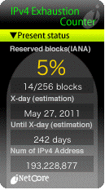
inetcore.com/project/ipv4ec/index_en.html

Slide 37
The Internet, Post-IPv4 Run Out
Running out of IPv4 addresses isn’t like running out of water in the middle of the desert, or air while SCUBA diving -- if you already have IPv4 address space, the space you already have will continue to work just fine.
People who WILL run into problems, however, include:
-- growing ISPs who need more IPv4 IP addresses
-- new ISPs who need IPv4 addrs just to get started
-- customers of existing IPv4-based ISPs who may need
to access network resources available ONLY via IPv6
-- customers behind weird/broken stopgap kludges
Eventually, we risk the bifurcation of the Internet: part of the Internet may cling to IPv4 addressing, while the rest may end up having no choice but to use IPv6 addressing. Eventually, this will be a serious issue.

Slide 38
6 (b). Understanding the Drivers for IPv6: Regaining Internet Transparency

Slide 39
“But What About NAT?”
While some sites (including uoregon.edu) assign each system on campus a globally routable IP address. Other sites (including many home users and many corporate sites) routinely employ network address translation (or “NAT”). NAT (actually PAT) makes it possible for multiple workstations to all use a single shared globally routable IPv4 address. If all you do is browse the web or use a web email service such as Hotmail, or Yahoo! Mail, or Gmail, NAT may superficially work fine for your needs.
On the other hand, if you want to do Internet video conferencing, or use peer-to-peer applications, or you’re trying to track down and fix malware-infested hosts connecting from behind a NAT, you may find that NAT will make your life significantly more difficult.

Slide 40
NAT: A (Semi) Protocol-Aware Protocol
Some network protocols (such as H.323) embed IP addresses in the traffic generated by those protocols.
Because NAT rewrites network addresses, it needs to know HOW each protocol embeds IP addresses in network traffic streams. That is, NAT boxes need to
be “protocol aware,” and thus networks using NAT
are NOT “end-to-end transparent.” (Packets get rewritten during transport while passing through a NAT)
If a NAT box faces traffic of a type that it doesn’t know how to handle, such as some new protocol, it can’t rewrite that traffic, and as a result that application will fail when run behind a NAT. This is very commonly the case for H.323 video conferencing, for example.
Because of this, NAT’d networks can stifle application layer network innovation, or at least make it far harder!

Slide 41
The “Two Port Internet”
Because of the problems that application developers face getting past NAT boxes (and restrictive firewalls!) it is common for developers to implement new protocols over http instead of developing new native protocols. Some of my colleagues refer to this as the “two port Internet”
-- in this model, virtually all user traffic is either http (port 80) or https (port 443).
Obviously this is something of an exageration (they forgot about DNS for example :-)), but it isn’t entirely an argument w/o merit. All you need to do is look at network traffic and try to identify what applications make up most of the traffic to see the problem -- you can’t do it any more just based on ports.
C.F.: “A Look at the Unidentified Half of Netflow,”
pages.uoregon.edu/joe/missing-half/missing-half.pdf

Slide 42
End-To-End Transparency
If you’d like to read about the importance of end-to-end transparency, some excellent starting points are:
-- RFC2775, “Internet Transparency,” B. Carpenter,
February 2000, http://tools.ietf.org/rfc/rfc2775.txt
-- RFC4924, “Reflections on Internet Transparency,”
B. Aboba and E. Davies, July 2007,
http://tools.ietf.org/rfc/rfc4924.txt
While Internet transparence is less often mentioned than imminent IPv4 address exhaustion as a reason why we need to deploy IPv6, transparency is nonetheless a very important underlying motivation for IPv6.

Slide 43
6 (c). Understanding the Drivers for IPv6: Controlling Route-Table Bloat

Slide 44
Controlling Route Table Bloat
Another important (if little recognized) reason for promoting use of IPv6 has been the need to control the growth in the size of the global routing table. In fact,
RFC4984 ( http://www.ietf.org/rfc/rfc4984.txt ) states,
“[…] routing scalability is the most important problem
facing the Internet today and must be solved […]”

Slide 45
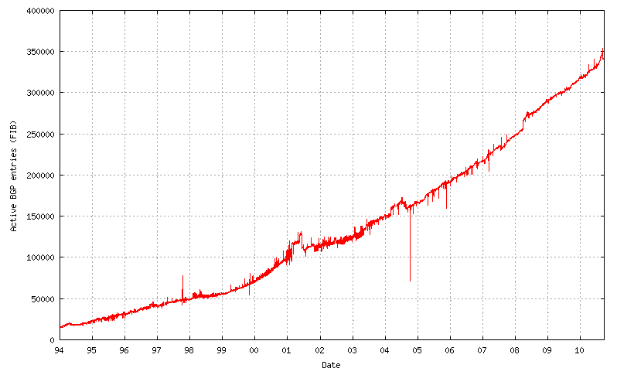
The IPv4 Route Table
Continues to Grow…
350,000
Source: http://bgp.potaroo.net/as6447/

Slide 46
IPv6 Was Supposed to Help Fix That
When IPv6 was designed, address assignment was supposed to be hierarchical. That is, ISPs would be given large blocks of IPv6 address space, and they’d then use chunks of that space for each downstream customer, and only a single entry in the IPv6 routing table would be needed to cover ALL the space used by any given ISP and ALL their downstream customers (see RFC1887, “An Architecture for IPv6 Unicast Address Allocation”)
But now, let’s pretend that my Internet connectivity is important to me, so I don’t want to rely on just a single ISP -- I want to connect via multiple ISPs so that if one provider has problems, the other ISPs can still carry traffic for my site. This connection to multiple sites is known as “multihoming.”

Slide 47
If I’m Multihomed, Whose
Address Space Do I Use?
When I get connectivity from sites A, B and C, whose address space would I announce? Address space from A? Address space from B? Address space from C? No…
-- A doesn’t want me to announce part of its address
space via B and C
-- B doesn’t want me to announce part of its address
space via A and C
-- C doesn’t want me to announce part of its address
space via A and B.
I need to either assign each host multiple addresses (e.g., one address from A, one from B, and one from C), or I need to get my own independent address space which I can use for all three ISPs, but which will then take up a slot in the global routing table.

Slide 48
The Original Multiple IP Approach in IPv6
The multiple IP approach was the original “answer” to this question in the IPv6 world.
But if I assign multiple IPs to each host, one for each upstream ISP I connect to, how do I know which of those IP addresses I should use for outbound traffic generated by each host? Do I arbitrarily assign the address from A to some traffic? The address from B to other traffic? What about the address from C?
Which of those addresses do I map to my web site or other servers via DNS? Do I use just A’s address? Just B’s? Just C’s? All three of those addresses? What if one of my providers goes down? Will traffic failover to just the other two providers quickly enough?

Slide 49
The Multihoming Reality Today
IPv6 multihoming without use of provider independent address space is one of the unsolved/open issues in the IPv6 world today. Operationally, in the real world, ISP customers who need to multihome request their own provider independent IPv6 address space (cue Sonny and Cher: “The beat goes on, and the beat goes on…”)
Route table growth may be a critical issue facing the Internet in the long term, but for now, the community has “dropped back into punt formation,” and we’re doing what needs to be done (at least for now) to get IPv6 deployed in a robust way (e.g., with multihoming). The good news is that the IPv6 table is still small (so we still have time to solve the IPv6 routing table growth issue); the bad news is that the IPv6 table is still small (which means many people still haven’t deployed IPv6!)

Slide 50
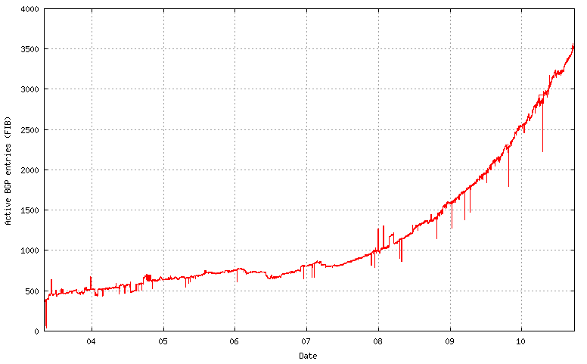
IPv6 Route Table Growth
3500
Source: http://bgp.potaroo.net/v6/as6447/

Slide 51
6 (d). Understanding the Drivers for IPv6: Regulatory Compliance

Slide 52
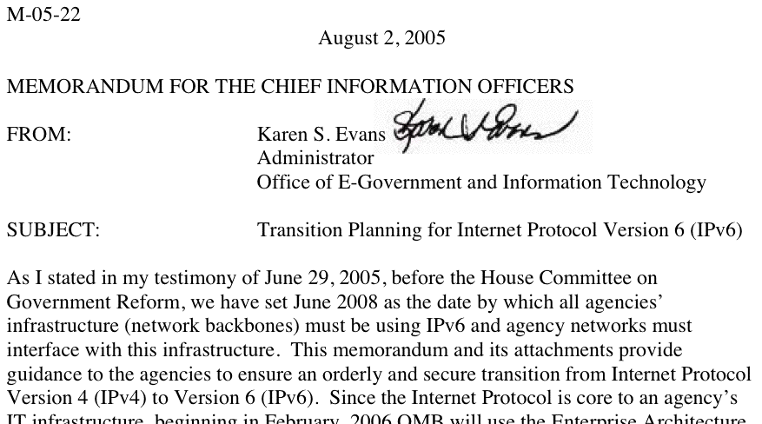
Federal Networks, For Example,
Are Supposed to Be IPv6 Ready
Source: www.whitehouse.gov/omb/memoranda/fy2005/m05-22.pdf

Slide 53
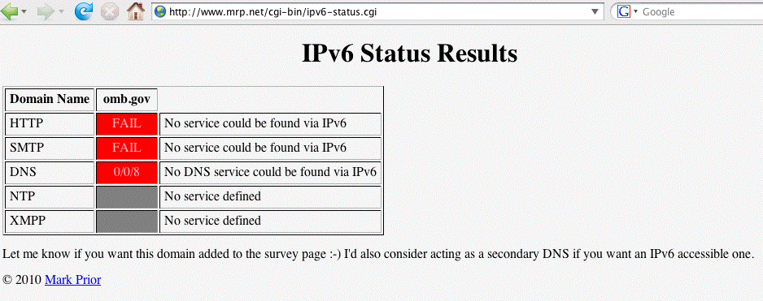
Theoretically All Federal Networks (At Least Temporarily) Met That Mandate, But…
Reportedly many federal networks, having passed one IPv6 packet (and thus, however briefly, demonstrated that their backbones were IPv6 capable), promptly
“re-disabled” IPv6 (ugh!)
Check your favorite fed sites -- are they v6 accessible? See: http://www.mrp.net/cgi-bin/ipv6-status.cgi

Slide 54
IPv6 and Fed Scorecard Network Homepages?
www.dhs.gov --> no
www.doc.gov --> no
www.dod.gov --> no
www.doe.gov --> no
www.dot.gov --> no
www.ed.gov --> no
www.epa.gov --> no
www.hhs.gov --> no
www.hud.gov --> no
www.doi.gov --> no
www.doj.gov --> no
www.dol.gov --> no
www.nasa.gov --> no
www.nsf.gov --> no
www.nrc.gov --> no
www.opm.gov --> no
www.sba.gov --> no
www.ssa.gov --> no
www.state.gov --> no
www.usaid.gov --> no
www.usda.gov --> no
www.ustreas.gov --> no
www.va.gov --> no
Or pick another federal agency of your choice: the pattern is pretty consistent I’m afraid…

Slide 55
“Planning Guide/Roadmap Toward IPv6
Adoption Within the US Government”
This is a new document (ca. May 2009) from the Federal CIO Council Architecture and Infrastructure Committee, Technology Infrastructure Subcommittee, Federal IPv6 Working Group, see http://tinyurl.com/fed-cios-ipv6
I quote: “The purpose of this document is to provide U.S. government agency leaders with practical and actionable guidance on how to successfully integrate Internet Protocol version 6 (IPv6) throughout their enterprise. […] without a concentrated effort by Federal agencies to effectively and efficiently deploy secure IPv6 network services, the Government’s technical advancement and ability to meet its mission needs will be critically impacted during the next 2 to 3 years.”

Slide 56
And Just This Last Week…
On Sept. 28th, 2010, the NTIA held a workshop at which Federal CIO Vivek Kundra announced a directive “requiring all U.S. government agencies to upgrade their public-facing Web sites and services by Sept. 30, 2012, to support IPv6…” and that access must be via native IPv6 rather than an IPv6 transition mechanism.
A second deadline, Sept. 30th, 2014, applies for federal agencies to upgrade internal client applications that communicate with public servers to use IPv6.
For more, see
“White House Issues IPv6 Directive,”
http://www.networkworld.com/news/2010/
092810-white-house-ipv6-directive.html?page=1

Slide 57
A Major Potential Stumbling Block:
Non-IPv6 Content Delivery Networks (CDNs)
Many federal web sites (and key commercial web sites) use Akamai (or another CDN) in order to handle huge online audiences, deliver good performance worldwide, and to resist DDoS attacks.
For example, www.irs.gov is actually just a cname for www.edgeredirector.irs.akadns.net; whois confirms that akadns.net actually belongs to Akamai.
If Akamai doesn’t do IPv6, will current major Akamai customers (such as Apple, Cisco, Microsoft, RedHat, the Whitehouse, etc.) be willing to deploy IPv6 for critical sites without them?
BTW, at least one vendor, Limelight, DOES offer an IPv4 and IPv6 CDN service…

Slide 58
But Speaking of Akamai,
Akamai Is Reportedly Working On IPv6…
I’m happy to report that Akamai is now reportedly working on IPv6-ifying its CDN infrastructure. See, for example, the coverage in:
“Akamai: Why Our IPv6 Upgrade Is Harder
Than Google’s,”
http://www.networkworld.com/news/2010/
091610-akamai-ipv6.html
September 16th, 2010

Slide 59
The Issue Isn’t Just Web CDNs…
A growing number of sites outsource their email operations. Unfortunately some email-as-a-service (and some cloud-based spam filtering services) don’t support
IPv6, thereby limiting the ability of their customers to integrate IPv6 into their existing IPv4-based services.
CDNs and outsourced email and spam filtering services aren’t the only reason why IPv6 adoption has been slow at some major Internet sites, but they can certainly be stumbling blocks that will need to get resolved.
Some of these outsourced email/spam filtering services and CDNs are being actively monitored on MRP’s survey page, see www.mrp.net/IPv6_Survey.html , including Akamai, Google, McAfee, MessageLabs, MacQuarie, Microsoft, Postini, ProofPoint, RedCondor and Websense.

Slide 60
7 (a). Understanding IPv6 Myths:
‘IPv6 Will Improve “Network Security” Due to IPv6 Having “Mandatory” IPSec’
(Sorry, No)

Slide 61
IPv6 and IPsec
IPsec is not new with IPv6; in fact, IPsec dates to the early 1990’s. What’s different when it comes to IPv6 is that support for IPsec was made “mandatory” for IPv6 (see for example “Security Architecture for IP,” RFC4301, December 2005 at section 10, and “IPv6 Node Requirements,” RFC4294, April 2006 at section 8.)
If actually used, IPsec has the potential to provide:
-- authentication
-- confidentiality
-- integrity, and
-- replay protection
All great and wonderful security objectives -- IF IPsec gets used. Unfortunately, as we’ll show you, what was supposed to be the cornerstone of the Internet’s security architecture has proven in fact to be widely non-used.

Slide 62
IPv6 Does NOT Require IPSec to Run…
IPv6 can be brought up without IPSec getting enabled, and in fact this is routinely the case -- see an example on the next slide.
More broadly, if people are doing cryptographically secured protocols of *any* sort, they inevitably run into problems -- crypto stuff just tends to be inherently complex and hard to learn to use. For example, how many of you routinely use PGP or GPG to cryptographically sign or encrypt your email, eh? How many of you are doing DNSSEC to cryptographically protect the integrity of your DNS traffic?
Now think about how often you see people moaning about problems they’re having getting IPSec to work with IPv6
-- do you EVER see that sort of thing on the mailing lists or discussion groups you’re on? No, right? That’s because hardly anyone is doing IPSec with IPv6.

Slide 63
Some IPv6 Traffic Statistics From A Mac
OS X Host (Note That It’s NOT Doing IPSec)
# netstat -s -finet6 <-- let’s look just at IPv6 traffic
[snip]
ip6:
124188 total packets received
[snip]
84577 packets sent from this host
[snip]
ipsec6: <-- how much of it was Ipsec protected?
0 inbound packets processed successfully
0 inbound packets violated process security policy
[snip]
0 outbound packets processed successfully
0 outbound packets violated process security policy
[snip]

Slide 64
IPsec (Even on IPv4!) Isn’t Getting Much Use
Raw IPsec traffic (AH+ESP, protocols 50 & 51) isn’t seen much on the commercial IPv4 Internet.
For example, about a year or so ago, Jose Nazario of Arbor Networks estimated IPsec traffic at 0.9% of octets (statistic courtesy the ATLAS project).
CAIDA (thanks kc!) also has passive network monitoring data available; see
http://www.caida.org/data/passive/monitors/equinix-chicago.xml
You can see the protocol distribution from a couple of CAIDA’s monitors for one recent day on the next couple of slides. IPsec traffic is basically too small to even be seen for the most part.

Slide 65
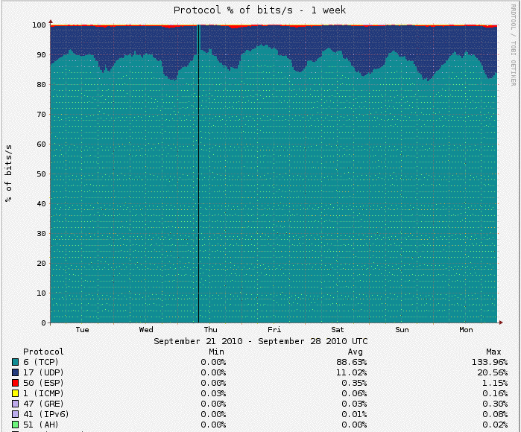
Protocol Distribution From One of CAIDA’s Passive Monitors

Slide 66
Bad News/Good News
It would be foolhardy to expect IPsec to provide any material improvement to your site’s security since the vast majority of your aggregate traffic (including virtually all your IPv4 traffic) will NOT be IPsec secured.
On the other hand, the “good news” is that a lack of IPsec usage in the IPv6 world is substantively no worse than a lack of IPsec usage in the IPv4 world.

Slide 67
7. (b) Understanding IPv6 Myths:
“IPv6 Will Simplify Renumbering,
Improve Routing Performance By
Simplifying Packet Formats,
Improve Support For QoS,
Facilitate Mobility, etc.”
(maybe, but frankly, no one cares)

Slide 68
I Really Don’t Mean to Sound Harsh, But…
IPv6 may very well bring many cool new features to networking, but quite frankly, all of these incidental
new features really don’t matter -- they’re not “make
or break” drivers when it comes to adoption of IPv6.
I’d love to hear hard evidence to the contrary, but truly, I’ve seen no indication that any of these other factors carry much weight in helping to shape the IPv6 go/no-go decision.
On the other hand, there are some genuine reasons why people adamantly are NOT interested in doing IPv6.

Slide 69
7. (c) Understanding IPv6 Myths:
Everyone’s Running Out of IPv4
Address Space and Will Need IPv6
(No, Actually Some Sites Still Appear
To Have Quite A Bit of IPv4 Space Left)

Slide 70
If You Have Abundant IPv4 Address Space, It May Be Hard to Get Excited About IPv6
The definition of “abundant” will vary from site to site, but, for example, many universities have legacy /16’s, and 2^16 (or roughly 65,500 addresses) can seem like “a lot” of addresses (even though they can go awfully fast when you have a campus of 20,000-25,000 people, most of whom have multiple networked devices, plus lots of printers and other networked infrastructure).
Others, however, have /8’s (2^24, or roughly 16,777,200 addresses per /8), and that may be large enough to eliminate all worries at those sites about address scarcity.
If you haven’t recently looked at the list of who has /8’s, you can check http://www.iana.org/assignments/
ipv4-address-space/ipv4-address-space

Slide 71
Considering Just Large Federal Netblocks…
The US government (typically as the US Department of Defense) controls a relatively large fraction of the entire Intenet IPv4 space, including a dozen slash 8’s: 6/8, 11/8, 21/8, 22/8, 26/8, 28/8, 29/8, 30/8, 33/8, 55/8, 214/8, and 215/8 (to say nothing of additional /8 blocks controlled by defense industrial contractors with close/ extensive military contracts, plus miscellaneous smaller netblocks scattered hither and yon). Given that level of public IPv4 address space availability, one can understand that some federal agencies have not felt a particularly pressing need to move to IPv6 real ricky-ticky soon now.
An aside about those large federal netblocks: even though addresses from some of those block may not show up in public routing tables, they are still being used, you’re just not seeing them in some public routing tables.

Slide 72
Another Manifestation of the “Oh, No Worries, I’ve Got Plenty of Address Space” Phenomena
While there are obviously only a comparative handful of sites which have their own public /8, many sites use RFC1918 “private” non-publicly routable address space, such as addresses from 10/8.
If NAT currently meets your needs, as long as you have 10.0.0.0-10.255.255.255 (and 172.16.0.0-172.31.255.255, and 192.168.0.0-192.16.255.255) available, again, you may feel like your private IPv4 addressing needs are generally being well met (provided, of course, that you can also get the comparative handful of public IPv4 addresses you may also need).
But, as we’ll see later, use of NAT forecloses some of the easiest IPv6 transition mechanisms, such as use of 6to4.

Slide 73
7 (d). Understanding IPv6 Myths:
‘If You Enable IPv6, You’ll Suddenly Have Access to Lots of “Cool New Stuff” That’s Not Available via IPv4’
(Nope. Anything That’s Available Via IPv6, Will Also Be Equally Available via IPv4)

Slide 74
An Important/Subtle Point to Understand
Sometimes folks ask, “So if I begin to do IPv6, what new stuff can I get at that I can’t get at already?”
Can you imagine Google, or Amazon, or Microsoft, or CNN, or <fill in the name of an important Internet site here> making their web site or other online resources ONLY available via IPv6? No, probably not.
Any/all important Internet resources will ALWAYS be available via IPv4, even if those resources are ALSO available via IPv6.
Thus moving to IPv6 does NOT magically give you access to new stuff that you couldn’t get to via IPv4 (well, technically there are a few IPv6-only things mentioned at http://www.sixxs.net/misc/coolstuff/ , but nothing in
and of itself that’s enough to justify deploying IPv6)

Slide 75
At Some Point In The Future,
Though, The Default Will Change
At some point in the future, people will eventually ask, “So if I still bother doing IPv4, what sort of ‘old stuff’ can I get at that I can’t get at already via IPv6?”
We’re still a LONG way off from that point, but it WILL eventually happen.
Remember when people used to carry AppleTalk or IPX or DECNet on their local area networks? They sure don’t anymore (or at least no one I know still does!)

Slide 76
7 (e). Understanding IPv6 Myths:
“All The Techies Will Figure Out Some New Way To Stretch Out What IPv4 Space We’ve Got Left -- I’m Not Going to Worry”
(I Admire Your Confidence,
But Personally, I Don’t Think
I’d Be So Sanguine)

Slide 77
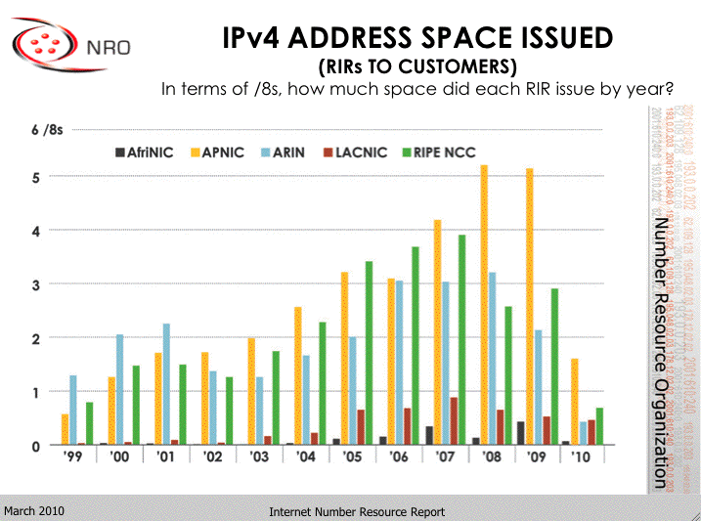
We’re Not The (Only) Ones Driving
The Address Consumption Bus!
http://www.arin.net/participate/meetings/reports/ARIN_XXV/PDF/Monday/Nobile_NRO_joint_stats.pdf

Slide 78
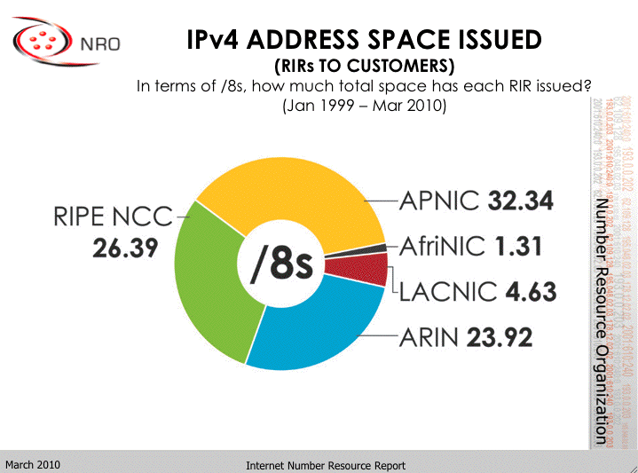
A Cumulative View
http://www.arin.net/participate/meetings/reports/ARIN_XXV/PDF/Monday/Nobile_NRO_joint_stats.pdf

Slide 79
What If IPv4 Address Usage Was Proportionate to Regional Population?
Population % /8’s % Ratio
Asia: 4,121,097 60.3% 32.34 36.5% 0.605
Africa: 1,009,893 14.7% 1.31 1.4% 0.095
Europe: 732,206 10.7% 26.39 29.7% 2.775
L. Amer.: 582,418 8.5% 4.63 5.2% 0.611
N. Amer.: 348,360 5.1% 23.92 27% 5.29
Oceania: 35,387 0.5%
Total: 6,829,360 88.56
Population in thousands, mid year 2009 estimates
Note: Oceania’s addresses are handled by APNIC (e.g., Asia)
http://esa.un.org/unpd/wpp2008/jpg/WPP2008_Wall-Chart_Page_1.jpg

Slide 80
The Future: Notice Relatively “Tiny” Africa
Historically, Africa’s IP address usage to date has been minimal, less than one and a half /8s.
This was likely due to a variety of factors, but at least one important factor was the high cost of connectivity (thousands of dollars per Mbps per month vs. just dollars per Mbps per month in the US (for large customers)).
Another driver was widespread use of satellite Internet connectivity, with high latency, NAT’d connections and IPs provided by the satellite operator.
Improved fiber connectivity is changing all that. Some of the world’s largest and most densely populated regions in both Africa and Asia are now coming online, and I believe the improved connectivity to those areas will result in a substantial demand for new IPv4 addresses.

Slide 81
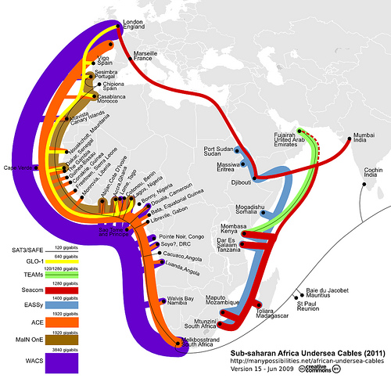
http://blog.foreignpolicy.com/files/images/090618_africa_underseas_cables.jpg

Slide 82
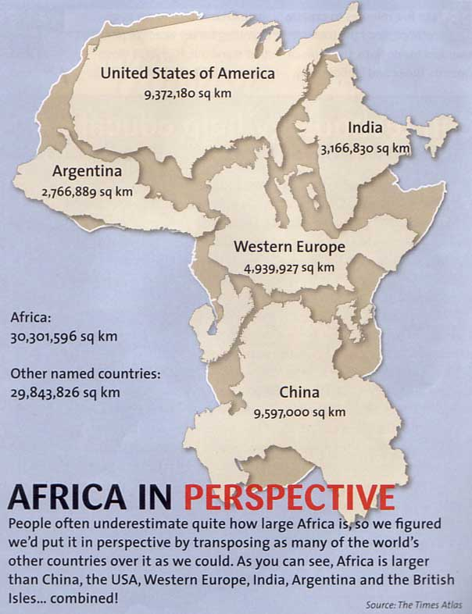
http://strangemaps.files.wordpress.com/2006/11/africa_in_perspective_map.jpg

Slide 83
If You Believe We Have Enough IPv4 Addresses
Given the preceding slides, you must also believe in miracles! :-)
In my case, I’d rather be prepared to work with IPv4 AND IPv6 :-)

Slide 84
7 (f). Understanding IPv6 Myths:
“Customers Just Aren’t Asking
For IPv6 (Except You!)”

Slide 85
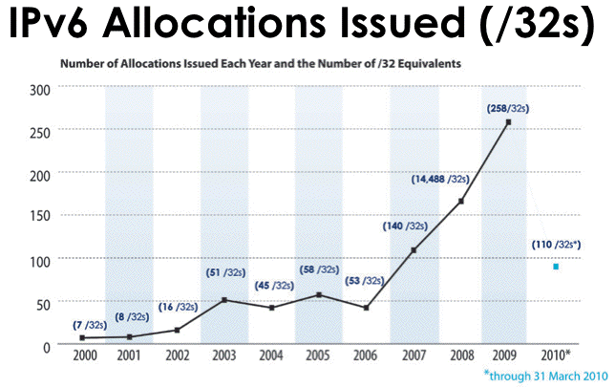
That’s Not The Impression I’m Getting…
Source: https://www.arin.net/participate/meetings/reports/ARIN_XXV/PDF/Wednesday/Nobile_RSD.pdf

Slide 86
From the NANOG Mailing List, April 2010
> What I heard at a recent (within the past six months)
> conference was that "there is no customer demand for v6" so it
> isn't on the immediate needs list. He said they had a lot of
> inquiries about v6, but to date not having native v6 wasn't a
> deal breaker with anyone
I watched a vendor at one conference tell 20 people in a row that each one of them was the only one asking for IPv6. I mentioned to him that he should have his short-term memory loss checked out by a physician. At first he was confused. When I pointed out what I had just seen him do, he went from confused to embarrassed and admitted that it was the party line from his marketing department and they knew IPv6 was important, but, didn't have a story to tell yet, so, they were trying to spin for delay.
http://seclists.org/nanog/2010/Apr/71

Slide 87
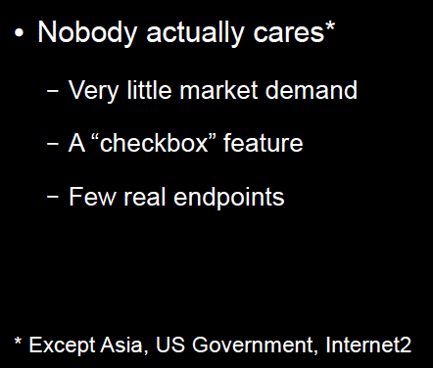
But The Perception Persists…
www.metasploit.com/data/confs/sector2008/exploiting_ipv6.pdf

Slide 88
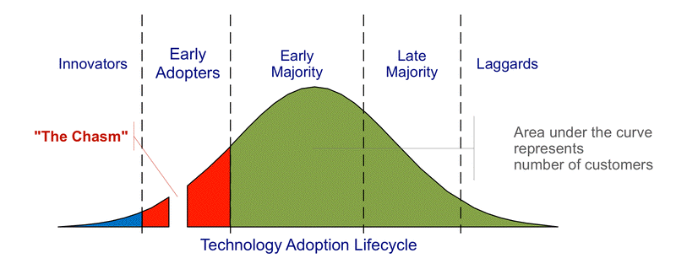
The Question That’s Really Being Asked Is…
“What’s the business case?”
Vendors who ask that question obviously fail to understand the technology adoption lifecycle:
http://commons.wikimedia.org/wiki/File:Technology-Adoption-Lifecycle.png

Slide 89
We’re Crossing “The Chasm” Right Now
The companies that are ready to support IPv6 will be well positioned to support emerging customer needs and to thrive in an IPv6 environment
The companies that are not ready will find their customers doing what they need to do (nothing personal, it’s just business, and since “no one but me” cares about IPv6, I’m sure you won’t mind that I’m taking my business elsewhere, see ya…)

Slide 90
A 2nd Opportunity For You To Bail Out
So that’s the end of Part II of today’s IPv6 discussion;
the final chunk of our training today will begin to expose you to some technical material relating to IPv6.
If you’re not a “techie” and your head already hurts and you’re not interested in diving in deeper, feel free to bail out now. You will not hurt my feelings if you do so. :-)

Slide 91
PART III.
IPv6 Technology Primer

Slide 92
8. (a): IPv6 Addresses

Slide 93
Starting With What We Know: IPv4
IPv4 addresses are 32 bits long
2^32=4,294,967,296
Normally represented in “dotted decimal” format:
-- four 8 bit octets (0 to 255 decimal)
-- each octet is seperated from the next by a dot
-- leading zeroes in each octet may be omitted
Examples:
-- 127.0.0.1
-- 128.223.142.89
-- 64.170.98.32

Slide 94
Something A Little Different: IPv6
IPv4 addresses are 128 bits / 32 hexadecimal digits long
2^128=340,282,366,920,938,463,463,374,607,431,768,211,456
(e.g., 3.4x10^38 addresses)
Normally represented in “colon separated” format:
-- eight sets of four hex digits (0000 to FFFF hex)
-- chunks are separated with colons (:)
-- leading zeroes in each chunk may be omitted
-- for convenience, :: (two successive colons) may replace
one or more all-zero chunks, but only once in any addr
Examples:
2001:48a8:6880:0095:0000:0000:0000:0021
::1
2001:468:d01:d6::80df:d617
fe80::203:93ff:fecf:b638

Slide 95
Quick Quiz
Structurally/superficially valid or invalid?
If invalid, why?
A) 2001:468:0d01:003c:0000:0000:80df:3c15
B) 2001:468:0d01:003c::80df:3c15
C) 2001:468:d01:3c::80df:3c15
D) 2001:760:2e01:1::dead:beef
E) 2001:480:10:1048:a00:20ff:fe9a:58c1:80
F) 2001:500::4:13::80
G) 2001:13G7:7002:4000::10
H) 2607:f278:4101:11:209:5bff:fe8f:6609
I) fe80::209:3dff:fe13:fcf7
J) ::

Slide 96
Quick Quiz Answers
Structurally/superficially valid or invalid?
If invalid, why?
A) Valid
B) Valid
C) Valid
D) Valid
E) Invalid (nine chunks instead of eight)
F) Invalid (double colons appear more than once)
G) Invalid (G is not a valid hexadecimal digit)
H) Valid
I) Valid
J) Valid (albeit as the IPv6 “unspecified address”)

Slide 97
8. (b): IPv6 Prefixes

Slide 98
Starting With Something We Know:
IPv4 Prefixes
We originally had class A, class B and class C blocks:
Name CIDR equiv Number Addresses Per Block
Class A /8 128 16,777,216
Class B /16 16,384 65,536
Class C /24 2,097,152 256
Like Goldilocks, some of those were too large, and some of those were too small.
We needed something a little more flexible, and that’s what we got from CIDR, or Classless Inter-Domain Routing.

Slide 99
Common IPv4 CIDR Prefix Lengths
/8 ==> 16,777,216 addresses /23 ==> 512
/9 ==> 8,388,608 /24 ==> 256
/10 ==> 4,194,304 /25 ==> 128
/11 ==> 2,097,152 /26 ==> 64
/12 ==> 1,048,576 /27 ==> 32
/13 ==> 524,288 /28 ==> 16
/14 ==> 262,144 /29 ==> 8
/15 ==> 131,072 /30 ==> 4
/16 ==> 65,536 /31 ==> 2
/17 ==> 32,768 /32 ==> 1
/18 ==> 16,384
/19 ==> 8,192
/20 ==> 4,096
/21 ==> 2,048
/22 ==> 1,024
IPv4 subnets are often /24’s (or maybe /23’s or /25’s)

Slide 100
IPv6 Uses Prefixes, Too
IPv6 prefixes are just a “little bit” bigger…
Prefix IPv6 Addresses
/32 2^(128-32) =
79,228,162,514,264,337,593,543,950,336
(that’s like getting 4,294,967,296 /64 subnets)
/48 2^(128-48) =
1,208,925,819,614,629,174,706,176
(that’s like getting 65,536 /64 subnets)
/56 4,722,366,482,869,645,213,696
(that’s like getting 256 /64 subnets)
/64 18,446,744,073,709,551,616 IPv6 addresses each

Slide 101
General Rules for IPv6 Allocations/Assignments/Subneting
Local Internet Registries (LIRs), e.g., ISPs, statewide networks, etc., will get one (or more) IPv6 /32 from ARIN, RIPE, APNIC, etc.
Large sites will get an IPv6 /48 from their LIR’s /32
Small sites needing only a few subnets over 5 years will get an IPv6 /56 from their LIR’s /32 (some LIRs will just always issue /48’s)
If one and only one subnet is needed, that entity gets an IPv6 /64
(some LIRs will just always issue /48’s)
Hosts get one or more IPv6 /128s
ALL SUBNETS at most sites will normally be /64s (even if they have only one or a small handful of hosts).
Do NOT try to get clever and do something exotic when it comes to subnetting in IPv6.

Slide 102
8. (c): Types of IPv6 Addresses

Slide 103
Types of IPv6 Addresses
Global Unicast: 2000::/3
Link Local Unicast: FE80::/1
Loopback: ::1/128
6to4: 2002::/16
Teredo: 2001:0000::/32
Unique Local Unicast: FC00::/7
Multicast: FF00::/8
IPv4-Mapped: ::ffff:128.223.214.23
Deprecated: Site Local addrs and IPv4-Compatible addrs.
For more on IPv6 addresses, see RFC4291 (+ other RFCs).
For the most part, we primarily care about global unicast, link local unicast, and loopback addresses

Slide 104
Address Type Discussion
Global Unicast addresses are globally unique, “real” IP addresses. These are the way you’ll normally refer to most IPv6 hosts
Link Local Unicast addresses are used for some purposes local to a particular link; outside the extent of that link, they don’t get used.
Loopback addresses -- just like 127.0.0.1 in IPv4 space, the IPv6 loopback address (::1/128) is an internal virtual address that the server can use to refer to itself.
6to4 and Teredo addresses are special IPv4-to-IPv6 transition mode technologies. As a sender, you won’t be using these.
Unique Local Unicast addresses (RFC4193) are the IPv6 equivalent of RFC1918 IPv4 addresses. Don’t use them.
Multicast addresses are just like multicast in IPv4, except that in IPv6 they’re used extensively on the LAN, but IPv6 multicast traffic rarely appear on the wide area Internet, unlike IPv4 where the exact opposite is largely true.
IPv4-Mapped addresses allow hosts that only bind IPv6 sockets to also accept IPv4 addresses. (largely of interest to programmers)

Slide 105
Anycast
IPv6 also uses "anycast" addresses. Anycast addresses look just like regular global unicast addresses, however the same prefix gets advertised from multiple locations.
Through the magic of routing, users automatically connect to the closest anycast instance when accessing a UDP service (such as DNS) hosted on an anycast prefix.
If one anycast instance goes down, routes adjust, and the other anycast instances seamlessly assume the additional load.

Slide 106
8. (d): Addresses and Systems

Slide 107
Expect Multiple Addresses
When you look at the interfaces on an IPv6-enabled system, it will be routine for it to have multiple addresses/interface.
Sometimes this will just be a single globally unique unicast address, plus a link local address, plus some other bits and pieces, other times you may see multiple globally unique unicast addresses.
Do not let this shake you up.
Speaking of multiple addresses, most hosts will have
both IPv6 AND IPv4 addresses on some interfaces. This is known as being “dual stacked” and is perfectly normal and acceptable.

Slide 108
Looking at Addresses on Interfaces on Linux
% ifconfig -a
eth0 Link encap:Ethernet HWaddr 00:09:3D:13:FC:F7
inet addr:128.223.142.32 Bcast:128.223.143.255 Mask:255.255.254.0
inet6 addr: 2001:468:d01:8e:209:3dff:fe13:fcf7/64 Scope:Global
inet6 addr: fe80::209:3dff:fe13:fcf7/64 Scope:Link
UP BROADCAST RUNNING MULTICAST MTU:1500 Metric:1
RX packets:1187468996 errors:0 dropped:1805 overruns:0 frame:0
TX packets:1338373204 errors:0 dropped:0 overruns:0 carrier:0
collisions:0 txqueuelen:1000
RX bytes:232065679216 (216.1 GiB) TX bytes:915094219311 (852.2 GiB)
Interrupt:185
[snip]
lo Link encap:Local Loopback
inet addr:127.0.0.1 Mask:255.0.0.0
inet6 addr: ::1/128 Scope:Host
UP LOOPBACK RUNNING MTU:16436 Metric:1
RX packets:8143461 errors:0 dropped:0 overruns:0 frame:0
TX packets:8143461 errors:0 dropped:0 overruns:0 carrier:0
collisions:0 txqueuelen:0
RX bytes:4295055907 (4.0 GiB) TX bytes:4295055907 (4.0 GiB)

Slide 109
How Addresses Get On Interfaces: IPv4
Starting with something you know, IPv4, most end-user workstations get their IP addresses automatically assigned via DHCP.
Besides IPv4 addrs, RFC2132 describes additional useful bits that a host can get from a DHCP server, including:
-- subnet mask
-- router address(es)
-- domain name server(s)
-- the host name
-- the domain name
-- MTU information
-- broadcast address
-- plus an amazing amount of other bits and pieces
(check it out if you don’t believe me!)

Slide 110
How Addresses Get On Interfaces: IPv4 (2)
Some sites may use host-specific DHCP entries to configure servers, too, but most IPv4 servers tend to be manually configured by a system administrator with a statically assigned IP addresses, host name and domain information, name server information, broadcast address, MTU information, etc.

Slide 111
How Addresses Get On Interfaces: IPv6
In IPv6 world, most user workstations will get IPv6 addresses from state-less address auto configuration, or SLAAC. SLAAC runs on a router (not on a separate DHCP server), and as you might expect from the name, the IPv6 addresses that one gets via SLAAC are not maintained in a table anywhere (no “state” gets created when an IPv6 address is assigned via SLAAC).
So how does the router know that it won’t accidentally give you the same address as someone else (e.g., assign a duplicate address) if it doesn’t keep track of who it has given an address to? Answer: it derives the address it gives you from something only you have, namely the MAC (hardware ethernet) address of your NIC

Slide 112
IPv6 Modified EUI-64 Format Identifier
We need to take the 48 bit globally unique hardware MAC address from your network card, and convert that into a 64 bit dynamically assigned address. We do this by:
-- Taking the left most 24 bits of the MAC, and using
that for the left most 24 bits of the EUI-64 ID
-- Taking the right most 24 bits of the MAC, and using
that for the right most 24 bits of the EUI-64 ID
-- Cram the constant “FFFE” in the middle 16 bits
-- Tweak bit 7 (counting from the left) from zero to
one (this is the “universal/local” bit)
The “front half” of the 128 bit address comes from the network (remember our rule that all subnets are /64s!)

Slide 113
“But Joe!” [Pretend You’re A Geek]
“The whole world will know my unique and unvarying hardware MAC address! Evil marketers will track and correlate my every move wherever I may connect my IPv6 device, based on my invariant MAC address! This is worse than cookies!”
True.
This concern spawned another type of IPv6 address, so-called RFC3041 “Privacy Addresses.” These addresses effectively use a random address for the low order 64 bits of the IPv6 address, instead of a value derived from the host’s MAC address. Systems may also periodically change those addresses from time to time.

Slide 114
“BUT JOE!!!!!”
“That’s NOT what I wanted! If we give users random network addresses, how will we be able to track down abusers??? The same user may have one IPv6 address now, and another completely different IPv6 address later, and I don’t see how we’d keep track of who’s got what address when!!! What a pain!”
One bit of potential happiness: NDPmon (think of this as “arpwatch for IPv6”). See ndpmon.sourceforge.net
Another potential option: control network access just as you currently control network access for wireless networks (e.g., use 802.1x or a homegrown authentication solution)

Slide 115
Selecting/Deselecting Privacy Addresses
Windows: privacy addresses are enabled by default when IPv6 is enabled on Windows XP. To disable them, see the next slide.
Macs: privacy addresses are disabled by default.
To enable them:
# sysctl net.inet6.ip6.use_tempaddr=1
Linux: like Macs, privacy addresses are disabled by default. To enable them:
# sysctl net.ip6.conf.all.use_tempaddr=2
# sysctl net.ip6.conf.default.use_tempaddr=2
Periodically recheck your assigned addresses if this is a big deal for you, and remember, this is NOT life-and-death privacy, it is just “something-to-make-life- hard(er)-for-intrusive-marketers”-grade privacy.

Slide 116
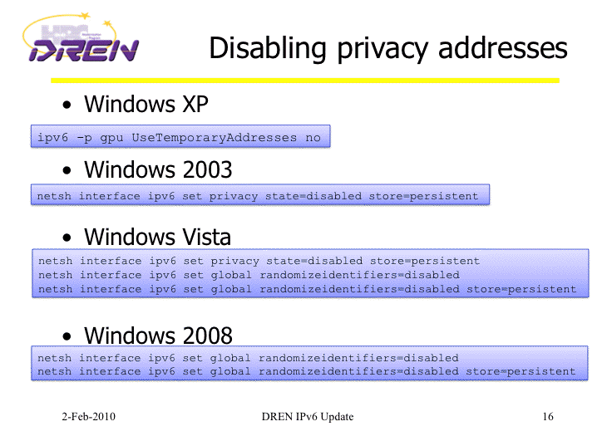
Disabling IPv6 Privacy Addresses
http://www.internet2.edu/presentations/jt2010feb/20100202-broersma.pdf

Slide 117
A Stateful Alternative to SLAAC: DHCPv6
An alternative to SLAAC for workstations is DHCPv6, much like DHCP for IPv4.
One critical difference: while DHCPv6 is well supported by IPv6ified versions of Microsoft Windows, at least some important vendors (read that as “Apple”) do not support DHCPv6 at this time (and may never do so).
If you’re using a Mac OS X box and you want or need to do DHCPv6, you will need to run a third party DHCPv6 client (Dibbler is a commonly suggested option, see http://klub.com.pl/dhcpv6/ , but note the comment there that “Due to work on my Ph.D, the Dibbler project is in the maintenance mode. Active development and
non-critical bug fixing is on hold, until I finish my dissertation. Sorry.”)

Slide 118
8. (e): IPv6 DNS

Slide 119
If You Run Your Own Name Servers:
Make Those Name Servers IPv6 Aware
You'll need to think about making your name servers IPv6 aware. By this I mean your recursive resolvers and your authoritative name servers should both "know about" AAAA records.
Your access to your name servers need not change -- you can continue to access them over IPv4 -- you just need to make sure that they understand AAAA records.
Recent versions of BIND from ISC, the most common name server, are fully able to support IPv6
If you have off site secondary name servers, make sure that those secondary name servers are also IPv6 aware
A new option for folks is to outsource recursive DNS to Google -- 8.8.8.8 and 8.8.4.4 are already IPv6 aware

Slide 120
IPv6 DNS Is Fairly Similar to IPv4 DNS
In IPv4 world, servers and other hosts use “A” records to map fully qualified domain names to IP addresses:
% dig www.uoregon.edu a +short
128.223.142.89
In IPv6 world, we use “AAAA” (“quad A”) records instead of A records to map fully qualified domain names to IPv6 addresses:
% dig network-services.uoregon.edu aaaa +short
2001:468:d01:3c::80df:3c15

Slide 121
Inverse Address Records Are Also Similar
IPv4 world:
% dig -x 128.223.142.89 +short
www.uoregon.edu.
IPv6 world:
% dig -x 2001:468:d01:3c::80df:3c15 +short
network-services.uoregon.edu.
If you need a web-accessible IPv6 dig interface, try
http://www.digwebinterface.com/

Slide 122
Complication: IPv6 Inverse Address Records
There aren’t a lot of good solutions for IPv6 inverse address record creation (other than manually creating them for servers, publicly visible network links, etc.).
Dynamic DNS isn’t such a hot idea, nor is building an inverse address record for millions of IPv6 addresses
which may never get used!
Ron Broersma from DREN described one potential approach in a talk he did at Joint Techs, see: http://www.internet2.edu/presentations/jt2010feb/20100202-broersma.pdf
but it is unclear if the code he mentions there will be available for others to also use. (I hope it will be!)

Slide 123
Complications: IPv6 AND IPv4 Domain Names
If a fully qualified domain name is bound to both IPv4 and IPv6 addresses, which one gets used? Which one should be “preferred?” The IPv6 one or the IPv4 one?
This may be determined by the application (e.g., it may ask for both, and then use its own internal precedence information to determine which it will use), or by the DNS server (if it can give you an IPv6 address for a host, it will, and it will then stop; this is a problem if you advertise an IPv6 address for a host but then don’t actually offer IPv6 connectivity for that domain name!)
One sort of kludgy solution: put the IPv6 address in a subdomain. E.g., www.example.com (IPv4 only) might also have a related domain www.ipv6.example.com (IPv6 only)

Slide 124
What Address Do I Appear to Be Using?
Sometimes you just want to know what address your system appears to be using.
When that’s the case, try:
http://whatismyv6.com/
If you find yourself routinely curious about whether you're connecting to a site via IPv4 or IPv6, you can install the ShowIP Firefox addon available from
https://addons.mozilla.org/en-US/firefox/addon/590
It will then report the IP address that it is using for each web site you visit, green for IPv6 and red for IPv4

Slide 125
Protocol Precedence More Generally
Assume you have IPv4 connectivity as well as IPv6.
If a host is available via both IPv4 and IPv6, what’s the “right” order (or “precedence”) with which traffic to that dual stack host should be tried? Should traffic go over IPv4 whenever possible, or over IPv6 whenever possible? Obviously IPv4 is the old-and-proven familiar/safe/ production-quality choice, but the object of this whole exercise is to eventually move to IPv6, right?
On the other hand, some IPv6 connectivity may be less direct/more circuitous than production IPv4 connections, with greater latency and maybe even some packet loss. Do we really want to force as much traffic as possible over that sort of “disadvantaged” connection?
Thoughts?

Slide 126
8. (f): Enabling IPv6 in Desktop Operating Systems

Slide 127
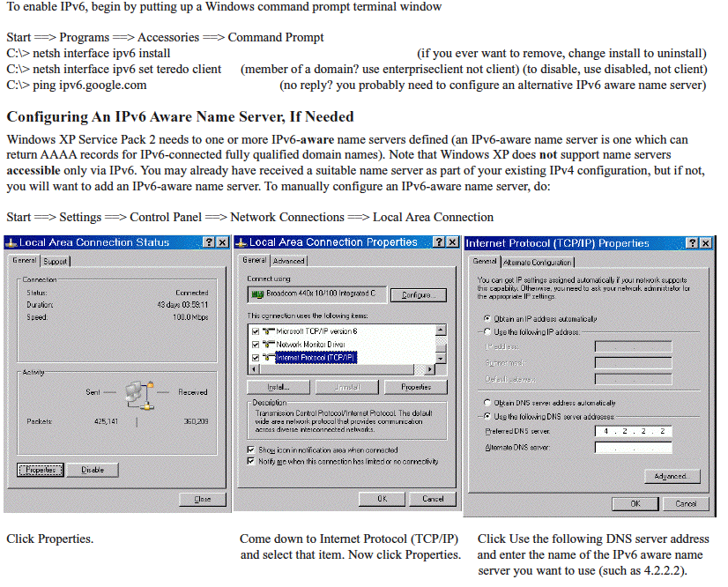
Most Desktop OS's Will Autoconfigure (Except XP)

Slide 128
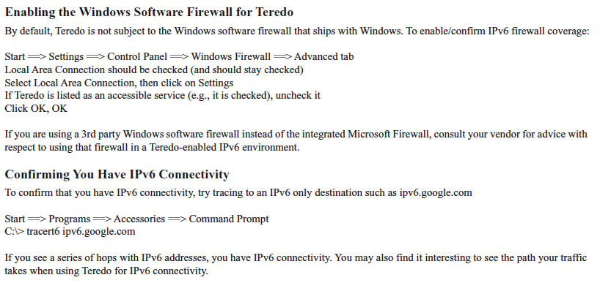
http://www.uoregon.edu/~joe/ipv6/windows-xp-ipv6-with-teredo.pdf

Slide 129
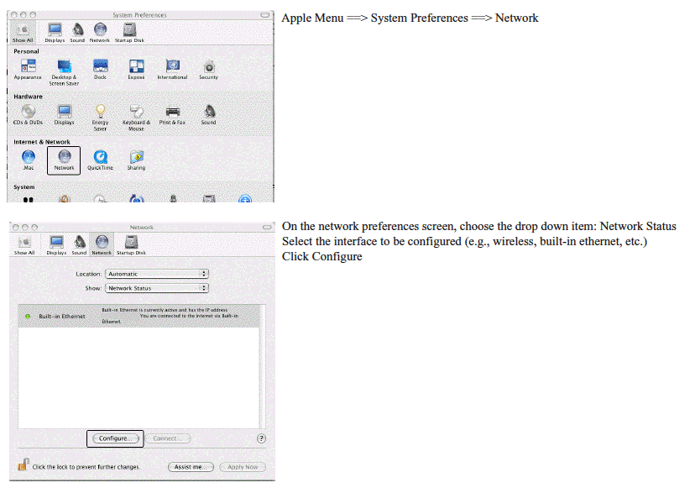
Mac OS X

Slide 130
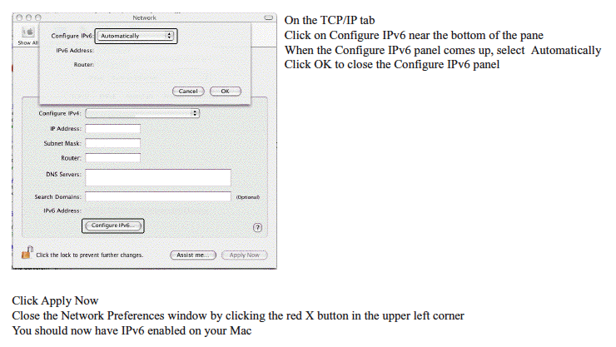

Slide 131
8. (g): IPv6 Web Browsers

Slide 132
Enabling IPv6 in Firefox for the Web
If you don’t already have Firefox, download it from:
http://www.mozilla.com/firefox/
Firefox is IPv6 aware, but may need to be tweaked the first time you use it (it will remember this setting after that):
-- Launch Firefox
-- In the address bar, enter about:config and hit return
-- Filter on ipv6
-- Make sure network.dns.disableIPv6 is set to false
-- If it isn’t, double click on it to toggle it to false
Now try going to http://ipv6.google.com/

Slide 133
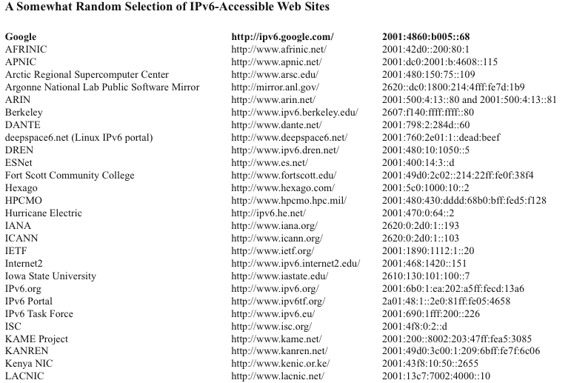

Slide 134
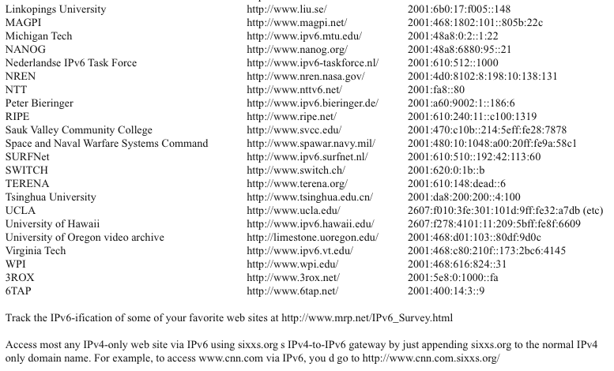

Slide 135
What About Other GUI Web Browsers?
Opera ( http://www.opera.com/ ) is ready to use IPv6 as shipped with no tweaking required, likewise Internet Explorer 8.
Safari is IPv6 enabled, but some versions of Safari may prefer IPv4 to IPv6 when both are available. To reverse that preference for dual stack sites:
1) In a Mac terminal window (Applications --> Utilities
--> Terminal) enable the Safari Debug menu by entering:
defaults write com.apple.Safari IncludeDebugMenu 1
You can then close the terminal window.
2) Launch Safari, then go to Safari’s Debug Menu (on the far right side of the main Safari menu), and come all the way down to Supported Protocols and uncheck http: (Simple Loader). You only need to do this once.

Slide 136
8. (h): IPv6 Email Clients

Slide 137
Modern Mail User Agents Support IPv6
Apple Mail.App
Opera Mail client
Outlook 2007
(see http://support.microsoft.com/kb/924469 )
Thunderbird: (see the next slide)
Other MUAs?

Slide 138
Enabling IPv6 in Thunderbird for Email
Thunderbird (Mozilla’s graphical email client, sibling application to the Firefox web browser) may ship with IPv6 DNS queries disabled by default.
Enabling IPv6 DNS queries requires you to:
-- Start Thunderbird
-- Go to Thunderbird --> Preferences
-- Go to Advanced (the “sprocket” or “gear” at the top)
-- Click the “Config Editor” button near the bottom
-- In the about:config window’s Filter: box, enter ipv6
-- You should see:
network.dns.disableIPv6 [etc] false
-- If, however, that setting is true, double click true
to toggle it to false

Slide 139
Public IPv6-Accessible Web Email
As another example of IPv6 email lagging relative to where it should be, consider web-based email, one of the most popular and widely used applications on the Internet today.
To the best of my knowledge, there is currently only ONE (1) public web email provider which has even an experimental web email service accessible via IPv6, and that's http://ipv6.rollernet.us/
Technically, if you're able to manipulate your local hosts file, you can also access Google's Gmail via IPv6, see
http://jeremy.visser.name/2008/11/25/
how-to-access-gmail-and-google-reader-over-ipv6/ (URL wrapped due to length), but that's hardly the sort of thing that a typical user should be expected to be able to do.
If you're aware of any additional IPv6-accessible public web email service providers, I'd love to know about them.

Slide 140
8. (i): ssh for IPv6

Slide 141
ssh and IPv6
ssh supports IPv6. To get OpenSSH (5.5p1 was released 4/15/2010!) go to www.openssh.com/portable.html (be sure you’re also running the latest OpenSSL -- 1.0.0 was released 3/29/2010 -- see www.openssl.org/ and don’t forget to set a sane installation prefix!)
To force ssh to use IPv6, use:
% ssh -6 joe@example.com
To force ssh to use IPv4, use:
% ssh -4 joe@example.com

Slide 142
8. (j): Web Servers

Slide 143
What About Your Web Site?
Is your web site IPv6 accessible? If not, why not? The most popular web servers, e.g., Apache and Microsoft IIS, both support IPv6 these days! So what's the "holdup," eh?
One potential roadblock to explore is whether hardware load balancers are IPv4 only. Hardware load balancers commonly sit in front of multiple physical computers, making a pile of systems act as if they were one computer. Some popular hardware load balancers know how to do IPv6, but license IPv6 functionality separately from IPv4.
Other times the issue may be the use of outsourced content delivery networks (CDNs) which may not be IPv6-enabled (previously discussed)
Lastly, at least sometimes, no one may every have asked, "Hey, why isn't our web site IPv6 accessible?" Perhaps that's a question that YOU should ask once you're done with this training?

Slide 144
Apache Web Server and IPv6
Get Apache 2.2.15 (or whatever’s the latest stable version) from http://httpd.apache.org/
Review httpd.apache.org/docs/2.2/bind.html#ipv6
but otherwise build, install and configure as normal
When configuring for IPv6, in /etc/httpd/httpd.conf, bind to an appropriate static IPv6 address:
BindAddress [2001:468:d01:d6::80df:d617] <-- example only!
Check your config and start httpd; typically:
/usr/local/apache2/bin/apachectl configtest
/usr/local/apache2/bin/apachectl start
Confirm that you can connect OK to your IPv6 httpd:
% telnet 2001:468:d01:d6::80df:d617 80 <-- example only! GET / (note: case matters, GET, not get)
Problems? Likely a firewall thing, as “always!” :-;

Slide 145
Don’t Forget About IPv6 Addrs in Log Files
# cd /usr/local/apache2/logs
# cat access_log
[…]
2001:468:d01:d6::80df:d617 - - [23/Apr/2010:10:20:29 -0700]
"GET / HTTP/1.1" 200 54
[etc]
Does your log file analyzer product support IPv6 addresses?
Some, like AWStats from http://awstats.sourceforge.net/
require a separate plugin to enable some IPv6 functionality;
other functionality, like mapping addresses to geographic
locations, may simply not be available for IPv6

Slide 146
Conclusion

Slide 147
Learning More About IPv6: Books
A nice online reference: 6Net IPv6 Cookbook, www.6net.org/publications/deliverables/D3.1.2v2.pdf
Traditional printed books about IPv6 are also available. If you go to Amazon's book section and search for IPv6, for example, you get 873 hits. That's a bit better than it was in the old days. :-)
When considering which of those books might work for you, recognize that some are written for specific audiences (like programmers), and those sort of books may not meet your particular needs (unless you're a coder and you're trying to come up to speed for IPv6).
Also recognize that IPv6 is rapidly evolving, so beware of any books that haven't been recently updated.

Slide 148
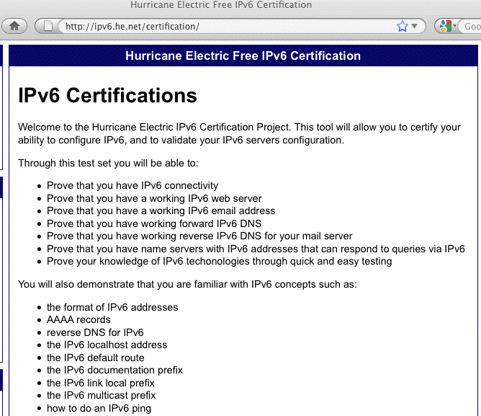
Hurricane Electric’s IPv6 Certification

Slide 149
Thanks For the Chance To Talk!
Are there any questions?

