Slide 1
Spam, Domain Names and Registrars
Joe St Sauver, Ph.D. (joe@uoregon.edu)
Senior Technical Advisor
Messaging Anti-Abuse Working Group
MAAWG 12th General Meeting, San Francisco
February 18th-20th, 2008
http://www.uoregon.edu/~joe/maawg12/
Disclaimer: all opinions expressed in this talk are solely those of the author, and do not necessarily represent the opinion of MAAWG or any other entity. Recognizing that conditions are continually evolving over time, please carefully re-evaluate this data yourself before drawing any conclusions from it or taking any action based on it. This analysis is not intended to be used for operational purposes. It is offered as is, where is, with no warranty or assertion of fitness for any purpose whatsoever

Slide 2
Attacking Spam By Focusing on the Resources That Spammers Need
In order to spam, spammers require access to a variety of resources.
For example, let's assume that in order to send spam, a spammer needs (at a minimum):
-- spam sending software
-- addresses to spam
-- hosts on unblocklisted IP addresses through which to route
their spam (these may be compromised consumer hosts on
a rented botnet, for example)
-- hosting for spamvertised web sites (whether on so-called
bullet proof hosting, fast flux hosting, or whatever), and
-- domain names for that hosting, among other things.
If we can cut off spammer access to at least one those required resources, spamming becomes harder.

Slide 3
Domain Names Are One Fundamental Component of the Internet Ecosystem
Domain names are a fundamental part of the Internet, and it would be hard to imagine the Internet working without them.
Those who abuse email unquestionably depend on the continued availability of domain names.
For example, in a typical pillz spam, the spam message may urge the spam recipient to visit a given domain name (e.g., web page "URL" or "URI") to buy a controlled substance.
Just a single pillz spam campaign might use dozens or even hundreds of domain names.
You might wonder, "Why would a spammer use so many domain names? Why not just spamvertise the address of
one web site and be done with it?"
There are actually many reasons. A few of those are...

Slide 4
The Many Reasons for Spamvertising
Many Different Domain Names
Avoiding SURBL/URIBL Filtering: Let's assume that a foolish spammer only spamvertised a single URI for weeks (or months!) on end. Once that URI got identified, it would be a trivial task to filter messages referring to that URI. Clearly, spammers need to continually introduce new domains as their old domains get identified and SURBL or URIBL listed.
Trying to Stay Off Law Enforcement (LE)'s Radar:
Prioritization of official anti-spam efforts also is often volume-related: "let's go after the worst of the bad guys first; we'll deal with all the little guys later." If a spammer spamvertises multiple domain names (rather than just one domain name),
it becomes at least marginally harder for LE to mechanically aggregate all that spam traffic, thereby potentially reducing a spammer's chance of being targeted for prosecution.

Slide 5
The Many Reasons for Spamvertising Many Different Domain Names (2)
Load Balancing and/or Enhanced Survivability:
Use of multiple domain names also makes it possible for the spammer to do load balancing and/or to increase the survivability of his/her web site. For example, spamvertised domains A, B, and C might be configured to go to backend server farm #1, while spamvertised domains D, E, and F might get sent to backend server farm #2. Any attempt to take that spammer down would require hitting both of those backend server locations more or less simultaneously – and you'd also need to tear down all of those domain names so the spammer couldn't simply repoint that set of domains to some third backend server location. Clearly spamvertising multiple domain names increases a spammer's ability to manage his/her traffic and to survive attempts at interference

Slide 6
The Many Reasons for Spamvertising Many Different Domain Names (3)
Market Segmentation: Use of multiple domain names also facilitate spammer market segmentation. For example, a pillz spammer might use some domain names to route potential benzodiazepine customers directly to pages selling benzodiazepines, while customers for erectile dysfunction medications might be sent to different pages offering those medications, instead.
Tracking/Crediting Affiliate Traffic: Spamvertising multiple domain names also makes it easy for spammers to track and credit affiliate traffic. The spammer assigns a different set of domain names to each affiliates, and then checks the referrer logs, watching to see which of those assigned domains ends up referring traffic to the spammer's real web site or sites.

Slide 7
Some of The Hassles of Having to Operate In A "Many Domain World"
There are some disadvantages to spammers having to operate in a "many domain world," including (among others):
-- purchasing large numbers of domains may contribute to
the erosion of spammer profits (unless the spammer
owns or effectively controls his/her own registrar)
-- using many different domains increases operational
complexity, and creating and efficiently managing large
numbers of spam-related domains may require automated
domain name provisioning software or other assistance
-- effectively re-contacting customers who respond to spam
via a spamvertised web site may require special steps
(such as polling customers by phone or by email for
"refills"), since the spamvertised domain the customer
used last time may no longer be operational this time

Slide 8
Spamvertised URIs and URI Block Lists
Even though spammers may continually introduce new domains to be spamvertised, URI block list operators have done a very good job of keeping up with the spammers as
new spammy domains have been created.
Because of the extreme effectiveness of URI-based block lists, some spammers have been forced to resort to sending:
-- spam which doesn't use or need a URI (such as stock
pump-and-dump spam),
-- spam which attempts to use image files in an effort to
keep embedded URIs from being mechanically "read",
-- spam which attempts to channel responses via an email
drop box address or a VoIP phone number (as is the
case in many 4-1-9 advance fee fraud scam spam), or
-- spam which attempts to hide spamvertised URLs behind
web redirector pages, search engine search strings, etc.

Slide 9
Spammers Also Need Domain Names for Other Purposes
While spammers need domain names to spamvertise, they also need domain names for other operational purposes.
For example, they need domain names to use to name their servers, so that when that server connects to a remote mail server, it has a domain name, not just a raw IP address. Why is this important? Well, Some ISP have published email technical standards which require connecting hosts to have rDNS (http://postmaster.aol.com/guidelines/standards.html states that "AOL's mail servers will reject connections from any IP address that does not have reverse DNS (a PTR record")), and having rDNS requires having a domain name.
Spammers also need domain names for use in HELO/EHLO and in message headers (such as in From: headers). Things like SPF/SenderID may limit their ability to use others'!

Slide 10
Okay, So Spammers Need Domain Names. Where Do They Get Them?
The get them from registrars (or registration service providers), just like anyone else. Well, almost just like everyone else….
Some registrars really don't like spammers, and if they find they've unintentionally sold a domain name to a spammer, or they've got a domain name that has bogus whois data, they'll promptly suspend that domain (yes, this is allowed, see Spamhaus' discussion of this at http://www.spamhaus.org/
faq/answers.lasso?section=Generic%20Questions#127 ).
If enough registrars became intolerant of spam-related domains, domain non-availability could become a critical spam choke point. Registrars and registration service providers thus have the potential to play a crucial role in the fight against spam.

Slide 11
Not All Registrars May Be Willing to Help
We know, for example, that there are some registrars or registration service providers who offer so-called bullet proof domain names (check for that phrase in your favorite search engine to see some examples).
Of course, if you're a bad guy and need a domain name that won't be shut down in response to complaints, you should plan to pay a premium for that privilege (~$100/domain?).
I recognize that those "bulletproof" registrars may be unwilling to refrain from selling domains to spammers,
since that may be their targeted/primary customer base.
That may seem worrisome, but it's actually okay -- IF we're able to identify those registrars and the domains they've sold
We also need to recognize that we don't live in just a dot com/dot net/dot org world. We also need to think about other top level domains, such as ccTLDs.

Slide 12
Margins for Some TLDs May Be Thin, Limiting Resources for Abuse Handling
For example: see '"Experience .CN Domain Name for One Yuan Campaign" will extend till 31st December, 2008,'
http://www.cnnic.cn/html/Dir/2007/12/27/4953.htm
For those of you who don't routinely memorize foreign exchange rates, 1 Yuan = US$ 0.139 as of 2/10/2008
At $0.139/domain, there's NOT going to be a lot of money available to investigate .cn domain name abuse complaints.
For example, I bet you didn't know that "your" company's domain name may already be registered by someone in .cn, e.g., maawg.cn is currently at 218.244.140.62
Rebuttable hypothesis: at just $0.14/domain, domain name speculation and squatting may now be fairly rampant in the
dot cn TLD. So how do domain name disputes get resolved?

Slide 13
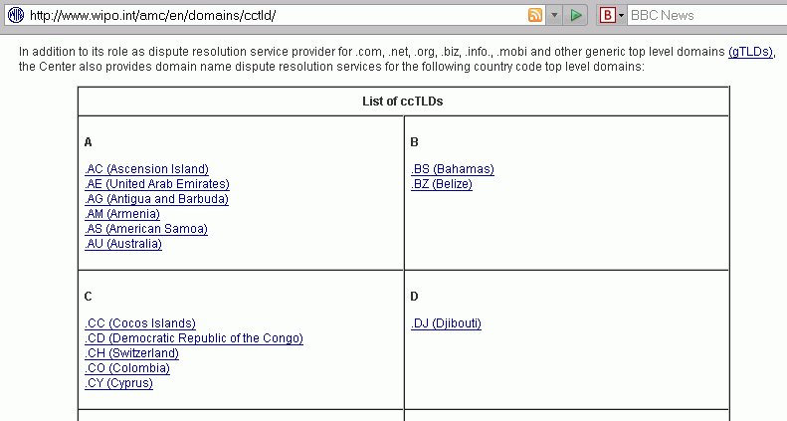
For Example, Does the Normal WIPO Dispute Resolution Process Apply?
The gTLDs, and many ccTLDs, use the WIPO framework (http://www.wipo.int/amc/en/domains/cctld/ ) but .cn does not:

Slide 14
If You'd Like To Read About The Rules Which DO Apply to .cn Domains...
www.cnnic.net.cn/html/Dir/2006/02/14/4008.htm states:
"Article 2. The policy is applicable to disputes result from registration or usage of domain names. [...] the Dispute Resolution Service Providers do not accept the Complaint regarding domain names with registration term of over (including) TWO years. [emphasis added]
www.cnnic.net.cn/html/Dir/2006/03/15/3655.htm states:
"Article 8: Unless otherwise agreed by the Parties or determined in exceptional cases by the Panel, the language of the domain name dispute resolution proceedings shall be Chinese. The Panel may order that any documents submitted in languages other than Chinese be wholly or partially translated into Chinese." [emphasis added]

Slide 15
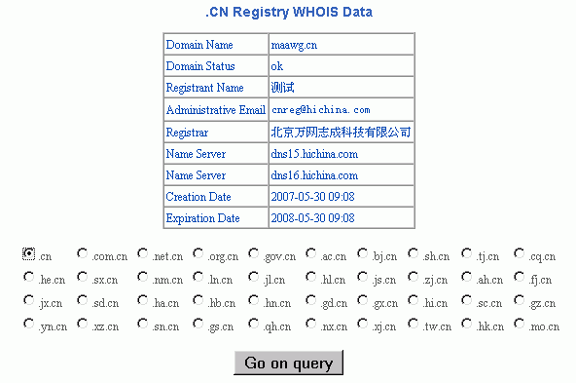
And Speaking of Dot cn Domains...
We're entering a brave new world where English language domain information (or even Roman character sets!) shouldn't even be presumed in whois data:

Slide 16
Quick "Quiz"
Pronounce the registrant's name from the preceding slide.
What's his/her snail mail postal address? Phone number?
Is this a "domain name privacy" registration where hichina.com has done a proxy registeration of this domain for someone else? A domain owned by hichina.com itself?
I showed you the .cn registry whois. Is there a referral to a registrar whois server with more detail? If so, what's the name of the registrar's whois server you should check?
How many .cn domains can you query per hour/day/ whatever before your IP address gets rate limited/blocked?
How many provincial and other subdomains are available
below dot cn addition to the "top level" dot cn domain? (I'll stipulate and agree that you may not be allowed to register domain names in some of them, e.g., gov.cn for example)

Slide 17
And If You're Still Not Interested In China
I'd encourage you to look at Google's February 2008 tech report, "All Your iFRAMEs Point to Us," by Niels Provos, Panayiotis Mavrommatis, Moheeb Abu Rajab, and Fabian Monrose, which is available online at http://research.google.com/archive/provos-2008a.pdf
Specifically, note the comments on pdf page 9 of that report:
"One noteworthy result is the geographic locality of web based malware. […] The results show that a significant number of Chinese-based sites contribute to the drive-by problem. Overall, 67% of the malware distribution sites and 64.6% of the landing sites are hosted in China."
See also report page 13, stating that "malware distribution sites are concentrated in a limited number of /8 prefixes. About 70% of the malware distribution sites have IP addresses within 58.* -- 61.* and 209.* -- 221.* network ranges." <cough>

Slide 18
But Let's Move On: What About gTLD
Domain Names With Bad Whois Data?
gTLD domains are required, pursuant to the registrar's accreditation agreement with ICANN, to maintain accurate whois data for their domains (see http://www.icann.org/whois/
whois-data-accuracy-program-27apr07.pdf ).
From time to time, however, particularly if you're looking at spamvertised domain names, you may run into names with bad or incomplete whois data.
For instance, when you check whois for a domain you may find that the street address given for the domain registrant (or administrative contact or technical contact) may be missing, incomplete, inconsistent, or otherwise invalid (www.usps.gov/zip4 is great for checking US addresses)
The General Accounting Office has previously investigated the issue of bad whois data for Congress.

Slide 19
The 2005 GAO Whois Data Study
In November 2005, the General Accounting Office released, GAO 06-165, "INTERNET MANAGEMENT: Prevalence of False Contact Information for Registered Domain Names" (see http://www.gao.gov/new.items/d06165.pdf )
That study estimated that 8.65% of all .com/.net/.org domains had at least one patently false or incomplete required fields in whois.
The study also found that when they looked at a random sample of 900 domains (300 each from .com, .net and .org) and identified and reported 45 of those domain names for identified inaccuracies or omissions, a month later 33 of the 45 domains (73%+) did not have their inaccuracies or omissions corrected despite having been reported.

Slide 20
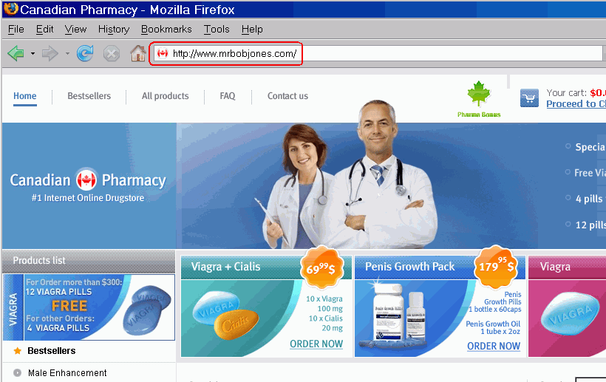
A Concrete Example From This Month

Slide 21
What Does the Whois Data Look Like For That Domain?
[whois.dns.com.cn]
Domain Name.......... mrbobjones.com
Creation Date........ 2008-01-27 13:53:12
Registration Date.... 2008-01-27 13:53:12
Expiry Date.......... 2009-01-27 13:53:12
Organisation Name.... Ruby Diamond Bhd
Organisation Address. Brail City } not much of an
Organisation Address. } address, eh?
Organisation Address. Brazil }
Organisation Address. 45123 }
Organisation Address. WG }
Organisation Address. BR }
[continued next slide]

Slide 22
What Does the Whois Data Look
Like For That Domain? (2)
Admin Name........... Ruby Diamond Bhd
Admin Address........ Brail City
Admin Address........
Admin Address........ Brazil
Admin Address........ 45123
Admin Address........ WG
Admin Address........ BR
Admin Email.......... brazil@gmail.com
Admin Phone.......... +86.452133
Admin Fax............ +86.5457331
[etc]
Name Server.......... ns4.jokens.com [116.199.138.24]
Name Server.......... ns3.jokens.com [116.199.135.168]
Name Server.......... ns2.jokens.com [58.20.84.92]
Name Server.......... ns1.jokens.com [221.122.64.14]
[All of those name server IP's are on the SBL]

Slide 23
Reporting Inaccurate Whois Data
If you do run into a gTLD domains with bad whois data, you can file a complaint about it via http://wdprs.internic.net/
According to http://www.icann.org/whois/
whois-data-accuracy-program-27apr07.pdf , there were about
6.35 non-duplicative reports made per 10,000 .com domains (.com domains accounted for nearly 75% of all complaints).
That same report notes that a relatively small number of reporters, just 20 people (<1% of all those who filed reports) accounted for over 87% of all 50,189 inaccuracy reports, and just *one* person accounted for approximately 40% of all inaccuracy reports. Quoting from the report,
"From both anecdotal information received by ICANN and text accompanying the body of WDPRS reports received,
we conclude that most, if not all, of the high volume reporters are driven by a concern about abuses involving email."

Slide 24
Those Are Fascinating Statistics
And Ones Which Raise Some Questions
Why are just twenty reporting parties carrying the lion's share of the burden when it comes to reporting domain names with bad whois data to Internic? Why isn't everyone who's here today reporting domain names with bad whois data when they run into them?
Would a bulk-reporting interface help, so that multiple domains all sharing the same whois data defects can be reported en-masse, instead of onesie-twosie style?
Why aren't leading providers pressing ICANN to deal more aggressively with accredited registrars who aren't fulfilling their obligations with respect to maintaining whois data accuracy? If a domain has bad whois data, there's no reason why it should still be up/uncorrected months later.
There are other domain/whois-related issues, too…

Slide 25
For Example: The Glue Record Problem
Glue records are static name server records in the TLD created to help bootstrap access to that domain
So if a bad domain name gets taken down, what happens to the name server glue records which may be associated with that domain? Do they also go away?
The answer is, "It depends." It is not uncommon to run into situations where a particular domain name no longer exists, but glue records associated with that domain remain active (and usable!) in conjunction with other potentially abused domains.
Does this mean that we should we work towards eliminating all glue records? No. For example, if there were to be a requirement that glue records be present and correct for all domains, things like double fast flux domains would become extremely difficult for the bad guys/bad gals to implement.

Slide 26
ICANN SSAC Comments to the GNSO Regarding WHOIS Studies (7 Feb 2008)
[see http://www.icann.org/committees/security/sac027.pdf]
The ICANN Security and Stability Advisory Committee recently provided comments on whois related issues to the ICANN Generic Names Supporting Organization, noting in part:
-- "The GNSO should continue current and proposed work to resolve legal and privacy issues within the existing WHOIS framework."
-- "ICANN should take aggressive measures with respect to improving registration data accuracy and integrity. Future agreements should include data accuracy and integrity (e.g., archival and restoration) guidelines and should include provisions for sanctions or other penalties for those who do not comply with these guidelines."

Slide 27
ICANN SSAC Comments to the GNSO Regarding WHOIS Studies (continued)
-- "The ICANN community should adopt an Internet standard directory service as an initial step toward deprecating the use of the WHOIS protocol in favor of a more complete directory service."
-- 'ICANN should work with all TLD registry operators to develop a timeline and transition plan for migrating from the current WHOIS service to a successor Internet “domain” directory service.'
Clearly I'm not the only one frustrated by the current state
of affairs with respect to the accuracy of domain name data in whois. :-)

Slide 28
Of Course, If Domains Are Registered Via A Proxy Registration Service...
... then you won't see much in the way of the underlying domain owner's contact data to validate and/or to report.
While people may have perfectly valid and legitimate reasons for wanting to use a proxy registration service,
it is unfortunate that many abusive domains are also registered via proxy registration services.
As a result, at least one DNS-based whois service, www.openwhois.org, has begun to offer a service which
will allow you to check to see if a domain of interest has been registered with a proxy registration service, and if it has, well, then you have the option of taking whatever
action you deem appropriate. That type of test can be
easily integrated into a spam scoring system such as SpamAssassin, etc

Slide 29
Why Are Some Proxy or Private
Domain Registrations Problematic?
Proxy registrants may be effectively impossible to map to a real person or company. Proxy registration services may initially shield the identity of their customer, and if/when a court order or other legal paperwork compels them to disclose the underlying identity of the customer, that data may be turn out to be completely bogus since it is subject to review only by the proxy registration service provider itself.
Proxy registrations make it more difficult to accumulate reputation across domain names. That is, if I find that domains A, B, C, D, and E all are registered to a particular individual, and all are spammy, if I find additional domains
F or G or H, I might be predisposed to assuming those domains are spammy too, until proved otherwise. Proxy registrations make it impossible to do that sort of thing...

Slide 30
Some Proxy Registration Providers Do A Good Job Of Handling Abuse
For example, some proxy registration service providers are well known for their policy of cancelling a domain's proxy registration status if a proxy registered domain is used for spam or otherwise unacceptable purposes, "outing" (publishing) the customer's normally withheld contact details at that time. Good job!
Other registrars (or proxy registration service providers) may be less aggressive in dealing with problematic domain names. A prime indication that problems may exist may be restrictive proxy registration complaint communication policies (such as only accepting complaints via certified mail, or only accepting complaints via email, or only accepting complaints made by telephone, or only accepting complaints made via a web form). Again, let's consider an example...

Slide 31
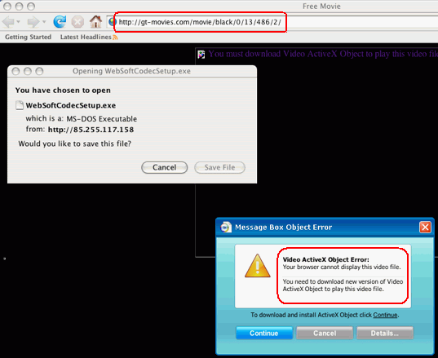
CAUTION: MALWARE!
CAUTION: MALWARE!

Slide 32
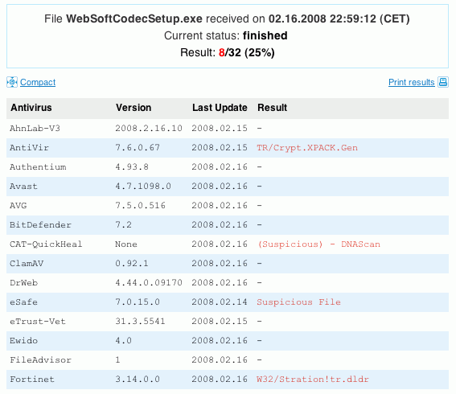

Slide 33
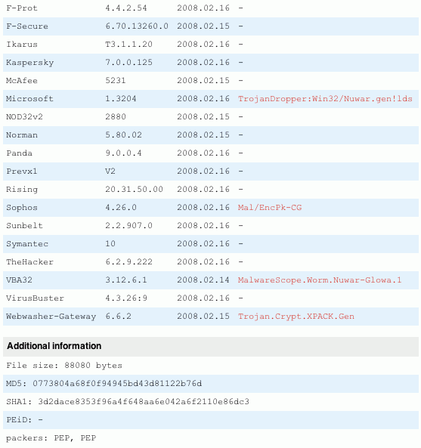

Slide 34
[whois.estdomains.com]
Registration Service Provided By: ESTDOMAINS INC
Contact: +1.3027224217
Website: http://www.estdomains.com
Domain Name: GT-MOVIES.COM
Registrant:
PrivacyProtect.org
Domain Admin (contact@privacyprotect.org)
P.O. Box 97
All Postal Mails Rejected, visit Privacyprotect.org
Moergestel
null,5066 ZH
NL
Tel. +45.36946676
Creation Date: 10-Feb-2008
Expiration Date: 10-Feb-2009
Domain servers in listed order:
ns2.gt-movies.com
ns1.gt-movies.com

Slide 35
So In That Example…
We have a domain name which is associated with malware
The domain name is hidden behind a privacy service reg
The privacy service has chosen to severely constrain how they will accept complaints about their customers' domains
Because the owner of that domain is concealed, it is harder for us to identify other domains which may exhibit similar misbehavior
These factors make it hard(er) for us to combat the malware associated with that site or set of sites.
I would assert that as this sort of thing becomes more common, a growing number of sites will begin to pay attention to things like www.openwhois.org's list of proxy/private registration service providers
In fact, some sites may begin to scrutinize registrars and their associated characteristics more closely in general.

Slide 36
Some Accredited Registrars May
Be Working From IP Addresses On
The Spamhaus SBL and DROP Lists
For example, what about www.estdomains.com, as seen in the preceding example?
1) www.estdomains.com ==> 216.255.186.100
2) 216.255.186.100 is on the Spamhaus SBL at SBL53319
3) SBL53319 is on the Spamhaus DROP list
If you wish to review that SBL listing, it is at
http://www.spamhaus.org/sbl/sbl.lasso?query=SBL53319
You can also review the listing criteria for DROP at http://www.spamhaus.org/drop/index.lasso

Slide 37
So Does This Mean You Want ICANN to Use Spamhaus Listing Status As An Accreditation/Reaccreditation Criteria?
Not necessarily. What ICANN chooses to use or not as a gating criteria for accreditation or reaccreditation decisions is up to them, and I wouldn't presume to attempt to dictate policy to them or to the registrar community, except to note that registrars do have special access to critical community resources, and that special access implies (or should imply) a broad level of community confidence and trust.
On the other hand, if an accredited registrar is broadly blocklisted, it will be operationally very hard for them to
send email to many potential recipients, including registration-related emails for things such as verifying domain whois email points of contact, etc. *That* may be an issue which merits discussion in the ICANN community.

Slide 38
Accumulating Registrar
Reputation Data
As you check domain after spam-related domain with bad or hidden whois data, you may begin to notice registrar reputation-related data patterns emerge. For example,
some registrars routinely and promptly suspend domains
associated with bad whois data or with spam issues, while others may not.
Castlecops has actually begun to formally track registrar
performance when it comes to removing domains in response to complaints, tracking the results on a
registrar-by-registrar basis for selected registrars. See the report on the following slide (sorry about the sideways orientation of that page).

Slide 39
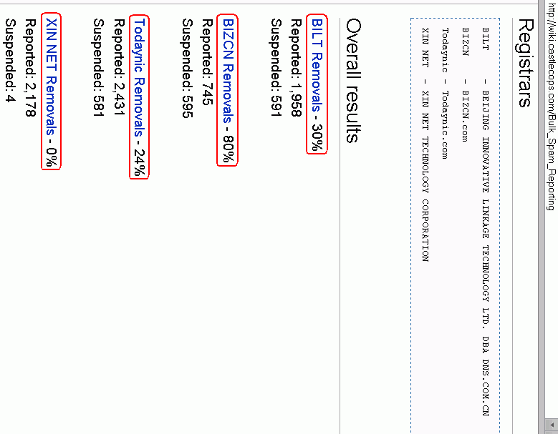

Slide 40
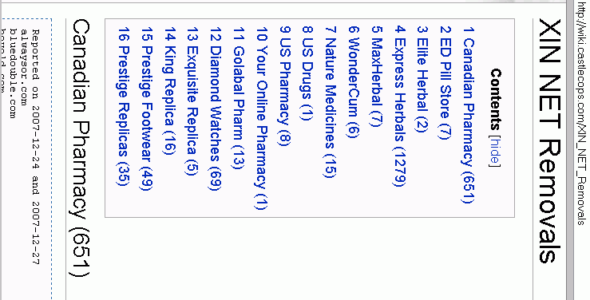
Castlecops Even Gives You A Breakdown of Domains Reported by "Brand" and Domain Names

Slide 41
But What of Other Registrars?
I was curious about all registrars, not just the handful of Chinese registrars that Castlecops tracked (although I must say that I do find their work exceptionally interesting).
The operators of the URIBL block list do look at the top
250 registrars associated with the domains they list, see
http://rss.uribl.com/nic/
The spacing of their report makes it hard for me to show it to you onscreen, so I've excerpted and slightly reformatted that data to show you on the following slide.
Note, too: you can click on a link on http://rss.uribl.com/nic/ to see the hosts which are URIBL listed for that registrar

Slide 42
[Excerpted and slightly reformatted rendition of http://rss.uribl.com/nic/ data]
Rank Registrar Listed Active Percent
1 MONIKER ONLINE SERVICES, INC 2488 3007 82.74%
2 ENOM, INC 2197 3468 63.35%
3 TODAYNIC.COM, INC 1220 1228 99.35%
4 GO DADDY SOFTWARE, INC 947 3378 28.03%
5 XIN NET TECHNOLOGY CORPORATION 790 848 93.16%
6 DYNAMIC DOLPHIN, INC 486 489 99.39%
7 SPOT DOMAIN LLC DBA DOMAINSITE.COM 333 362 91.99%
8 BLOG.COM DIGITAL COMMUNICATIONS INC 327 334 97.90%
9 BIZCN.COM, INC 238 260 91.54%
10 BEIJING INNOVATIVE LINKAGE TECHNOLOGY LTD. DBA DNS.COM.CN
237 276 85.87%
11 INTERCOSMOS MEDIA GROUP, INC DBA DIRECTNIC.COM 191 373 51.21%
12 DIRECT INFORMATION PVT LTD DBA PUBLICDOMAINREGISTRY.COM
179 295 60.68%
13 PLANET ONLINE CORP 169 173 97.69%
14 GKG.NET, INC 152 216 70.37%
15 TUCOWS INC 147 1412 10.41%
16 REGISTER.COM, INC 144 683 21.08%
17 NETWORK SOLUTIONS, LLC 109 4433 2.46%
18 NUCLEAR NAMES, INC 80 81 98.77%
19 DOTSTER, INC 58 271 21.40%
20 DOMAIN CONTENDER, LLC 49 65 75.38%

Slide 43
The URIBL is *NOT* The Only URI Block List Out There. What Do We See for the SURBL URI Blocklist?
I decided to see who was the registrar of record for the domain names listed on the SURBL (www.surbl.org), another publicly available and widely used URI block list
The SURBL folks were good enough to give me rsync access to their list of domains for this purpose, thank you very much! As of 2/16/2008, the multi.surbl.org.rbldnsd zone is roughly 1.24 million entries long.
If you've not seen a copy of the SURBL zone file, some of the URI hosts in the SURBL include numeric IP addresses, as well as domains from diverse TLDs. Obviously we're not going to be looking at any domain registrar data for numeric IP's. There are a few other domains we also can't process…

Slide 44
Omitted SURBL Listed Domains
Some SURBL'd domains were from TLDs (such as some ccTLDs) which don't offer whois service
Other TLDs offer whois service, but severely limit the maximum number of whois queries which one can make
per querying IP per day.
An additional group of SURBL listings were domains which appeared to have been already suspended or deleted (that list of domains has been provided to the SURBL folks for their review).
Finally, some domains, because of how they format their whois data, will not be included in this preliminary report
(for example, co.uk domains put their registrar data on a separate line from the Registrar: field name, and as a
result I ended up missing collecting data from that TLD)

Slide 45
What We Were Left With...
After considering the previously mentioned factors, we ended up with a data set of right around 600,000 SURBL'd domains and their associated registrars.
In my opinion, that's still enough domains to be worth a look.
What do we see as we look at that data?

Slide 46
A Small Number of Registrars Have The Potential To Be Hugely Influential When It Comes to Combating Abuse
Looking at the domains on the SURBL for which it was possible to identify a responsible registrar (just under 600,000 listed domains):
-- 4 registrars account for 50% of listed domains
-- 24 registrars account for 80% of listed domains
-- 69 registrars (all of the ones with more than a
tenth of a percent of all listed domains) cover
roughly 92% of listed domains
See the following table...

Slide 47
REGISTRAR Freq % Cum Freq %
ENOM INC 108,965 18.34 108,965 18.34
MONIKER ONLINE SERVICES INC 92,765 15.61 201,730 33.95
DIRECT INFORMATION PVT LTD DBA
PUBLICDOMAINREGISTRY.COM 50,180 8.44 251,910 42.39
GODADDY.COM INC 49,309 8.30 301,219 50.69
TUCOWS INC 17,045 2.87 318,264 53.56
MELBOURNE IT LTD DBA
INTERNET NAMES WORLDWIDE 15,369 2.59 333,633 56.14
SPOT DOMAIN LLC DBA
DOMAINSITE.COM 13,750 2.31 347,383 58.46
BEIJING INNOVATIVE LINKAGE TECHNOLOGY
LTD DBA DNS.COM.CN 13,444 2.26 360,827 60.72
COMPUTER SERVICES LANGENBACH
GMBH DBA JOKER.COM 12,833 2.16 373,660 62.88
DYNAMIC DOLPHIN INC 11,594 1.95 385,254 64.83
NETWORK SOLUTIONS LLC 11,480 1.93 396,734 66.76

Slide 48
REGISTRAR Freq % Cum Freq %
XIN NET TECHNOLOGY CORP 10,207 1.72 406,941 68.48
WILD WEST DOMAINS INC 9,529 1.60 416,470 70.08
ESTDOMAINS INC 9,499 1.60 425,969 71.68
THE NAME IT CORPORATION DBA
NAMESERVICES.NET 9,435 1.59 435,404 73.27
INTERCOSMOS MEDIA GROUP INC
DBA DIRECTNIC.COM 7,155 1.20 442,559 74.47
REGISTER.COM INC 6,827 1.15 449,386 75.62
BIZCN.COM INC 6,357 1.07 455,743 76.69
GKG.NET INC 5,283 0.89 461,026 77.58
DOTSTER INC 4,662 0.78 465,688 78.37
TODAYNIC.COM INC 4,588 0.77 470,276 79.14
DSTR ACQUISITION VII LLC 4,569 0.77 474,845 79.91
ONLINENIC INC 4,450 0.75 479,295 80.66
SCHLUND+PARTNER AG 4,413 0.74 483,708 81.40
PARAVA NETWORKS INC DBA
REGISTRATEYA.COM NAAME.COM 4,144 0.70 487,852 82.10

Slide 49
REGISTRAR Freq % Cum Freq %
INNERWISE INC DBA
ITSYOURDOMAIN.COM 4,074 0.69 491,926 82.78
ABSYSTEMS INC 3,740 0.63 495,666 83.41
BASIC FUSION INC 3,074 0.52 498,740 83.93
DOMAIN CONTENDER LLC 2,712 0.46 501,452 84.38
NAME.COM LLC 2,241 0.38 503,693 84.76
NAMEKING.COM INC 2,153 0.36 505,846 85.12
IP MIRROR PTE LTD DBA IP MIRROR 2,087 0.35 507,933 85.48
PLANETDOMAIN PTY LTD 1,962 0.33 509,895 85.81
KEY-SYSTEMS GMBH 1,889 0.32 511,784 86.12
MYDOMAIN INC 1,838 0.31 513,622 86.43
NAME.NET LLC 1,588 0.27 515,210 86.70
DOMAINDISCOVER 1,471 0.25 516,681 86.95
COMPANA LLC 1,415 0.24 518,096 87.19
PLANET ONLINE CORP 1,407 0.24 519,503 87.42
ULTRARPM INC DBA
METAPREDICT.COM 1,404 0.24 520,907 87.66

Slide 50
REGISTRAR Freq % Cum Freq %
DOMAINDOORMAN LLC 1,331 0.22 522,238 87.88
RED PILLAR INC 1,308 0.22 523,546 88.10
BELGIUMDOMAINS LLC 1,305 0.22 524,851 88.32
CSC CORPORATE DOMAINS INC 1,157 0.19 526,008 88.52
RUCENTER-REG-RIPN 1,145 0.19 527,153 88.71
OMNIS NETWORK LLC 1,090 0.18 528,243 88.89
HICHINA WEB SOLUTIONS (HK) LTD 1,003 0.17 529,246 89.06
NUCLEAR NAMES INC 1,000 0.17 530,246 89.23
FABULOUS.COM PTY LTD 934 0.16 531,180 89.39
TLDS LLC DBA SRSPLUS 920 0.15 532,100 89.54
CAPITAL NETWORKS PTY LTD 867 0.15 532,967 89.69
CAPITOLDOMAINS LLC 837 0.14 533,804 89.83
MELBOURNE IT LTD 833 0.14 534,637 89.97
1-877NAMEBID.COM LLC 813 0.14 535,450 90.11
DYNADOT LLC 742 0.12 536,192 90.23
ANSWERABLE.COM (I) PVT LTD 727 0.12 536,919 90.35

Slide 51
REGISTRAR Freq % Cum Freq %
NICREG LLC 725 0.12 537,644 90.48
PSI-USA INC DBA DOMAIN ROBOT 682 0.11 538,326 90.59
NETFIRMS INC 681 0.11 539,007 90.70
ENOMAU INC 679 0.11 539,686 90.82
DOMAINPEOPLE INC 662 0.11 540,348 90.93
ENOMX INC 656 0.11 541,004 91.04
VISESH INFOTECNICS LTD 655 0.11 541,659 91.15
ENOMMX INC 640 0.11 542,299 91.26
MONIKER ONLINE SERVICES LLC 639 0.11 542,938 91.37
WEBAIR INTERNET DEVELOP. 635 0.11 543,573 91.47
FASTDOMAIN INC 630 0.11 544,203 91.58
ABACUS AMERICA INC DBA
NAMES4EVER 629 0.11 544,832 91.68
[all remaining registrars individually represented 1/10th of 1% of the total or less]

Slide 52
Caution: Glancing at That Raw Table May Give You A Misleading Impression
Domain names are not equally distributed across all accredited registrars. There are some accredited registrars who have a huge share of the market, while others are quite a bit smaller. We therefore should adjust that listing according to relative registrar market share.
Some registrars may also have multiple independent accredited registrar units. For example, in addition to ENOM INC, the top registrar in our dataset, there are also additional potentially related registrar entities such as ENOMAU INC, ENOMX INC, ENOMMX INC, ENOMTEN INC, ENOMTOO INC, ENOM CORPORATE INC, ENOM1 INC, ENOM3 INC, ENOMNZ INC, ENOMEU INC, ENOM4 INC, ENOM5 INC, ENOM GMP SERVICES INC, ENOM WORLD INC, etc., etc. Potentially related registrars have NOT be aggregated.

Slide 53
More Cautions
We also need to recognize that some registrars may have many domains for which we could not get registrar whois data, so for now let's just focus on .com and .net domains
for comparability purposes.
Dot com and dot net account for > 95% of the "registrar-attributable" SURBL domains in our dataset anyway...
Cumulative Cumulative
TLD Frequency Percent Frequency Percent
----------------------------------------------------------
com 498642 82.04 498642 82.04
net 82664 13.60 581306 95.64
Focusing on dot com and dot net also makes it easy to get registrar market share statistics from Verisign's monthly registry reports (see www.icann.org/tlds/monthly-reports/ ). The most recent registry data available is from October 2007.

Slide 54
What's In The Table On The Next Slide?
For registrars with at least 0.2% of the .com+.net SURBL dataset, the spreadsheet on the next slide shows some initial results, namely:
  Registrar Name
  Number of .com+.net SURBL'd domains associated with that registrar
  Total .com domains for that registrar as of October 2007
  Total .net domains for that registrar as of October 2007
  Sum of those October 2007 .com + .net domain counts
  Ratio of (.com and .net SURBL listed domains associated with this registrar)/(all .com+.net domains associated with this registrar)*100
  Ratio of (the % of all SURBL domains for this registrar)/(the % of all .com+.net domains for this registrar); entries in the table are sorted by this column.
  Note: one registrar (MYDOMAIN INC) did not appear in the Verisign Monthly report; the whois server associated with at least a couple of MYDOMAIN INC domains showed a whois server of whois.namesdirect.com but for now I've simply omitted that registrar

Slide 56
How Do I Read The
Values In That Chart?
Looking at the two ratios shown for each registrar:
-- The first of those two ratios is essentially the percent of .com and .net domains (for that registrar) which are listed on the SURBL list. Lower values are better.
-- The second of those two ratios is the percent of SURBL listings associated with a given registrar divided by the market share of that ratio. If a registrar has just "its proportionate share" of SURBL listings, it would have a
ratio of 1.0. If the registrar appears to have more than "its proportionate share" of SURBL listings, it will have a ratio that's greater than 1, and conversely, if it appears to have less than its proportionate share of SURBL listings, it will have a ratio of less than 1. (Again, lower values are better.)

Slide 57
Interpretive Cautions/Disclaimers
Just like earlier tables, the table on slide 55 also needs to be interpreted carefully. For example, because the most recent com/net domain market share data available was from October 2007, if a registrar listed in that table experienced growth between October 2007 and the end of January when I obtained SURBL data for this study, they might show higher ratios than they should; conversely, if registrar share dropped during the period while SURBL listings remained unchanged, they might show undeservedly low ratios.
Those ratios are also just a "snapshot" in time; any registrar can develop a temporary infestation of abusers, or have a temporary clean streak. :-) The correct thing to watch is what happens to SURBL listing counts over time. Do the counts associated with providers go up (as infestations get worse), or do they go down as problematic domains get terminated?

Slide 58
Interpretive Cautions/Disclaimers (2)
While these statistics are derived from dot com and dot net domains listed in the SURBL data, replacing the SURBL data with a different unwanted domain data source, or inclusion of other TLDs (such as dot org), just to name two factors among many, might dramatically change individual registrar rankings for the better (or for the worse).
While I've attempted to exercise all due care, I may have made some yet-to-be-identified error so I would urge you to carefully re-evaluate this data yourself before drawing any conclusions from it or taking any action based upon it.
The preceding analysis is meant to illustrate one possible analysis which one might do, and is intended to stimulate further discussion. This data should NOT be used for operational purposes, and comes with no warranty.
If you use this data for anything, you do so at your own risk.

Slide 59
Conclusion/Summary
Spammers need a variety of resources in order to be able to send spam. If denied access to those resources, their ability to continue to be able to spam will be diminished.
Domain names are one such resource, which means that registrars can potentially play a critical role in fighting spam.
A relatively small number of registrars control a significant fraction of the addresses listed on the SURBL. Other registrars may have a high concentration of domains associated with abuse, and may (or may not) be willing to take action to deal with those problematic domains.
Proxy/private registration services may exacerbate the problems associated with abused/abusive domains.
The status of any registrar at any single point in time is not as important as what happens over time -- are the number abused/abusive domains increasing or decreasing?

Slide 60
Are There Any Questions?
Thanks for the chance to talk today, and thanks to those who contributed suggestions/comments on a draft version of this talk!

