Slide 1
The New Darkwing
Joe St Sauver, Ph.D. (joe@uoregon.edu)
Director, User Services and Network Applications
Computing Center Staff Briefing
January 19, 2004
http://darkwing.uoregon.edu/~joe/new-darkwing/

Slide 2
This Talk
This talk is designed to give CC staff an overview of where Darkwing will be going/how it is being upgraded.
We’ve attempted to hit the sweet spot between giving you too much detail and being vague.
One area where we will be intentionally vague relates to the production network attached storage (NAS) filers because that procurement is ongoing at the time this is being written.
Everything should be viewed as being subject to change; nothing’s written in stone (but we would like to stick to the plan if at all possible :-))
While I’m delivering this talk, the new architecture is the work of a lot of people, and will require a lot of people’s continued effort to bring it to fruition.

Slide 3
The Recent Load Problems
While people often think about Darkwing as an mail server, it actually does many other key things too, including web, authentication, streaming media, etc.
Although Darkwing is/has been a mission critical host, it is six years old, has been struggling under its load, and had become basically unusable for some applications
For example, green web email had gotten VERY slow
Some services (such as POP and IMAP) could not be technically throttled without replacing inetd with xinetd; user response to requests for voluntary load reduction were less than fully successful even when users were directly and personally contacted.
Once the system load got high enough, some services (such as mail delivery) simply ceased to run entirely

Slide 4
But The Problem Wasn’t Just Load…
Somewhere along the line, we’d made two fundamental mistakes:
-- Everything ran on Darkwing, and
-- We only had one Darkwing.

Slide 5
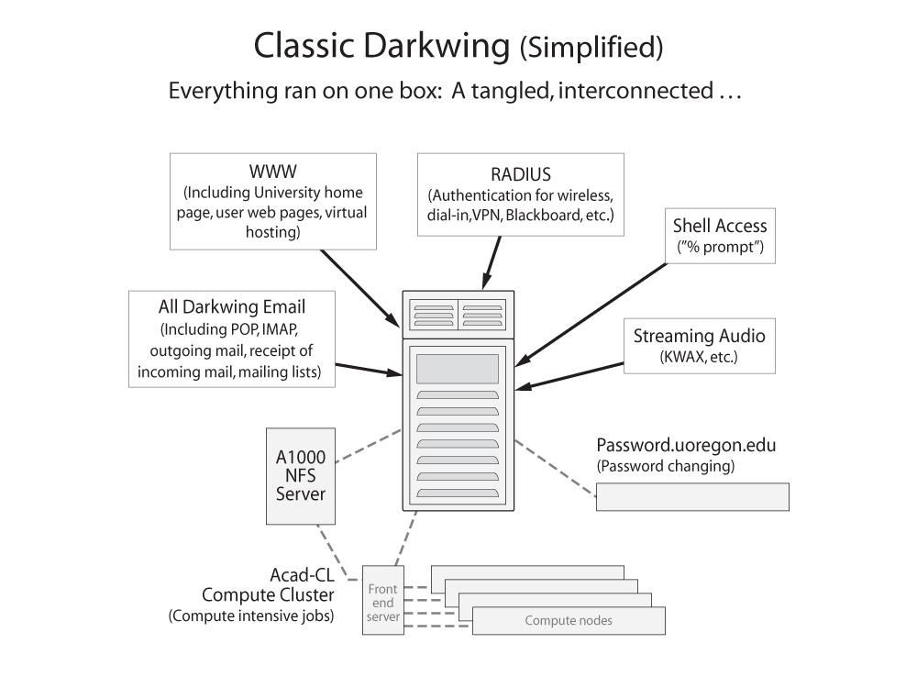

Slide 6
“Okay, So… Let’s Just Buy A Bigger Darkwing, Just Like Our Current One?”
One potential solution to the problem of classic Darkwing being “out of gas” would have been to just buy a bigger version of the same thing. However…
-- Large monolithic servers have limited markets.
Because of that, large systems capacity is expensive
in $’s/unit capacity vs. capacity from smaller systems
-- We’d still be on Solaris
-- We’d still have too many services on one box
-- Running a single system would still result in periodic
downtime for maintenance
-- Continuing to run everything on one system would do
nothing to help our disaster planning/survivability
-- At some point, we would NOT be able to keep buying
bigger and bigger monolithic systems
-- What about storage?

Slide 7
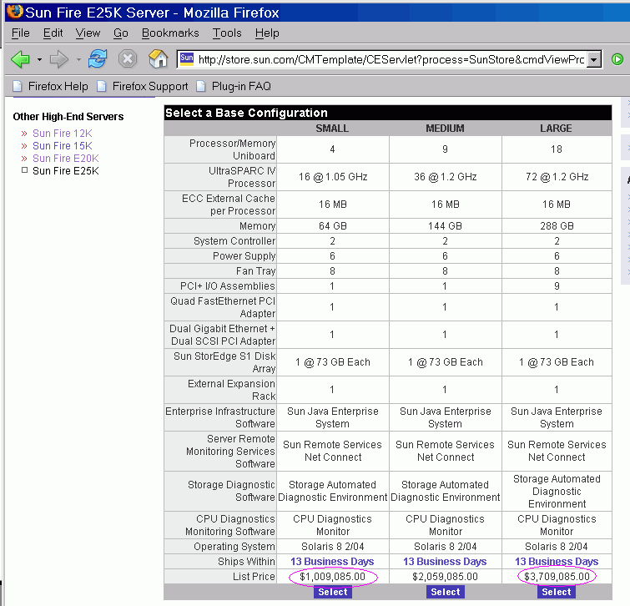
Some Large Sun Options, For Context

Slide 8
What About Alternative Approaches?
If we’re not going to just buy a bigger version of what we had, what else could we do?
-- we could do nothing (but the system as a whole would
likely undergo congestive collapse, which would be
something we’d rather avoid)
-- we could try (again) to shed load, but that would be
both hard to do and unlikely to provide either
substantial immediate relief or required long term
capacity; not a winning strategy
-- OR we could try a new architecture that subdivides
our load into chunks that could be handled by smaller
systems, breaking the load up either by chunks of
users or by service. Which of those two approaches
to dividing the load should we do?

Slide 9
Dividing The Load
Dividing by user requires that:
-- each node run all services
-- we have some mechanism to hash users to nodes in
a user-transparent way
-- we be willing to accept substantial potential licensing
pain (if we needed to purchase and deploy licensed
products at each node)
-- if we need to add capacity, this implies shuffling users
-- we accept it is hard to share load among nodes evenly
Dividing by service allows us to:
-- tailor nodes to the needs of particular services
-- point traffic for a given service via DNS
-- limit the extent of licensed products
-- add capacity transparently by replicating servers
behind a load balancer, should we need to do so

Slide 10
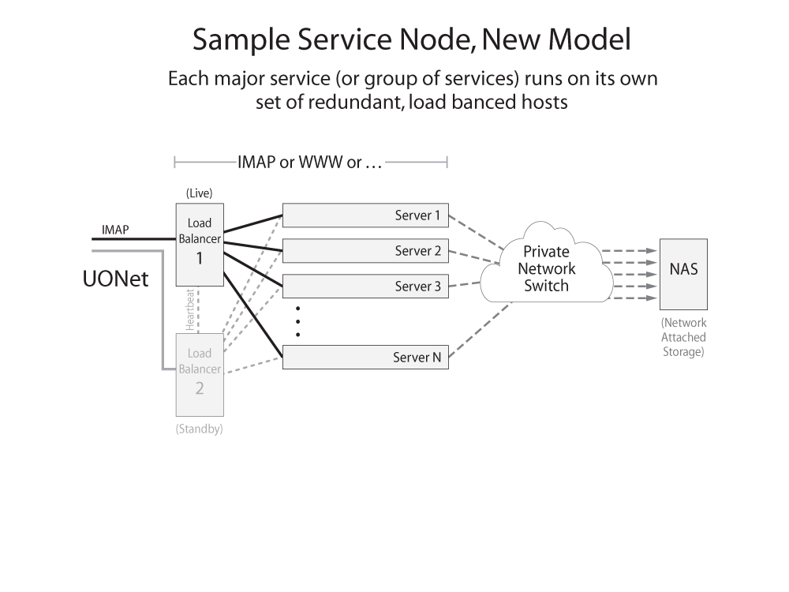

Slide 11
Server Building Blocks; Load Balancing
An inherent part of the new model is the use of “building block” servers. We’ve chosen to use commodity dual AMD Opteron–based 1U rackmount systems which cost less than $5K each. [1U dual Opterons have proven themselves nicely in service as the core of the acad-cl compute intensive hosts]
Multiple building block servers sit behind a pair of load balancers (which are themselves simply yet another building block server, this time configured to run the LVS load balancing software). Load balancers look at incoming connections along with backend server load, and then route incoming connections to a suitable server, either working round-robbin style or by monitoring the load on each backend server, and sending connections to the most lightly loaded host.

Slide 12
Resilience
Achieving operational resilience requires the ability to work on a component of the system without having to take an outage for the whole thing.
By deploying N servers behind a load balancer, we gain the ability to take one of those N servers out of service for maintenance or upgrades, without users even noticing.
The down side of this approach is that it increases server count (redundant servers are required) and it requires a way to share load across the servers (e.g., use of load balancers).

Slide 13
What Do The Building Block
Servers Actually Look Like?

Slide 14
An Evolving Issue: Do We Also Need
Smaller Server Building Blocks?
We may actually end up adding one additional type of cheaper (~$1K/unit)
and less powerful building block server,
for situations where we don’t need the horsepower of the dual Opterons (or even the horsepower of a single Opteron), but do want/need to field physically separate servers rather than aggregating functions on shared hosts.
Examples: syslog hosts, monitoring hosts.

Slide 15
Some Notes About the New Model
Besides fixing the load problem, the new model…
-- gives us a clean path for future growth
-- reduces the extent to which everything happens on
a single monolithic system
-- minimizes downtime for routine system maintenance
-- eliminates reliance on expensive proprietary hardware
-- eliminates reliance on proprietary operating systems
-- potentially improves survivability in the event of a
physical disaster (fire, flood, etc.) or network attack
-- reduces growing cost of maintaining aging hardware
-- gets Darkwing to the point where it had the capacity
to handle the remaining-to-be-moved OpenVMS users
-- sets the stage for consolidation of Darkwing/Gladstone
-- enable new services (larger quotas, CIFS access, true
email virus scanning, SpamAssassin scanning/tagging)

Slide 16
So What Do Users See?
Some Users Will See Temporary Inconveniences
For example…
The recent transition-related disruptions
Some users (e.g., POP/IMAP users) needed to change their email clients to use new server names (one time)
When we get migrating web services, we’ll need to deal with other places where Darkwing has been historically “hard-coded” (e.g., in URLs)
All Users Will See Lasting Improvements
Same username/password/email address
Faster performance
Less downtime
All the old familiar services (plus new improved services)

Slide 17
What About Internal to The CC?
Possible disadvantages…
More complex architecture, with an increased box count (more hosts to patch, backup, monitor, etc.), increased reliance on the network as part of the architecture
Decreased operational transparency (some things happen on systems to which access is limited)
Subtle interactions have the potential to occur
Certain benefits…
A ton more capacity (which improves stability and gives us flexibility)
Mainstream OS, mainstream hardware direction
Less maintenance window time pressure
Easier sparing (we’re using common “building blocks”)

Slide 18
Where Are We At Now?
Some parts are done (e.g., enough to keep Darkwing afloat and uncrushed by the production load it faces)
Lots more is still in progress, including:
-- clean up/review what’s been done so far
-- migrate remaining major services (inbound MX
mail server, web, mailing lists, etc.)
-- complete production filer procurement and installation
-- complete Academic OpenVMS phase out
-- eliminate black web email; evaluate and introduce
third generation web email client
-- adjust quotas
-- consolidate Gladstone user base with Darkwing
-- migrate to LDAP for auth
-- introduce new services enabled by the new
architecture

Slide 19
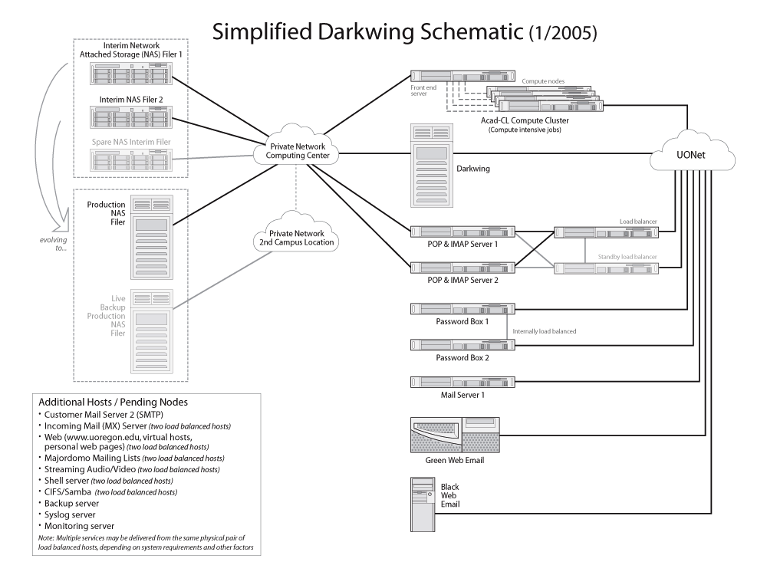

Slide 20
Production vs. Interim Filers
The network attached storage (NAS) filers are really at the heart of the new architecture, albeit functioning in the background in a way that should be transparent to users
We’re currently using interim filers to buy time for the production filer procurement to complete; the technology we’re using has proven itself storing data for RouteViews
The production filers differ from the interim filers in that:
-- they will begin larger than the interim filer (~8X interim)
and can grow to ~40X the capacity of the interim filer
-- they will have greater throughput
-- they will have a higher level of vendor support
-- they will be deployed as a pair of units, one in the CC,
another (live backup) at another location on campus
-- they will offer a broader range of services (e.g., CIFS/
Samba access, user accessible backup restorations)

Slide 21
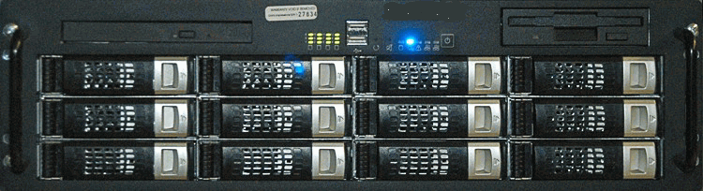
What Does An Interim Filer Look Like?

Slide 22
What’s CIFS/Samba?
Traditionally Darkwing’s storage has been accessed via NFS (Network File System), a Unix-oriented file sharing protocol.
CIFS (Common Internet File System) (also often referred to as Samba) is a file sharing protocol that comes out of the Windows environment; deploying it will improve access to Darkwing files from Windows systems, and increase Darkwing’s value to those who work in a Windows-oriented environment.
N.B.: CIFS service is not available now, it is a future service. We’ll share more information with you about it once we complete procurement of the production filers and get closer to offering this service for users.

Slide 23
Thank You!
Are there any questions?

