Slide 1
Thinking About Your Wide Area Network Connectivity
NWACC Networking for the 21st Century
Portland, Oregon, June 15th, 2001
Joe St Sauver, Ph.D. (joe@oregon.uoregon.edu)
Computing Center
University of Oregon

Slide 2
I. Introduction

Slide 3
Why Bother Thinking About Your Wide Area Connectivity?
If you are like many folks, it may be the area of networking you enjoy least
Your existing connectivity may (or may not) fully meet your users’ expectations
Wide area connectivity is probably your single largest budget line item (except for staff salaries)
You may have been doing the “same old thing” for some time, and may wonder if you should be looking at new options.

Slide 4
Disclaimer
If you’re happy with what you’re currently doing, by all means keep doing it, more power to you. Don’t mess with success.
Every situation is going to be subtly different, so before you change course based on anything I suggest, get a second opinion and be sure that YOU are completely comfortable with whatever approach you finally select.

Slide 5
Having Said That...
Let’s begin by outlining where I believe many of you may be now, and then we’ll talk about where you may want to go in the future (and why).
Parts of this talk may be old hat for some of you, but we’ll nonetheless start from ground zero and build from there; we apologize for any material that’s “old news” for you.

Slide 6
II. Understanding The Traditional “Smaller College” Internet Connectivity Model

Slide 7
T1 (or 2xT1)
For the last decade or so, many smaller liberal arts colleges have connected to the Internet via a flat rate T1 (1.5 Mbps), or perhaps via a pair of flat rate T1s (3.0 Mbps) serviced by a commodity Internet Service Provider (ISP).
This is the same model that many smaller local ISPs have themselves used.

Slide 8
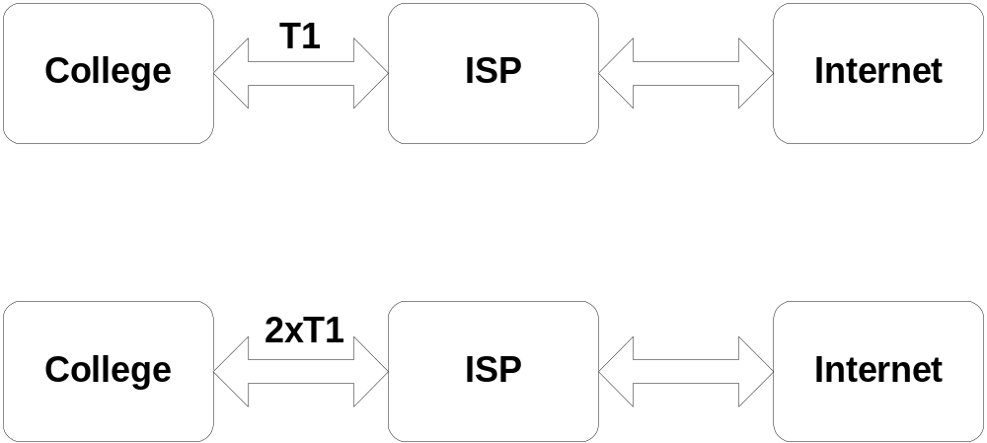
T1 or 2xT1

Slide 9
In General That Traditional Model Has Worked “Okay”...
It is straight forward/simple
For a typical smaller school, T1 (or 2xT1) connectivity is sufficient for faculty, student, and staff to have email access as well as casual access to the world wide web, and it also usually sufficient to service the college’s own web site.
Costs for this model are known/bounded

Slide 10
Total Costs for Traditional T1
(or 2xT1) Service Include:
The ISP’s port charge (the ISP’s charge for agreeing to provide you with X Mbps worth of Internet drainage)
Local loop costs (e.g., the cost of leasing a physical circuit from the phone company to the ISP’s closest point of presence (POP))
Network hardware costs (router, CSU/DSU)
One time installation costs

Slide 11
Typical T1 Port Charges From National Backbone Providers
AT&T $1,970/mo + $1K setup
UUNet $1,795/mo + $3K setup
Sprint $1,420/mo + $1K setup
Globix $1,328/mo + $549 setup
CWIX $1,300/mo + $300 setup
Qwest $1,185/mo + $1K setup
Verio $995/mo + $500 setup (1 yr/term)
ELI $700/mo + $1K setup (1 yr/term)
Data from http://www.boardwatch.com/

Slide 12
Local Loop Charges
… usually have a fixed and a milage sensitive component
Local loops may be provisioned by the ILEC (incumbent local exchange carrier, e.g., Qwest) or by a CLEC (competitive local exchange carrier such as ATT, ATG, ELI, etc.)
Sample (confusing) tariffs are available online from http://tariffs.uswest.com/
Figure roughly “n” hundred dollars/month

Slide 13
Hardware Costs
For a T1, you are typically looking at something like a Cisco 2620 or 2650 router, (which can be purchased with an integrated CSU/DSU you’ll also need) for ~$2K--2.5K
Costs for hardware at the T1 level are quite modest, but required hardware costs can quickly become material at higher connection speeds

Slide 14
Installation Costs
Designed to cover time and committed equipment on the provider’s end, PLUS (at least in some cases) the installation charge is intended to act as a deterrent to provider-hopping customers (“Gee, we just paid $3K for install… even if this other provider is a lot cheaper, we DID just pay $3K!)
Installation costs often start high so they can be negotiated down as a “deal sweetener”

Slide 15
End Result...
The institution has Internet connectivity
The institution usually uses non-portable IP address space obtained from the ISP
The institution needs little if any wide area networking expertise on site
Relationship is a businesslike (paying) customer to (paid) service provider, a defined arrangement of known parameters

Slide 16
Known Parameters==SLAs?
Many ISPs now routinely offer “service level agreements” whereby the customer can request a refund of a portion of the amount paid if services fail to meet agreed upon specifications (for example, outages exceed some stipulated level).
In reality, SLAs are simply a distraction -- trivially small SLA refunds cannot begin to compensate you for poor quality service.
Buy a good ISP don’t shop for ‘good’ SLAs

Slide 17
III. Making the Traditional Model Cheaper #1:
Frame Relay As A
Replacement For
Point-to-Point Circuits

Slide 18
Substituting Frame Relay T1s For Point-to-Point T1s
If the goal is to drive down the cost of provisioning T1s, one alternative to consider is substituting frame relay T1s for point-to-point T1s.
In the frame relay model, locations connecting via frame relay connect to a common frame relay “cloud” rather than connecting directly on a point-to-point basis.

Slide 19
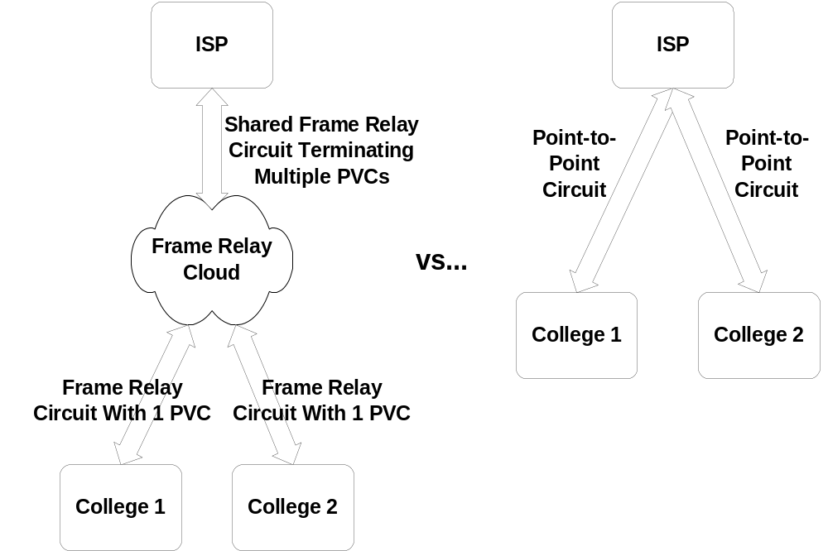
Frame Relay (continued…)

Slide 20
How Come A Frame Relay
T1 Can Be Cheaper Than A
Point-to-Point T1?
At least in Oregon under the State’s Fast Packet contract, frame relay service is distance insensitive. This is hugely important if you’re connecting a truly remote site.
Assuming the other end already connects to the frame relay cloud, you only end up paying for “one end” of the circuit plus (implicitly/indirectly) part of the other end

Slide 21
How Can Frame Relay T1’s
Be Cheaper (continued….)
The upstream (ISP) end does not need to add equipment to terminate each new frame relay circuit on a 1:1 ratio (they can all be accommodated via a single shared device and shared frame relay connection)
Some ISPs are somewhat aggressive in how they underprovision/overcommit shared frame relay circuits
The CIR is seldom 100% of the nominal rate

Slide 22
“What’s CIR?”
The Committed Information Rate (CIR) is the amount that you will be able to routinely send on a sustained basis. The CIR might be 256Kbps or 512Kbps or 768Kbps on a “T1”
Frame relay service is statistically designed to accommodate brief traffic bursts to the full nominal capacity of the circuit… but only for bursts, and then only when capacity happens to be available.

Slide 23
Example of When
CIR Mattered...
We wanted to test Cisco’s IP/TV MPEG1 IP multicast product with an Oregon Community College partner of ours. IP/TV would send multicast video traffic at 1.5Mbps on a more or less steady basis… this did NOT work well until we cranked the sending rate down to no more than the CIR (1Mbps in this case).

Slide 24
Frame Relay Pricing Under The OR Fast Packet Contract
T1: $450/month/end with one permanent virtual circuit (plus $616.74 installation)
See: http://telecom.das.state.or.us/data/
billing/nonwan1.htm
This is JUST local access (e.g., you’re only replacing the point to point T1 local loop with frame relay service), this is not inclusive of Internet transit (port) charges

Slide 25
Internet Service (Port Charge) on a Frame Relay Circuit
Frame relay T1s often tend to end up being serviced via a local/regional ISP rather than a national backbone, which have different cost structures than national backbones
See: http://thelist.internet.com/areacode/541
(or whatever area code’s of interest) for lots of providers offering frame relay service in the 541 area code

Slide 26
So Should I Convert My Point to Point T1s to Frame Relay?
The answer really is “it depends on a case by case basis.” FR isn’t always cheaper.
You really need to look at the cost of all the various options in your case (including paying attention to CIR rates when making comparisons or assessing the value of a point-to-point T1 vs. a frame relay “T1”)
Also be aware that frame relay’s traditional niche is “under siege” from DSL services...

Slide 27
IV. Making the Traditional Model Cheaper #2:
DSL

Slide 28
DSL Service
Depending on where you’re located, another alternative might be high bit rate DSL service, e.g., here in Qwest territory:
-- 1.2Mbps down/1.1Mbps up ($80/mo)
-- 4.4Mbps down/1.1Mbps up ($150/mo)
-- 7.1Mbps down/1.1Mbps up ($250/mo)
… this is just DSL loop, not Internet service

Slide 29
Internet Service for that
DSL Loop… Add...
If you buy Internet service from Qwest.Net (one of many potential ISPs to service that DSL circuit):
-- 1Mbps $115/mo (e.g., total of $195/mo)
-- 4Mbps $135/mo (total of $285/mo)
-- 7Mbps $155/mo (total of $405/mo)
see: http://www.qwest.net/nav4/solutions/
internet/ow_pricing.html (be sure to also figure in the cost of a business phone line)

Slide 30
“Wow… It Looks Like DSL Could Be a Real Bargain…”
Key point 1: you WILL NOT be able to order DSL service everywhere (particularly in the case of high bit rate DSL service). DSL service (particularly high bit rate DSL service) will only be available for sites “close” (18,000’ max) to a suitably equipped telco central office, and then only at sites lucky enough to have excellent quality copper with no bridge taps, etc.

Slide 31
DSL... Bargain? (cont)
Key Point 2: High Bit Rate DSL is asymmetric… while you may get 7Mbps down to your site from the Internet, your upload speed to the Internet will only be ~1Mbps. [On the other hand, that asymmetry may mesh rather well with the usage pattern typical of most smaller colleges (where downloads from the Internet dominate uploads to the Internet)]

Slide 32
DSL… Bargain? (cont.)
Key Point 3: At least some DSL-servicing ISPs (such as Qwest.Net) force web traffic thru the ISP’s web cache, thereby breaking Internet transparency. [You wondered how they could afford to offer those great prices -- they are taking advantage of the fact that some large fraction of your traffic will probably be http, and probably web pages serviceable from a local web cache at that.]

Slide 33
DSL… Bargain? (cont.)
Key Point 4: Your equipment options may be limited. Most DSL service providers have standardized on a particular brand of DSL modem (such as the ~$300 Cisco 675 or 678), and that is what you will need to use if you want DSL service, like it or not. [Why is this an issue? Well, for example, many DSL modems are clearly consumer-grade rather than carrier-grade gear…]

Slide 34
DSL… Bargain? (cont.)
Key Point 5: You will have a restricted set of possible ISPs to offer service on your DSL circuit. E.g., most national backbones and many regional ISPs will not be available, the result being that you need to pick either a local DSL-servicing ISP or the phone company’s unregulated ISP affiliate:
http://www.qwest.com/dsl/learn/isplist.html

Slide 35
So Is DSL The Right Replacement for Traditional Point-to-Point T1 Service?
Probably not yet, at least not for mission critical services (good though DSL’s pricing may be). DSL is still rather young and is really positioned as a consumer access technology, rather than a large business/ institutional access technology. Outage response and repair time is one particularly critical but currently unbounded factor...

Slide 36
So Is DSL The Right
Replacement (continued…)
On the other hand, DSL is cheap and your equipment investment would be low, and since there is no need to enter a long term contract you could easily experiment with DSL if you had a mind to do so.
Unfortunately, if you’re like many, your location may not let you get the DSL service you might want to buy (at least not yet, anyhow), making this all rather moot.

Slide 37
V. Limitations of the Traditional Connectivity Model
(In Any of Its Permutations)

Slide 38
The Zen-Like Paradox of the Traditional Connection Model
The basic T1 (or 2xT1) connection model is built on a very subtle paradox: it only works well when people:
(a) don’t use it (or don’t use it much) and
(b) don’t depend on it.

Slide 39
Why Do We Say That a T1 (or 2xT1) Only Works Well When People Don’t Use It?
A T1 (or 2xT1) is easy for even a single directly connected user to saturate… to say nothing of hundreds (or thousands) of simultaneous directly connected users.
1.5 to 3 Mbps TCP flows used to be a big deal for a end system to generate, but now projects like www.web100.org will push routine system throughput to 100Mbs...

Slide 40
Or Consider, As A Benchmark, the Capacity of a T1 in “CD’s”
1.5Mbps ==>
1.5Mbps * (60 min/hr)(60 sec/min) ==>
8 bits/byte
675 Mbyte/hour (e.g., roughly one
“CD equivalent” worth of “stuff” per hour) -- and many free software distributions now are multi CD affairs….

Slide 41
There Is No Financial
Incentive Not to Use Capacity
Moreover, virtually no college (at least none that I’m aware of) implements usage sensitive pricing: use a lot, use a little, it doesn’t (financially) matter to the end user.
We know what happens when “free” shared resources are made available: the “Tragedy of the Commons” results in increasing levels of use by economically rationally users until the resource is overused/ruined.

Slide 42
“OK, What Do You Mean About Not Depending On It?”
Consider electrical power or plain old telephone service -- those are mission critical resources which you “depend on” and which are available everywhere
For a long time and at many sites, however, Internet service has been viewed somewhat more casually, with access, reliability and redundancy a secondary consideration.

Slide 43
“Not Depending On It…” (continued)
For example:
-- consider the casualness with which we
joke about “the network being down” (as
long as it isn’t down TOO long) or
-- consider the fact that while traveling, we
accept the fact that network connectivity
may be poor (e.g., dialin), or non-existent
at many locations
-- we don’t REALLY depend on it

Slide 44
“Not Depending On It…” (continued)
We have routinely seen multiple parallel “dedicated-purpose” T1s deployed to shelter one category of traffic from another (prime example: generic Internet traffic vs. H.323 video conferencing traffic). Why?
Users are unwilling to take a “chance” that the network will be busy due to random traffic at the time a high priority apps (like a class videoconference) needs bandwidth...

Slide 45
“Not Depending On It” (continued…)
A single T1, or two T1s from the same provider, also means that you have no protection against provider-related difficulties -- if your one-and-only provider goes down, you have no redundancy.
You can obtain redundancy and a degree of survivability by multihoming (buying service from more than one ISP).

Slide 46
VI. Multihoming

Slide 47
Multihoming
Multihoming for redundancy and improved reliability is a relatively common practice today, although not necessarily at the T1 (or 2xT1 level).
By providing two paths to the Internet, failure of a single ISP should be insufficient to take you off line.
By multihoming, you also become less a “captive customer” of a single ISP.

Slide 48
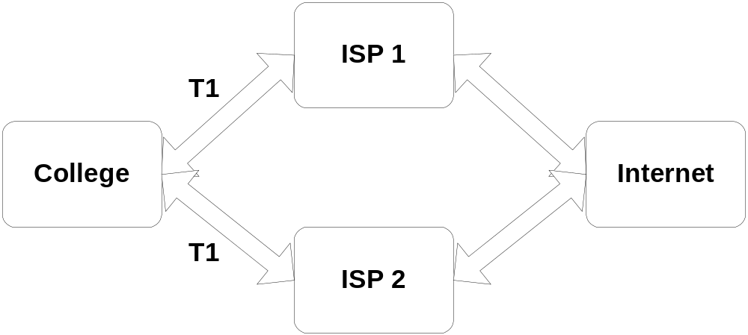
Multihoming

Slide 49
Some Limits of Multihoming
Of course, if you really want to protect your traffic, you need to have enough capacity to handle ALL your load via either single ISP, in case either of your ISPs has a failure)
Thus, if you are multihomed, multiply virtually all costs by two... and as you write those extra checks, remember you’re buying ‘insurance’ network capacity which you may never actually need to use.

Slide 50
But You Won’t Be Able to Resist Eating the Emergency Rations...
Of course, it takes tremendous discipline to provision redundant network capacity and then not routinely use it. You WILL be tempted to eat the emergency rations (e.g., to routinely utilize all your circuits to their full capacity), even though you multihomed for improved reliability, not to add extra capacity.

Slide 51
“Why Is It Bad to Routinely Use All Available Capacity In A Multihomed Scenario?”
If you are multihomed and routinely run both your circuits to full capacity, you will be horribly congested if/when one or the other of those circuits fails and ALL your load has to be serviced by the remaining circuit (which will have far less than the capacity it needs to do the job).

Slide 52
And Recognize That Your Load Will Not Automatically Balance
With two providers, you might assume that your load will automatically split nicely between the two in some magic fashion. This is NOT the case, particularly if your two providers are not of roughly equal influence Internet wide (e.g., assume one provider is a national backbone, and the other provider is a regional provider). Configuring to use both 50-50 will be tricky.

Slide 53
And Recognize That Multihoming May Make Your Traffic Asymmetric
When we talk about traffic being “asymmetric,” we mean packets may go out to an Internet destination via one path, but come back another. This can have some subtle but important implications; see, for example: http://www.internet-2.org.il/
i2-asymmetry/index.htm

Slide 54
More Implications of Multihoming
The “simple” act of adding a second ISP also raises the technical bar for your wide area connectivity substantially, adding:
-- the need for provider-independent
independently routable address space,
-- an autonomous system (AS) number,
-- larger/faster/more expensive routers
-- use of BGP4 for your external routing

Slide 55
And If You’re Multihoming for Improved Reliability...
Be sure to also investigate how your local loops are being provisioned (and note that simply buying one local loop from your ILEC and another from a CLEC does NOT guarantee that the loops will share no common points of failure -- the “CLEC’s” loop may end up being provisioned for the CLEC by the ILEC in the same conduit as your original loop)

Slide 56
So Should I Multihome?
If you are serious about improving your reliability, and if you have the resources (financial, technical, and managerial), yes.
In many cases, however, smaller schools may not have those sort of resources, and may have to forgo the advantages of multihoming.

Slide 57
VII. Peering

Slide 58
Internet Transit vs.
Internet Peerage
When you buy Internet transit from an ISP, the ISP agrees (for a fee) to carry traffic for you to/from ANY Internet destination (up to the agreed upon capacity purchased).
Internet peerage is different. When you peer with someone, you agree to exchange direct customer traffic, and ONLY direct customer traffic, usually without financial settlements

Slide 59
Peering Does Not Eliminate the Need for Transit Connectivity
I want to stress that peering does NOT eliminate your need for transit connectivity. It should REDUCE the amount of transit connectivity you need to buy, but you will never peer with everyone, so you still need to have some guaranteed path (e.g., transit connectivity) to/from your site for all those providers with whom you don’t peer.

Slide 60
The Mechanics of Circuit Based Peering: Bad Scalability
Peering could occur via a dedicated circuit established directly between each two interested parties. However, for more than two parties, that approach scales poorly. If four sites (A, B, C, and D) all wanted to directly peer amongst themselves, that would require six circuits (A-B, A-C, A-D, B-C, B-D, C-D); if 6 sites wanted to peer, that would require 15 circuits, etc. Ugh!

Slide 61
Voila! The Exchange Point
The preferred approach, therefore, is for all parties interested in peering to agree to meet at an exchange point, where customer traffic can be exchanged between multiple peers without requiring an ISP to provision a new circuit for each peer of interest.
The Oregon Internet Exchange is one example of a local exchange point (see:
www.oregon-ix.net). See also www.ep.net

Slide 62
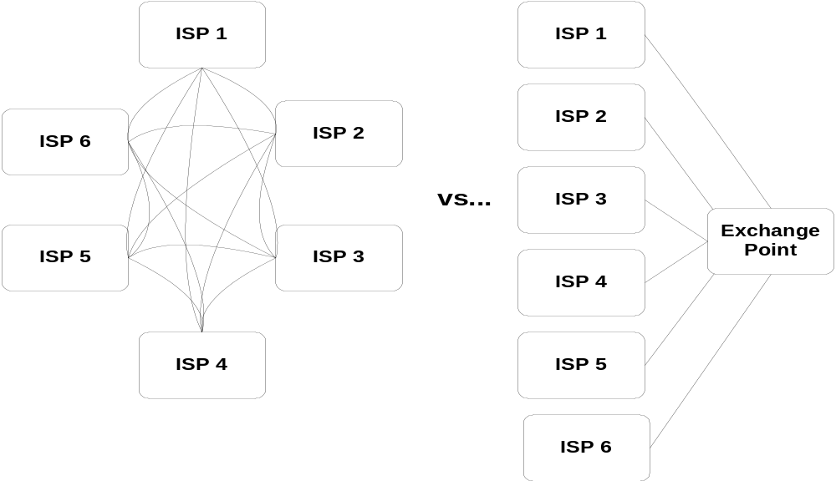
Direct Circuit-Based Peering vs. Use of An Exchange Point

Slide 63
Multilateral vs. Bilateral Peering at Exchange Points
Arranging to exchange traffic among peers may be done via one of two models: multilateral peering or bilateral peering.
In multilateral peering, you agree to peer with anyone else present at that exchange point. Advantage: simple/straightforward.
In bilateral peering, peering is arranged separately between each pair of peers. Advantage: greater control and selectivity.

Slide 64
“Peering Sounds Great -- Why Doesn’t Everyone Do It?”
Participating at an exchange point raises the same technical challenges as multihoming; small sites may find the benefits not worth the hassle.
Participating at an exchange point will also have some direct costs (e.g., a circuit from your site to the exchange point, equipment for use at the exchange point, maybe exchange point participation fees, etc.)

Slide 65
“Why Doesn’t Everyone Peer?” (continued….)
Also, providers will usually only agree to peer when they are roughly the same size. [If someone’s small & a potential customer, peering with that potential customer may reduce the likelihood of that potential customer purchasing commodity transit.]
Peering only makes sense if you’ve got a material amount of customer traffic to exchange with the peers at an exchange.

Slide 66
Participating At An Exchange Point Does Mean More Than Reducing Transit Costs...
It is also important to point out that when you participate at an local exchange point, you get more than reduced transit costs -- local traffic stays local (rather than bouncing up to Seattle or down to the Bay Area or over to Denver to be switched from one transit provider to another), which means performance will usually improve.

Slide 67
It’s a Bummer Being Small...
By now, you may be noting a recurring theme: there are lots of interesting things (like multihoming or participating at an exchange point) which are hard to do if you’re a small college or other small entity. Are small colleges just out of luck?
No. Small colleges should strongly consider participating in network consortia, which can aggregate their demand.

Slide 68
VIII. Network Consortia

Slide 69
There Is Strength In Numbers
When multiple smaller sites band together, a lot of things which might be impractical for each of the individual smaller sites to do on their own suddenly become (at least potentially or theoretically) possible.

Slide 70
Some Examples of Local
Network Consortia
A fine example of a network consortia is Oregon’s OPEN statewide K12 network, interconnecting virtually all public K12 schools in the state of Oregon. See:
http://www.open.k12.or.us/
Another example is OWEN/NERO, connecting virtually all public universities in the state of Oregon. See:
http://www.nero.net/

Slide 71
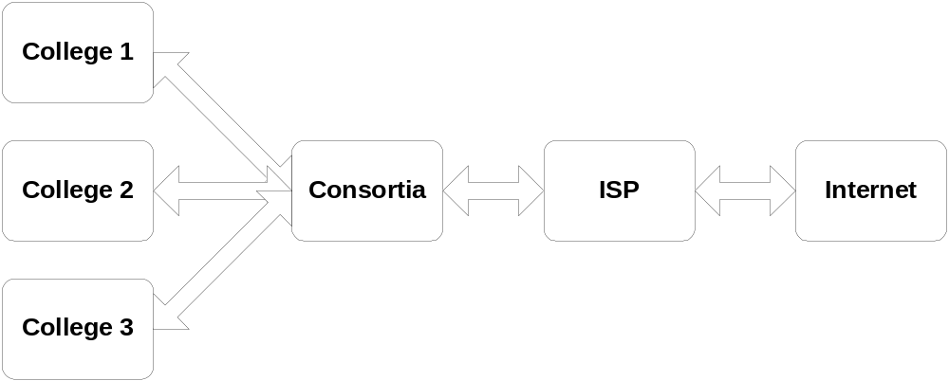
Example Network Consortia Connectivity Model

Slide 72
Network Consortia Model
In the network consortia model, the consortia acts as an intermediary between the end site and the ISP, buying wholesale network bandwidth from one or more internet service providers and then making that aggregate bandwidth available to the members of the consortia.

Slide 73
Implications of Participating in a Network Consortia
Participating in a network consortia has a number of interesting implications:
-- greater statistical multiplexing
-- improved reserves against load spikes
-- bifurcation of traffic into local (no cost)
and non-local (regular Internet) traffic
-- increased opportunities for resource
sharing & experimentation

Slide 74
Statistical Multiplexing of Demand
By aggregating a large number of users, brief peaks and valleys in demand end up “averaging out,” resulting in more efficient circuit utilization.
Compare the two graphs on the following slide...

Slide 75
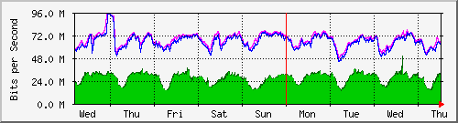
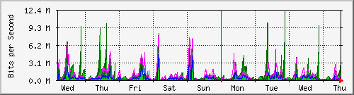
Statistical Multiplexing
Highly aggregated traffic showing smoothing/statistical multiplexing
Versus traffic from a single subnet, showing much wider variation/more “peakyness”

Slide 76
Inreased Reserve Capacity to Handle Load Spikes
Aggregation also allows for greater reserve capacity to handle load spikes than individual sites could provision. Consider: (a) ten sites each buying T1s individually (and each never having more than a T1’s worth of bandwidth) vs. (b) ten sites sharing 15Mbps, where at least some fraction of that capacity (let’s say 5Mbps) is available for use to buffer brief spikes in demand...

Slide 77
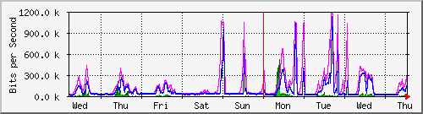
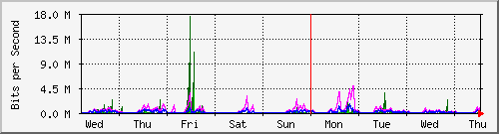
Reserve Peaking
Load Capacity
Limited (1.5Mbps) peaking load capacity:
vs extensive excess load capacity available
for peaking use (note scale on vertical axis)

Slide 78
Local vs. Non-Local Traffic
When you buy connectivity directly from an ISP, all your wide area traffic flows via that ISP’s connection (and all that traffic counts against your purchased Internet bandwidth)
When you buy connectivity from a local consortia, traffic destined for another member of the consortia never leaves the local consortia’s circuits, and hence doesn’t use any expensive wide area connectivity

Slide 79
Local vs. Non-Local Traffic (continued…)
Thus, the utility of network consortia improves with the size of the consortia -- the more members participating in a consortia the better (just like peering points)
On the other hand, the bigger the consortia grows the harder it becomes to informally handle allocation of shared resources such as the consortia’s wide area bandwidth

Slide 80
Formally Handling The Cost of Network Consortia Wide Area Bandwidth
If you let bandwidth use run unchecked and just bill partnrs for actual usage, one or more partners may end up using all or most provisioned bandwidth (to the irritation of the other consortia members, and to the financial horror of the pigish partner)
Trying to provision consortia capacity to meet that varying load is also pretty tough

Slide 81
An Alternative Approach
Let the consortia partners specify how much Internet capacity they want (“12 Mbps”)
Charge them for that amount, whether they use it or not (“please pay us $9,000/month”)
Reserve that amount of capacity for them
Drop traffic in excess of the contracted rate
Allow the partner to ratchet traffic upward
(at the partner’s discretion) (“we want 15 Mbps now and will pay you $11,250/mo”)
Exempt local traffic from charges

Slide 82
In Fact You Can Also Probably Exempt Still More Traffic...
If your consortia members are like most sites, they will tend to consistently use
more inbound bandwidth than outbound bandwidth. Since one cannot provision inbound bandwidth separately from outbound bandwidth, inbound demand ultimately determines the bandwidth which must be provisioned, and thus, as long as outbound traffic doesn’t get too hot, it can also be left unmetered

Slide 83
You Can Also Exempt Traffic to Motivate Desired Behaviors
You can also do interesting things with consortia bandwidth pricing to incent desired behaviors. For example, if you assume that some large percentage of all network traffic is http traffic, you might exempt from charges all http traffic that comes through a consortia partner’s web cache, particularly if that web cache is part of a consortia-wide cache hierarchy.

Slide 84
Exempting Traffic to Motivate Desired Behaviors (cont….)
Web caching will be particularly important if consortia partners do not ratchet up their bandwidth to meet observed growth in inbound bandwidth demand. Exempted web cache traffic would thus run free and unconstrained, while users who elect to access web pages directly would get slower and slower page load times due to consortia traffic caps applicable to that partner

Slide 85
A Consortia Can Support Resources That Indvidual Sites May Not Be Able to Afford
For example, a consortia may run a central Usenet newsfeed box, taking inbound articles on a central system and then fanning them out so there aren’t multiple parallel/identical Usenet feed streams running over the consortia’s constrained inbound links.

Slide 86
Consortia and Content Delivery Networks
Another example of a shared resource valuable to consortia members, and one probably not directly obtainable by non-aggregated sites, is local access to content delivery network servers such as Akamai’s. Oh, even if you’re an independent, Akamai will still send pages to you, it is just that they will come in over your (paid) Internet transit rather than from a local (free) box.

Slide 87
Internet2 Access, Another
Example of a Shared Resource
Another example of a consortia shared resource is access to high performance research and education networks such as Abilene/Internet2 (www.internet2.edu). While individual colleges may find it difficult to underwrite Abilene connectivity (the smallest Abilene pipe starts at OC3 speed, 155Mbps), a consortia of multiple colleges can share those costs.

Slide 88
I2 Sponsored Educational
Group Participants
Participation in a consortia/statewide education network is effectively required for educational groups which would like to be connected to Internet2 as a Sponsored Educational Group Participant (SEGP), as Oregon’s OPEN is… (For more information about SEGPs, see: http://www.internet2.edu/abilene/html/
faq-sponsored.html )

Slide 89
So Should You Join A Network Consortia of Some Sort?
YES (no ifs, ands or buts about this one)

Slide 90
IX. What’s Still Ahead

Slide 91
A Confession
I might as well “come clean.” At the start of this talk, I said, “If you’re happy with what you’re currently doing, by all means keep doing it, more power to you. Don’t mess with success.” That was actually a lie.
Irresistible technological and financial forces are gathering, and like it or not, you will almost certainly have to make some changes to your wide area networking.

Slide 92
The Coming Theme:
Fast and Cheap (F&C)
F&C powerful commodity PC hardware
F&C local area hundred megabit and gigabit networking hardware
F&C high speed remote access (DSL & cable modems)
F&C specialized wide area connectivity (I2)
F&C commodity connectivity (e.g., Cogent Communications, Yipes, Telseon, et. al.)
F&C metropolitan fiber networks

Slide 93
...Clashing With Some Crucial Choke Points That Aren’t Changing [Fast Enough]
Essentially invariant commodity T1 pricing
A lack of readily available wide area network engineering talent
Old approaches to new P2P apps
Many sites are connecting to Internet2 and/or deploying private fiber or doing other advanced networking initiatives … but many more sites are not.

Slide 94
Fast And Cheap Commodity
PC Hardware
Virtually any current commodity PC can easily source tens of Mbps worth of traffic on a sustained basis (e.g., a student’s five hundred dollar hand-me-down PC can saturate your wide area T1 or 2xT1).
With relatively trivial tuning, that same PC can easily saturate a DS3 (45Mbps).

Slide 95
Local High Capacity Disk Is Becoming Dirt Cheap
40GB IDE drives are available for less than $100, which implies that students (for example) can build substantial disk arrays to provide “content” for their PCs to serve. Do not be surprised when you bump into students with half-terabyte or terabyte disk arrays within a year.

Slide 96
Network Cards Are Getting Faster and Cheaper
Fast ethernet (100Mbps) ethernet cards are now down to less than thirteen bucks each, quantity one (e.g., Netgear FA311TX from http://www.warehouse.com after $5 mail in rebate)
Gigabit over copper (1000Mbps) ethernet cards are now less than $120.00 each (e.g., Addtron AEG-320T)

Slide 97
And Even Ethernet Switches Have Become Absurdly Cheap
HP 4000M’s with 40 10/100Mbps ports have been routinely available at less than $1300 after rebates (e.g., $32.50/fast ethernet port)!
Given the price of NICs and switch ports, from a LAN point of view, there’s really no reason NOT to engineer your local network to go fast… except that you then slam that LAN firehose into a WAN drinking straw.

Slide 98
DSL Service and Cable Modems Have Displaced Traditional Dialup Modems
Students and faculty with 1/2 to 1/3 of a T1’s worth of DSL service at home may not have their expectations me sharing a single T1 at work with hundreds or thousands of other users
Cable modem service (up to 8Mbps on an asymmetric basis) for ~$40/month may REALLY spoil users for T1 or 2xT1 service

Slide 99
I2 Is Connecting More Users & Is Getting Ever faster, But There Are Many Non-I2’ers
The I2 SEGP program is greatly increasing the number of users connected to Internet2
A growing number of foreign research and education networks peer with Internet2
I2 is no longer selling any connections slower than OC12 (622 Mbps) [although old OC3’s have been grandfathered in]
==> A new “digital divide” will hit independent colleges particularly hard...

Slide 100
Absurdly Cheap Wide Area Bandwidth Is Now Available
… At Least In Some Cities
In the top 20 markets (basically, the so-called “NFL franchise cities”) you could purchase 100Mbps worth of ethernet provisioned commodity transit from Cogent Communications for $3K/month, or 1Gbps worth of commodity transit for $10K/month (see: http://www.cogentco.com/)
See also Yipes, Telseon, etc.

Slide 101
Yet The Price Little Guys Pay For T1s Isn’t Dropping...
As you look at everything that’s getting faster and cheaper, it is ironic that one thing that’s not getting faster and cheaper is the T1 (or pair of T1s) that you probably rely on for wide area connectivity.
Beyond T1s, DS3 and fractional DS3s have gotten cheaper, but they still aren’t cheap, and greater than T1 speed local loops aren’t available everywhere in Oregon anyhow.

Slide 102
Maybe The Hardest Choke Point to Overcome: The Shortage of Network Engineers
You may find that you face an insurmountable obstacle: competent wide area network engineers are hard to find and hire at any price… yet without good network geeks, you’re going to be hard pressed to execute any sort of advanced network strategy… (beware hired guns who build it, turn it on, get paid, and leave)

Slide 103
And Meanwhile, Back
At the Ranch: P2P Apps
Your users continue to discover new bandwidth intensive peer-to-peer file sharing applications like Audio Galaxy (www.audiogalaxy.com) or Kazaa (www.kazaa.com) or EDonkey2000 (“harness the power of 2000 electronic donkeys!”), and as P2P applications start to port hop and encrypt their traffic, you will find it harder and harder to know what’s up

Slide 104
And No, I Don’t Think Network Policing Boxes Are the Answer to P2P Apps
Any automated network policing box which you can install to detect and limit P2P apps will eventually be overcome by smarter and smarter P2P apps (so don’t even go down that P2P “arms race” road).
Automatic app-neutral traffic shapers don’t fix the problem you have, either -- they just hide the symptoms and make it harder to detect and treat the underlying problem

Slide 105
And All The While, Users Are Probably Telling You…
It’s Too Slow!
And you know what? They’re right. The world has changed and is still changing.
If you’re doing the same thing now that you were doing ten years ago, you’re in trouble.
If money is no object and you live in the right place, you MAY be able to buy your way out by just throwing money at the problem (e.g., replace your T1s with DS3s). But in most cases, you’ll need to work hard.

Slide 106
X. So What Should You Do?

Slide 107
Our Top 10 Recommendations
(In No Particular Order)
If you aren’t part of a statewide network consortia yet, join one.
Track what’s going on. You need to be monitoring your network usage at least with MRTG or a comparable “big picture” macroscopic network monitoring tool.
Plan to spend more on wide area networking. [As a rule of thumb, plan to spend as much for wide area networking as you do for telephones or electric power.]

Slide 108
Our Top 10 Recommendations (continued…)
Plan strategically. For example, you know you will need fiber within a few years, and since it takes time to find/obtain access to an asset like that, begin working on it now.
Hire a competent wide area network engineer. Yes they are hard to find and yes they are expensive, but they are worth their weight in gold. You need one. Hire one.

Slide 109
Our Top 10 Recommendations (continued…)
Make yourself use and depend on the network. When something breaks, find out why and make sure it gets fixed.
Act like one of your users. If you can get DSL or cable modem service at home, do it -- they all are. How does your service compare? Try new peer to peer applications yourself -- that’s the only way you’ll understand their allure for your users.

Slide 110
Our Top 10 Recommendations (continued…)
Figure out one new thing to offer every term. Web email. 802.11 wireless. PalmOS support. IP multicast. IPv6. Whatever… conciously force yourself to evolve your network service offerings. Don’t stagnate.
Make sure that whatever you do, your approach scales well. Don’t be the victim of your own success. Assume users will love whatever you give them, and want more.

Slide 111
Our Top 10 Recommendations (continued…)
Do it yourself, locally. If you start down the “lets outsource” road, or if you settle for folks “doing for you” elsewhere, you’re on the slippery slope to hell. Develop and cherish local expertise and your local infrastructure. It will matter in the long run. Zen koan for future meditation: reconcile “doing for yourself, locally,” with being “pro consortia.” (This one does have an answer)

Slide 112
Thanks for the chance to talk today!
Questions?

