Slide 1
The Security of Mobile Internet Devices
Northwest Academic Computing Consortium (NWACC)
2010 Network Security Workshop
Joe St Sauver, Ph.D.
Nationwide Internet2 Security Programs Manager
Internet2 and the University of Oregon
(joe@uoregon.edu or joe@internet2.edu)
http://www.uoregon.edu/~joe/nwacc-mobile-security/
This talk has been prepared in a detailed format for ease of indexing and to insure accessibility for the disabled.

Slide 2
Acknowledgement and Disclaimer
I’d like to begin by thanking Adrian Irish for the opportunity to share some thoughts with you today.
I’d also like to thank NWACC for continuing to host
these security workshops. I know there are a lot of topics competing for NWACC attention and support,
so it’s gratifying to see network and system security continuing to be identified as a topic of ongoing interest.
Because I wear a variety of different “hats” from time-to-time, let me keep this talk straightforward by offering the following simple disclaimer: the opinions expressed in this talk are solely those of the author, and do not necessarily reflect the opinion of any other entity.

Slide 3
Format of This Session
Rather than doing this session as just a straight lecture
(as I sometimes do), I decided that I wanted to try to have this be at least a little more of an interactive session.
I know some of you are likely tired from all the earlier sessions held as part of this workshop, and some of you may even feel ready to be heading home, so let me say thank you for sticking it out for the very last session!
Anyhow, what I’m hoping to do today is introduce a
series of topics, offer some observations, and then encourage you, the audience, to participate in a discussion of each issue raised. This is a bit of an experiment…

Slide 4
1. What Is A Mobile Device?
Are Your Users Using Them?

Slide 5
iPhones, BlackBerries, etc.
I generally think of a “mobile Internet devices” as the sorts of things you might expect: iPhones, BlackBerry devices, Android phones, Windows Mobile devices, etc. -- pocket size devices that can access the Internet via cellular/3G/4G, WiFi, etc.
If you like, we can stretch the definition to include tablet computers such as the iPad (maybe you have big pockets?), and maybe even include conventional laptops, regular cell phones, etc.
We’ll try to draw a hard line at anything that requires fiber connectivity or a pallet jack to move. :-)
What about at your school? Do you have a formal definition of what’s considered a mobile Internet device, or is it just informally “understood?”

Slide 6
Are Students Using Them? Yes
ECAR Study of Undergraduate Students and Information Technology 2009 ( http://www.educause.edu/ers0906 ):
About half of the respondents (51.2%) indicated
that they own an Internet capable handheld
device, and another 11.8% indicated that they
plan to purchase one in the next 12 months [...]
Another study, by the Ball State Institute for Mobile Media Research, states that 99.8% of all students
have a cell phone and “smart phones now account for 49% of mobile communication devices on campus,” see
http://www.bsu.edu/news/article/0,1370,7273-850-64351,00.html

Slide 7
Mobile Internet Devices at UO
A local Eugene example: “High Tech Ubiquitous on Campus,” Eugene Register Guard, Thursday, Sept 20, 2010, www.registerguard.com/csp/cms/sites/web/news/cityregion/25348487-41/corner-welch-bookstore-hall-cell.csp
Reporter Bob Welch surveyed the campus scene near the UO Bookstore last month, and found that these days…
[…] what you mainly see is gobs of students talking
on phones, texting on phones and grooving to who
knows what inside their white-budded ears. Of a
random sample of 100 young people, 44 were either
talking, Tweeting or texting on phones — or plugged
into headphones. Sometimes both. [article continues]

Slide 8
What About Faculty/Staff?
Faculty/staff ownership of mobile internet devices is more complicated:
-- costs of service plans can be high (“It costs HOW
much per month for your data plan???”), and
-- historically the IRS has treated them oddly (see
www.irs.gov/govt/fslg/article/0,,id=167154,00.html )
although thankfully that issue is beginning to get
untangled courtesy of good old Section 2043 of H.R.
5297 (the “Small Business Jobs Act of 2010”), signed
into law by the President on September 27th, 2010.
(Revised tax guidance from the IRS is expected)
-- there are a variety of devices available, so which
one(s) should the institution buy and support? What
are you doing at your school?

Slide 9
2. Which Mobile Devices
Should You Support?

Slide 10
Starting With What We Know
In the traditional desktop/laptop world, our choices for the question “What should we support?” are simple:
-- everyone supports some flavor of Microsoft Windows
-- most of us also support Mac OS X
-- some of us even support other operating systems such
as Linux or *BSD or OpenVMS or [whatever]
We have expertise, specialized tools and techniques, and documentation ready to support this (relatively small) number of platforms – because it’s just a few platforms.
The world is a little more complex in the mobile internet device space. What should we support there?

Slide 11
One Approach: Software Quality?
Just as Secunia tracks vulnerabilities and patches for traditional desktop and laptop computer systems, Secunia also tracks vulnerabilities for mobile Internet devices:
-- Blackberry Device Software 4.x:
secunia.com/advisories/product/14662/?task=advisories
-- iPhone OS (iOS) 4.x:
secunia.com/advisories/product/31370/?task=advisories
-- Microsoft Windows Mobile 6.x:
secunia.com/advisories/product/14717/?task=advisories
-- Palm Pre Web OS 1.x:
secunia.com/advisories/product/26219/?task=advisories
[No Secunia page for Android currently]
Is software “quality” a decision criteria in selecting devices?

Slide 12
More Likely Strategy: Pick What’s “Popular”
If you don’t have a better strategy, another option is to pick what’s most popular, and just support those sort of devices.
So what are the most popular Internet mobile devices?
Well, it can vary…

Slide 13
Mobile Internet Devices, U.S. Market Share
Reportedly, U.S. market share information as of July 2010 (see tinyurl.com/comscore-mkt-share-2 ) looks like:
-- Research In Motion (e.g., Blackberry): 39.3%
-- Apple (iPhones): 23.8%
-- Google (Android): 17.0%
-- Microsoft (Windows Mobile) 11.8%
-- Palm (Palm Pixi, Palm Pre, etc.) 4.9%
-- Other 3.2%

Slide 14
A Second Take On Smart Phone Market Share
Worldwide smart phone market share, 2Q10, Gartner:
-- Symbian 41.2%
-- Research In Motion (e.g., Blackberry): 18.2%
-- Google (Android): 17.2%
-- Apple (iPhones): 14.2%
-- Microsoft (Windows Mobile) 5.0%
-- Other 4.2%

Slide 15
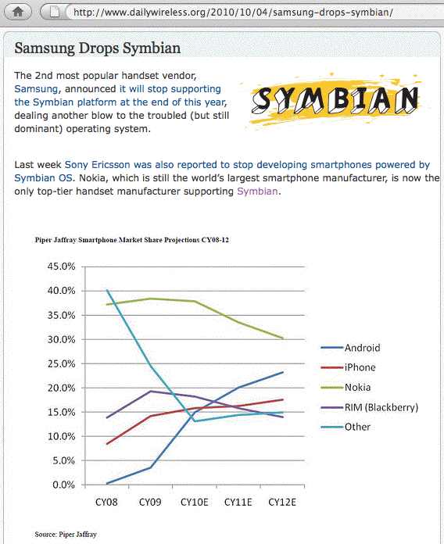
But Note, When It Comes to Symbian…

Slide 16
Most Vendors Are Making Mobile Internet Devices in All Popular Form Factors
Some device types are exceptionally popular (in general)
You’re going to see a lot of “touch screen devices” that (sort of) look or act like iPhones.
You’re going to see a lot of “exposed QWERTY keyboard devices” that (sort of) look or act like classic BlackBerries.
Slide open-format devices are also quite common.
See the following examples…

Slide 17
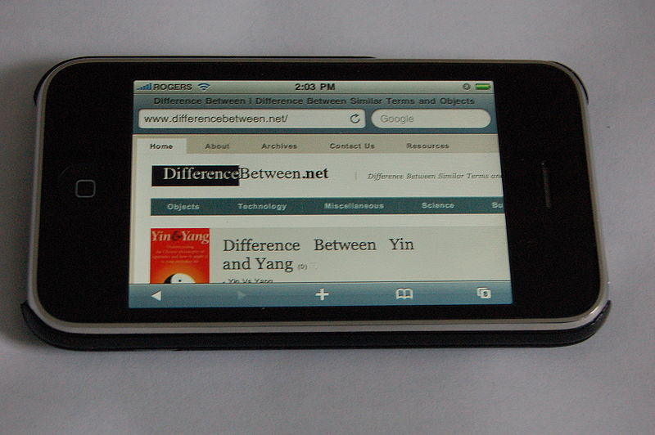
Sample Apple iPhone 4
commons.wikimedia.org/wiki/File:Safari_iphone.JPG

Slide 18
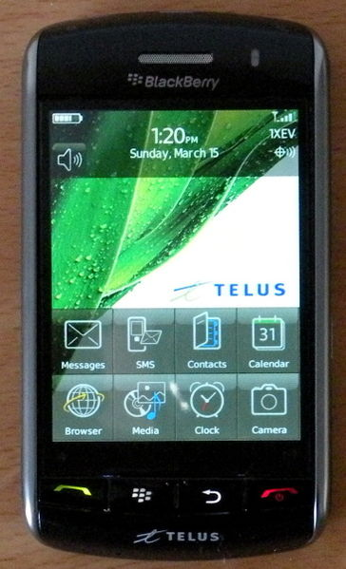
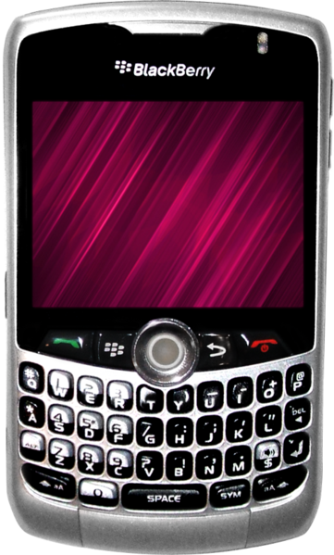
Sample Blackberry Devices
commons.wikimedia.org/wiki/
File:Blackberry_Storm.JPG
commons.wikimedia.org/wiki/
File:BlackBerry_Curve_8330.png

Slide 19
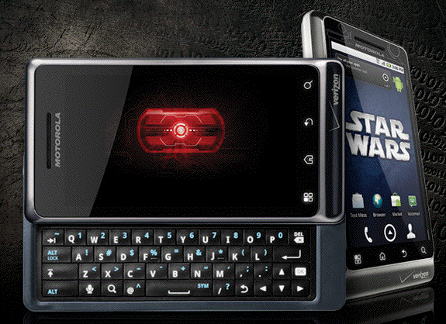
Sample Android Device
www.motorola.com/Consumers/US-EN/Consumer-Product-and-Services/
Mobile-Phones/ci.Motorola-DROID-2-US-EN.vertical

Slide 20
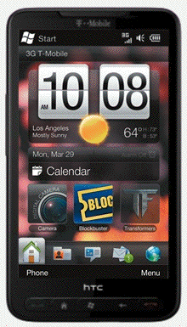
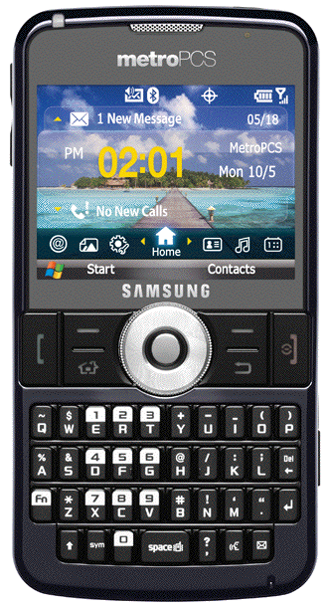
Sample Windows Mobile Device
htchd2.t-mobile.com/touch-screen-phones
tinyurl.com/samsung-windows-mobile

Slide 21
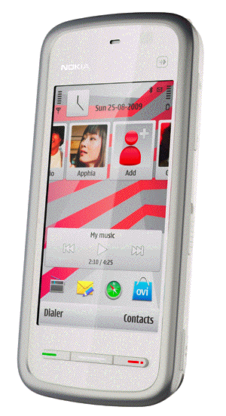
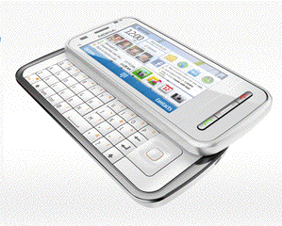
Sample Symbian Devices
europe.nokia.com/find-products/devices/nokia-c6-00
tinyurl.com/symbian-nuron

Slide 22
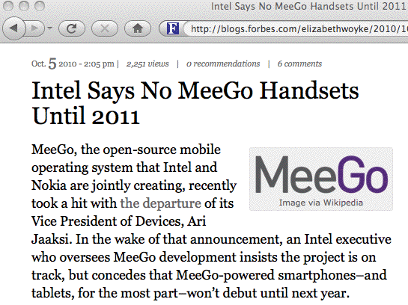
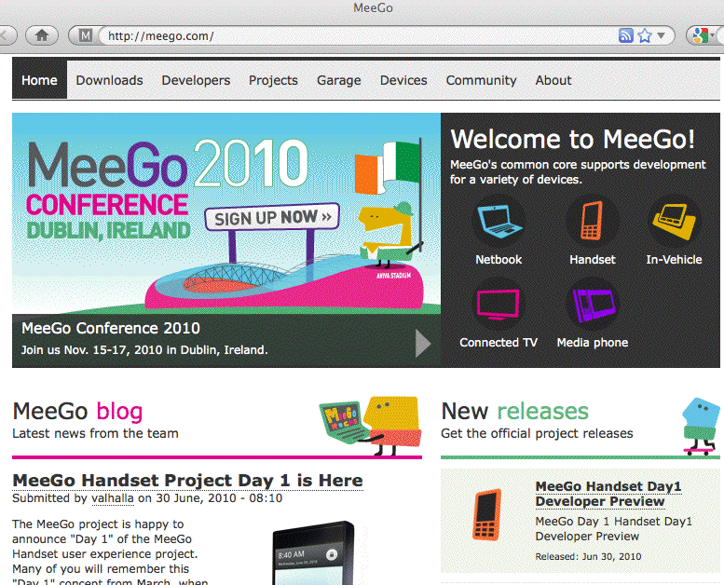
What About “Open Source” Mobile Devices?

Slide 23
Why Not Just Support “Everything?”
Device support costs can kill you! Sites need to buy the devices themselves, and build documentation, and maintain connectivity for that stable of devices, and this gets harder (and more expensive!) as the number of mobile devices you support increases. It’s crazy to try to keep “one of everything” on hand when at least some products may rarely get purchased/used by your local users.
In other cases, while two or three products may seem to be quite similar, one may in fact be decidedly better than other “similar” alternatives.
If you’re already supporting a “best of breed” product there’s little point to supporting an “also ran” contender.
In still other cases, at least some faculty/staff may
only be allowed to purchase devices listed on a mandatory/exclusive contract.

Slide 24
Beware “Contract Lock-In”
On Old, Crumby Devices
At times it can be hard to comprehend how fast mobile Internet devices are evolving. We may have a three or even four year life cycle for desktops and laptops, but mobile devices are continually being updated, and most people update their cell devices every two years.
If you have a limited list of “approved” mobile Internet devices, negotiated three or four years ago based on what was available then, what’s on the list today will definitely be yesterday’s technologies (and often at yesterday’s prices!)
Be SURE to have a mechanism by which users can pass along feedback or suggestions regarding devices they’d like to have available and supported!

Slide 25
3. GSM? iDEN? CDMA?

Slide 26
Choice of Connectivity
Not all phones use the same sort of connectivity.
At the same time your university is deciding on which mobile internet device operating systems it will support, you should also be thinking about the sort of connectivity your phones-of-choice will be using.
Call coverage and quality may be impacted by your choice, but choice of connectivity can also impact confidentiality.
Some sites may decide to offer multiple vendors/support multiple connectivity options for very pragmatic reasons.

Slide 27
GSM (and UMTS)
GSM==Global System for Mobile Communication (and the follow-on 3G Universal Mobile Telecommunication System)
The most common worldwide (82% share).
So-called “World Phones,” (quad-band or even penta-band phones), support multiple GSM frequency ranges:
-- GSM 850 (aka “GSM 800”) and GSM 1900; the typical
GSM frequencies in the United States and Canada
-- GSM 900 and GSM 1800 (aka “Digital Cellular
Service”); the most common GSM frequencies in
Europe and worldwide
GSM is used by AT&T and T-Mobile in the U.S.
Uses SIM cards (but some phones may be “locked”)
Unfortunately both GSM’s A5/1 and A5/3 encryption *have* been cracked

Slide 28
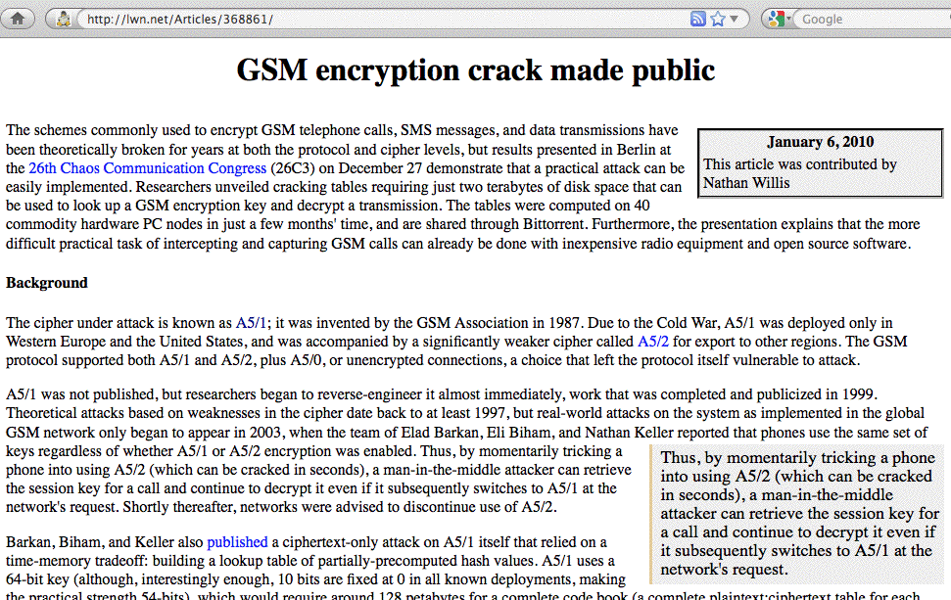

Slide 29
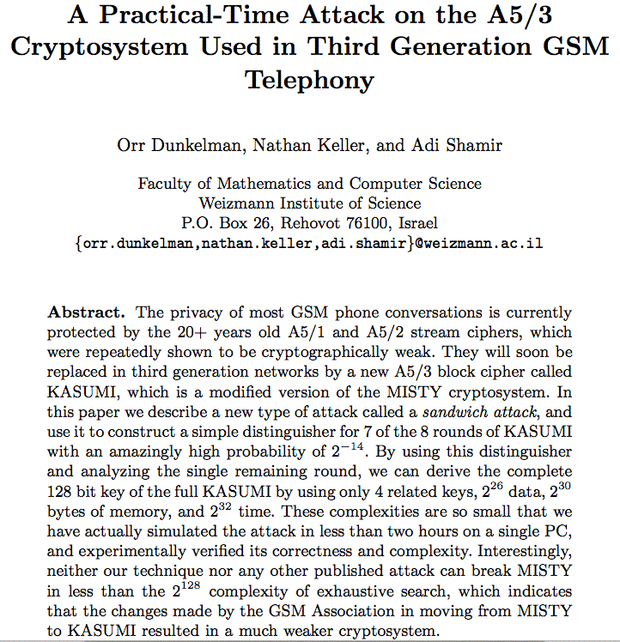

Slide 30
Still Don’t “Get The Problem” with GSM?
One more try.
See “Practical Cell Phone Snooping,”
www.tombom.co.uk/cellphonespying.odp
and
www.tombom.co.uk/blog/?p=262 (August 1st, 2010)
(odp file extension == OpenOffice)

Slide 31
iDEN
Integrated Digital Enhanced Network.
Motorola proprietary format.
Supported by Sprint (iDEN had formerly been a “Nextel thing”), and you can even get Boost Mobile prepaid iDEN phones (look for their “i”-prefix handsets such as the Motorola Clutch i465)
iDEN is perhaps most famous for its nationwide “push to talk” (PTT) service, an instant-on walky-talky-like service
Popular with federal “three letter agencies” and local/regional emergency personnel, courtesy van drivers, etc.
There have been persistent rumors that iDEN will be phased out, reserved for exclusive use by the Feds, etc.
Uses SIM cards (not compatible with GSM SIM cards)

Slide 32
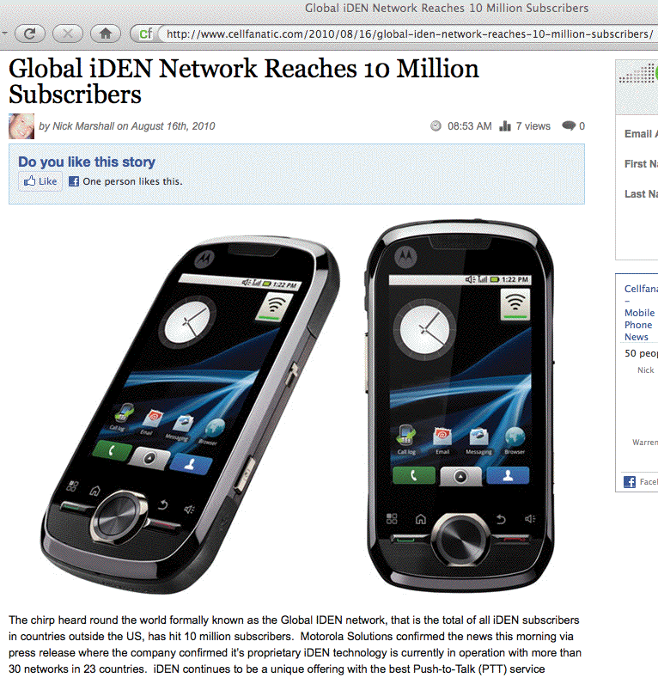
Rumors of iDEN’s Demise Are Premature

Slide 33
CDMA (and CDMA2000)
CDMA == Code Division Multiple Access; CDMA2000 is the 3G follow-on technology to CDMA. There are a couple of variations of CDMA2000 (e.g., 1X and EV-DO)
CDMA is probably the most common cellular connectivity choice in the United States.
CDMA is generally not very useful if travelling abroad (with only a few rare exceptions).
Some leading CDMA cellular carriers in the US include: Verizon, Sprint, Cricket, MetroPCS, and Qwest
CDMA is generally considered harder for an unauthorized party to eavesdrop upon than GSM (lawful intercept can still be performed), but from a resistance-to- eavesdropping point of view, I still like iDEN best.

Slide 34
So Which Cellular Technology To Pick?
You may not have a choice: if you want an iPhone, that’s a “GSM only” proposition (at least for now; rumors about release of a CDMA iPhone continue to circulate – we’ll see what comes out next year)
You may not have a choice: you may live or work somewhere where coverage is limited. If CDMA service is strong where you need coverage, and GSM is weak, buy a CDMA phone.
You may not have a choice: you may be subject to mandatory exclusive contract restrictions, although some organizations (including UO) offer both a CDMA provider and a GSM provider as an option.
What are YOU recommending, and why?
CAN you influence what phones people buy and use?

Slide 35
4. Getting Influence Over Mobile Internet Device Choices At Your Site

Slide 36
Let’s Start With A Very, Very, Basic Question
Who at your site has a mobile Internet device?
You simply may not know -- users will often independently purchase mobile devices (particularly if
it’s hard/uncommon for a site to do so for its staff)
Those devices may connect via a third party/commercial network, and may not even directly access your servers.
If those devices do access your servers, unless they have to authenticate to do so, you may not know that it is a device belonging to one of your users.

Slide 37
And If You Don’t Know Who Has Those Devices
… you probably also don’t know:
-- how they’re being configured and maintained, or
-- what data may be stored on them.

Slide 38
A Semi-Zen-like Koan
“If I didn’t buy the mobile device, and the mobile device isn’t using my institutional network, and the mobile device isn’t directly touching my servers, do I even care that it exists?” (Not quite as pithy as, “If a tree falls in the forest when no one’s around, does it still make any sound?” but you get the idea). Yes, you should care.
You may think that that device isn’t something you need to worry about, but at some point in the future that WILL change. Suddenly, for whatever reason (or seemingly for no reason) at least some of those devices WILL begin to use your network and/or servers, or some of those devices WILL end up receiving or storing personally identifiable information (PII).

Slide 39
Want Influence? It’ll Probably Cost You…
This is the slide that I hate having to include, but truly,
If you want the ability to influence/control what
happens on mobile Internet devices on your campus,
you’re probably going to need to “buy your way in.”
By that I mean that if you purchase mobile Internet devices for your faculty or staff, you’ll then have an acknowledged basis for controlling/strongly influencing
(a) what gets purchased,
(b) how those devices get configured, and
(c) (maybe) you’ll then even know who may be using
these devices.

Slide 40
What About Student Mobile Devices?
Same idea: if you have a discounted/subsidized/required mobile device purchase program for students, you may be able to control (or at least strongly influence) what they purchase, how those devices gets configured, etc.
But buying in may not be cheap…

Slide 41
Mobile Data Plans Are Expensive
One factor that I believe is an impediment to mobile device deployment at some institutions is the cost of the service plans required to connect the devices (the upfront cost of the device itself is negligible relative to the ongoing cost of purchasing service for the device)
For example, while the iPhone 3GS itself starts at just $99, and the iPhone 4 starts at just $199, the monthly recurring costs currently range from a bare-bones plan at $54.95/month all the way up to $114.99/month from AT&T in the U.S.; a text messaging plan, if desired, adds up to another $20/month.
Thus, non-device costs for iPhones for 20,000 users for a year would cost from $54.99/month*12 months/year *20,000 = $13,197,600/yr all the way up to $32,397,600 (e.g., ($114.99+$20)*12*20,000). That’s a chunk of money.

Slide 42
Those Cost Aren’t Just an “iPhone” Thing
Some folks may think that the prices mentioned are purely an artifact of Apple/AT&T. They’re not.
For example, domestic service plans for BlackBerry devices, e.g., from Verizon, tend to be comparable --
talk plans in Oregon run from $39.99-$69.99, with texting $20 extra, with the only realistic data
package you’ll also need being the $29.99 “unlimited” one.
$69.99+$20.00+$29.99 = $119.98
$119.98/month*12 months*20,000 = $28,795,200/yr
to service 20,000 users.
Once again, that’s a big chunk of dough.

Slide 43
International Charges
If you have faculty or staff who travel internationally, international voice and data usage would be extra.
In the iPhone’s case, data usage ranges from $24.99/month for just 20MB to $199.99/month for just 200MB. Over those limits, usage runs from $5/MB on up (ouch). These and all other rates may change over time; check with your mobile carrier for more details.
Obviously I think many people may want to consider disabling data roaming while traveling abroad.

Slide 44
Your Institution May Be Able to
Negotiate A Better Rate
Never assume that the onesie-twosie retail price is the price applicable to higher ed users; always check for existing special pricing, and don’t hesitate to negotiate!
Even if you can’t chisel much off the price sometimes, you may at least get better contract terms as part of that arrangement.
Has YOUR college wrestled with the financial issues associated with mobile devices? If so, did you come up with any solutions?

Slide 45
5. Mobile Device Policies

Slide 46
Sure Mobile Internet Devices Are Popular (And Expensive!), But Are They Secure?
Many sites, faced with the ad hoc proliferation of mobile devices among their users, have become concerned:
Are all these new mobile Internet devices secure?
Since misery loves company, it may help to recognize that we’re not the only ones wrestling with mobile device security. Remember when the most powerful person in the free world didn’t want to part with his BlackBerry?
Specialized, extra-secure devices (such as the GD Sectera or the L-3 Guardian) are available to users in the gov/mil/three letter agency markets, but those devices are typically expensive ($3,500) and heavy compared to traditional mobile Internet devices, and are unavailable to those of us who do not hold federal security clearances, anyhow.

Slide 47
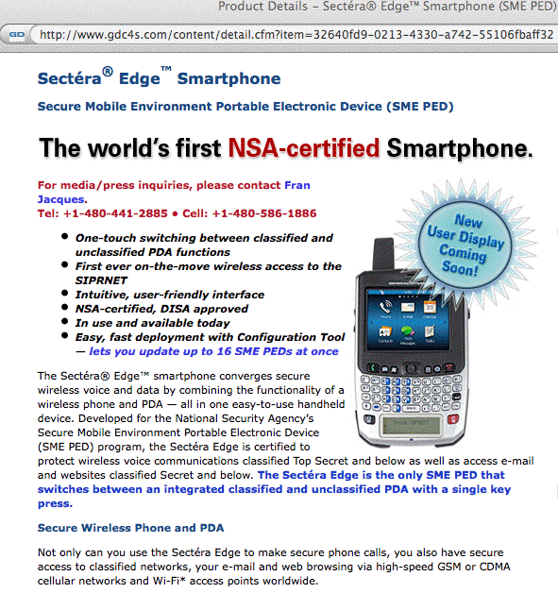
SME PED: GD Sectera

Slide 48
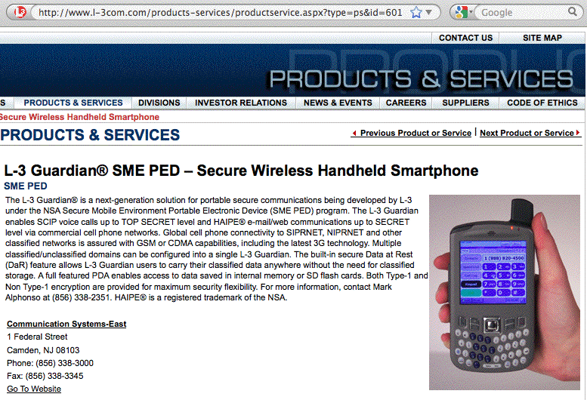
SME PED: L-3 Guardian

Slide 49
The Sort of “Security” We Need
In our case, we’re not worried about the remnants of the Cold War espionage world, or terrorists, we’re worried about issues such as:
-- Is all device traffic encrypted well enough to protect
PCI-DSS or HIPAA or FERPA data that’s present?
-- Is there PII on our users devices? Do those devices
have “whole device” data encryption to protect that
data?
-- What if one get lost or stolen? Can we send the device
a remote “wipe” or “kill” code?
-- How are we sync’ing/backing those devices up?
-- Do we need antivirus protection for mobile devices?
-- And how’s our mobile device security policy coming?

Slide 50
Are We Seeing A Recapitulation of The “Managed vs. Unmanaged PCs” Wars?
For a long time way back in the “old days,” traditional IT management pretended that PCs didn’t exist. While they were in “denial,” people bought whatever PCs they wanted and “administered” them themselves. While that sometimes worked well, other times chaos reigned.
Today's more closely managed “enterprise” model was the result of that anarchy. At some sites, standardized PC configurations are purchased and tightly locked down and are then centrally administered. While I’m not a fan of this paradigm, I recognize that it is increasingly common.
Are we re-experiencing that same evolution for mobile Internet devices? Or are we still denying that mobile Internet devices even exist? What policies might we see?

Slide 51
An Example Device Policy: Device Passwords
If a mobile Internet device is lost or stolen, a primary technical control preventing access to/use of the device is the device’s password.
Users hate passwords, but left to their own devices (so to speak), if they use one at all, they might just use a short (and easily overcome) one such as 1234
You and your school might prefer that users use a longer and more complex password, particularly if that mobile Internet device is configured to automatically login to your VPN, or the device has sensitive PII on it. You might even require use of two factor auth for your VPN, or require the device to wipe itself if it detects that it is the target of an password brute force attack.
If the device is managed, you can require these things.

Slide 52
Managing Mobile Internet Device Policies
Both RIM and Apple offer guidance for configuring and centrally managing their mobile Internet devices in an enterprise context.
If you’re interested in what it would take to centrally manage these devices and you haven’t already seen these documents, I’d urge you to see:
http://na.blackberry.com/eng/ataglance/security/it_policy.jsp
http://manuals.info.apple.com/en_US/
Enterprise_Deployment_Guide.pdf

Slide 53
Example:
What Can Be Required for iPhone Passwords?
Looking at the iPhone Enterprise Deployment Guide:
-- you can require the user *have* a password
-- you can require a *long*/*complex* password
-- you can set max number of failures (or the max days
of non-use) before the device is wiped out (the device
can then be restored from backup via iTunes)
-- you can specify a maximum password change interval
-- you can prevent password reuse via password history
-- you can specify an interval after which a screen-lock-
like password will automatically need to be re-entered
RIM offer similar controls for BlackBerry devices.

Slide 54
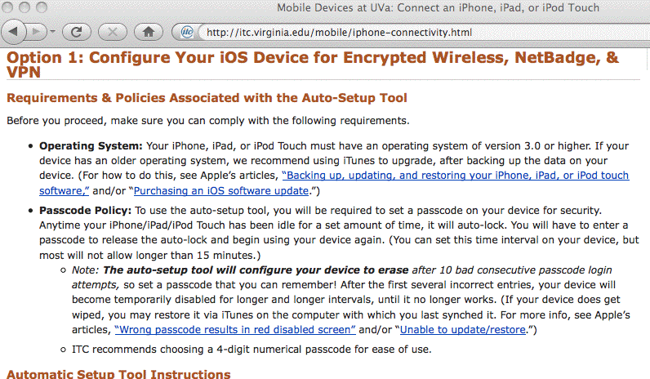
What Policies Has Your Site Adopted?
Do you have mobile Internet device-specific policies at your site? An example from UVa:

Slide 55
Other Potential Local iPhone “Policies” Include
Adding or removing root certs
Configuring WiFi including trusted SSIDs, passwords, etc.
Configuring VPN settings and usage
Blocking installation of additional apps from the AppStore
Blocking Safari (e.g., blocking general web browsing)
Blocking use of the iPhone’s camera
Blocking screen captures
Blocking use of the iTunes Music Store
Blocking use of YouTube
Blocking explicit content
Some of these settings may be less applicable or less important to higher ed folks than to corp/gov users.

Slide 56
Scalably Pushing Policies to the iPhone
To configure policies such as those just mentioned on the iPhone, you can use configuration profiles created via the iPhone Configuration Utility (downloadable from
http://www.apple.com/support/iphone/enterprise/ )
Those configuration files can be downloaded directly to an iPhone which is physically connected to a PC or Mac running iTunes -- but that's not a particularly scalable approach. The configuration files can also be emailed to your user’s iPhones, or downloaded from the web per chapter two of the Apple Enterprise Deployment Guide.
While those configuration files need to be signed (and can be encrypted), there have been reports of flaws with the security of this process; see “iPhone PKI handling flaws” at cryptopath.wordpress.com/2010/01/

Slide 57
What’s The ‘Big Deal’ About Bad Config Files?
If I can feed an iPhone user a bad config file and convince that user to actually install it, I can:
-- change their name servers (and if I can change their
name servers, I can totally control where they go)
-- add my own root certs (allowing me to MITM their
supposedly “secure” connections)
-- change email, WiFi or VPN settings, thereby
allowing me to sniff their connections and credentials
-- conduct denial of service attacks against the user,
including blocking their access to email or the web
These config files also can be made non-removable (except through wiping and restoring the device).

Slide 58
We Need to Encourage “Healthy Paranoia”
Because of the risks associated with bad config files, and because the config files be set up with attributes which increase the likelihood that users may accept and load a malicious configuration file, iPhone users should be told to NEVER, EVER under any circumstances install a config file received by email or from a web site.
Of course, this sort of absolute prohibition potentially reduces your ability to scalably and securely push mobile Internet device security configurations to iPhones, but…
This issue also underscores the importance of users routinely sync’ing/backing up their mobile devices so that if they have to wipe their device and restore it from scratch, they can do so without losing critical content.

Slide 59
Classroom Mobile Internet Device Policies
Anyone who’s ever been in a class/meeting/movie
theater plagued by randomly ringing cell phones understands just how distracting they can be. Some instructors therefore insist that all cell phones be silenced or turned off completely during class.
Mobile Internet devices are also a potential source of unauthorized assistance during exams, and may need to be controlled to prevent rampant collusion or cheating:
-- classmates could text answers to each other during
an exam
-- students could consult Internet sources for help
on some subject material
-- tests used during an early section might potentially
get photographed and shipped by telephone to students
who will be taking the same (or a similar) test later

Slide 60
Classroom Mobile Internet Device Policies (2)
On the other hand, mobile internet devices may play a critical role in helping to keep campuses safe: a growing number of schools have programs in place to push emergency notifications to campus populations via their mobile devices, and when you’re facing severe weather or an active shooter on campus, time may be of the essence.
Mobile internet devices may also be essential for student parents to remain accessible in case a child is hurt or injured, and contacting the student parent becomes necessary.
Remaining accessible 24x7 may also be a job requirement for some emergency-related occupations.

Slide 61
Phones in Another “Controlled Environment”
If you think higher ed struggles with its mobile internet devices, things are far worse in some other environments.
For example, cell phones are routinely banned outright in most prisons, but reportedly contraband cell phones may sell “inside” for as much as $5,000.* (Inmates cherish cell phones because they allow them to remain surreptitiously in control of criminal enterprises even while incarcerated)
Some prison authorities have begun to lobby for authority to use cell phone jammers to control inmate cell phone use, however the FCC has historically been unwilling or unable to permit their use, even in penitentiaries. (Sniffers or passive detection may be an option, however)
----
* “Cell phones behind bars: Can you hear me now?”
http://www.corrections.com/articles/13233-cell-phones-behind-bars-can-you-hear-me-now-

Slide 62
Mobile Device Forensic Tools
What if an iPhone IS lost/stolen/seized/confiscated, what sort of information might be able to be recovered?
See the book “iPhone Forensics” by Jonathan Zdziarski, http://oreilly.com/catalog/9780596153595
Some (of many) potential tools (in alphabetical order):
-- Device Seizure, http://www.paraben.com/
-- iPhone Insecurity, http://www.iphoneinsecurity.com/
-- Lantern, http://katanaforensics.com/
-- Oxygen, http://www.iphone-forensics.com/
Notes: Some tools may only be available to gov/mil/LE. Also, if you must jailbreak an iPhone to use a tool, this may complicate use of resulting evidence for prosecution
Interesting review from 2009: viaforensics.com/wpinstall/
wp-content/uploads/2009/03/iPhone-Forensics-2009.pdf

Slide 63
What About Hardware Encryption?
An example of a common security control designed to protect PII from unauthorized access is hardware encryption. For example, many sites require “whole disk” encryption on all institutional laptops containing PII.
Some mobile Internet devices (such as earlier versions of the iPhone) did not offer hardware encryption; 3GS and 4G iPhones now do. However, folks have demonstrated that at least the 3Gs (and at least for some versions of iOS) was less-than-completely bullet proof; see for example Dr NerveGas (aka Jonathan Zdziarski’s) demo “Removing iPhone 3G[s] Passcode and Encryption,” www.youtube.com/watch?v=5wS3AMbXRLs
This may be a consideration if you are planning to use certain types of iPhones for PII or other sensitive data.

Slide 64
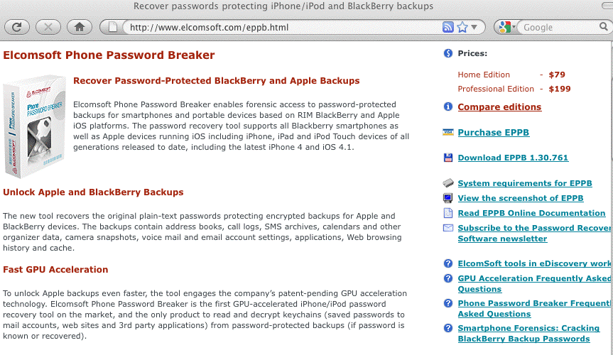

Professional Phone Password Recovery Tools
[But…]

Slide 65
Hardware Encryption on the BlackBerry
Hardware encryption on the BlackBerry is described in some detail in “Enforcing encryption of internal and external file systems on BlackBerry devices,” see
http://docs.blackberry.com/en/admin/deliverables/3940/file_encryption_STO.pdf
If setting encryption manually, be sure to set
-- Content Protection, AND
-- Enable Media Card Support, AND Encrypt Media Files
If setting encryption centrally, be sure to set all of…
-- Content Protection Strength policy rule
-- External File System Encruption Level policy rule
-- Force Content Protection for Master Keys policy rule
For “stronger” or “strongest” Content Protection levels, set min pwd length to 12 or 21 characters, respectively

Slide 66
Note Those Recommended Password Lengths
We’ve previously talked specifically about passwords at the 2009 NWACC Security Meeting (see www.uoregon.edu/~joe/passwords/passwords.pdf (or .ppt))
I suspect that most folks do NOT routinely use 12 to 21 character passwords even on highly important “regular” administrative accounts, so convincing users, particularly senior administrative users, to use a 12 or 21 character password “just” for their BlackBerry may be a tough sell.

Slide 67
Remotely Zapping Compromised Mobile Devices
Strong device passwords and hardware encryption are primary protections against PII getting compromised, but another potentially important option is being able to remotely wipe the hardware with a magic “kill code.” Both iPhones and BlackBerry devices support this option.
Important notes:
-- If a device is taken off the air (e.g., the SIM card
has been removed, or the device has been put into a
electromagnetic isolation bag), a device kill code may
not be able to be received and processed.
-- Some devices (including BlackBerries) acknowledge
receipt and execution of the kill code, others may not.
-- Pre-3GS versions of the iPhone may take an hour per
8GB of storage to wipe; 3GS’s wipe instantaneously.

Slide 68
Terminating Mobile Device-Equipped Workers
A reviewer who looked at a draft of these slides pointed out an interesting corner case for remote zapping:
-- Zap codes are usually transmitted via Exchange Active
Sync when the mobile device connects to the site’s
Exchange Server, and the user’s device authenticates
-- HR departments in many high tech companies will
routinely kill network access and email accounts when
an employee is being discharged to prevent “incidents”
-- If HR gets network access and email access killed
before the zap code gets collected, the device may
not be able to login (and get zapped), leaving the now
ex-employee with the complete contents of the device
See: http://tinyurl.com/zap-then-fire
Of course, complete device backups may also exist…

Slide 69
What Are Your Plans For Departing Employees?
Do you have a checklist you go through when an employee leaves (voluntarily or involuntarily)?
Does the plan include mobile devices and the content thereon?
What if the employee is using a personally purchased mobile devices?

Slide 70
6. Mobile Device Applications

Slide 71
Mobile Devices as Terminals/X Terminals
One solution to the problem of sensitive information being stored on mobile Internet devices is to transform how they’re used.
For example, if mobile Internet devices are used solely as ssh (“VT100-type”) terminals, or solely as X Windows terminals, the amount of sensitive information stored on the device could presumably be minimized (modulo caching and other “incidental” PII storage).
iPhone users can obtain both ssh and X terminal server applications for their devices from www.zinger-soft.com and from other vendors
It is critical that communications between the mobile device and the remote system be encrypted (including having X terminal session traffic securely tunneled)

Slide 72
Web Based Applications on the iPhone
Of course, most sites don’t use “VT100” and/or X term apps any more -- everything is done via a web browser.
So what web browsers can we use on our mobile devices? (some sites or some critical applications may strongly prefer or require use of a particular browser)
Traditionally, Safari was the only true web browser available for the iPhone.
Firefox, for example, isn’t and won’t be available (and
no, Firefox Home for iPhone does not count), see
https://wiki.mozilla.org/Mobile/Platforms
Opera Mini was approved for the iPhone on April 13th, 2010, but note that Opera Mini differs from “regular” Opera in that remote servers are used to render what Opera Mini displays (and they auto-“MITM” content for you, see www.opera.com/mobile/help/faq/#security)

Slide 73
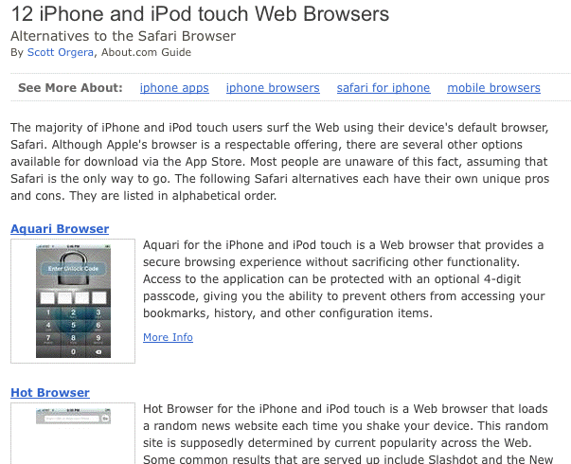
A Review of 12 Alternative Browsers for iPhone
See: http://browsers.about.com/od/iphonewebbrowsers/
tp/iphone-web-browsers.htm

Slide 74
Web Based Applications on the BlackBerry
What about BlackBerry users?
Just like iPhone users, BlackBerry users can run Opera Mini (see www.opera.com/mobile/download/blackberry/ ) but not Firefox (see https://wiki.mozilla.org/Mobile/Platforms#Supported_Platforms )
There’s a nice review of some other mobile web browsers at www.pcmag.com/article2/0,2817,2358239,00.asp

Slide 75
Back End Servers Supporting Mobile Devices
Many mobile Internet apps, not just Opera Mini, rely on services provided by back end servers -- sometimes servers which run locally, othertimes servers which run "in the cloud."
If those servers go down, your service may be interrupted. This is a real risk and has happened multiple times to BlackBerry users; some examples include:
-- "International Blackberry Outage Goes Into Day 2," March 9th, 2010, http://tinyurl.com/intl-outage-2nd-day
-- "BlackBerry users hit by eight-hour outage," December 23rd, 2009, www.cnn.com/2009/TECH/12/23/blackberry.outage/index.html
See http://www.dataoutagenews.com/ for more outages.
Availability is, or can be, another critical information security consideration (remember “confidentiality, integrity and availability”!)

Slide 76
What Do Your Key Websites
Look Like On Your Mobile Internet Device?
Web sites optimized for fast, well-connected computers with large screens may not look good or work well on mobile devices. If those sites are running key applications, a lack of mobile device app usability may even be a security issue (for example, normal anti-phishing visual cues may be hard to see, or may be easily overlooked on a knock-off "secure" site).
Have you looked at your home page and your key applications on a mobile Internet device? How do they look? One web site which may help open your eyes to the need for a redesign (or at least a separate website for mobile devices) is http://www.testiphone.com/
Should you create an http://m.<yoursite>.edu/ page?
Has someone else already created such a site?

Slide 77
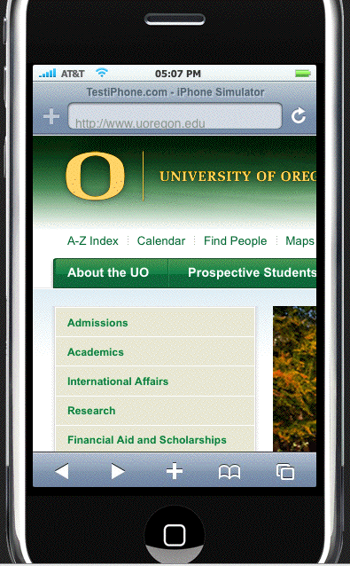
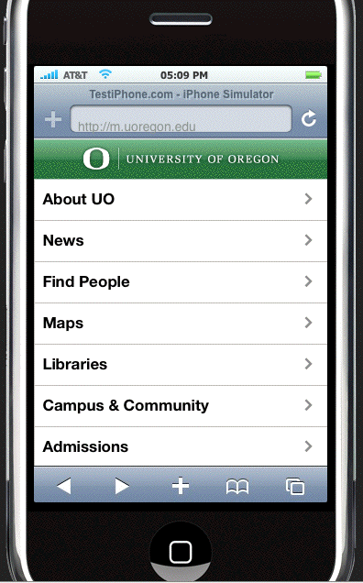
Sample Web Page

Slide 78


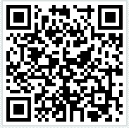
Quick Response Codes
Speaking of mobile devices and the web, a relatively new development is the “Quick Response” or “QR” code, the little square dot-like bar codes that are meant to be photographed by mobile devices as a convenient way of taking your mobile device to a particular location online (or giving folks a phone number, text, etc.)
Quick, what do those barcodes say, eh?

Slide 79
Do We All Think Like Security People?
What was the first thing you thought when you saw those things?
I know what my first thought was… Just looking at one of those things with the naked eye, you sure can’t tell WHAT you’re going to get/where you’re going to go.
Yes, we are a relatively cynical/paranoid lot, aren’t we?
There may be offsetting/compensating controls (but those controls may also potential impact user/site privacy)

Slide 80
7. Spam, Malware, and Broken Jails

Slide 81
Spam Sent Directly to Mobile Devices
Some users may read their “regular” email via their mobile devices; in those cases, their “regular” host-based spam filtering will continue to be applicable, regardless of the device used to read that email.
Managing spam sent directly to mobile devices is a different problem: users need to rely more on the provider’s filtering (good or bad as it may be), having
few if any options for doing their own bespoke filtering.
A cool new initiative: while many mobile operators have intra-company spam reporting, GSM mobile users should be aware of a new effort which will allow them to easily centrally report any spam that may have slipped through. See: “Phone Networks Try New Spam Abuse System,”
25 March 2010, http://tinyurl.com/gsm-7726
Use the SMS code 7726 (or 33700 in some locations)

Slide 82
Malware and A/V on the Non-Jailbroken iPhone
Because earlier versions of the iPhone disallowed applications running in the background, it was difficult for traditional antivirus products to be successfully ported to the iPhone.
To the best of my knowledge, your options for antivirus software on the iPhone are still “quite limited,” with no offering from traditional market leaders such as Symantec and McAfee at that time.
On the other hand, since the iPhone used/uses a
sandbox-and-cryptographically "signed app" model,
it was hard for the iPhone to get infected.

Slide 83
Malware and A/V on the BlackBerry
Regarding the Blackberry, see RIM’S FAQ item
“Does my BlackBerry smartphone need anti-virus software?” at
http://na.blackberry.com/eng/ataglance/security/knowledgebase.jsp#faq8

Slide 84
And If There’s NOT A/V For Mobile Devices…
Some sites may “accidentally” adopt an “overly broad” policy when it comes to deploying antivirus, perhaps decreeing that “If it can’t run antivirus, it can’t run.”
As you might expect, I believe this is a mistake when there are compensating controls (such as use of a
signed-app model in the case of the iPhone), or cases where the demand for A/V on a platform is so minimal there’s not even a commercial A/V product available.
There are ways to avoid malware besides just running antivirus software!
Remember “compensating controls!”

Slide 85
What About Jailbroken iPhones?
Normally only Apple-approved applications run on the iPhone. However, some users have developed hacks (NOT blessed by Apple!) that will allow users to “break out of that jail” and run whatever applications they want.
Jailbreaking your iPhone violates the license agreement and voids its warranty, but it is estimated that 5-10% of all iPhone users have done so.
Q: “Is jailbreaking my iPhone legal?”
A: I am not a lawyer and this is not legal advice, but see:
“EFF Wins New Legal Protections for Video Artists, Cell Phone Jailbreakers, and Unlockers,” July 26, 2010,
http://www.eff.org/press/archives/2010/07/26

Slide 86
Jailbroken iPhones and Upgrades
When a jail broken iPhones gets an OS upgrade, the jailbreak gets reversed and would typically need to be redone.
This may cause some users of jail broken iPhones to be reluctant to apply upgrades (even upgrades with critical security patches!), until the newly released version of iOS also gets jailbroken.
That’s obviously a security issue and cause for concern.

Slide 87
Jail Breaking Apps Are OS Release-Specific
Because jail breaking the iPhone is (cough!) not a supported and endorsed activity, every time Apple upgrades its iOS, it inevitably “fixes” (e.g., breaks) the exploits that were formerly being used to escape the iPhone jail.
As a result, whenever there’s an upgrade, there are a whole bunch of jailbroken iPhone users who anxiously await some new jailbreak for the new version of the iPhone operating system.
There are real applications which will (eventually) accomplish this, such as…

Slide 88
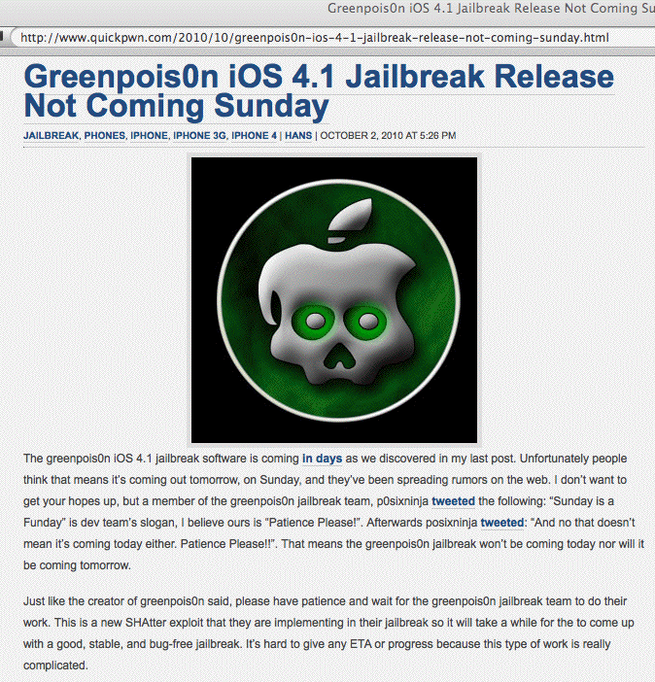
Greenpois0n for iOS 4.1

Slide 89
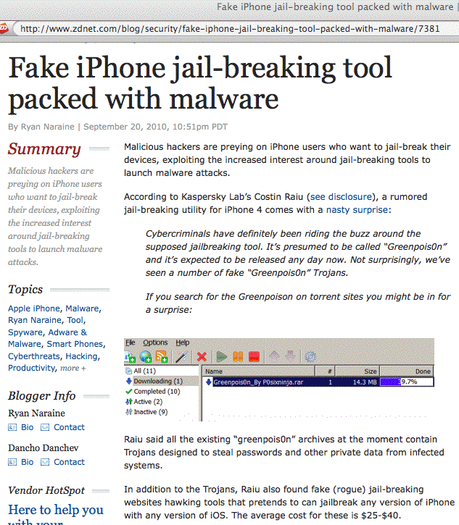
But Beware Fake Jailbreaking Apps

Slide 90
And When You Do Get Successfully Jailbroken
If you do successfully jailbreak your iPhone (with an app that’s not malicious in and of itself!), your exposure to OTHER malware will increase.
Some of the malware which has targeted jailbroken iPhones has targeted unchanged OpenSSh passwords for the root and/or mobile accounts (which defaulted to “alpine”) :
-- the “ikee” worm (aka “RickRolling” worm)
-- the “Duh” worm (which changed “alpine” to “ohshit”,
scanned for other vulnerable iPhones, and stole data)
-- the "iPhone/Privacy.A” (stole data/opened a backdoor)

Slide 91
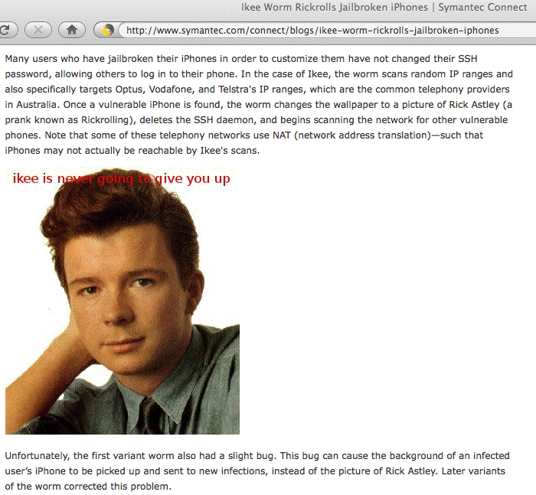
The “ikee” Worm

Slide 92
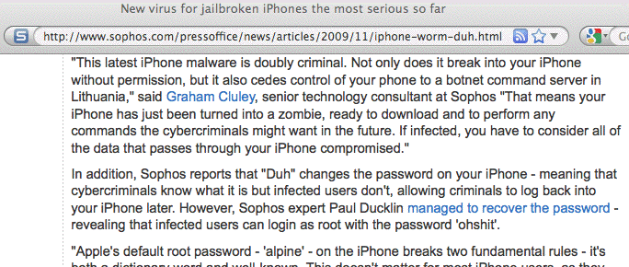
The “Duh” Worm

Slide 93
Mobile Malware May Exploit Vulnerable Apps
For example, just as Adobe Reader has been a popular target for malware on traditional desktop and laptop computers, Adobe Reader is also a popular attack vector on handheld mobile devices.

Slide 94
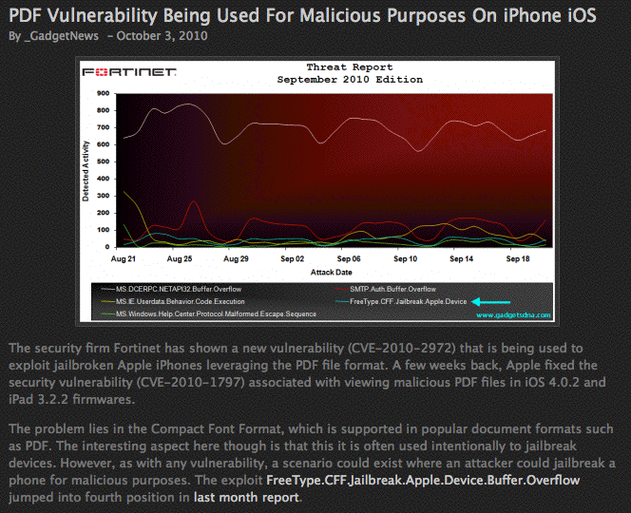
PDF Vulnerabilities on the iPhone
mygadgetnews.com/2010/10/03/pdf-vulnerability-being-used-for-malicious-purposes-on-iphone-ios/

Slide 95
App Vetting and Third Party App Sources
While regular iPhones usually get apps from the iTune Apps Store, jail broken phones can get apps from 3rd party repositories such as Cydia.
It is unclear how much vetting new apps get before being listed at Cydia.
The problem of rogue applications is not unique to just the iPhone…

Slide 96
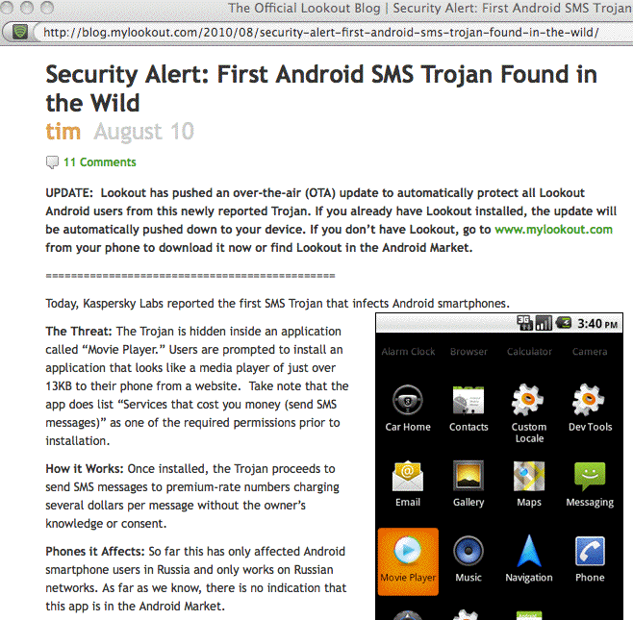
A Sample Malicious Android Application

Slide 97
8. Some Hardware Issues

Slide 98
1) Non-Vendor Hardware
Counterfeit computer and network hardware is a major concern for some manufacturers and the U.S. government
Knock-off iPhones are currently being seen in the U.S.
One good description of a knock off iPhone is available at http://www.macmedics.com/blog/2009/06/27/
counterfeit-iphone-3g-stops-by-macmedics-by-way-of-disputed-ebay-auction/
Apple and legal authorities are putting pressure on the sources of some of these knock-offs (e.g., see "Chinese Counterfeit iPhone Workshop Raided," Jan 20, 2010, http://www.tuaw.com/2010/01/20/
chinese-counterfeit-iphone-workshop-raided/ ), but until this problem is resolved (if ever!) you should be on guard against counterfeit hardware from 3rd party sources.

Slide 99
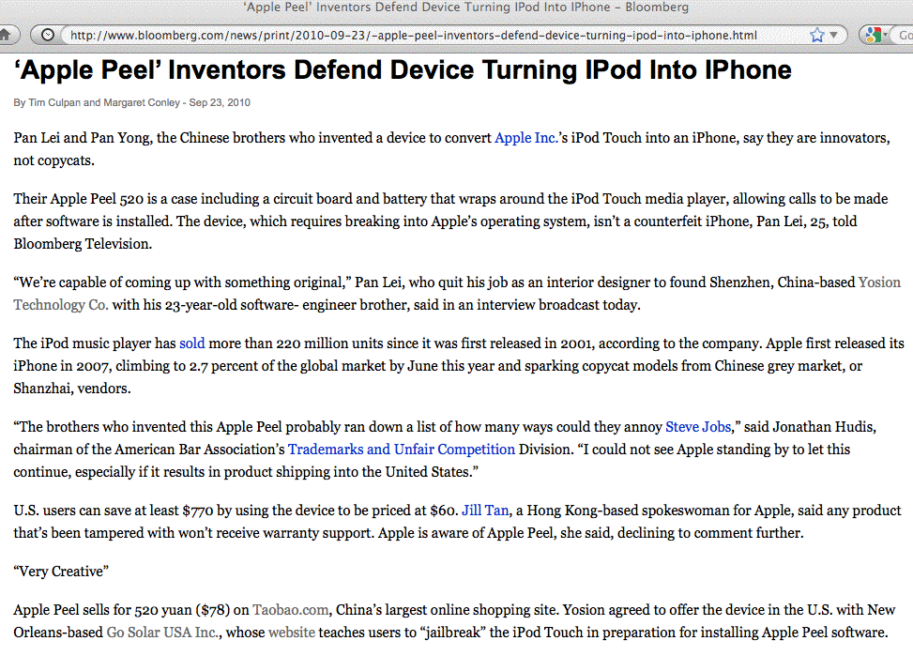
“Apple Peel:” iPod into iPhone?

Slide 100
Some Implications of Non-Vendor Hardware
Manufacturers are obviously unhappy at losing profit from what they view as a key market segment to unauthorized clone makers
Customers may get a lower quality product, or may not be able to get warranty service, or may find that in the future they can’t install updated versions of the mobile device OS.
There is also the possibility that the counterfeit device is intentionally “hardware backdoored” – you just don’t know.
Of course, the “real thing” is also sourced offshore…

Slide 101
2) Are Mobile Internet Devices Tough Enough?
Mobile devices (even devices from the real vendors!) can be exposed to pretty tough conditions -- pockets and belt holsters can be pretty unforgiving places.
Mobile devices end up getting dropped, exposed to moisture (especially here in the Northwest!), extremes of temperature, etc.
Are mobile Internet devices tough enough to hold up?
The best solution may be relatively inexpensive water tight cases from vendors such as drycase.com or otterbox.com

Slide 102
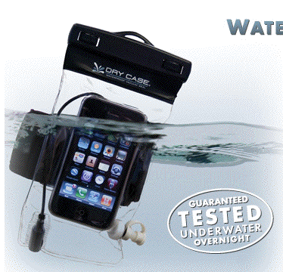
DryCase

Slide 103
9. Privacy Issues

Slide 104
Throw Away Prepaid Cell Phones
One approach to mobile privacy is to use cheap throw away prepaid cell phones, and change them often.
While this approach may not provide technical security, it may do surprisingly well when it comes to making your traffic difficult to find and intercept (assuming you don’t always call the same predictable set of friends!)
It may not work so well for incoming calls (assuming you get a new number each time you change phones, and of course, if you kept the same phone number, there wouldn’t be much point to changing phones, now would there be?)

Slide 105
Geolocation
Your phone knows where it is:
-- Lat, Long, Elevation (think office towers!)
-- Tower triangulation
-- GPS
This may be unquestionably a good thing:
-- it enables voluntary location based services (“Where is
the nearest Krispy Kreme donut store?”)
-- I’m having a coronary but manage to dial 911
But what if I’m a dissident in a foreign country?
Should a court order or other paperwork be required to monitor someone’s geolocation, or is geolocation data inherently public, like watching someone walk down the street?
How much precision is “enough?”
How long should location data be retained?

Slide 106
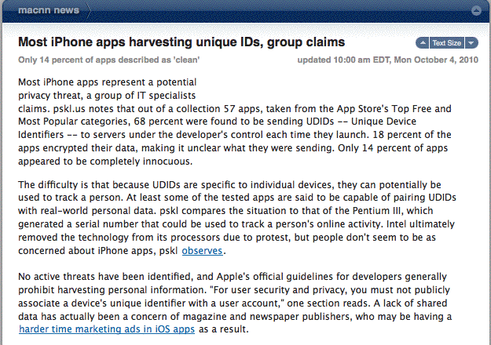
iPhone UDIDs

Slide 107
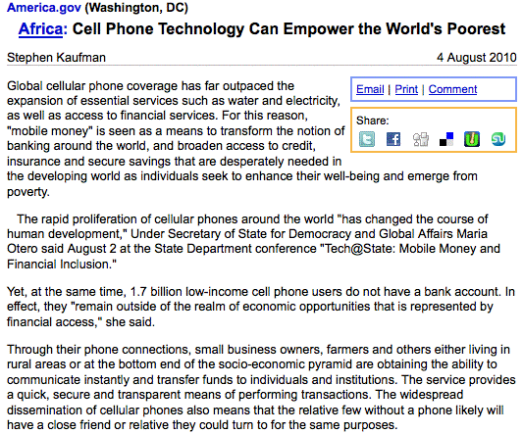
Mobile Money (Mobile Phishing, Too?)

Slide 108
10. Health and Safety Issues

Slide 109
Cellular Radiation Risks
Each phone has a Specific Absorbtion Rate, or SAR
Cannot exceed 1.6 watts per kilogram by law in the U.S.
Varies dramatically from phone to phone, see
http://www.ewg.org/cellphoneradiation/
Get-a-Safer-Phone?allavailable=1
Are you and your users even thinking about this issue?
Use of blue tooth hands-free devices may at least move the primary radiation source somewhat away from your brain, or minimize your usage (yeah, right!)

Slide 110
DWD (Driving While Distracted)
Use of cell phones while driving is widely prohibited, although in some cases it is allowed if you use a “hands free” kit (as suggested on the preceding page)
Bottom line, it still distracts you from what you’re (supposed to be) doing: driving
Is DWD the biggest potential “health risk” of them all?
Does your institution have policy guidance on this sort of thing for employees who are operating institutional motor vehicles, or who routinely log a lot of miles?

Slide 111
Thanks For the Chance to Talk!
Are there any questions?
What did we forget to cover that we should have
mentioned?
Safe travels home (no DWD!), and hope we’ll see you all next year!

