Slide 1
Passwords
Joe St Sauver, Ph.D.
Security Programs Manager, Internet2
(joe@uoregon.edu or joe@internet2.edu)
NWACC Security Conference, Portland, Oregon
Wednesday, November 18th, 2009, 1:00-2:15PM
http://www.uoregon.edu/~joe/passwords/
Disclaimer: All opinions expressed in this presentation are solely those of the author and do not necessarily represent the official opinion of the University of Oregon, Internet2, or any other entity.

Slide 2
The Format of This Talk; Acknowledgments and Disclaimer
Yes, this is another one of those oddly formatted
"Joe talks." For those who haven't seen one of my talks before, I make them verbose so they’ll be readable after the fact for those who couldn't be here today, as well as for search engines, readers for whom english is a second language, the hearing impaired, etc. Please don't let my odd format shake you up. :-) I promise I won’t read my slides to you, nor do you need to read them as I talk.
With that out of the way, I’d like to thank Adrian Irish of the University of Montana and NWACC for the chance to talk today, although I should remind folks that all opinions expressed represent solely my own perspective, and do NOT necessarily represent the opinion of Adrian, UMT, NWACC, Internet2 nor the University of Oregon.

Slide 3
The Original Invitation
Speaking of Adrian, when he’d originally asked me to come and present, we talked a little about potential topics for this meeting. Since I’d recently been at the annual Anti-Phishing Working Group (APWG) meeting and eCrime Researchers Summit in Tacoma, he suggested that I consider talking about phishing, or maybe malware.
I mulled that over, then counter-proposed “passwords.” Adrian assented, although he cautioned me that “this is a fairly technical, details oriented, hands on group.”
Those of you who know me, and the way I tend to approach things, know that he probably didn’t need to worry too much about that particular point.
Oh, and by the time we’re done, you may believe I decided to cover Adrian’s original suggestion, anyhow. :-)

Slide 4
Some Specifics of Our Coverage
Oh yes, while you may know (or quickly notice), while I’m generally a Unix-oriented person, I’ll try to remember to include at least a little Windows-related stuff in this talk, too. :-)
I’ll also tell you right up front that while I may mention specific products, those product references are meant by way of example, and should not be taken as denigrating equally capable alternative products (I just don’t have room to mention every product in a talk of this length).
Finally, I'm assuming you're only working domestically, so we won't go into export control issues that may come up when we talk about crypto-related stuff, although I will note that a growing number of American colleges and universities have overseas branch campuses, etc.

Slide 5
So How Does This Talk Fit Into Internet2’s Overall Security Agenda?
Because I serve as Internet2’s Security Program Manager under contract through the University of Oregon, I try to make sure that the topics I cover when speaking to the community fit into Internet2’s overall strategic plan, and into the security topics that we’ve identified for attention (see: www.uoregon.edu/~joe/security-tasks.pdf )
If you check out that list of security-related tasks, you’ll see that item six is “Replacing traditional passwords” and item three is “Phishing.”
I’m always happy when I color within the lines. :-)
Before we dive into today’s topic in depth, however, let me just give you today’s one slide sound-bite-length takeaway message…

Slide 6
Today’s Talk’s Sound-Byte-Length Message
Traditional passwords are insufficiently secure. The time has come for you to replace traditional passwords with hardware crypto tokens (or some other more-secure-than-traditional-passwords authentication mechanism).
So we’ve got an hour or so to talk a little about
why I feel that way, and why I think you should, too.
I also want to make sure I leave some time for questions and discussion at the end…

Slide 7
Some Authentication Options
When it comes to authentication options, conventional options include:
-- something you know (such as a password)
-- something you have (such as a hardware crypto token)
-- something you are (biometrics, such as retinal scans)
We might also consider “authentication architectures” where “what you can access” is controlled by “where you are,” whether that’s via an nnrp.access file in INN (limiting access by IP address range), or a closed point-to-point circuit-based network architecture.
In reality, however, at least today, authentication is normally all about passwords.

Slide 8
Passwords Are Ubiquitous
It is hard to think of an online service that doesn’t use traditional passwords of one sort or another…
-- workstation, server, network device and mobile device
logins including wireless auth, VPNs, etc.
-- networked applications such as your email (and instant
messaging, and calendaring, and…)
-- many web sites (such as Amazon, eBay, Facebook, etc.)
-- campus course management systems (e.g., Blackboard)
-- campus administrative systems (with FERPA data)
-- online financial accounts (with GLB data)
-- medical and insurance-related sites (with HIPAA data)
-- etc., etc., etc.
We truly use passwords everywhere.

Slide 9
So That Means All of Us Must
Trust Passwords, Right?
Quick informal poll: How many of you do trust passwords?
Put another way, knowing the sensitive assets that passwords protect, do you feel secure that passwords provide adequate protection for those resources and information assets?
-- Yes?
-- No?
-- Gee, Joe, I wish you hadn’t asked that question!
If some of us don’t completely trust passwords, that may point to a problem, because…

Slide 10
Passwords Are Truly Critical to IT Security
If one or more of your passwords are compromised:
-- confidential materials may be accessed or disclosed
(resulting in you being sued/fired/arrested)
-- critical files may be surreptitiously modified or deleted,
(including potentially irreplaceable data)
-- you may be denied access to your own resources
(e.g., if the bad guys decide to “lock you out”)
-- your personal or institutional reputation may be
damaged (for example if spam is sent from your
account, your college may end up being blocklisted)
-- miscreants may take your money or even co-opt
your identity
I think passwords play a critical security role, so if we’re going to rely on them, then they’d BETTER be trustworthy

Slide 11
Thought Experiment: Would You Trust (Just) Traditional Passwords To Secure Access To…
Industrial control systems (“SCADA”), including life safety-critical things? Apparently many people do, at least for things like transportation facilities, power plants and energy transmission facilities, chemical factories, etc.
How about sensitive national security information, such as confidential diplomatic, defense, law enforcement, or intelligence-related information?
In fact, since I mentioned defense systems, let’s play
“war games” for a minute: would you trust a password to adequately secure a thermonuclear weapon and its delivery system?
I sure wouldn’t, and apparently the Air Force didn’t, either, although not for the reasons you might think.

Slide 12
Nuclear Weapons and “Passwords”
Keeping Presidents in the Nuclear Dark
(Episode #1: The Case of the Missing “Permissive Action Links”)
Bruce G. Blair, Ph.D, CDI President, bblair@cdi.org
Feb. 11, 2004
Last month I asked Robert McNamara, the secretary of defense during the Kennedy and Johnson administrations, what he believed back in the 1960s was the status of technical locks on the Minuteman intercontinental missiles. […] McNamara replied, in his trade-mark, assertively confident manner that he personally saw to it that these special locks (known to wonks as “Permissive Action Links”) were installed on the Minuteman force, and that he regarded them as essential to strict central control and preventing unauthorized launch.
When the history of the nuclear cold war is finally comprehensively written, this McNamara vignette will be one of a long litany of items pointing to the ignorance of presidents and defense secretaries and other nuclear security officials about the true state of nuclear affairs during their time in the saddle. What I then told McNamara about his vitally important locks elicited this response: “I am shocked, absolutely shocked and outraged. Who the hell authorized that?” What he had just learned from me was that the locks had been installed, but everyone knew the combination.
The Strategic Air Command (SAC) in Omaha quietly decided to set the “locks” to all zeros in order to circumvent this safeguard. During the early to mid-1970s, during my stint as a Minuteman launch officer, they still had not been changed. Our launch checklist in fact instructed us, the firing crew, to double-check the locking panel in our underground launch bunker to ensure that no digits other than zero had been inadvertently dialed into the panel. SAC remained far less concerned about unauthorized launches than about the potential of these safeguards to interfere with the implementation of wartime launch orders. And so the “secret unlock code” during the height of the nuclear crises of the Cold War remained constant at OOOOOOOO. [source: http://www.cdi.org/blair/permissive-action-links.cfm ]
[And if you want something “better” than PALs, how about this one: “British Nukes Were Protected With Bike Locks,” http://news.bbc.co.uk/2/hi/programmes/newsnight/7097101.stm ]

Slide 13
Managing Risk
This is the point where someone probably will speak up and say something like:
“But Joe!!! Security is really all about managing risk!
Sure, passwords aren’t perfect, but in our case we’re
not trying to secure nuclear weapons, we’re just
trying to keep email accounts from sending spam or
kids from logging in and changing their grades!
Passwords are secure enough for that sort of thing!”
Maybe, maybe not -- that’s what we’ll spend some time talking about today. Maybe by the time we’re done, I will have been able to change your mind.

Slide 14
Cost/Benefit Analysis
This is also the point where other people may chime in:
“BUT JOE! I’d *love* to replace traditional passwords
with something stronger/cooler, but we just can’t
AFFORD it! When we do a cost/benefit analysis, the
numbers just DON’T work!”
We’ll also talk a little about *that* argument a little later in this talk.

Slide 15
The Insecurity of Passwords:
Let Me Count The Ways I Love Thee

Slide 16
1. People Will Pick Weak Passwords
We know from personal experience that if users are given the chance to do so, they’ll routinely pick “weak” passwords, including:
-- password == username
-- trivially short (6 character or less) passwords
-- passwords that use only lower case letters
-- passwords that are words in the dictionary
-- passwords that are a pattern on the keyboard
(12345678, qwerty, etc.)
Why are weak passwords a problem? Well, weak passwords can be successfully attacked with either brute force attacks (password = a, b, c, d, … z, aa, ab, ac, ad, … az, ba, … zzzzz), or via dictionary attacks (try all words found in the dictionary as potential passwords)

Slide 17
You Can (Try To) Force Users to Pick Strong Passwords
For example, you can use modules such as pam_passwdqc to do password length and quality enforcement, see http://www.openwall.com/passwdqc/
Users WILL complain if you impose sufficiently fascist password quality requirements, and visits to the helpdesk will go up if users find it "impossible" to pick a password that will “pass muster.” [maybe try password generators?]
Users may also employ “alternative channels” (such as manual password changes by privileged administrators) to overcome password policies which they don’t “buy into."
Recommendation: system admins and/or security admins (with prior mgmt approval!) should audit user passwords using commonly available password cracking tools…

Slide 18
Password Cracking Tools
There are many password cracking tools in circulation, both “open source” and commercial.
I never like to help the script kiddies by providing pointers, but note that these tools aren’t exactly “obscure.”
See, for example, the results of Googling for
password cracking tools
including
http://sectools.org/crackers.html

Slide 19
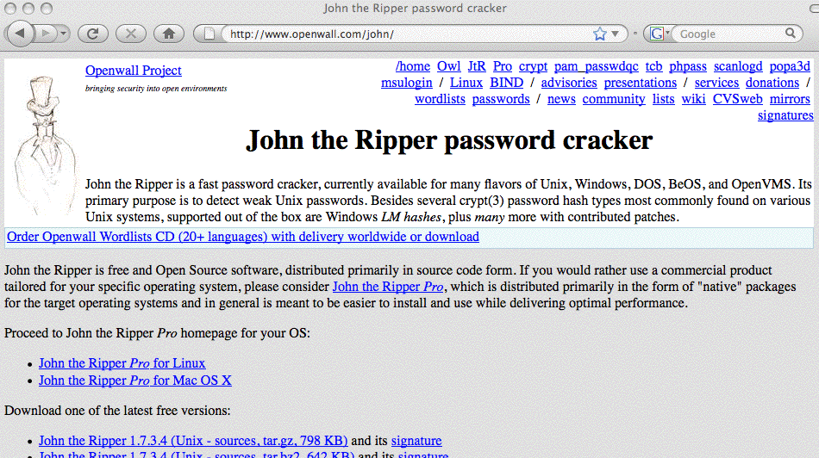
A Sample Tool From the Sectools.org Listing

Slide 20
One Password Cracking Approach Particularly Worth Highlighting:
Rainbow Table Methods
Most computational algorithms, including password cracking algorithms, involve tradeoffs between time and space, e.g., I can use more CPU, or more RAM or disk storage, depending on how (algorithmically) I decide to attack a problem. Rainbow tables use precomputed stored hash chains (e.g., more storage) to dramatically reduce the CPU/clock time required to crack password hashes.
For more information on Rainbow Tables, see:
http://project-rainbowcrack.com/ and
http://project-rainbowcrack.com/tutorial.htm and
http://www.ethicalhacker.net/content/view/94/24/

Slide 21
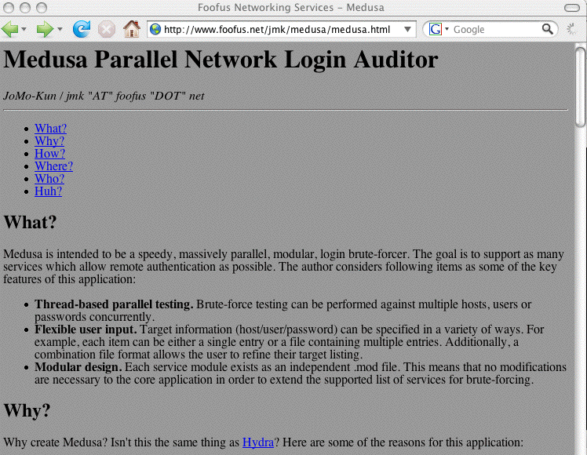
A Sample Open Source In-Situ
Brute Force Network “Auditing” Tool

Slide 22
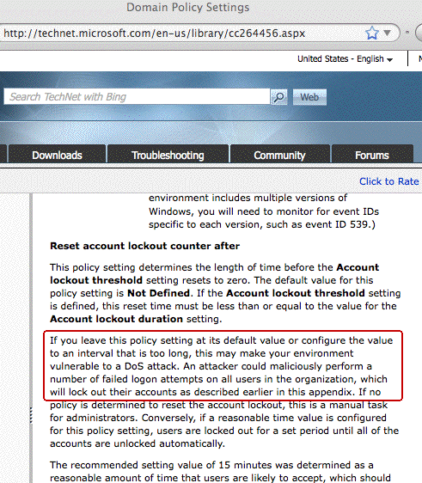
Can "Brute Forcers" Accidentally (or Intentionally) DDoS Your Users?

Slide 23
More In-Situ Brute Forcing Points To Consider
Are you limiting the number of password attempts you allow? For example, after three failed logins do you stop listening to additional login attempts from a source IP, but only for a period of time? [see preceding slide!]
Do you log (and analyze!) all authentication failures?
If you use the same authentication service for multiple network applications, do you track/limit/log login failures from ALL of them? Or are you only protecting one service (such as sshd) while allowing someone to flood "more obscure" services (such as POP3 or IMAP) with query traffic w/o those attacks being detected and handled?
Moving services off their default ports, and/or using port knocking can help cut down on the network noise; if you'd like to read more about port knocking, see…

Slide 24
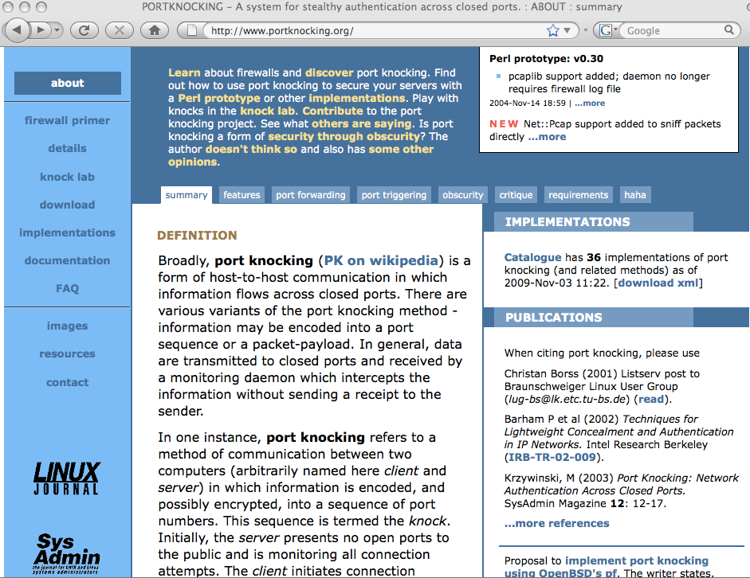
portknocking.org

Slide 25
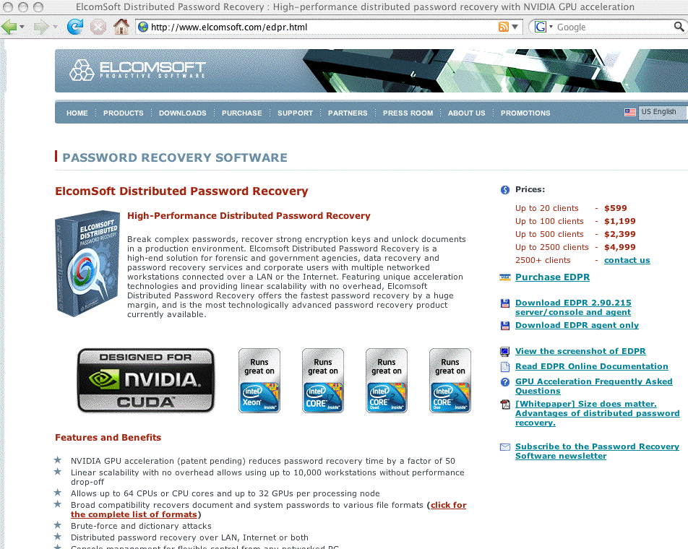
A Comercial Parallel GPU-Enabled Password
Recovery Product From A Russian Company

Slide 26
Shadow Password Files
Of course, offline password cracking tools require password hashes as input, and these days most operating systems store password hashes as shadow files, accessible only by privileged users.
Shadow files are still of great interest to crackers, being among the top 10 targets seen by the Honeynet Project (see www.honeynet.org/book/export/html/14 )
Hmm… what might a cracker do? Well, let’s assume he/she manages to obtain access to your backup server, or to
your unencrypted backup media, including a copy of /etc/shadow … Suddenly, (s)he’s got plenty of fodder to
feed to his/her favorite password cracking tool(s).
Now you know one reason why I tend to harp on the importance of encrypting and/or controlling access to
your backups!

Slide 27
Passwords Encryption Algorithms
You should insure that you're using a strong password encryption algorithm (assuming your operating system gives you that choice).
Some systems may still be storing passwords encrypted with the traditional “crypt” based on 56-bit DES encryption. That’s pretty bad. You shouldn’t use it.
There are alternative password encryption algorithms available on at least some systems, such as Redhat Linux, including MD5 (identified by the leading $1$ in the printable form of the password file), and Blowfish (tagged with $2$ or $2a$), however I’d recommend SHA256 ($5$) or SHA512 ($6$), which may be the default on (some) distros. See people.redhat.com/drepper/SHA-crypt.txt
and kbase.redhat.com/faq/docs/DOC-15806 and httpd.apache.org/docs/2.2/misc/password_encryptions.html

Slide 28
LAN Manager Password Hashes on Windows
On many versions of Windows, password hashes are stored in multiple formats: LM hash (for "compatibility"), plus other formats. LM hash format hashes are vulnerable to fast brute force attacks. For example, LMCrack says, “The design goal of LMCrack was to walk a large key space based on a dictionary style attack rather than on a comprehensive brute force attack and to complete the task in under 5 minutes. The result is a program that utilises a database of pre-computed hashes, which can search an effective key space of 3 trillion passwords in less than 60 seconds with an average success rate of 50+%.” (ouch)
See “How to prevent Windows from storing a LAN manager hash of your password in Active Directory and local SAM databases,” support.microsoft.com/default.aspx?scid=KB;E
N-US;q299656& (or tinyurl.com/no-lan-man-hashes )

Slide 29
Windows Syskey
“How to use the SysKey utility to secure the Windows Security Accounts Manager database”
http://support.microsoft.com/kb/310105/
“The Microsoft Windows 2000, Microsoft Windows XP, and Microsoft Windows 2003 Security Accounts Management Database (SAM) stores hashed copies of user passwords. This database is encrypted with a locally stored system key. To keep the SAM database secure, Windows requires that the password hashes are encrypted. Windows prevents the use of stored, unencrypted password hashes.
“You can use the SysKey utility to additionally secure the SAM database by moving the SAM database encryption key off the Windows-based computer. The SysKey utility can also be used to configure a start-up password that must be entered to decrypt the system key so that Windows can access the SAM database. This article describes how to use the SysKey utility to secure the Windows SAM database.”

Slide 30
Sometimes People Don’t Even Bother Changing Default Device Passwords
Not changing default/well known passwords is an extreme example of “picking bad passwords”, but it is still all too common.
You may or may not be aware that lists of default/well known passwords for particular devices are in widespread circulation -- if you didn’t know this, you do now.
It is absolutely critical that any or all default accounts/passwords get changed (or disabled) when
devices are put on the wire.

Slide 31
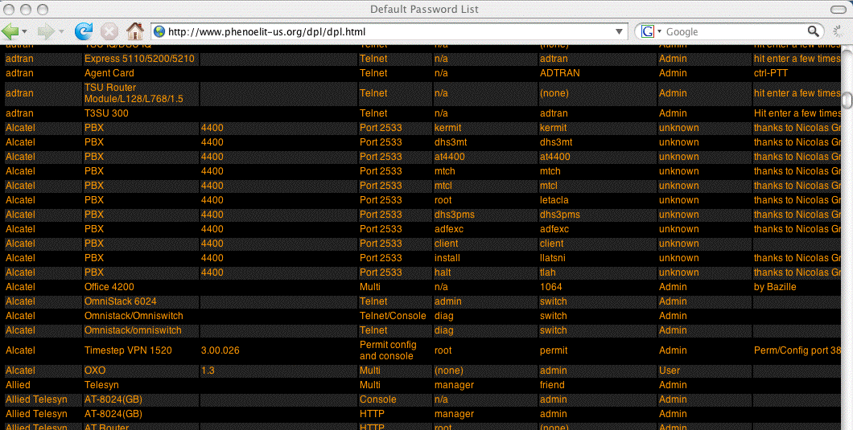
One Example of A Default Password List

Slide 32
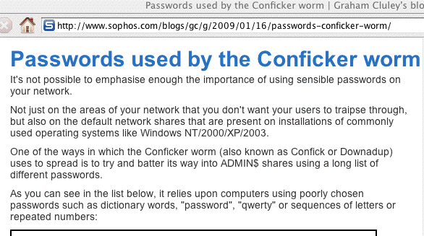
Some Malware Includes Password Attack
Code Targeting Poor Password Choices

Slide 33
2. People Will Disclose Their Passwords
Users will disclose their passwords in many different ways.
For example, phishing exists because people can be “socially engineered,” into revealing their passwords.
If you have users whom you’ve trained to be cynical, skeptical and defiant, they may (properly) refuse to reveral their passwords when receiving phishing attacks. Unfortunately, some regions of the country (e.g., the Midwest), and some groups (including higher education, unfortunately) have cultures which reward trust and unquestioning compliance when confronted with authoritatively presented demands:
Phisher: “Tell me your password immediately!”
User: “Okay, okay! It’s LetMeIn123, don’t 'disable' me!”
Small bribes can also work wonders…

Slide 34
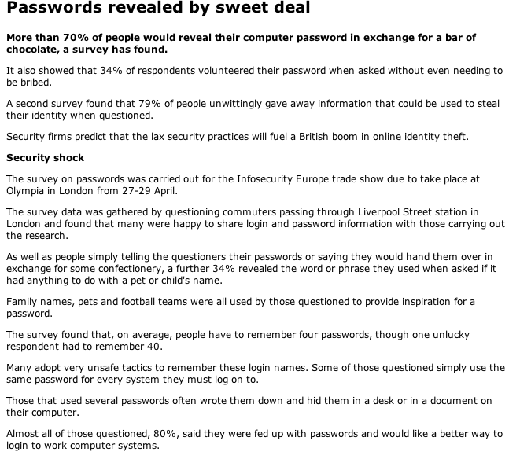
Source: http://news.bbc.co.uk/2/hi/technology/3639679.stm

Slide 35
Sharing Passwords
Sometimes users will “voluntarily” share their password with others (even without chocolate!)… For example:
-- An executive delegates triage of her email to her
administrative assistant; sometimes the administrative
assistant is out sick or on vacation, so the executive’s
password is also shared with the backup admin
assistant, and of course the password’s never changed…
-- Supervisors may demand to know the password of
subordinates accounts so that they can “access
critical files” the subordinate may be working on when
the subordinate is sick or out on vacation.
-- Spouses often will routinely trust each other with
their passwords, even though they shouldn’t (sorry,
honey, we’ve been married 25 yrs but you simply
don’t need to know!)

Slide 36
Writing Passwords Down
If password requirements are sufficiently complex, users have little choice but to record them if they’re to have a hope of remembering all them.
The yellow sticky note on the side of the monitor is the stereotypical password repository site (although others may favor the top drawer of their desk).
This presents obvious risks if you have visitors (and even if you don’t think you have visitors, you probably at least have custodial staff occasionally servicing your office)
Carrying ones passwords in one’s wallet is probably at least marginally more secure, although it isn’t ideal. (You can read one person’s take on the wallet as an option at
http://askthegeek.kennyhart.com/index.php/2009/02/04/why-your-wallet-is-the-best-password-manager/ )

Slide 37
Sharing Passwords With Any/All
Users of Their Computer
We all know people who routinely save their passwords in applications such as email clients, so that anyone who physically is at their computer can automatically “login” as them just by sitting down at their computer and starting the application with the saved password.
Requiring a username and password to login to the computer, and/or consistently employing a locking screen saver, and or/or using RF proximity cards (such as the "walk away security" cards from Xyloc) , may help control that exposure, but saving passwords in apps is still an evil practice, and one that causes a lot of forgotten password issues (“I can’t remember what I set my password to, I just saved whatever it was in my client”).

Slide 38
Another Form of Password Sharing: Password Reuse on Multiple Sites
Other users will share passwords across multiple systems, using the same password for critical, highly sensitive administrative systems, and for their online bridge club account (and for <fill in the blank>). If I can crack their password on any of those systems, I’ll be able to get into ALL of their accounts, including the highly sensitive ones.
Sometimes users will even give login information, including passwords, to other sites to save and routinely re-use.
Classic example of this is email POP consolidation, where a free web email account may offer to use your credentials to periodically fetch other email by logging in to a remote system as you (I kid you not). Obviously, unless it is going to prompt you for your password each time it does this, it needs to know/save your unhashed (raw) password.

Slide 39
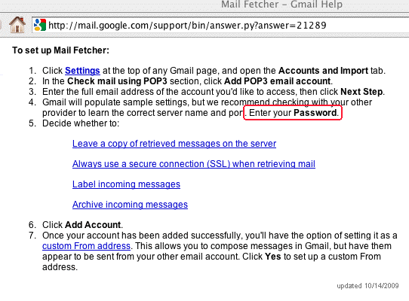
Example of POP Email Consolidation: Gmail

Slide 40
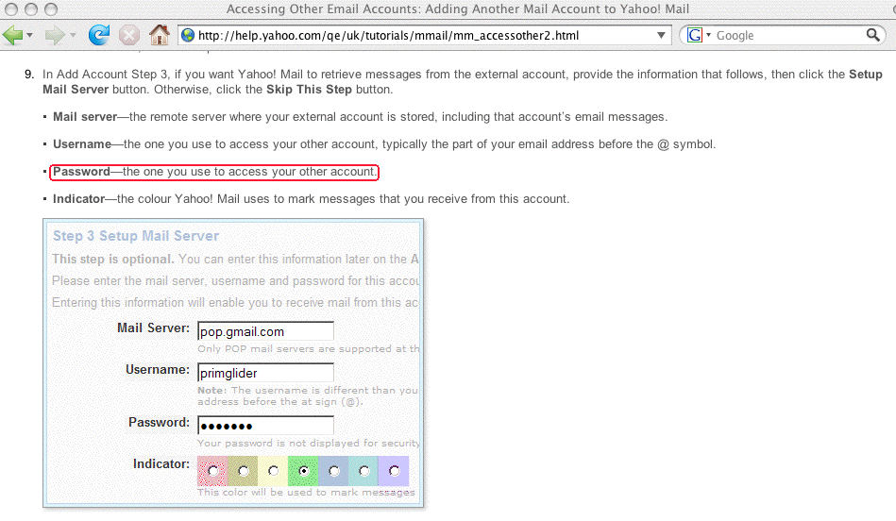
Example of POP Email Consolidation: Yahoo

Slide 41
“Rubber Hose Cryptography”
We must also recognize that if someone wants your password badly enough, they may be willing to use extreme physical measures, such as torture, to get it. This is sometimes sardonically referred to as “rubber
hose cryptography.”
A (somewhat) more civilized version of “rubber hose cryptography” would be judicially mandated password production (presumably under threat of contempt of court).
See, for example, the case of Sebastien Boucher…

Slide 42
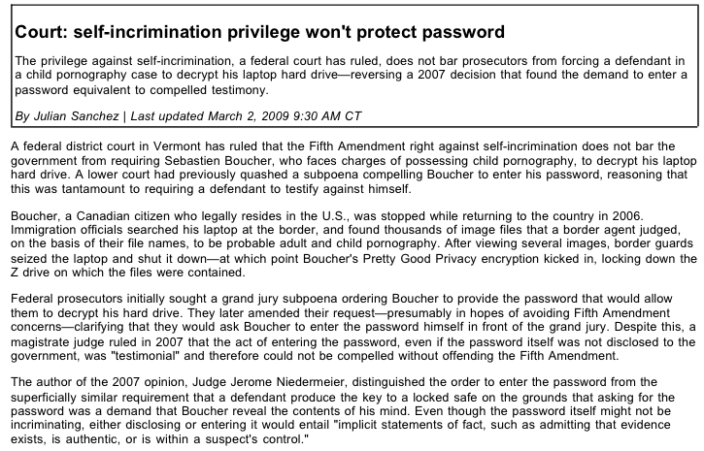
See http://arstechnica.com/tech-policy/news/2009/03/ court-self-incrimination-privilege-stops-with-passwords.ars

Slide 43
Password “Safes”
Some users, overwhelmed by password proliferation, don’t even attempt to memorize all the passwords they need to juggle, they simply store them in an online encrypted password “safe” or password “wallet.” One example of such a product is KeePass (see http://keepass.info/ ).
While this is convenient, obviously this is a case of putting all one’s eggs in one’s basket. Should the password safe or password wallet be compromised, you’re likely to experience severe problems.
I would be particularly wary of password safes which tightly integrate with browsers or other applications; if you use a password safe, I’d suggest using one that merely displays your username and password, at which point you can manually enter those values into applications as you deem appropriate.

Slide 44
3. Passwords Will Be Sniffed
In addition to people picking weak passwords, and sharing those passwords in various ways, passwords will also be captured, or “sniffed.”
“But Joe, everyone knows that passwords should only be sent over encrypted channels! You’d have to be an idiot
to send your password in clear text over the wire!”

Slide 45
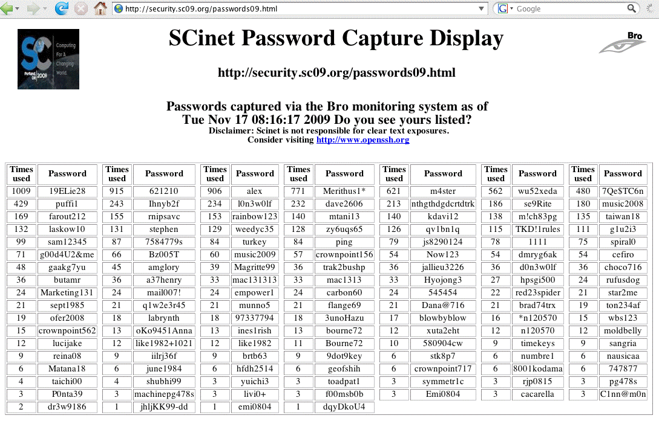
Passwords From SC2009, In PDX This Week

Slide 46
And If The Smart Guys From SC Screw Up…
SO WILL YOUR (EVEN SMARTER) USERS.
I promise, your users WILL send their passwords over unencrypted links.
I’m also willing to bet that at least some of you enable or facilitate those mistakes by permitting plain text password-using daemons (such as telnet, ftp, etc.) to continue to run on your local systems, or by allowing unencrypted web login pages.
You need to go on a personal crusade to stomp out any and all remaining plain text-using protocols running on your campus network.
FTP (as used by many web page development and publishing tools) is a particularly probable source of exposure.

Slide 47
“BUT JOE! We’re 100% switched! We’re Safe!”
From time-to-time I run into people who believe that they don’t have any sniffing exposure because their network architecture is 100% switched, and in such an architecture network traffic shouldn’t be visible to eavesdroppers (the way it would be on a shared network link).
I would suggest that between arp spoofing, mac flooding, and mac duplication (among other methods), there’s a good chance that a bad guy or bad gal can still arrange to see network traffic even in a fully switched environment.
For those who insist on details, see for example
http://monkey.org/~dugsong/dsniff/ or http://www.oxid.it/cain.html
Switched networks do NOT provide sufficient protection against network traffic sniffing

Slide 48
“BUT JOE! We have a VPN!”
Another technology that’s often trotted out as a solution to the problem of sniffing is the use of VPNs.
Virtual private networks provide an encrypted tunnel between the end user’s workstation and the VPN concentrator. As far as they go, they’re fine, they just don’t far enough: VPN’s are NOT “end-to-end secure,” they’re only “one-end-to-VPN-concentrator secure”, and a bad guy can still attempt to sniff the VPN’d traffic after it exits the VPN in clear text.
Don’t get me wrong, VPNs can help reduce the traffic exposure problem, and if you’ve got one, I’d certainly encourage you to still use it, you just need to recognize
that you still have traffic that’s exposed.
VPNs are not (complete) protection against sniffing.

Slide 49
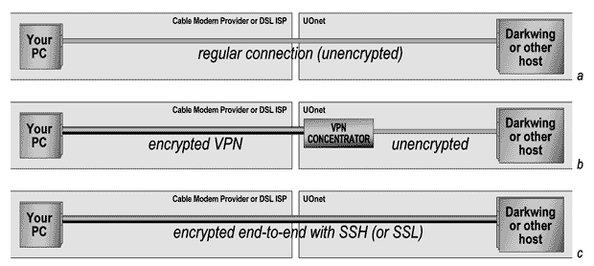
VPN vs. End-to-End Encryption

Slide 50
“BUT JOE! We *DO* Encrypt End-To-End!”
Excellent! I’m delighted to hear that you’re using ssh and SSL/TLS to minimize your exposure to sniffing on the wire! It is an important step!
Unfortunately, you’re still not safe from eavesdroppers snarfing your passwords…
Let me give you just a few examples…

Slide 51
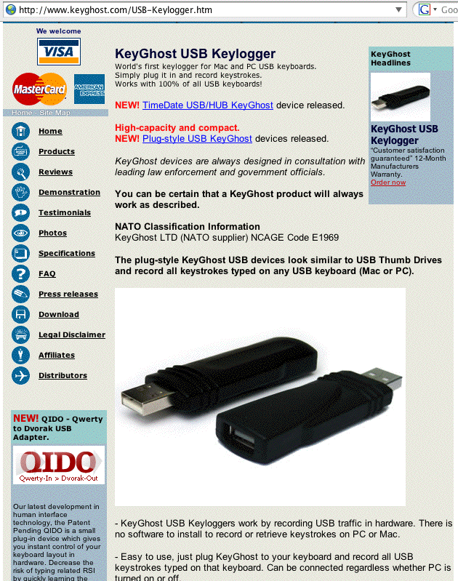
Hardware Keystroke Grabbers

Slide 52
Trojan’d ssh/sshd
If I can get root on a box you login to, a cracker can install a trojan’d sshd, and having done that, he can then collect username/password pairs at his leisure, even if you consistently use end-to-end encryption.
Think this doesn’t happen?
“The Stakkato Intrusions,”
www.nsc.liu.se/~nixon/stakkato.pdf

Slide 53
Shoulder Surfing and/or
Video Cameras Watching Keyboards
This can be a very low tech attack (as simple as your seat mate watching your fingers while you login to your laptop on an airplane or at a conference), or a very sophisticated high tech attack (perhaps using clandestinely-installed ceiling-mounted miniature wireless cameras focussed on office workstation keyboards).
Either way, the bad guys can still “get” your password.
While you’re protecting your keystrokes from nosy neighbors, you may also want to consider installing a
3M privacy filter to reduce snooping of what’s shown on your screen. See http://www.3M.com/PrivacyFilters

Slide 54
Don't Forget About Malware
Targeting Passwords
Passwords (including online banking credentials!) are a prime target for major malware infestations these days, including:
-- Clampi/Ligats/Ilomo/Rscan
-- Zeus/Zbot/WSNPOEM/NTOS/PRG
-- Koobface
-- Taterf
For a discussion of my perspective on these and other malware threats and how you might mitigate them, see
"Coping With Malware and Other Sorts of Automated Abuse," www.uoregon.edu/~joe/malware/malware.pdf
Speaking of mitigation, why isn't everyone doing the right thing, and encrypting all their traffic?

Slide 55
“We’d LOVE to Encrypt, But We Just CAN’T!”
One such argument normally goes something like this…
A. We’d love to use end-to-end encryption, but after
thinking about it, we just “can’t”
B. Why not?
A. If everyone were to use strong encryption we
ourselves couldn’t monitor what people do on
the network -- all that traffic would be opaque
to our monitoring systems!
B. But what’s the bigger risk: having a bad guy sniffing
your passwords, or having an employee who’s screwing
around checking out his favorite team on ESPN, eh?

Slide 56
Simple Network Management Protocol
SNMP is a mechanism for remotely administering and monitoring network devices such as switches, routers, etc.
Read (and/or write) access to SNMP managed devices is controlled via SNMP “community strings” (e.g., passwords).
Because SNMP was developed long ago, and is often used to interact with relatively “simple” network devices, encryption was not a mandatory part of the protocol. Thus SNMP (pre-SNMPv3) community strings are totally vulnerable to sniffing attacks, and unfortunately, deployment of SNMPv3 remains relatively limited.
Recommendation: If you use SNMP, try to make sure it is SNMPv3, use community strings which aren’t “public” and “private,” use a dedicated out-of-band network for SNMP management and monitoring, and block off-site SNMP traffic (port 161 and 162, tcp and udp) at your border.

Slide 57
“Good News! We’ve Encrypted Our Wireless Links To Prevent Password Sniffing”
Just for the record and as a matter of due diligence,
we all know that WEP really doesn’t offer any security against eavesdropping, and that WPA (TKIP) isn’t much better, right? If you’re doing wireless encryption, these days you really need to be doing WPA (AES) or WPA2. (See, e.g., http://www.smallnetbuilder.com/content/view/
24251/100/ and http://www.networkworld.com/news/
2009/082709-new-attack-cracks-common-wi-fi.html )
Better yet, why encrypt traffic ONLY on your wireless network? Traffic on ALL network segments is vulnerable to being sniffed, so ALL traffic should be encrypted
end-to-end ALL the time! Encrypting JUST wireless links leaves all your other traffic vulnerable to being sniffed!

Slide 58
“Evil Twin” Wireless Nodes
Not to make you paranoid, but let me also bring up another wireless issue: how do you know that the wireless access point you’re connecting to is the *real* wireless access point you intended to connect to?
You should be aware that a bad guy could potentially put up an “evil twin” wireless access point -- using the same SSID your production access points normally use -- and in most cases your users wouldn’t be able to tell the difference. If the bad guy can con you into using his node, he may be able to sniff all your traffic, including your passwords, even if your real nodes have been secured.
802.1x can help to address some of these issues, but deploying 802.1x is not painless (and is not a “Uncle Bob” or “Aunt Sue”-ish project for home wireless networks)

Slide 59
4. Passwords Won’t Get Changed
Most sites encourage (read: “require”) users to change their password at least once every <N> months, where <N> might be as little as one month, or as much as twelve months or even more.
There is often confusion about the origin and purpose of this periodic password change requirement, sometimes even among security staff, and some frankly view it as a pointless or even counter-productive policy (although folks still go through the motions to at least keep the auditors happy).
I believe that periodic password changes are useful, and SHOULD be required.
Let me tell you some reasons why.

Slide 60
Periodic Password Changes Limit
The Window for Brute Force Attacks
If you never change your password, an attacker conducting a brute force attack on your password may have a protracted window during which he or she can concentrate on cracking your password, confident that you haven’t changed your password during that time.
If you do change your password, the attacker will need to restart their cracking effort because cracking your old password typically won’t help the attacker deduce your new password (unless your current password is derived from your previous password in some ascertainable way).
The permissible time between changes is thus determined at least in part by the length and complexity of the passwords being used.

Slide 61
Password Changes Can Terminate Unknown Access by Parasitic “Silent Riders”
Assume you have a user who buys a new computer, and sells their old one, failing to nuke-and-pave its disk before doing so.
Also assume that the user has configured various applications to take advantage of saved passwords, perhaps for dialup, wireless, or VPN access.
The purchaser of the old system thus gets not just a system, but also the former owner's network access, and will be able to continue using those saved credentials unless/until the former owner changes their passwords, thereby rendering the saved credentials invalid.
If password changes don't take place, the parasitic silent rider can continue their unauthorized access forever…

Slide 62
Password Changes Make It Harder For
Users To Reuse Passwords on Multiple Sites
Assume that at least some users will be prone toward using the same password on all the sites they frequent.
Requiring periodic password changes may result in at least modest password diversity (following the change, the user may have the same password on all their sites except for the one that insisted on a password change).
Of course, there’s also the possibility that users will simply update ALL their passwords to the new value that one site may insist they pick, but sometimes you just can’t keep people from shooting themselves in the foot. :-;

Slide 63
Password Changes Make It Harder For Users
To Hardcode-and-Forget Their Passwords
If I don’t think that I’ll ever have to change my password, I may very well just save it in my browser and all my other applications, and then happily forget about it.
On the other hand, if I know that every three months (or whatever), I’ll have to change my password, and I know that I’ll need to know my old password to pick a new one, I’m less likely to hardcode-and-forget my passwords.

Slide 64
Users Need to Know HOW They Should
Legitimately Be Changing Their Password
With phishing emerging as a growing problem at many sites, users may be continually presented with bogus requests to “confirm” their current password.
One step toward hardening users to resist that sort of phishing is insuring that users know how the should be legitimately changing their password.
Periodic password changes cause users to practice that process so they have an established mental baseline against which to compare illegitimate phishing efforts.
Routinizing password changes also effectively prevents "ask the admin to change it for me" password changing channels simply because there'd be too many requests
(the admins would quickly get tired of doing them!)

Slide 65
Requiring Password Changes Provide A “Teachable Security Moment”
Users need ongoing encouragement and education when it comes to system and network security.
For example, users need reinforcement when it comes to basic security training, including things as basic as:
“Never disclose your password to anyone.”
Most users, however, will not attend formal training sessions, and may never interact with security staff
one-on-one. Things like quarterly password changes at least force users to think (at least a little!) about security at least a few times a year.

Slide 66
Some Final Thoughts on Password Changes
When you initially assign passwords to new accounts, are those values random (for example, h9KU#rIZ%3a), derived (perhaps the users’s DOB), or a constant (ChangeMeNow)?
If passwords seldom get changed, I sure hope you're assigning truly random passwords!
Do you require users to change their passwords when they first login? What if they only use POP, IMAP or some other service that doesn’t support compulsory password changes, rather than traditional shell service?
You may find it interesting to check to see how many users have NEVER changed their password from its initial value (you may also want to check for users who aren’t using their accounts at all)

Slide 67
5. Password Administration Is A Huge
PITA, Insecure, and Very Expensive, Too
How much do you spend just trying to create, distribute, manage, reset and terminate accounts? That is, what are
you spending on various identity management projects this year?
If your help desk is like many, a major part of its workload is handling forgotten passwords. How much do you pay to staff that operation?
If you require staff or students to appear in person with picture identification when password resets are required, what’s a half hour of a tenured professor’s time worth?
If you buy a commercial product to try to automate/ simplify password resets, what did that cost? Does it work well for you? Is it *really* secure?

Slide 68
Email As a Password Reset Channel
We’re all familiar with sites that allow you to send a one-time password reset link to another email account (which you provided at the time you signed up).
Does that process feel secure to you? It shouldn’t…
There are many ways that a bad guy could exploit that sort of password reset mechanism to steal your credentials, including:
-- sniffing (unencrypted) email to get a reset link (miss
the first one? just ask for it another time…)
-- hijacking email traffic for a site by injecting a bogus
DNS MX record (see Dan Kaminsky’s “forgot my
password” scenario/discussion at slides 24-39 of
http://www.blackhat.com/presentations/bh-dc-09/
Kaminsky/BlackHat-DC-09-Kaminsky-DNS-Critic
al-Infrastructure.pdf )

Slide 69
“Trivial Pursuit” Passwords Resets
Other sites allow password resets if the user can successfully regurgitate what I call “personal trivia.”
Classic examples of “personal trivia” include:
-- date and/or place of birth
-- mother’s maiden name
-- last four digits of your social security number
-- your driver’s license number
-- name of your first employer
-- name of your favorite dog or cat
-- favorite flavor ice cream, etc., etc.
Unfortunately, a lot of personal trivia answers are
(a) easily forgotten; or (b) are a matter of public record due to things like genealogical databases, and social networking sites; or (c) have low information entropy
(e.g.: favorite ice cream flavor? Vanilla’s a safe bet)

Slide 70
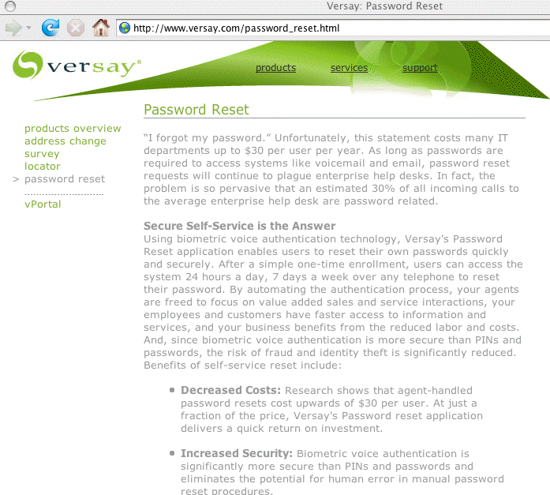
A Biometric Approach to Password Resets

Slide 71
6. The Ten-Ton Gorilla in the Room
Even if passwords had no technical security issues or practical security issues, there are policy driven reasons why passwords are no longer good enough.
For example, consider the Payment Card Industry Data Security Standard (PCI-DSS) 8.3 (Version 1.2.1, July 2009). It requires:
"Incorporate two-factor authentication for remote
access (network-level access originating from outside
the network) to the network by employees,
administrators, and third parties."
Trust me, two factor authentication is in your future.

Slide 72
Two Factor Authentication

Slide 73
The Most Common Alternatives
To Just Traditional Passwords
Two factor authentication combines two or more types of authentication, such as:
-- Hardware cryptographic tokens (crypto key fobs)
-- Biometrics (such as thumbprint scanners)
-- Smart cards or USB thumb drives with certs
Today, let’s just consider hardware crypto tokens.
Given all the problems that traditional passwords represent, why haven’t sites rushed out to deploy hardware crypto tokens?

Slide 74
Cost Is One of The Primary Reasons Why There’s Resistance to Replacing Passwords
As expensive (and insecure) as passwords may potentially be, the cost of alternatives is one of the primary reasons why there’s resistance to replacing passwords with something else.
For example, some hardware cryptographic tokens may run $20 to $30+ per year per person (e.g., $50 to $60+ for a crypto token with a 2-3 year life from one vendor).
If we assume that we’d like to issue crypto fobs to everyone on campus, if we’re at a campus with 25,000 students, faculty and staff, doing the math that implies a cost of $500,000 to $750,000 per year just for tokens!
That’s a non-trivial expense, particularly if passwords are “free” (even though we know they’re NOT really “free.”)

Slide 75
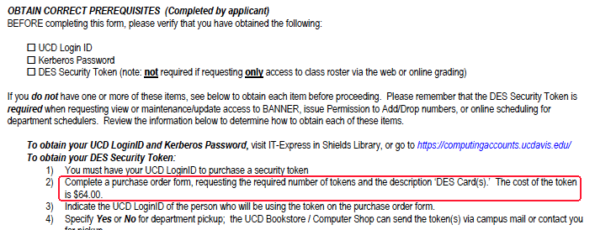
Sample Cost/Token For One Edu Site

Slide 76
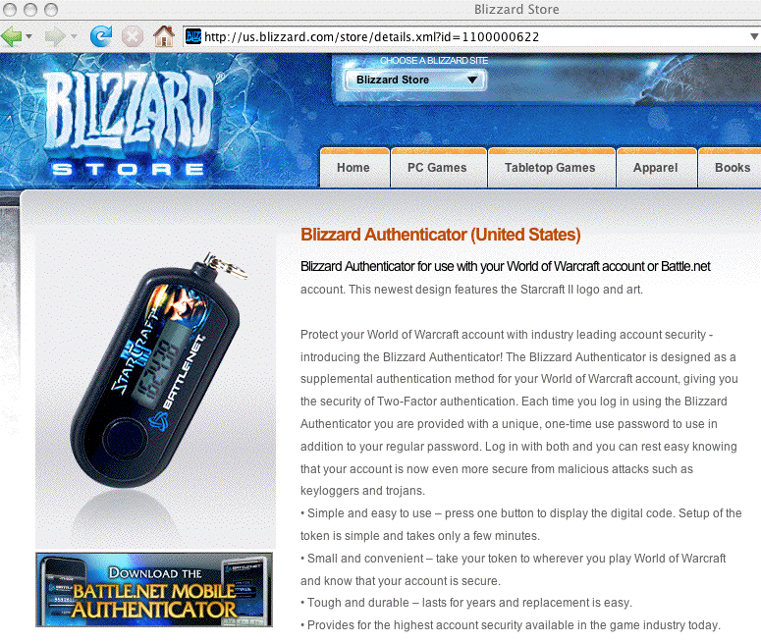
Some Sites Have Deployed Hardware Tokens At Significantly Lower Costs (WOW=$6.50)

Slide 77
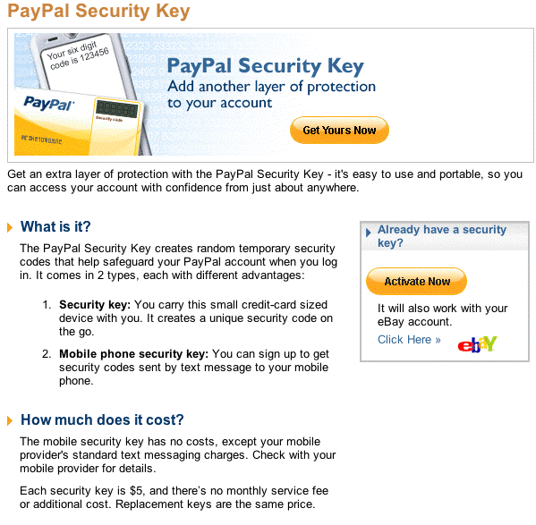
PayPal SecurityKey: $5

Slide 78
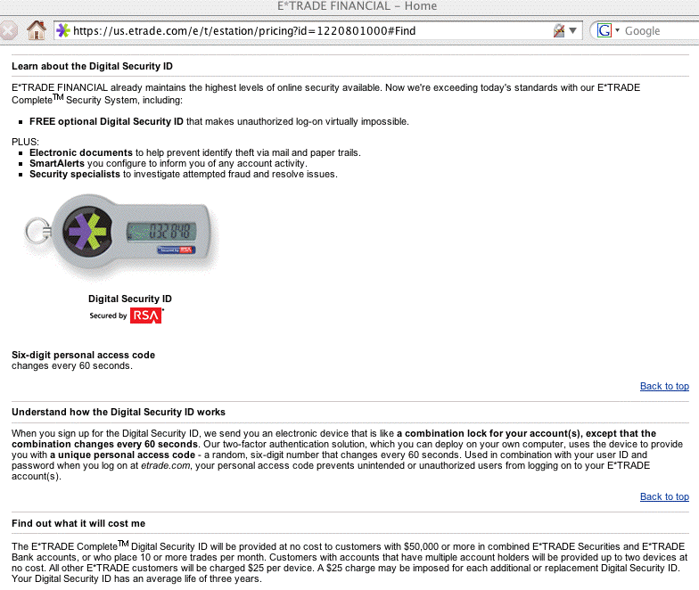
E*Trade: Free For Bigger Customers

Slide 79
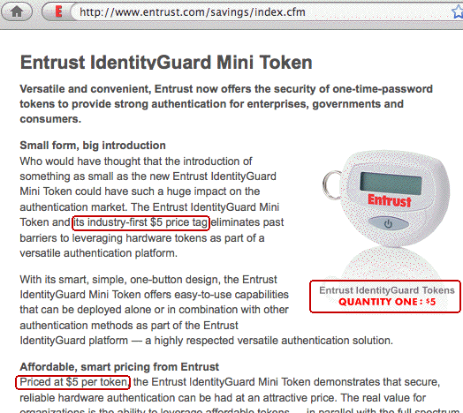
Sample Token Vendor Competing On Price…

Slide 80
Incremental Deployment Is Also A Possibility
If you can’t afford to deploy hardware crypto tokens everywhere due to cost, potentially consider an incremental deployment strategy.
For example, perhaps you may want to consider initially deploying hardware crypto tokens just for administrative system users, or privileged users, or even just for all faculty/staff.
By limiting the number of tokens you initially deploy, you can:
-- focus on the most security-sensitive areas first
-- keep the total cost for the project low
-- gain experience deploying and administering tokens
-- help campus users become familiar with tokens and how
they work (many users may never have heard of them)

Slide 81
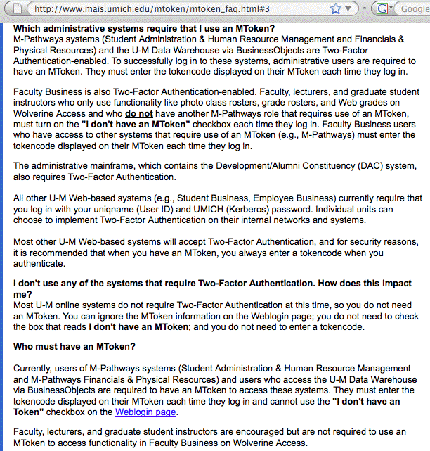
Sample EDU Incremental Deployment

Slide 82
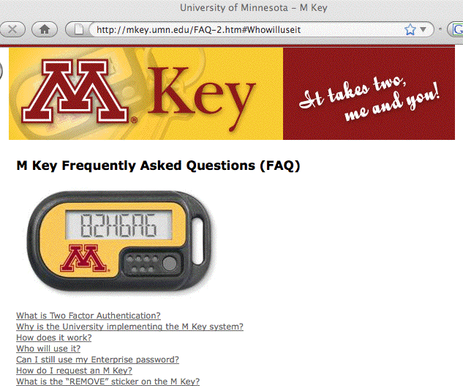
Example #2 (They've Deployed ~8K Tokens)

Slide 83
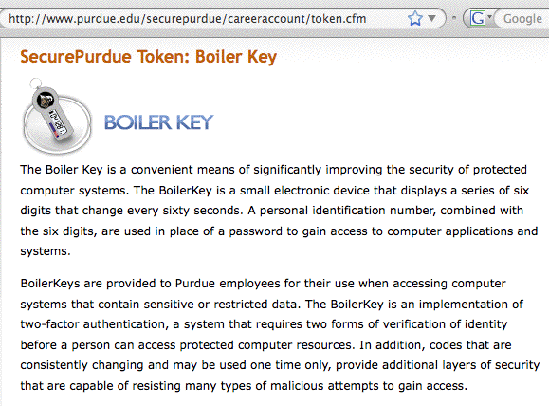
Example #3

Slide 84
Another Option: Allow Individuals To Opt-In
Interest among users varies when it comes to security
You may want to take advantage of those differences by allowing (but not requiring) users to opt-in to better-than-traditional-password authentication, with participation contingent upon the user self-funding purchase of a hardware crypto token. (Note that this is the WoW, eBay, etc. model)
The trade-off here is that administration of this sort of onesie-twosie adoption will be more manual/labor intensive, and the cost per token may also be higher since volumes will likely be lower.
Remaining non-crypto-fobbed accounts will also continue to be the target of hacker/crackers.

Slide 85
Please Don’t Make My Pants Fall Down
Assume each of the following services decided to replace their traditional passwords with hardware crypto fobs:
-- your general purpose university account
-- other specialized university systems (perhaps core
networking devices, or a departmental HPC cluster, say)
-- your bank or credit union
-- your brokerage
-- your health care provider
-- your favorite Internet online auction site
-- your favorite online gaming site
-- etc., etc., etc.
Also assume that no two sites use the same token (or even the same brand of tokens!)
Soon we may all be carrying around huge rings of hardware crypto fobs! We *need* to get federated!

Slide 86
Tokenless/Phone-Based Second Channel
If we assume that everyone has a cell phone, is that the ultimate tokenless (and scalable!) "2nd factor?" (actually, 2nd channel)
User goes to login as they normally would with username and password
As part of that login process, a magic code gets sent to user's pre-registered cell phone as a text message
User is prompted to enter the code they've been sent
User enters the provided magic code
Authentication then proceeds as normal
Example implementation: see www.phonefactor.com

Slide 87
Conclusion/Summary
Traditional passwords have many security issues, but they are still all-too-widely used
The time has come for you and your site to replace them with something stronger, such as hardware crypto tokens
You may NEED to do so for compliance reasons (PCI-DSS)
Leading online sites (such as eBay, gaming sites, and brokerages) are already deploying hardware tokens, and
so are leading educational institutions (at least for selected groups)
Cost remains a potential issue, but can be potentially finessed
Scalability is the other issue we need to keep in mind; second channel authentication (e.g., magic codes sent to user cell phones via text messages) may be one answer.

Slide 88
Thanks For the Chance to Talk Today!
Are there any questions?

