Slide 1
Physical Security of Advanced Network and Systems Infrastructure
Joe St Sauver, Ph.D.
(joe@uoregon.edu or joe@internet2.edu)
Internet2 Nationwide Security Programs Manager
Spring 2011 Internet2 Members Meeting
4:30-5:30 PM, Tuesday, April 19th, 2011
http://pages.uoregon.edu/joe/phys-sec-i2mm/
Disclaimer: all opinions expressed are those of the author

Slide 2
I. Introduction

Slide 3
Do IT Security People Care About Physical Security?
If you’re involved with IT system and network security, it’s comparatively common to see security people continually worried about “online” security threats, paying relatively little attention to the physical security of systems and networks. Why?
One factor may be that we all know the “whole world” can
attack our systems and networks online via the Internet,
while (in general) attackers need to be locally present to exploit physical security vulnerabilities. As a result, we continually see attacks from online sources, but if we’re lucky, we may never have personally experienced a physical attack on IT systems and network resources.
We may also (incorrectly) view physical security as something that’s “someone else’s problem” – for example, isn’t the physical security of our systems and networks something that the campus police department will take care of? (Maybe, maybe not)

Slide 4
Understanding The Physical Security Risk Model
What Might Happen?
Damage from a natural disaster, such as an earthquake or flood
Accidental damage (e.g., backhoe fade on poorly marked fiber)
Intentional vandalism (or complete destruction) of facilities
Theft of hardware (servers, routers, core switches, etc.)
Loss of system or network integrity (potentially with unauthorized disclosure of PII or other sensitive data)

Slide 5
Understanding The Physical Security Risk Model
Who Might Do It?
Act of God
Random individual (in the accidental case)
Disgruntled insider (or former employee)
Financially-motivated criminals
(Maybe) ideologically-motivated actors (“terrorists”)
(Or even) state-sponsored professionals (“spies”)

Slide 6
A Couple of Headlines
“California Telecom Knocked-Out By Low-Tech Saboteur”
April 11th, 2009, http://tinyurl.com/datfv3
Shortly before 1:30 a.m. on Thursday morning, four fiber-optic cables
were severed in an underground vault along Monterey Highway in San
Jose, Cal. About two hours later, another four were cut in San Carlos,
followed by two more in San Jose shortly thereafter.
“Masked thieves storm into Chicago colocation (again!)”
November 2nd, 2007, http://tinyurl.com/2pn32z
The recent armed robbery of a Chicago-based co-location facility has
customers hopping mad after learning it was at least the fourth forced
intrusion in two years. […] In the most recent incident, "at least two
masked intruders entered the suite after cutting into the reinforced
walls with a power saw," according to a letter C I Host officials sent
customers. "During the robbery, C I Host's night manager was
repeatedly tazered and struck with a blunt instrument. After violently
attacking the manager, the intruders stole equipment belonging to
C I Host and its customers." At least 20 data servers were stolen […]

Slide 7
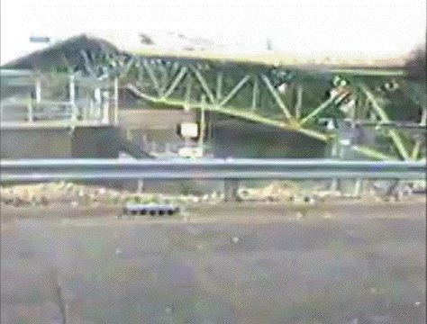
Fiber Runs Cross Bridges;
Bridges Sometimes Fall Down:
The I-35 Bridge, St Paul MN, August 1st, 2007
Video: http://www.youtube.com/watch?v=EKLjB_nq76c

Slide 8
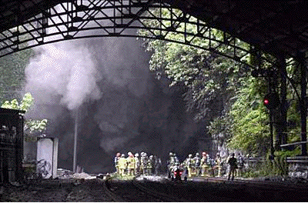
Fiber Runs Often Pass Through Tunnels;
Tunnels Sometime Burn:
The Howard St Tunnel Fire, Baltimore, July 18th, 2001
Image: www.baltimoresun.com/features/bal-trainfiregallery,0,1855948.photogallery
See also section 3.4.1 of http://ntl.bts.gov/lib/jpodocs/repts_te/13754.html

Slide 9
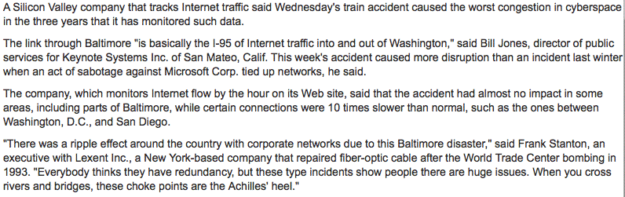
Tunnels Like The Howard Street One
Can Be Key Physical Security Choke Points
Source: http://articles.baltimoresun.com/2001-07-21/news/
0107210195_1_fiber-pratt-st-internet-traffic

Slide 10
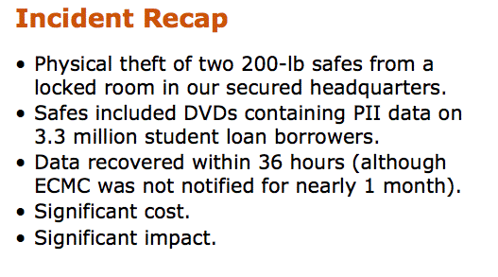
A More Recent Physical Security Incident: ECMC
www.ifap.ed.gov/presentations/attachments/50DontBeTomorrowsHeadlinesV1.ppt
(Reportedly, the stolen safes were small consumer-sized
units, and were wheeled out on rolling office chairs…)

Slide 11
This is Not Just a Domestic Problem
“BT Mayfair phone exchange raided by network hardware thieves leaving customers cut off”, September 12th, 2008, http://tinyurl.com/46mfsmf
Thieves have broken into a BT phone exchange in London's plush
Mayfair and stolen an estimated £2m worth of communications
equipment. The theft led to BT business customers and home users in
the area being cut off from their phone and broadband internet
services. […] They ripped out servers, routers and network cards, which
can all fetch a high price on the black market.
‘Mysterious "Spy" Computer In [Iceland’s] Parliament Works Differently Than Being Reported, Tech Expert Says,’
January 20th, 2011, http://tinyurl.com/6ja62rq
An unmarked computer found in a spare room of [Iceland’s] parliament,
and connected directly to parliament’s internet system, was most
certainly planted there […] Any identifying serial numbers had been
erased from the machine, nor were any fingerprints found, and its
origins have not yet been traced. The police believed that the matter
was the work of professionals.

Slide 12
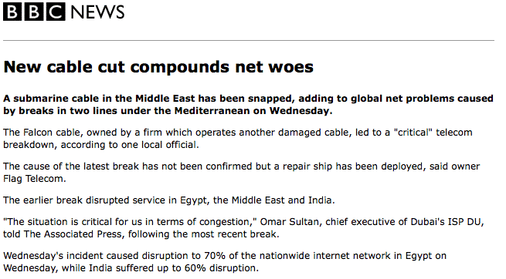
Suboceanic Cable Outages
http://news.bbc.co.uk/2/hi/7222536.stm , October 4th, 2008

Slide 13
How Does This All Relate to BTOP/US-UCAN?
The new BTOP US-UCAN network will serve a broader and potentially more sensitive mix of customers than the classic Abilene network or the current Internet2 Network.
Quoting from the “Notice of Funds Availability” (NOFA) for BTOP
Round 2, http://tinyurl.com/yc5m7d5 at page 3797,
“Community anchor institutions [“CAIs”] means schools,
libraries, medical and healthcare providers, public safety
entities, community colleges and other institutions of higher
education, and other community support organizations and
agencies that provide outreach, access, equipment, and
support services to facilitate greater use of broadband service
by vulnerable populations, including low-income, the
unemployed, and the aged.”

Slide 14
IF Your Customers Include Health Care Facilities or Public Safety, Security Becomes More Important
For example, natural disasters often can cause network outages.
If you’re servicing local health care facilities or public safety entities via that down network, local residents who are also affected by that natural disaster may no longer be able to reach emergency responders because of that network outage. Thus, the US-UCAN backbone, and the aggregation networks connecting CAIs to it, may effectively become “life/safety critical” systems.
Similarly, health-related information and law-enforcement information running over the network may be quite sensitive. Presumably that information would always be protected by
strong end-to-end encryption, but given the reality that even access to encrypted traffic can still potentially result in undesirable information disclosure (as a result of traffic analysis, etc.), well, everyone may need to be just a little more careful.

Slide 15
Other Factors
The BTOP program will result in a substantial amount of new physical facilities (fiber, colo space, network gear, servers, etc.);
all those new assets that will also need physical protection.
The US-UCAN network will be running at very high speeds, and very high speed gear tends to be very expensive. Very expensive assets deserve top notch physical protection.
The BTOP program will service some difficult/tricky rural locations. That increases the likelihood that it may be hard to at least initially deploy a fully-redundant network architecture
Federal oversight/review is a given, and the Federal Information Security Management Act (FISMA), includes a variety of physical security-related controls (see PE1-PE19, Appendix F, NIST Special Publication 800-53 Rev 3, http://tinyurl.com/6awxb8d ). Even if US-UCAN isn’t technically subject to FISMA, federal agencies may still bring a “FISMA perspective” to any security review they do.

Slide 16
Physical Security Areas From FISMA: PE1-PE19
PE1 Physical and Environmental Protection Policy and Procedures
PE2 Physical Access Authorizations
PE3 Physical Access Control
PE4 Access Control For Transmission Medium
PE5 Access Control for Output Devices
PE6 Monitoring Physical Access
PE7 Visitor Control
PE8 Access Records
PE9 Power Equipment and Power Cabling
PE10 Emergency Shutoff
PE11 Emergency Power
PE12 Emergency Lighting
PE13 Fire Protection
PE14 Temperature and Humidity Controls
PE15 Water Damage Protection
PE16 Delivery and Removal
PE17 Alternate Work Site
PE18 Location of Information System Components
PE19 Information Leakage

Slide 17
Why Should The Folks Here Today Care About This?
A chain is only as strong as its weakest link (a cliché, but true).
US-UCAN will likely be built in a way that’s quite similar to how
the Internet2 network was built: to ensure scalability, the backbone will likely rely on regional aggregators to provide connectivity to individual community anchor institutions [CAIs].
Therefore, for the system *as a whole* to be secure, we need:
-- the US-UCAN backbone to be secure, AND
-- the links between the backbone and regional aggregators to
also be secure, AND
-- the links between the regional aggregators and the CAIs to also
be secure.
Securing the network will thus require the participation and cooperation of regional aggregators. Many of those regional aggregators are present here in the audience today.
So what physical security vulnerabilities should you worry about?

Slide 18
II. Physical Security Vulnerabilities

Slide 19
0) You Can’t Worry About “Everything…”
In the real world, we all have to “make our numbers,” and that usually means prioritizing and only spending money on security measures when it is necessary and cost effective for us to do so.
The risks that you or I perceive may be different than the risks
that someone else sees under different circumstances.
For example, a military unit in the Mideast or Southern Asia
might devote considerable attention to protecting facilities from attack by vehicle borne improvised explosive devices (VBIEDs).
VBIEDs are generally considered to be a top military threat, particularly after the attack on the Marine Barracks in Beirut in 1983, and the Khobar Towers bombing in Saudi Arabia in 1996.

Slide 20
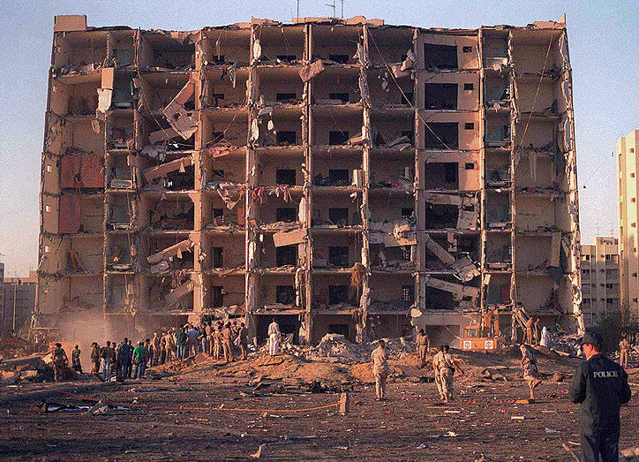
Khobar Towers, Saudi Arabia

Slide 21
But This Isn’t The Mideast, Right?
Here in the United States, higher education might largely discount VBIEDs as a threat, choosing to accept that risk rather than making investments in anti-VBIED technologies such as physical standoff zones, blast resistant glazing, vehicle inspection stations, etc.
Bomb *threats,* however, can be quite common on campus – and quite disruptive. A growing number of campus police departments have decided to deploy local K-9 units to help clear buildings in response to campus bomb threats they may receive.
These dogs and their handlers should be good friends with your campus system and networking staff, and routinely invited to
walk/sweep campus data centers, labs, steam tunnels, etc.

Slide 22
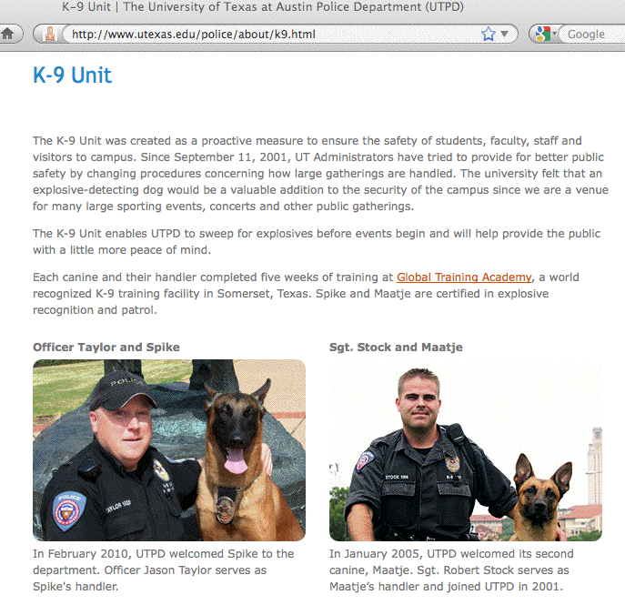
University of Texas Police Department K-9 Unit

Slide 23
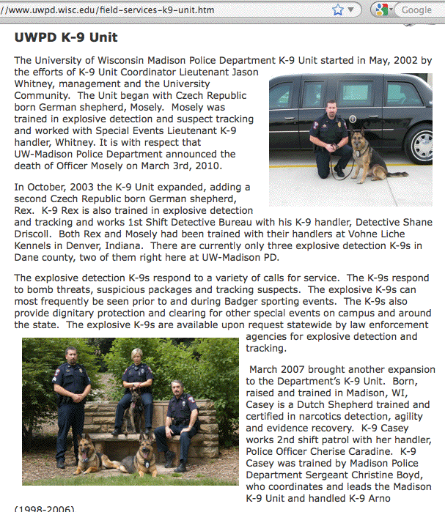
University of Wisconsin Police Department K-9 Unit

Slide 24
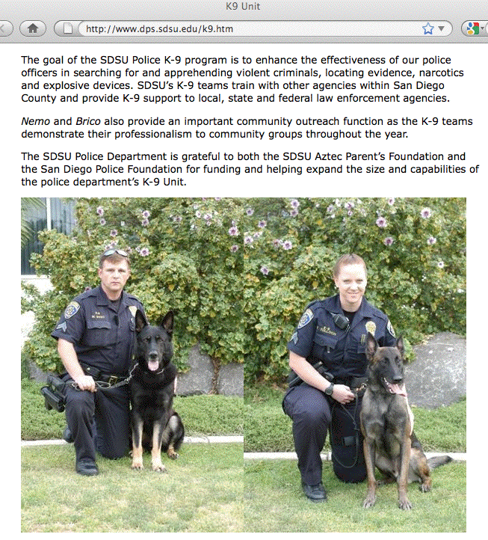
San Diego State Police Department K-9 Unit

Slide 25
1) Fiber Cuts
Regardless of how skeptical we may be of other physical security threats, one very real threat that I think we’re all willing to acknowledge is that backhoes and other heavy equipment have an uncanny ability to find and accidentally cut buried fiber.
You can help minimize the risk of unintentional damage to buried fiber by taking appropriate steps, including insuring that:
-- all buried facilities are well-documented as actually constructed
-- easily visible “buried cable” posts or signs are installed where
appropriate or required
-- you (or your service agent) subscribe to your state’s call-before-
you-dig one-call utility notification center, insuring that you
make timely response to all relevant locate-and-mark requests
-- any non-conductive/otherwise hard to locate facilities should be
buried with a tracer wire or conductive marking tape (this may
be a legal requirement in some states, e.g., OAR 952-001-0070)

Slide 26
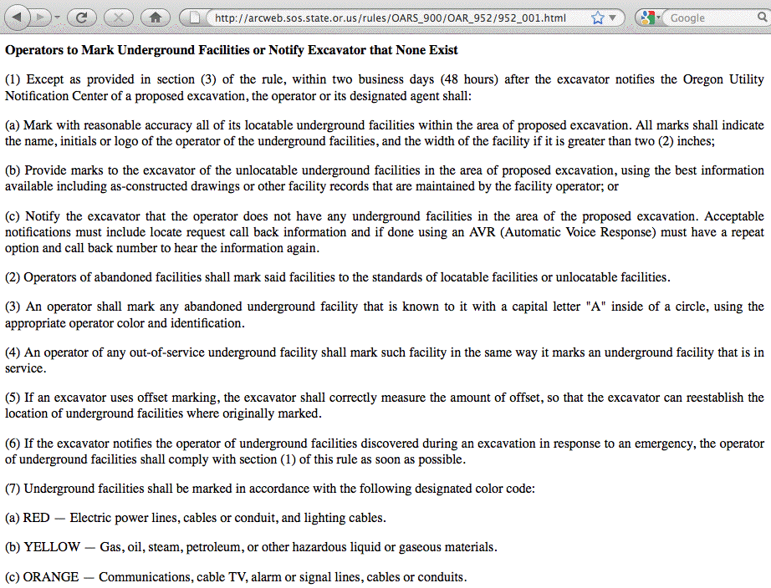
OAR 952-001-0070

Slide 27
The Downside of Transparency
At the same time we recognize and accept the need to be transparent about where fiber is located in an effort to avoid the problem of accidental fiber cuts, potential bad guys might also be interested in our fiber deployments. For example:
-- Are there critical choke points, such as bridges across major
rivers or tunnels through large mountain ranges, where
virtually all fiber follows a common path out of necessity?
-- Are there unmonitored access points (manholes, hand holes,
fiber pedestals, etc.) where an attacker might be able to gain
access to your fiber without being detected?
Obviously you need to balance the need to provide enough information to avoid accidents, while simultaneously avoiding giving your enemies a “blueprint” for how to best attack you.

Slide 28
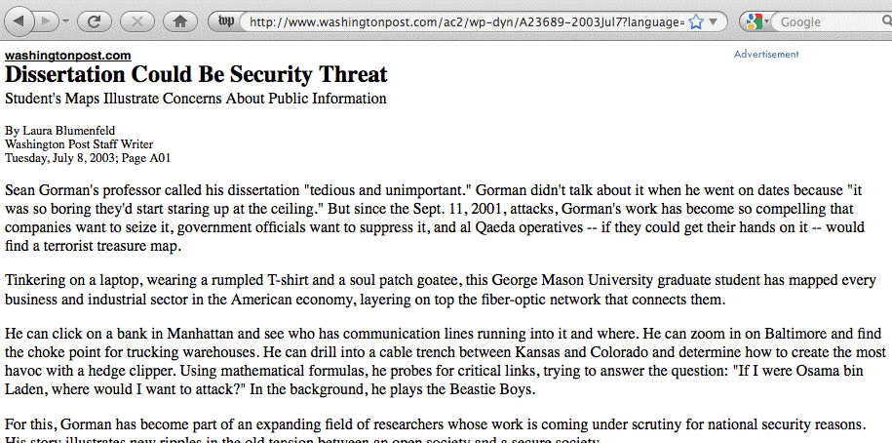
Remember Sean Gorman’s Dissertation?

Slide 29
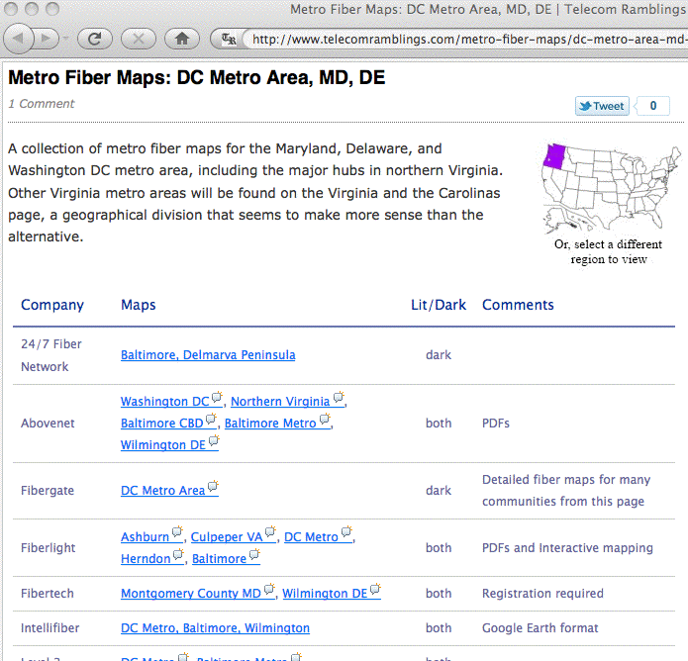
Fiber Maps Are Still Widely Available…

Slide 30
Architecting and Building for High Availability
One way you can improve the physical security of your network is by adding redundancy, excess capacity, and resiliency to it.
Your network should be architected and constructed so that there are no choke points or “single points of failure” -- loss of any single link or piece of gear should NOT result in an outage! Think, “We must always have redundant paths over diverse facilities!”
Moreover, you must also have enough spare capacity on failover links so that if you do end up needing to actually use them, they won’t be congested (or you need a plan to selectively shed load until you’ve eliminated congestion).

Slide 31
Obtaining High Availability Isn’t Free
Of course, the downside of all this is that high availability comes
at a cost (as the saying goes, “you can get whatever level of availability you can afford to buy”).
If you’re building out fiber paths, the first path between two
paths normally goes via the cheapest and most direct route.
A diverse path (virtually by definition) will need to go via some longer/less desirable/more expensive-to-provision path.
You also need to accept that you’ll be buying capacity that you normally won’t be using. (If you do end up relying on use of your “backup” link to have enough capacity to accommodate your production traffic requirement, what will you do if your primary link goes down? Each link should be able to independently carry all the traffic at your site)
High availability also means that you’ll need more hardware (e.g., at a minimum, more network interfaces for your routers, etc.)

Slide 32
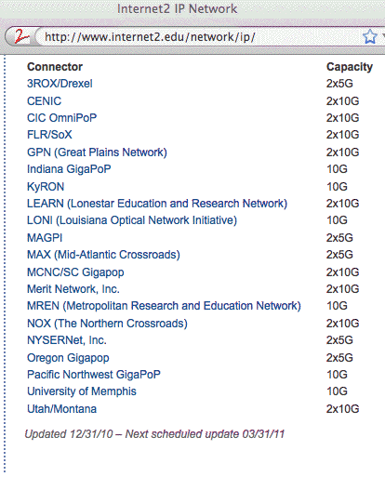
All That Said, Many Internet2 Connectors
Do Have Multiple Connections To Internet2

Slide 33
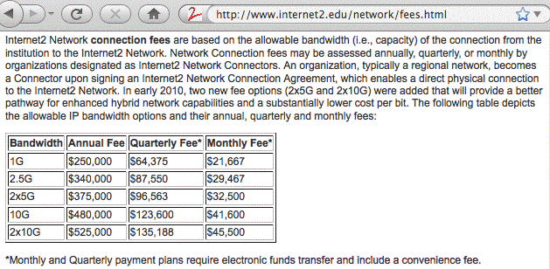
The Incremental Port Charge to Go From
1xN to 2xN On Internet2 Is Relatively Small
Note: 1x2.5Gbps → 2x5Gbps for ($375K-$340K=) just $35K incremental!
1x10Gbps → 2x10Gbps for ($525K-$480K=) just $45K incremental!

Slide 34
Diminishing Returns
When you’re thinking about how much you want to spend to insure that your network is “always available,” you need to remain cognizant of the law of diminishing returns.
The first backup/failover circuit you add will likely provide a substantial improvement in system availability, since if your main production circuit fails, that backup circuit will save your bacon. It likely represents an excellent bit of insurance for you to buy.
If you’re really risk averse or your service must absolutely remain available, a second backup/failover circuit might allow you to avoid an outage in the rare circumstances where both your primary and your secondary circuits simultaneously experience an outage – but, that *should* be a vanishingly rare event.
But what of a third or fourth or n’th backup/failover circuit?
You might only need that extra circuit one time in ten million, and the cost of eliminating an event that rare may be prohibitive.

Slide 35
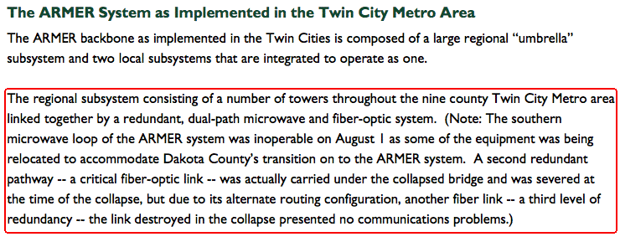
But An Example of How Sometimes Having Multiple Redundant Paths Can Pay Off Big Time: Public Safety Communications On August 1st, 2007 in St Paul
http://www.srb.state.mn.us/pdf/I-35W%20Final%20Report.pdf

Slide 36
Hardware Sparing
You also want to work to ensure that if an outage does occur due to a hardware failure, you can recover from it in a timely fashion.
For example, are you continually monitoring your network and maintaining adequate local spares?
Often, particularly in smaller secondary markets, more expensive spares are not stocked locally, they’re shipped in from regional depots on an as-needed expedited basis.
When multiple customers simultaneously suffer outages and all need replacement parts at the same time, or when same day courier service is disrupted due to a disaster, a lack of local spares could get ugly.

Slide 37
2) Network Confidentiality and Fiber Taps
As the network begins to carry potentially sensitive health care related traffic or classified traffic from public safety agencies, traffic confidentiality will become more important.
You may want to proactively and continually monitor your network links for any brief outages (windows which might be associated with the introduction of splitters or other unauthorized network elements). At the most basic, this can be done by sending/continually monitoring an ongoing “heartbeat” signal.
More sophisticated units (as used to protect federal classified networks such as SIPRNet and JWICS), are also available if appropriate (see http://www.networkintegritysystems.com/ )
You may also want to periodically characterize your deployed fiber with an OTDR (optical time-domain reflectometer) to identify any “unexpected physical anomalies” which may have “developed.” (Macrobends may be enough for data interception)

Slide 38
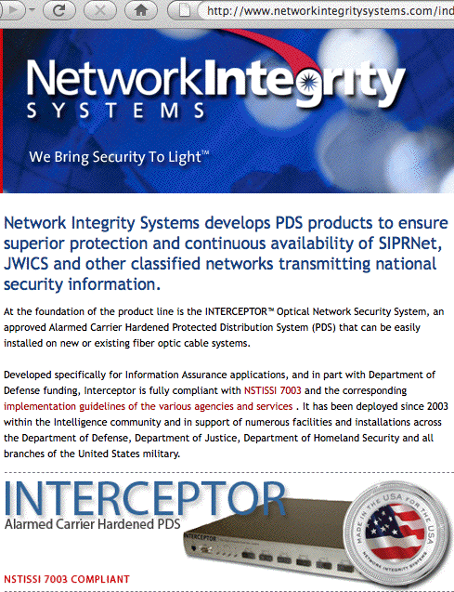
Network Integrity Monitoring

Slide 39
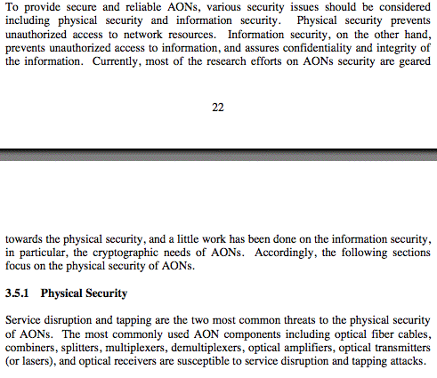
Physical Security Of All Optical Networks (AON)
See National Communications Systems Technical Information Bulletin 00-7,
“All-Optical Networks,” www.ncs.gov/library/tech_bulletins/2000/tib_00-7.pdf

Slide 40
Live Open Ethernet Jacks/Ports
It is amazing how often organizations will tolerate live open ethernet jacks/ports to which random people can plug in systems. Sometimes this even includes unlocked wiring closets, or publicly touchable routers, switches, or other network equipment.
Most universities do not allow “free love” open wireless networks, so why would you allow anyone with an ethernet cable to have open access to your wired network? Some options to consider:
-- only heat up jacks on request, or at least disable jacks in
hallways and empty offices by default
-- require authentication for most physical ethernet connections
the same way you do for wireless connections
-- consider locking unused jacks and installed patch cables (e.g.,
see www.rjlockdown.com, but remember that Torx screwdriver
bits are publicly available and recognize that jack plates can still
be removed or patch cables cut and reterminated for access)

Slide 41
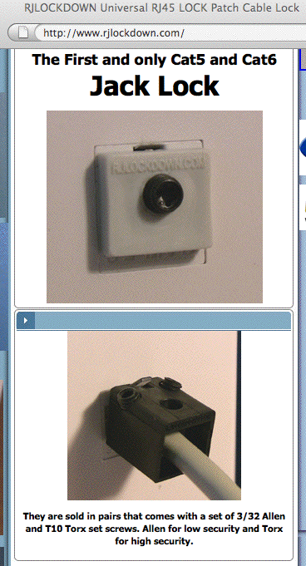

Slide 42
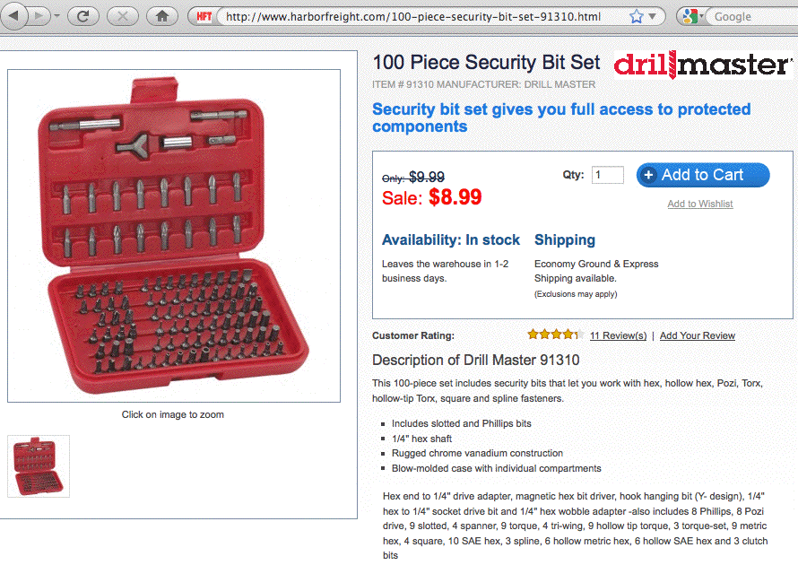
$8.99 to Defeat “Secure” Fasteners…

Slide 43
3) The Security of Cabinets, Rooms and Buildings
When we think about the physical security of networks, there’s a temptation to think just about the network, e.g., the fiber and the ethernet themselves.
In reality, every network also has numerous other physical facilities (cabinets, rooms, buildings, etc.) housing things such as key network equipment (optronics, routers, switches, etc.), as
well as servers, critical staff, documentation, media, etc.
Those facilities also need to be physically secure.
Physical security can mean, among other things, that the facilities aren’t likely to be damaged by a deluge or other natural disaster.

Slide 44
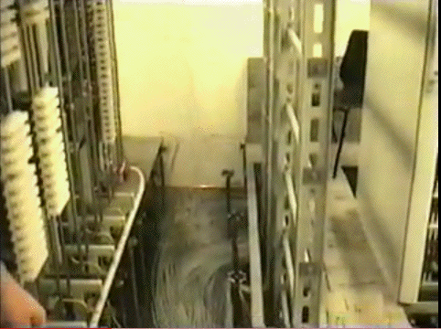
A Flooded Data Center…
Video: http://www.youtube.com/watch?v=ANU-oSE5_hU

Slide 45
Locks
Once we get beyond things like protecting a site from flooding, physical security often focuses on access control via locks.
Naturally, we all know that the locks on data equipment cabinets typically aren’t very strong, and more often than not the keys for those cabinet are just left on top of the cabinet so they don’t get “lost,” cough, but because locks are used so many places related to computing and networking, let’s talk a little about locks.

Slide 46
Surreptitious Opening of
Traditional Pin Tumbler Locks
Even though traditional pin tumbler locks have well known limitations, they still form at least part of the physical security at most sites, including many computer or networking sites.
If you think that traditional pin tumbler locks provide anything even *remotely* approaching reasonable security, I’d urge you to think again.
In particular, you should learn about “bump keys.”

Slide 47
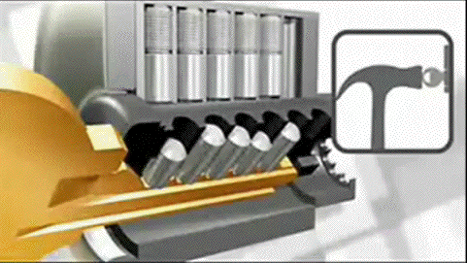
Video: How Lock Bumping Works
Video: http://www.youtube.com/watch?v=7xkkS2p7SuQ

Slide 48
If Detection Isn’t A Problem…
If discovery of an intrusion isn’t a problem, you should also know that many traditional locks can be drilled, pried, ground, frozen or otherwise defeated by brute force in just a matter of minutes.
Thus, for any lock that “matters,” you should probably consult with a professional locksmith and have a high security lock (such as those made by Medeco) installed, reinforcing the door and the door jamb (including the strike plate area) at the same time.
Don’t forget to secure any exposed outward-swinging external door hinges, too!

Slide 49
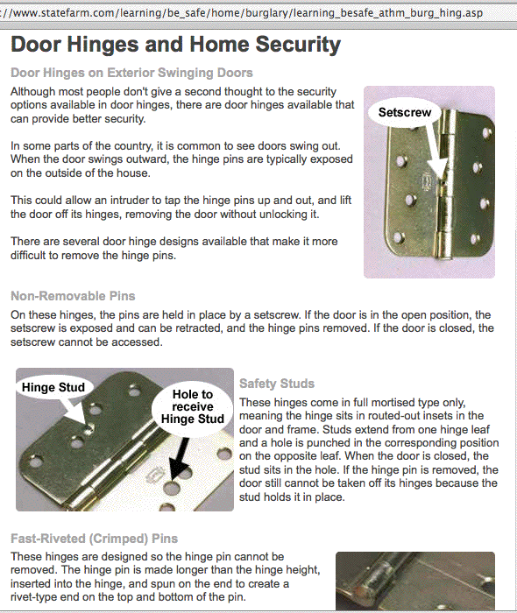
Hinges

Slide 50
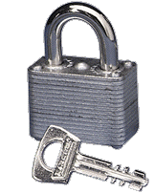
Padlocks
Padlocks are widely used to secure network equipment. They are typically subject to all the issues associated with traditional pin tumbler locks, but they have additional issues of their own:
-- warded padlocks (see image at right) are
trivial to open; they should NEVER be used
-- some padlocks are stamped with their
“key code;” if you don’t remember to remove
that code, it may be possible to use those
numbers to create or find a key for that lock
-- the unshielded shackle of a padlock can
often be cut with bolt cutters or a torch
-- even if you have a padlock that’s secure, it may be used in
conjunction with a weak and easily defeated hasp or chain
The ultimate? The Navy has approved the S&G 951 High Security Padlock, but at >$1,000/lock, it might be, um, a little pricey

Slide 51
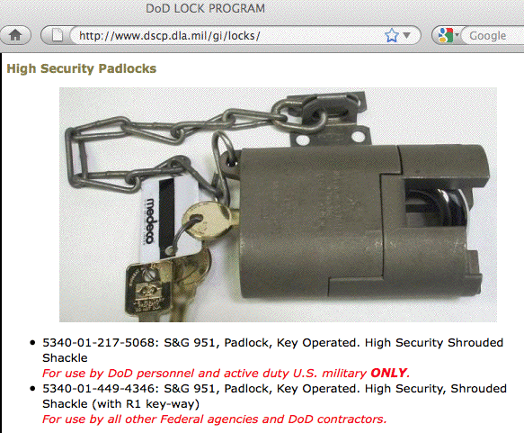
A S&G 951 Padlock
(Different key-ways are intended for use by different audiences)

Slide 52
Keys
Key-related issues are another reason why traditional locks often provide mediocre security.
In a university environment, it is routine for the same key to get issued to multiple people. When one of those keys get lost (or is not recovered when someone quits or is terminated), the locks that are opened by that key tend not to get rekeyed (typically, the cost of doing this would be prohibitive, and there are only a finite number of usable key combinations given physical constraints).
Many sites also use master keys, allowing supervisors or custodial staff to have access to all offices on a given floor or in a particular building. If control over a master key is even temporarily lost (or an intruder can gain access to lock cylinders from multiple doors which all use the same master key), the intruder may be able to make a duplicate master and have the run of your facility.
You really want to have a conversation with your lock & key person

Slide 53
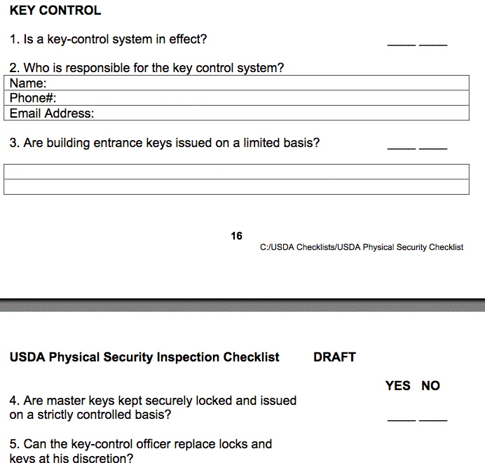
Part of A Keys Control Checklist from the USDA
See: http://www.usda.gov/da/physicalsecurity/physicalcheck.pdf

Slide 54
Alternatives to Locks and Keys
Many facilities have moved to “key cards” (swipe cards, prox cards, etc.) as an alternative to traditional locks & keys
Key cards offer distinct advantages over traditional locks and keys:
-- key cards can be integrated into user site IDs/badges
-- key card use can be tracked, while use of a key leaves no audit
trail or record
-- key cards can be programmed to work only during particular
days or particular periods of time, while keys work all the time
-- many key card systems can be configured to require “two
factors” (e.g., you must use your key card AND enter a PIN code)
-- upon termination, a key card can be instantly canceled with no
need to manually rekey the system, etc.
Sometimes, though, key cards may offer only an illusion of security. For example, some may be easily brute forced using widely available tools.

Slide 55
Some Prox Cards Tools
Some resources mentioned in http://www.mcafee.com/us/resources/white-papers/foundstone/wp-proxbrute.pdf
-- Proxmark III: http://www.proxmark3.com
-- Proxpick: http://www.proxpick.com/
-- ProxClone: http://proxclone.com/reader_cloner.html
Also worth a read:
“The RFID Hacking Underground,” Wired, May 2006
http://www.wired.com/wired/archive/14.05/rfid.htm
and
http://rfidiot.org/

Slide 56

Proxmark3

Slide 57
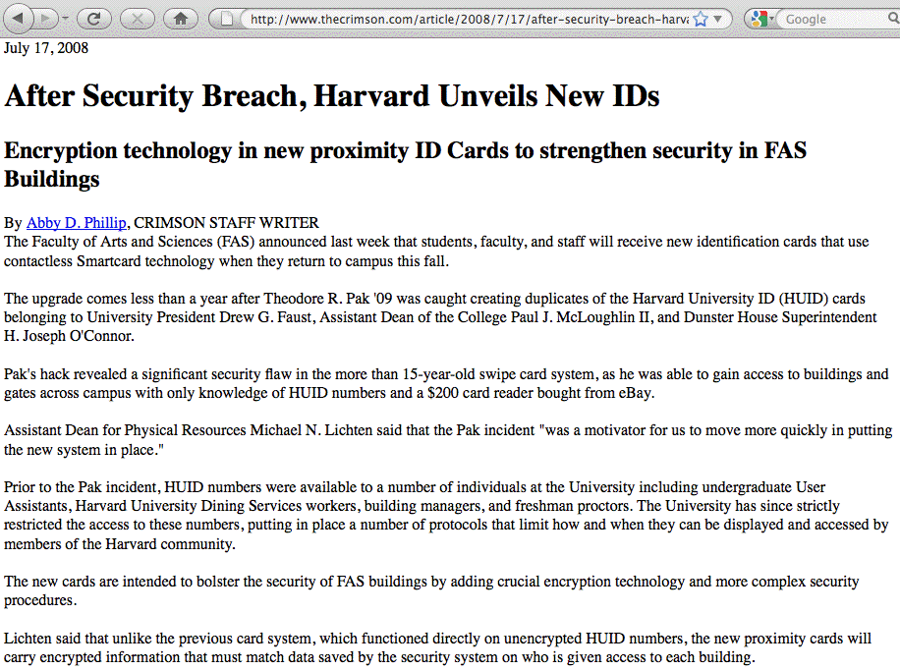
FWIW, Many Swipe-Style Cards Aren’t Perfect Either

Slide 58
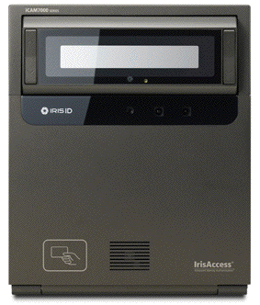
Biometrics
Biometric systems use your physical characteristics to decide if you should or shouldn’t be granted access to a facility or resource.
Examples include:
-- fingerprint or hand geometry readers
-- iris and retina scanners
-- voice identification
-- facial recognition
-- signature recognition
Nice discussion of biometric
issues in GAO-O3-1137T,
“Challenges in Using Biometrics,”
http://www.gao.gov/new.items/
d031137t.pdf
Not a huge fan of biometric
solutions.

Slide 59
Building Security:
Piggy Backing/Tailgating/Social Engineering
Key cards or biometrics won’t help if random individuals can gain access to a secure facility by piggy backing/tailgating behind an authorized user, or by manipulating basic social courtesies.
A nice example of manipulating basic social courtesies, mentioned to me by a colleague recently: approach the door to a controlled area carrying what’s obviously a heavy box. It takes a pretty heartless person to not help that person out by holding the door for them.
Floor to ceiling turnstiles or mantraps (interlocking pairs of doors) can be used to help physically prevent these sort of phenomena.
An attendant at the door can also ensure that everyone coming in “cards in” as may be required (but I know that this is something that many higher education sites have trouble enforcing).

Slide 60


Slide 61
Building Security: Stay Behinds
There’s also the potential problem of “stay behind” visitors –
if you’re not continually escorting all visitors from entry to exit, or at least signing all visitors in and out, how do you know that all visitors who’ve *entered* your facility have *left* by the end of the day?
An unescorted and forgotten visitor can be the “camel’s nose” that defeats many of your physical access controls, potentially allowing anyone or everyone to gain access to your facilities.
For example, a stay behind visitor can open an unalarmed external door from the inside, thereby allowing entry of additional people.
Finding stay-behinds is easier if a building has motion sensor alarms deployed, or if the organization routinely uses security dogs to sweep sensitive buildings at closing time. Routinely lock all places where an unauthorized person might hide, out of sight, until the building empties (such as supply closets, unused offices, etc.)

Slide 62
Walls, Ceilings, Floors, Roofs, Utility Tunnels, Etc.
Sometimes you’ll see a high security lock “protecting” a room with a hollow core door, externally accessible glass windows, sheetrock walls, a suspended ceiling, and maybe even a raised floor.
In that sort of environment, an intruder can ignore the high security lock and just break the door or the window, or punch through the sheet rock walls, or climb in above the suspended ceiling or below the raised floor. (Embedded heavy gauge wire mesh can at least make that sort of through-the-wall or through-the-ceiling or floor entry more difficult)
Similarly, have you secured your roof? Or could someone use an extension ladder to get to your roof, and then go through an unsecured roof hatch or skylight?
What about any utility tunnels? Manholes are often one of the easiest-to-breach access points. Although locking manhole covers are available (e.g., see www.securemanholes.com), most manhole covers are simple cast iron units that provide no impediment to an intruder with a manhole cover lifter (or just a couple of bolts and some wire).

Slide 63
Fencing
University campuses aren’t like industrial or government facilities, but if you can add a fenced perimeter around critical facilities, that fence will immediately adds significantly to your site’s physical security.
Government and military folks (who do worry about things like VBIEDs) like a wire cable-reinforced perimeter fence that’s ideally at least fifty feet away from the facility that’s protected, built from 9 gauge (or heavier) chain link, seven feet or more tall, with an outward facing razor wire top guard plus a bottom rail, well anchored and backed up by things like interlocking precast concrete obstacles or large concrete planters.
Dual fence designs are also popular.
That may all be a bit much for university environments, but if you can deploy it, it’s another layer of physical security.

Slide 64
Exclusion Zones, Intrusion Detection & Landscaping
Most fences (particular with proper signage) will at least serve to create a public exclusion zone in which an intruder can be readily identified and intercepted for questioning.
Extensive lighting plus physical intrusion detection systems will help managing that exclusion zone.
Any landscaping should not provide hiding spots for intruders.
Any trees near or overhanging a security fence should also be trimmed or removed to prevent the tree from being used as a pathway over the fence.

Slide 65
Example of a Fencing Failure
“A fence approximately six feet high surrounds some of [the Kinshasa Nuclear Research Center] CREN-K. The fence is constructed of cement in some places and chain-link in others. The fence is not lit at night, has no razor-wire across the top, and is not monitored by video surveillance. There is also no cleared buffer zone between it and the surrounding vegetation. There are numerous holes in the fence, and large gaps where the fence was missing altogether. University of Kinshasa students frequently walk through the fence to cut across CREN-K, and subsistence farmers grow manioc on the facility next to the nuclear waste storage building. […] No fence separates the nuclear waste storage building and the University of Kinshasa’s women’s dormitory. The two buildings sit approximately 300 meters apart, and one can walk freely from one to the other across the manioc field.”
http://tinyurl.com/68sgdds

Slide 66
Alarms and Guards
Access control features such as locks and reinforced doors and walls can’t keep a determined intruder out “forever” – virtually
any facility can eventually be breached if the intruder has
enough time and no interruptions.
What access control features do give you is a window of time for guards to respond and deal with any intrusion attempt.
The sooner your guards know that someone is attempting to
break in, the more time they’ll have to mobilize and deal with
the attempted intrusion. Alarms buy you that response time.
Again, just as was the case with locks, you should consider engaging an alarm professional to help you plan and deploy a suitable comprehensive alarm system (including things like area motion detectors, and perimeter integrity alarms with window-ajar and door-ajar sensors). You should also review response requirements with campus police and municipal law enforcement.

Slide 67
Surveillance Video
You can’t be everywhere at once, so take advantage of surveillance cameras to increase your security leverage. Cameras have come way down in price, while quality has gone up (as has ease of installation). It should now be possible for you to affordably add surveillance video throughout all critical campus facilities.
Surveillance video may deter issues from arising in the first place: if people know they’re potentially being monitored, that alone may deter them from engaging in illegal activities.
If illegal activities do occur, surveillance video can provide crucial evidence documenting what happened during the incident:
(a) When did the incident occur? (b) How did the incident occur?
(c) Who did it? (d) What did they take/what did they do?
Consider using a redundant out-of-building digital video recorder to ensure that an in-building video recorder doesn’t get stolen or compromised during a security incident.

Slide 68
4) Emergency Systems: Fire Detection & Suppression
Electrical fires are one of the most destructive events an IT organization can run into, and fire suppression has become trickier since new inert gas (“Halon 1301”) installations have been banned due to ozone depletion concerns.
Automatic water sprinkler systems (“dry pipe” systems) are the most common alternatives, but water sprinkler systems may not be effective when it comes to suppressing electrical fires occurring in machine rooms under raised floors.
Non-Halon gaseous fire suppression systems (for example, carbon dioxide based systems) may be an alternative, but they represent serious potential risks for operators and other personnel who may need to be rapidly evacuated in the event of a fire. See the discussion of some Halon alternatives: http://tinyurl.com/6agevle
Note: Regrettably, not all fires will take place in your well-
fire-suppressed machine room…

Slide 69
OSU’s Thanksgiving 2010 Steam Tunnel Fire
“Oregon State University resumes classes, though some phone and computer services still disabled from fire,” November 29th, 2010, http://tinyurl.com/5sxxx3c [emphasis added below]
Some Oregon State University buildings still had not regained telephone or
computer data service Monday as the result of an electrical fire last week, but all
classes resumed normally. The fire erupted early last Wednesday morning in wiring
that runs through the university's steam tunnels, 6-to-8-foot-tall tunnels that run
under most buildings on campus. Electrical wiring, telephone lines and fiber optic
cables thread through the tunnels along with wrapped steam pipes that carry heat
to buildings. Investigators are still trying to determine what caused an arc flash – a
burst of electrically charged energy that burns at a temperature of 5,000 degrees
or higher. The arc singed sections of wiring extending about a 100 feet from the
flash point in three directions, said Vincent Martorello, director of facility services.
The university gave its nearly 24,000 students early dismissal for the Thanksgiving
break on Wednesday morning because the fire had disabled fire alarms in some
buildings, Simmons said. The fire did not affect dormitories, but it left five
buildings Monday without computer data connections and a dozen buildings
without telephone service. Telephone service may not be fully restored until the
end of the fall term, university officials said.

Slide 70
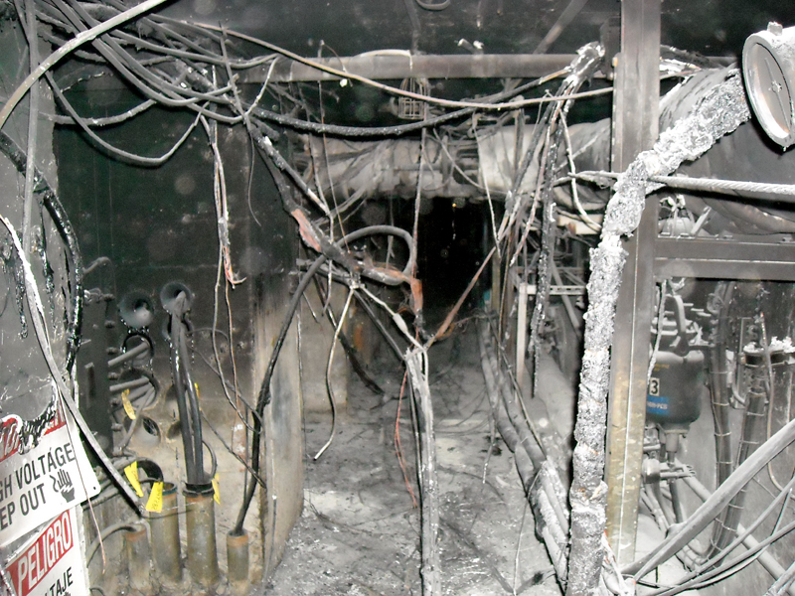
Source: http://tinyurl.com/65mrh3w

Slide 71
Emergency Power and Cooling
Often uninterruptible power supplies prove to be too small for the load they’ve been stretched to support. In those cases, even
if you immediately began shutting down systems as soon as the power flipped to the UPS, you would not be able to cleanly take down all the covered equipment before running out of juice (and naturally most people don’t want to begin powering things down until they’re SURE that they’re not facing just a brief outage). Check and figure out how long you can run with your actual load.
UPS systems need to be backed up by diesel generators. Have you tested yours recently? How much fuel do you have available for it? In an emergency will you be able to get more? Are you sure?
While most sites worry about emergency power, many forget to think about emergency cooling. If your machine room is going to overheat, even if you have juice, you won’t be able to stay online. Spend some time thinking about your emergency cooling plan.

Slide 72
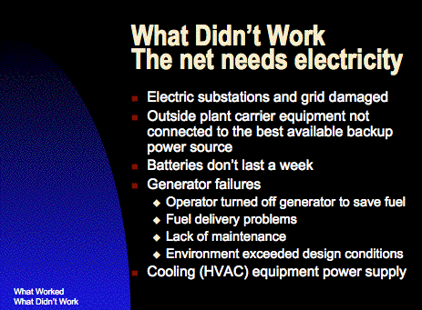
An Example from 9/11
http://www.nanog.org/meetings/nanog23/presentations/donelan.ppt

Slide 73
Network Operational Continuity in a Disaster
Would your network continue to operate if your primary network operations center was hit by a major disaster, such as an earthquake?
We can tease apart two issues here:
-- Will you have a functional NOC, post-disaster?
-- And will your remote network equipment continue to operate?
These days, realistically speaking, you will likely want full replication of your NOC at an out-of-region location if you want to be able to continue to operate your network after a major disaster.
That replicated NOC will need both trained and ready-to-go network engineers and NOC staff, as well as replicated servers and live current copies of all NOC databases. We recognize that this is a potentially expensive proposition, but one that we think deserves serious consideration.

Slide 74
Disaster Continuity for Remote Gear,
Including Emergency Out-Of-Band Access
A major disaster, such as an earthquake, may also directly
impact remote network equipment. Don’t forget to plan for the emergency power, cooling and remote access needs of your remote networking sites (including fiber equipment huts).
Every installation with active electronics needs, at a minimum,
its own emergency power and cooling, particularly if primary power is coming from only a single utility feeder, or the utilities
for a remote site are aerial rather than buried.
It may also be worth spending some time thinking about how you will securely handle emergency out-of-band access to remote gear if in-band access gets interrupted due to a network outage.

Slide 75
5) Miscellaneous Items: Personnel Controls
Personnel vetting and related controls are often viewed as a key part of physical security because on-site personnel enjoy unique physical access to site facilities.
Historically universities have rarely done background checks on their employees, however, that practice has been evolving over time, particularly for system and networking staff members having effectively unlimited access to the University’s infrastructure.
As staffs are beefed up to support BTOP/US-UCAN activities, don’t neglect personnel background checks in your eagerness to fill some of those hard-to-fill positions!
Be sure to discuss any planned background checks with your Human Resources Department, since specific notice and consent requirements or other limitations may apply, and typically vary from state to state.

Slide 76
ID Badges
ID badges are another routine component of personnel security programs, and become necessary when an organization grows beyond a size where “everyone knows everyone” and “everyone knows what everyone should (or shouldn’t) be doing.”
Ideally, ID badges would:
-- identify the person bearing the badge (“Sam Anderson”), and
make it easy for third parties to verify that the right person has
that badge (e.g., the picture on the badge matches its user)
-- give the person’s status (“employee”, “visitor”, etc.) and role
(“senior network engineer”, “custodian”, etc.)
-- signal any atypical access (“machine room access allowed” or
“must be accompanied at all times”)
-- include a magstripe or barcode that allows the credential to
be easily verified against an authoritative database
-- be difficult to forge, resistant to unauthorized modifications,
hard to accidentally damage, and cheap

Slide 77
Credentials and A False Sense of Security
While ID badges have the potential to improve security if properly used, sites need to be on guard against letting ID badges lull them into a false sense of security. Just because someone has an ID badge doesn’t mean that they should be immune from being challenged if they’re somewhere they shouldn’t be, or doing something they shouldn’t be doing.
Credentials should also be challenged and verified if the person presenting them isn’t known, or just “feels wrong” (trust your paranoia).
For example, it has been reported that penetration testers have been routinely able to gain unauthorized access to sterile areas of airports and sensitive federal facilities by displaying bogus law enforcement credentials. Such access is particularly troubling when those individuals are allowed access with firearms or other weapons.

Slide 78
An Example of Credential Abuse From the GAO
“Our undercover agents were 100 percent successful in penetrating 19 federal sites and 2 commercial airports. We were able to enter 18 of the 21 sites on the first attempt. The remaining 3 required a second visit before we were able to penetrate the sites.
At no time during the undercover visits were our agents’ bogus credentials or badges challenged by anyone. At the 21 sites that our undercover agents successfully penetrated, they could have carried in weapons, listening devices, explosives, chemical/biological agents, devices, and/or other such items/materials.
At each visit, our agents carried bogus badges and identification, declared themselves as armed law enforcement officers, and gained entry by avoiding screening. At least one agent always carried a valise.
Sixteen of the sites we visited contained the offices of cabinet secretaries or agency heads. At 15 of these sites, our undercover agents were able to stand immediately outside the suites of the cabinet secretary or agency head. In the 5 instances in which our agents attempted entry into such suites, they were successful. At 15 of the sites, our agents entered a rest room in the vicinity of these offices and could have left a valise containing weapons, explosives, and/or other such items/materials without being detected. Except for one agency, we made no attempt to determine whether any of the cabinet secretaries or agency heads were present at the time we visited their agencies.
At a federal courthouse, our agents were waved through a magnetometer but not screened. A briefcase that one of the agents carried was not checked. The agents were escorted to a gun box room, which they were permitted to enter alone. They were then instructed to lock their weapons, but no one supervised or observed the actual surrender of the agents’ weapons.
At the two airports we visited, our agents used tickets that had been issued in their undercover names for commercial flights. These agents declared themselves as armed law enforcement officers, displayed their spurious badges and identification, and were issued “law enforcement” boarding passes by the airline representative at the ticket counter. Our agents then presented themselves at the security checkpoints and were waved around the magnetometers. Neither the agents nor their valises were screened.”
Source: GAO/T-OSI-00-10, “Security Breaches at Federal Agencies and Airports,” May 25th, 2000,
http://ntl.bts.gov/lib/11000/11400/11410/os00010t.pdf

Slide 79
6) “Information Leakage” (FISMA PE19)
The final area of physical security we might consider is what FISMA PE19 calls “information leakage.”
If we weren’t talking about physical security today, when you hear the term “information leakage,” the first thoughts that would probably come to mind would probably include:
-- sniffing unencrypted network traffic
-- SQL injection attacks (potentially extracting PII or other
confidential data in unanticipated_x0017_ ways)
-- malware (such as “banking trojans”) eavesdropping on user
financial data
-- BGP route injection attacks (“BGP shunts”)
-- DNS poisoning
-- etc.

Slide 80
Physical Surveillance Devices
The physical analog to some of those network-based eavesdropping attacks would be physical surveillance devices, colloquially known as “bugs.”
For some reason, while most people are all too willing to believe that hackers and malicious software exist and could spy on your online activity, they are often skeptical that there are physical surveillance devices that are an equal or greater threat.
Put another way, some people think that “physical surveillance devices are something that only the tin foil hat crowd tends to worry about. No one’s going to bother ‘bugging’ my computer or my office or my car.”
I’m happy that those folks are feeling so secure, but that sense of security may be unwarranted. Physical surveillance devices DO exist.

Slide 81
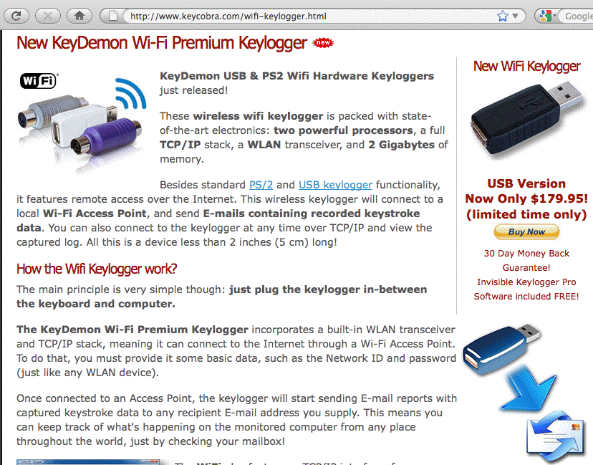
Simple Example: A Hardware Keylogger

Slide 82
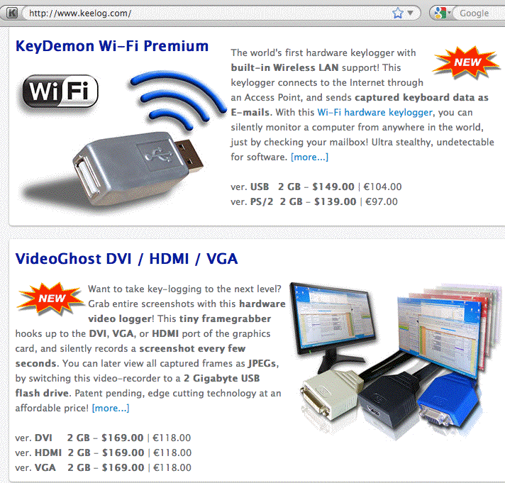
Some More Hardware Logging Gear

Slide 83
Eavesdropping
Just as your computer may have a hardware “bug” attached to it, so, too, in some circumstances your data center or offices may be end up with a physical bug (surreptitious microphone or camera).
While popular television shows frequently show these devices being easily detected, in reality, at least when professional quality equipment is used and installed by a skilled professional, it can be difficult to detect and neutralize those bugs (the process of locating and defeating bugs is normally referred to as “technical surveillance counter measures” or TSCM).
If you remain skeptical that bugs are an real physical security issue, or that they can be difficult to detect and remove, I recommend you review the presentation: “Phone Talk,”
http://www.tscm.com/Phone_Lecture_2009/Phone_Lecture_Reston_VA-2009.htm (167 slides)

Slide 84
(Un)Trustworthy Hardware?
“Information leakage” and “physical security problems” take on a profound new meaning if you can potentially end up with counterfeit hardware, or hardware made with counterfeit chips.
I would encourage you to become familiar with the threat I’m referring to in this area – a nice briefing is the FBI PowerPoint deck entitled, “FBI Criminal Investigation – Cisco Routers,” as
embedded in graphical form in “FBI Fears Chinese Hackers Have Back Door Into US Government and Military,” see
http://www.abovetopsecret.com/forum/thread350381/pg1
See also the excellent article “Dangerous Fakes,”
http://www.businessweek.com/magazine/content/08_41/b4103034193886.htm
Buying counterfeit products is one physical security risk, but other physical security risks are associated with disposing of surplus/no longer needed hardware on the other end of the cycle…

Slide 85
Dumpster Diving and Surplus Equipment
Historically, many crackers got their start by digging interesting computer and networking gear out of corporate dumpsters (a fine art normally known as “dumpster diving”).
Today, there’s much more emphasis on recycling, and that’s laudable, but any storage media in surplus equipment needs to get wiped before that gear gets sold or otherwise disposed of, even if the system itself no longer boots/runs.
Beware of amateur efforts at rendering hard drives unusable – staff members can easily hurt themselves while attempting to destroy surplus equipment with sledge hammers or other improvised tools (one particularly dangerous example involved amateur use of thermite!). Surprisingly, information may still sometimes be able to be recovered from a “destroyed” drive.
Consider hiring a contractor to crush or shred your drives, or (if your volume is large), perhaps get your own crusher/shredder.

Slide 86
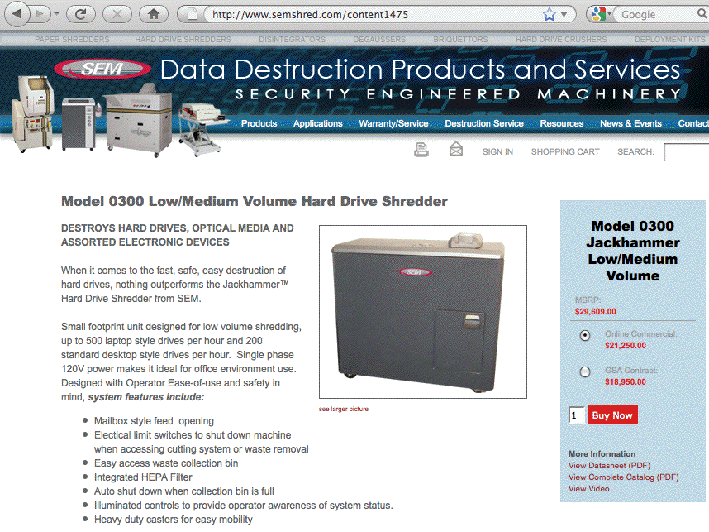

Slide 87
Outputs: Confidential Documents
Sensitive documents also need to be shredded, incinerated, or sequestered in a confidential document disposal container for approved disposal.
Speaking of confidential document disposal containers, it is routine for these “wheelie” cans to live in mailrooms or corridor areas, locked to prevent casual browsing of discarded confidential documents, but often not living chained down.
Presumably the unauthorized removal of a full document disposal container full of confidential documents would be a disconcerting event, so please be careful and secure your wheelie cans of sensitive documents!

Slide 88
All The Rest
It isn’t possible to go over everything that we really should talk about when it comes to IT physical security in only an hour, so please don’t think that this is a comprehensive treatment –it’s not. This talk is really just designed to “wet your whistle” when it comes to thinking about physical security.
If you’re not routinely talking about physical security at your site, or you don’t have a formal physical security policy, you may want to think about having someone focus on this important area.
Hopefully this talk will at least provide some starting points for that conversation.

Slide 89
Thanks for the Chance to Talk!
Are there any questions?

