Slide 1
SCADA Security and Critical Infrastructure
Eugene, Oregon Infraguard Meeting
9:30AM December 7th, 2004, 308 Forum, LCC
Joe St Sauver, Ph.D.
University of Oregon Computing Center
joe@uoregon.edu
http://darkwing.uoregon.edu/~joe/scadaig/
Portions of this talk were originally presented at the Internet2/ESCC
Joint Techs Meeting in Columbus, Ohio, July 21, 2004

Slide 2
I. Introduction

Slide 3
My Interest In SCADA; This Talk
I grew up around industrial facilities (for example, my Dad was a stationary engineer who helped run an industrial steam facility for a major airline)
My terminal degree is in Production and Operations
SCADA-related incidents have continued to pop up in the news, sustaining my interest over time
One note: The technical level of this talk has been tailored to insure that it doesn’t provided a detailed “cookbook” that can be used by the bad guys to attack SCADA systems, while still providing sufficient technical detail/evidence to highlight some of the issues that need to be addressed.
I also recognize that there are basically two different audiences present: LE folks and industry people. A separate glossary has been provided. :-)

Slide 4
So What the Heck IS “SCADA?”
SCADA is “Supervisory Control and Data Acquisition” – realtime industrial process control systems used to centrally monitor and control remote or local industrial equipment such as motors, valves, pumps, relays, sensors, etc.
SCADA is used to control chemical plant processes, oil and gas pipelines, electrical generation and transmission equipment, manufacturing facilities, water purification and distribution infrastructure, etc.
Industrial plant-scale SCADA is often referred to as a “Distributed Control System” or DCS
SCADA nuzzles up to embedded system issues, too.

Slide 5
Think of SCADA As…
… the computer equivalent of George, the guy in the hard hat, going around reading gauges and recording values on a clip board, or opening valve #173 and turning on pump #8 at 11:15AM on December 7th when the schedule says it is time to make another batch of product <foo>.
Of course, because we’re talking about computerized systems, we’ll typically be talking about complex systems with hundreds, thousands or tens of thousands of remotely managed control points. At that volume, it is not surprising that SCADA is often “event driven” (e.g., “signal an alarm, something’s out of spec”)

Slide 6
II. Wow. That Sounds About As Exciting As Watching Paint Dry….

Slide 7
Actually, SCADA Can Be
Frighteningly “Exciting”…
SCADA insecurity may have contributed to the end of the Cold War*
SCADA may be of substantial interest to major terrorists
SCADA systems may suffer sabotage by disgruntled insiders, acting individually
SCADA may have “big” technical failures
… but we’d really prefer it to be VERY dull!
*SCADA’s role in bringing an end to the Cold War needs to balanced against activities elsewhere, as described, for example, in George Crille’s book “Charlie Wilson’s War,” (Grove Press, 2003, 0-8021-4124-2)

Slide 8
“The Most Monumental Non-Nuclear Explosion and Fire Ever Seen From Space."
Thomas C. Reed, Ronald Regan’s Secretary of the Air Force, described in his book At The Abyss (Ballantine, 2004, ISBN
0-89141-821-0) how the United States arranged for the Soviets
to receive intentionally flawed process control software for use in conjunction with the USSR's natural gas pipelines, pipelines which were to generate critically needed hard currency for the USSR.
Reed stated that "The pipeline software that was to run the pumps, turbines, and values was programmed to go haywire, after a decent interval, to reset pump speeds and valve settings to produce pressures far beyond those acceptable to pipeline joints and welds."
The result? A three-kiloton blast in a remote area of Siberia in 1982, which, only by some miracle, apparently didn't result in any deaths. (For context, the Halifax Fire Museum lists the massive 1917 Mont Blanc ship explosion in the Halifax Harbor at a force of 2.9 kilotons.)
(but also see www.themoscowtimes.ru/stories/2004/03/18/014.html )

Slide 9
Nation-States Aren’t the Only Ones Interested in SCADA Security
‘A forensic summary of the investigation, prepared in the Defense Department, said the bureau found "multiple casings of sites" nationwide. Routed through telecommunications switches in Saudi Arabia, Indonesia and Pakistan, the visitors studied emergency telephone systems, electrical generation and transmission, water storage and distribution, nuclear power plants and gas facilities.
‘Some of the probes suggested planning for a conventional attack, U.S. officials said. But others homed in on a class of digital devices that allow remote control of services such as fire dispatch and of equipment such as pipelines. More information about those devices -- and how to program them -- turned up on al Qaeda computers seized this year, according to law enforcement and national security officials.’
“Cyber-Attacks by Al Qaeda Feared”
http://www.washingtonpost.com/ac2/wp-dyn/A50765-2002Jun26
[See also: http://www.pbs.org/wgbh/pages/frontline/shows/cyberwar/
vulnerable/alqaeda.html ]

Slide 10
SCADA and Terrorists: Dissenting Opinions, In The Interest of Balance
“Despite tantalising accounts of Al Qaeda interest in targeting SCADA networks and other critical infrastructure, there actually appears to be little interest among the hacker community in developing tools and exploits against PLC or industrial protocols such as Modbus/TCP or Ethernet/IP. Unlike IT products, tools for automatically "hacking " PLCs, remote IO devices, robots, or Ethernet-based sensors are not readily available. Bedroom hackers with little or no knowledge of automation systems are, in reality, unlikely to cause deliberate harm.”
[ http://ethernet.industrial-networking.com/articles/i15security.asp ]
‘”Our research shows that terrorist groups are definitely interested in attacking critical infrastructures," said Eric Byres, research director at the Internet Engineering Laboratory of the British Columbia Institute of Technology in Burnaby. "The good news is that we don't think they have the technical ability yet -- in other words, the combined IT and control system skills needed to penetrate a utility network. The bad news is that they're beginning to acquire some of these skills." computerworld.com/securitytopics/security/story/0,10801,97953,00.html

Slide 11
Terrorists Aside, What About Sabotage of SCADA Systems By Others, Such As Insiders?
In 2000, in Maroochy Shire, Queensland, Vitek Boden released millions of liters of untreated sewage using a wireless laptop, apparently taking revenge against former employers. He was arrested, convicted and jailed.
-- http://www.news.com.au/common/story_page/
0,4057,3161206%255E1702,00.html
-- http://www.theregister.co.uk/2001/10/31/
hacker_jailed_for_revenge_sewage/

Slide 12
The Boden Incident Wasn’t Unusual…
Wireless Network Porosity Is Common
‘Paul Blomgren […] measures control system vulnerabilities. Last year, his company assessed a large southwestern utility that serves about four million customers.“ Our people drove to a remote substation," he recalled. "Without leaving their vehicle, they noticed a wireless network antenna. They plugged in their wireless LAN cards, fired up their notebook computers, and connected to the system within five minutes because it wasn't using passwords. […] Within 15 minutes, they mapped every piece of equipment in the operational control network. Within 20 minutes, they were talking to the business network and had pulled off several business reports.’ http://www.memagazine.org/backissues/dec02/
features/scadavs/scadavs.html

Slide 13
Vandalism By The Public Is Also A Risk
For example, simple vandalism is a real/well known risk:
-- “[…] vandals shot out approximately 80 individual insulators on the BPA Cougar-Thurston 115,000 volt transmission line causing it to go out of service at that time. The vandalism occurred near Cougar Dam, which is approximately 25 miles east of Eugene. BPA crews replaced the damaged insulators at an estimated cost of $6,000. Even though no electrical service to EWEB and Lane Electric Cooperative customers was disrupted by the vandalism, Eugene Water and Electric had to purchase additional power to serve its customers during the 13 hours that it took to repair the damaged line.” http://www.bpa.gov/ corporate/BPAnews/archive/2002/NewsRelease.cfm?ReleaseNo=297
-- ‘A Washington man who admitted to tampering with more than 20 high-voltage transmission towers in four Western states said yesterday he was trying to point out the power system's vulnerabilities. "I intended to loosen the bolts and by doing so illustrate the vulnerabilities of these towers," Poulin told the judge. Poulin said in a telephone interview before his arrest that he considered his actions necessary to point out that he was able to damage the towers despite being "62 years old, overweight, arthritic, diabetic, half-blind and a cancer patient living on a minimum of 12 medication pills a day.“’ seattletimes.nwsource.com/html/localnews/2001796373_transmission20m.html
Those same attacks could also target SCADA control system network infrastructure, which often runs over vast distances on the same physical facilities carrying the power lines.

Slide 14
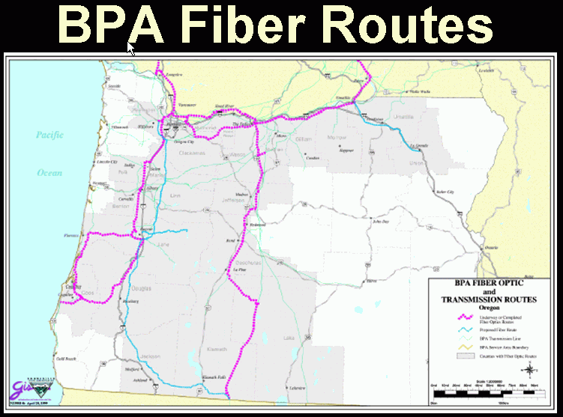
For Example, BPA Uses Its Fiber Optic Network to Control Energy Generation and Distribution Assets…

Slide 15
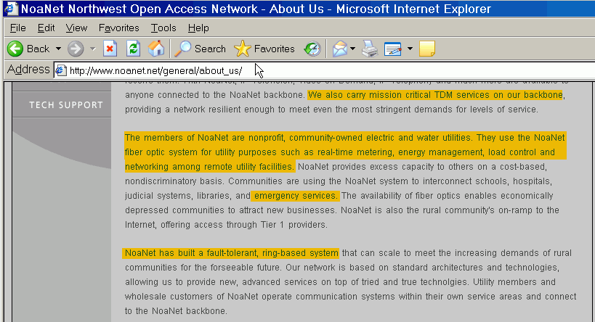
BPA Fiber Is Also Use By Others
[emphasis added]

Slide 16
Architectural Measures Designed to Protect Against Accidental Failures May Not Resist
Intentional Vandalism (Particularly By Insiders)
“According to reports, Canadian telecommunications company Aliant (aliant.com) suffered an attack of vandalism on its network Tuesday night. The vandals reportedly cut fiber optic cables, leaving thousands of users in Nova Scotia and Newfoundland without phone and Internet service. Approximately 125,000 people in Newfoundland (half its population) and 5,000 in Nova Scotia were affected. Services were taken down at about 10:30 p.m. Service was not restored until 7:00 a.m. Cables were cut in two separate locations. In Newfoundland, a connection to the main network and the backup was targeted. In Nova Scotia, one piece of fiber optic cable was cut. According to Aliant, the individual or individuals responsible had extensive knowledge of telecommunications networks. Aliant is currently embroiled in a major labor dispute with its 4,200 employees. Several reports have already noted the possible link between the dispute and the attack. The Royal Canadian Mountain Police are investigating. As of Thursday, Aliant said service had been almost completely restored.”
http://www.thewhir.com/marketwatch/van061004.cfm

Slide 17
III. Oregon Has Critical Facilities

Slide 18
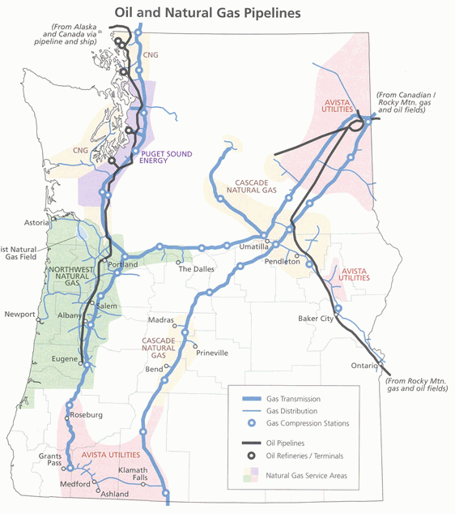
For Example, Pipelines…
[Atlas of Oregon, 2nd Edition, 2001]

Slide 19
Those Pipelines Are Potentially Vulnerable
“Sixty percent of the Northeast’s refined oil products are piped from refineries in Texas and Louisiana. A coordinated attack on several key pumping stations—most of which are in remote areas, are not staffed, and possess no intrusion detection devices—could cause mass disruption to these flows. Nearly fifty percent of California’s electrical supply comes from natural gas power plants and thirty percent of California’s natural gas comes from Canada. Compressor stations to maintain pressure cost up to $40 million each and are located every sixty miles on a pipeline. If these compressor stations were targeted, the pipeline would be shut down for an extended period of time. A coordinated attack on a selected set of key points in the electrical power system could result in multistate blackouts. While power might be restored in parts of the region within a matter of days or weeks, acute shortages could mandate rolling blackouts for as long as several years. Spare parts for critical components of the power grid are in short supply; in many cases they must be shipped from overseas sources.”
“America Still Unprepared – America Still in Danger,”
http://www.cfr.org/pdf/Homeland_Security_TF.pdf

Slide 20
There Is Too Little Understanding of How Little Reserve Capacity/Redundancy Exists, And the Current Lack of Delivery System Diversity
One practical example I experienced while traveling in Phoenix during August 2003: a 50-year-old, Kinder Morgan 8” gasoline pipeline failed, effectively reducing the available supply of gas in the Phoenix area by 1/3rd.
-- Loss of that single gasoline pipeline caused serious disruptions to the
availability of fuel in Phoenix (stations completely out of fuel, long lines,
gas prices skyrocketed, etc.), despite the fact that a second pipeline
remained in operation and gas was being trucked into the area to provide
additional capacity. (See http://www.cnn.com/2003/US/Southwest/08/18/
phoenix.gas.crunch.ap/ ) Why? The delivery trucks that would normally
be delivering fuel from the tank farm to the gas stations were now making
round trips to Tucson to ferry loads of fuel, one truckload at a time…
-- Ground water contamination also is a serious concern (as of 1/28/2004,
monitoring wells found liquid petroleum floating about 3 feet above ground
water, about 140 feet below ground, according to reports in the Arizona
Daily Star (http://www.dailystar.com/dailystar/relatedarticles/7534.php )
Not a SCADA failure, but an example of how precarious and reserve-free things have become… But let’s bring our focus back to SCADA…

Slide 21
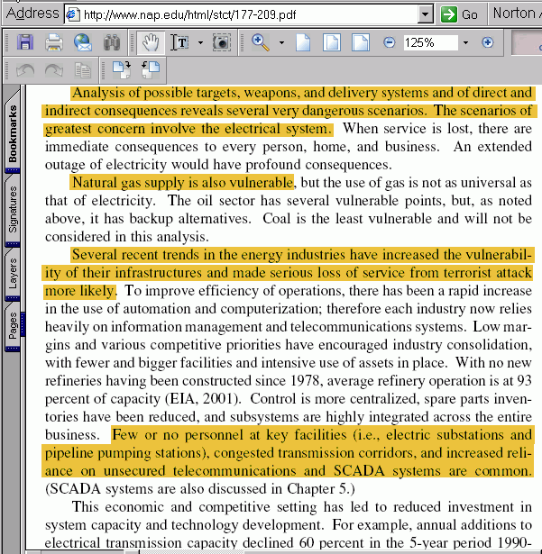
The Energy Sector and SCADA…
[emphasis added]

Slide 22
IV. Failure of Industrial Systems Such As Pipelines or Electrical Power Service (Whether SCADA-Induced or Otherwise Caused) Can Have Serious Consequences

Slide 23
Direct Effects, Indirect Effects, and 2nd Order Effects Associated with Incidents
In some cases, SCADA-related incidents cause direct problems: discharge of a polutant, destruction of property, fatalities.
In other cases, SCADA-induced incidents may cause indirect problems, as in the case of a loss of power: the power failure may not directly cause damage, but its absence may make it impossible for businesses to operate, etc.
In still other cases, that same loss of power might cause still other critical systems to fail, causing 2nd order effects resulting from the cascading failures, from one critical system to another.

Slide 24
Colonial Pipeline, Murfreeboro TN
Nov 1996 Diesel Fuel Pipeline Rupture
Quoting from http://www.ntsb.gov/publictn/1999/PAB9903.pdf
“With the pipeline continuing to operate, pressure was increasing at Murfreesboro. The controller did not note the overpressure condition that had developed at Murfreesboro, because the pressure transmitter for the station was downstream of the closed mainline block valve. (See figure 2a.) The controller was not aware of the actual pressure transmitter location because the supervisory control and data acquisition (SCADA) system schematic for the Murfreesboro station erroneously depicted the pressure transmitter as located upstream of the electric block valve, as it was at most other stations on the pipeline. […]
“The controller attempted to reopen the electric block valve at Murfreesboro for the first time at 9:35:02 a.m. Although the controller saw no indication of high pressure at the station because of the location of the pressure transmitter, pressure data evaluated since the accident indicated that a high differential pressure, at least 1,700 psig, existed across the valve at that time. This pressure exceeded the design limits (1,440 psi) of the motor used to remotely operate the valve, and the valve did not open. [continues]
84,700 gallons of diesel were spilled, with $5.7 million in damages; as of the time of the report (December 1998), only 43% of the spilled diesel had been recovered.

Slide 25
The ($50B) 9/14/2003 U.S. Blackout
“Starting around 14:14, FE [FirstEnergy] control room operators lost
the alarm function that provided audible and visual indications when a significant piece of equipment changed from an acceptable to problematic status. Analysis of the alarm problem performed by FE after the blackout suggests that the alarm processor essentially “stalled” while processing an alarm event. With the software unable to complete that alarm event and move to the next one, the alarm processor buffer filled and eventually overflowed. After 14:14, the FE control computer displays did not receive any further alarms, nor were any alarms being printed or posted on the EMS’s alarm logging facilities.
“FE operators relied heavily on the alarm processor for situational awareness, since they did not have any other large-scale visualization tool such as a dynamic map board. The operators would have been only partially handicapped without the alarm processor, had they known it had failed. However, by not knowing that they were operating without an alarm processor, the operators did not recognize system conditions were changing and were not receptive to information received later from MISO and neighboring systems. The operators were unaware that in this situation they needed to manually, and more closely, monitor and interpret the SCADA information they were receiving.”
ftp://www.nerc.com/pub/sys/all_updl/docs/blackout/
NERC_Final_Blackout_Report_07_13_04.pdf [emphasis added]

Slide 26
SCADA Failures Can Kill People
June 10, 1999, a 16” Olympic Pipeline Company pipeline ruptured and released 237,000 gallons of gas into a creek in Bellingham, Washington.
90 minutes after the rupture, the gas ignited and burned 1.5 miles along the creek, killing two 10-year-old boys and an 18-year-old man, as well as causing $45M in damages. See the NTSB Pipeline Accident Report (“Pipeline Rupture and Subsequent Fire in Bellingham, Washington, June 10, 1999”) at http://www.ntsb.gov/publictn/2002/PAR0202.pdf :
“As the delivery points were switched, pressure in the 16-inch pipeline began to build upstream from the delivery point. Controllers said such an increase was normal and that the incident response was usually to start a second pump at the unattended Woodinville station. The accident controller issued a command on OLY02 [one of two redundant SCADA systems used] to start the second pump at Woodinville. At 3:18:58, the event log indicates that the system failed to execute the command. At the same time, the SCADA system displayed an alarm from Allen station because of a high discharge pressure of 1,444 pounds per square inch, gauge (psig). Almost simultaneously, the controller operating the other pipeline section noted that the OLY02 system had become unresponsive to his commands. [continues]
See also http://www.cob.org/press/pipeline/whatcomcreek.htm

Slide 27
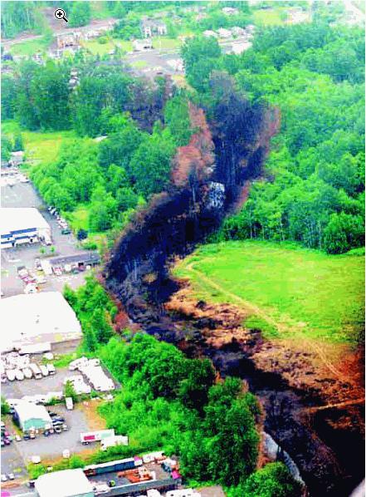
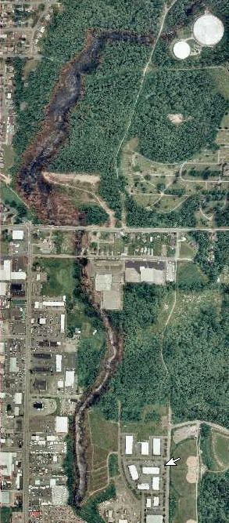
The Bellingham WA June 10, 1999
Gasoline Pipeline Rupture and Fire…

Slide 28
Sometimes Failures Aren’t Directly SCADA-Related, But Critical Infrastructure Incidents
Can Still Teach Valuable Lessons
Consider, for example, the El Paso Natural Gas 30” Pipeline rupture and fire near Carlsbad NM, August 19, 2000 described by the NTSB at http://www.ntsb.gov/publictn/2003/PAR0301.pdf
12 people were camping near the site and were killed in this incident. It is hard to believe that camping near a site of this sort was possible/tolerated, but at the time of the accident the site was privately owned and unfenced, although warning signs were posted (presumably unseen/disregarded).
Four natural gas transmission pipelines traversed the same site, along with a gas gathering line and a water pipeline (reuse of right of way is common, but it does introduce risk: e.g., damage to one pipeline might result in the damage or destruction of others)
While the NTSB concluded that SCADA issues did not contribute to this accident, there were multiple interruptions to transmissions between the control center and one of the compressor stations at about the time of the incident; it was established that at least the later of the interruptions was caused by emergency power shutdown of the compressor station, a step which cut power to the local SCADA computer and modem (the station has a UPS, but the SCADA computer and modem weren’t powered by it).

Slide 29
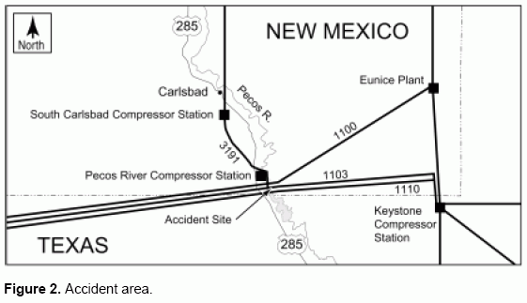
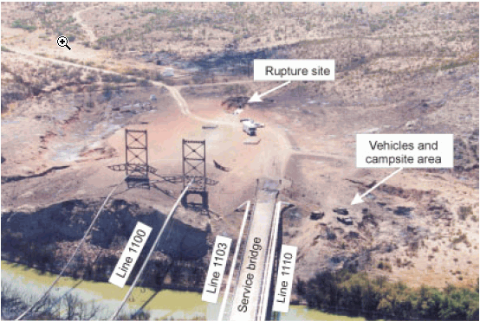
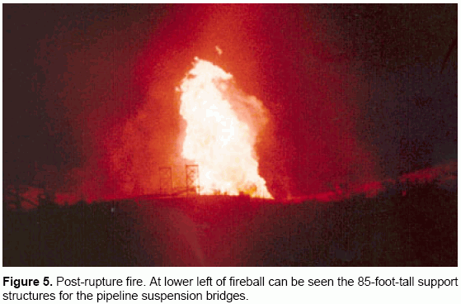
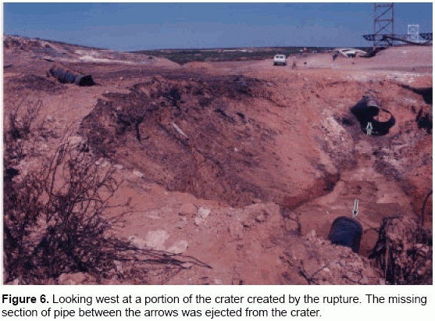
El Paso Natural Gas 30” Pipeline Rupture and Fire Near Carlsbad NM, August 19, 2000

Slide 30
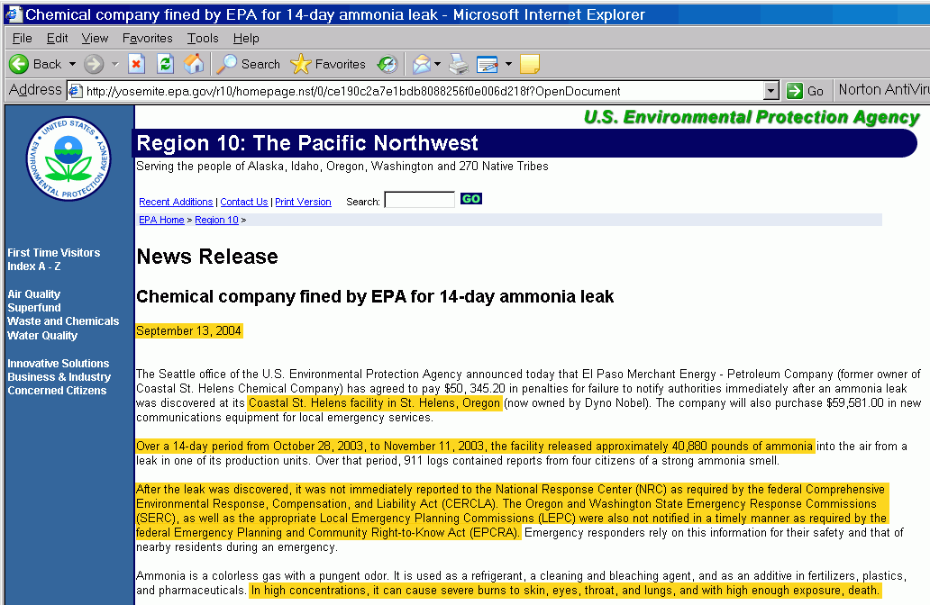
Another Example of An Instructive Incident:
The 14 Day St. Helens, Oregon Ammonia Leak…

Slide 31
Simple Loss of Electrical Power Can Have 2nd Order Effects
Plum Island Animal Disease Center ( http://www.ars.usda.gov/plum/ ), just off the coast of Long Island, NY, is the nation’s only center for the study of infectious animal diseases. A recently released book, Lab 257 by Michael Christopher Carroll (Harper Collins, NY, 2004, ISBN 0-06-001141-6) describes how on Sunday, August 18th, 1991 Hurricane Bob, a category 3 hurricane, hit Plum Island. Quoting from Carroll’s book:
-- ‘Normally, Plum Island’s power was supplied by the Long Island Lighting Company, via an undersea cable on the ocean floor. But the LILCO power grid shorted out and mainland power to the island laboratory failed. Fortunately, there was a backup plan. Oil-fired power generators kicked in at Building 103, the Plum Island emergency power plant, and supplied the island with electricity. The huge generators in Building 103 were old, but well maintained and effective. Building 103 supplied Lab 257 with power through overhead power lines and through underground cables that provided “redundancy.” […] Hurricane winds, gusting over one hundred miles per hour, topped the island’s overhead electric poles. […] Three months prior to Hurricane Bob, in a flurry of sparks and a wisp of gray smoke, one of the underground conductors shorted out; with it went the underground cable as a source of electricity. […] [The laboratory administrator], Dr. Breeze and his facility manager, Ernest Escorsica, thought replacing the cable was too expensive. The cost: $70,000. It would have to wait for next year’s budget.”

Slide 32
Loss of Electrical Power Can Have 2nd Order Effects (cont)
Continuing from Carroll’s book, “To maintain biological containment in 257, B Crew [four persons]needed to preserve sewage treatment, storage freezers, steam and negative air pressure.” All of that required electricity.
-- The sewage holding tank, containing biologically contaminated animal waste (feces, urine, blood, vomit, etc.) quickly filled and overflowed, contaminating large areas of the lab; staff had to pump that sewage without respirators or other protective gear
-- The lab’s freezer, which held samples of foot-and-mouth disease, African swine fever, Rift Valley fever, and other extremely dangerous pathogens, normally at negative 158 degrees Farenheit, began to thaw without power; the emergency liquid nitrogen transport container, was missing/unavailable.
-- The biologically hot areas of the lab, normally sealed with pressurized rubber gaskets, lost their seal integrity. With the seals gone, the lab’s normal negative air pressure normalized to ambient levels; emergency air dampers which were supposed to automatically close in case of power loss, failed open. Insects were seen flying in and out of the biologically hot labs.
In September, the four men who worked during that incident were RIF’d. Two subsequently came down with illnesses: one with a severe flu-like disease which lasted six years, and which was never able to be positively diagnosed; the other with an arthritis-like condition that lasted 18 months.
See also: http://www.gao.gov/new.items/d03847.pdf

Slide 33
V. And Say What You Will,
The Security of SCADA Systems
IS Often Poor

Slide 34
The Core Of This Talk:
SCADA’S Problems
Having established that dire things can happen when critical infrastructure fails, what can we say about SCADA’s structural issues without saying too much?

Slide 35
SCADA Security Today : Where Enterprise Network Security Was 5-10 Years Ago
“The present state of security for SCADA is not commensurate with the threat or potential consequences. The industry has generated a large base of relatively insecure systems, with chronic and pervasive vulnerabilities that have been observed during security assessments. Arbitrary applications of technology, informal security, and the fluid vulnerability environment lead to unacceptable risk. […] Security for SCADA is typically five to ten years behind typical information technology (IT) systems because of its historically isolated stovepipe organization.”
Federal Technical Support Working Group (TSWG)’s
“Sustainable Security for Infrastructure SCADA”
http://www.tswg.gov/tswg/ip/SustainableSecurity.pdf
(emphasis added)

Slide 36
The “Hidden Half” of the Network
Traditionally network and security folks have focused virtually all their attention on the “enterprise” side of the network, ignoring the parallel “hidden” half of the network associated with process control systems and distributed/embedded systems.
Process control systems and distributed/ embedded systems may use different protocols, do use different jargon, and no one ever really mentions them. They are out of sight and out of mind, and everyone assumes that things are being “handled” by the hardware guys.

Slide 37
“Hidden” Does Not Always Equal “Physically Separated”
In the old days, process control systems used proprietary protocols and ran with serial communications (e.g., RS232 connections or modems) or even on physically separated (“air gapped”) private/dedicated networks, but that’s no longer routinely the case.
These days, process control systems often run using MODBUS/TCP on the enterprise LAN and over the Internet; process control traffic may be commingled with web pages, email, P2P traffic, VoIP traffic, etc.

Slide 38
But Don’t Take My Word For It…
‘MISCONCEPTION #1 – “The SCADA system resides on a physically separate, standalone network.”
‘Most SCADA systems were originally built before and often separate from other corporate networks. As a result, IT managers typically operate on the assumption that these systems cannot be accessed through corporate networks or from remote access points. Unfortunately, this belief is usually fallacious.’
“Understanding SCADA System Security Vulnerabilities”
http://www.iwar.org.uk/cip/resources/utilities/
SCADAWhitepaperfinal1.pdf (RIPTECH, Inc., January 2001)

Slide 39
Serious Consequences of
SCADA-Related Compromises
While enterprise network security is undeniably important, unlike enterprise network security, SCADA compromises can have real world life safety impacts.
Enterprise network security breach: financial consequences, customer privacy is compromised, systems need to be rebuilt, spam gets sent, etc., but life goes on.
SCADA security breach? Property can be destroyed and people can be hurt or killed (e.g., recall some of the examples mentioned earlier).

Slide 40
Simple Protocols
Because SCADA devices with embedded controllers tend to have limited computational power, and have historically been connected via low speed serial lines, SCADA protocols tend to be quite simple, with little or no protection against spoofing, replay attacks, or a variety of denial of service attacks.
‘In a demonstration at a recent security conference, [Jeff Dagle, a PNNL EE] hacked into his testbed system and tripped an electrical breaker. The breaker then signaled the SCADA software that it had opened. But the SCADA controller did not respond because it had not instructed the breaker to open. It was a classic denial-of-service attack. "We were demonstrating a weakness at the protocol level itself," said Dagle.’ http://memagazine.org/ backissues/dec02/features/scadavs/scadavs.html

Slide 41
Long Life Cycle Devices
Industrial plants, and the instrumentation they include, tend to be long life cycle projects – ten, fifteen or twenty year project lives are by no means uncommon. As a result, the devices that may be deployed as part of that construction may be virtual antiques by the time the facility is finally decommissioned, and there’s no provision for refreshing those devices the way you might upgrade out of date PCs in an office.
‘"Anti-virus software doesn't work on these SCADA systems," said Robert Childs, information security analyst at the Public Service Company of New Mexico, who spoke at NetSec about the challenges in working with SCADA vendors to get them to comply with the new rules. "Many of these systems are based on old Intel 8088 processors, and security options are limited to us.“’ http://napps.nwfusion.com/news/2004/062104secwrap.html

Slide 42
Windows-Based Control Stations
SCADA devices are often controlled from central monitoring stations (MTUs, or “master terminal units”). Historically those were Unix-based systems, but many contemporary MTUs are now Microsoft Windows based.
“The end-of-life for Windows NT is having a big impact on manufacturers.”
http://www.digitalbond.com/SCADA_Blog/
2004_07_01_archive.html

Slide 43
Hard-to-Upgrade Remote Devices
Remote devices (RTUs and PLCs) also tend to be hard to upgrade :
-- the device may use an OS and application that was burned to ROM, and which is not rewritable (“upgrade” == replacing ROMs)
-- the device may be physically sealed and not upgradeable, or be located in a difficult location, or have no removable media
--- the vendor may no longer be in business, or may not be producing upgrades, or the vendor may not be allowing upgrades

Slide 44
Certifying Patches
An example from the embedded system world:
“Health care IT professionals say medical device makers prohibit them from changing the systems and even from running anti-virus software in some cases. These IT administrators say manufacturers often are slow to supply software patch updates and routinely claim the Food and Drug Administration (FDA) requires approval of patch-base changes. However the FDA says it has no such rules…”
http://www.nwfusion.com/news/2004/
070504hospitalpatch.html

Slide 45
Need For Positive Control ==> Simple Known/Shared Passwords
Because of the need for positive access and control, there is a trend toward simple, known, and shared passwords. Users like to avoid situations such as: “Do you know the password to turn off the nuclear reactor before it melts down? I forgot mine today…”
But there’s hope: people in the SCADA community are beginning to talk about strong auth systems: http://www.digitalbond.com/
dale_peterson/ISA%20July%20Event.ppt

Slide 46
Common Passwords
Across Multiple Devices
There’s also the sheer issue of managing passwords for thousands of devices – passwords will tend to be common across devices as a practical matter (this is much like SNMP community strings)
And of course those passwords aren’t changed very often (if at all), even when staff transitions occur or years have gone by…

Slide 47
Access Control Granularity and Accountability
Related to the problem of shared, simple passwords is the issue of poor access control granularity; again, like SNMP, in most cases access control is “read” (everything) or “read/write” (everything).
Accountability with common passwords is poor/non-existent, which may be one reason that transaction logging also may be limited. (Any bets how long it will take to get something like syslog-ng or SDSC Secure Syslog for SCADA systems?)

Slide 48
Plain Text (Unencrypted) Traffic
These days, few of us would be willing to send our passwords over plain text transmissions paths (as we would when using telnet), yet plain text transmissions are still very common in the SCADA world.
One notable exception: the AGA/GTI SCADA Encryption initiative…
http://www.gtiservices.org/security/
In the realtime world, encryption
overhead and jitter may be the crucial problems to overcome…

Slide 49
All Traffic Is On Just One Port
In many cases, SCADA traffic will be on just one port such as 502/tcp (e.g., Modbus/TCP). This is both good and bad.
The use of a single port (or just a couple of ports) makes it easy to track that traffic, or to poke a hole in firewalls to allow that traffic to pass, but it also makes it easy for the bad guys to scan for connected devices, and it makes it impossible to do port-based selective filtering.

Slide 50
Few Firewall Options
Speaking of firewalls, SCADA-protocol aware firewall choices are pretty limited out there right now; I’m aware of:
http://modbusfw.sourceforge.net/
and that’s about it.
Where are the commercial SCADA-protocol-aware firewall vendors? I’d love to find out that there are dozens out there that are available which I’ve missed…

Slide 51
Critical Control Traffic on a Best Effort Network
In some cases, SCADA systems may be impacted incidentally, as a side effect of a more general problem (e.g., frame relay network congestion and outages associated with the Slammer worm). See for example “Slammer worm crashed Ohio nuke plant network,” in
http://www.securityfocus.com/news/6767/
citing http://www.esisac.com/publicdocs/
SQL_Slammer_2003.pdf

Slide 52
VI. What Must We
[Network/IT Folks] Do?

Slide 53
SCADA Systems Must Be Hardened
All the security areas just mentioned need to be reviewed and addressed on a system by system basis, which in some cases will mean substantial new investments/forklift upgrades, or even concerted pressure on vendors for whom new security requirements may come “like a bolt out of the blue.”

Slide 54
That Said, Many Vendors Are Ramping Up
Cisco deserves a big “atta boy” for its
Critical Infrastructure Assurance Group:
http://www.cisco.com/security_services/ciag/
You may also want to check out the Cyber Security Industry Alliance (CSIA) at
https://www.csialliance.org/ whose members include over a dozen leading security-related vendors.
Vendors of SCADA-enabled devices might be moving a little slower…
Make sure vendors know what SCADA security products YOU need them to be making!

Slide 55
Hard-won Lessons From Enterprise IT Need to Be Tech Transferred to SCADA Networks and Systems
Much of what’s being faced in the SCADA world has already been hashed through and fixed in the enterprise IT world. Those solutions, where suitable, need to be “thrown over the wall” to SCADA networks and systems so SCADA folks don’t “reinvent the wheel.” IT folks need to visit with the process control guys and gals.

Slide 56
Our Local SCADA Infrastructure
Needs to Be Secured
While admittedly many SCADA issues are national in scope, there are undoubtedly SCADA control systems here in Oregon – perhaps even SCADA systems operated by people in this room today – which need review.
Are those local SCADA systems secure?
What about the networks they use?
Do you see local port 502/tcp traffic on your enterprise backbone or transit links? Should it be there?
Are you seeing probes targeting SCADA facilities from offsite? Are you reporting or blocking those probes?

Slide 57
Speaking of Probes…
One familiar technique from enterprise network security is the “honeypot,” or a system that *looks* vulnerable/exploitable, but which is actually well instrumented and being run solely to capture evidence of miscreant misbehavior.
There’s one SCADA honeypot project:
http://scadahoneynet.sourceforge.net/
but how many folks are actually deploying SCADA honeypots? Not very many, I suspect… Maybe deploy one?

Slide 58
Update Intrusion Detection Systems
Work has just recently begun on a DHS-funded research projected focused on developing Snort signatures for MODBUS/TCP; see:
http://www.digitalbond.com/SCADA_Blog/
2004_05_01_archive.html
The excellent open source protocol analyzer Ethereal (www.ethereal.com) and a number of other common protocol analyzers also support Modbus protocols.

Slide 59
If You Do Security Training, Add
SCADA Security to The Syllabus
If you teach network security courses at your company, or as part of the training the cybercrime investigators receive, make sure SCADA security becomes part of that syllabus.
Besides the topics covered already in this talk, some additional areas which may be worth consideration include…

Slide 60
Embedded Real Time
Operating Systems (RTOS)
We all know some version of Windows (or Unix), but quick check: how many of you are also familiar with embedded RTOS’s like:
-- Integrity from http://www.ghs.com/
-- LynxOS or BlueCat from
http://www.lynuxworks.com/
-- QNX Neutrino http://www.qnx.com/
-- RTOS-32 from http://www.on-time.com/
-- TinyOS from http://www.tinyos.net/
What are their respective security strengths and weaknesses? SHOULD you know?

Slide 61
How About Hardware Topics, Such as Programmable Logic Controllers?
Unless you’re an electrical engineer, you probably never had a chance to learn about PLCs, even though there’s excellent support for educational use of programmable microcontrollers such as Basic STAMPs from www.parallax.com
or more traditional ladder-logic programming PLCs such as Toshiba’s T1 (see http://xtronics.com/toshiba/plcnf.htm and http://xtronics.com/toshiba/Ladder_logic.htm

Slide 62
VII. What Are A Few Things
Critical Infrastructure Industries Should Be Thinking About?
What Should They Be Fixing?

Slide 63
The Potential List Is Long, And Parts Aren’t Well Suited to Public Discussion
What’s required may vary from industry to industry
It is hard to make concrete suggestions without identifying current vulnerabilities
We’ll offer just a few strategic observations, and then a few tactical suggestions…

Slide 64
Work With Government Agencies to Insure Security Priorities Have Been Set Appropriately
If you were to compare security initiatives in the area of critical infrastructure (particularly in the electricity generation and distribution area, and the pipeline area) to security initiatives for commercial aviation or nuclear power, how would that balance look to you?
“Congress Passes DHS Spending Bill” http://www.fcw.com/fcw/articles/2004/1011/web-dhs-10-11-04.asp
-- $32 Billion to DHS
-- $67.4 Million for “cybersecurity”
[For context, one V-22 Osprey tilt-rotor aircraft costs $100 million according to http://www.washingtonpost.com/wp-dyn/articles/A25659-2004Oct11.html ]
See also “Cybersecurity for the Homeland,” House Subcommittee on Cybersecurity, Science, and Research & Development (released yesterday) http://hsc.house.gov/files/cybersecurityreport12.06.04.pdf

Slide 65
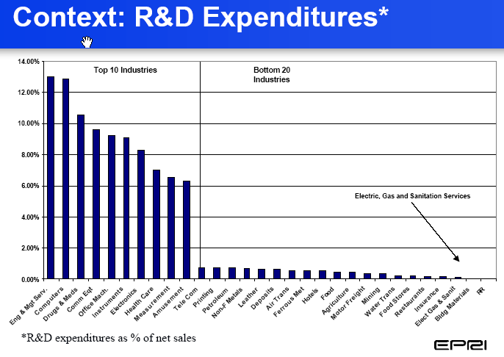
Increase Industry Spending On
R&D (Including Security R&D)…
[chart from Massoud Amin’s “R&D challenges in R&D challenges in
Security of the Security of the Electricity Infrastructure”, Feb 2004]

Slide 66
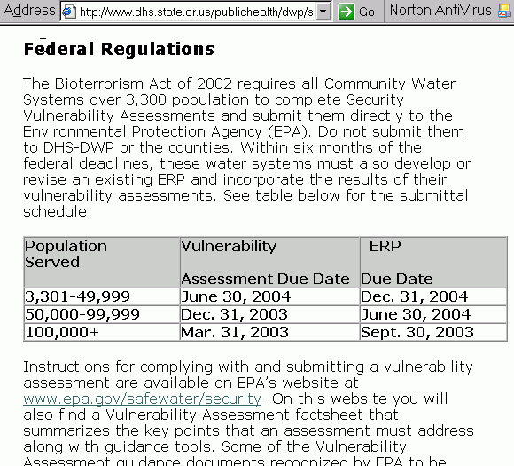
Do Vulnerability Assessment/Security Auditing/Penetration Testing of SCADA Systems
Some named industries are already required to do this sort of thing…

Slide 67
Be Sure Any Security
Exercises Are Realistic
Don’t do it the NRC way…
GAO: “NRC: Oversight of Security at Commercial Nuclear Power Plants Needs to Be Strengthened” (September 2003)
http://www.gao.gov/new.items/d03752.pdf
-- “The [security] exercises were conducted infrequently, against plant security that was enhanced by additional guards and/or security barriers, by simulated terrorists who were not trained to operate like terrorists, and with unrealistic weapons. In addition, the exercises did not test the maximum limits of the design basis threat…”
-- “According to NRC officials, they provided the licensee with up to 12 months’ advance notice of OSRE [force-on-force] exercises so that it could assemble a second team of security guards to protect the plant while the exercise was being conducted. However, the advanced notification also allowed licensees to enhance security prior to the OSRE exercises, and they were not required to notify NRC of any enhancements to their security plan. As a result, according to NRC officials, during the exercises, many plants increased the number of guards that would respond to an attack; added security barriers, such as additional fencing; and/or added defensive positions that they did not previously have…”

Slide 68
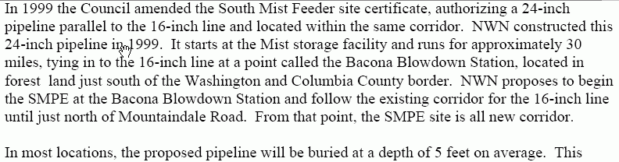
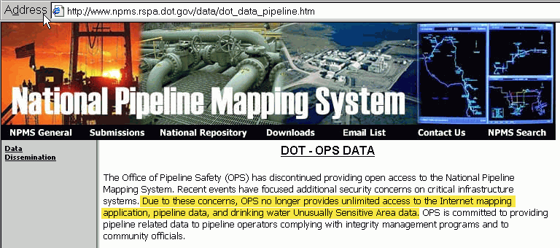
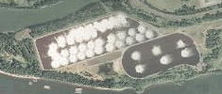
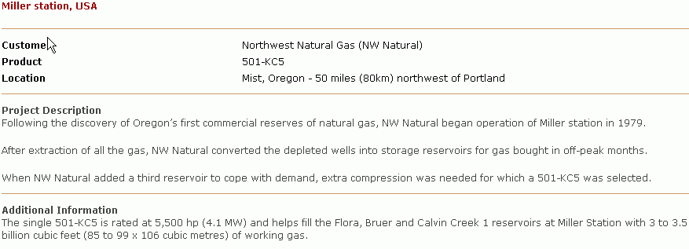
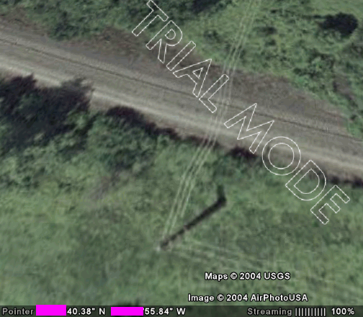
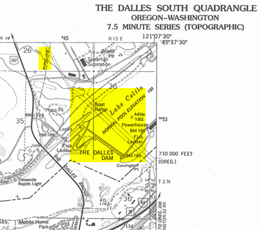
Think About Information Management and Target Intelligence Collection

Slide 69

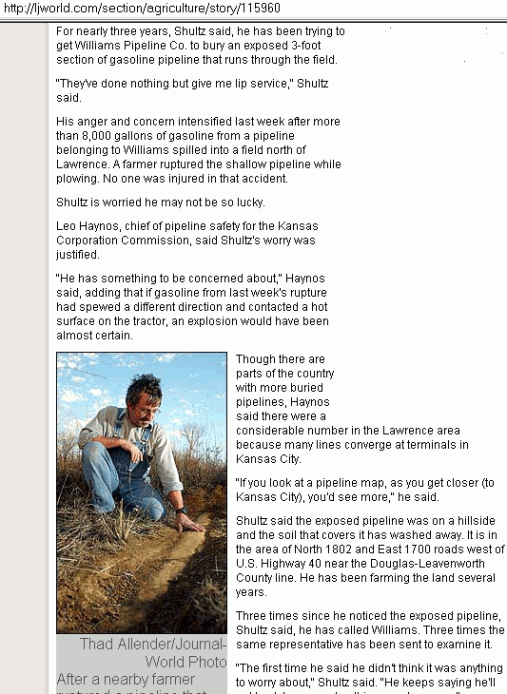
Reconsider The Extent To Which
Buried == “Inaccessible and Safe”

Slide 70

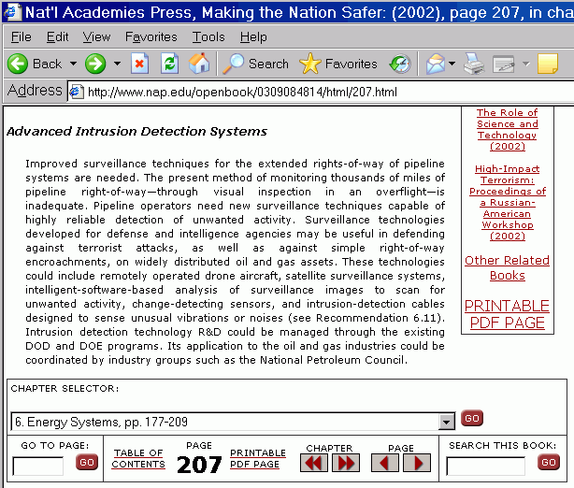
Increase/Improve ROW Surveillance
[emphasis added]

Slide 71
Improve Remote Monitoring of Key Sites
If you have fiber to remote facilities, you have sufficient bandwidth to allow for extensive video and audio instrumentation of that facility, and for reports from sophisticated intrusion detection systems. Those systems should be tied into SCADA systems, and system responses should be recalibrated in response
to identification of active or potential threats.
Alternatively, aren’t key remote facilities (many of which cost millions to build, and which are virtually irreplaceable) important enough to justify round-the-clock on-site technical and security personnel?

Slide 72
Assume Technical Staff May Need
Security Support at The Site of Incidents
If you assume the severity of an incident is proportional (in part) to its duration, it would be reasonable to assume that terrorists might actively attempt to prevent crews from accessing and repairing a damaged facility. Assuming this is true, technical staff may need security staff to protect them from attack or to help them avoid IEDs/booby traps while restoring a damaged facility. [Protection of technical staff should be a very high priority given that there may be a limited number of qualified and knowledgeable individuals available.]

Slide 73

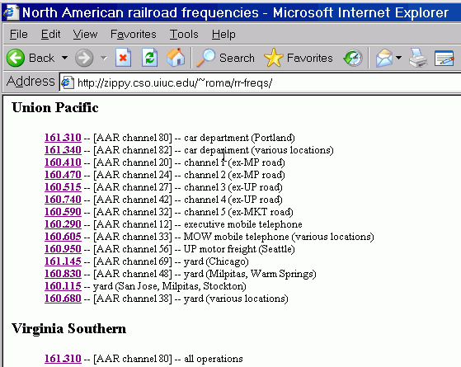
When a SCADA Incident Occurs, LE & Company Staff On Site Routinely Use VHF/UHF Radios for Communications; People May Be Listening, Even With Digital Trunking

Slide 74
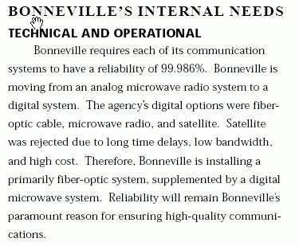
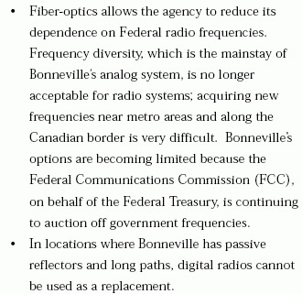
When Upgrading Communication Systems, Retain Those Moldy-Oldie Communication Systems For Potential Backup SCADA Use

Slide 75
Improve Vetting of Key Staff;
Review Personnel Policies
Insider threats will always remain a serious potential issue; insiders have specialized knowledge and tools, trusted access, etc.
Are you thoroughly screening your staff? (You can see what the federal government requests for their sensitive positions at “Questionnaire for Public Trust Positions” at
http://www.opm.gov/forms/pdf_fill/SF85P.pdf )
Have you visited with your personnel office about the potential impact of labor actions on staffing requirements and staff access to critical systems? (labor issues were involved, for example, in the water facility sabotage that reportedly occurred on Plum Island, as described in the report at http://www.gao.gov/new.items/d03847.pdf )

Slide 76
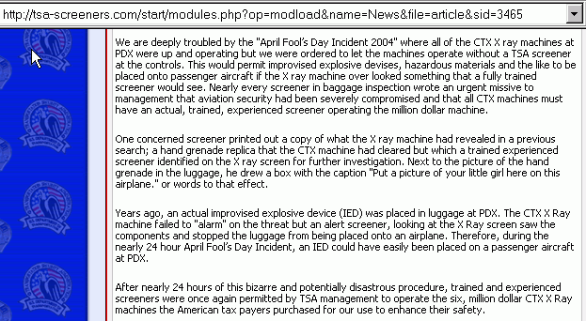
Provide An Appropriate Mechanism By Which Staff Can Share Crucial Security Issues :-)
[excerpt from a petition reportedly sent on 8/23/04 to DHS Secretary Tom
Ridge, TSA Director David M. Stone, US federal inspector general, the TSA
Inspector General, the Oregon and State of Washington Congressional
Delegations, and the Oregon and Washington Governors]

Slide 77
Questions?
Thanks for the chance to talk today!

