Slide 1
Security Activities Update
Internet2/ESnet Joint Techs
College Station TX, February 4th, 2009
Joe St Sauver, Ph.D.
Manager, Internet2 Security Programs
(joe@uoregon.edu or joe@internet2.edu)
http://www.uoregon.edu/~joe/sec-update-2009/
Disclaimer: The opinions expressed in this talk do not
necessarily reflect the opinion of any other party.

Slide 2
Goal Of This Session
This session is meant to bring you up to speed on some of the things that have been going on in the higher ed security
community, including:
-- some Internet2-community security activities, and
-- emerging security issues you should be tracking.
Since this is only a twenty minute slot, you're only going to get a "20,000 foot" view, but feel free to drop me a note if you have any questions following today's talk

Slide 3
(1) Security and Internet2
The Internet2 Security Program is part of the Internet2 Middleware and Security Area, led by Ken Klingenstein.
Security activities within Internet2 have traditionally been guided by SALSA, a technically focused group currently led by Chris Misra of the University of Massachusetts.
Over the last year or so, Internet2 has established also established senior advisory councils to help advise and shape the work of Internet2. Within Internet2, the Security Area is advised and guided by the Applications, Middleware and Services Advisory Council (AMSAC), chaired by Ray Ford of the University of Montana.
During the Fall Internet2 Member Meeting AMSAC met in public session and had a chance to consider a two page table listing twenty or so security areas which the Internet2 community could potentially work on.
Topics on that list included (in no particular order)…

Slide 4
Twenty Potential Security Topics
Spam | FWNA/Netauth (Federated Wireless Net Access)
Malware | REN-ISAC Incident Handling and Trust Community
Phishing | Development and Distribution of Security Tools
DDoS | Mobile Devices
Encryption, Sniffing and Privacy | Disaster Planning and Recovery
Replacing Traditional Passwords | Convening Senior Campus Leadership & the Campus Expectations Task Force
Firewalls, Middleboxes and End-to-End Transparency | Security Technology Evangelism and Leadership
IPv6 and Security | Security Policies
Domain Names, IP Addresses, DNS and DNSSEC | Engaging Standards Bodies (IETF, etc.) Regarding Security Issues
Switching and Routing Security (including Securing BGP) | Management/Security Support for Distributed Servers

Slide 5
Some Notes About That “Security Areas” Document
For each security area mentioned, we provided AMSAC with:
-- a nutshell description of the topic
-- an explanation of why it was a potentially worthy area
-- a sense of “just how bad is this problem?”
-- some key potentially relevant technologies, and
-- some potential commercial/technical partners
If you’d like to see the actual table, it is available on the web at
http://www.uoregon.edu/~joe/security-tasks.pdf
Please note three things about that table:
-- That chart only included the most urgent of issues; additional
important security issues also exist which probably exceed our
available capacity
-- Topics in the table are NOT listed in priority order
-- For some security topics, Internet2 might be a supporting partner
rather than the lead for that area

Slide 6
What Security Topics Would
You Like to See Us Work On?
While that table lists some potential security areas we could work on, Internet2 is and should be a member-driven organization, so we'd love to hear from you about the security topics you'd like to see us focus on. If you have comments or suggestions please feel free to contact me: joe@oregon.uoregon.edu or joe@internet2.edu
Just to help get that conversation started:
-- Is security an issue or concern for you and your site?
-- Are you primarily concerned about short term operational
security threats, or would you rather see Internet2 focused
more on intermediate (or longer term) security issues?
-- Internet2's portfolio obviously embraces the national backbone,
but should it also have an end-to-end security focus, including
regional networks, campus networks, and host and app security?

Slide 7
We're Also Explicitly Asking For Your Help
Internet2 does not have a huge staff of employees working on security issues, so if we're going to make progress on some of these issues, we need your help and involvement
Many times, you can help the community tremendously just by employing security best common practices on your own network (e.g., deploy BCP38 anti-spoofing filters, harden your DNS servers, monitor your own routes, etc), and by responding to any security incidents which may come to your attention.
Ideally, however, we'd love to see you and/or your security people go beyond that and actively help work on Internet2 security projects and areas, perhaps volunteering to work on (or even lead!) a working group tackling one security area or another.
Also, should we be increasing student involvement in security, perhaps offering distributed security internships to help get more students involved in the community's security work?

Slide 8
(2) DOJ Grant and Security Workshop
You may recall that a year or two ago the community received a grant from the Department of Justice Office of Justice Programs supporting a workshop and a number of other activities (e.g., see
mail.internet2.edu/wws/arc/i2-news/2007-03/msg00001.html )
I'm pleased to be able to report that another year of funding has been received from DOJ.
That funding will underwrite a two day invitational security workshop which will be held in spring or early summer, most likely in the Baltimore, Maryland area. The workshop will focus on data driven approaches to collaborative system and network security in high performance networks, and will bring together members of the academic security community, private sector security researchers, and government/law enforcement participants.
If you’re interested in potentially attending or presenting at this workshop, please send me email.

Slide 9
(3) One Example of Work Funded by the DOJ Grant: SES (Security Event Standardization)
Work underway: REN-ISAC, Internet2 CSI2, DOJ grant
Coordinated with similar work at Argonne National Lab for the Department of Energy.
If you:
  operate an IDS or firewall
  have ACLs, or iptables
  collect netflow or similar data
  operate a DNS server and log requests
  run an sshd, or
  etcetera
Then you have the potential to collect valuable security intelligence

Slide 10
SES (Security Event Standardization)
Security event information is being shared, but most current methods are cumbersome, are not easily automated, aren’t based on a standardized data representation, and are not structured for correlation and analysis.
SES: In real-time, and in a standardized (IDMEF*) representation, share security event information within a trusted federation, and among federations
-------
* IDMEF == Intrusion Detection Message Exchange Format, see RFC4765

Slide 11
SES (Security Event Standardization)
Phase I Solution
  Local log (IDS, firewall, sshd, DNS, darknet sensor, etc.) parsing to yield “mid-level events”.
  Normalized data description in IDMEF
  Transport, storage, and retrieval
  In the context of a trusted federation
  Pilot and production deployments (spring/summer) in REN-ISAC
  Framework:
    incorporation of additional correlation and analysis tools
    Interface with systems that notify abuse contacts regarding infected systems, e.g. the REN-ISAC notification system
    Interface with systems that treat higher-level incident information in a federated context

Slide 12
SES (Security Event Standardization)
Extending the framework
  Long term intelligence storage
  Feed of security intelligence to other federations and mitigation communities
  Threat analysis platform
  The Future
    Rapid application development
    “Super Crunching” of data

Slide 13
SES (Security Event Standardization)
If you’re interested, please contact:
  Doug Pearson
    dodpears@ren-isac.net
  Wes Young
    wes@barely3am.com
Now let's look at some changes that are coming to the REN-ISAC.

Slide 14
(4) REN-ISAC
Most of you already are familiar with the REN-ISAC, higher ed's security incident handling trust community. However, if you're not familiar with the REN-ISAC, there are some great introductory overview documents you can check out:
  REN-ISAC flier (8.5 x 11 color glossy):
  http://www.ren-isac.net/docs/ren-isac_brief.pdf
  Executive Overview:
  http://www.ren-isac.net/docs/ren-isac_executive_overview.pdf
Membership is open to:
  institutions of higher education,
  teaching hospitals,
  research and education network providers, and
  government-funded research organizations;
  international, although focused on U.S.
Current membership: 261 institutions, 563 individuals

Slide 15
Please Note That The REN-ISAC Membership Model Is Changing
Objectives of the new model are to:
  Extend the reach of REN-ISAC more broadly in the R&E community (make it easier for entry-level participation), while retaining, a strongly trusted information sharing core
  Establish a long-term sustainable business model
Feb 2009 – a new, tiered membership model.
  Institutions (not individuals) join, represented by a “management representative” and one or more “member representatives”.
  General and XSec (eXtraSecure) member representatives. The tiers differ in the criteria for membership, the degree vetting that member representatives undergo, and the classification of sensitive information shared in the tier.
July 2009 – a modest membership fee
Changes described in: "Membership Model Changes - 2009"
http://www.ren-isac.net/docs/ren-isac_membership_20090127.pdf

Slide 16
REN-ISAC Contacts
Executive Advisory Group, see https://secure.ren-isac.net/eag/
Jack Suess, Chair EAG, jack@umbc.edu
Mark Bruhn, Executive Director, mbruhn@iu.edu
Doug Pearson, Technical Director, dodpears@ren-isac.net
Gabriel Iovino, Principal Security Engineer,
giovino@ren-isac.net
http://www.ren-isac.net
24x7 Watch Desk:
soc@ren-isac.net
+1 (317) 278-6630

Slide 17
(5) Federal Cyber Security Initiatives
Over the last year or so a number of federal agencies have been working on their medium to long term roadmaps for their network security research initiatives (including potentially future community security research funding opportunities).
We've participated in a number of those roadmap workshops, along with other members of the higher ed security community, government agency staff members, and researchers from private sector security firms. Attendees would commonly hear a number of invited presentations, and then break out into groups to consider issues the community faces.
The synthesis of those various agency roadmaps, along with input from independent groups (such as the Commission on Cyber Security for the 44th Presidency, http://www.csis.org/tech/cyber/ ),
will likely profoundly influence the new administration's cyber security programs and research initiatives. We're already seeing signs that the White House takes cyber security very seriously….

Slide 18
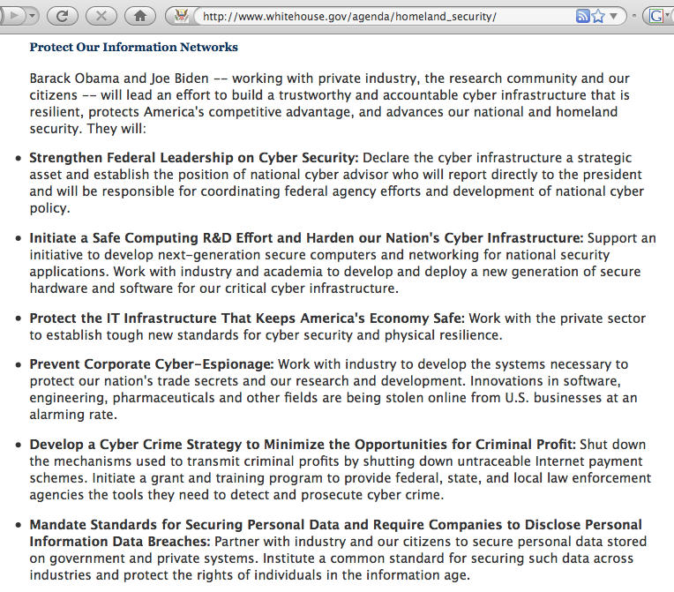

Slide 19
(6) ICANN GNSO Fast Flux Working Group
We've also been busy with key non-governmental community networking organizations.
Some of you may be familiar with the notion of “fast flux hosting.” Fast flux hosting is a technique in which a miscreant rotates a domain name across a pool of botted PCs (via automatically-updated DNS entries with short TTLs), using those hosts to provide highly survivable web hosting or for other purposes.
Sites hosted on fast flux web sites often include malware, phishing sites, pirated software sites, child porn sites, sites selling narcotics and other illegal prescription drugs, etc. -- illegal content that legitimate hosting companies obviously will not tolerate.
We were invited to participate in the ICANN GNSO Fast Flux working group, and that group recently released a 121 page initial report for public review and comment (through 15 February 2009). If you'd like to read that report and offer comments, please see www.icann.org/en/announcements/announcement-26jan09-en.htm

Slide 20
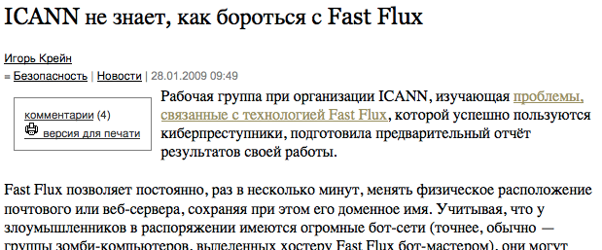
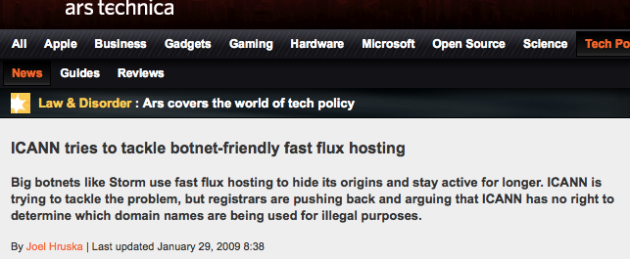
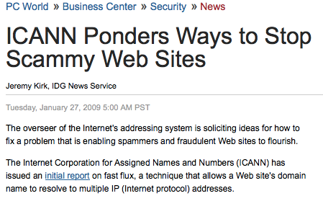
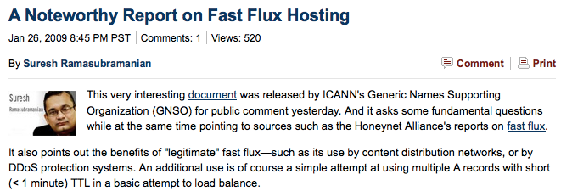
This GNSO Report Has Gotten Press Worldwide

Slide 21
This Is Your Chance to Weigh In On What You'd Like to See ICANN Do (or Not Do)
This is a somewhat pivotal moment for ICANN. During the last ICANN Meeting (held in Egypt), I'm told that there was an unprecedented level of attendee interest in cyber security issues.
Many attendees in Egypt were urging ICANN to take a more active role in addressing cyber abuse issues; at the same time, there are others who would strongly prefer that ICANN minimize or avoid taking on any new activities in the security area.
What would YOU like to see? Is Fast Flux (and other security issues) a problem that ICANN should tackle? Should ICANN ignore these issues?
If you have an opinion about this issue, be sure to send your comments about the Fast Flux report to ICANN no later than 15 February 2009.

Slide 22
(7) Cyber Infrastructure Architectures,
Security and Advanced Applications
At the Spring 2008 Member Meeting, we talked about how cyber security often comes up -- but not for the right reasons. More often than not, security practices and security-oriented network architectures hinder, rather than help, user to do their work.
Firewalls are a special area of concern. In that paper we talked about why people turned to them, their strengths and weaknesses, and some alternatives to a classic perimeter firewall architecture.
The risk we face is that if we aren't careful, eventually only the web (and things which tunnel traffic in web-like ways) will remain.
We also talked about a new potential role, the “network usability officer,” a person who is really is the third leg of an institutional network policy triad (the other two legs would be the institutional chief information security officer and the site’s privacy officer).
See www.uoregon.edu/~joe/architectures/architecture.pdf

Slide 23
(8) Security and DNS
The Domain Name System (DNS) is fundamental to everything we do on the Internet, but it remains woefully insecure. Because of that insecurity, DNS is becoming an increasingly popular target
for abuse. Common DNS attacks now include DNS poisoning, DNS amplification attacks, and "DNS changer" attacks.
DNS poisoning: EVERYONE must now run a DNS server product that is resistant to the DNS poisoning vulnerabilities Dan Kaminsky identified; check yours using
https://www.dns-oarc.net/oarc/services/dnsentropy (see next slide)
DNS amplification via spoofed traffic: The DNS attack de jour uses spoofed DNS queries asking for root NS info; again, a web based tester is available, see: http://isc1.sans.org/dnstest.html
DNS changer: Malware substitutes the IPs of the bad guy's name servers for yours; once they control your DNS servers, game's over! Watch for customer DNS going directly to odd IP addresses!

Slide 24
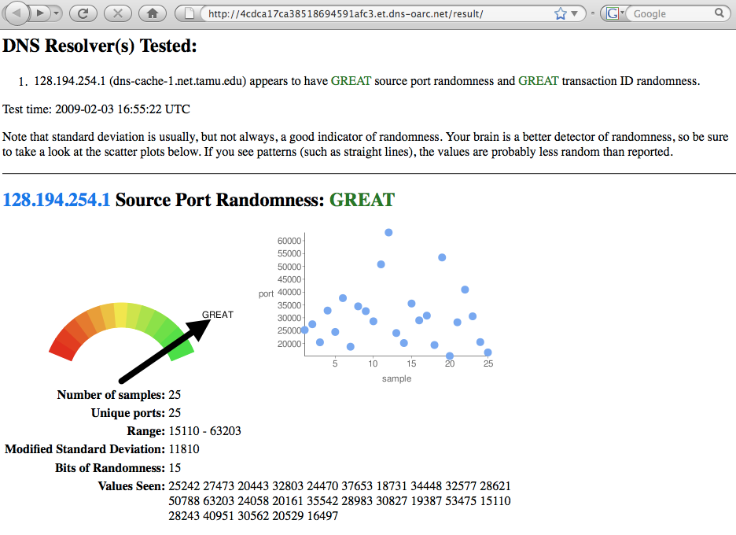
<== Good work, Texas A&M!

Slide 25
Fixing DNS (If It Does Need Some Attention)
As a basic matter, you need to get your DNS servers correctly architected (e.g., splitting your authoritative servers and your recursive resolvers), and you must also appropriately control
non-customer access to your recursive resolvers.
Beyond basic things like that, however, you should be planning for deployment of DNSSEC. DNSSEC uses cryptographic signatures so that IF a DNS entry has a valid signature, THEN we can trust the DNS responses we receive. While there are still many issues which the community needs to work through, DNSSEC is incredibly important, and something whose deployment your campus or site should be working on now.
Interested in learning more about DNSSEC? Internet2 has a DNSSEC effort that holds periodic conference calls and which has a mailing list; to subscribe send email <sympa@internet2.edu> _x000b_with the SUBJECT LINE: subscribe dnssec FirstName LastName
We're also beginning to plan for an Internet2 DNSSEC workshop.

Slide 26
(9) Securing the Routing Infrastructure
While DNSSEC has a lot of momentum right now, there are some other network security areas that have had a much slower start.
For example, consider S*BGP. Cryptographic approaches to routing security just really haven’t caught on despite demonstrated examples of stunning insecurities related to BGP.
The good news is that DHS has announced a new emphasis on improving router security; you may have seen Douglas Maughans's comments in "U.S. plots major upgrade to Internet router security: Millions to be spent adding cryptography to BGP," 1/15/2009, www.networkworld.com/news/2009/011509-bgp.html
I'm happy to report that Douglas has agreed to come and provide a briefing on this new initiative for the Spring Member Meeting.

Slide 27
(10) Salsa-DR
Our colleagues at Educause annually ask higher ed CIO's to rank their top ten IT issues. In 2008, the most recent year for which data is available, the number one issue was "Security" (a good and bad place to be!) but their number six issue was "Disaster Recovery & Business Continuity." (see http://tinyurl.com/EducauseTopTen )
Internet2's primary effort to address the CIO disaster recovery concern is SALSA-DR.
In addition to work on recommendations for IT disaster recovery best practices, Salsa-DR also pioneered work on campus real time emergency communication efforts (as mandated by the Clery Act), and now many of our campuses have reverse-911 service, reader boards, and other real time emergency communication capabilities.
Opportunity: Salsa-DR's former head recently stepped down due to new state wide travel restrictions; if you're from an Internet2 site and would be interested in leading this work, please send me email.

Slide 28
(11) A "Mundane" Risk: The Insider Threat
During the Fall Internet2 Member Meeting, we talked about “Loss of Network Control Incidents,” specifically the issues the city of San Francisco ran into whereby they were locked out of their network, allegedly the result of actions by a city employee. If you didn’t have the opportunity to attend that session, detailed slides are available at www.uoregon.edu/~joe/loss-of-network-control/
The insider threat continue to be a serious risk during this period of economic uncertainty. A recently revealed example was the alleged Fannie Mae “logic bomb” incident (targeting data on 4,000 Fannie Mae systems for potential deletion). An FBI press release dated January 27th, 2009 describing the alleged incident is at http://baltimore.fbi.gov/dojpressrel/pressrel09/ba012709a.htm
We urge you to review your policies and controls intended to limit potential misbehavior by insiders, including things such as policies enforcing separation of duties, code change reviews & testing, etc.

Slide 29
(12) Something A Little More Exotic: Cyber War
Politically-oriented cyber attacks are a rare exception to the rule that most cyber attacks today are economically motivated. The latest nation state to come under cyber attack was Kyrgyzstan.
See, for example “The Kyrgyzstan Cyber Attack That No One Is Talking About,” http://intelfusion.net/wordpress/?p=509
Multiple cyber attacks over the last year have even been called “cyber war” by the media, although those incidents often fail to justify that moniker when subjected to closer review.
Nonetheless, given the frequency with which "cyberwar" was allegedly happening, I did a talk attempting to clarify what is and isn’t real “cyber war.” See http://www.uoregon.edu/~joe/cyberwar/
If you are interested in the issue of cyber war, the NATO Center for Cooperative Cyber Defense in Estonia has issued a call for research papers for a conference on cyber warfare to be held June 17th-19th, 2009, see http://www.ccdcoe.org/20.html

Slide 30
Summary
An awful lot is going on in the cyber security community right now, and we need your help, input and involvement, whether that's just keeping your own network secure, or helping with an existing effort, or leading a new security effort.
The United States higher education community can't handle all these system and network security issues on our own; we need to work with other agencies and organizations for maximum effect.
There are many exciting security-related areas that are still virtually "green field" and where will be substantial funding opportunities chasing a relatively limited number of security researchers. We encourage you and your staff and faculty to get involved!
Are there any questions?

