Slide 1
Updates on Two Topics:
The Security of Cloud Computing, and
The Security of Mobile Internet Devices
Joe St Sauver, Ph.D.
Security Programs Manager, Internet2
joe@uoregon.edu or joe@internet2.edu
Internet2 Fall Member Meeting, Arlington VA
Salon B, 1:15-2:30, Tuesday, April 27th, 2010
http://www.uoregon.edu/~joe/sec-update-spring10/
Disclaimer: all opinions strictly my own.

Slide 2
Introduction

Slide 3
Today’s Talk: The Security of Cloud Computing, and The Security of Mobile Internet Devices
In the past we’ve tried covering a lot of ground during some security updates, and in fact, some of the feedback we’ve received has been that we’ve tried to cover too much material. We’re working on being better about listening to that sort of feedback. :-)
So, today, in part because we’ve got two other speakers during this session, we’re focusing on just two timely topics:
-- the security of cloud computing, and
-- the security of mobile devices.
Our coverage of these topics today is based on talks we
did earlier at Internet2 Joint Techs in Salt Lake City, and at Educause Security Professionals in Atlanta, but we don’t think there’s likely to be much overlap between the
attendees at those earlier sessions and today’s audience.

Slide 4
Part I: The Security of Cloud Computing

Slide 5
Some Cautions About Our First Topic Today
As you likely already know, there's a LOT of hype associated with cloud computing. I'm sorry about that (but I can't fix that)
Cloud computing is a huge topic. It encompasses diverse models and technologies, even though users and the trade press tend to lump them under a common name. Covering all potential security issues in part of one session is impossible.
For that matter, please note that we're still discovering many of the security issues which will challenge cloud computing!
Why? In part, that's because cloud computing is still a work-in-progress. Because it is rapidly evolving, what I tell today you may quickly become irrelevant or obsolete.
Nonetheless, there's so much thrust behind cloud computing that we simply don't have the option of sitting back and waiting to understand address cloud computing security issues.

Slide 6
What's Driving Cloud Computing? Drivers Include…
Thought leaders: Amazon, Google, Microsoft and many other Internet thought leaders have all aligned behind the cloud
The economy: Because cloud computing should theoretically help sites avoid major new capital expenditures (capex) while also controlling some ongoing operational expenses (opex), cloud computing is potentially a "lifesaver" for financially strapped businesses, including many major universities.
The Feds: Cloud computing has substantial momentum in Washington DC: it was featured in the just-released federal IT budget; Vivek Kundra, the federal CIO, has championed creation of http://apps.gov/ , a “one-stop shop” for cloud computing services for federal agencies; DISA has created a very successful cloud computing project called "RACE;" and Howard Schmidt, the new federal cyber security coordinator, has said that securing cloud computing will be a top priority.

Slide 7
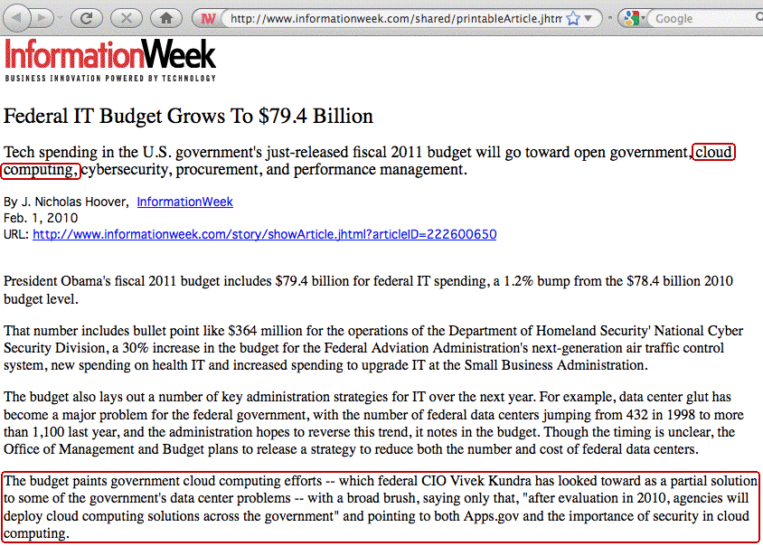

Slide 8
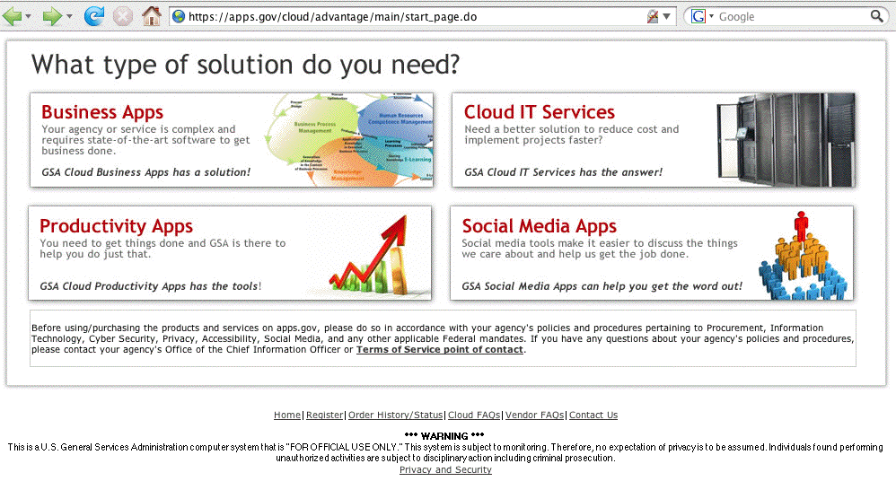
Apps.Gov

Slide 9
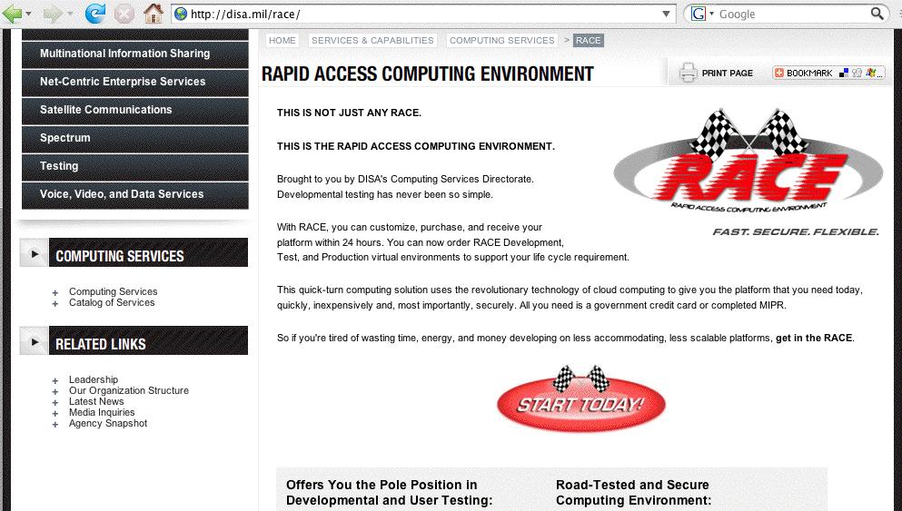
DISA's RACE

Slide 10
Our Community Is Also Pressing Ahead
Cloud computing seem to be turning up on pretty much every networking and security mailing list I'm on
You've heard/will be hearing a number of cloud computing talks during this week's meeting, which is probably not surprising since cloud computing was a Member Meeting explicit focus area.
But I'm seeing clouds everywhere, not just here at the Member Meeting.
Heck, I'm even seeing "clouds" (with frequent references to security!) appear in things like the last Internet2 Member Meeting "Introduction to Internet2" talk

Slide 11
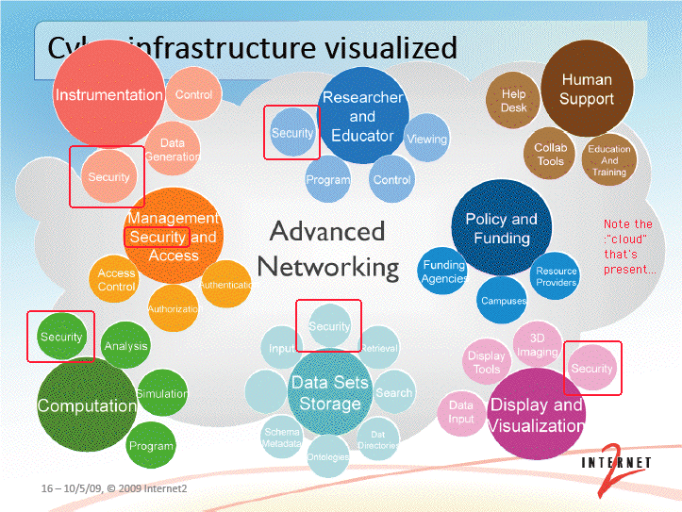
"Cyberinfrastructure Visualized:"
A Cloud, With Lots of "Security" References

Slide 12
Why Is "Security" Everywhere on That Slide?
Security is generally perceived as a huge issue for the cloud:
During a keynote speech to the Brookings Institution policy forum, “Cloud Computing for Business and Society,” [Microsoft General Counsel Brad] Smith also highlighted data from a survey commissioned by Microsoft measuring attitudes on cloud computing among business leaders and the general population.
The survey found that while 58 percent of the general population and 86 percent of senior business leaders are excited about the potential of cloud computing, more than
90 percent of these same people are concerned about the security, access and privacy of their own data in
the cloud.
http://www.microsoft.com/presspass/press/2010/jan10/1-20BrookingsPR.mspx

Slide 13
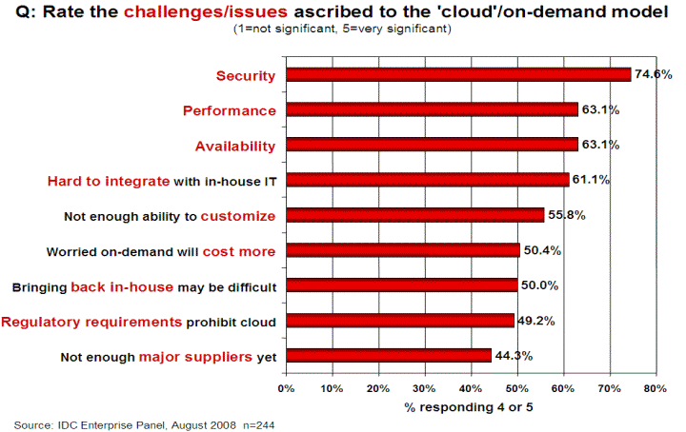
Another Data Point for Clouds and Security
Source: http://www.csrc.nist.gov/groups/SNS/cloud-computing/cloud-computing-v26.ppt
at slide 17

Slide 14
Cloud Computing Is Many Different
Things to Many Different People
All of the following have been mentioned from time to time as examples of “cloud computing:”
-- Amazon Web Services including the Elastic Compute
Cloud (EC2), Amazon Simple Storage Service (S3), etc.)
-- Rackspace Cloud (formerly Mosso)
-- Google’s App Engine
-- Windows Azure Platform (now a production/for-fee service)
-- the OGF (including its Open Cloud Computing Interface)
-- SETI@Home, Folding@Home, distributed.net, etc.
-- outsourced campus email service (to Gmail or Live.com),
or outsourced spam filtering (e.g., to Postini or Ironport)
-- use of virtualization (e.g., VMware) to host departmental
systems either on local servers, or on outsourced VPS
In reality, some of those activities are not (strictly speaking) what's usually defined as "cloud computing."

Slide 15
Some Generally Accepted Characteristics
Most people would agree that true cloud computing…
-- usually has low or zero up front capital costs
-- largely eliminates operational responsibilities (e.g., if a disk
fails or a switch loses connectivity, you don’t need to fix it)
-- for the most part, cloud computing eliminates knowledge of
WHERE one’s computational work is being done; your job
is being run “somewhere” out there in the “cloud”
-- offers substantial elasticity and scalability: if you initially
need one CPU, that’s fine, but if you suddenly need 999
more, you can get them, too (and with very little delay!)
If/when demand drops, you can scale your usage back, too
-- cloud computing leverages economies of scale (running
mega data centers with tens of thousands of computers is
far less expensive (per computer) than running a small
machine room with just a modest cluster of systems)

Slide 16
Some "Clouds" Won't Necessarily
Have All of Those Characteristics
For instance, if your site is running a local private cloud:
-- there WILL be capital expenditures up front,
-- you (or someone at your site) WILL still care about things
like hardware failures, and
-- you likely WON'T have the illusion of a seemingly infinite
inventory of processors (or memory or disk)
Nonetheless, a local private cloud service may functionally work the same way as a public cloud service, and hybrid cloud models may even combine private and public cloud services in a fairly seamless way.
Ubuntu's enterprise cloud offering is a nice example of this.

Slide 17
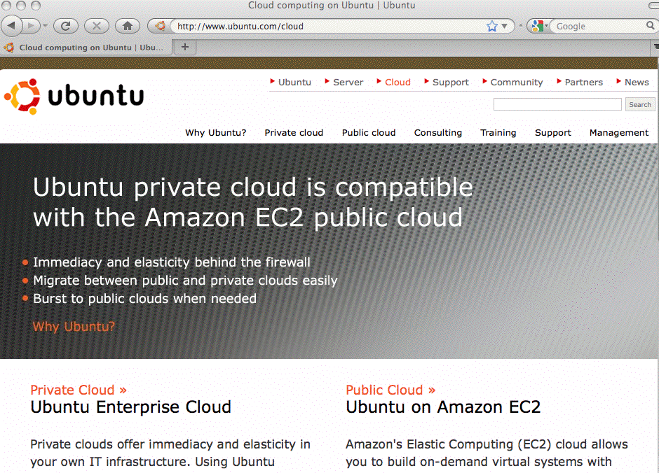

Slide 18
Will Your Campus Offer Private Cloud Services?
If you haven't been thinking about offering private cloud services, I would suggest that you might want to, including thinking hard about any potential security issues associated with doing so.

Slide 19
So What About Security in the Cloud?
For the remainder of this half of our talk, we'll outline some of the security issues you might run into when using cloud computing

Slide 20
In Some Ways, "Cloud Computing Security"
Is No Different Than "Regular Security"
For example, many applications interface with end users via the web. All the normal OWASP web security vulnerabilities
-- things like SQL injection, cross site scripting, cross site request forgeries, etc., -- all of those vulnerabilities are just
as relevant to applications running on the cloud as they are to applications running on conventional hosting.
Similarly, consider physical security. A data center full of servers supporting cloud computing is internally and externally indistinguishable from a data center full of "regular" servers. In each case, it will be important for the data center to be physically secure against unauthorized access or potential natural disasters, but there are no special new physical security requirements which suddenly appear simply because one of those facilities is supporting cloud computing

Slide 21
There Are Some Unique Cloud-Related Areas Which We're NOT Going To Worry About Today
Contracting for Cloud Services: Even though contractual terms (including things like SLAs) can be used to mitigate some risks, I'm not a lawyer, and I'm not going to pretend to be one, so we're not going to cover issues related to contracting for cloud services. Fortunately, NACUA did a great job discussing this topic in a recent seminar, see www.nacua.org/meetings/VirtualSEminars/december2009/home.html
Compliance, Auditing and eDiscovery: Because this meeting is primarily about research and education, not business processes and university administration, we will not consider the potential need for cloud computing to be compliant with Payment Card Industry security standards, FERPA, HIPAA, GLBA, or other related compliance mandates.
So what are some cloud-related security issues?

Slide 22
The "A" in The Security "C-I-A" Objectives
Computer and network security is fundamentally about three goals/objectives:
-- confidentiality (C)
-- integrity (I), and
-- availability (A).
Availability is the area where cloud based infrastructure appears to have had its largest (or at least most highly publicized) challenges to date.
For example, consider some of the cloud-related
outages which have been widely reported…

Slide 23
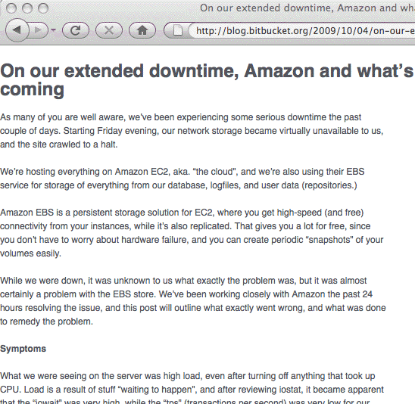
Bitbucket, DDoS'd Off The Air

Slide 24
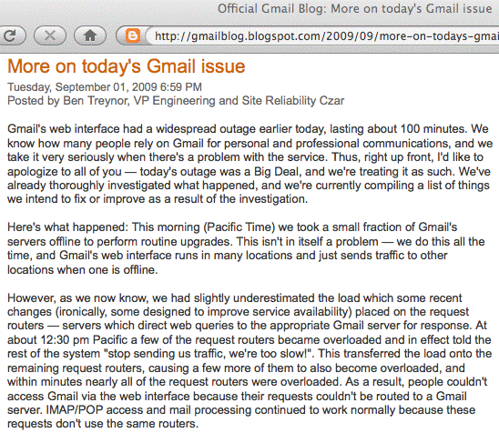
Maintenance Induced Cascading Failures

Slide 25
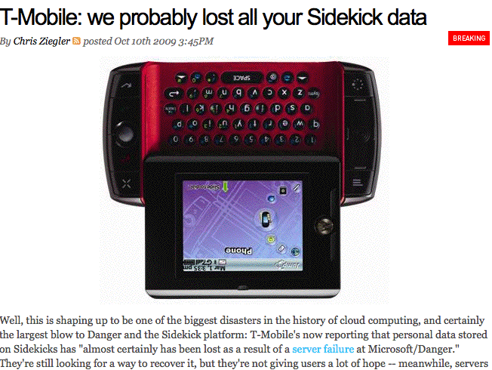
It's Not Just The Network: Storage Is Key, Too
See http://www.engadget.com/2009/10/10/t-mobile-we-probably-lost-all-your-sidekick-data/
However, see also: Microsoft Confirms Data Recovery for Sidekick Users
http://www.microsoft.com/Presspass/press/2009/oct09/10-15sidekick.mspx

Slide 26
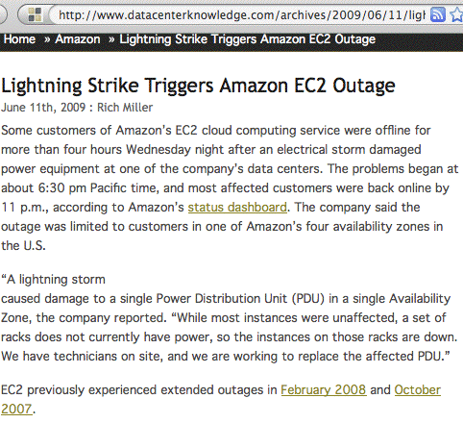
And Let's Not Forget About Power Issues

Slide 27
Mitigating Cloud Computing Availability Issues
Risk analysts will tell you that when you confront a risk, you can try to eliminate the risk, you can mitigate/minimize the impact of the risk, or you can simply accept the risk.
If you truly require non-stop availability, you can try using multiple cloud providers, or you could use public and private cloud nodes to improve redundancy.
Some cloud computing services also offer service divided into multiple "regions." By deploying infrastructure in multiple regions, isolation from "single-region-only" events (such as the power outage mentioned previously) can be obtained.
Availability issues may also be able to be at least partially mitigated at the application level by things like local caching.
Sometimes, though, it may simply make financial sense for you to just accept the risk of a rare and brief outage. (Remember, 99.99 availability==> 52+ minutes downtime/yr)

Slide 28
Mitigating Data Loss Risks
The risk of data loss (as in the T-Mobile Sidekick case) is an exception to the availability discussion on the preceding slide. Users may be able to tolerate an occasional service interrup-tion, but non-recoverable data losses can kill a business.
Most cloud computing services use distributed and replicated global file systems which are designed to insure that hardware failures (or even loss of an entire data center) will not result in any permanent data loss, but I believe there is still value in doing a traditional off site backup of one's data, whether that data is in use by traditional servers or cloud computing servers.
When looking for solutions, make sure you find ones that backs up data FROM the cloud (many backup solutions are meant to backup local data TO the cloud!)

Slide 29
Cloud Computing And Perimeter Security
While I'm not a huge fan of firewalls (as I've previously discussed at the Spring 2008 I2MM in "Cyberinfrastructure Architectures, Security and Advanced Applications," see http://www.uoregon.edu/~joe/architectures/architecture.pdf ), at least some sites do find value in sheltering at least some parts of their infrastructure behind a firewall.
There may be a misconception that cloud computing resources can't be sheltered behind a firewall (see for example "HP's Hurd: Cloud computing has its limits (especially when you face 1,000 attacks a day)," Oct 20th, 2009, http://blogs.zdnet.com/BTL/?p=26247 )
Contrast that with "Amazon Web Services: Overview of Security Processes" (see the refs at the back). AWS has a mandatory inbound firewall configured in a default deny mode, and customers must explicitly open ports inbound.

Slide 30
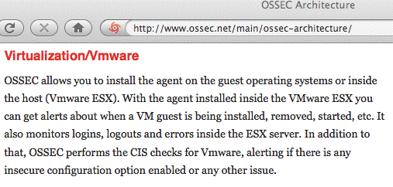
Cloud Computing & Host-Based Intrusion Detection
While I'm not very enthusiastic about firewalls, I am a big fan of well-instrumented/well-monitored systems and networks.
Choosing cloud computing does not necessarily mean forgoing your ability to monitor systems for hostile activity.
One example of a tool that can help with this task is OSSEC (the Open Source Host-Based Intrusion Detection System), an IDS which supports virtualized environments:

Slide 31
Cloud Computing Also Relies on the Security of Virtualization
Because cloud computing is built on top of virtualization, if there are security issues with virtualization, then there will also security issues with cloud computing.
For example, could someone escape from a guest virtual machine instance to the host OS? While the community has traditionally been somewhat skeptical of this possibility, that changed with Blackhat USA 2009, where Kostya Kortchinsky of Immunity Inc. presented "Cloudburst: A VMware Guest to Host Escape Story", see
http://www.blackhat.com/presentations/bh-usa-09/KORTCHINSKY/
BHUSA09-Kortchinsky-Cloudburst-SLIDES.pdf
Kostya opined: "VMware isn't an additional security layer, it's just another layer to find bugs in" [put another way, running a virtualization product increases the attack surface]

Slide 32
Choice of Cloud Provider
Cloud computing is a form of outsourcing, and you need a high level of trust in the entities you'll be partnering with.
It may seem daunting at first to realize that your application depends (critically!) on the trustworthiness of your cloud providers, but this is not really anything new -- today, even if you're not using the cloud, you already rely on and trust:
-- network service providers,
-- hardware vendors,
-- software vendors,
-- service providers,
-- data sources, etc.
Your cloud provider will be just one more entity on that list.

Slide 33
Cloud Provider Location
You may want to know (roughly) where your cloud lives.
For example, one of the ways that cloud computing companies keep their costs low is by locating their mega
data centers in locations where labor, electricity and real estate costs are low, and network connectivity is good.
Thus, your cloud provider could be working someplace you
may never have heard of, such as The Dalles, Oregon,
where power is cheap and fiber is plentiful, or just as easily some place overseas.
If your application and data do end up at an international site, those systems will be subject to the laws and policies of that jurisdiction. Are you comfortable with that framework?
Are you also confident that international connectivity will remain up and uncongested? Can you live with the latencies involved?

Slide 34
Cloud Provider Employees
If you're like most sites, you're probably pretty careful about the employees you hire for critical roles (such as sysadmins and network enginers). But what about your cloud provider? If your cloud provider has careless or untrustworthy system administrators, the integrity/privacy of your data's at risk.
How can you tell if your cloud provider has careful and trustworthy employees? You need to ask them!
-- Do backgrounds get checked before people get hired?
-- Do employees receive extensive in-house training?
-- Do employees hold relevant certifications?
-- Do checklists get used for critical operations?
-- Are system administrator actions tracked and auditable on
a post hoc basis if there's an anomalous event?
-- Do administrative privileges get promptly removed when
employees leave or change their responsibilities?

Slide 35
Cloud Provider Transparency
You will only be able to assess the sufficiency of cloud provider security practices if the cloud provider is willing to disclose its security practices to you.
If your provider treats security practices as a confidential or business proprietary thing, and won't disclose their security practices to you, you'll have a hard time assessing the sufficiency of their security practices. Unfortunately, you may need to consider using a different provider.
Remember: "Trust, but verify." [A proverb frequently quoted by President Reagan during arms control negotiations]
I'm not known for being a big Microsoft cheerleader, but Microsoft deserves recognition for promoting both their Cloud Computing Advancement Act and pressing cloud vendors to police themselves when it comes to transparency. See www.microsoft.com/presspass/presskits/cloudpolicy/

Slide 36
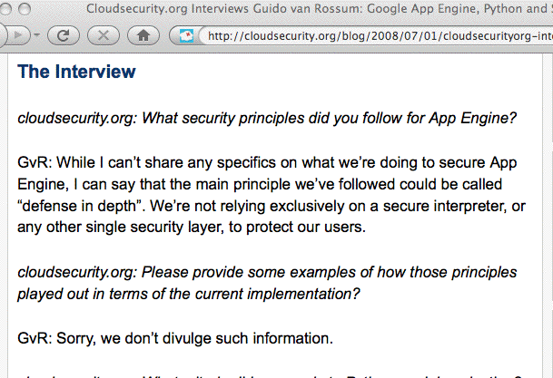
An Example of The Wrong Approach
Source: http://cloudsecurity.org/blog/2008/07/01/
cloudsecurityorg-interviews-guido-van-rossum-google-app-engine-python-and-security.html

Slide 37
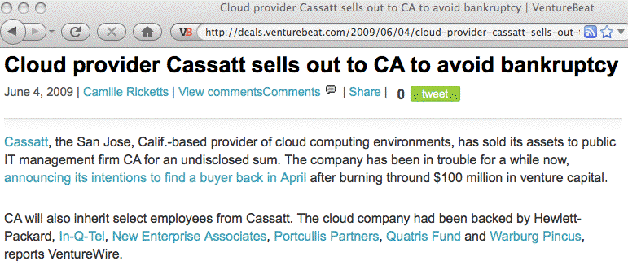
Provider Failures Are Also A Real Possibility
Even for a red-hot technology like cloud computing, there is no guarantee that your providers will financially survive. What will you do if your provider liquidates?

Slide 38
Pen Testing; Working Incidents In The Cloud
Standard pen testing processes which you may use on your own infrastructure may not be an option in an outsourced environment (the cloud provider may not be able to distinguish your tests from an actual attack, or your tests may potentially impact other users in unacceptable ways)
If you do have a security incident involving cloud-based operations, how will you handle investigating and working that incident? Will you have the access logs and network traffic logs you may need? Will you be able to tell what data may have been exfiltrated from your application?
What if your system ends up being the origin of an attack? Are you comfortable with your provider's processes for disclosing information about you and your processes/data?

Slide 39
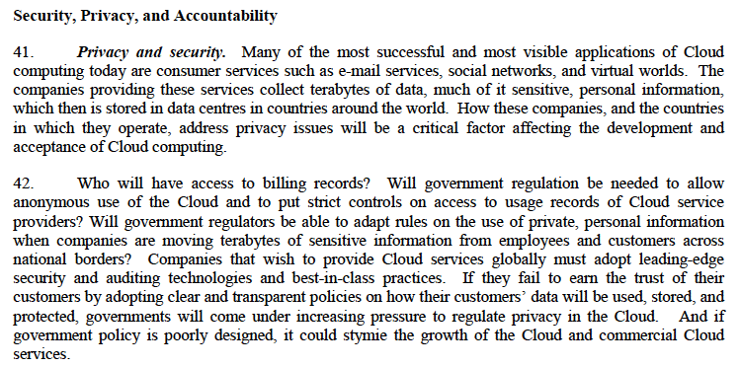
OECD, The Cloud, and Privacy
Cloud Computing and Public Policy, 14 October 2009
http://www.olis.oecd.org/olis/2009doc.nsf/ENGDATCORPLOOK/NT00004FC6/$FILE/JT03270509.PDF

Slide 40
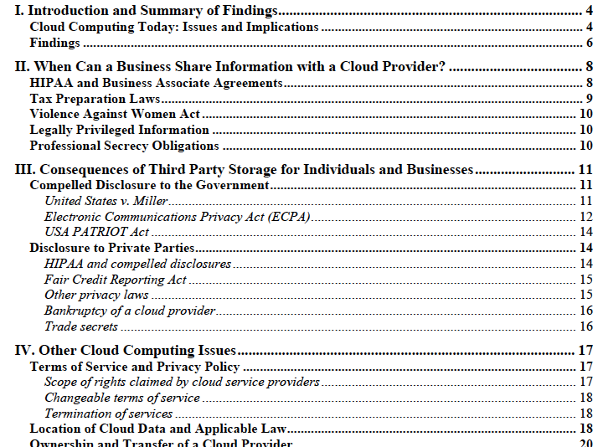
World Privacy Forum Privacy In The Clouds Report
From: "Privacy in the Clouds: Risks to Privacy and Confidentiality from Cloud Computing,"
Released February 23, 2009, http://www.worldprivacyforum.org/cloudprivacy.html

Slide 41
Part II: The Security of
Mobile Internet Device

Slide 42
What’s A Mobile Internet Device?
For the purposes of this session, we’ll define “mobile Internet devices” to be the sorts of things you might expect: iPhones, BlackBerry devices, Android phones, Windows Mobile devices, etc. -- pocket size devices that can access the Internet via WiFi, cellular/3G, etc.
If you like, we can stretch the definition to include traditional laptops and tablet computers such as the iPad (maybe you have big pockets?), and maybe even conventional cell phones, thumb drives, etc.
We’ll try to draw a hard line at anything that requires fiber connectivity or a pallet jack to move. :-)

Slide 43
Mobile Devices Are Common in Higher Ed
ECAR Study of Undergraduate Students and Information Technology 2009 ( http://www.educause.edu/ers0906 ):
About half of the respondents (51.2%) indicated
that they own an Internet capable handheld
device, and another 11.8% indicated that they
plan to purchase one in the next 12 months [...]
Faculty/staff ownership of mobile internet devices is more complicated: there are a variety of devices available
(“Which one(s) should we support?”), costs of service plans can be high (“It costs how much per month for your data plan???”), and the IRS’ treats them oddly
(see www.irs.gov/govt/fslg/article/0,,id=167154,00.html )

Slide 44
But Are Mobile Internet Devices Secure?
Many sites, faced with the ad hoc proliferation of mobile devices among their users, have become concerned:
Are all these new mobile Internet devices secure?
Sometimes, that concern manifests itself as questions:
-- Who has one?
-- Is there PII on them? What if one get lost or stolen?
Does it have “whole device” data encryption? Can we
send the device a remote “wipe” or “kill” code?
-- How are we sync’ing/backing those devices up?
-- Do we need antivirus protection for mobile devices?
-- Is all the WiFi/cellular/3G traffic encrypted? Will
they work with our VPN (even with VPN hw tokens)?
-- And how’s our mobile device security policy coming?

Slide 45
Let’s Start With a Very, Very, Basic Question
Who at your site has a mobile Internet device?
You simply may not know -- users will often independently purchase mobile devices (particularly if it’s hard/uncommon for a site to do so for its staff)
Those devices may connect via a third party/commercial network, and may not even directly access your servers.
If those devices do access your servers, unless they have to authenticate to do so, you may not know that it is a device belonging to one of your users.
Postulated: If you don’t even know who has a mobile Internet device, you probably also don’t know how they’re being configured and maintained, or what data may be stored on them.

Slide 46
A Semi-Zen-like Koan
“If I didn’t buy the mobile device, and the mobile
device isn’t using my institutional network, and the mobile device isn’t directly touching my servers, do I even care that it exists?” (Not quite as pithy as, “If a tree falls in the forest when no one’s around, does it still make any sound?” but you get the idea). Yes, you should care.
You may think that that device isn’t something you need to worry about, but at some point in the future that WILL change. Suddenly, for whatever reason (or seemingly for no reason) at least some of those devices WILL begin to use your network and/or servers, or some of those devices WILL end up receiving or storing personally identifiable information (PII).

Slide 47
Want Influence? It’ll Probably Cost You…
This is the slide that I hate having to include, but truly, if you want the ability to influence/control what happens on mobile Internet devices on your campus, you’re probably going to need to “buy your way in.”
If you purchase mobile Internet devices for your faculty or staff, you’ll then have an acknowledged basis for controlling/strongly influencing (a) what gets purchased,
(b) how those devices get configured, and (c) (maybe) you’ll then even know who may be using these devices.
Similarly, if you have a discounted/subsidized/required mobile device purchase program for students, you may be able to control/strongly influence what they purchase, how those devices gets configured, etc.
But buying in may not be cheap…

Slide 48
Mobile Data Plans Are Expensive
One factor that I believe is an impediment to mobile device deployment at some institutions is the cost of the service plans required to connect the devices. For example, while the iPhone 3GS itself starts at just $199 for qualified customers, the monthly recurring costs currently range from $69.99 to $99.99 from AT&T in the U.S. plus a text messaging plan of up to $20/month. (Domestic service plans for BlackBerry devices, e.g., from Verizon, tend to be comparable). Thus, iPhones for 20,000 users would cost from $1.6 to $2.4+ million/yr!
If you travel internationally, international voice and data usage is extra, ranging from $24.99/month for 20MB to $199.99/month for 200MB. Over those limits, usage runs from $5/MB to $20/MB (ouch). (You may want to consider disabling data roaming while traveling abroad)

Slide 49
Are We Seeing A Recapitulation of The
Good Old “Managed vs. Unmanaged PCs” Paradigm?
For a long time, way back in the “old days,” traditional IT management pretended that PCs didn’t exist. While they were in “denial,” people bought whatever PCs they wanted and “administered” them themselves. While that sometimes worked well, other times chaos reigned.
Today's more closely managed “enterprise” model was the result of that anarchy. At some sites, standardized PC configurations are purchased and tightly locked down and are then centrally administered. While I’m not a fan of this paradigm, I recognize that it is increasingly common.
Are we re-experiencing that same evolution for mobile Internet devices? Or are we still denying that mobile Internet devices even exist? What policies might we see?

Slide 50
An Example Device Policy: Device Passwords
If a mobile Internet device is lost or stolen, a primary technical control preventing access to/use of the device is the device’s password.
Users hate passwords, but left to their own devices (so to speak), they might use a short (and easily overcome) one such as 1234
You/your school might prefer that users use a longer and more complex password, particularly if that mobile Internet device is configured to automatically login to your VPN or the device has sensitive PII on it. You might even require use of two factor auth for your VPN, or require the device to wipe itself if it detects that it is the target of an password brute force attack.
If the device is managed, you can require these things.

Slide 51
Managing Mobile Internet Device Policies
Because Blackberries (42.1% U.S. market share as of April 2010 reports, see tinyurl.com/comscore-mkt-share ) and iPhones (25.4% U.S. market share) are the most popular mobile Internet devices, we’ll focus on them for the following discussion. (Usage patterns will likely vary in higher ed, but if anything, I’d expect a greater iPhone market share in higher ed than anything else)
Both RIM and Apple offer guidance for configuring and centrally managing their mobile Internet devices in an enterprise context. If you’re interested in what it would take to centrally manage these devices and you haven’t already seen these documents, I’d urge you to see:
-- na.blackberry.com/eng/ataglance/security/it_policy.jsp
-- manuals.info.apple.com/en_US/Enterprise_Deployment_Guide.pdf

Slide 52
Example: What Can Be Required for iPhone Passwords?
Looking at the iPhone Enterprise Deployment Guide:
-- you can require the user *have* a password
-- you can require a *long*/*complex* password
-- you can set max number of failures (or the max days
of non-use) before the device is wiped out (the device
can then be restored from backup via iTunes)
-- you can specify a maximum password change interval
-- you can prevent password reuse via password history
-- you can specify an interval after which a screen-lock-
like password will automatically need to be re-entered
RIM offer similar controls for BlackBerry devices.

Slide 53
Other Potential Local iPhone “Policies” Include
Adding or removing root certs
Configuring WiFi including trusted SSIDs, passwords, etc.
Configuring VPN settings and usage
Blocking installation of additional apps from the AppStore
Blocking Safari (e.g., blocking general web browsing)
Blocking use of the iPhone’s camera
Blocking screen captures
Blocking use of the iTunes Music Store
Blocking use of YouTube
Blocking explicit content
Some of these settings may be less applicable or less important to higher ed folks than to corp/gov users.

Slide 54
Scalably Pushing Policies to the iPhone
To configure policies such as those just mentioned on the iPhone, you can use configuration profiles created via the iPhone Configuration Utility (downloadable from
http://www.apple.com/support/iphone/enterprise/ )
Those configuration files can be downloaded directly to an iPhone which is physically connected to a PC or Mac running iTunes -- but that's not a particularly scalable approach. The configuration files can also be emailed to your user’s iPhones, or downloaded from the web per chapter two of the Apple Enterprise Deployment Guide.
While those configuration files need to be signed (and can be encrypted), there have been reports of flaws with the security of this process; see “iPhone PKI handling flaws” at cryptopath.wordpress.com/2010/01/

Slide 55
What’s The ‘Big Deal’
About Bad Config Files?
If I can feed an iPhone user a bad config file and convince that user to actually install it, I can:
-- change their name servers (and if I can change their
name servers, I can totally control where they go)
-- add my own root certs (allowing me to MITM their
supposedly “secure” connections)
-- change email, WiFi or VPN settings, thereby
allowing me to sniff their connections and credentials
-- conduct denial of service attacks against the user,
including blocking their access to email or the web
These config files also can be made non-removable (except through wiping and restoring the device).

Slide 56
We Need to Encourage “Healthy Paranoia”
Because of the risks associated with bad config files, and because the config files be set up with attributes which increase the likelihood that users may accept and load a malicious configuration file, iPhone users should be told to NEVER, EVER under any circumstances install a config file received by email or from a web site.
Of course, this sort of absolute prohibition potentially reduces your ability to scalably and securely push mobile Internet device security configurations to iPhones, but…
This issue also underscores the importance of users routinely sync’ing/backing up their mobile devices so that if they have to wipe their device and restore it from scratch, they can do so without losing critical content.

Slide 57
Mobile Device Forensic Tools
What if an iPhone IS lost/stolen/seized/confiscated, what sort of information might be able to be recovered?
See the book “iPhone Forensics” by Jonathan Zdziarski, http://oreilly.com/catalog/9780596153595
Some (of many) potential tools (in alphabetical order):
-- Device Seizure, http://www.paraben.com/
-- iPhone Insecurity, http://www.iphoneinsecurity.com/
-- Lantern, http://katanaforensics.com/
-- Oxygen, http://www.iphone-forensics.com/
Notes: Some tools may only be available to gov/mil/LE. Also, if you must jailbreak an iPhone to use a tool, this may complicate use of resulting evidence for prosecution
Interesting review from 2009: viaforensics.com/wpinstall/
wp-content/uploads/2009/03/iPhone-Forensics-2009.pdf

Slide 58
What About Hardware Encryption?
An example of a common security control designed to protect PII from unauthorized access is hardware encryption. For example, many sites require “whole disk” encryption on all institutional laptops containing PII.
Some mobile Internet devices (such as earlier versions of the iPhone) did not offer hardware encryption; 3GS iPhones now do.
However, folks have demonstrated that this is less-than-completely bullet proof [cough]; see for example Dr NerveGas (aka Jonathan Zdziarski’s) demo “Removing iPhone 3G[s] Passcode and Encryption,”
http://www.youtube.com/watch?v=5wS3AMbXRLs
This lack of hardware encryption may make it difficult
to securely use even a 3GS iPhone for PII or other
sensitive data.

Slide 59
Hardware Encryption on the BlackBerry
Hardware encryption on the BlackBerry is described in some detail in “Enforcing encryption of internal and external file systems on BlackBerry devices,” see
http://docs.blackberry.com/en/admin/deliverables/3940/_x000b_file_encryption_STO.pdf
If setting encryption manually, be sure to set
-- Content Protection, AND
-- Enable Media Card Support, AND Encrypt Media Files
If setting encryption centrally, be sure to set all of…
-- Content Protection Strength policy rule
-- External File System Encruption Level policy rule
-- Force Content Protection for Master Keys policy rule
For “stronger” or “strongest” Content Protection levels, set min pwd length to 12 or 21 characters, respectively (yes, dang, those are long passwords, aren’t they?)

Slide 60
Remotely Zapping
Compromised Mobile Devices
Strong device passwords and hardware encryption are primary protections against PII getting compromised, but another potentially important option is being able to remotely wipe the hardware with a magic “kill code.” Both iPhones and BlackBerry devices support this option.
Important notes:
-- If a device is taken off the air (e.g., the SIM card
has been removed, or the device has been put into a
electromagnetic isolation bag), a device kill code may
not be able to be received and processed.
-- Some devices (including BlackBerries) acknowledge
receipt and execution of the kill code, others may not.
-- Pre-3GS versions of the iPhone may take an hour per
8GB of storage to wipe; 3GS’s wipe instantaneously.

Slide 61
Terminating Mobile Device-Equipped Workers
A reviewer who looked at an early draft of this talk pointed out an interesting corner case for remote zapping:
-- Zap codes are usually transmitted via Exchange Active
Sync when the mobile device connects to the site’s
Exchange Server, and the user’s device authenticates
-- HR departments in many high tech companies will
routinely kill network access and email accounts when
an employee is being discharged to prevent regretable
“incidents”
-- If HR gets network access and email access killed
before the zap code gets collected, the device may
not be able to login (and get zapped), leaving the now
ex-employee with the complete contents of the device
See: http://tinyurl.com/zap-then-fire
Of course, complete device backups may also exist…

Slide 62
Mobile Devices as Terminals/X Terminals
One solution to the problem of sensitive information being stored on mobile Internet devices is to re-envision how they’re used.
For example, if mobile Internet devices are used solely as terminals (or X terminals), the amount of sensitive information stored on the device could presumably be minimized (modulo caching and other incidental PII storage).
iPhone users can obtain both ssh and X terminal server applications for their devices from www.zinger-soft.com and other vendors
Obviously, it is critical that communications between the mobile device and the remote system be encrypted (including having X terminal session traffic securely tunneled)

Slide 63
Web Based Applications on Mobile Devices
Of course, most sites don’t rely on terminal or X term apps any more -- nowadays, virtually everything is done via a web browser.
So what web browsers can we use on our mobile devices? (some sites strongly prefer use of particular browsers)
On the iPhone, Safari is the only true web browser normally available (Firefox, for example, isn’t and won’t be available: https://wiki.mozilla.org/Mobile/Platforms )
Opera Mini was submitted to the Apple App Store on March 23rd, 2010, but note that Opera Mini differs from “regular” Opera in that remote servers are used to render what Opera Mini displays (and they auto-“MITM” secure sites for you, see www.opera.com/mobile/help/faq/#security)
What about BlackBerry users? Just like iPhone users, BlackBerry users can run Opera Mini but not Firefox.

Slide 64
Back End Servers Supporting Mobile Devices
Many mobile Internet apps, not just Opera Mini, rely on services provided by back end servers, sometimes servers which run locally, sometimes servers running "in the cloud.”
If those servers go down, your service may be interrupted. This is a real risk and has happened multiple times to BlackBerry users; recent examples include:
-- "International Blackberry Outage Goes Into Day 2," March 9th, 2010, http://tinyurl.com/intl-outage-2nd-day
-- "BlackBerry users hit by eight-hour outage," 12/23/2009, http://www.cnn.com/2009/TECH/12/23/blackberry.outage/index.html
Availability is, or can be, another critical consideration.

Slide 65
What Do Your Key Websites
Look Like On Your Mobile Internet Device?
Web sites optimized for fast, well-connected computers with large screens may not look good or work well on mobile devices.
If those sites are running key applications, a lack of mobile device app usability may even be a security issue (for example, normal anti-phishing visual cues may be hard to see, or easily overlooked on a knock-off "secure" site).
Have you looked at your home page and your key applications on a mobile Internet device? How do they look?
One web site which may help open your eyes to the need for a redesign (or at least a separate website for mobile devices) is http://www.testiphone.com/
Should you create an http://m.<yoursite>.edu/ page?

Slide 66
Malware and A/V on Mobile Devices
Because Apple disallows applications running in the background, it is difficult for traditional antivirus products to be successfully ported to the iPhone. On the other hand, since the iPhone uses a sandbox and a cryptographically "signed app" model, it is also difficult for the iPhone to get infected.
All bets are off, however, if you jailbreak your iPhone so that it can run non-Apple-approved applications.
Malware which has targeted jailbroken iPhones has (so far) been targeting unchanged OpenSSH passwords for the root and/or mobile accounts (which defaults to “alpine”) :
-- the “ikee” worm (aka “RickRolling” worm)
-- the “Duh” worm (which changed “alpine” to “ohshit”,
scanned for other vulnerable iPhones, and stole data)
-- the "iPhone/Privacy.A” (stole data/opened a backdoor)

Slide 67
Speaking of Jail Breaking the iPhone…
Blackra1n is one of the most well known tools for jail breaking the iPhone (so that it can run non-Apple-approved apps). Jailbreaking your iPhone violates the license agreement and voids the warranty, but it is estimated
that 5-10% of all iPhone users have done so.
When a jail broken iPhones gets an OS upgrade, the jailbreak gets reversed/must typically be redone. This may cause some users of jail broken iPhones to be reluctant to apply upgrades (even upgrades with critical security patches!). That is obviously a potential security issue and cause for concern.
While regular iPhones usually get apps from the iTune Apps Store, jail broken phones can get apps from 3rd party repositories such as Cydia. It is unclear how much vetting new apps get before being listed at Cydia.

Slide 68
Counterfeit Hardware
Counterfeit computer and network hardware is a major concern for some manufacturers and the U.S. government
Knock-off iPhones are currently being seen in the U.S.
One good description of a knock off iPhone is available at http://www.macmedics.com/blog/2009/06/27/
counterfeit-iphone-3g-stops-by-macmedics-by-way-of-disputed-ebay-auction/
Apple and legal authorities are putting pressure on the sources of some of these knock-offs (e.g., see "Chinese Counterfeit iPhone Workshop Raided," Jan 20, 2010, http://www.tuaw.com/2010/01/20/_x000b_chinese-counterfeit-iphone-workshop-raided/ ), but until this problem is resolved (if ever!) you should be on guard against counterfeit mobile Internet device hardware from
3rd party sources.

Slide 69
Are Mobile Internet Devices Tough Enough?
Mobile devices, even more so than laptops, can be
exposed to pretty tough conditions -- pockets and belt holsters can be pretty unforgiving places. Mobile devices end up getting dropped, exposed to moisture (especially here in the Northwest!), extremes of temperature, etc. Are mobile Internet devices tough enough to hold up?
Specialized extra-rugged devices (such as the GD Sectera) are available to users in the gov/mil/three letter agency markets, but those devices are typically expensive and heavy compared to traditional mobile Internet devices,
and government crypto-enhanced devices are unavailable to those of us who do not hold federal security clearances.
The rest of us may best off just improvising at least partial protection with inexpensive water tight cases from vendors such as drycase.com or otterbox.com

Slide 70
Are There Any Questions?
Thanks for the chance to talk today!

Slide 71
Additional Cloud Computing Security Resources
"AWS Security Whitepaper," http://s3.amazonaws.com/
aws_blog/AWS_Security_Whitepaper_2008_09.pdf
"Cloud Computing Security: Raining On The Trendy New Parade," BlackHat USA 2009,
www.isecpartners.com/files/Cloud.BlackHat2009-iSEC.pdf
“ENISA Cloud Computing Risk Assessment,” November 20th, 2009, www.enisa.europa.eu/act/rm/files/deliverables/
cloud-computing-risk-assessment/at_download/fullReport
“Presentation on Effectively and Securely Using the Cloud Computing Paradigm v26,” 10/7/2009, NIST, http://www.csrc.nist.gov/groups/SNS/cloud-computing/
cloud-computing-v26.ppt
“Security Guidance for Critical Areas of Focus in Cloud Computing, V2.1,” December 2009, Cloud Security Alliance,
http://www.cloudsecurityalliance.org/csaguide.pdf

