Slide 1
Messaging and Network Security:
Guest Lecture, Current Topics in Information Systems and Technology
Joe St Sauver, PhD (joe@uoregon.edu or joe@internet2.edu)
Security Programs Manager, Internet2
Utah Valley University, Orem Utah
December 1st, 2009
http://www.uoregon.edu/~joe/uvu/

Slide 2
Introduction; Disclaimer; Agenda
It’s a real pleasure to meet with you tonight by telephone from the University of Oregon to talk with you a little about messaging and network security. Let me thank your instructor, and my colleague, Jaren T. Angerbauer, for the invitation to be with you tonight.
Let me also note for the record that while Jaren invited me to be with you, the opinions I’ll express tonight are solely my own, and do not necessarily represent the opinion of Jaren, nor the Utah Valley University, the University of Oregon, Internet2, or any other party.
I’ve got some material I’ve put together to set the stage for tonight’s session, and when we’re through with that, since this is a small group, we can either spend the rest of the time talking, or I can cover some other material I’ve previously delivered.

Slide 3
Utah and Networking
You’re fortunate to live in Utah, a wonderful state with great people, and to be studying systems and networks.
You may know that Utah has the honor of having hosted one of the earliest nodes on what grew to become the Internet: e.g., the fourth node on ARPANET (after only UCLA, SRI at Stanford, and UCSB). It was a DEC PDP-10 running Tenex at the University of Utah graphics department, and the year was December 1969.*
Utah continues to be in the forefront of networking.
For example, Utah National Guard Camp Williams was recently announced as the location for a major new data center which will support the intelligence community.**
----
http://www.livinginternet.com/i/ii_arpanet.htm
** http://www.odni.gov/speeches/20091023_speech.pdf

Slide 4
A Little About Me, and About Internet2
My Ph.D. is in Productions and Operations Management from the University of Oregon (UO) School of Business, and I work as Internet2’s Security Program Manager under contract through UO Information Services.
If you’re not familiar with Internet2, you can read all about it at http://www.internet2.edu/ at your leisure, but for now, you can think of it as “higher education’s high speed national network backbone” (plus a lot more).
Internet2 doesn’t replace the conventional commercial Internet, it runs “along side it.”
Internet2 carries conventional IPv4 packet traffic between leading higher education sites, while also supporting advanced services such as jumbo frames,
IPv6, IP multicast and dynamic circuit connections.

Slide 5
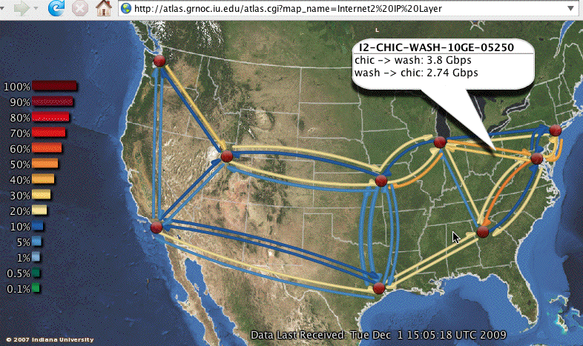
The Internet2 Backbone This Morning
Yes, the third red dot from the left represents an
Internet2 routing node that’s in Salt Lake City, one
of only nine in the country. See, Utah is special! :-)

Slide 6
A Brief Geek Discursion:
The Internet2 Path From Me to You at UVU
Whether you’re aware of it or not, UVU has connectivity to Internet2 via Westnet/the Utah Education Network.
% traceroute www.uvu.edu
traceroute to webprod.uvu.edu (161.28.25.131), 30 hops max, 40 byte packets
1 vl-214.uonet2-gw.uoregon.edu (128.223.214.3) 1.785 ms 0.384 ms 0.347 ms
2 0.ge-0-1-0.uonet8-gw.uoregon.edu (128.223.3.8) 0.374 ms 0.601 ms 0.464 ms
3 vl-105.ge-2-0-0.core0-gw.pdx.oregon-gigapop.net (198.32.165.89) 2.807 ms
2.886 ms 2.849 ms
4 vl-101.abilene-losa-gw.oregon-gigapop.net (198.32.165.66) 29.27 ms 24.87 ms
24.851 ms
5 so-3-1-0.0.rtr.salt.net.internet2.edu (64.57.28.47) 48.245 ms 48.221 ms
48.231 ms
6 i2-urn-salt.net.internet2.edu (64.57.28.30) 48.501 ms 48.63 ms 48.516 ms
7 140.197.252.87 (140.197.252.87) 48.458 ms 48.44 ms 48.48 ms
8 140.197.252.98 (140.197.252.98) 49.44 ms 49.527 ms 49.471 ms
9 140.197.252.109 (140.197.252.109) 49.516 ms 50.778 ms 49.438 ms
10 204.113.112.98 (204.113.112.98) 49.807 ms 49.776 ms 49.757 ms
11 webprod.uvu.edu (161.28.25.131) 51.131 ms 50.658 ms 50.207 ms

Slide 7
Whois
How could we find out who is responsible for some of the IP’s that don’t have reverse DNS on the preceding slide? We could use whois…
% whois -h whois.arin.net 140.197.252.87
OrgName: Westnet West Regional Network
OrgID: WWRN
Address: Computer Center
Address: 3440 Merrill Engineering Building
Address: Univiersity of Utah
City: Salt Lake City
StateProv: UT
PostalCode:
Country: US
NetRange: 140.197.0.0 - 140.197.255.255
CIDR: 140.197.0.0/16
NetName: WESTNETW-NET
[continues next slide]

Slide 8
Whois (continued)
[continuing from preceding slide]
NetHandle: NET-140-197-0-0-1
Parent: NET-140-0-0-0-0
NetType: Direct Assignment
NameServer: NS.UTAH.EDU
NameServer: NS1.WESTNET.NET
Comment:
RegDate: 1990-06-01
Updated: 1991-02-15
RTechHandle: AC98-ARIN
RTechName: Cole, Allen
RTechPhone: +1-801-581-8805
RTechEmail: cole@cc.utah.edu
FWIW, Allen Cole doesn’t show up in the University of Utah online directory, and that phone number is listed as belonging to someone in Environmental Health & Safety. After going on twenty years, you have to expect some changes, I guess. :-)

Slide 9
Back To More Boring Background Stuff
In addition to the work I do for the University of Oregon and Internet2, I’m also am active in a variety of national and international security-related initiatives.
For example, I serve as one of half a dozen senior technical advisors for the Messaging Anti-Abuse Working Group (MAAWG), the carrier anti-spam forum. MAAWG participants include AOL, AT&T, Bell Canada, Cablevision, Comcast, Cox, Earthlink, France Telecom, Google, HP, Microsoft, Sprint, Sun, Time Warner, Verizon, Yahoo and many others key companies. To read more about MAAWG, see http://www.maawg.org/
I’ve got some fairly uncommon talks about network security-related topics available on my home page at http://www.uoregon.edu/~joe/

Slide 10
The Odd Format Of This (And All My) Talk(s)
Pretty much all of my talks have a fairly distinctive format, much like the one you’re looking at right now.
Don’t let this strange format shake you up. You’re not expected to read it as I go along, nor, hopefully, will I be reading my slides to you.
So why do detailed slides?
-- without them, I tend to ramble and get side tracked
-- I often share a lot of detail, and detailed slides
mean that you don’t need to scramble to take notes
-- detailed slides mean I hopefully won’t be misquoted
-- detailed slides are helpful if you’re hard of hearing or
deaf, or if you’re a non-native english speaker, and
-- detailed slides index better in Internet search engines
than sparse “bulleted outline”-format talks

Slide 11
I. How Did We Get
Where We Are Today?

Slide 12
I’m From the Old School
My earliest computing experience dates all the way back to my high school years, when I’d write BASIC programs on an ASR 33 teletypewriter. That TTY connected via a 110 baud accoustical coupler over a dialup phone line to an HP time sharing system at St Johns University in Collegeville, Minnesota. My programs were stored on, and read from, punched paper tape.
When I graduated from that TTY, I moved on to punched cards, COBOL and a large Amdahl (an IBM mainframe clone), courtesy of a Boy Scouts of America Explorer Scout program offered at Burlington Northern Railroad.
Things were different back then, most notably because that was still 10 years before the Internet took off (even NSFNet, a 56kbps network, only dates to ~1985)

Slide 13
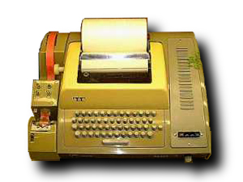
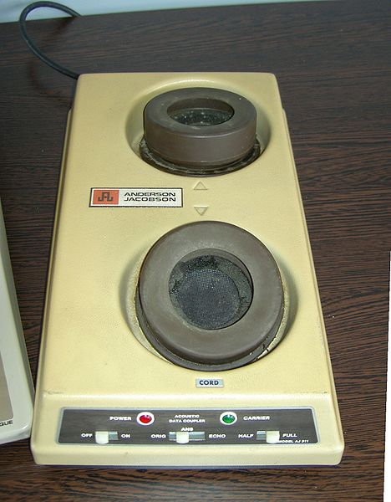
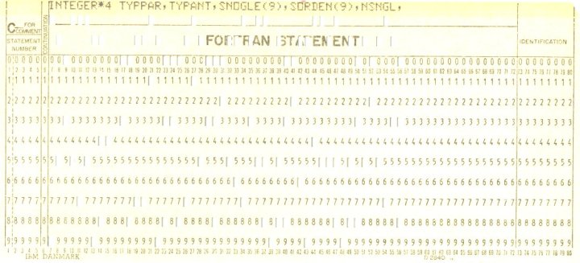
Acoustic Coupler; ASR 33; Punched Cards
http://commons.wikimedia.org/wiki/File:AJ_311_Acoustic_modem.JPG
http://commons.wikimedia.org/wiki/File:ASR-33_1.jpg
http://commons.wikimedia.org/wiki/File:Punch-card--fortran.jpg

Slide 14
Yes, There Was Life Before The Internet
Do you remember:
-- computing that didn’t emphasize networking? :-;
-- when doing research for a paper involved visiting a
library and using a card catalog, and writing that
paper meant using a typewriter?
-- when communicating with a remote friend or relative
involved mailing a letter or calling “long distance?”
(to say nothing of telegrams, cables, and ham radio!)
-- when news came from morning & evening newspapers?
-- when music came from a radio, or on records?
-- when pictures and movies were shot on film?
-- when shopping was done in person?
-- when friends were usually people we’d met in person?
Much has changed as a result of the Internet, most things for the better.

Slide 15
But Do You Also Remember…
What life was like before…
-- you had to apply a never-ending cycle of computer
patches and updates?
-- spam grew to be >90% of all email?
-- you even knew what malware was?
-- phishing and online scams had become routine part of
your life?
-- you enjoyed some measure of personal privacy?
-- you had to be continually “connected” and reachable?
Simpler times, no question about it. We were all to some degree innocents.
Now we live and work in a “flattened world.”

Slide 16
Distance Is Now (Largely) Irrelevant;
The Whole World’s Our Neighbor

Slide 17
Accra, Ghana, The Old Way
I recently attended the 7th Open Access Conference in Accra, Ghana (see www.wideopenaccess.net ), as well as the West and Central African National Research and Education Networks meeting held at the same time.
To be able to go to Ghana, I had to apply for a visa by sending my passport, four recent photos and a fee to the Embassy of Ghana in Washington DC.
I also needed to be vaccinated for yellow fever and to take a course of mefloquine for malaria prophylaxis.
When it was actually time to travel, I took a half hour flight to PDX, then an eleven hour flight from PDX to AMS, plus a seven hour flight from AMS to ACC.
I also needed to go through customs going into Ghana, and coming back into the United States.

Slide 18
Accra, Ghana, The New Way
# tcptraceroute www.ug.edu.gh
Tracing the path to www.ug.edu.gh (80.87.82.10) on TCP port 80 (http), 30 hops max
1 vl-214.uonet2-gw.uoregon.edu (128.223.214.3) 0.477 ms 0.624 ms 0.242 ms
2 0.ge-0-1-0.uonet8-gw.uoregon.edu (128.223.3.8) 0.333 ms 0.404 ms 0.310 ms
3 vl-3.uonet9-gw.uoregon.edu (128.223.3.9) 0.262 ms 0.405 ms 0.296 ms
4 eugn-car1-gw.nero.net (207.98.68.181) 0.257 ms 0.403 ms 0.322 ms
5 eugn-core2-gw.nero.net (207.98.64.162) 0.446 ms 0.496 ms 0.395 ms
6 ptck-core2-gw.nero.net (207.98.64.10) 2.835 ms 2.942 ms 2.879 ms
7 ptck-core1-gw.nero.net (207.98.64.137) 2.907 ms 3.198 ms 3.085 ms
8 so-6-1.hsa2.seattle1.level3.net (63.211.200.245) 6.209 ms 6.135 ms 6.206 ms
9 ae-31-51.ebr1.seattle1.level3.net (4.68.105.30) 6.630 ms 14.064 ms 17.981 ms
10 ae-1-100.ebr2.seattle1.level3.net (4.69.132.18) 17.136 ms 16.708 ms 17.913 ms
11 ae-2.ebr2.denver1.level3.net (4.69.132.54) 33.939 ms 33.542 ms 41.370 ms
12 ae-3.ebr1.chicago2.level3.net (4.69.132.62) 57.202 ms 56.552 ms 57.010 ms
13 ae-1-100.ebr2.chicago2.level3.net (4.69.132.114) 56.631 ms 56.916 ms 56.728 ms
14 ae-2-2.ebr2.washington1.level3.net (4.69.132.70) 74.551 ms 74.285 ms 74.528 ms
15 ae-62-62.csw1.washington1.level3.net (4.69.134.146) 84.909 ms 74.636 ms
84.055 ms
16 * ae-1-69.edge1.washington4.level3.net (4.68.17.18) 75.758 ms 76.137 ms
17 * cable-wirel.edge1.washington4.level3.net (4.53.112.2) 76.115 ms 75.688 ms
18 ge-1-0-0.dcr1.ash.cw.net (195.2.21.185) 75.964 ms 77.243 ms 76.054 ms
19 so-7-0-0-0-ecr2.mia.cw.net (195.2.3.54) 89.878 ms 90.129 ms 90.064 ms
20 ptcomm3.mia.cw.net (195.2.6.22) 233.013 ms 223.828 ms 229.685 ms
21 lis2-br1-gi-12-0-0.cprm.net (195.8.0.90) 234.631 ms 234.512 ms 243.170 ms
22 ghanatel1.10.8.195.in-addr.arpa (195.8.10.182) 299.999 ms 309.304 ms 330.711 ms
23 arn-m10i-core-ge-0-1-0-vlan2.4u.com.gh (80.87.78.2) 417.906 ms 382.507 ms 343.059 ms
24 * * *

Slide 19
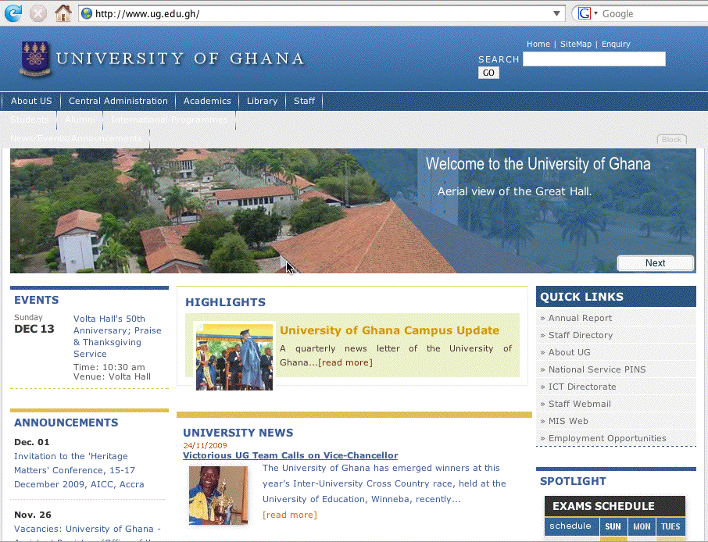
www.ug.edu.gh

Slide 20
Some of The Differences, Old vs. New
In the new way:
-- I didn’t need to get a visa
-- No one in Ghana even knew that I’d “visited”
-- I didn’t need any innoculations or other medications
-- My “travel time” was half a second
-- My travel cost was zero
-- There was no border control
On the other hand, in the old way:
-- I made some great new friends, and
-- I experienced the tastes, smells and sounds of Ghana.
The key point is that distance has (largely) become irrelevant. The world has become flat, and people in West Africa are now as much my neighbors as people in Eugene or Springfield or Portland or Orem.

Slide 21
We’re Connected to the Whole World
Having all those new neighbors in all the countries of the Americas, Europe, Asia, Africa, and Oceania is generally an amazing and wonderful thing.
I’m now connected to the world!
However there are still a few “minor” issues:
-- I should have paid more attention in geography class
-- we don’t speak the same language (although as an
english speaker, I’m far more fortunate than many)
-- we don’t even use the same alphabet(s) (again, using
the latin alphabet is far easier than using hangul, say)
-- we aren’t up and active at the same time (try finding
a time for a conference call if you’ve got people on
the East and West Coast of the United States,
Europe, and Asia who all need to participate!)
-- we still lack adequate bandwidth to some locations.

Slide 22
There’s Good and Bad In Everything

Slide 23
Oh, and One Other Problem: Bad Neighbors
There’s one other problem that I should mention, and that is the problem of bad online neighbors.
Let’s assume that 99.999% of all people online are good, regardless of where they live, are honest, hardworking people, just like you and I. Unfortunately, that still leaves a residual, 100%-99.999%=0.001%, or 1 in 100,000, of all people online who are NOT good.
If we assume that there are 6,800,589,053 people in the world as of 17:27 UTC on Dec 01, 2009, and that one quarter of them are online, that implies that there are still 6,800,589,053*.25*.00001=17,001 bad people online.
Those 17,001 bad online neighbors all have the ability to raise heck online, doing things like sending spam, phishing for your credentials, hacking/cracking systems, etc.

Slide 24
Real World vs. Online
Of course, my 99.999 vs. 0.001 split may be optimistic, as is the assumption that that sort of split is consistent across countries. Let’s just consider the proportion of people incarcerated* in some common countries as one benchmark for our 1-in-100,000 estimate:
United States 2,310,984 prisoners (760/100,000)
Russian Federation 877,595 prisoners (620/100,000)
Brasil 469,546 prisoners (242/100,000)
UK (England & Wales) 84,622 prisoners (154/100,000)
China 1,565,771 prisoners (119/100,000)
France 59,655 prisoners (96/100,000)
Switzerland 5,780 prisoners (76/100,000)
----
* http://www.kcl.ac.uk/depsta/law/research/icps/worldbrief/

Slide 25
Hmm… Adjusting Our Estimate
Of course, most people in prison (hopefully!) aren’t online, and many criminals reform while in prison, but what if everyone who was in prison got out and went online to engage in criminal behavior?
If the *real* rate of online badness worldwide is 760/100,000 (e.g., the US incarceration rate), that
would imply we’d have 12,921,119 bad people online. If the *real* rate of online badness worldwide was “just” 76/100,000 (e.g., the rate of incarceration in CH), that would imply we’d “only” have 1,292,112 bad people online.
One way or the other, however, whether we’re talking about 17,001 or 1,292,112 or 12,921,119 bad people online, there ARE bad people online these days, and we see them when they spam, scam, phish, hack/crack, etc.

Slide 26
International Law and Cyber Crimes
While all the world’s our neighbor now, law enforcement is still largely a national (or local!) matter.
If I violate the law here in Eugene, I will likely deal with the Eugene Police Department, or the Lane County Sheriff, or the Oregon State Police, or perhaps the Federal Bureau of Investigation. I will not be arrested by some pan-national police force. This is as true elsewhere as it is here.
But now remember that I may be subject to an online attack coming from a compromised computer that’s located somewhere I’ve never heard of before, and where the police don’t speak english, and where they have more serious violent crime problems than someone trying to hack/crack one of my systems. In fact, many countries may not even have any laws covering cyber crime.

Slide 27
The International Corruption Problem
While it would be great if international corruption wasn’t a problem, unfortunately, it is. For international corruption rankings, see Transparency International’s Annual Corruption Report, www.transparency.org
We must recognize that cyber criminals will pay relevant authorities to “look the other way” when it comes to cyber crimes, particularly if the cyber crimes appear “minor” (“it’s only a little spam, after all”), or the official in question is underpaid and has a hungry family he/she’s trying to keep alive (this doesn’t excuse that corruption, but it does make it understandable).
Combine tottering economies, out-of-date laws, corruptable officials and good connectivity, and you have a recipe for cybercrime activity hotspots.

Slide 28
Bringing This Back to Messaging

Slide 29
What Does This All Have to Do With Messaging?
Contrary to what you might think, the first networks were not designed for email. :-)
Initially, networks were meant as a way for scientists to be able to login and work on remote systems (think of the “telnet” protocol, although that wasn’t what was actually used at that time), and to copy files from one system to another (think of “ftp”, although again, that wasn’t the actual protocol in question).
For a discussion of how email did arise, see “Email History,” http://www.livinginternet.com/e/ei.htm and
“First Email Message,” http://www.velocityguide.com/
internet-history/first-email-message.html and
http://www.nobell.org/~gjm/about/ihnp4.html

Slide 30
The First Spam and Commercial Use
The first spam sent on the Arpanet was sent on May 1st, 1978, from a Digital Equipment Corporation (DEC) marketing representative, Gary Thuerk, touting a product presentation for some of their systems in California. (See http://www.templetons.com/brad/spamreact.html#msg )
Because the ARPANET was non-commercial/for official government business only, this message represented a flagrant violation of ARPANET policy.
That ban on commercial use persisted in one form or another until 1992, when Congress passed the “Scientific and Advanced-Technology Act,” legalizing interconnection of the NSFNet with commercial networks, although commercial usage remained limited through May 1995 when the NSF stopped underwriting the backbone.

Slide 31
Usenet Green Card Spammers
Email was not, and is not, the only form of messaging. For example, there was (and is) a distributed one-to-many messaging system called USENET.
Messages in USENET are organized hierarchically by topic, and are propagated from USENET server to USENET server via NNTP (Network News Transport Protocol). Users read USENET using a news reader such as Free Agent (for Windows), trn, or tin (for Unix). Google makes at least some USENET Groups available to the public via http://groups.google.com/
The first commercial spam on USENET was the famous “Green Card Spam” from Canter and Siegel, on April 12th, 1994, spamvertising their legal services to over 6,000 USENET groups.

Slide 32
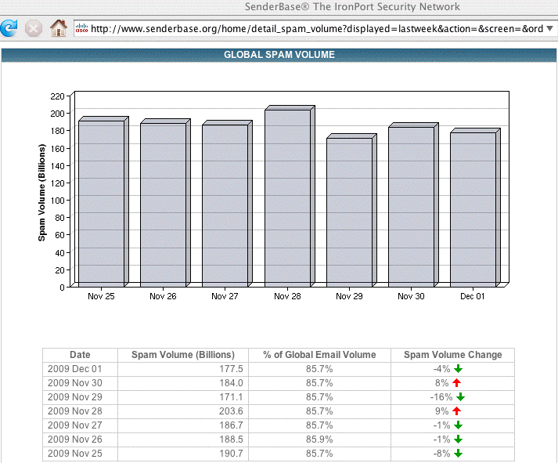
Spam Volumes Today

Slide 33
Cybercrime Motivations
Let there be no confusion about motivations: spammers and other cybercriminals want to make money.
It doesn’t really matter if we’re talking about DEC in 1978, Canter and Siegel in 1994, or Canadian Pharmacy today, spammers are in it for the bucks.
A couple of books that makes this entirely clear include: “Inside the SPAM Cartel: by Spammer-X,” and
“Spam Kings: The Real Story Behind the High-Rolling
Hucksters Pushing Porn, Pills and %*@)# Enlargements”
Most spammers do not operate on their own. Instead, most spammers work as part of an “affiliate program.” Affiliate programs pay “affiliates” for each person they successfully “convert,” or make a sale to. Payments may range from pennies to hundreds of dollars per conversion.

Slide 34
Affiliate Programs
It isn’t hard to find affiliate programs -- they advertise on the web like any other business. Try googling for “affiliate programs” to see some examples.
You should understand that there’s a complete spectrum of affiliate programs, ranging from “white hat” affiliate programs do not allow their affiliates to spam to “grey hat” affiliate programs which may be ambivalent about spamming, to “black hat” affiliate programs which may affirmatively permit or even encourage spamming.
Many affiliate programs rely on products which have huge markups, or for which legitimate online and/or bricks-and-mortar sales channels have problems.
For example, consider erectile dysfunction (“ED”) drugs such as Viagra, Cialis or Levitra.

Slide 35
ED Pillz Sales From the Bad Guy's POV
At least some erectile dysfunction ("ED") drugs sell for ~$20/pill at neighborhood pharmacies, but just ~$2/pill online (and those pills only cost spammers pennies/pill in bulk from overseas manufacturers). Markups are good.
Insurance plans won't cover ED drugs, and neither are ED drugs available as generics from large discount chain store under chain store $4 per-month-or-$10-for-a-90-day-supply plans. Unable to afford the real thing, users will do what they feel they must.
At least some users are also embarrassed when it comes to getting a legitimate prescription from their family doctor and then buying ED drugs from a local pharmacy. Online, they're "anonymous.”

Slide 36
ED Pillz Sales From the Bad Guy's POV (2)
Law enforcement risks from selling pillz via spam are minimal (from the bad guy's point of view).
Spam cases are complex and hard to prosecute, and spam, like most white collar crimes, isn't an viewed as being "on par" with crimes of violence. That is, you're unlikely to be investigated; if investigated, you probably won’t be prosecuted; if prosecuted you're unlikely to be convicted; if convicted, you won't get hard time.
While the DEA focuses on enforcement of laws relating to controlled substances, online pharmacies which avoid controlled substances are under the jurisdiction of the FDA, an understaffed and overworked agency.
ICE can only inspect a small fraction of each day's flood of incoming parcels. Our borders are pretty porous.

Slide 37
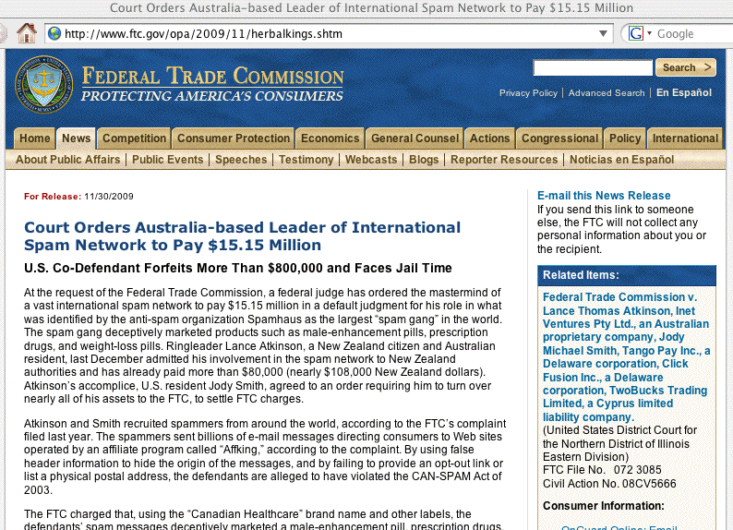
Sometimes, However, They’re Wrong…

Slide 38
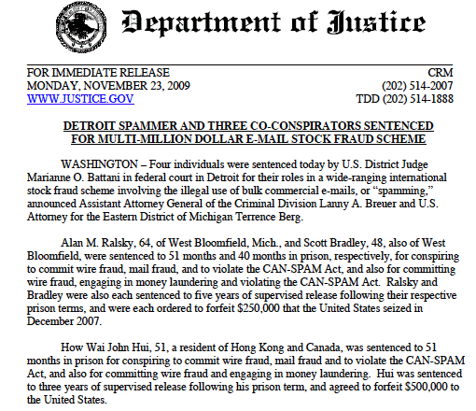
Sometimes, However, They’re Wrong (2)

Slide 39
Spammers Aren't Repacking Pillz in the Garage
Sometimes people have a mental image of spammers taking orders in their home office and then repacking bulk pillz into retail quantities in their garage or something of the sort. This is not a correct mental model (or at least it isn't most of the time)
A more realistic model would be a specialized ecosystem, with various interlocking specialized parts:
-- affiliate programs generate visits to pharma web
sites, typically via email spam or web spam
-- high risk payment processing firms specialize in
handling credit card for those online drug orders
-- drop shippers handle actual backend order fulfillment
-- the bad guys make lots of $$$, and that's without
hustling sales leads themselves, or counting pills, or
taking much risk.

Slide 40
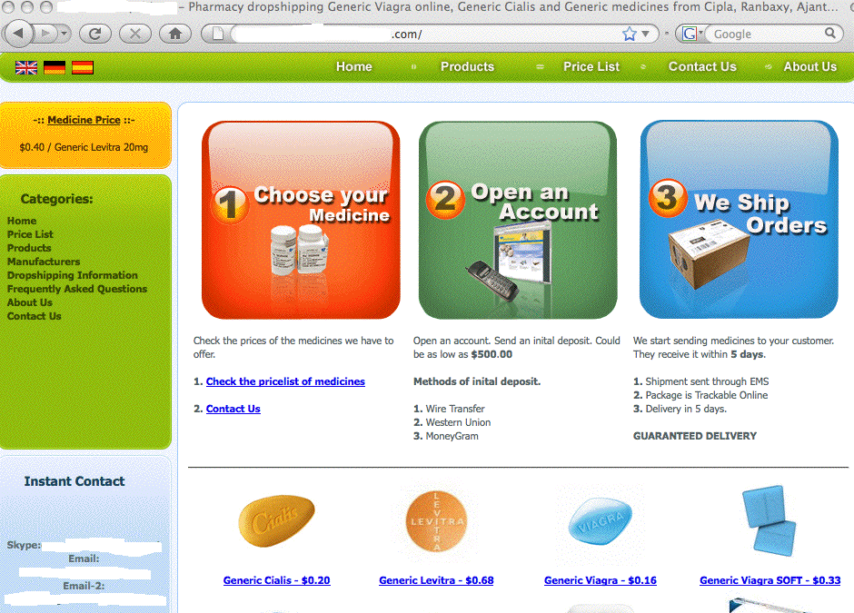

Slide 41
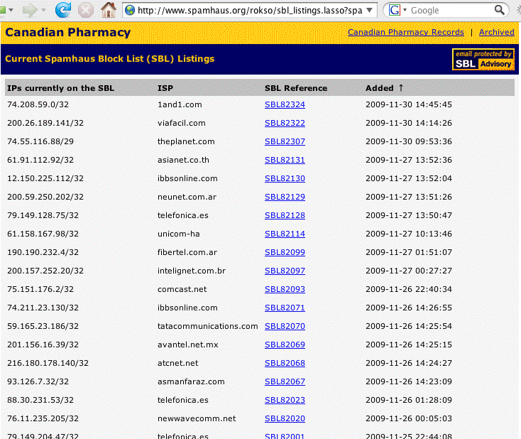
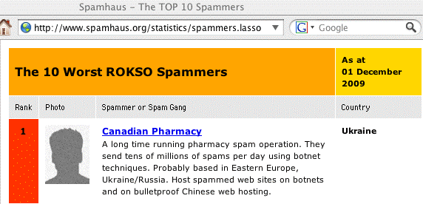

Slide 42
The SBL Listings On the Preceding Page
Spammers face some problems when it comes to spamvertising their products, including, most notably, having the systems they’ve used listed on block lists such as the Spamhaus Zen list (www.spamhaus.org/zen)
Once listed on Spamhaus (or other block lists), systems sending spam have a much harder time doing so. Many sites will block connections from those systems outright, subject traffic from those systems to extra scrutiny, rate limit traffic from those systems, etc.
Spammers thus are constantly on a quest for alternative channels which they can use to send spam.
The original alternative channel used by spammers many years ago was the “open SMTP relay.”

Slide 43
Open SMTP Relays
Mail servers were originally designed to accept and attempt to deliver all email traffic. If mail was for a local user, the email would be delivered locally, otherwise the email would be forwarded, or “relayed,” on toward its ultimate destination. If the mail that a server was seeing was from a local user, or was for a local user, this was entirely normal and appropriate.
If, however, the mail that a server saw was neither from a local user nor to a local user, there’s no reason why that email should be going via that mail server. Servers that failed to correctly reject misdirected relay email were and are known as “open SMTP relays” and were and are beloved by spammers as a way of doing an “end run” around direct blocks on the spammer’s own address space.

Slide 44
Open Proxies
Eventually, the community succeeded in eliminating most open SMTP relays, either through education or through direct blocklisting. Spammers moved on to open proxies.
Proxies are much like SMTP relays in that a proxy is designed to accept a connection from a client, and then act on the client’s behalf to get/process some content.
For example, many international sites force customer web traffic through a caching web proxy so that popular (and invariant) content can be served from a local copy, rather than having to be pulled from an international site each time it’s needed by a local user.
Unfortunately, some proxies would proxy ANY type of connection, including SMTP sessions, for ANY user, ANY where, sometimes even concealing the requesting IP address.

Slide 45
Closing Open Proxies; Bots
Spammers quickly burned through all the organically occurring natural proxies (contrary to popular belief, there was not and is not an infinite supply of mis-configured systems connected to the Internet :-) ).
Q: What were the spammers to do then? A: custom create their own abusable systems using either exploitable vulnerabilities (“scan and sploit”) or malware
These hijacked systems (created by scan and sploit or malware), are often called “spam zombies,” or “bots.” “Botmasters” run collections of “bots” as “botnets.”
Historically, they were controlled by IRC, although modern bots use improved C&C’s.
Bots can be used to send spam, but they’re like potatoes or tofu, very adaptable for a variety of needs

Slide 46
The Many Faces of Bots
Besides being used for spam, bots can also be used for:
-- hosting phishing sites, malware, pirated software,
etc. (this is often done via a technique known as
“fast flux hosting”)
-- conducting distributed denial of service (DDoS)
attacks by flooding sites with traffic
-- pay-per-click click fraud meant to cheat advertisers
-- scanning hosts for vulnerabilities
-- sniffing network traffic for unencrypted login
credentials or passwords
-- etc.
There are currently over six million known bots listed
on the Composite Blocking List, the CBL

Slide 47
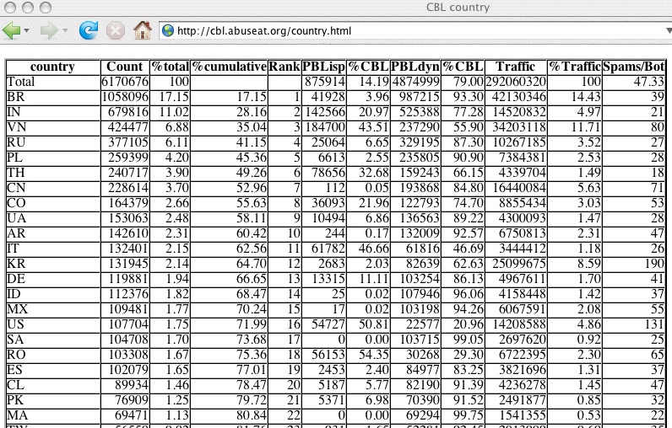
Where Do Bots Live?
(countries with >1% of total as of Dec 1st)
Note: just 22 countries account for >80% of all bots

Slide 48
How Do All Those Systems Get 0wn3d?
Many different reasons, including:
-- failure to patch the operating system and
applications: try running Secunia’s PSI on your own
Windows PC sometime, you’ll be surprised at what
you see: secunia.com/vulnerability_scanning/personal/
-- failure of signature-based antivirus: if the good guys
release new antivirus signatures a couple of times a
day, but the bad guys release new variants of their
malware every hour, guess what? At least some folks
will ALWAYS be vulnerable even if the good guys had
signatures for everything they’ve seen
-- operator error: weak password, no password, sent
password to bad guy in response to phishing attack,
shared entire hard drive read/write with the world,
etc., etc., etc.

Slide 49
“And I Bet They Didn’t Use a Firewall!”
Unlike most guys, I’m not hear to preach the firewall “gospel.” If a firewall works well for you, that’s great, keep using it, more power to you.
However, recognize that firewalls, particularly if they’re deployed at a campus border in front of 20,000 of your closest friends, really don’t provide all that much protection. Firewalls can interfere with advanced applications and hinder the detection and remediation of incidents (particularly if deployed as NAT/PAT).
There’s a lot more to the Internet than just the web and email, so don’t settle for crippled Internet access where that’s all that’s allowed through a firewall. Strive to preserve Internet transparency and the
end-to-end model that’s enabled so much innovation!

Slide 50
Patching In the Developing World
Network security is particularly tough in the developing world where bandwidth is scarce and expensive. If you’re only getting 20 or 30 Kbps throughput, are you really going to take *hours* to download a 70 MB service pack? (do the math: 70,000 KByte * 8 bits/byte / 30 K bits/second / 3600 seconds/hour ==> 5.18 hours)
Besides, if you’re running a pirated copy of your operating system or major applications, you may be reluctant to try patching it anyhow!
A little additional problem: for many in the developing world, virtually all the information about securing your system is written in a language you don’t understand, English, rather than your native language.
But what about antivirus software? Won’t it help?

Slide 51
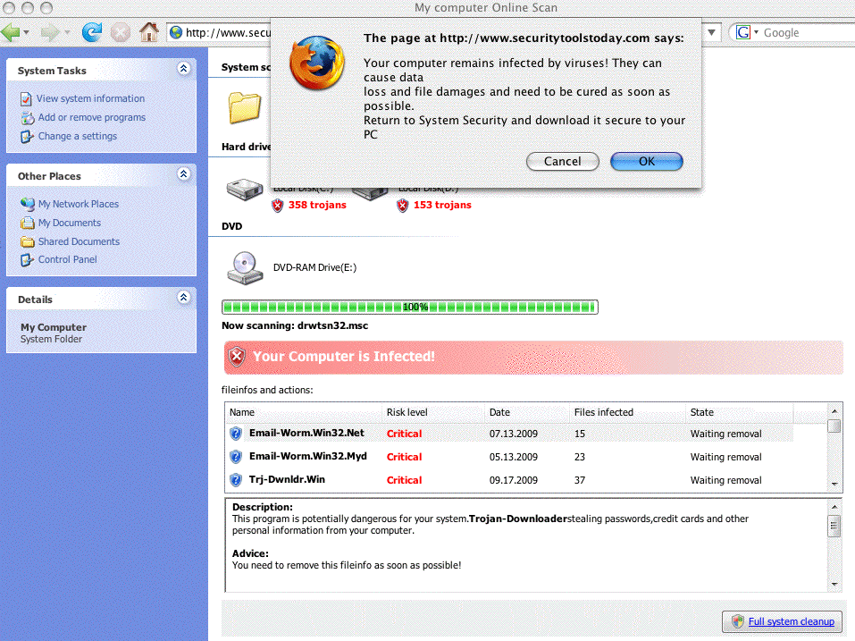
Why The World Gets Confused
[CAUTION: SITE CONTAINS MALWARE]

Slide 52
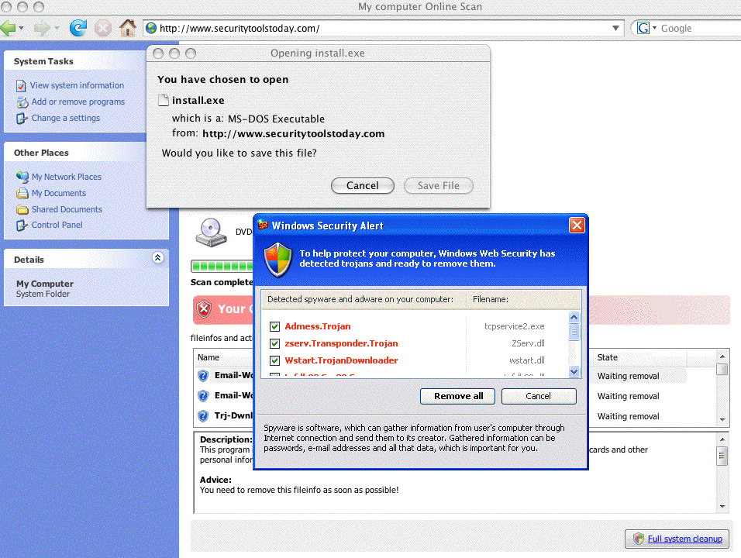
Why The World Gets Confused (2)
[CAUTION: SITE CONTAINS MALWARE]

Slide 53
Why The World Gets Confused (3)
Note that that report came from my Mac, which doesn’t run Windows nor does it have a C:\ drive nor is it infected
:-)
If you were to download the recommended installer, it contains malware, although only one antivirus product in five currently detects it. See the Virustotal report on the next slide…

Slide 54
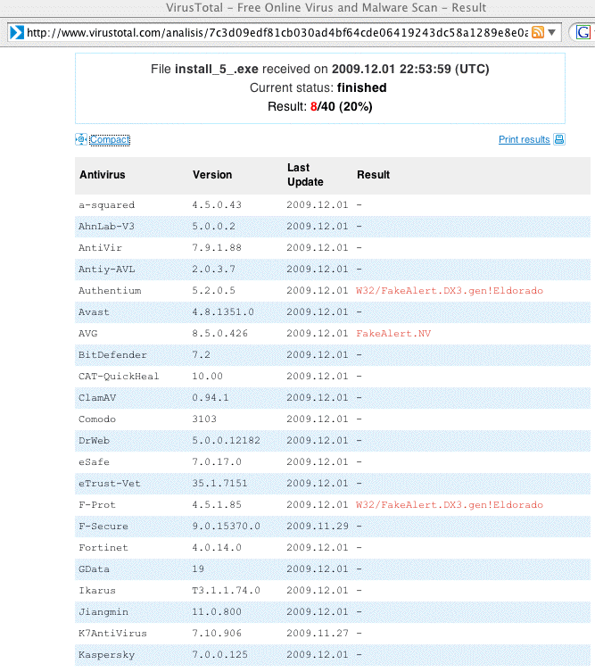
The Widespread Failure of Antivirus

Slide 55
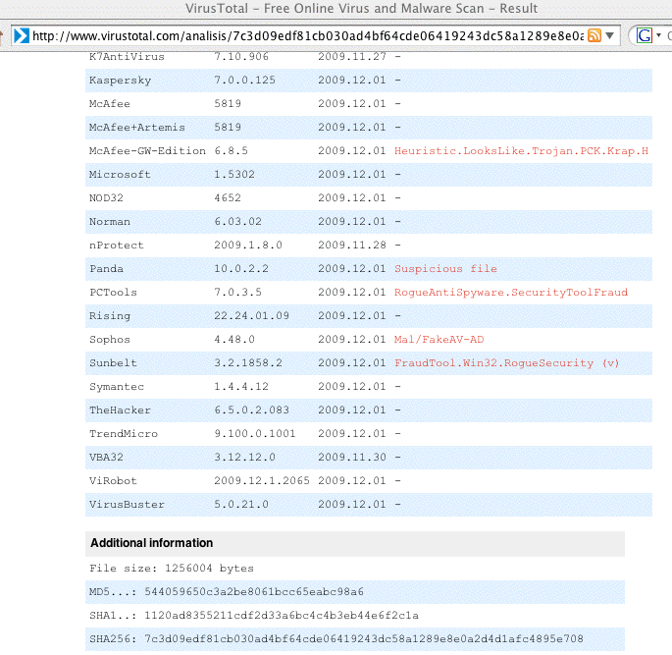
The Widespread Failure of Antivirus (2)

Slide 56
Looking At That Infested Site Just A Little
% dig www.securitytoolstoday.com +short
94.102.63.245
% whois -h whois.ripe.net 94.102.63.245
inetnum: 94.102.63.128 - 94.102.63.255
netname: KINGH-NET
descr: The King Host
country: NL
admin-c: AW137-RIPE
tech-c: AW137-RIPE
status: ASSIGNED PA
mnt-by: ECATEL-MNT
mnt-lower: ECATEL-MNT
mnt-routes: ECATEL-MNT
source: RIPE # Filtered
person: Andrew Willson
address: Honderdland 112F, 2677LT Maasdijk
phone: +31174712185
abuse-mailbox: ipadmin@thekinghost.biz
nic-hdl: AW137-RIPE […]

Slide 57
Looking At That Infested Site A Little (2)
% whois securitytoolstoday.com
Domain name: securitytoolstoday.com
Name servers:
ns1.securitytoolstoday.com
ns2.securitytoolstoday.com
Registrar: Regtime Ltd.
Creation date: 2009-11-25
Expiration date: 2010-11-25
Status: active
Registrant:
Kevin Neely
Email: kevinrneely@trashymail.com
Organization: Private person
Address: 3809 Hillview Drive
City: Oakland
State: CA
ZIP: 94612
Country: US
Phone: +1.7072310192
[etc]

Slide 58
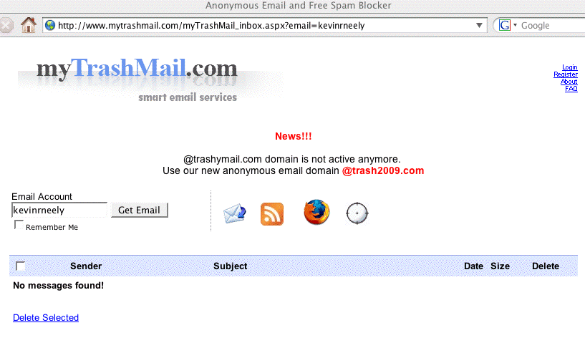
Looking At That Infested Site A Little (3)

Slide 59
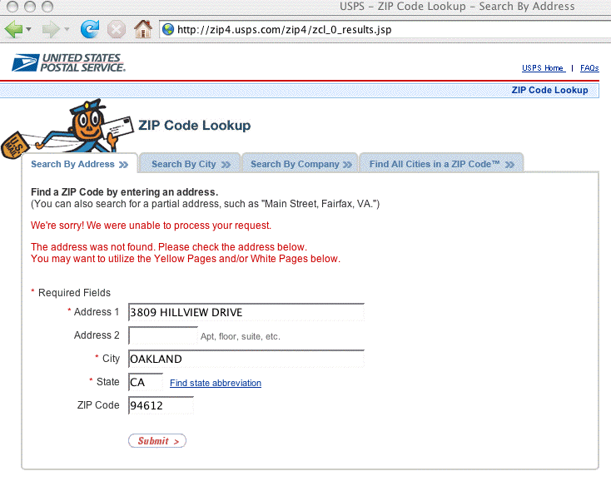
Looking At That Infested Site A Little (4)

Slide 60
If You’re So Inspired…
You can report the bogus whois data in this (or other) domain whois records to Internic using the form at:
http://wdprs.internic.net
Note that the WDPRS process isn’t particularly rapid, and by the time you make progress on this one, the bad guys will usually have moved on and will be using another domain.
Dot cn domains have been particularly popular because there is no WDPRS system for them, and they can cost
as little as one yuan (USD ~$0.15) to buy.

Slide 61
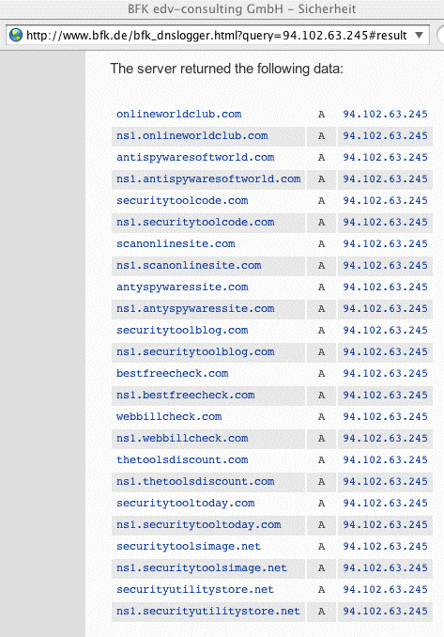
Are There Potentially-Related Sites?

Slide 62
“What About Phishing?”
What about it?
You know what it is: phishing is when bad guys con you or me into providing login credentials, credit card information, or other sensitive information, typically in response to an “urgent” message insisting that we do so AT ONCE!
If users wouldn’t “play along” and provide that information, phishing would largely cease to be an issue except for information stealing malware.
Resist urgent commands! Be cynical! Refuse to do as you’re told! Never disclose passwords or private info!

Slide 63
What About 4-1-9 (and Other) Scams?
4-1-9 scams, also known as advance fee fraud scams, rely on people’s gullibility and greed.
Miriam Abacha does not now, nor will she ever, have millions of dollars to share with you if you will only temporarily cover some “short term processing fees.”
Similarly, no legitimate company needs you to cash checks for them, nor do they need you to reship merchandise, nor will they pay you a percent a day to temporarily use your money.
Don’t be a sucker.

Slide 64
“I Want To Harden My Email”

Slide 65
A Simple Recommendation:
Use Plain Text Email ONLY
Only read your email with a text-only email reader (such as Pine running in a Mac terminal window); do not use a graphical (point and click) email client
Do not accept ANY HTML formated email
Do not accept attachments (even from someone you know)
Do not accept base64-encoded or even QP (quoted-printable) format messages
If you run a mailing list, consider protecting your list participants by enforcing these same policies for all postings to your mailing list

Slide 66
Use GPG To Sign and Encrypt Your Email
Email usually travels the Internet unencrypted, and gets stored on disk unencrypted. Consider protecting your privacy by encrypting and signing your email with PGP or GPG.
If you use do use a point-and-click mail reader such as Mozilla Thunderbird (email companion application to the Firefox Mozilla web browser), you can install GPG and Enigmail for a comparatively easy-to-use interface.
See: http://www.mozillamessaging.com/
http://www.gnupg.org/
http://enigmail.mozdev.org/

Slide 67
Use A Multi-Stage Process To Filter Spam
The process that seems to work well for many sites is described at
http://www.spamhaus.org/effective_filtering.html
and relies on a combination of block lists, URI-based blocklists (such as the SURBL), and final filtering with SpamAssassin.
Be sure to whitelist known-good correspondents.
If you don’t run your own mail server, shop around for a mail server that’s run the way you’d like it to be run.

Slide 68
Even If A/V Isn’t Perfect, Still Use It
Flawed as signature-based antivirus software may be, you should still use it.
Run one product on your mail server, and a different product on your desktop to get the benefit of overlapping coverage.
You may also want to consider Procmail Email Sanitizer, www.impsec.org/email-tools/procmail-security.html , which defangs structurally dangerous message constructs which might otherwise slip by
I’m sure you also know and understand that some operating systems are more plagued with malware than others, for whatever reason. If malware is a concern for you, remember, you do have options.

Slide 69
Thanks for The Chance to Talk Today!
Are there any questions?

Slide 70
If You’re Still Not Tired/Bored to Tears…
Some other areas we can explore if folks still have time and energy tonight (in alphabetical order):
-- 2009 Tour of Cybercrimes
http://www.uoregon.edu/~joe/cybercrime2009/
-- Cyber War, Cyber Terrorism and Cyber Espionage
http://www.uoregon.edu/~joe/cyberwar/
-- Doing DNS As If DNS Actually Mattered
http://www.uoregon.edu/~joe/dnssec-nd/
-- Electromagnetic Pulse
http://www.uoregon.edu/~joe/infragard-2009/
-- IPv6 and the Security of Your Network and Systems
http://www.uoregon.edu/~joe/i2mm-spring2009/
-- SCADA Security and Critical Infrastructure
http://www.uoregon.edu/~joe/scadaig/

