Slide 1
Volcanoes
Salsa-DR BoF
Internet2 Spring Member Meeting
Joe St Sauver, Ph.D.
Internet2 Security Programs Manager
(joe@uoregon.edu or joe@internet2.edu)
Tuesday, 4/27/2010, Madison Room
Marriott Crystal Gateway, Arlington VA
http://www.uoregon.edu/~joe/volcanoes/

Slide 2
Welcome to the Spring 2010 Member Meeting and the Salsa-DR BoF!
Thank you for getting up early today, particularly in the case of those of you from the West Coast, where I know this feels particularly early!
I’d like to begin today with introductions -- as we go around the room, please tell us a little about yourself:
-- your name
-- your institution
-- your interest in disaster recovery and planning
-- any topic or topics you might like to go over during the meeting
today

Slide 3
A Quick Bit of Administrivia
Interested in being Co-Chair of Salsa-DR?
The current chair of the Salsa-DR group had hoped to be with us today, but was unable to do so due to conflicts. Because these sort of things do come up from time to time, one of the things we’d like to do is to identify a co-chair from the community who can help co-lead this activity, providing continuity and sharing in running Salsa-DR meetings at the Internet2 Member Meetings and Joint Techs meetings. If you’re interested in potentially being co-chair of Salsa-DR, please let me know.
Salsa-DR Mailing List:
I’d also like to remind you that we have a mailing list for Salsa-DR which you’re welcome to use. To join (it’s low volume), email: sympa@internet2.edu with the subject line
subscribe salsa-dr yourfirstname yourlastname

Slide 4
A Potential Topic for Today’s BoF
As a BoF, this event is intentionally relatively unstructured --
we’re here to talk about whatever disaster recovery and planning topics might be on your mind.
However, if no one has anything that they’re particularly eager to drill down on, I’ve prepared a few slides on one topic that’s been
on my mind, and that’s volcanoes.
Living in the Pacific Northwest, right on top of the “ring of fire,” and having had multiple family members who’ve lived in Hawaii, I’ve always been rather personally interested in volcanoes.
Some of you, however, may have become more interested in volcanoes recently. Recognize the picture on the following slide?

Slide 5
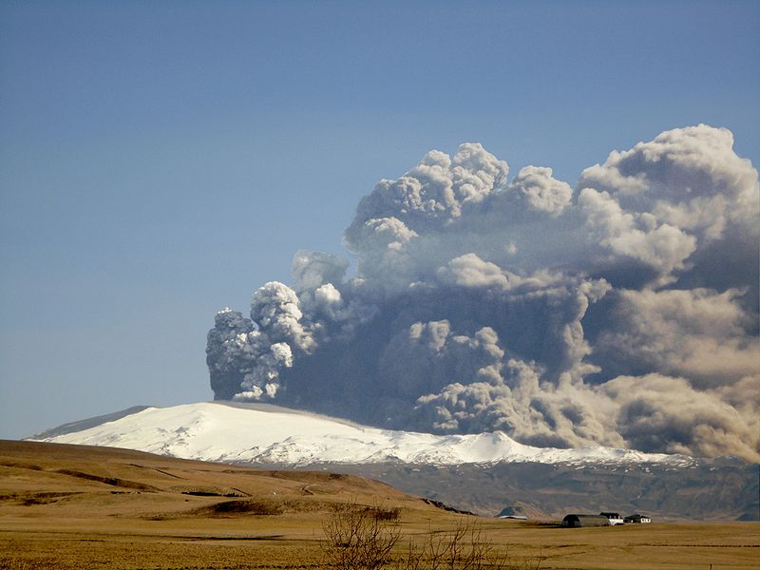
http://commons.wikimedia.org/wiki/File:Eyjafjallajokull-April-17.JPG

Slide 6
Eyjafjallajokull
The Icelandic Eyjafjallajokull (for those who want to attempt pronunciation, try: ay-yah-FYAH-lah-yer-kuhl) volcano has been much in the news as a result of its impact on European air travel.
Because injestion of airborne volcanic ash can cause jet aircraft engines to fail in flight, the ash from Eyjafjallajokull has grounded over 100,000 flights at many European airports for nearly a week.
That down time resulted in losses of over US$1.7 billion in revenue for airlines, and great personal hardship for many travelers.
Things could be worse, though: the last time Eyjafjallajokull erupted, it did so for 14 months, from 12/1821 to 1/1823 (dang!), and Katla, Eyjafjallajokull’s “big sister,” normally also erupts when Eyjafjallajokull does (see http://tinyurl.com/csmonitor-katla )
So far, though, we’ve gotten off easy: as of April 20th, European
air traffic has resumed, Katla is still quiet, and Eyjafjallajokull looks like it will end up with a final VEI of “only” 2 or 3.

Slide 7
Volcano Explosivity Index (VEI)
The VEI is a logarithmic scale (just as the Richter scale is for earthquakes). Some selected “recent” historical eruptions:
VEI Global Frequency Example Year
0 Constant Mauna Loa, HI 1984
1 ~Daily Kilauea, HI 1983-date
2 ~Weekly Kilauea, HI 1924
5 ~50 years Mt St Helens, OR 1980
6 ~100 years Mt Pinatubo, Phil. 1991
7 ~1,000 years Mt Tambora, Ind. 1815
There have been no VEI 8 eruptions in the last 10,000 years (and for that I am personally profoundly grateful!)
The factor that determines VEI class is total ejecta volume.

Slide 8
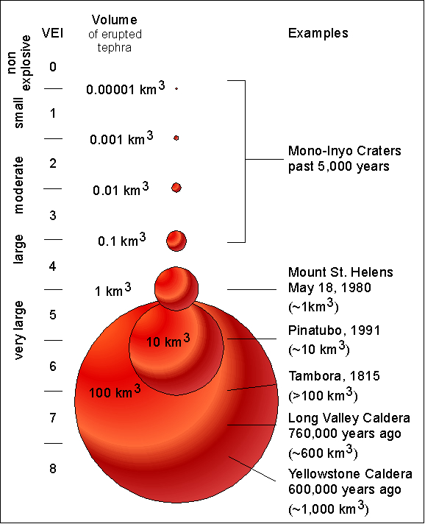
Volcano Ejecta Volume by VEI Class
Source: http://volcanoes.usgs.gov/Imgs/Jpg/Photoglossary/VEIfigure.jpg

Slide 9
“So What’s the Big Deal About a VEI 7 or 8?”
Disruptive as even a VEI class 2-3 volcano has been, class 7+ VEI ejecta volumes are believed to be capable of causing significant global cooling, cooling which can impact things as basic as food production worldwide.
See for example the impact of Mount Tambora on the world as recounted in “Blast From the Past,” Smithsonian, July 2002,
http://www.smithsonianmag.com/history-archaeology/blast.html
That 1815 eruption, a VEI 7, produced 12 cubic miles of ejecta and caused a half a degree drop in temperatures worldwide. A half a degree doesn’t sound like much, but 1816 is known as the “year without a summer.” Wikipedia also has an interesting article on
that topic: http://en.wikipedia.org/wiki/Year_Without_a_Summer
Some scientists believe that the largest of volcanic eruptions in ancient times may even have caused the extinction of the dinosaurs, see http://www.nsf.gov/news/news_summ.jsp?cntn_id=114648

Slide 10
But Let’s Not Assume “The Worst” Is Imminent
As good risk minimizing security folks, while it is important to keep worst-case scenarios such as VEI class 7 or 8 volcanoes in mind, fortunately those events are relatively uncommon <cough> (remember, VEI 8’s are 1-in-10,000 year class events)
A far more common occurrence, exemplified by the one which impacted many people just this month, are lower VEI class eruptions, such as VEI 2, VEI 3 or VEI 4 events.
What are the potential impacts of those far smaller eruptions on
our universities, their users, and their computer and network operations?

Slide 11
Stranded Travelers & Cancelled Meetings
---> Increased Interest in Videoconferencing
The higher education research and education community travels an awful lot, both for business and pleasure, and the most obvious impact of the recent eruption has obviously been stranded travelers. Our faculty/staff/students haven’t overlooked this.
In addition to the disruption that in-transit faculty, students and staff may have experienced or observed second hand, others may have found future meetings cancelled or deferred.
I believe the upshot of all this will be an increased interest in video conferencing as an alternative to some F2F meetings, much as there was increased interest in video conferencing as a result of 9/11, pandemic influenza planning, etc. Polish up those MCUs, folks! :-)

Slide 12
Next Impact: An Increased Need for
Roaming Wireless Network Access?
Another bit of fall-out from the current incident is likely to be a
re-assessment of the need for mobile connectivity. Users may not any control over flight cancellations, but at least if they have wireless access, they can get some work done while grounded.
Users may now want airport WiFi from providers such as:
-- Boingo ( http://www.boingo.com/ )
-- SprintPCS ( http://tinyurl.com/sprintpcs-airport )
-- T-Mobile ( http://hotspot.t-mobile.com/ )
Others may prefer a more general solution, such as nationwide 3G/4G broadband wireless connectivity from vendors such as:
-- AT&T ( http://tinyurl.com/att-broadband )
-- Clearwire ( https://www.clearwire.com/shop/ )
-- Sprint ( http://shop.sprint.com/en/solutions/mobile_broadband/ )
-- Verizon ( www.verizonwireless.com/b2c/mobilebroadband/ )

Slide 13
Important Caveat: What About INTERNATIONAL Broadband Access?
Will these solutions help keep your university’s “road warriors” online even if they’re stranded in Frankfurt or Amsterdam or
London or Paris? Note that most (all?) of the broadband providers don’t have a very satisfactory international broadband solution offering (they may not have coverage, or if they have coverage, it may be potentially astronomically priced).
Thus, if you have US users you’re trying to immunize against the next Icelandic volcano-induced European travel disruption, the solutions previously mentioned may not help.
I’d love to hear from members of the community about what solutions they’ve found that work well (and are affordable!) internationally, particularly for the EU.
Besides connectivity, your traveling users also need key information.

Slide 14
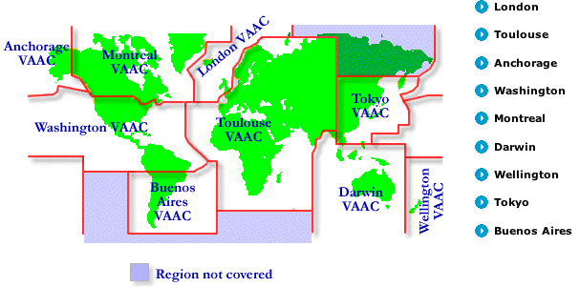
Supporting Users: Information Enables Action
If flights are grounded in some part of Europe, but not in others, one of the most useful things to have is information about what airports are open, and which ones are closed.
In the case of volcano-induced disruptions, the key resource to know about are the world’s nine Volcanic Ash Advisory Centers,
(VAACs) such as www.metoffice.gov.uk/aviation/vaac/index.html
Each VAAC issues advisories for volcanoes in its area of responsibility:

Slide 15
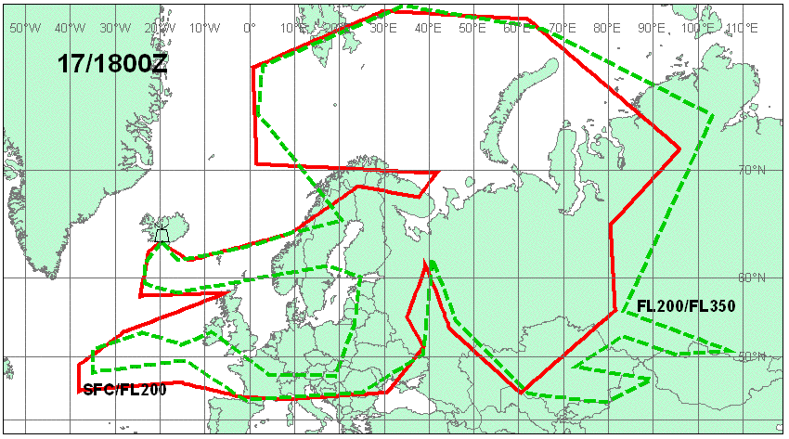
Example Advisory: Most of N Europe Affected
(But Not Including Portugal, Spain, Italy, etc.)

Slide 16
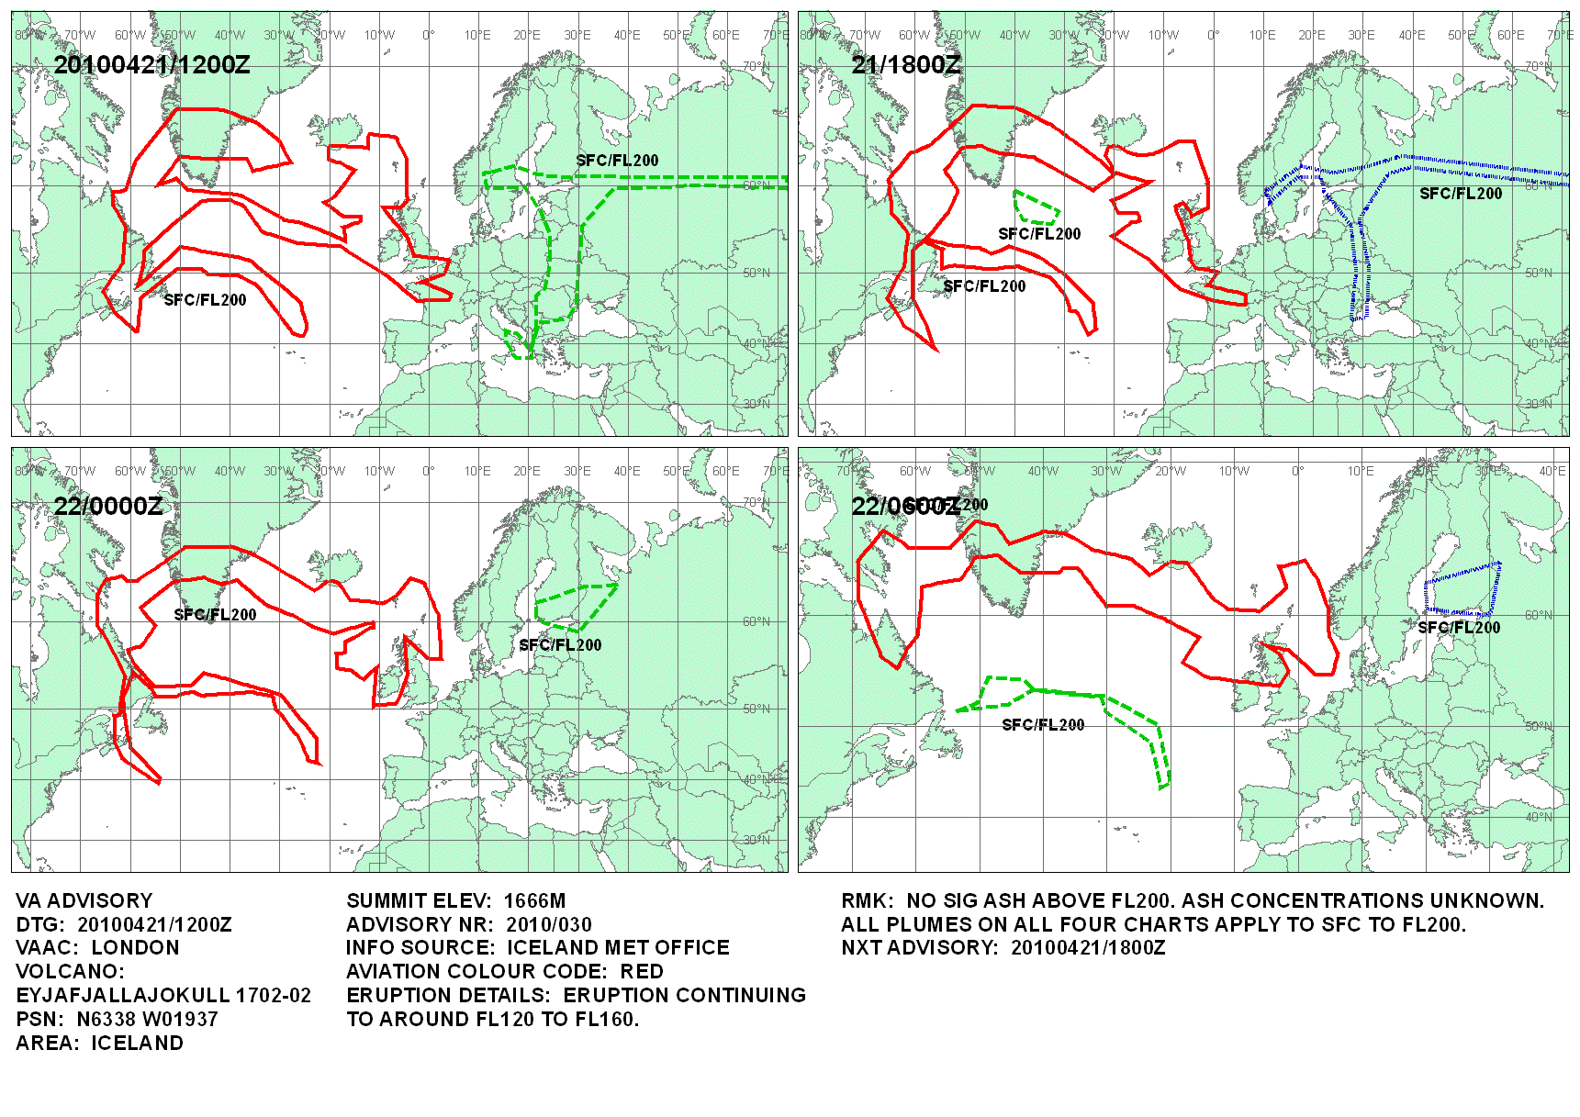
Later, Far Less Extensive, Ash Coverage Maps

Slide 17
None of Us Are Travel Agents, But…
Once users know airports are down, they may want help getting to areas where airports remain open. Trains, ferries and buses are key ground transportation options when it comes to getting from closed airspace to open airports. Unfortunately some US travel agents have limited experience arranging long haul “non-air” travel in Europe.
Information about European trains, in particular, can sometimes be hard to put together because many train web sites focus on just their own country, even though a train journey may span large chunks of Europe. Some national rail web sites may also only be available in a local language (e.g., a language other than English).
The single best resource for those trying to piece together a rail/ ferry trip in Europe is unquestionably http://www.seat61.com/
Those needing bus information should probably start with www.eurolines.com and/or www.nationalexpress.com/coach
Need help finding flight options? Try http://www.itasoftware.com

Slide 18
Meanwhile, Back At the Ranch:
Data Center Air Handlers and Particulates
The recent Icelandic eruption didn’t directly deposit much (if any) particulate matter or corrosive gas in US datacenters, but the next volcano to erupt might be a different matter.
If you haven’t looked at your data center’s air handlers recently,
the recent Icelandic eruption is a nice reminder that it might be time to do so. What’s the state of your filtration? Are filters being regularly serviced? Are your filters currently clean?
For that matter, do you know the level of particulates empirically present in your data center normally? I suspect that while many sites routinely monitor data center temperature and humidity, they’ve NOT tracked particulate counts or corrosive gas levels.

Slide 19
Particulates Can Be A Problem for Gear
Ash (and dust, etc.) can:
-- block airflow through fans and heatsinks, and cause a potentially
unsafe rise in device temperatures; that increase in temperature
may cause thermal overloads, or reduce the longevity of
equipment (this may be a particular problem for hard disks)
-- if conductive, ash can cause shorting or otherwise interfere with
a device’s electrical performance
-- if corrosive, ash can result in damage to leads, traces, and
other metallic components, or damage finishes
-- if abrasive, ash can damage bearings and other unsealed moving
parts
A general description of volcanic ash properties is available at
http://volcanoes.usgs.gov/ash/properties.html

Slide 20
Particulate Thresholds
“Particulate and Gaseous Contamination Guidelines for Data Centers” www.ashrae.org/docLib/20090915_whitepaperFINAL.pdf does a nice job of laying out the standards that many data centers might want to shoot for, basically ISO 14644-1 Class 8, or
-- no more than 3,520,000 particles/cubic meter > 0.5 micron
-- no more than 832,000 particles/cubic meter >1 micron
-- no more than 29,300 particles/cubic meter >5 micron
But how can you tell if your data center meets or exceeds these thresholds? Answer: you need to measure your facility, probably with a laser particle counter (trying to count 3.5+ million submicron particles manually would be tedious! :-)). Historically, most laser particle counters have been rather prohibitively expensive. Fortunately, there are now some less expensive options available.

Slide 21
Dylos DC1100 Pro With PC Interface
The Dylos DC1100 Pro is a true laser particle counter, focusing on two particle size ranges, down to half a micron and 2.5 microns and above, and comes with a COM port for logging to a PC. It is unusually affordable, costing less than $300. See http://www.dylosproducts.com/dcproairqumo.html for more info
Does this product have as many features as a full-fledged ~$4.5K- class particle counter? No. Then again, it is a fraction of the price and we are only targeting ISO 14644-1 Class 8 standards, after all.
I’d love to hear about other products in this same price range that cover the same sort of territory (as far as I can tell, all the other alternatives I could find run from ~$1,500 and up)
Large facilities (or facilities in particularly particle rich environments) may want to go with a more sophisticated distributed particulate monitoring system, but the Dylos should be great for those just getting started, smaller facilities, etc.

Slide 22
What About “Gaseous Contamination?”
In addition to particulate contamination, the ASHRAE data center whitepaper also mentions “gaseous contamination,” particularly from sulfur bearing gases such as sulfur dioxide or hydrogen sulfide
Apparently gaseous contamination has become much more of an issue recently because of the migration from traditional lead-based solder in computer equipment and electronics to silver-based replacements. [Lead is now banned in electronic equipment in many areas due to RoHS (Reduction of Hazard Substances) laws]
There are two basic approaches to monitoring your facility for gaseous contamination: reactive monitoring with copper and silver “coupon” based detectors, and reactive real-time monitors.
If your data center employs air-side economizers, you probably will want to use reactive real-time monitoring.
For more on monitoring gaseous contamination, see http://www.purafilonguard.com/history/general.htm

Slide 23
What If I Find That I Do Have Problems?
If it looks like you may have problems with particulates or gaseous contamination based on a preliminary check, I’d suggest:
-- Bring in an indoor air quality specialist or industrial hygienist
who focuses on data center air quality, and have them do a
comprehensive analysis and detailed report for you.
-- If there’s nothing obviously wrong which you can readily
correct (such as fixing missing filters or taking care of
inappropriate data center housekeeping practices), you should
probably consult a licensed HVAC engineer for a professional
analysis and remediation options. (For example, gas-phase
filtration may be needed to bring gaseous contamination levels
down within ISA 71.04 G1 severity levels)

Slide 24
Don’t Forget About Distributed Machine Rooms
While it is natural to initially focus on a site’s primary data center, most universities also have multiple distributed machine rooms located at branch campuses, within individual schools or departments, etc.
Because those facilities are often improvised, rather than having been designed from day one as protected environments for critical systems, air handling and filtration in distributed facilities may be an after thought, and marginal at best.
Do not forget about all those outlying sites!

Slide 25
“But I’m Not Really Worried About Volcanoes!”
I understand entirely. However, even if you decide that volcanoes are not something which need to be “on your radar,” I would encourage you to consider other potential sources of particulates and gaseous contamination, including:
-- chronic pollution sources (such as car exhaust in large cities, or
cigarette smoke when cigarette smoking is allowed near gear)
-- environmental factors such as windborne dust or sand, and smoke
from wildfires and intentional agricultural burns; for example,
grass farmers in the Willamette Valley traditionally burned their
fields after harvesting, although this was finally banned in 2009
-- episodic human contamination sources (such as chemical
spills, emissions from nearby factories or plants, dust from nearby
construction projects or remodeling work, etc.)
Bottom line, even if you don’t care about volcanoes, you should still care about all those other sources of particulate matter.

Slide 26
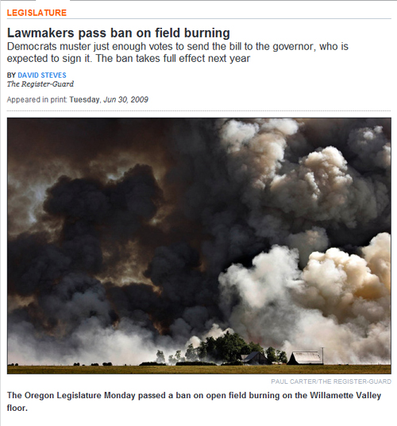
Example Smoke From Agricultural Field Burning

Slide 27
What’s Normal For Your Area?
Ignoring unexpected events such as wildfires for a moment, do you even know what’s “normal” for things like particulates in your area?
When we think about air quality issues, we normally think of “smog” in large cities such as Los Angeles or Atlanta.
However, even largely rural areas like the Pacific Northwest can have days with high particulates, particularly during cold winter weather when residents may crank up fireplaces or wood stoves
for supplemental heating.

Slide 28
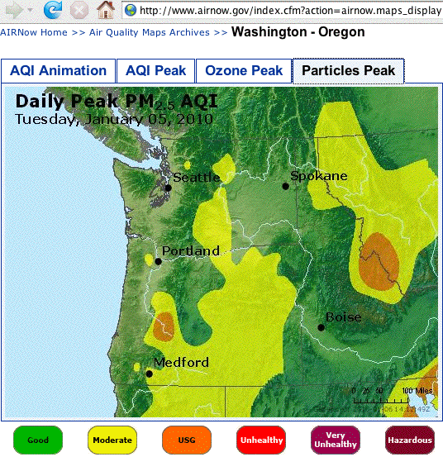
Sample Airnow.gov Regional PM2.5 Map, 1/5/10
To find maps for your area, go to www.airnow.gov/index.cfm?action=airnow.maps

Slide 29
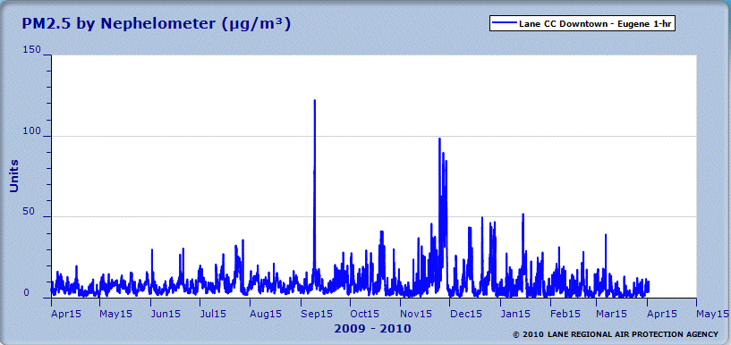
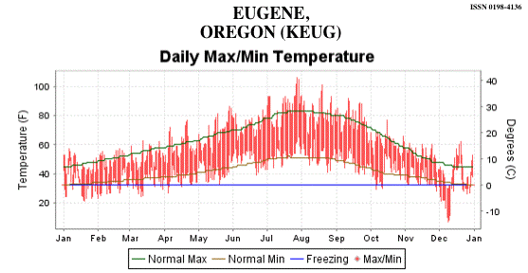
Sample Local Particulate & Temperature Graphs
EUG PM2.5 data from
http://mdas.lrapa.org/
To find temp. data for your city, see
www7.ncdc.noaa.gov/IPS/lcd/lcd.html

Slide 30
“What The Heck Does Local Air Quality
Have to Do With Computers and Networks?
Especially for small distributed or departmental equipment
sites with little or no formal air filtration, local ambient air
quality may be a major factor in determining the quality of
the air that computers and other gear are ultimately exposed to.
If you can’t filter the air that’s passed in to some of these distributed facilities, you may at least be able to pass the air
that’s circulating in the space through supplemental filtration
to help address the issue.
Commercial filtration units are one option, however even a simple improvised air filters are probably better than nothing, if that’s all that a site can afford (but obviously this sort of solution won’t be NEBS-compliant!) See the example on the following slide…

Slide 31
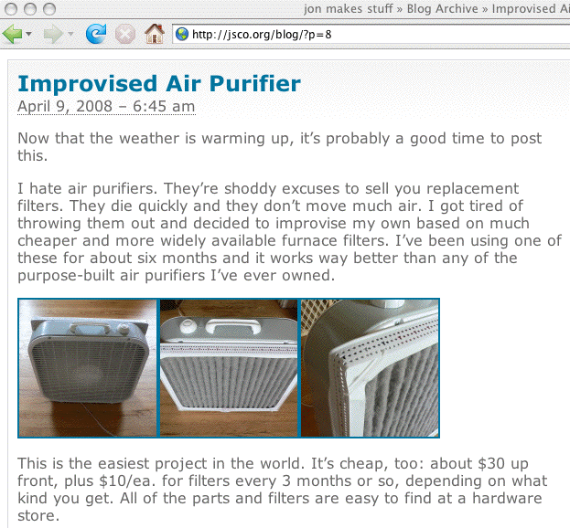
Example Of An Improvised Air Filter

Slide 32
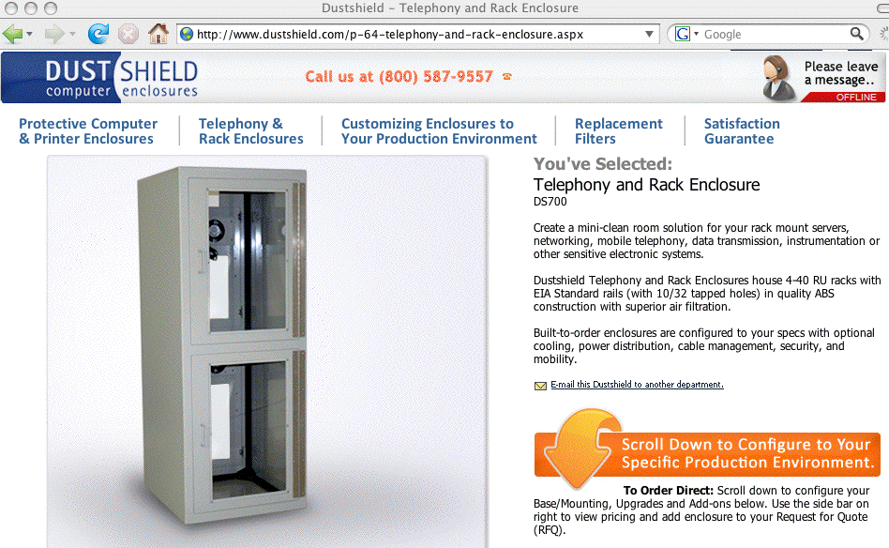
Another Option:
Add Per-System or Per-Rack Filtered Enclosures

Slide 33
Summary
You now know a little more about the recent volcanic eruption in Iceland, and volcanic eruptions in general
You also have some new ideas that might help if you have travelers stranded by air travel outages, particularly ones caused
by airborne volcanic ash
And you have some new parameters to think about (and monitor!) in your primary data center as well as in outlying machine rooms, namely particulates and gaseous contamination levels
We also talked a little about some steps that you might take to manage problematic particulate and gaseous contamination levels, if they arise, whether due to volcanic ash or other particulate sources.
Are there any questions?

