Slide 1

7COM1079-2024 Student Group No: A169
Names of Student Attendees:
Ghouse Mohiddin Shaik
Muqtadir Siddiqui Mohammed Abdul
kashif Uddin Mohammed
Shahzad Hussain
Hassan Qureshi
Group Name: A169
Name of Student Presenting: Ghouse Mohiddin Shaik
Research question: Is there a correlation between a movie's duration and its average votes on IMDb?
Tutorial Presentation for Feedback
Date: 10/11/2024

Slide 2
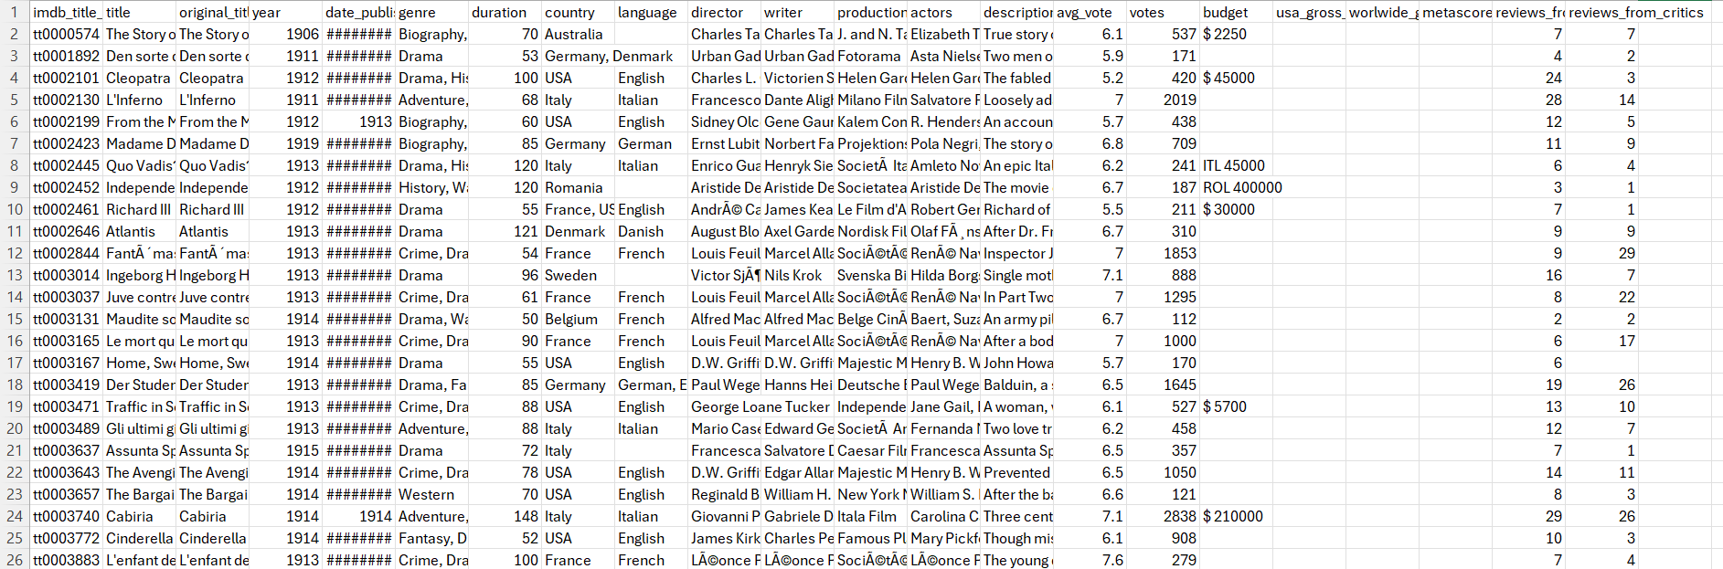
Sample data:
Columns used: 1. duration (minutes)
2. avg_vote (out of 10)
The dataset contains 81,273 rows and 22 columns in total.
2
7COM1079-2024 Student Group No: A169

Slide 3
This dataset is interesting to us because, it provides a large and diverse collection of data, which helps us to explore how a movie’s duration impacts the audience ratings and offers valuable insights for filmmakers. Our Independent variable duration. This Independent variable datatype : Interval/measurement data. Our Dependent variable is avg_vote. This Dependent variable datatype: Interval/measurement data.
Dataset ID: DS231 (IMDb movies.csv)
7COM1079-2024 Student Group No: A169
Notes:
Before specifying your Research Question you must define the type of data you are analysing. Are the variables you select interval data (measurement data you can divide, multiple, etc), OR are they ordinal (there is a definite order but the intervals between each variable are not necessarily equal, or the terms might be subjective like in a likert scale); OR are they just categorical/nominal (Items such as film names, cities, etc., that you can count numbers of occurrences? You also need to understand whether the variable is either dependent or independent and this will vary according to the context. Independent variables may cause an effect, whereas the dependent variable might be effected by the independent variable. Check the lecture notes on the RQ for more information and examples.
You will get only one opportunity to present your Research Question ahead of the submission date. Have your questions ready, and be ready to take notes on feedback.

Slide 4
Our Research Question:
Is there a correlation between average votes (dependent interval variable) and movie duration (independent interval variable)?
Hypotheses:
Null Hypothesis (H₀): There is no correlation between average votes and movie duration.
Alternative Hypothesis (H₁): There is a correlation between average votes and movie duration.
7COM1079-2024 Student Group No: A169

Slide 5
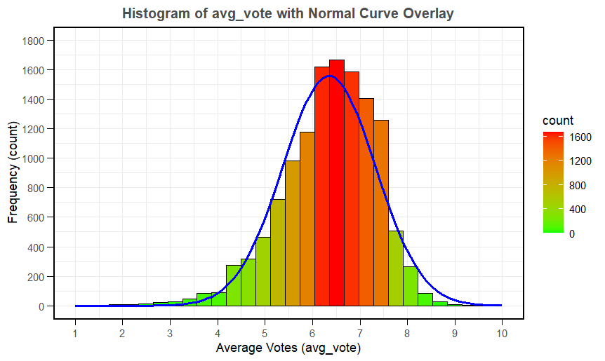
Here is a Histogram showing the frequencies of our dependent variable(avg_vote) to include the normal curve overlay.
Our RQ asks about Correlation
Choose one:
1. The blue normal curve overlay follows the contours of the underlying data, so for our analysis we will use a parametric test for correlation: Pearson’s r
OR
The normal curve overlay does not follow the shape of the underlying data, so for our analysis we use the non-parametric test for correlation that does not assume normality: Spearman’s Rho or Kendal’s Tau
The example here is borderline, in terms of shape, so when in doubt choose the non-parametric equivalent.
5
Notes:
5

Slide 6
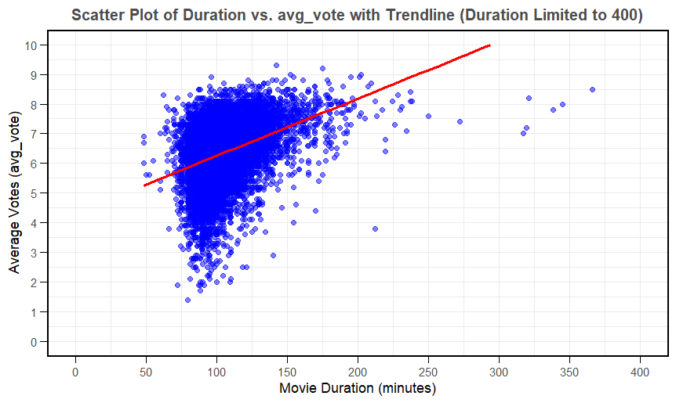
Here is the Scatter Plot of our independent (duration) vs. dependent (avg_vote) variables with trendline.
Our RQ asks about Correlation
Choose one:
1. The blue normal curve overlay follows the contours of the underlying data, so for our analysis we will use a parametric test for correlation: Pearson’s r
OR
The normal curve overlay does not follow the shape of the underlying data, so for our analysis we use the non-parametric test for correlation that does not assume normality: Spearman’s Rho or Kendal’s Tau
The example here is borderline, in terms of shape, so when in doubt choose the non-parametric equivalent.
6
Notes:
6

Slide 7
Ghouse\
7COM1079-2024 Student Group No: A169

